Slide 1
Welcome to Shabby Chic Projects... Click the book cover to see Rachel Ashwell’s website. Click here to reserve a copy of her book.

Slide 2
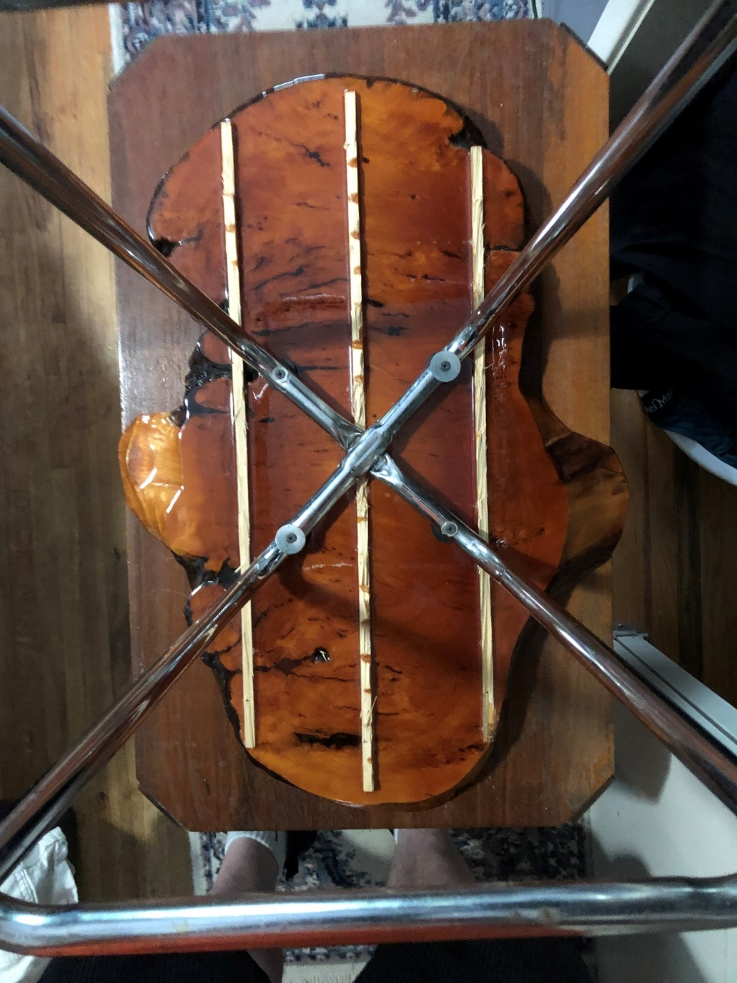
The project chooses you

Slide 3
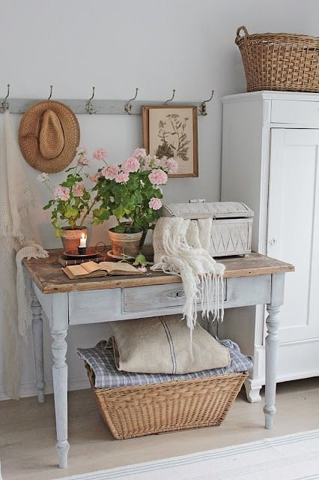
Layering Elements

Slide 4
Vision Board

Slide 5
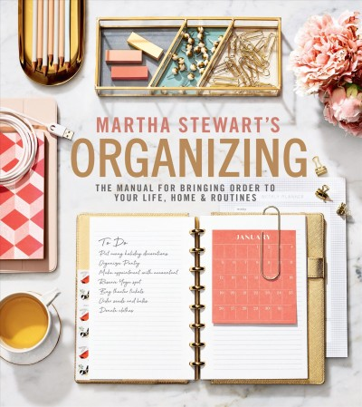
Storage and Workspace
Ironing board
Measuring tapes (plural)
Sanding sponges
Old cotton t-shirts
Glue sticks
Scissors
Bull dog clips
Gift wrapping station
Rubber stamps and ink pads

Slide 6
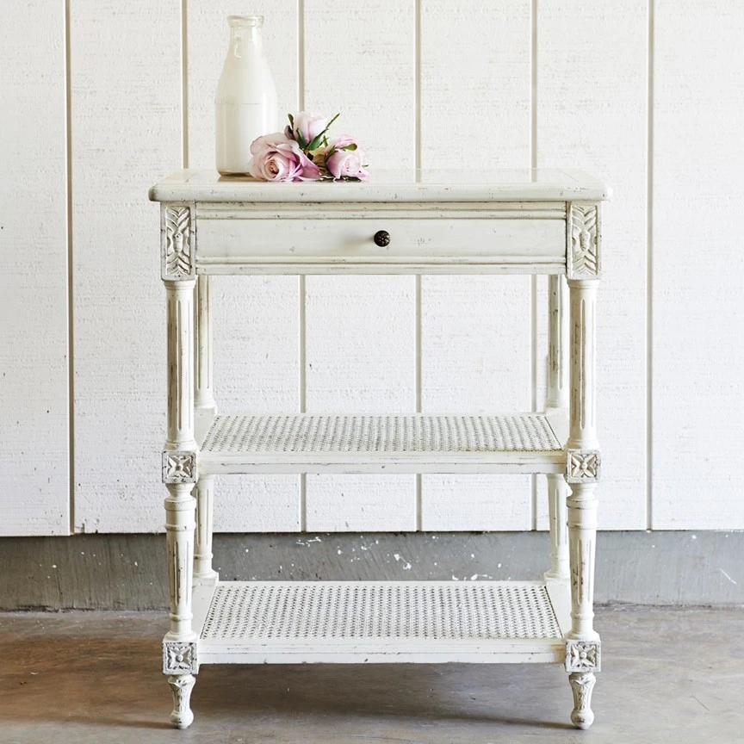
Product Knowledge
Old masters pickling white gel stain
Saman gel stain at home depot
Paint can lid is palette
Add white paint to change colour
Spray paint
Dollar Store latex paint
Modern masters metalic

Slide 7
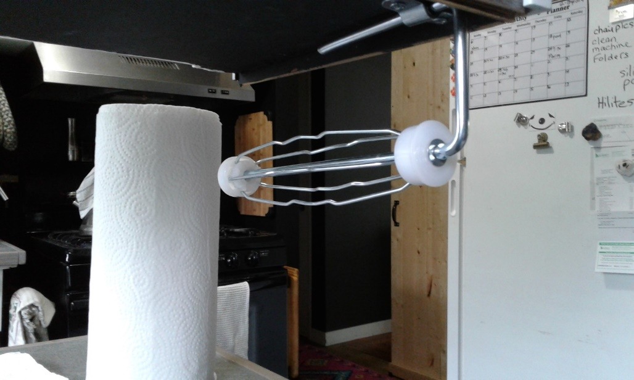
Start your own tool sharing group

Slide 8
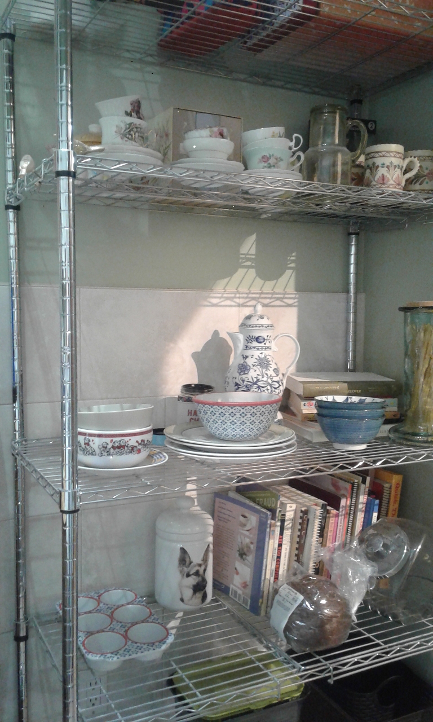
Regrets… When asked how high I want the tile, I should have said “to the ceiling”

Slide 9
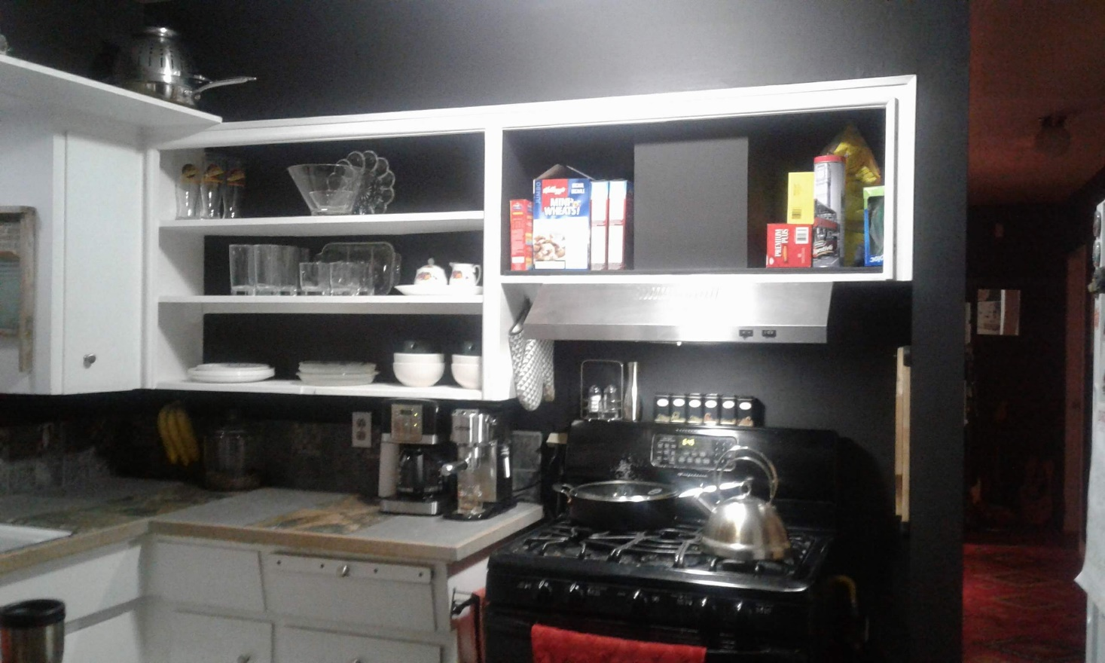
Sexy Black Kitchen

Slide 10
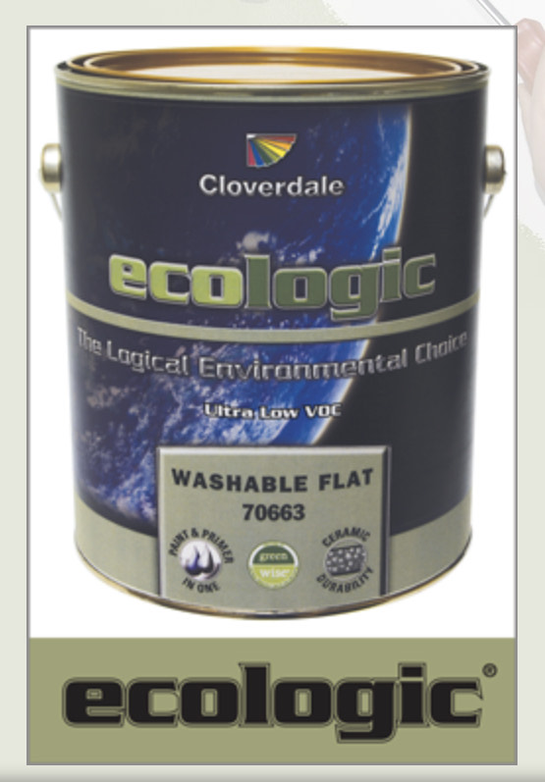
Product Knowledge
https://myoldmasters.com/color/pickling-white
https://saman.ca/en/produit/natural-oil-gel-stain/
https://www.modernmasters.com/landing/homeowners/brands
Paint can lid is palette
Add white paint to change colour
Spray paint
Dollar Store latex paint
Old cotton T-shirts to apply

Slide 11
How-to books from the library

Slide 12
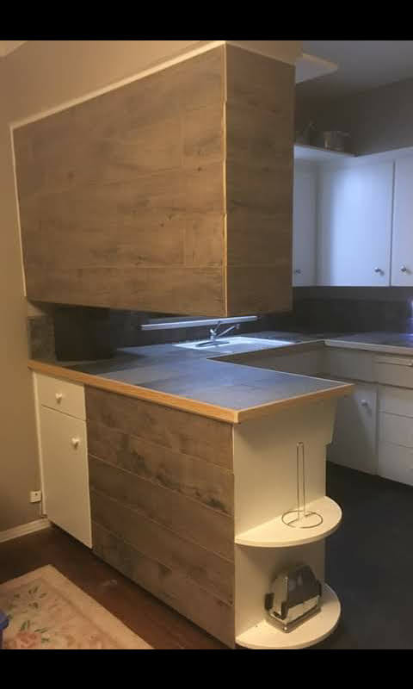
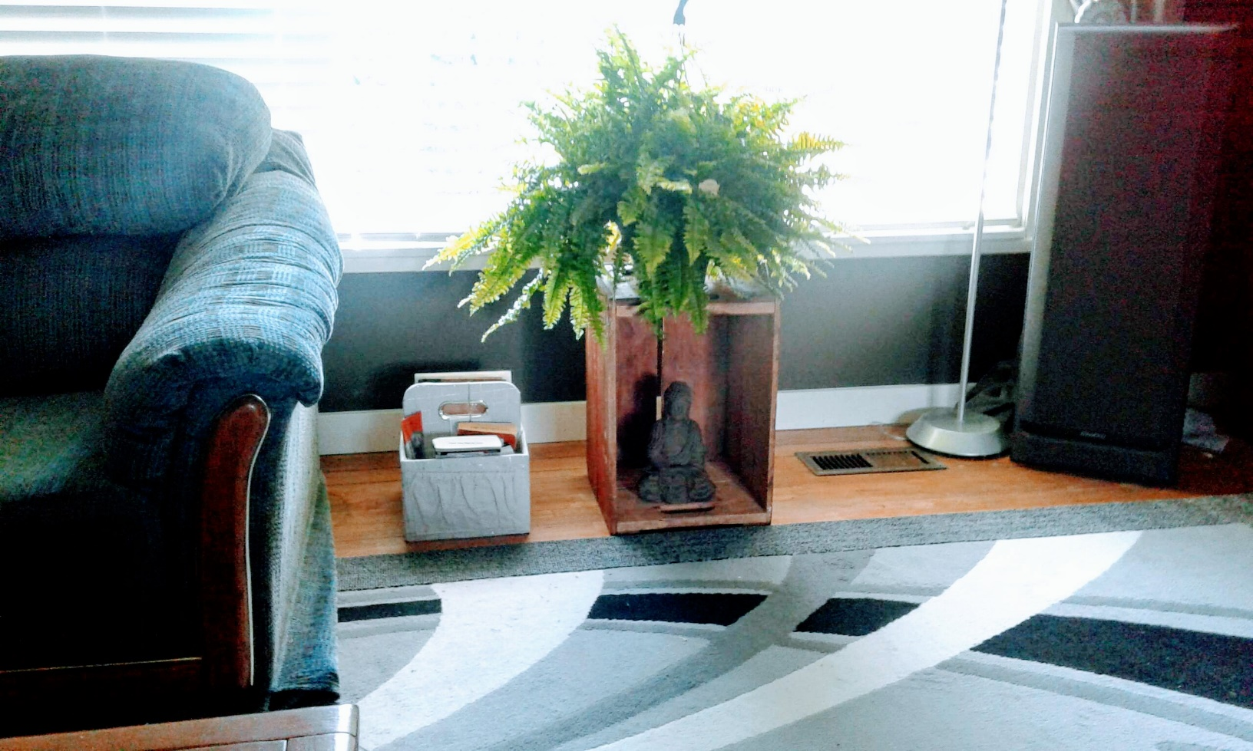
Junk from the Basement

Slide 13
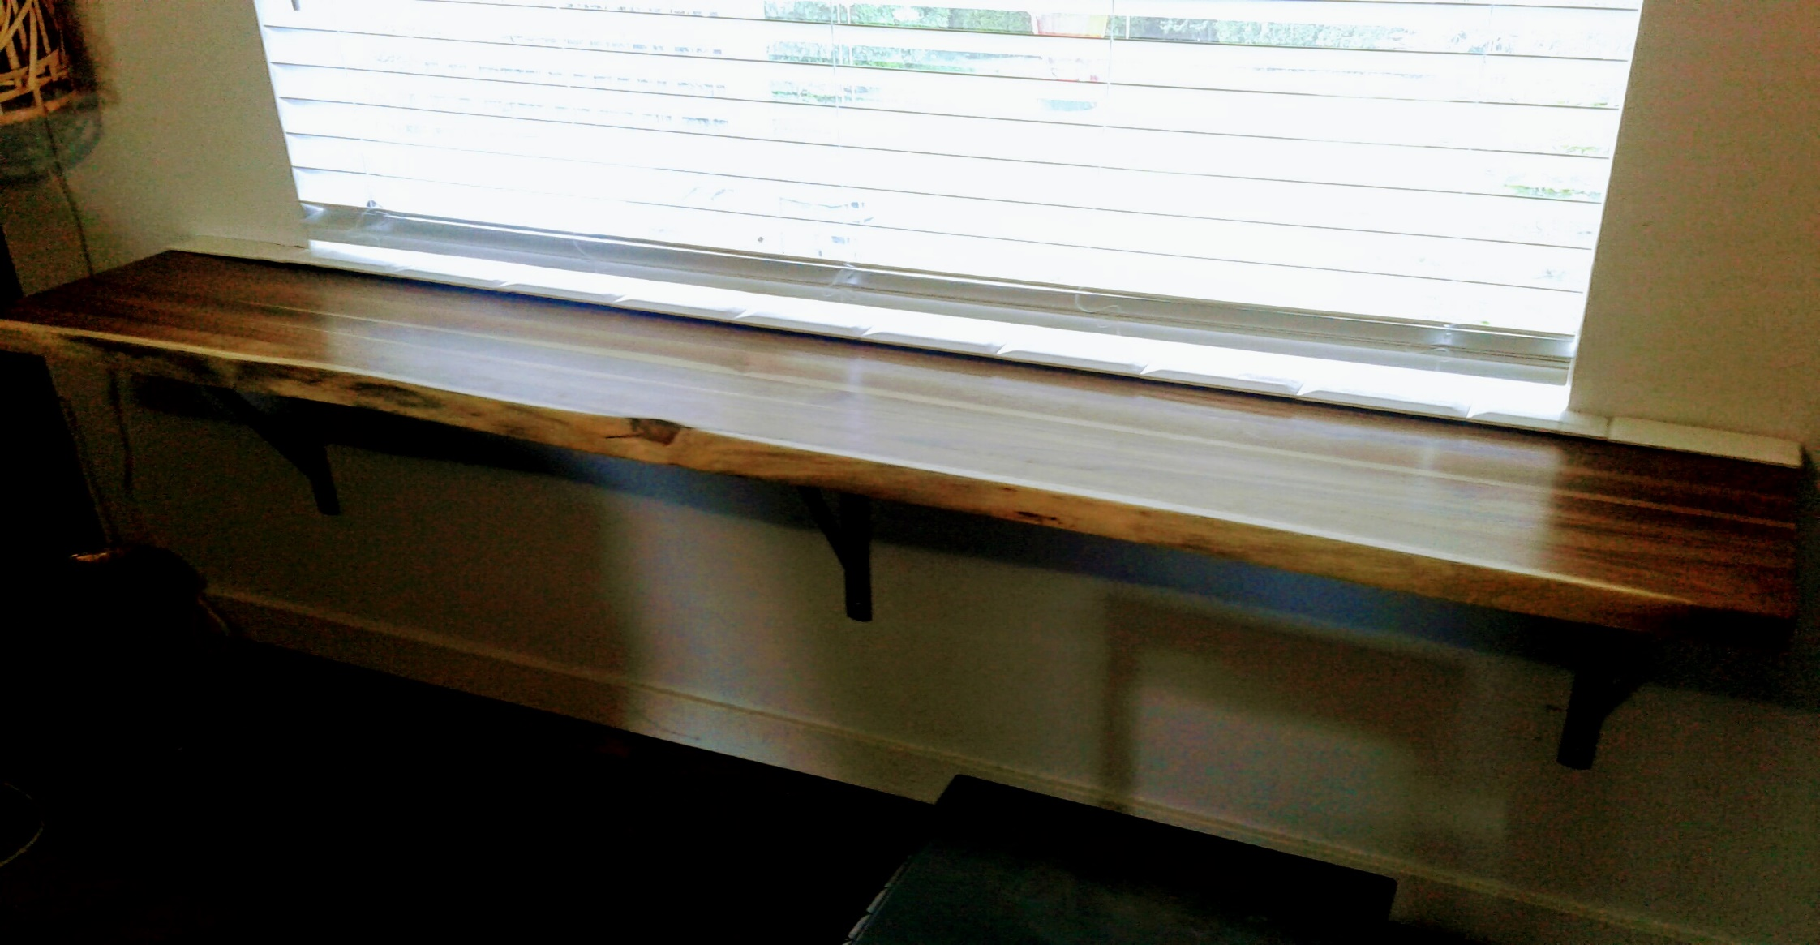
Discontinued products

Slide 14
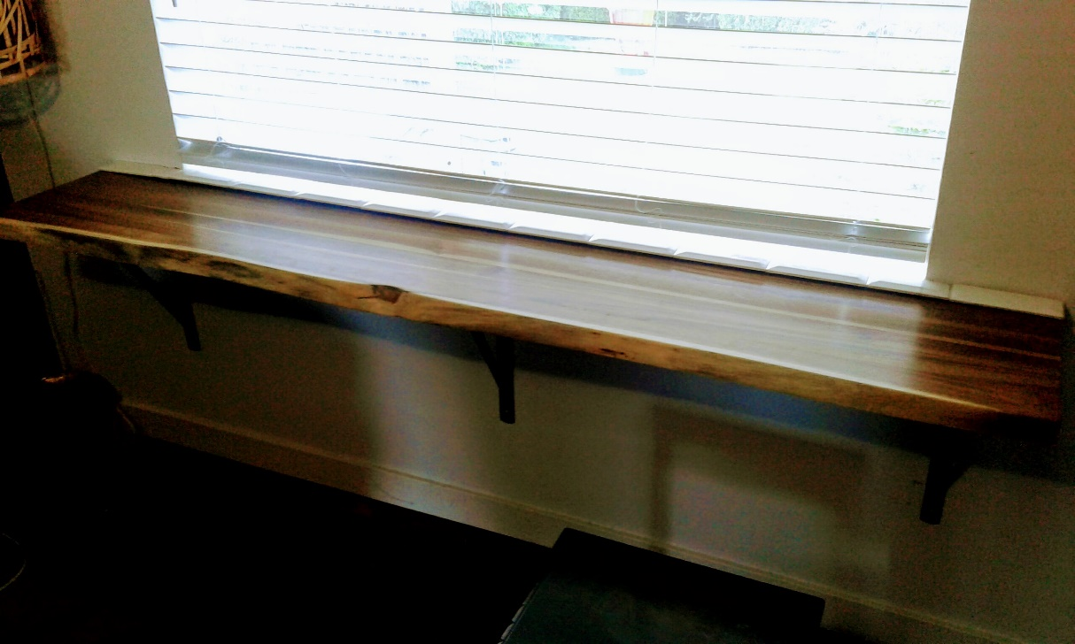
Natural wood can still be less expensive than newer materials

