Slide 1
CBAL-KLF Workshops Fall 2015 (focus on library services for seniors using iPads)
Presented by Sabina Iseli-Otto, BC Libraries Co-operative

Slide 2
Step 1: Create Account
Must do this through links on the library website; cannot be done through app.
While you’re at it: borrow some magazines.
This account also works for IndieFlix.

Slide 4
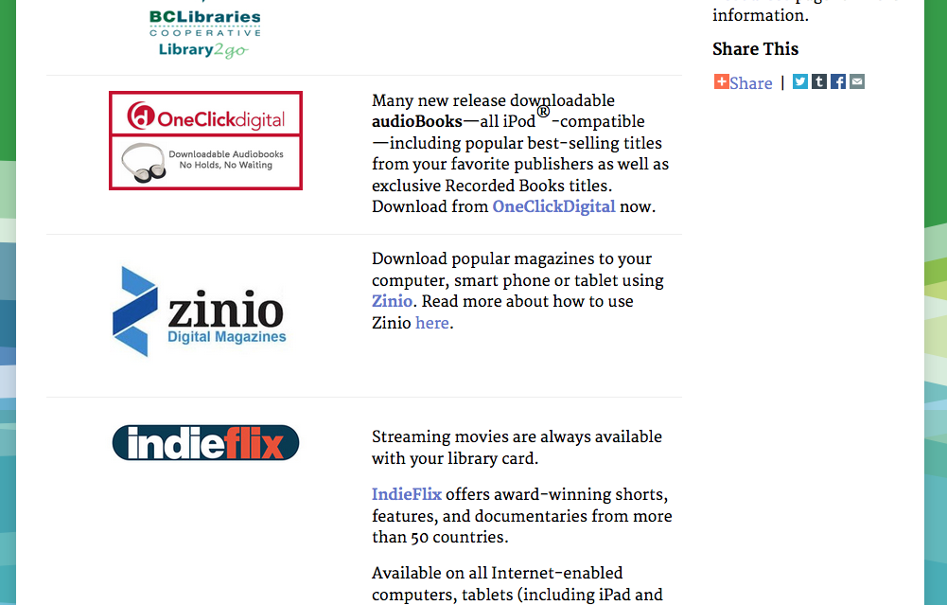

Slide 5
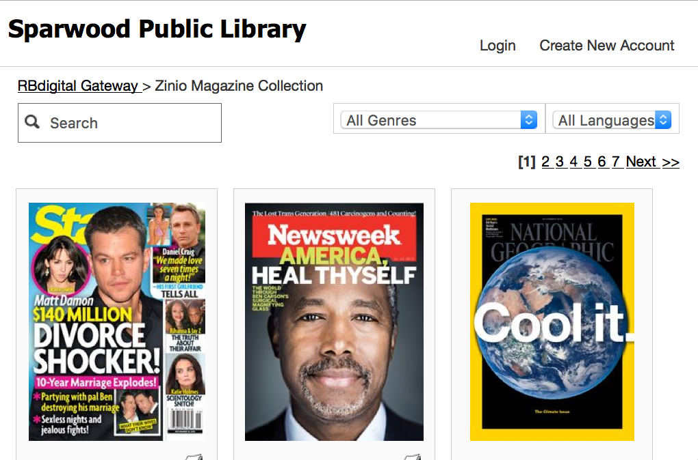

Slide 6
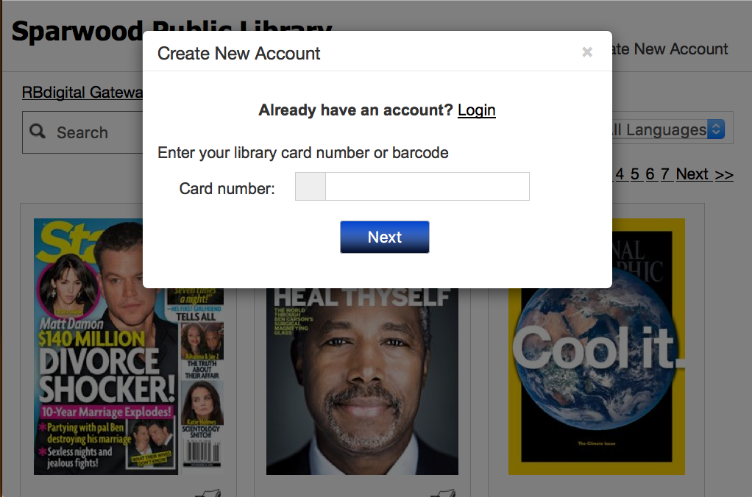

Slide 7
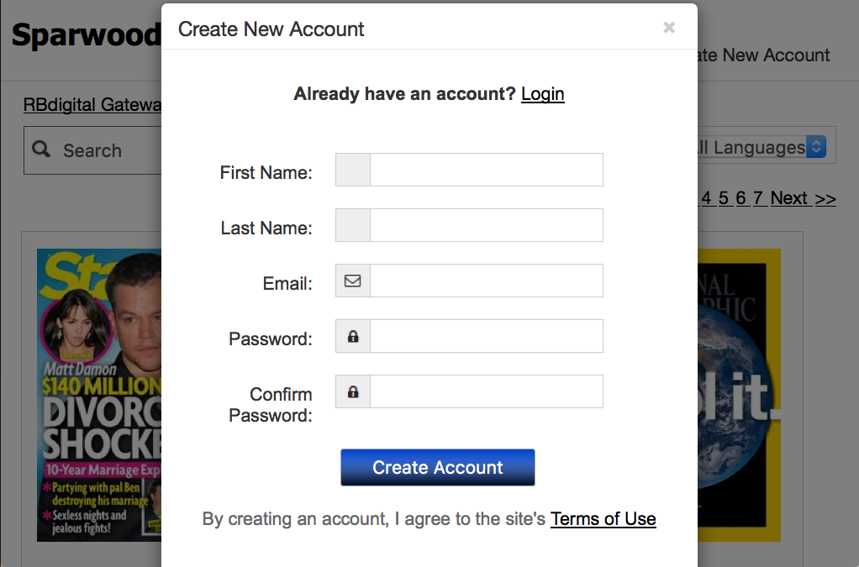

Slide 8
Done.
You now have an account.

Slide 9
Step 2
Download the app.

Slide 10
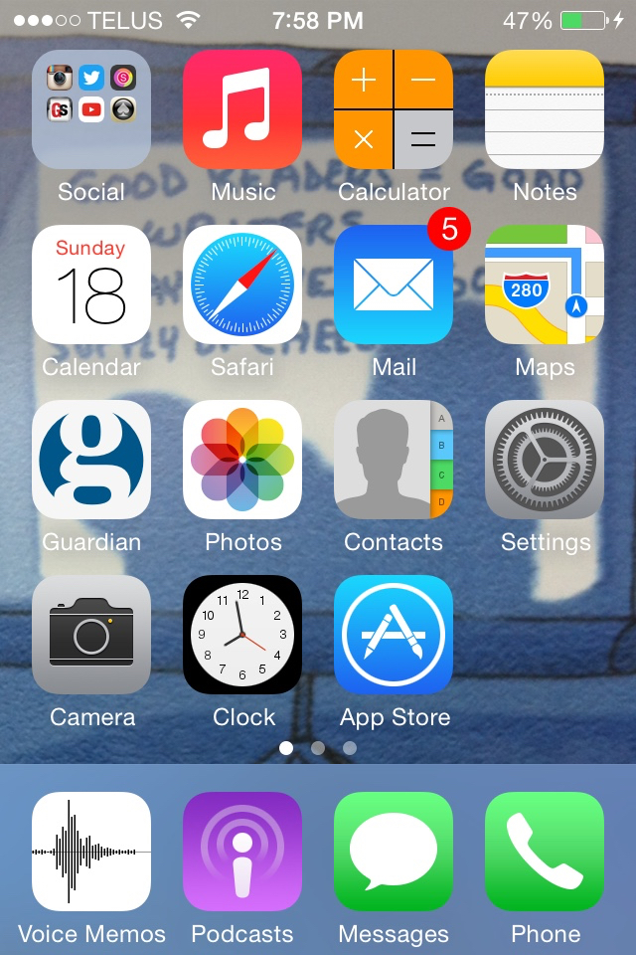

Slide 11
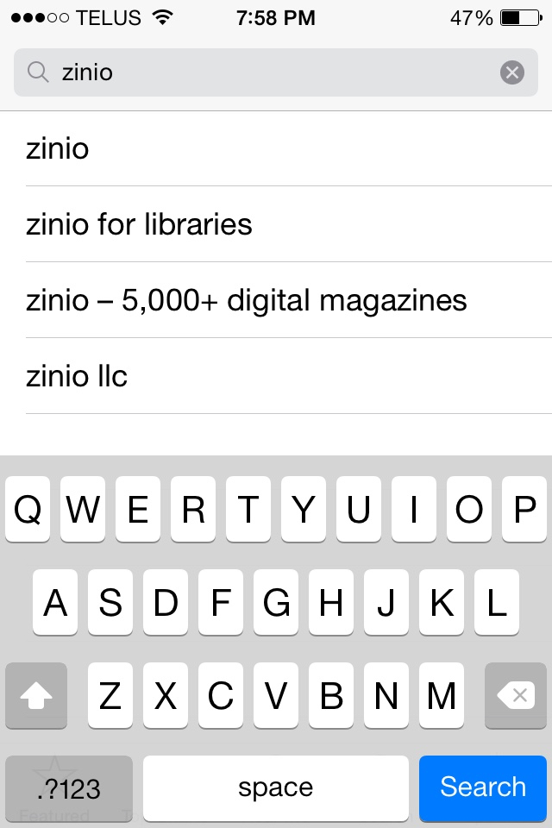
No to this one!
Yes to this one!

Slide 12
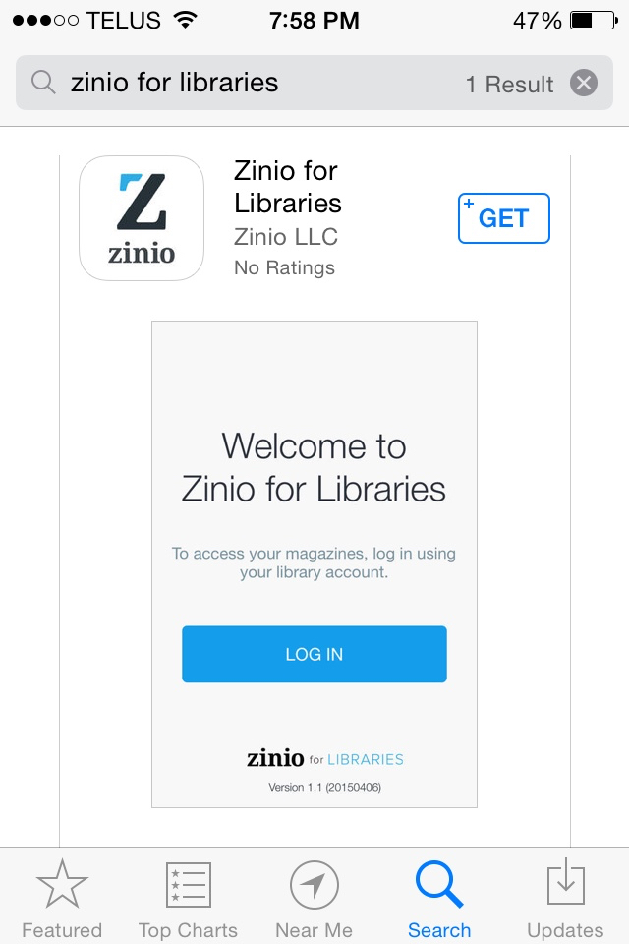

Slide 13
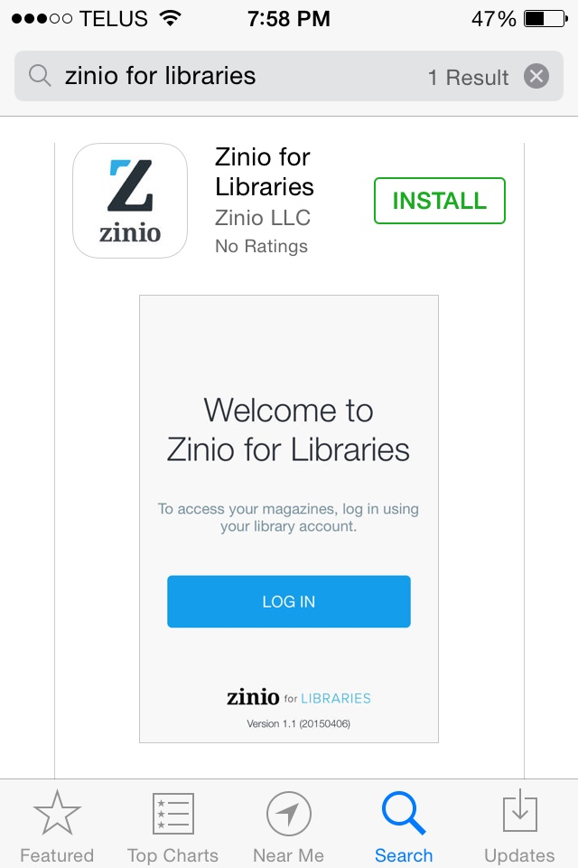

Slide 14
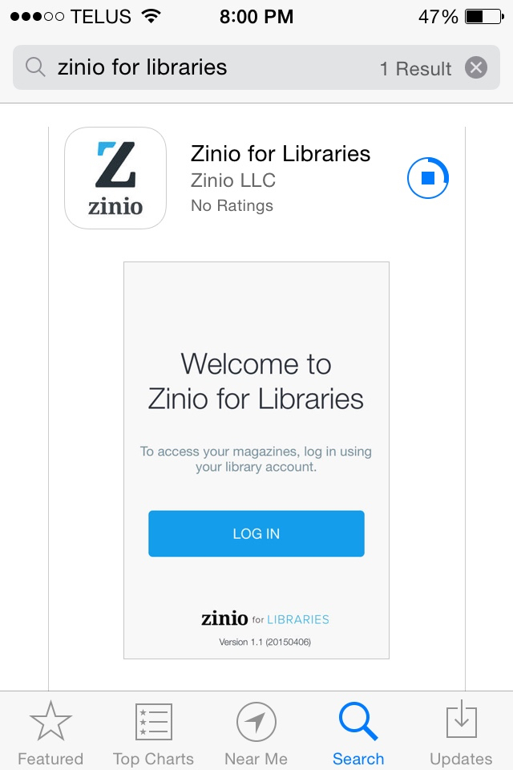

Slide 15
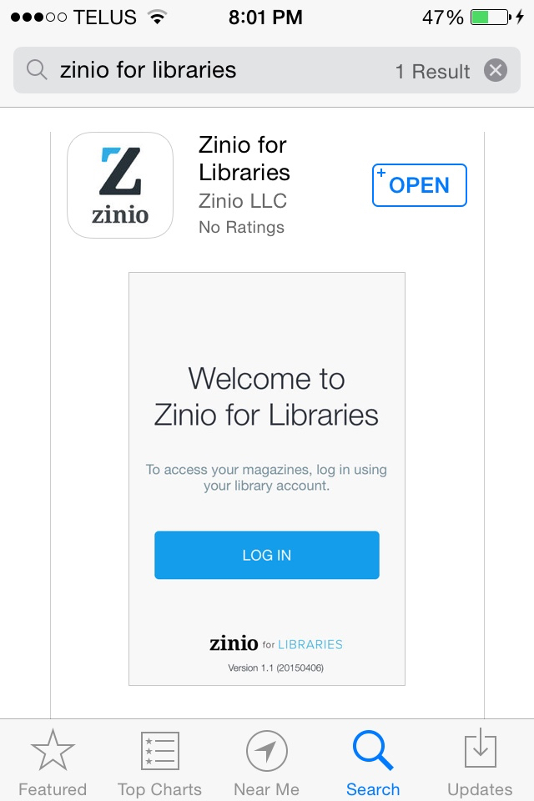

Slide 17
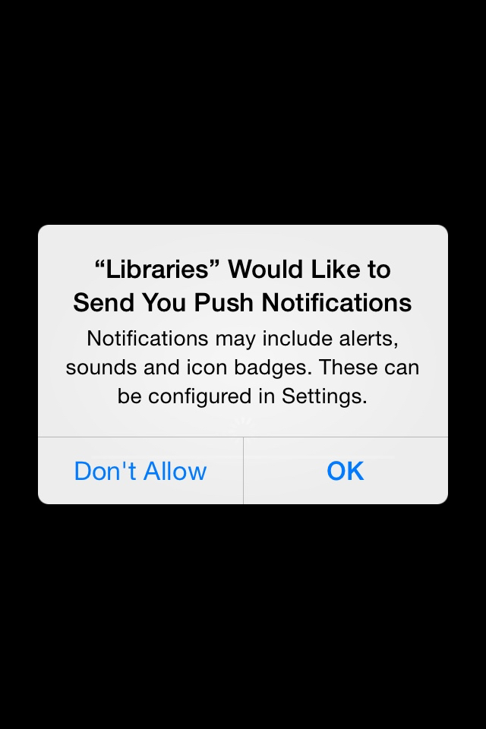
Either option is okay. Push notifications send alerts to the device. Some people like these; some do not.
For iOS devices, these can be turned on/off under Settings, then Notifications.

Slide 18
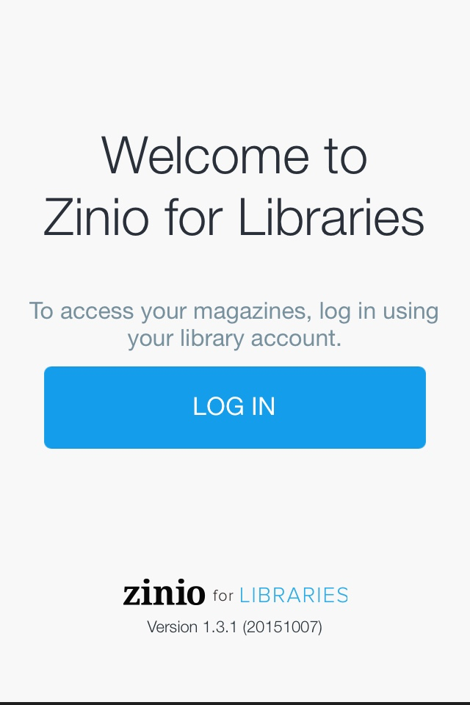

Slide 19
(Here Zinio is opening a web browser window – Safari in this case).

Slide 20
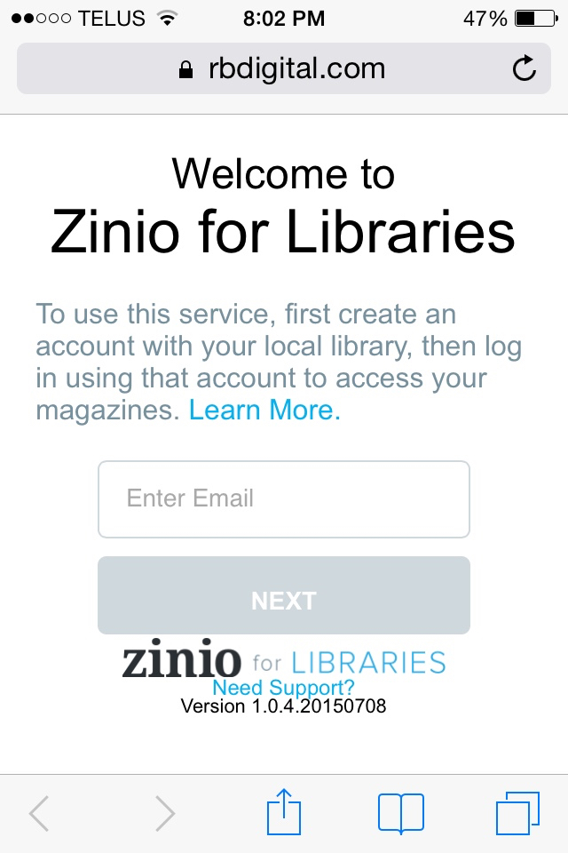

Slide 21
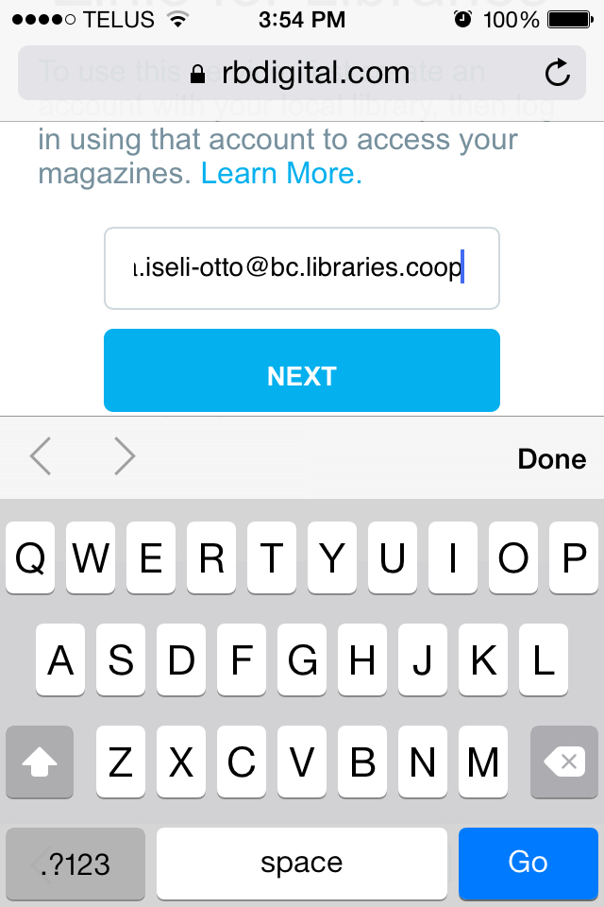

Slide 22
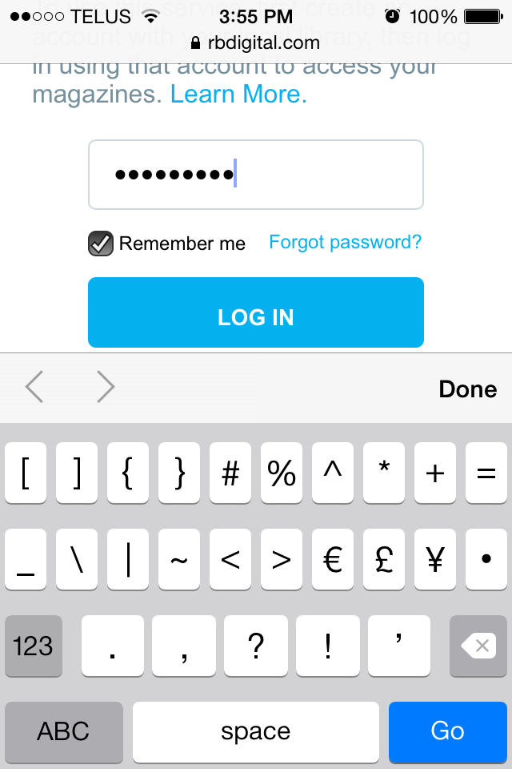

Slide 24
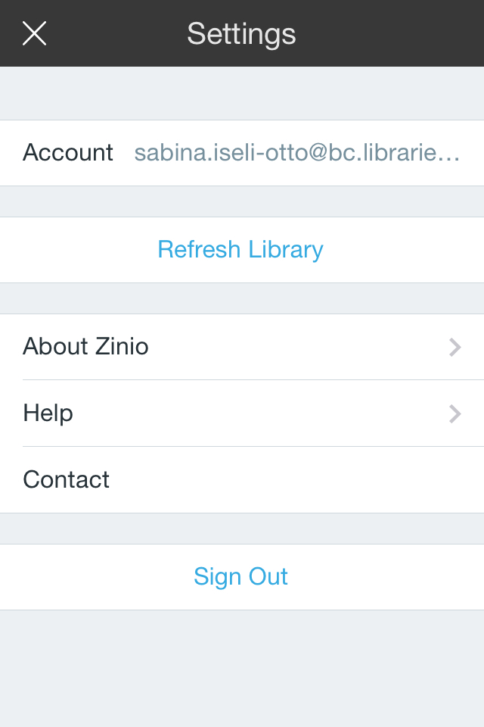

Slide 25
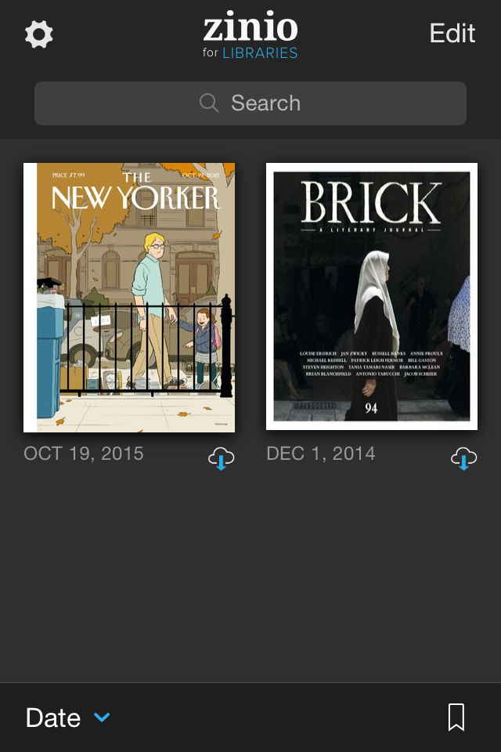
If this filter is set to “Downloaded”, you won’t see any of your new magazines, no matter how many times you refresh your library!

Slide 26
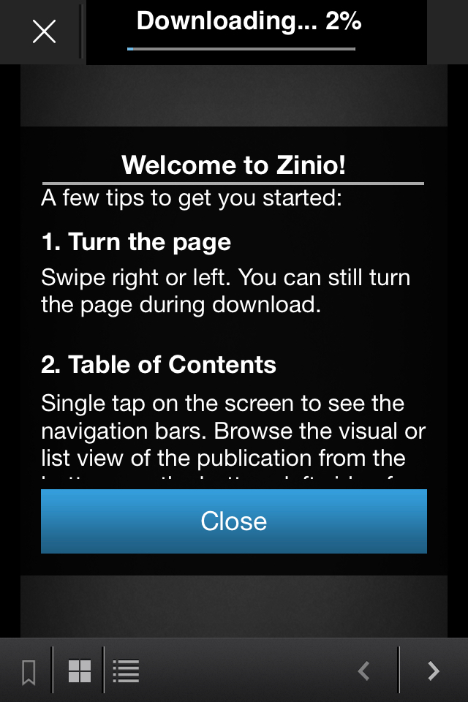

Slide 29
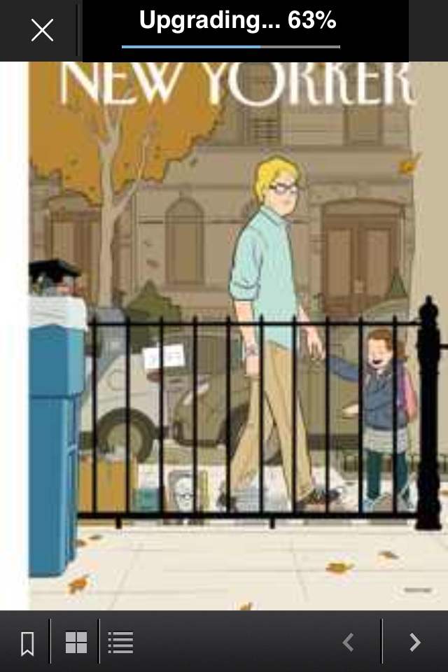

Slide 30
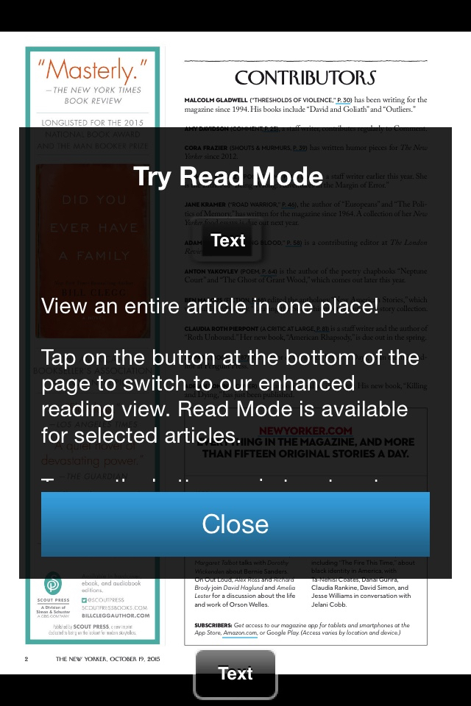

Slide 31
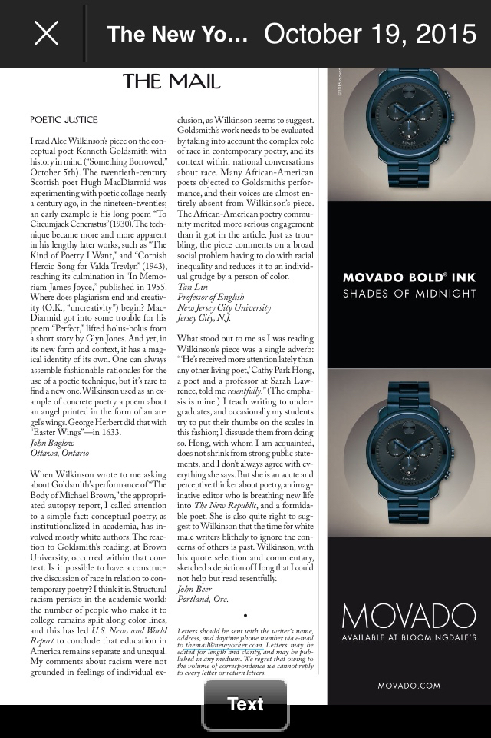

Slide 32
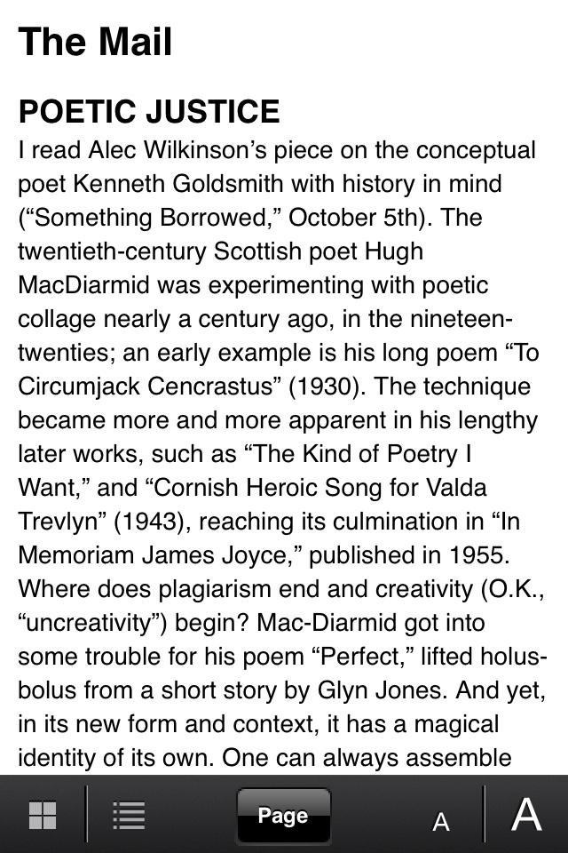

Slide 33
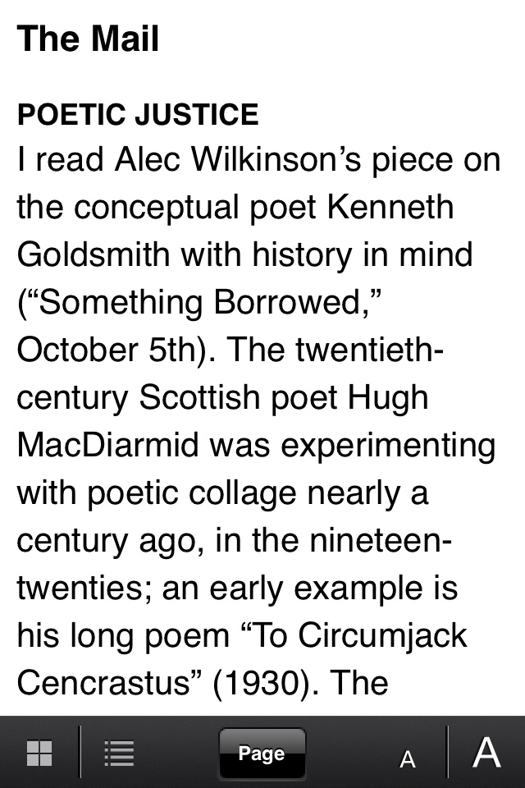

Slide 34
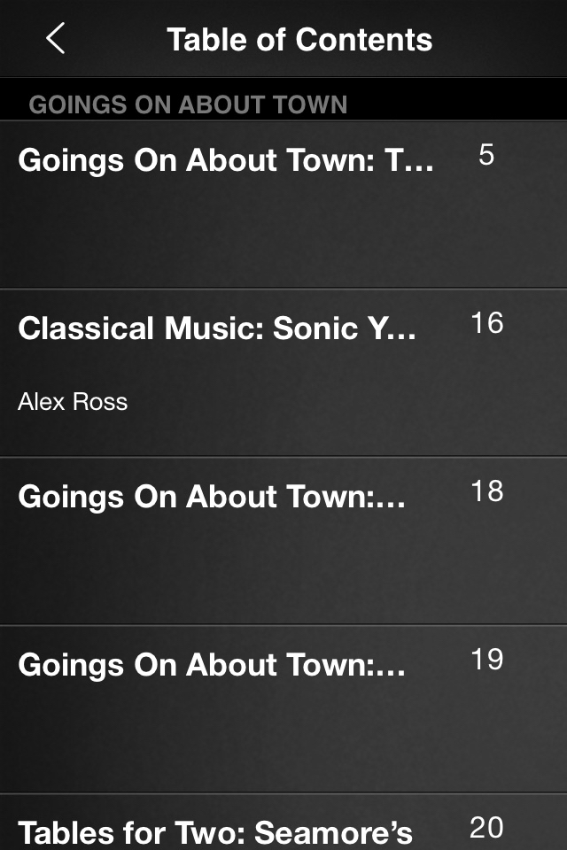

Slide 36
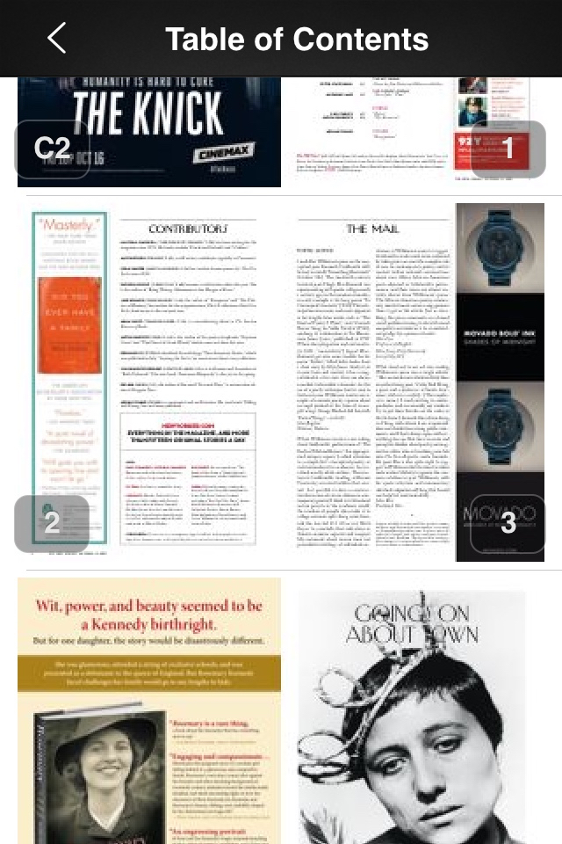

Slide 37
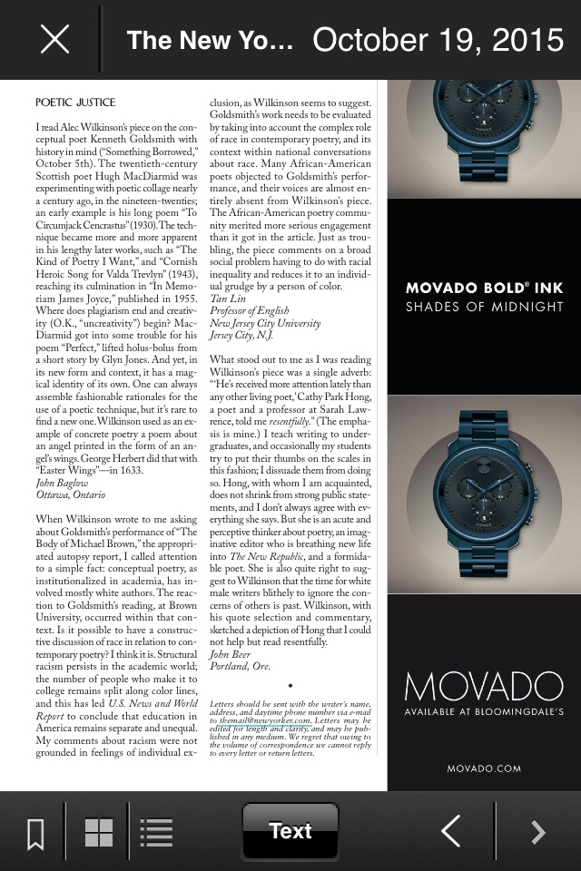

Slide 39
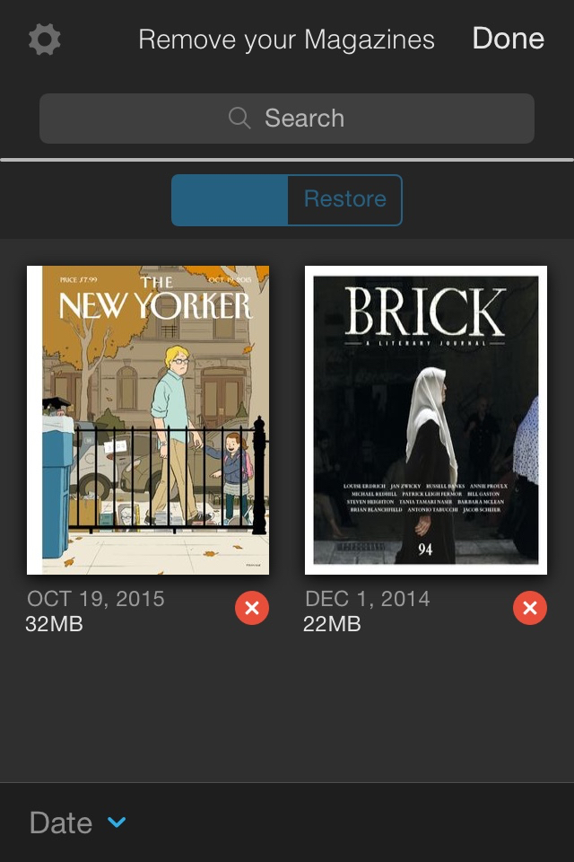

Slide 40
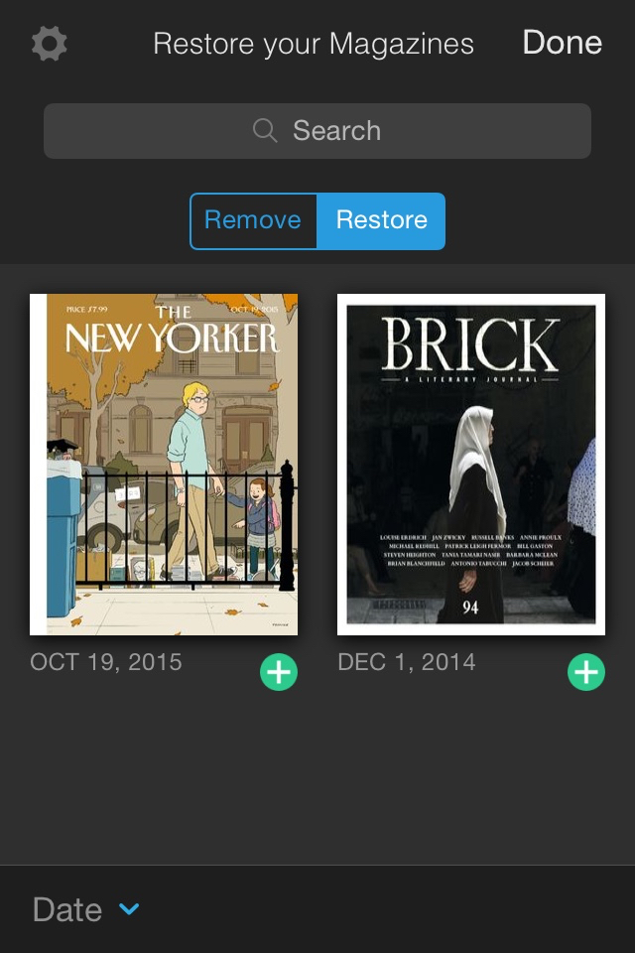

Slide 41
Step 3
Use your Zinio account to watch movies on IndieFlix, which you can (must) also access through your public library’s website.

Slide 42
Fun with Tech (and Reading)
Brought to you by :
BC Libraries Cooperative
Columbia Basin Alliance for Literacy
Kootenay Library Federation
Slides created by Sabina Iseli-Otto (support@nnels.ca), October 2015. No copyright on these contents, so please feel welcome to modify and share as you wish.
This project is funded by the Government of Canada’s New Horizons for Seniors Program.

