Slide 1


Surrey Libraries
Computer Learning Centres
Totally New to Computers
Where’s the Music?
January 2013 Teaching Script

Slide 2
MUSIC
This class will give you a brief overview of the Surrey Libraries music databases and web resources
You will also learn about other online music services

Slide 3
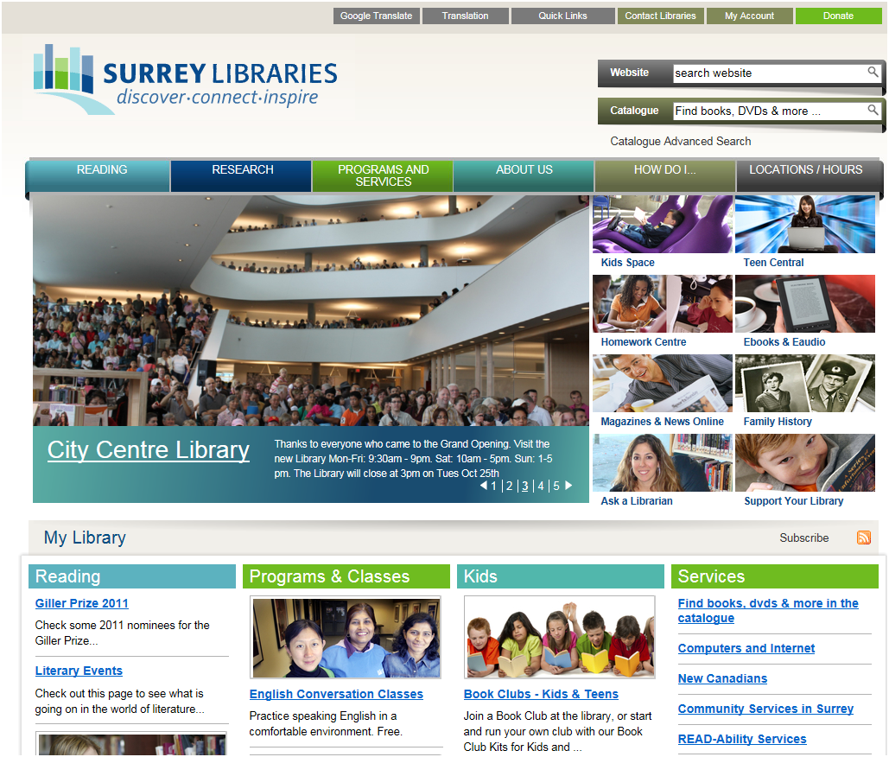
Surrey Libraries Website
Search
Main channels
Quick links
Slideshow

Slide 4
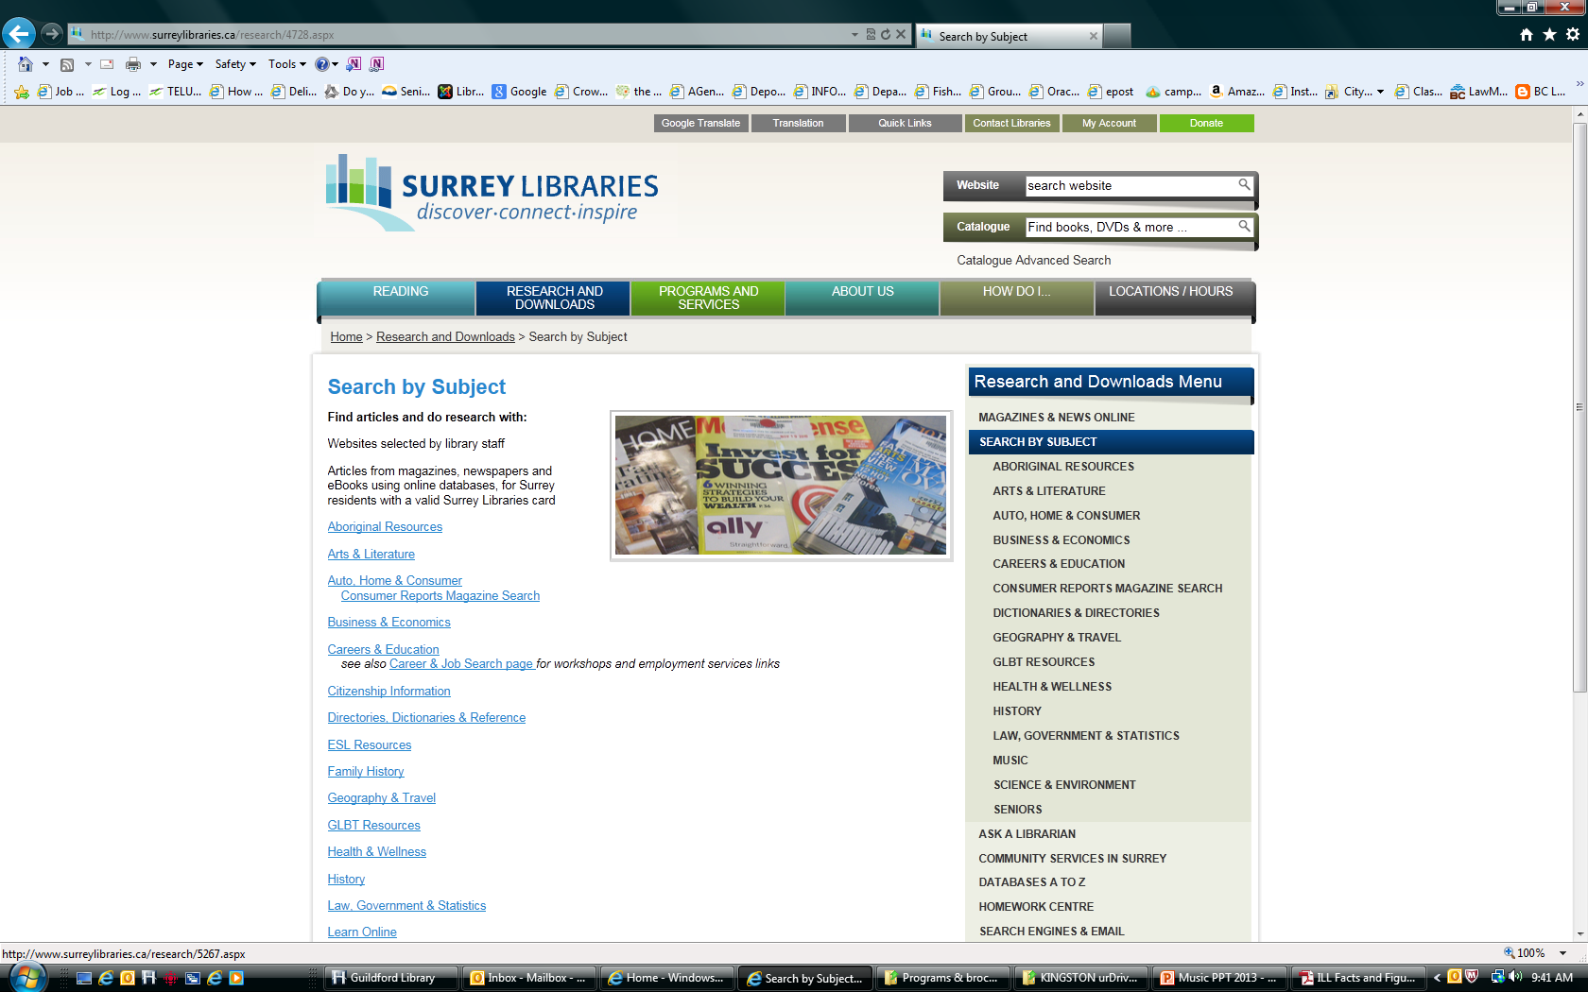
How Do I Find MUSIC?

Slide 5
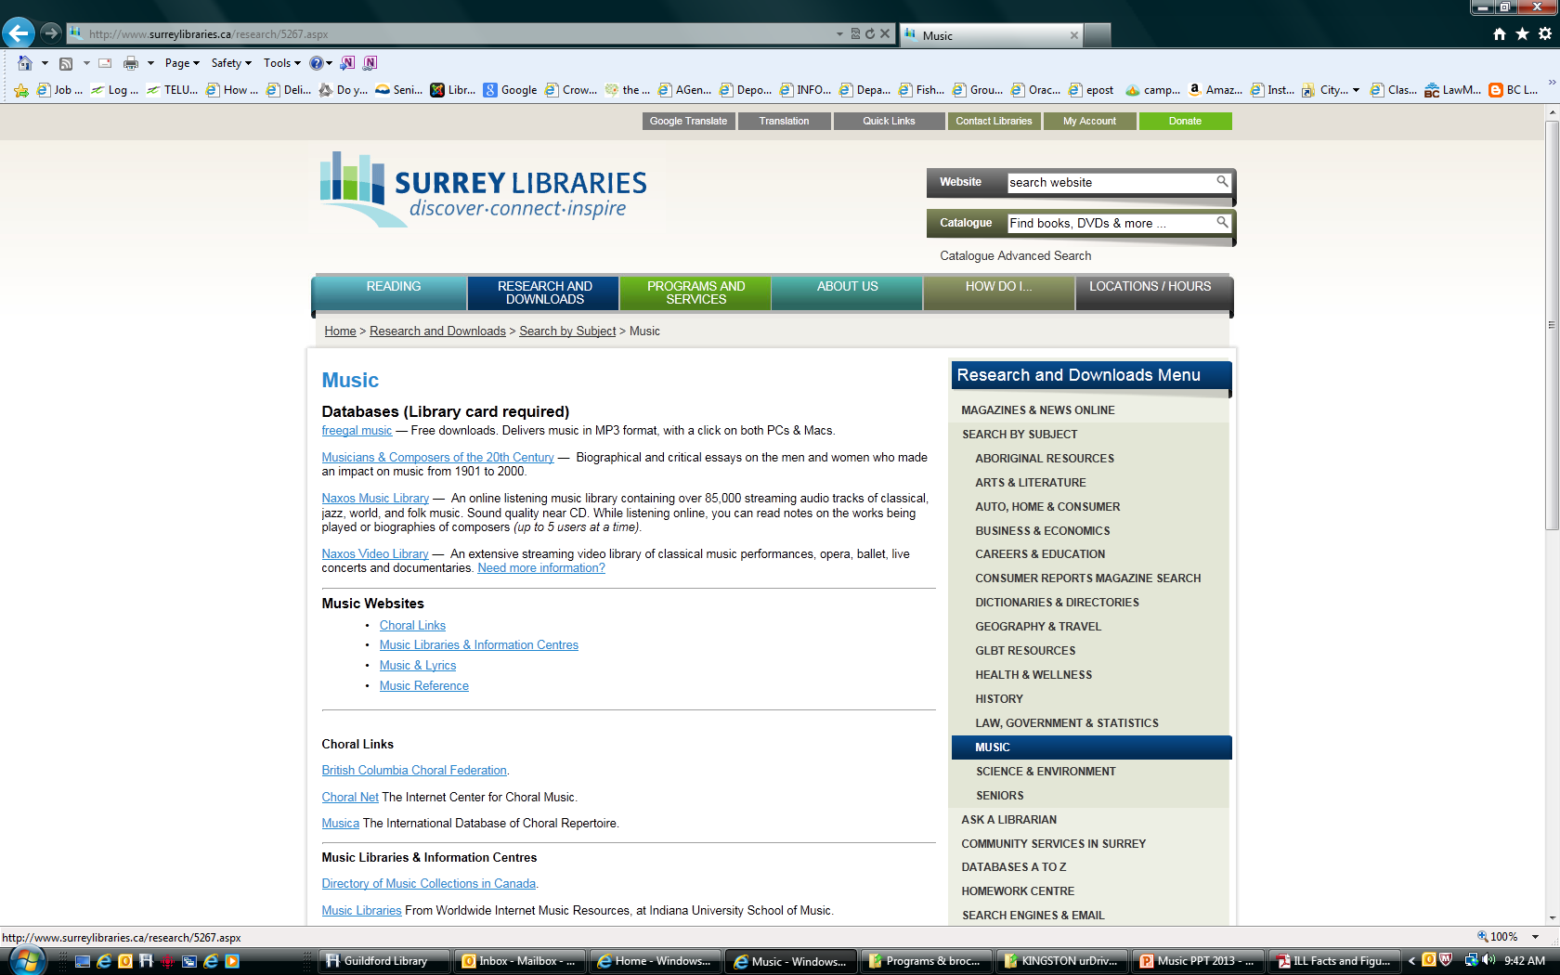
Find the MUSIC Databases

Slide 6
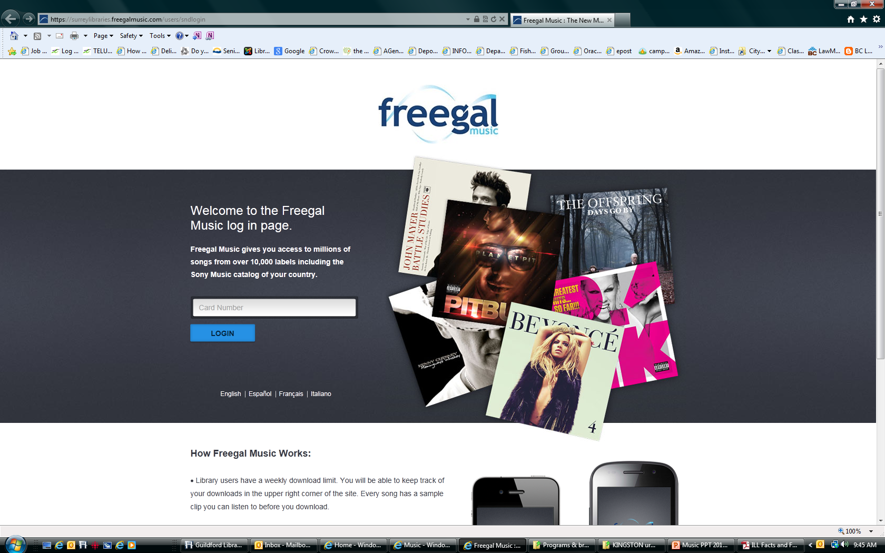
Freegal Music

Slide 7
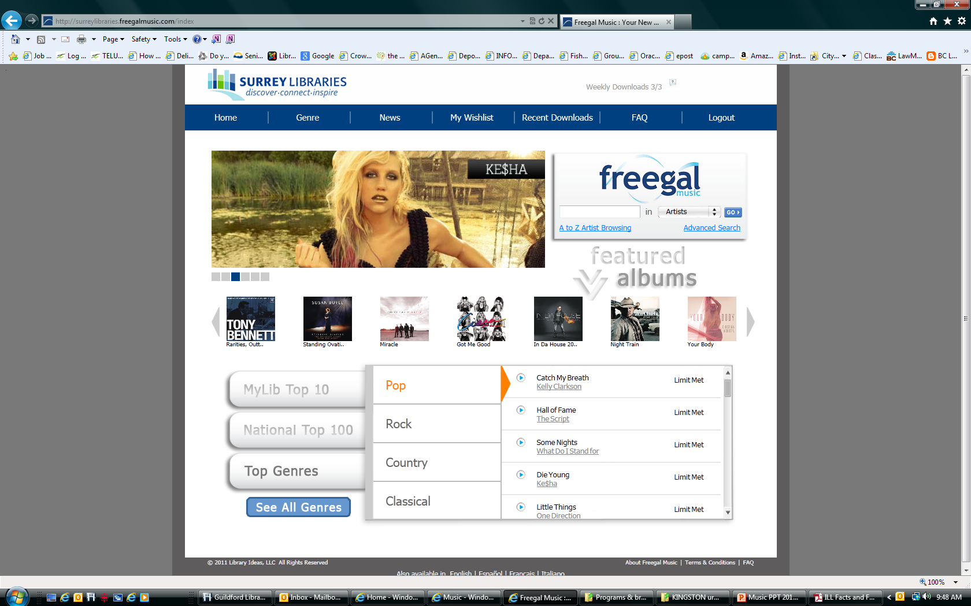
Current artists 3 per week

Slide 8
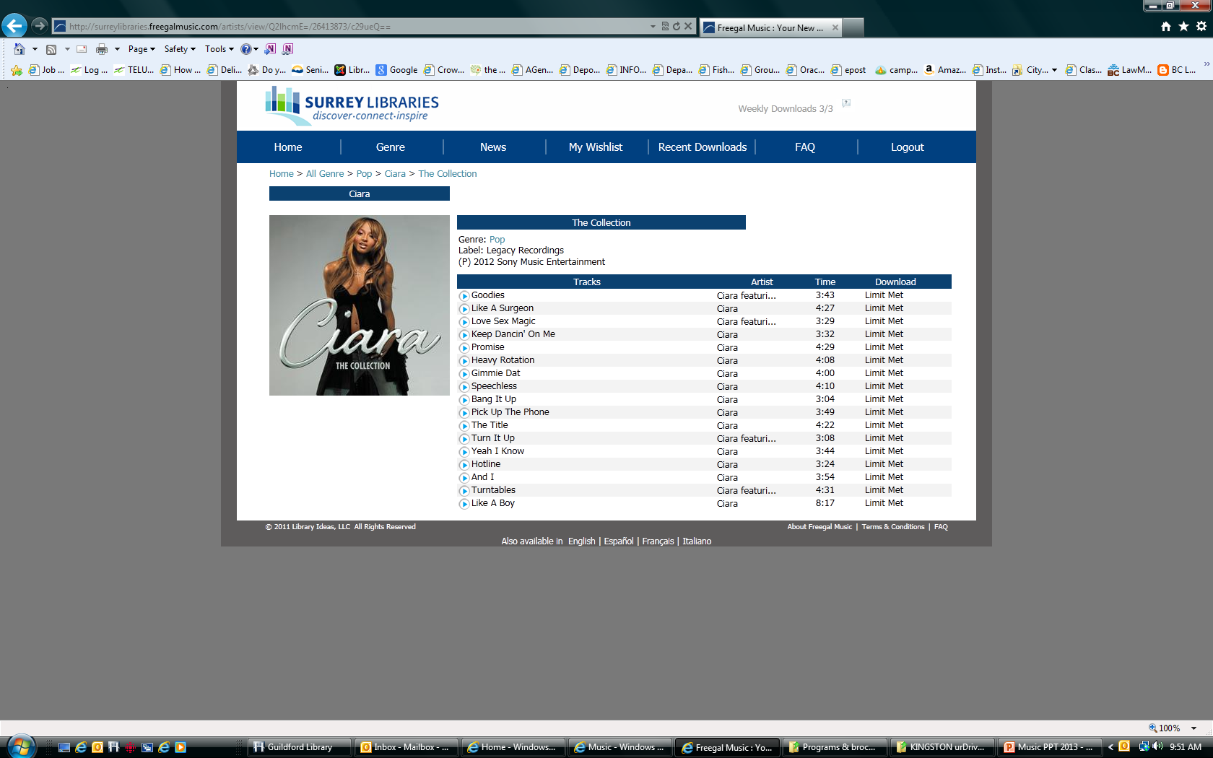
Picking a track
Notes:
Pick a track, 1) but if you have reached your 3 per week limit that will show 2) show download 3) then wishlist if available…

Slide 9
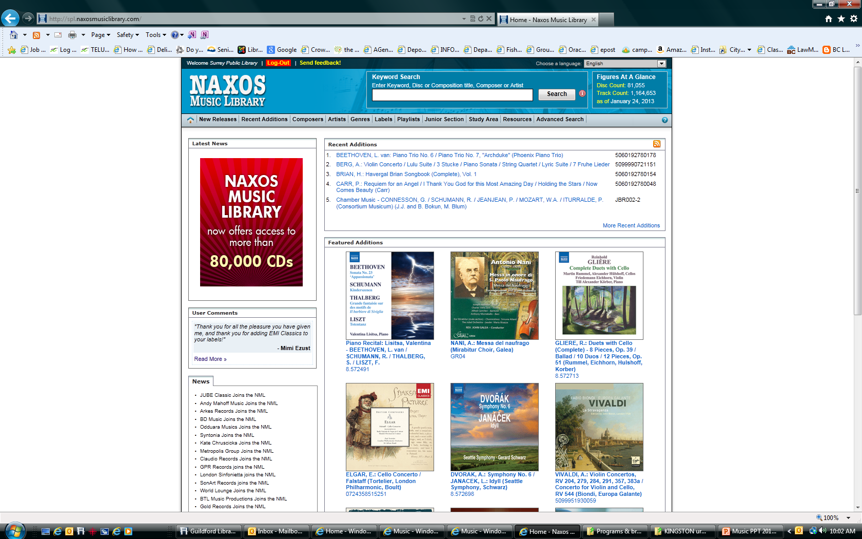
Naxos Music

Slide 10
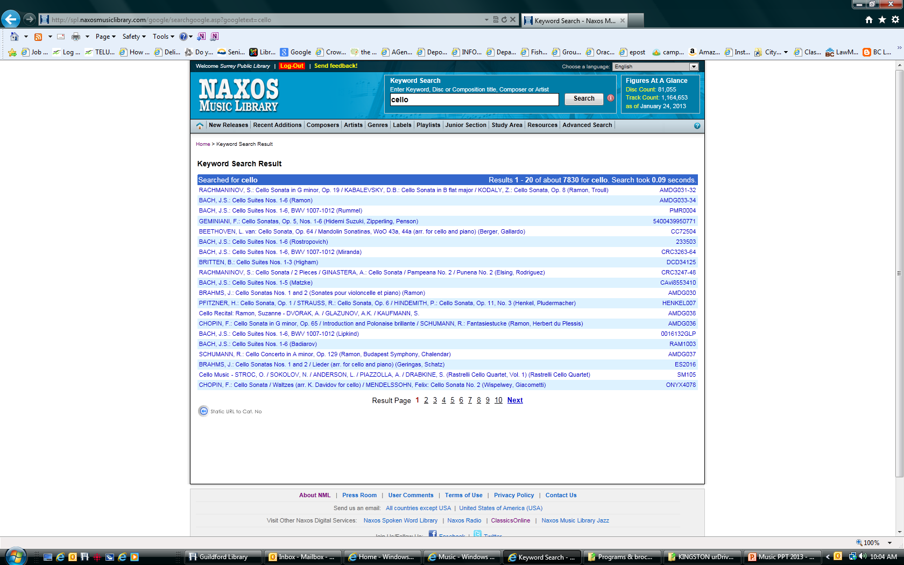
Searching Naxos

Slide 11
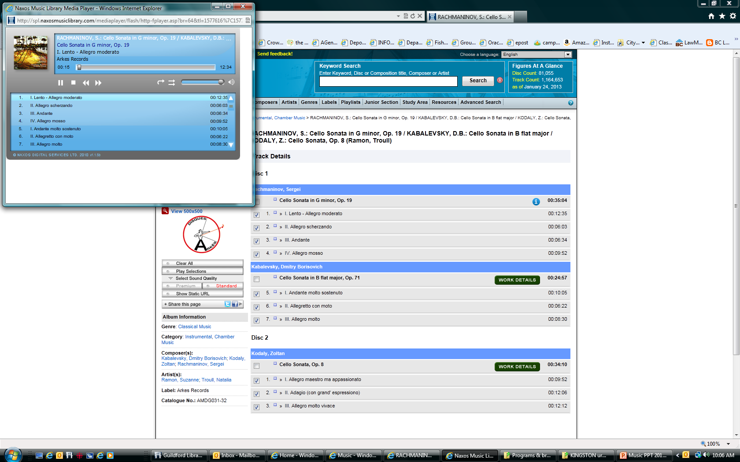
Playing the music

Slide 12
More music downloads
Canadian music centre
The Canadian Music Centre holds Canada's largest collection of Canadian concert music. The CMC exists to promote the works of its Associate Composers in Canada and around the world.
CBC Music: music.cbc.ca
TV/Video: www.cbc.ca/player/
Provides a wide range of media including a number of CBC Tv shows. Also provides a legal, music streaming site that lets you listen to free Canadian music.

Slide 13
More Music downloads
Bandcamp http://bandcamp.com/
Artists can sell music & merch directly to fans.
DaPiff www.datpiff.com
Free mixtapes from a wide variety of current artists. Great for R&B and hiphop fans.
Internet Archives archive.org
A large, sprawling website with free movies, music and books. Great source of vintage cartoons and older movies. Also features the ‘Way Back Machine’ which allows to you see older versions of websites.
Itunes

Slide 14
More music downloads
Jaroo www.jaroo.com
Songza http://songza.com/
a free app on iPad - has many channels and the playlists are made by an expert team of music critics, DJs, musicians, and musicologists.
Soundcloud https://soundcloud.com/
Hear the world’s sounds and explore a large community of artists, bands, podcasters and creators of music & audio
YouTube www.youtube.com
A wide range of videos of famous artists both old and new. All genres.
Search Rachmaninoff or Bill Evans or John Coltrane or Barbara Streisand

Slide 15

Review

Slide 16
Questions?
Thank You

