Slide 1
Web Design Essentials:
The Design Process
Vancouver Public Library

Slide 2
Learning Opportunities @ VPL!
Digital Essentials: vpl.ca/program/digital-essentials

Slide 3
Learning Opportunities @ VPL!
Lynda.com: vpl.ca/Lynda
VPL Research Guides: guides.vpl.ca
Web Design Essentials:
guides.vpl.ca/webdesign

Slide 4
Learning Opportunities @ VPL!
We are here to help!
604-331-3603
info@vpl.ca

Slide 5
Today We Will Learn How To . . .
Define, consider essential web design principles:
Website Purpose/Content Strategy
Aesthetics
Usability/Accessibility
Organize and iterate design ideas by using site maps and wireframes

Slide 6
Elements of Web Design. . .
Content strategy
Usability
Aesthetics

Slide 7
Content and Design Purpose
Content Strategy
What content are you featuring?
Who is your audience?
What do you want them to do on your website?

Slide 8
Types of Content
Short form text
Titles, descriptions, instructions
Long form text
News, articles, blogs
Graphics, images
Cartoons, art, photos
Videos
Instructional, entertainment

Slide 9
Aesthetics
Aesthetics
A set of principles concerned with the nature and appreciation of beauty, especially in art.

Slide 10
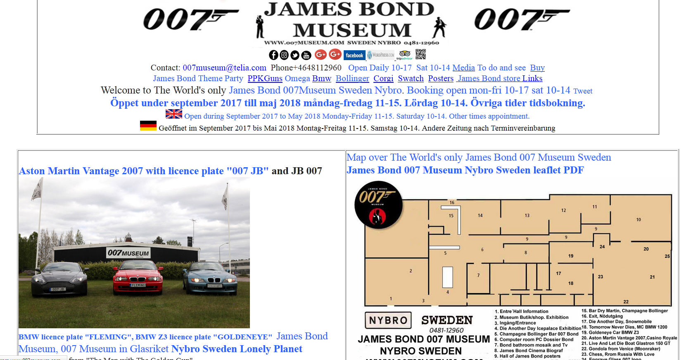
Aesthetics
http://www.007museum.com/

Slide 11
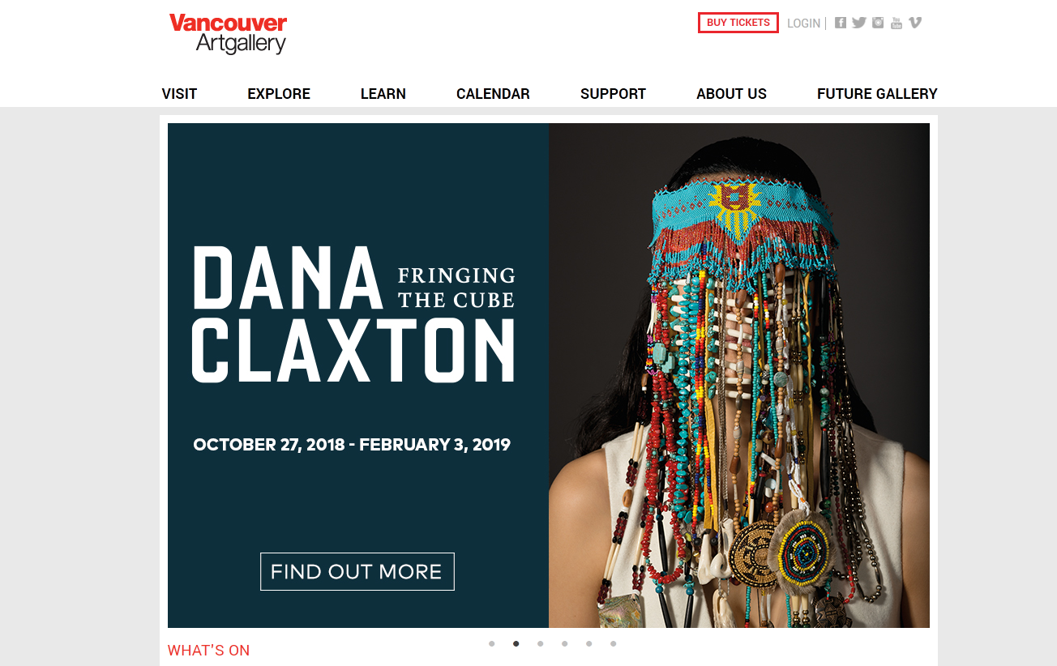
Aesthetics

Slide 12
Aesthetics
“Design is not just what it looks like and feels like.
Design is how it works.” --Steve Jobs
Balance design and usability!
Elements of Design (condensed):
Type/Font
Texture, form, whitespace
Colour palette

Slide 13
Aesthetics: Type & Fonts
Type is a key element of website design
Websafe fonts - pre-installed
Serif
Sans Serif

Slide 14
Aesthetics: White Space
https://www.lynda.com/Design-Techniques-tutorials/Using-space-organize-your-design/506078/539544-4.html

Slide 15
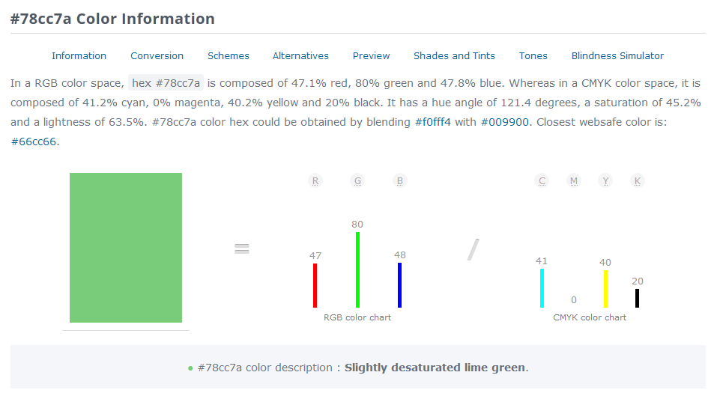
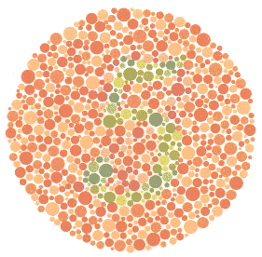
Aesthetics: Colour
Colour – conveys mood and balance.
Web-friendly colours –
use colour pickers
Accessibility – avoid relying on colour for key information
https://www.toptal.com/designers/colorfilter/

Slide 16
Aesthetics
We are creating a website to sell children’s wooden toys
Who is our target demographic?
What would our target demographic expect the website to look and feel like?
Comforting and welcoming? Flashy and edgy? Plain and simple? Complex and detailed?
Consider the elements of visual design:
Colour (hue), value (tone), texture, shape, form, space
(whitespace), line, type.
What other design choices should we make?

Slide 17
Usability
Usability is determined by design balance of:
a) the user context (what they want to do)
b) the use environment
(where/how they are using something)

Slide 18
Usability Testing
“If something requires a large investment of time — or looks like it will — it’s less likely to be used.” –
Steve Krug author of Don’t Make Me Think. 2014: New Riders
Test to see if users can use the website successfully. Use paper layouts, prototypes or live site.
Goodwill reservoir? Assess the problems that create the most frustration – fix first!
19/ 29

Slide 19
Usability: Conducting tests
Develop key tasks you would like people to take on your website.
Find a group of representative users (3-5).
Ask the users to perform or tasks and “think out loud” – what is noticed, where they succeed, and where they have difficulties.
Observe & document- prioritize changes and design decisions.

Slide 20
Accessibility

Slide 21
The Case for Accessibility
Access to information and communications technologies, including the Web, is a basic human right.
Accessibility supports social inclusion.
There is also a strong business case for accessibility.

Slide 22
Key Accessibility Considerations
Images - using the “alt text” code. Add in descriptive terms with images.
Inaccessible colours used for key elements e.g. buttons, navigation, fonts are in certain colours.
Videos used for key navigation elements – visual barriers, sound barriers

Slide 23
Responsiveness

Slide 24
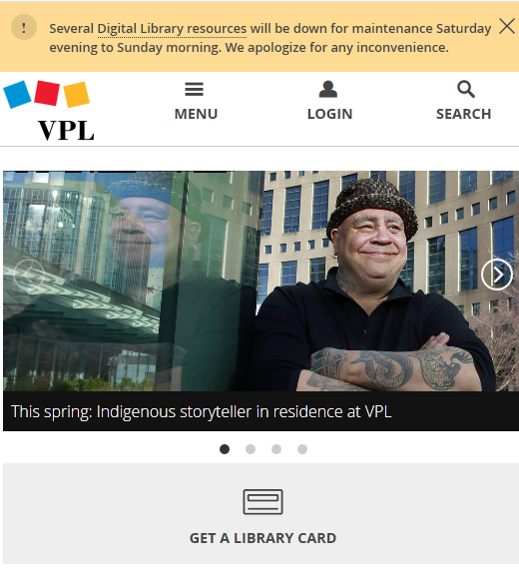
Responsiveness

Slide 25
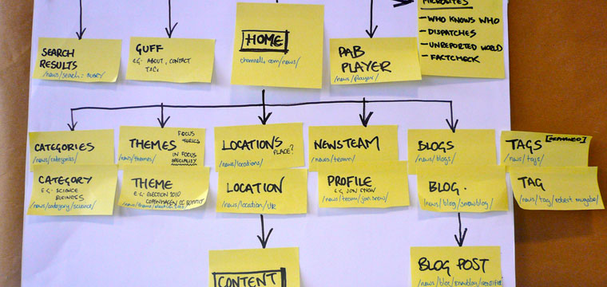
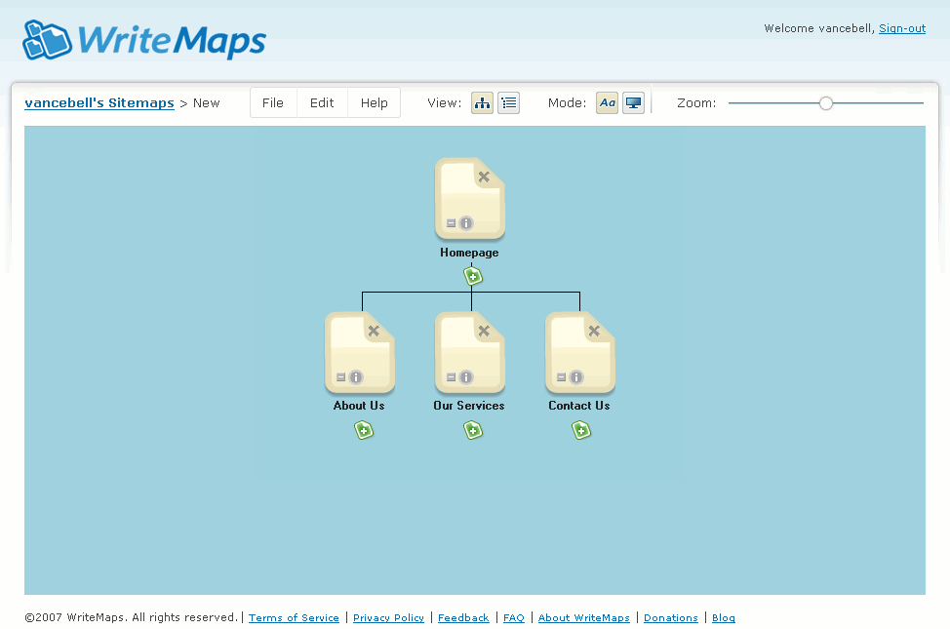
Create a Site Map
Images from:
https://www.linkedin.com/pulse/basic-guidelines-xml-sitemaps-rssatom-feeds-pramod-kumar/
https://writemaps.com/

Slide 26
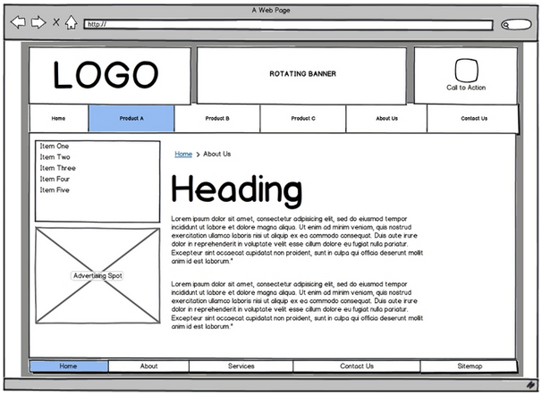
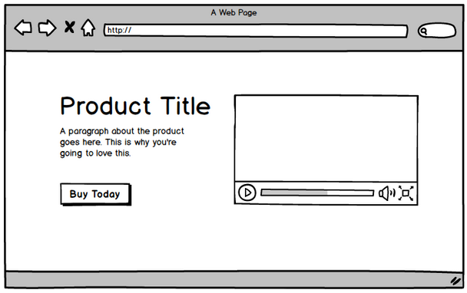
Create a Prototype/Wireframe
Images from: http://www.softwaretestinghelp.com/wireframes-prototype-testing/
http://freshpractices.com/sitemaps/

Slide 27
Bringing it All Together in Your Design
Content strategy
Usability
Aesthetics

Slide 28
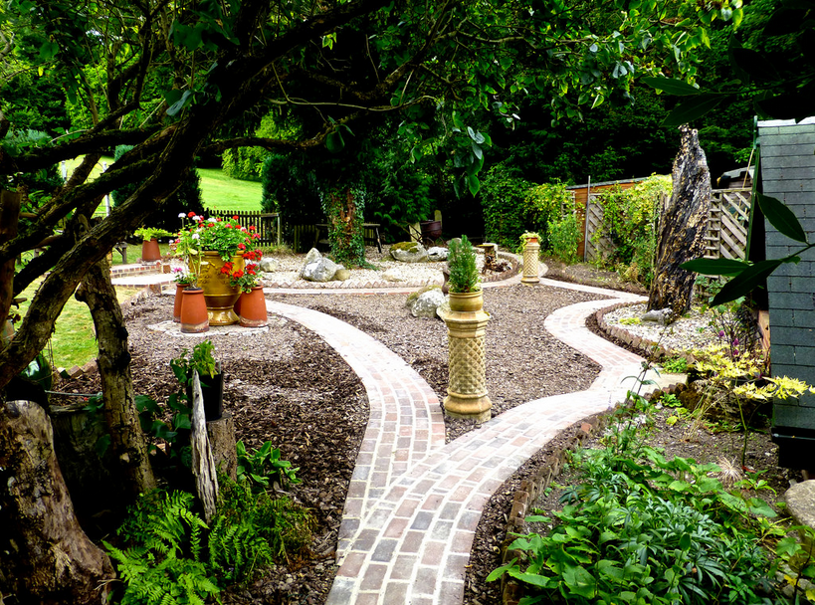
Let’s Practice!
Group 1
Quilting Shop
Group 2
Landscaping service
Notes:
Landscaping photo taken by Herry Lawford

Slide 29
Share Your Design Ideas with the Class!

Slide 30
Review: The Design Process
Put your thoughts on paper first
Define the style/look
Create a sitemap/website blueprint
Create a prototype/wireframe
Do usability testing
Revise as needed
Publish (next class)!

Slide 31
Did We Learn How To . . . ?
Define, consider essential web design principles.
Organize and iterate design ideas by using site maps and wireframes
Consider copyright and permissions

Slide 32
We want your feedback!
Please fill out an evaluation form to tell us what you thought of this class and help us improve our programs.
Online: www.vpl.ca/trainingfeedback
Thank you!

