Slide 1
Creating a Website with WordPress
Vancouver Public Library

Slide 2
Learning Opportunities @ VPL!
Digital Essentials: vpl.ca/program/digital-essentials

Slide 3
Learning Opportunities @ VPL!
Lynda.com: vpl.ca/Lynda
VPL Research Guides: guides.vpl.ca
Web Design Essentials:
guides.vpl.ca/webdesign
Excellent WordPress course, but an older version (interface is slightly different)

Slide 4
Learning Opportunities @ VPL!
We are here to help!
604-331-3603
info@vpl.ca

Slide 5
Today we will learn to…
Design a website using WordPress.com
Consider your site’s appeal and usability
Determine how copyright may impact the process

Slide 6
Elements of Web Design. . .
Content strategy
Usability
Aesthetics

Slide 7
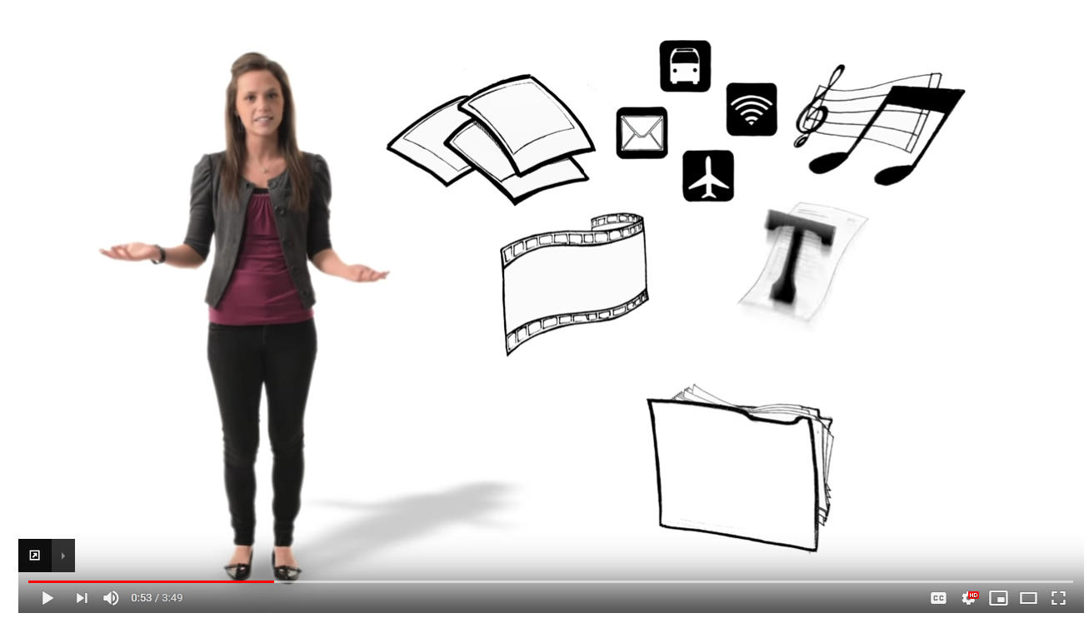
How do websites work?

Slide 8
How do websites work?
What is HTML, and what does it do?
What is a server?
What is a hosting service?
What does “DNS” mean?

Slide 9
Website Builders

Slide 10
.com OR .org
vs.

Slide 11
Wordpress.com “all in one”
Hosting
Domain name
Live CMS
Templates and quick editing

Slide 12
Getting started with Wordpress

Slide 13
Follow along!

Slide 14
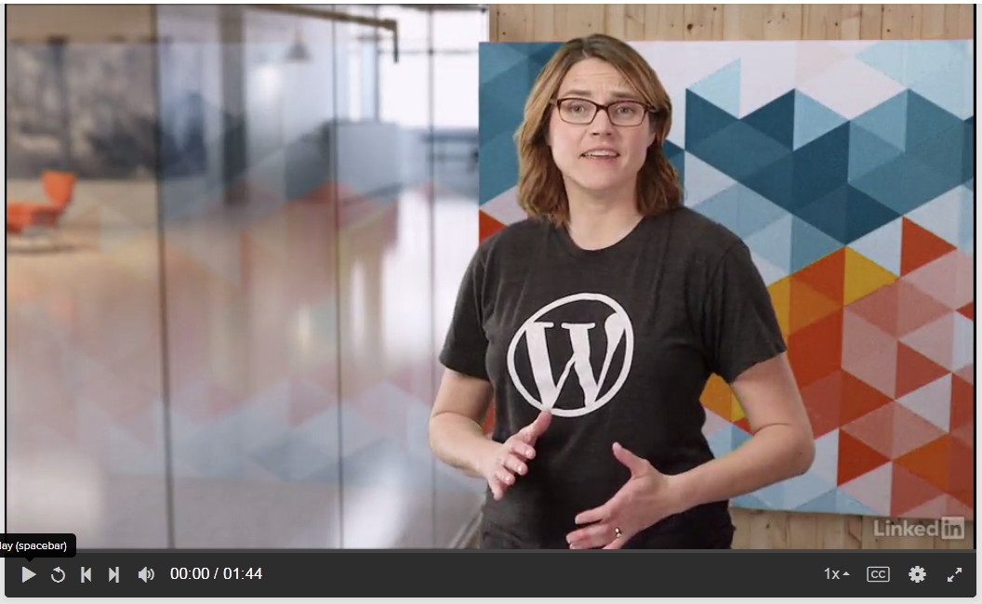
Posts vs Pages

Slide 15
Images: What You Need to Know
Most images you find online are copyright, which means they cannot be used by another person without the creator’s permission.
There are use cases that are allowed, referred to
in Canada as Fair Dealing. If something:
is for personal use
you’re crediting the creator
you’re not making money from it
you’re not prohibiting the original creator from making money
it might be allowed. However, publishing someone else’s image on your website will likely not fall under “Fair Dealing”. Refer to the handout for more information about Fair Dealing.

Slide 16
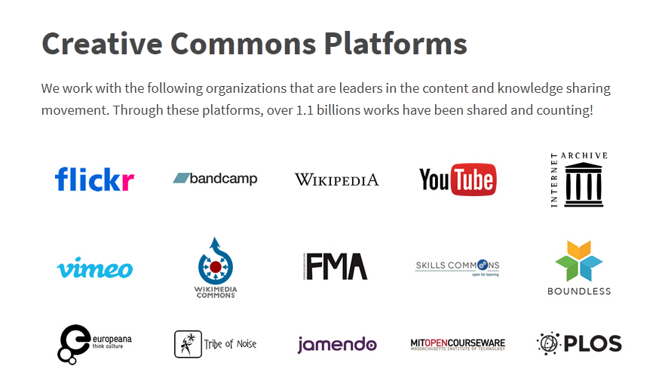
Images: What You Need to Know
search.creativecommons.org
pexel.com
Google Images (“Labelled for non-commercial reuse”)

Slide 17
Did we learn to…
Design a website using WordPress.com
Consider our site’s appeal and usability
Determine how copyright may impact the process

Slide 18
We want your feedback!
Please fill out an evaluation form to tell us what you thought of this class and help us improve our programs.
Online: www.vpl.ca/trainingfeedback
Thank you!

