Slide 1
Web Design Essentials: Basic Coding
Vancouver Public Library

Slide 2
Learning Opportunities @ VPL!
Digital Essentials: vpl.ca/program/digital-essentials

Slide 3
Learning Opportunities @ VPL!
Lynda.com: vpl.ca/Lynda
VPL Research Guides: guides.vpl.ca
Web Design Essentials:
guides.vpl.ca/webdesign

Slide 4
Learning Opportunities @ VPL!
We are here to help!
604-331-3603
info@vpl.ca

Slide 5
Today We Will Learn How To . . .
Identify how webpages are built with code
Recognize HTML tags, CSS style sheets, and JavaScript language, and their effects
Understand and apply appropriate basic coding to manipulate information on a webpage

Slide 6
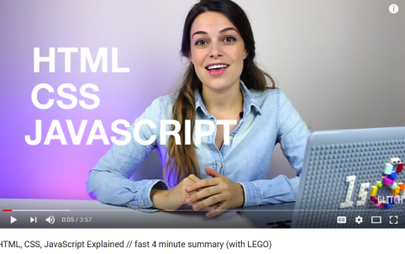
The 3 Core Languages

Slide 7
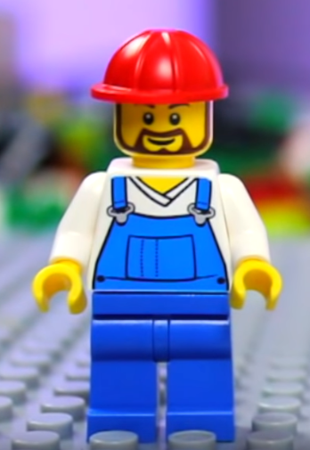
What is HTML?
Hyper Text Markup Language
Provides the structure for webpages
Labels content: heading, paragraph, etc.
The Builder

Slide 8
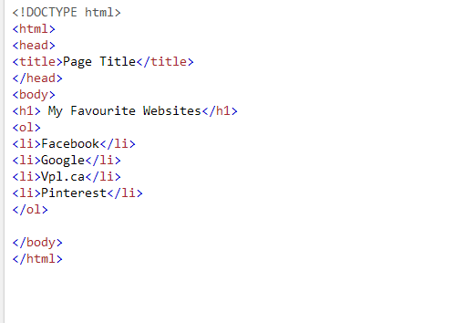
Website Builders : WYSIWYG
What You See Is What You Get (WYSIWYG)
Plain HTML Code

Slide 9
The Importance of HTML

Slide 10
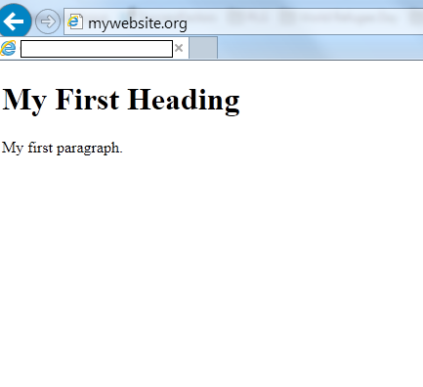
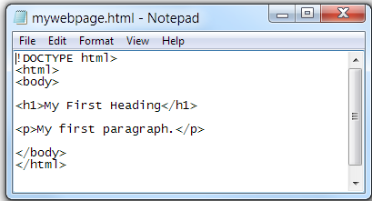
How HTML Files Become Websites

Slide 11
Building Blocks of HTML
HTML elements are the building blocks of webpage content
Elements are represented by tags. e.g. "heading” <h1> "paragraph“ <p> etc.
Browsers do not display tags → use them as instructions “markup” the content.

Slide 12
HTML the basics
Opening Tag
<tagname> Text here is affected by tagname element </tagname>
Closing tag (with forward slash)

Slide 13
HTML: Page structure
<html>
<head>
<title>website title</title>
</head>
…
</html>
<html> at start and </html> at end indicate this is an html document
<head> </head> indicates the header
Not displayed
The title tag shows up though in your browser frame.

Slide 14
Basic HTML: <body> <p>
<body>
<p>content of website in paragraphs </p>
<p>content of website in paragraphs </p>
</body>
Anything between <body> </body> is what is displayed on the webpage.
This example uses “paragraph” <p> </p> tags to space text.
Other “tags” give the text structure. Examples:
<strong> strong </strong> = strong
<em> emphasis</em> = emphasis
<u> underline </u> = underline

Slide 15
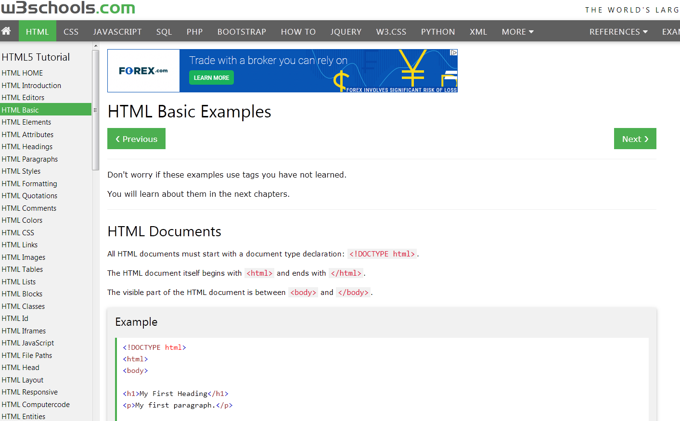
Let’s Practice HTML!
www.w3schools.com/html/html_basic.asp

Slide 16
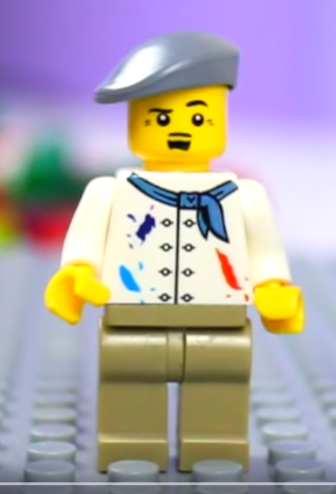
Let’s Talk about Style : CSS
What is CSS? Cascading Style Sheets
What it does:
Controls how your HTML appears
Adds a uniform look and style to your site
The Artist
Notes:
Phejt Photo
Intusick
https://www.flickr.com/photos/phejt/15419122433/in/photolist-c9eH27-brUVKQ-bmvUDT-sYwzc-pkv6Un-bmvRbr-8ZXjaL-i3ehbE-cHGsBU-YL543f-caR6M3-7tXzE4-72jnKd-9uCocv-cHGtFd-i3eroA-25iYSy6-9BLyST-72jqAG-25iYDYX-25iYyZt-bP3V3B-4ESZ1v-o7cRUU-pboDnS-ooGwjV-ZWpaKS-8sEUka-q8b7bi-2125dC8-9BKHTp-i3egeu-25iYEDz-jDPSqV-G5r9x6-b8m7et-YWpSQ3-cHGu4b-bRstUF-55v7MK-pQMN5G-9BKyzP-aQYWja-4uecA-pGKBR9-q9JcGw-pux2Uv-3jbDCD-owRnBa-7KKUJ8

Slide 17
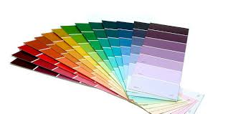
What CSS does
CSS Defines style
Font types
Colours
HYPERLINK looks
Helps a Plain
HTML
WEBPAGE
Look good
Background Colours

Slide 18
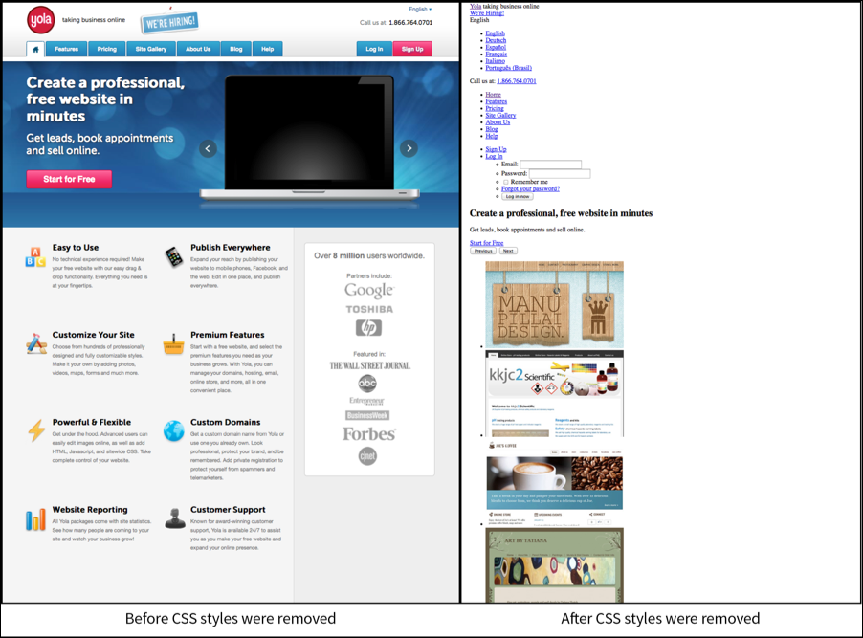
CSS vs. No CSS
Notes:
https://www.yola.com/blog/learn-the-basics-of-css-and-website-customization/

Slide 19
How CSS sheets link
Text/CSS and Style.css
Often separate page- linked in the html “head” section
-The sheet defines styles
CSS coded with {curly brackets}
e.g. body {font-family: Arial, sans-serif; line-height: 1.50; margin: 0 0;}
<html>
<head>
<title>website title</title>
<link rel="stylesheet" ink rel="stylesheet" type="text/css" href="style.css" />
/>
</head>

Slide 20
CSS syntax
This refers to the element in your HTML page
These define what you want it to look like, how it will be placed, how large it will be, how it will be framed, etc.
Note: {curly brackets} and separation semicolon ;

Slide 21
See what CSS can do!
www.w3schools.com/css/css_intro.asp
www.w3schools.com/css/css_syntax.asp

Slide 22
What is JavaScript?

Slide 23
What is JavaScript?
Interactive layer
Interacts with HTML Markup and CSS Rules to change what you see and what you can do
Runs in a browser
The Wizard

Slide 24
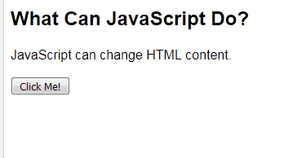
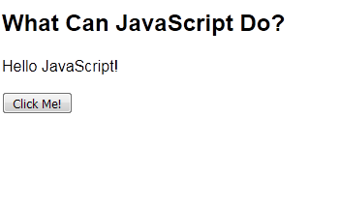
What does Javascript look like?
<!DOCTYPE html>
<html>
<body>
<h2>What Can JavaScript Do?</h2>
<p id="demo">JavaScript can change HTML content.</p>
<button type="button" onclick='document.getElementById("demo").innerHTML = "Hello JavaScript!"'>Click Me!</button>
</body>
</html>

Slide 25
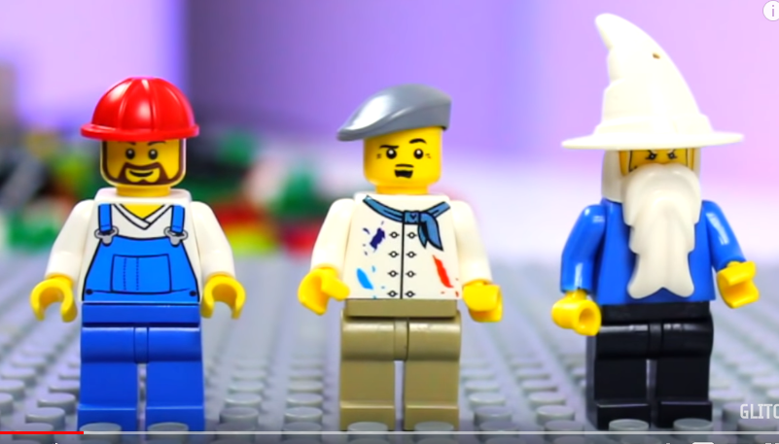
Review
HTML: The Builder CSS: The Artist JavaScript: The Wizard

Slide 26
Want More Practice?
 | w3schools Online tutorials: HTML CSS JavaScript
 | Lynda.com Online Video Courses: HTML Essential Training CSS Fundamentals JavaScript For Web Designers

Slide 27
Did We Learn How To . . . ?
Identify the ways that code underlies how the web is built and changed
Recognize basic HTML tags, CSS style sheets, and JavaScript language, and their effects
Understand and apply appropriate basic coding to manipulate and display information & data on the web

Slide 28
We want your feedback!
Please fill out an evaluation form to tell us what you thought of this class and help us improve our programs.
Online: www.vpl.ca/trainingfeedback
Thank you!

