Slide 1
Let’s Talk About
Participating Online
Vancouver Public Library

Slide 2
Learning Opportunities @ VPL!
Digital Essentials: vpl.ca/program/digital-essentials

Slide 3
Learning Opportunities @ VPL!
Lynda.com: vpl.ca/lynda
VPL Research Guides:guides.vpl.ca
Digital Awareness - guides.vpl.ca/digital_awareness

Slide 4
Learning Opportunities @ VPL!
We are here to help!
604-331-3603
info@vpl.ca

Slide 5
Today we will learn to…
Examine the consequences of sharing information online
Identify and manage your online information
Determine what social media accounts work for you
Understand how services can/cannot use your information
Recognize and report digital crimes

Slide 6
What is Your Online Identity?

Slide 8
What you share might influence…
Family
Friends
Work - current or potential
Volunteer organizations
Hobbies - sports, clubs, etc.
Committees, councils, etc.
Political or religious groups

Slide 9
Ask yourself...
Do I want to share?
Who will see it? Everyone?
What if others share my information?
What if others change the context?
In 10 seconds or 10 years -- will I wish I hadn’t shared it?
What if I want to remove it?

Slide 10
Notes:
New video?

Slide 11
Take the sharing test!
Notes:
New video?

Slide 12
Control Your Online Persona
Only share with people you know
Limit personal information
Create a pseudonym
Use an avatar
Create alternative email
Create strong passwords
Delete inactive accounts
Review privacy settings
Check privacy settings frequently

Slide 13
Finding Your Information
Google.com
Pipl.com
Canada411.ca

Slide 14
Easy
Difficult
Remove content yourself
Ask website to remove content
Legal recourse
Ask who posted content to remove it
Ask Google to remove search result

Slide 15
Deleting Accounts

Slide 16
Terms of Service

Slide 17
Terms of Service Example: Amazon.com

Slide 19
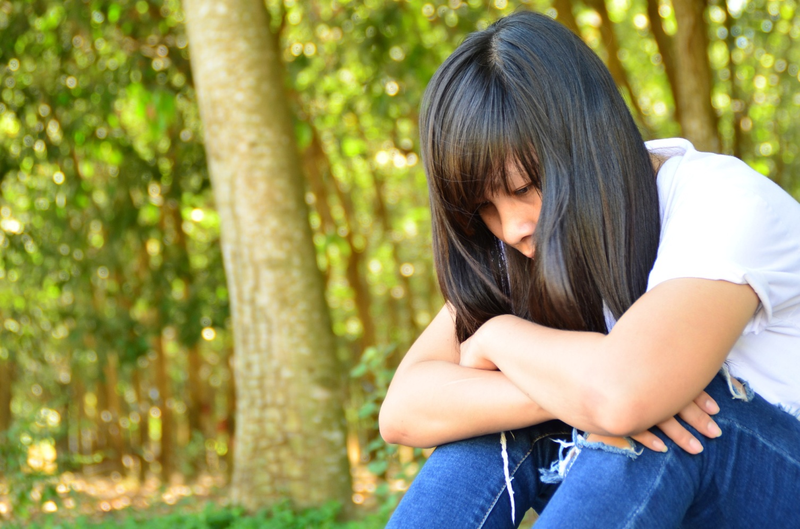
Cyberbullying and Harassment

Slide 20
Did we learn to…?
Examine the consequences of sharing information online
Identify and manage your online information
Determine what social media accounts work for you
Understand how services can/cannot use your information
Recognize and report digital crimes

Slide 21
We want your feedback!
Please fill out an evaluation form to tell us what you thought of this class and help us improve our programs.
Online: www.vpl.ca/trainingfeedback
Thank you!

