Slide 1
Working With Open Data
Vancouver Public Library

Slide 2
Learning Opportunities @ VPL!
Digital Essentials: vpl.ca/program/digital-essentials

Slide 3
Learning Opportunities @ VPL!
Lynda.com: vpl.ca/lynda
VPL Research Guides: guides.vpl.ca
Open Data – guides.vpl.ca/OpenData

Slide 4
Learning Opportunities @ VPL!
We are here to help!
604-331-3603
info@vpl.ca

Slide 5
Today We Will Learn How To . . .
Identify and locate open data sets on the internet.
Work with a single data set to follow the steps to use open data to create something new.
Distinguish between information license types and determine their impact on information access.

Slide 6
What is Open Data? Review

Slide 7
Steps to Using Open Data
Acquiring (Finding)
Extracting (Downloading)
Cleaning & Processing
Publishing
Maintaining

Slide 8
ACQUIRING: Where to find Data Sets
Government Data (Federal, Provincial, Municipal)
Research Data (Research Data Canada, Academic Institutions)
Social Data (Facebook, Instagram)
Weather Data (OpenWeatherMap, Environment & Climate Change Canada)
News Data (The Guardian, The New York Times)
Sports Data (Sports Reference)
Data Hubs (Qlik, Infochimps, CKAN, Google Public Data)

Slide 9
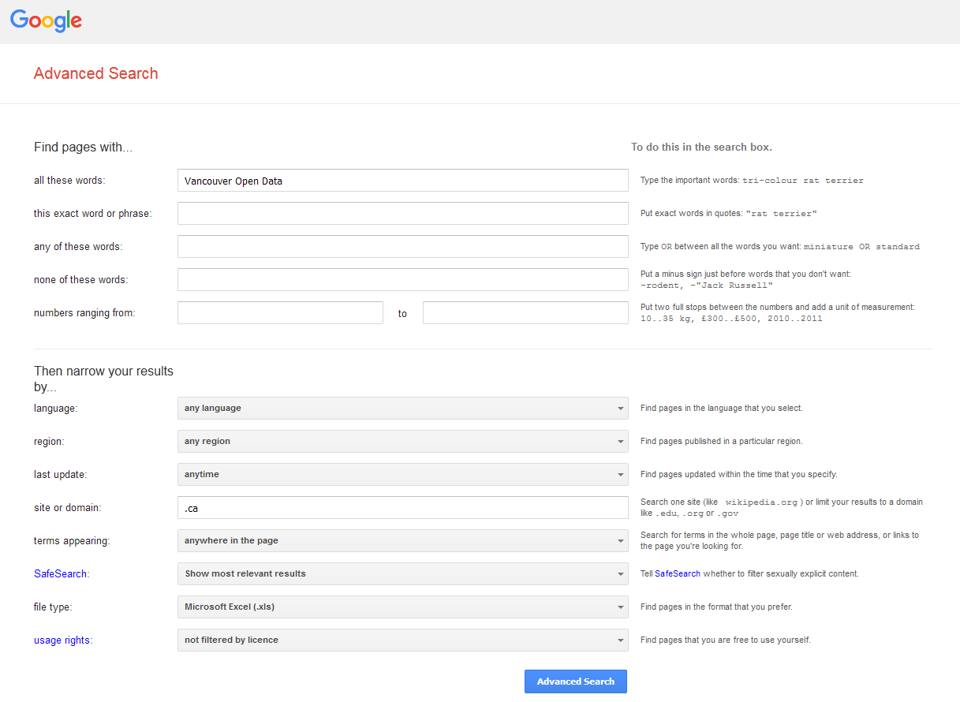
ACQUIRING: Searching for Data on the Web

Slide 10
ACQUIRING: Searching for Hidden Data

Slide 11
ACQUIRING: Reminder
Don’t forget to . . .
Check the license
Evaluate the data

Slide 12
Any Questions about Acquiring (Finding) Data?

Slide 13
EXTRACTING: Tips & Tricks
Look For Download Options
Download the Entire Database
Automate Downloads of Multiple Data Files

Slide 14
EXTRACTING: Data Management

Slide 15
Any Questions about Extracting (Downloading) Data?

Slide 16
CLEANING & PROCESSING

Slide 17
CLEANING & PROCESSING: Tools

Slide 18
3) Cleaning & Processing: Common Errors
Wrong date formats
Multiple representations
Duplicate records
Redundant data
Mixed numerical scales
Mixed ranges
Spelling errors

Slide 19
Any Questions about Cleaning or Processing Data?

Slide 20
Let’s Practice!

Slide 21
Find/Acquire a simple dataset
Download that dataset and convert it into a CSV file
Clean and Process the dataset (locate fix errors)
Use the dataset to create an amazing visualization (chart or graph)

Slide 23
Saving an Excel Document as a CSV File
CSV ‘Comma-separated values’, is a standard format for spreadsheet data.
Data is represented in a plain text file, with each data row on a new line and commas separating the values on each row.
As a very simple open format it is easy to consume and is widely used for publishing open data.

Slide 24
CSV Example
A table in Excel:
The above table of data represented in CSV format :
Year,Make,Model,Description,Price
1997,Ford,E350,"ac, abs, moon",3000.00
1999,Chevy,"Venture ""Extended Edition""","",4900.00
1999,Chevy,"Venture ""Extended Edition, Very Large""",,5000.00
1996,Jeep,Grand Cherokee,"MUST SELL! air, moon roof, loaded",4799.00

Slide 25
Using Excel to Create a CSV File

Slide 26
RECAP: Steps to Using Open Data
Acquiring (Finding)
Extracting (Downloading)
Cleaning & Processing
Publishing
Maintaining

Slide 27
PUBLISHING: Platforms
Publishing as files on a website
Uploading to a portal
Publishing through API
Creating an App

Slide 28
PUBLISHING: API

Slide 29
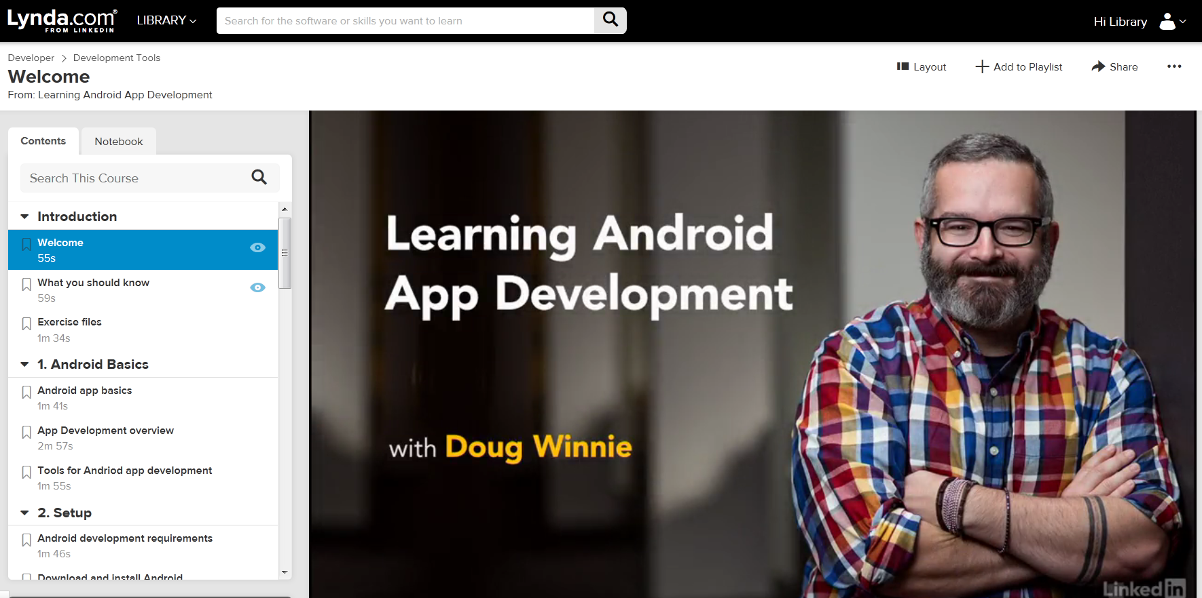
PUBLISHING: App Development

Slide 30
PUBLISHING: Adding Metadata
Metadata is:
Data that describes and gives information about other data (data about data)
Metadata helps people:
Discover data
Understand the nature and structure of the data
Find the origin of the data and under what terms it may be used

Slide 31
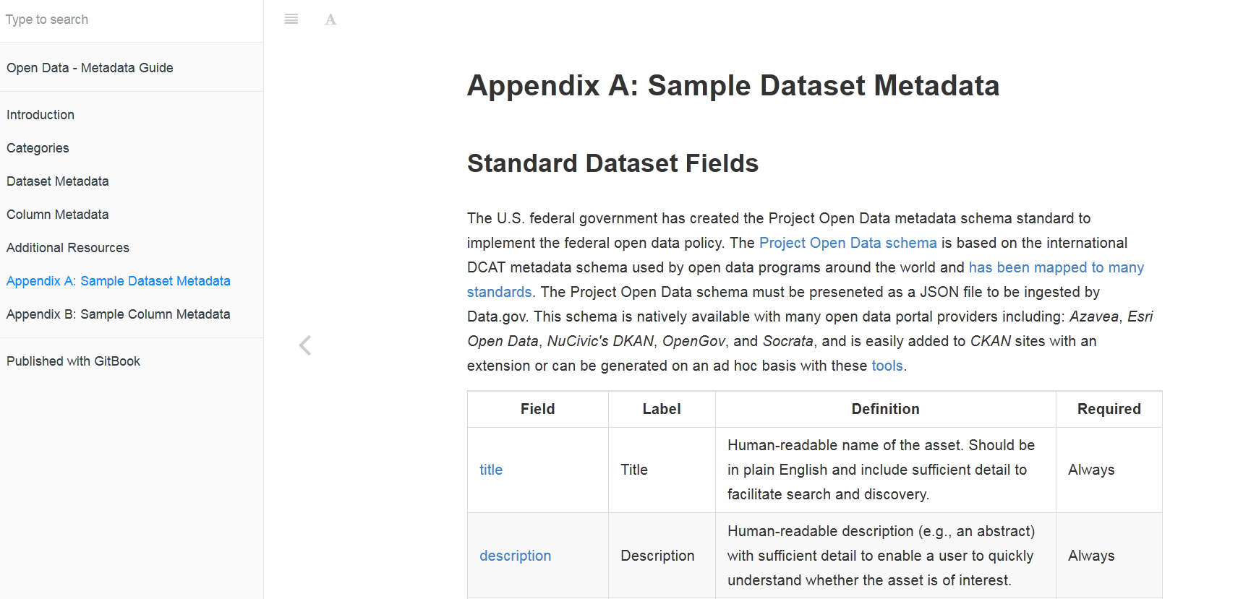
PUBLISHING: Standard Dataset Metadata

Slide 32
PUBLISHING: Metadata Training

Slide 33
PUBLISHING: Apply an Open License
Open Data Commons:
Public Domain Dedication and License
Puts all your material in the ‘Public Domain’ (waiving all rights).
Open Data Commons/Open Database License
Allows the public to copy, distribute, and adapt your data as long as they attribute , share-alike, and keep it open.
Open Data Commons/Attribution License
Allows the public to copy, distribute, and adapt your data as long as they attribute.
Creative Commons:
Free, easy-to-use copyright licenses to give the public permission to share and use your creative work–on conditions of your choice.

Slide 34
Any Questions about Publishing Data?

Slide 35
MAINTAINING
Maintain data and metadata regularly
Check links
Check user feedback

Slide 36
Brainstorming
Work in pairs or small groups
What sort of open data would you like to have access to?
How would you use this open data: what would you create?
Do you see any problems or issues that could potentially be solved using open data?

Slide 37
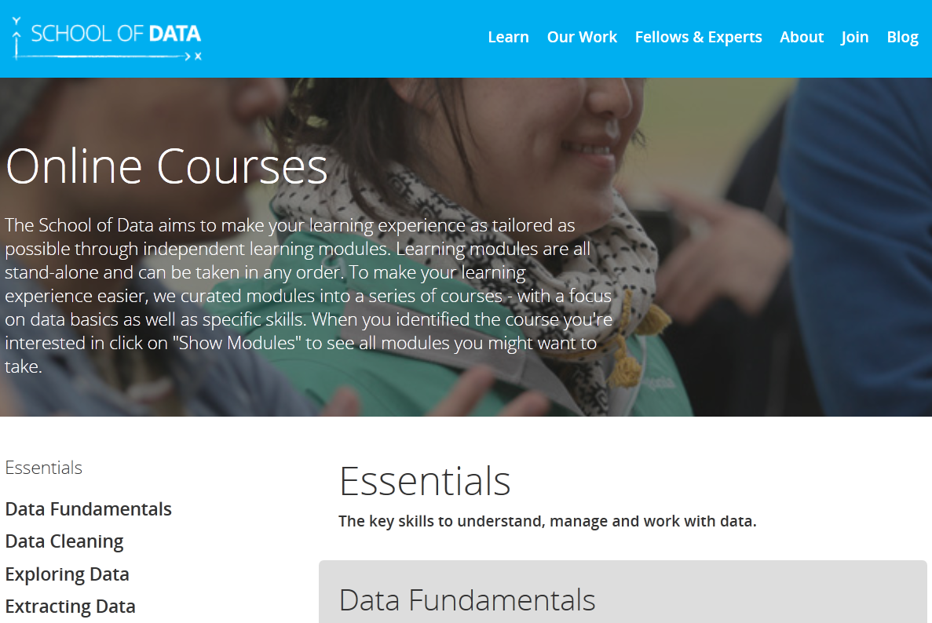
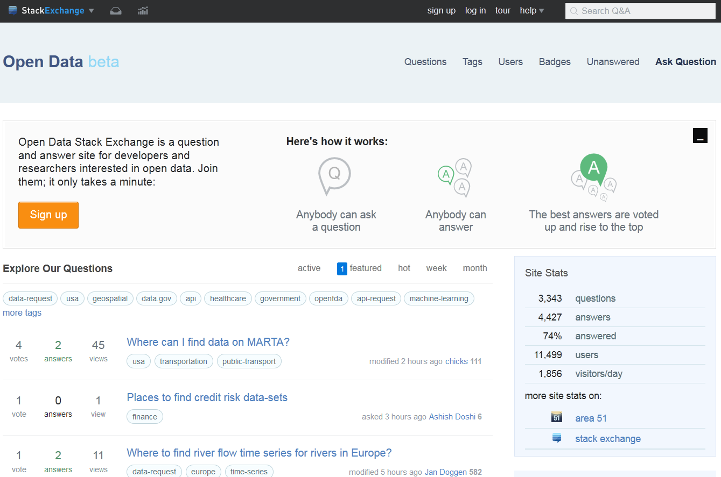
CONTINUED LEARNING

Slide 38
Did We Learn How To . . . ?
Identify and locate open data sets on the internet.
Work with a single data set to follow the steps to use open data to create something new.
Distinguish between information license types and determine their impact on information access.

Slide 39
We want your feedback!
Please fill out an evaluation form to tell us what you thought of this class and help us improve our programs.
Online: www.vpl.ca/trainingfeedback
Thank you!

