Slide 1
Let’s Talk About Open Data
Vancouver Public Library

Slide 2
Learning Opportunities @ VPL!
Digital Essentials: vpl.ca/program/digital-essentials

Slide 3
Learning Opportunities @ VPL!
Lynda.com: www.vpl.ca/lynda
VPL Research Guides: guides.vpl.ca
Open Data – guides.vpl.ca/OpenData

Slide 4
Learning Opportunities @ VPL!
We are here to help!
604-331-3603
info@vpl.ca

Slide 5
Today We Will Learn How To . . .
Discuss what “open” and “data” mean in an online context.
Think about the benefits and limitations different ways of sharing data.
Consider how organizations and individuals can use data from various digital sources to solve problems or explain concepts.
Discuss how the open and public nature of the web informs decisions about what to share and where.

Slide 6
What is Open Data?

Slide 7
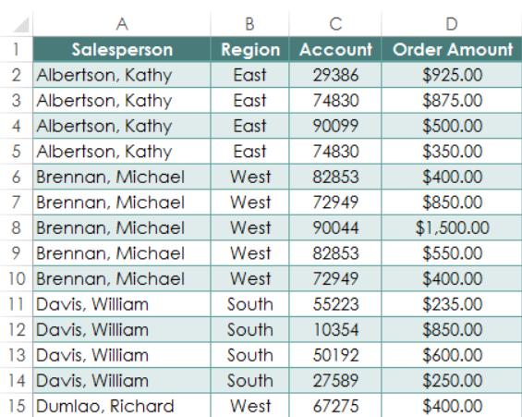
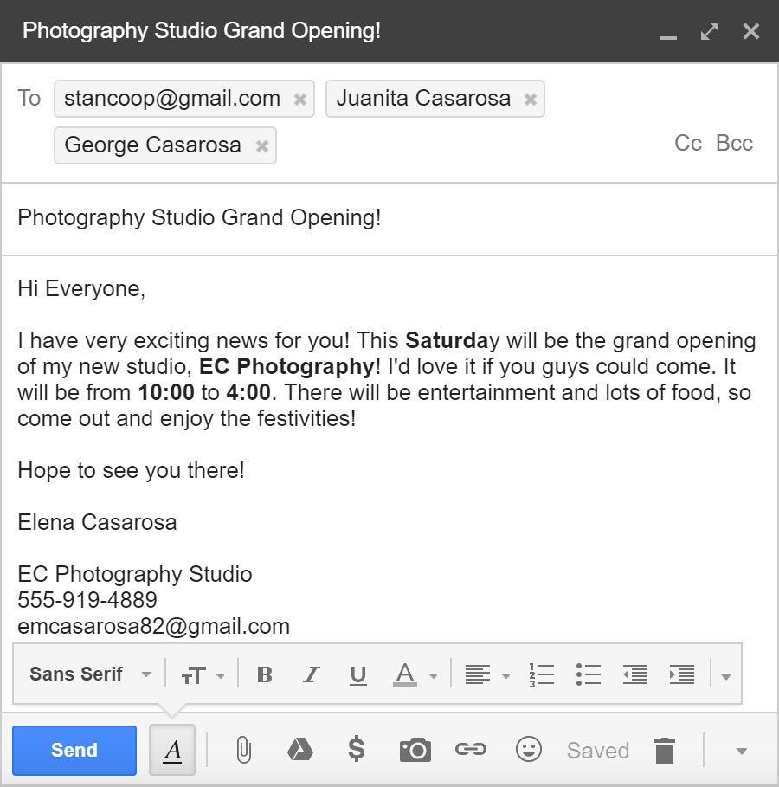
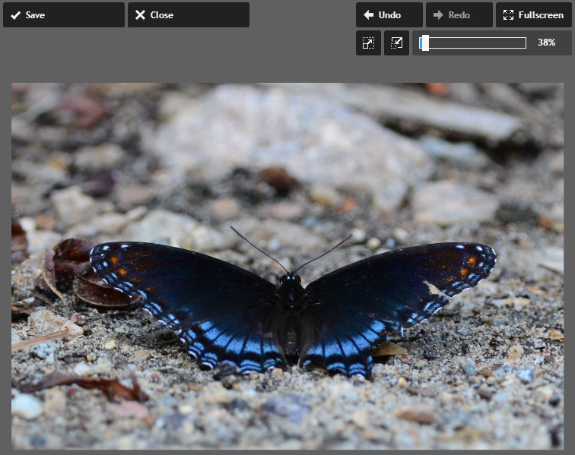
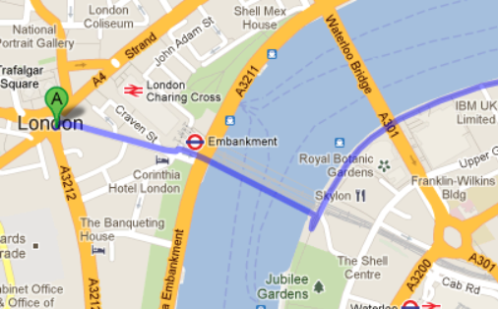
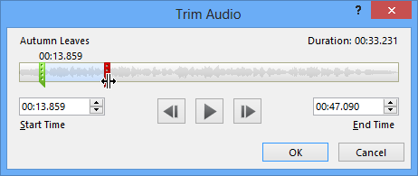
Types of Data

Slide 8
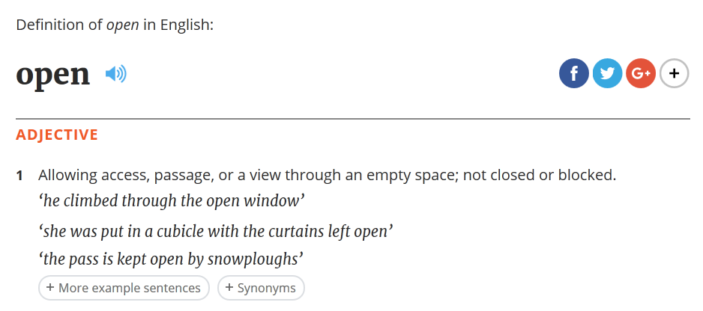
What Does the Word “Open” Mean to You?

Slide 9
What Data Should be Shared?
PUBLIC (OPEN)
PRIVATE (CLOSED)
Any factual data that cannot be copyrighted.
Any information released under an open licence for free use by and benefit to the public.
Anything under copyright or protected by licences or patent law.
Anything that threatens privacy concerns (like your medical records or your SIN).
Anything that threatens national security (like revealing vulnerabilities in our power grid).
Any personal information that has not been de-identified.

Slide 10
“Open data is digital data that is made available with the technical and legal characteristics necessary for it to be freely used, reused, and redistributed by anyone, anytime, anywhere.”
What is “Open Data”?
opendatacharter.net/principles

Slide 11
blog.okfn.org/2013/10/03/defining-open-data

Slide 12
Tim Berners-Lee: The Year Open Data Went Worldwide

Slide 13
History of Open Data
2009
2011 data.gc.ca launches
2013 data.gc.ca expands;
Open Dialogue and
Open Information added;
is now open.canada.ca

Slide 14
Open Data Around the World

Slide 15
Open Data Examples: Yelp

Slide 16
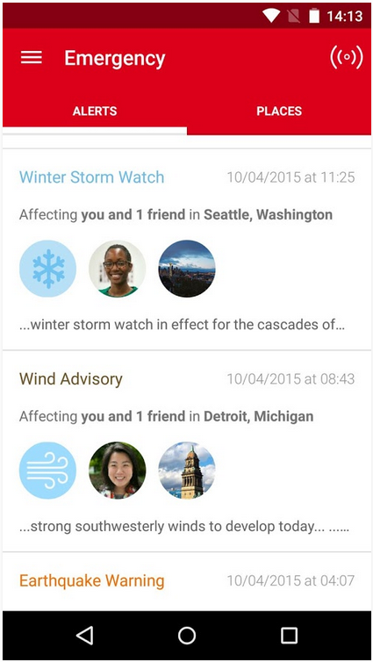
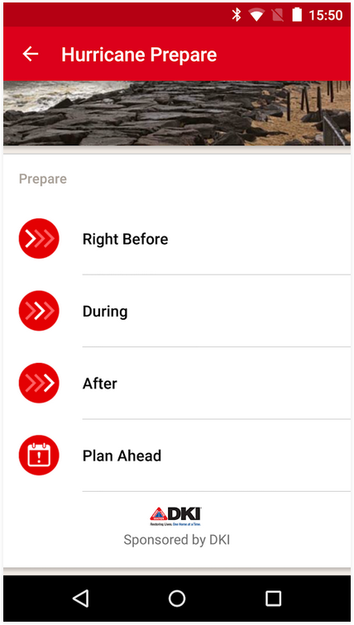
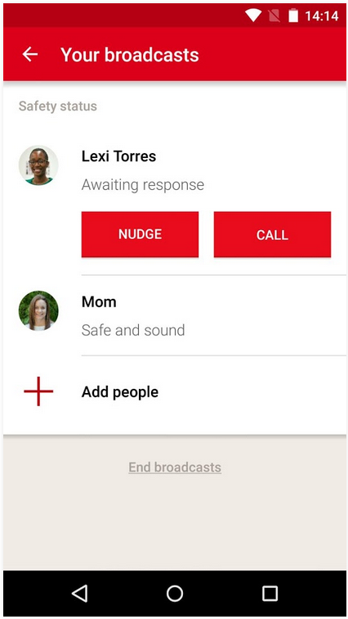
Open Data Examples: Red Cross Hurricane App

Slide 17
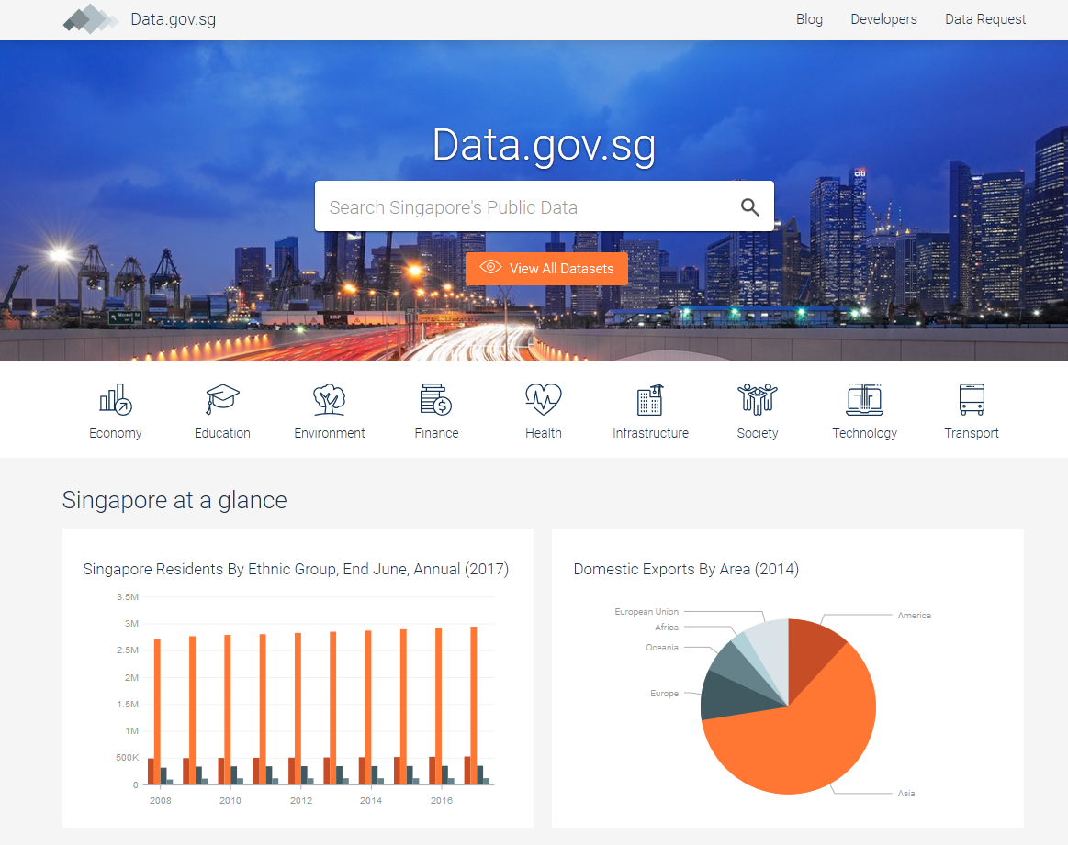
Open Data Examples: Singapore’s Public Data

Slide 18
Canada’s Open Data Principles
Completeness
Primacy
Timeliness
Ease of Physical and Electronic Access
Machine Readability
Non-discrimination
Use of Commonly Owned Standards
Licensing
Permanence
Usage Costs
open.canada.ca/en/open-data-principles

Slide 19
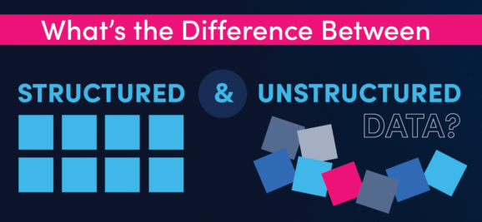
Structured vs. Unstructured Data
Source: blog.samanage.com

Slide 20
Structured vs. Unstructured Data
Structured Data
Unstructured Data
What most IT workers use.
Written in a format that’s easy for machines to understand.
Easily searchable by basic algorithms.
Examples include spreadsheets and data from machine sensors.
More like human language.
Doesn’t fit nicely into relational databases.
Searching it ranges from difficult to impossible.
Examples include emails, text documents (Word docs, PDFs, etc.), social media posts, videos, audio files, and images.

Slide 21
Optical, Machine-Readable, Representation of Data
Human Readable Barcode Numbers

Slide 22
City of Edmonton’s Open Data Portal

Slide 23
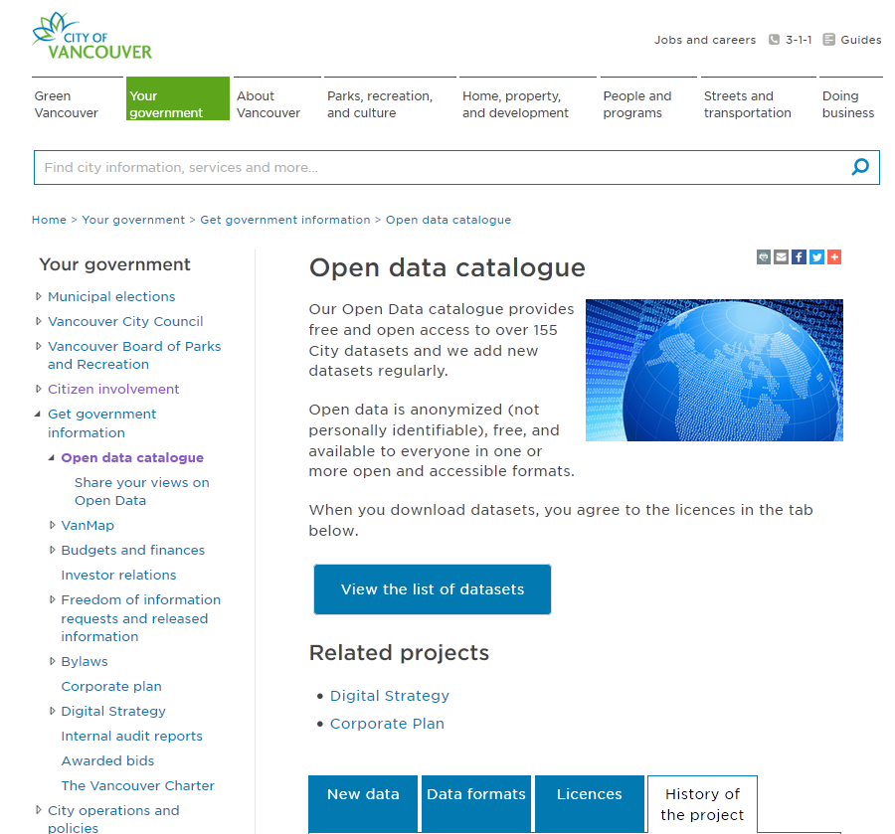
City of Vancouver Open Data Catalogue data.vancouver.ca

Slide 24
cyclinginvancouver.ca

Slide 25
What Are You Allowed to Do With Open Data?

Slide 26
Concerns about Open Data

Slide 27
Concerns about Open Data
Privacy
Cost
Quality

Slide 28
Benefits of Open Data

Slide 29
Benefits of Open Data
Support for innovation
Advancing the government's accountability and democratic reform
Leveraging public sector information to develop consumer and commercial products

Slide 30
Benefits of Open Data
Better use of existing investment in broadband and community information infrastructure
Proactive Disclosure
Support for research
Support informed decisions for consumers

Slide 31
Further Learning: VPL Resources
Lynda.com: www.vpl.ca/lynda
(search “Open Data”)
VPL Research Guides: guides.vpl.ca
(see “Open Data Essentials” guide)

Slide 32
Further Learning: Meet-Ups

Slide 33
Further Learning: Competitions & Hackathons
Vancouver Open Data Day Hackathon
Nasa International Space Apps Challenge
spaceappschallenge.org

Slide 34
Did We Learn How To . . . ?
Discuss what “open” and “data” mean in an online context.
Think about the benefits and limitations different ways of sharing data.
Consider how organizations and individuals can use data from various digital sources to solve problems or explain concepts.
Discuss how the open and public nature of the web informs decisions about what to share and where.

Slide 35
We want your feedback!
Please fill out an evaluation form to tell us what you thought of this class and help us improve our programs.
Online: www.vpl.ca/trainingfeedback
Thank you!

