Slide 1
Let’s Talk About
Online Privacy
Vancouver Public Library

Slide 2
Learning Opportunities @ VPL!
Digital Essentials: vpl.ca/program/digital-essentials

Slide 3
Learning Opportunities @ VPL!
VPL Research Guides
www.vpl.ca/researchguides

Slide 4
Learning Opportunities @ VPL!
We are here to help!
604-331-3603
info@vpl.ca

Slide 5
Today we will learn…
Balancing reward and risk of sharing online
Online data collection and tracking by corporations and governments
Practical strategies to protect your privacy and keep your personal information secure
How to protect yourself from identity theft online

Slide 6
Image from SecurityGladiators.com

Slide 7
Reward and Risk
ACTION: Using location services
REWARD: Find local services more easily; locate your device if lost.
RISK: Targeted ads; records/data may compiled and/or sold by advertisers.

Slide 8
Reasons People Collect Your Data
Targeted advertising (i.e. toward you)
Selling data to advertisers (i.e. a profile of you)
Product development
Malicious people (phishing, identity fraud)
Surveillance, public safety

Slide 9
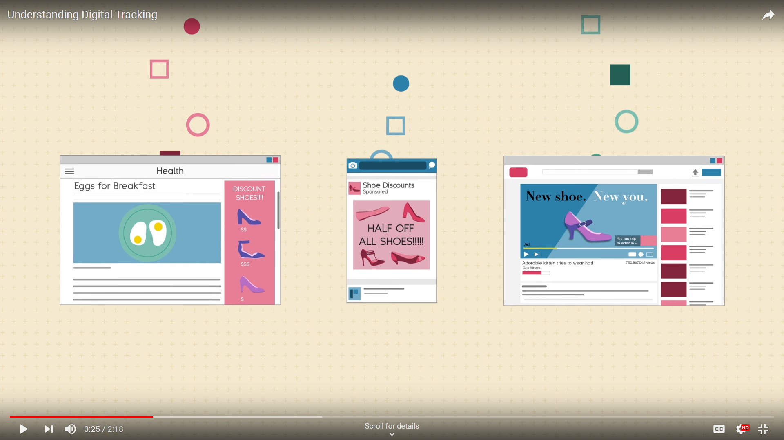
Tracking

Slide 10
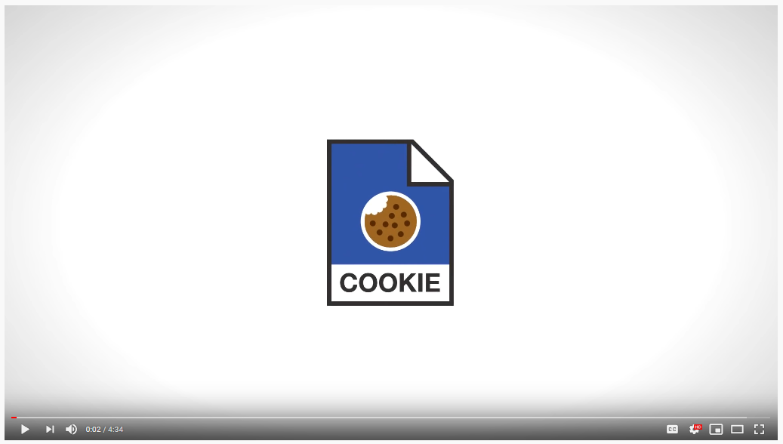
What are Cookies?

Slide 11
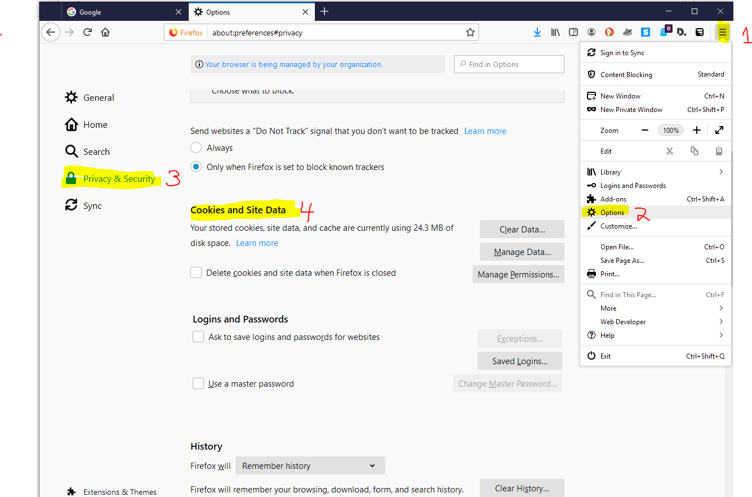
How to Delete Cookies

Slide 12
Private Browsing

Slide 13
Browser Extensions

Slide 14
Identity Theft and Fraud
Notes:
Source: http://www.cityofmadison.com/sites/default/files/events/images/identity-theft_full.gif

Slide 15
Tracking vs. Identity theft
 | TRACKING | IDENTITY THEFT
Legality | Legal | Illegal
Purpose | Advertising; profit. Surveillance; security. | Facilitate illegal theft
Reason | To build a profile of you | To impersonate you
Who | Companies; Government | Those interested in illegal theft
Impacts | Most of us | A few of us
Implication Level | Minor | Major

Slide 16
Most Common Vulnerable Passwords
123456
123456789
qwerty
password
111111
12345678
abc123
1234567
password1
12345
iloveyou
Don’t use these passwords!
Notes:
Source: https://www.cnn.com/2019/04/22/uk/most-common-passwords-scli-gbr-intl/index.html

Slide 17
Making a Strong Passwords
Do not use the same password more than once
Do not use personal information in your passwords
Change your passwords often
Mix upper case, lower case, numbers, symbols
Create a passphrase
e.g. I like to go to the store and buy apples!
iL2g2tsabA!
The longer the password the better (8+ characters)
Be careful where you store your passwords

Slide 18
2-step Verification
Image from George Washington University

Slide 19
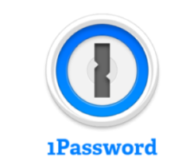
Password Managers
Secure software used to store all your passwords.
Means you only have to remember one, very good and secure password (to access the Password Manager).
Password Manager creates secure passwords for all your accounts (and you don’t need to remember them)
Costs range from free to $100/year

Slide 20
Phishing

Slide 21
Malware and Antivirus Programs
Malware = Malicious software
Often downloaded without your knowledge, often from by clicking spam emails or suspicious links on the web
Includes viruses and adware.
Installing strong Anti-virus software helps protect your computer from malware

Slide 22
What we learned
Balancing reward and risk of sharing online
Online data collection and tracking by corporations and governments
Practical strategies to protect your privacy and keep your personal information secure (cookies, private browsing, browser extensions)
How to protect yourself from identity theft online (passwords, phishing, malware)

Slide 23
We want your feedback!
Please fill out an evaluation form to tell us what you thought of this class and help us improve our programs.
Online: www.vpl.ca/trainingfeedback
Thank you!

