Slide 1
Get to Know the Internet
Vancouver Public Library

Slide 2
Learning Opportunities @ VPL!
Digital Essentials: vpl.ca/program/digital-essentials

Slide 3
Learning Opportunities @ VPL!
We are here to help!
604-331-3603
info@vpl.ca

Slide 4
Today we will learn to…
Understand what the internet is
Explore the key features of browsers
Explore the key features of a website
Browse and explore the library website and resources

Slide 5
What is the internet?
Listen for the following terms:
Internet
Internet Service Provide (ISP)
Network
Notes:
https://www.youtube.com/watch?v=jKA5hz3dV-g

Slide 6
Video review
Network: Computers that are connected together to share resources.
Internet: A vast computer network linking smaller computer networks. These networks allow for the sharing of vast amounts of information in different formats, such as text on a website.
Internet Service Provider (ISP): An organization/company that provides service for accessing and using the Internet. Some local examples are TekSavvy, Novus, Shaw and Telus. To get the internet at home, you will need to sign up with an ISP and pay a monthly fee.

Slide 7
Connecting to the Internet

Slide 8
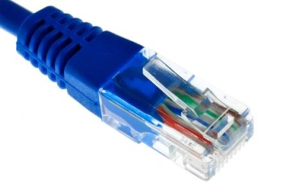
How do you access the internet?
4G/LTE

Slide 9
Accessing the Internet: Wi-Fi vs Data
Via Wi-Fi (wireless) | Via Data
Computers, laptops, phones, tablets, TV | For devices only: Phones (most common); Tablets (not common)
At home: needs a router/modem and an Internet Service Provider (ISP) (i.e. Shaw, Telus); in public this is often provided by organizations or business (i.e. Free Wi-fi at VPL or at coffee shop) | Needs a cellular/mobile phone service provider (i.e. Telus) and a data plan
Limited to the range of your router, which transmits the signal via its connection to the wall (via phone lines) | Limited to your phone’s service area as it is transmitted via cell phone signals

Slide 10
What is the World Wide Web?
Collection of websites you can access through the Internet
Commonly known as the “Web”
May be accessed by users by a web browser
Is what the www at the an website address stands for: i.e. www.websitename.org

Slide 11
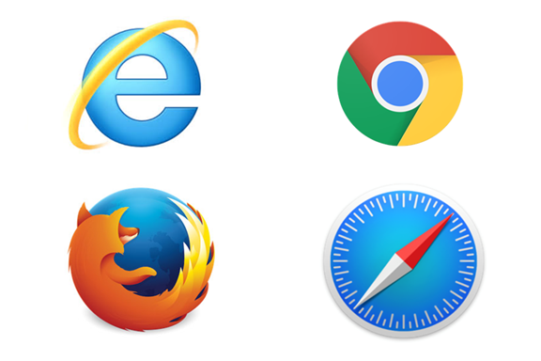
Web Browsers
Browser: Computer software that allows users to view information on the World Wide Web. It converts computer language (HTML) into images and text onto the screen.
(Microsoft) Internet Explorer (older)/
Edge (newer)
(Google) Chrome
(Mozilla) Firefox
(Apple/MAC)
Safari

Slide 12
Comparing Browsers

Slide 13
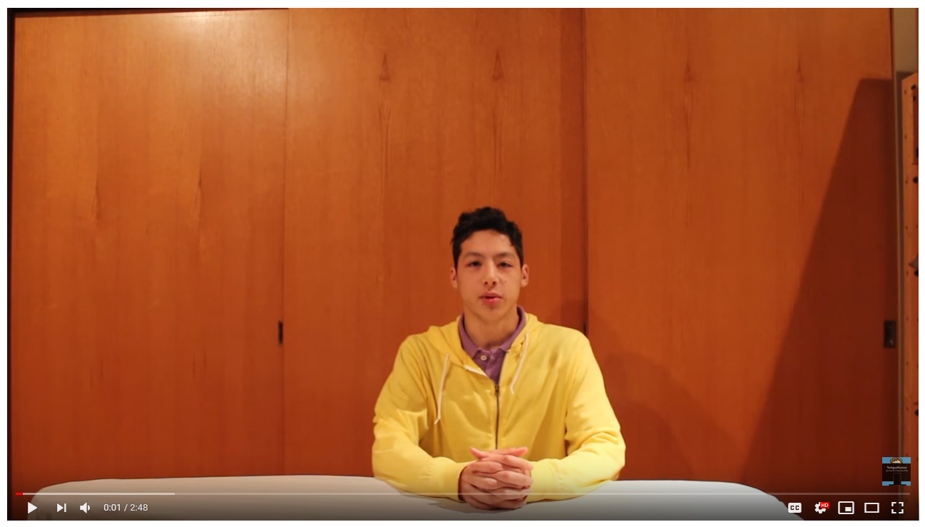
Tabs vs Windows

Slide 14
URL
URL: Uniform Resource Locator, also called “address” – what you type in the address bar
Tells the browser you are going to a website
“world wide web”
Website name
Domain extension
http://www.vpl.ca
Starts off almost every URL, so the browser will add it for you

Slide 15
Explore www.vpl.ca
What time does Central branch close today?
When and where is the next Lego Block Party?
Can you find information about borrowing musical equipment?
Can you find the events calendar?

Slide 16
Did we learn to…?
Understand what the Internet is
Explore the key features of browsers
Explore the key features of a website
Browse and explore the library website and resources

Slide 17
We want your feedback!
Please fill out an evaluation form to tell us what you thought of this class and help us improve our programs.
Online: www.vpl.ca/trainingfeedback
Thank you!

