Slide 1
Get the Most Out of Internet Searching
Vancouver Public Library

Slide 2
Learning Opportunities @ VPL!
Digital Essentials: vpl.ca/program/digital-essentials

Slide 3
Learning Opportunities @ VPL!
VPL Research Guides
www.vpl.ca/researchguides

Slide 4
Learning Opportunities @ VPL!
We are here to help!
604-331-3603
info@vpl.ca

Slide 5
Today we will learn to…
Use a search engine
Apply effective search strategies
Evaluate search results
Evaluate websites

Slide 6
Browser review
(Microsoft) Internet Explorer (older)/
Edge (newer)
(Google) Chrome
(Mozilla) Firefox
(Apple/MAC)
Safari

Slide 7
Browser Review

Slide 8
What is a search engine?
Software that allows Internet users to search for content found on the World Wide Web (WWW)
User enters key words or phrases into a search engine and receives a list of Web content results in the form of websites, images, videos or other online data.

Slide 10
Specific search engines

Slide 11
Searching with Google

Slide 12
Searching Strategies
Keywords
Helpful strategies, like “quotes” and –minus
Autocomplete
Searching: Images; Videos
These strategies apply to most search engines

Slide 13
Searching Strategies: Using Keywords
Identify the main concepts of your topic
Think about the language that will be used in the answer
Use nouns and verbs
Use at least 3 words
Spell out abbreviations
Try multiple times with variations, synonyms
Capitalisation doesn’t matter
Search engine will try to correct your spelling

Slide 14
Selecting Keywords Activity
Your question: “What are some alternatives to wheat flour I can use to make gluten-free cookies?”
What keywords could you use in your search? Try out some options.
“gluten-free cookie recipe”
Your question: “Is the grocery store by my house open on the upcoming statutory holiday?”
What keywords could you use in your search? Try out some options.
“kitsilano safeway hours”

Slide 15
More Searching Tips

Slide 16
More Searching Strategies
Search for an exact match
Put a word or phrase inside quotes.
Ex: “coble boat”
Search for wildcards or unknown words
Put a * in your phrase where you want to leave a placeholder.
Ex: “diabetic * diets”
Exclude words from your search
Put - in front of a word you want to leave out.
Ex: cookie recipe -chocolate
Source: Google Search Help

Slide 17
Searching Practice
Who starred opposite Clark Gable in the 1934 American romantic comedy It Happened One Night?
What are some of the most common questions asked at job interviews?
What are some events that VPL has scheduled for next month?
Find an image of a blue bathtub
Find a video about strategies for searching the internet

Slide 18
How to Read a Webpage

Slide 19
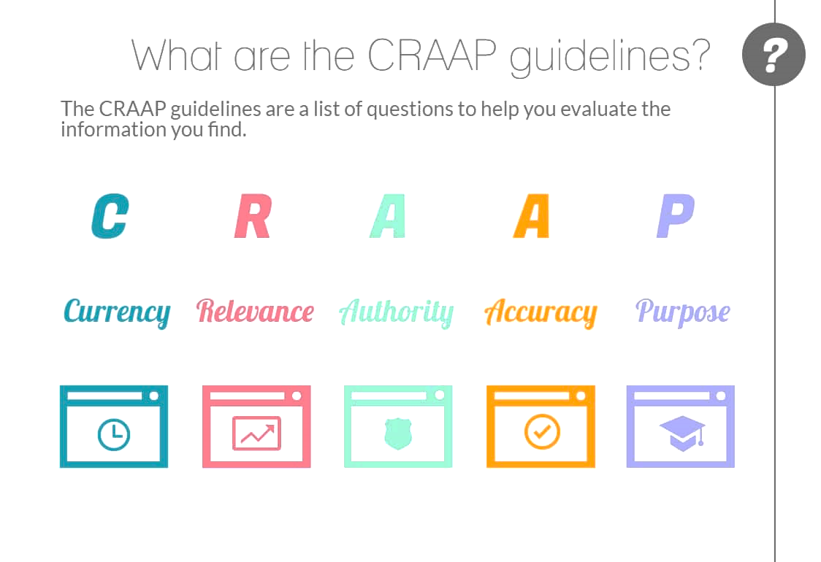
Evaluating Websites
Image from Deakin University

Slide 20
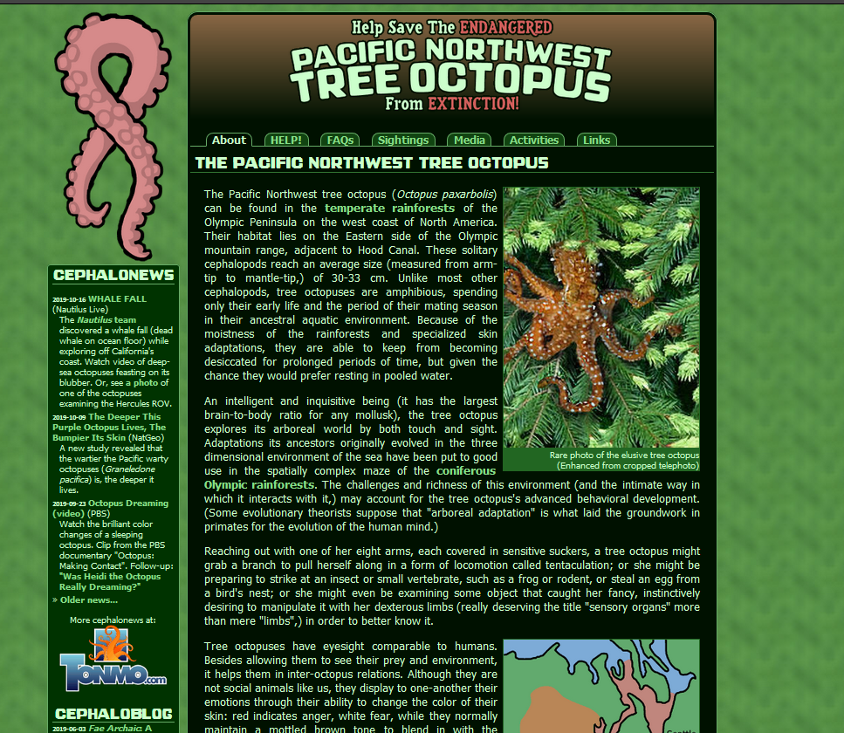
Applying CRAAP

Slide 21
Using CRAAP to Assess Wikipedia
Currency: Often the most current source for biographical information
Relevance: Huge array of articles on people, events, ideas etc. There will likely be something relevant to your query!
Authority: Varies hugely. Anyone can edit Wikipedia, and experts often do, but people without “credentials” often contribute substantially
Accuracy: 80-96% accurate, depending on who you ask
Purpose: Policies prevent advertising or conflict of interest from editors; Wikipedia is non-profit

Slide 22
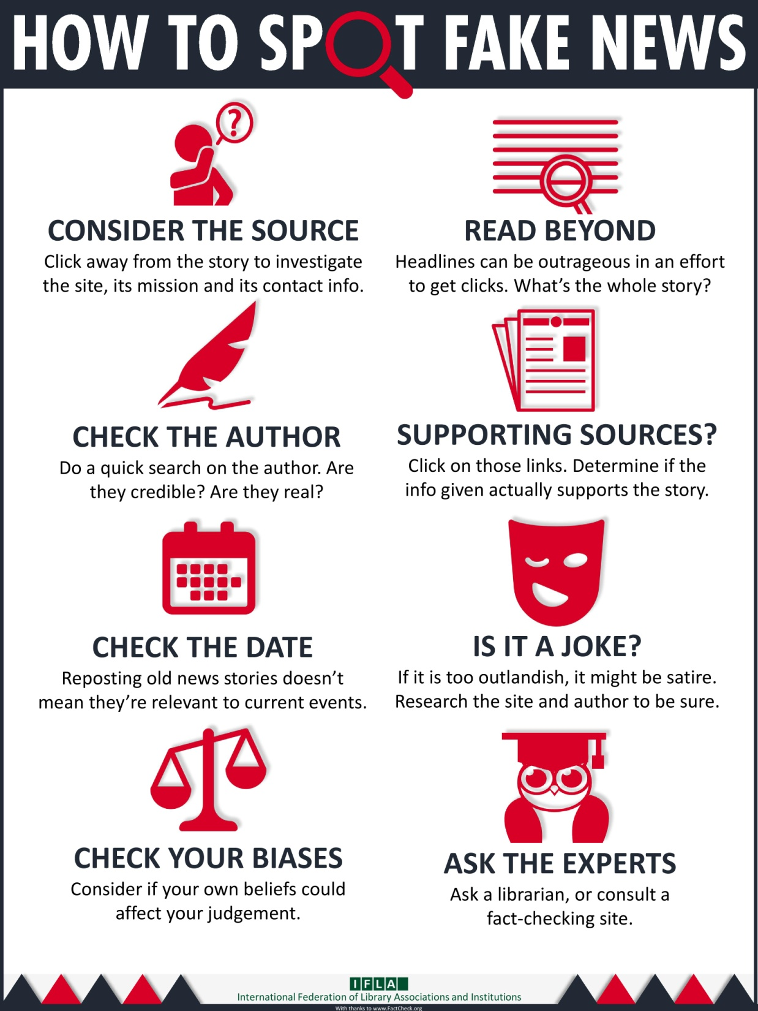

Slide 23
Fake News Activity
Search "Quiz: can you spot the fake news story?”
Click on the website link
Take the “Quiz”

Slide 24
Fact Checking Websites
Assess the truthfulness or facts behind a claim
Often focused on politicians
May also address online hoaxes and myths
Examples
Factscan.ca: nonpartisan fact-checker on Canadian federal politics
Factcheck.org: monitors the factual accuracy of what is said by major U.S. political players
Snopes.com: U.S.-based; broader focus than just assessing politicians’ claims
Fullfact.org: U.K.’s independent fact-checking charity

Slide 25
Tips for Evaluating Websites: Review
Use CRAAP guidelines
Do further research (i.e. more online searching or other research) to find other information on the topic/claim
Check in with those around you
Consider the layout and design of the website
Look on fact-checking websites
Ask your local librarian

Slide 26
Did we learn to…?
Use a search engine
Apply effective search strategies
Evaluate search results
Evaluate websites

Slide 27
We want your feedback!
Please fill out an evaluation form to tell us what you thought of this class and help us improve our programs.
Online: www.vpl.ca/trainingfeedback
Thank you!

