Slide 1
Get to Know
File Management
Vancouver Public Library

Slide 2
Learning Opportunities @ VPL!
Digital Essentials: vpl.ca/program/digital-essentials

Slide 3
Learning Opportunities @ VPL!
Lynda.com: vpl.ca/lynda
VPL Research Guides: guides.vpl.ca
Computer Essentials - guides.vpl.ca/ComputerEssentials

Slide 4
Learning Opportunities @ VPL!
We are here to help!
604-331-3603
info@vpl.ca

Slide 5
Today we will learn how to…
Distinguish files from folders
Distinguish different file types
Open files
Move files and folders
Save, delete, and rename files and folders

Slide 6
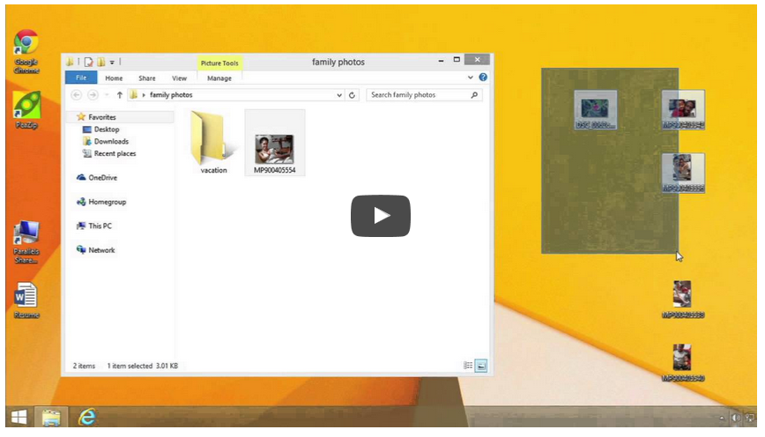
Using Files and Folders in Windows

Slide 7
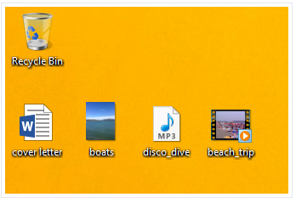
What is a File?

Slide 8
File Types

Slide 9
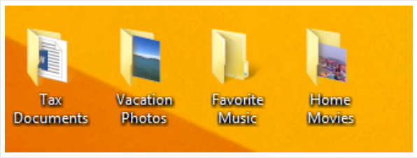
What is a Folder?

Slide 10
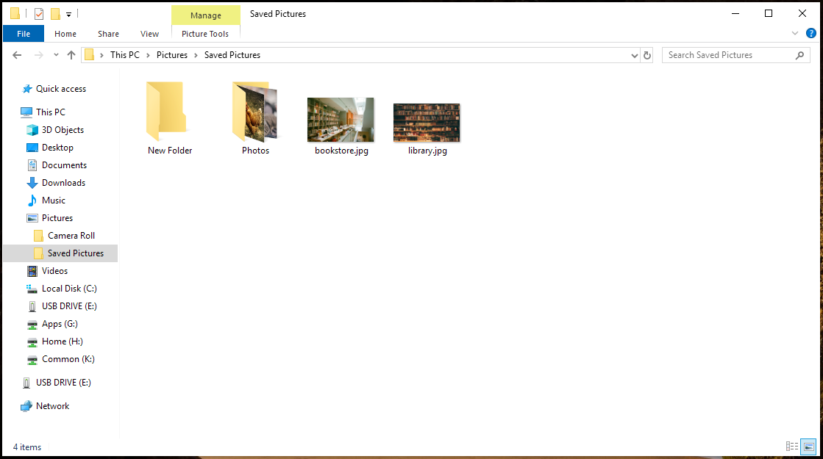
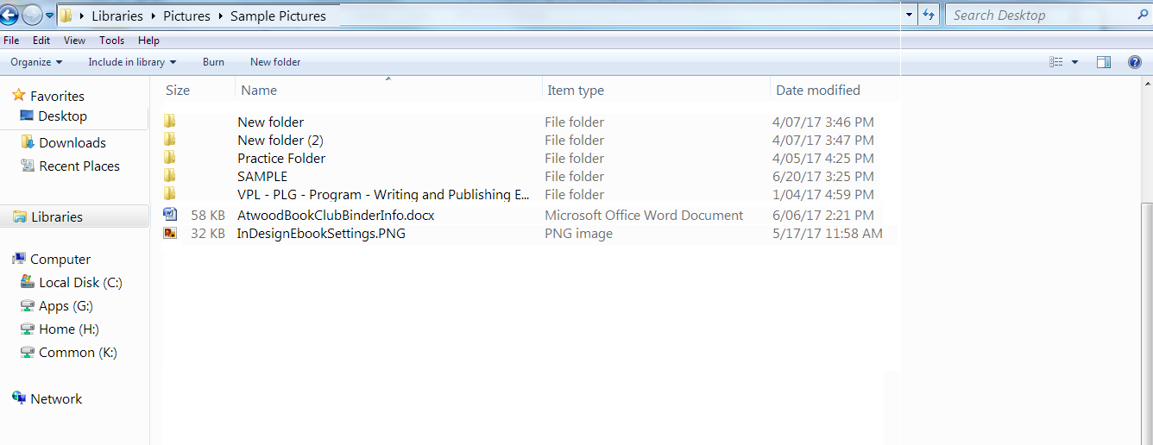
Windows Explorer

Slide 11
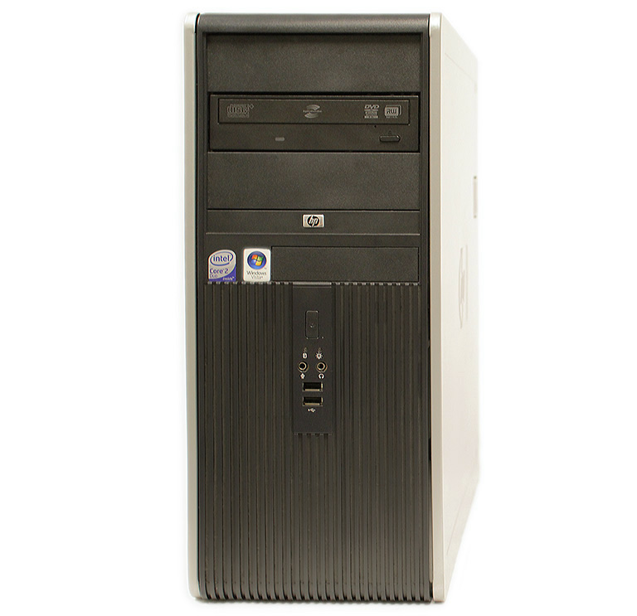
USB Flash Drive
USB Flash Drive
USB Symbol and Port

Slide 12
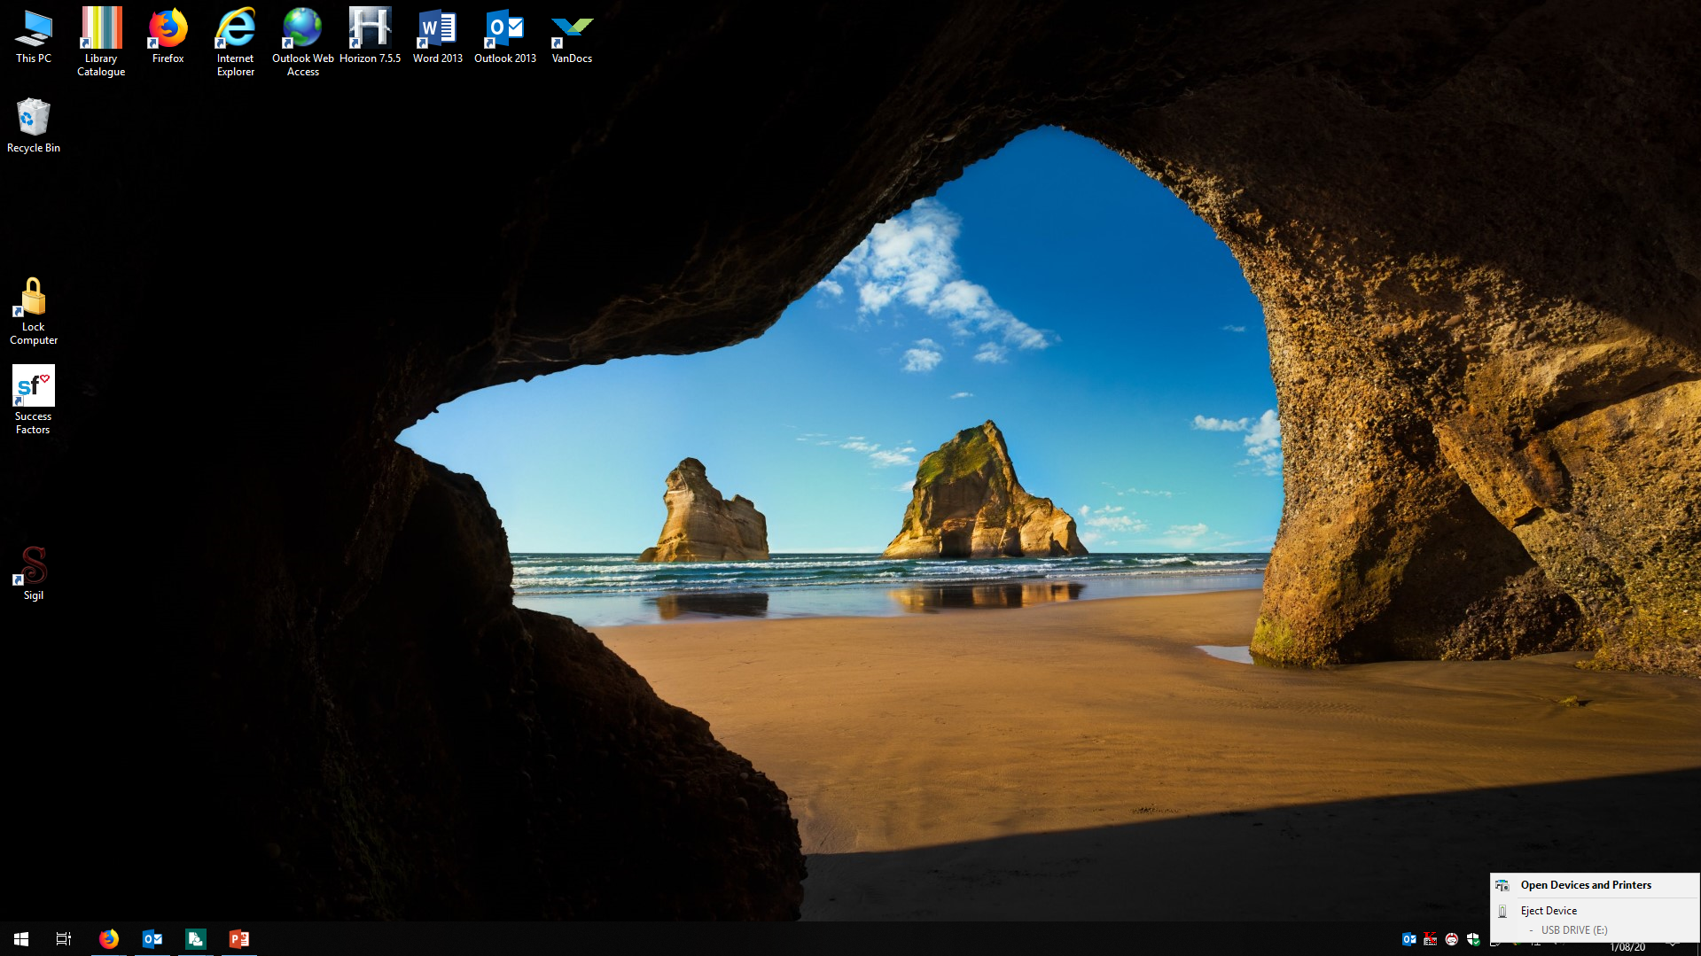
Removing a Memory Stick

Slide 13
Did We Learn How to. . .
Distinguish different file types
Distinguish files from folders
Open files
Move files and folders
Save, delete, and rename files and folders

Slide 14
We want your feedback!
Please fill out an evaluation form to tell us what you thought of this class and help us improve our programs.
Online: www.vpl.ca/trainingfeedback
Thank you!

