Slide 1
Zoom Programs For the Early Years
Lindsey Krabbenhoft Children’s Librarian, Vancouver Public Library

Slide 2
Let’s explore…
What was easy to adapt
What we had to change or add
What we let go of
What feedback we’ve received
What storytime looks like now

Slide 3
Traditional Programs
Staff Well-Being
Community Feedback
Notes:
Before we jumped into offering virtual storytimes, we thought about the following things;
The programs we used to offer in-person that have a built-in audience.
Community feedback we received through phone calls, emails, and outreach efforts.
What will bring staff joy in programming? How can programs support staff well-being and mental health.

Slide 4
Babytime
Fall 2020
Toddler Storytime
Winter 2021
Preschool Storytime
Spring 2021
Notes:
Based on those considerations we started by offering Zoom Babytime. We heard the most feedback from new parents who were feeling isolated. Then we added Zoom Toddler Storytime, and have finally added Zoom Preschool Storytime.

Slide 5
What was easy to adapt to a virtual environment?

Slide 6
Welcome Message
Welcome everyone to babytime! My name is Lindsey and I’m the children’s librarian at this branch. I am so excited to see everyone! Today we’re going to sing lots of songs and rhymes and read a book together. This is a time for you and your baby to bond so please sing along with me and take this chance to play and cuddle with your baby. If your little one is having a rough day feel free to step out and come back if you can; I promise I won’t be offended. And to respect everyone’s privacy I ask that you don’t film or record during babytime. I’ll stick around after the program if you want to hear something again. Let’s get started with our hello song!
Notes:
During in-person programs we always had an opening spiel that introduced ourselves, the program, and our general expectations. It might include privacy considerations. Here is an example of what my welcome message sounded like.

Slide 7
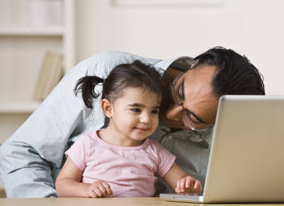
We are gathered on the unceded homelands of the Musqueam, Squamish, and Tsleil-Waututh Nations.
Notes:
In a virtual environment, you still have a welcome message and it’s even more important to let participants know how to engage and participate. You can even put up a slide like this to help ESL families. We don’t ever start with the slide - we always want people to see us first. But it can be something we screen share for a minute. As the session goes on, you can adapt it or even leave it out as people understand the expectations.

Slide 8
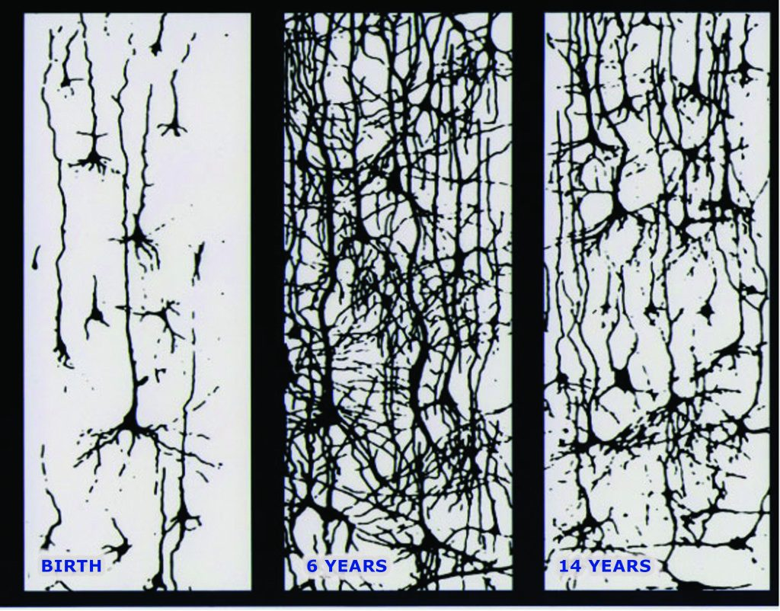
Notes:
Next we’re going to talk about songs and rhymes, but let’s take a look at this image first. What is it? When babies are born their brains are ready to learn. Every time they are stimulated by something in their environment – language, people, physical sensations – their brain cells reach out and make neural connections. Neural connections in the brain are called synapses, and when they are stimulated repeatedly, they become ‘hardwired.’ Hardwired means they are less likely to be pruned as the child grows older. When we repeat information, it makes these synapses thicker. The brain recognizes these thicker synapses and keeps them because they are strong.
This image from the Center on the Developing Child at Harvard University shows the number of synapses over the course of 14 years and the natural pruning process. Repetition of language and stories in the early years helps make that middle picture full of strong synapses that are less likely to be pruned.

Slide 9
“We loved it all. I really liked the repetition, so I could memorize some of the songs and fingerplays. We would sing some of the songs at supper time to help us recall the words.”
Notes:
So what does that have to do with singing in storytime? Just like in-person, songs and rhymes make up a huge part of storytime for all ages - babies, toddlers, preschoolers.
But don’t stress yourself out with thinking up new songs for every single storytime. Repetition is still very important and even more important in virtual storytime.
On our toddler storytime survey, one parent said, “We loved it all. I really liked the repetition, so I could memorize some of the songs and finger plays. We would sing some of the songs at supper time to help us recall the words.”

Slide 10
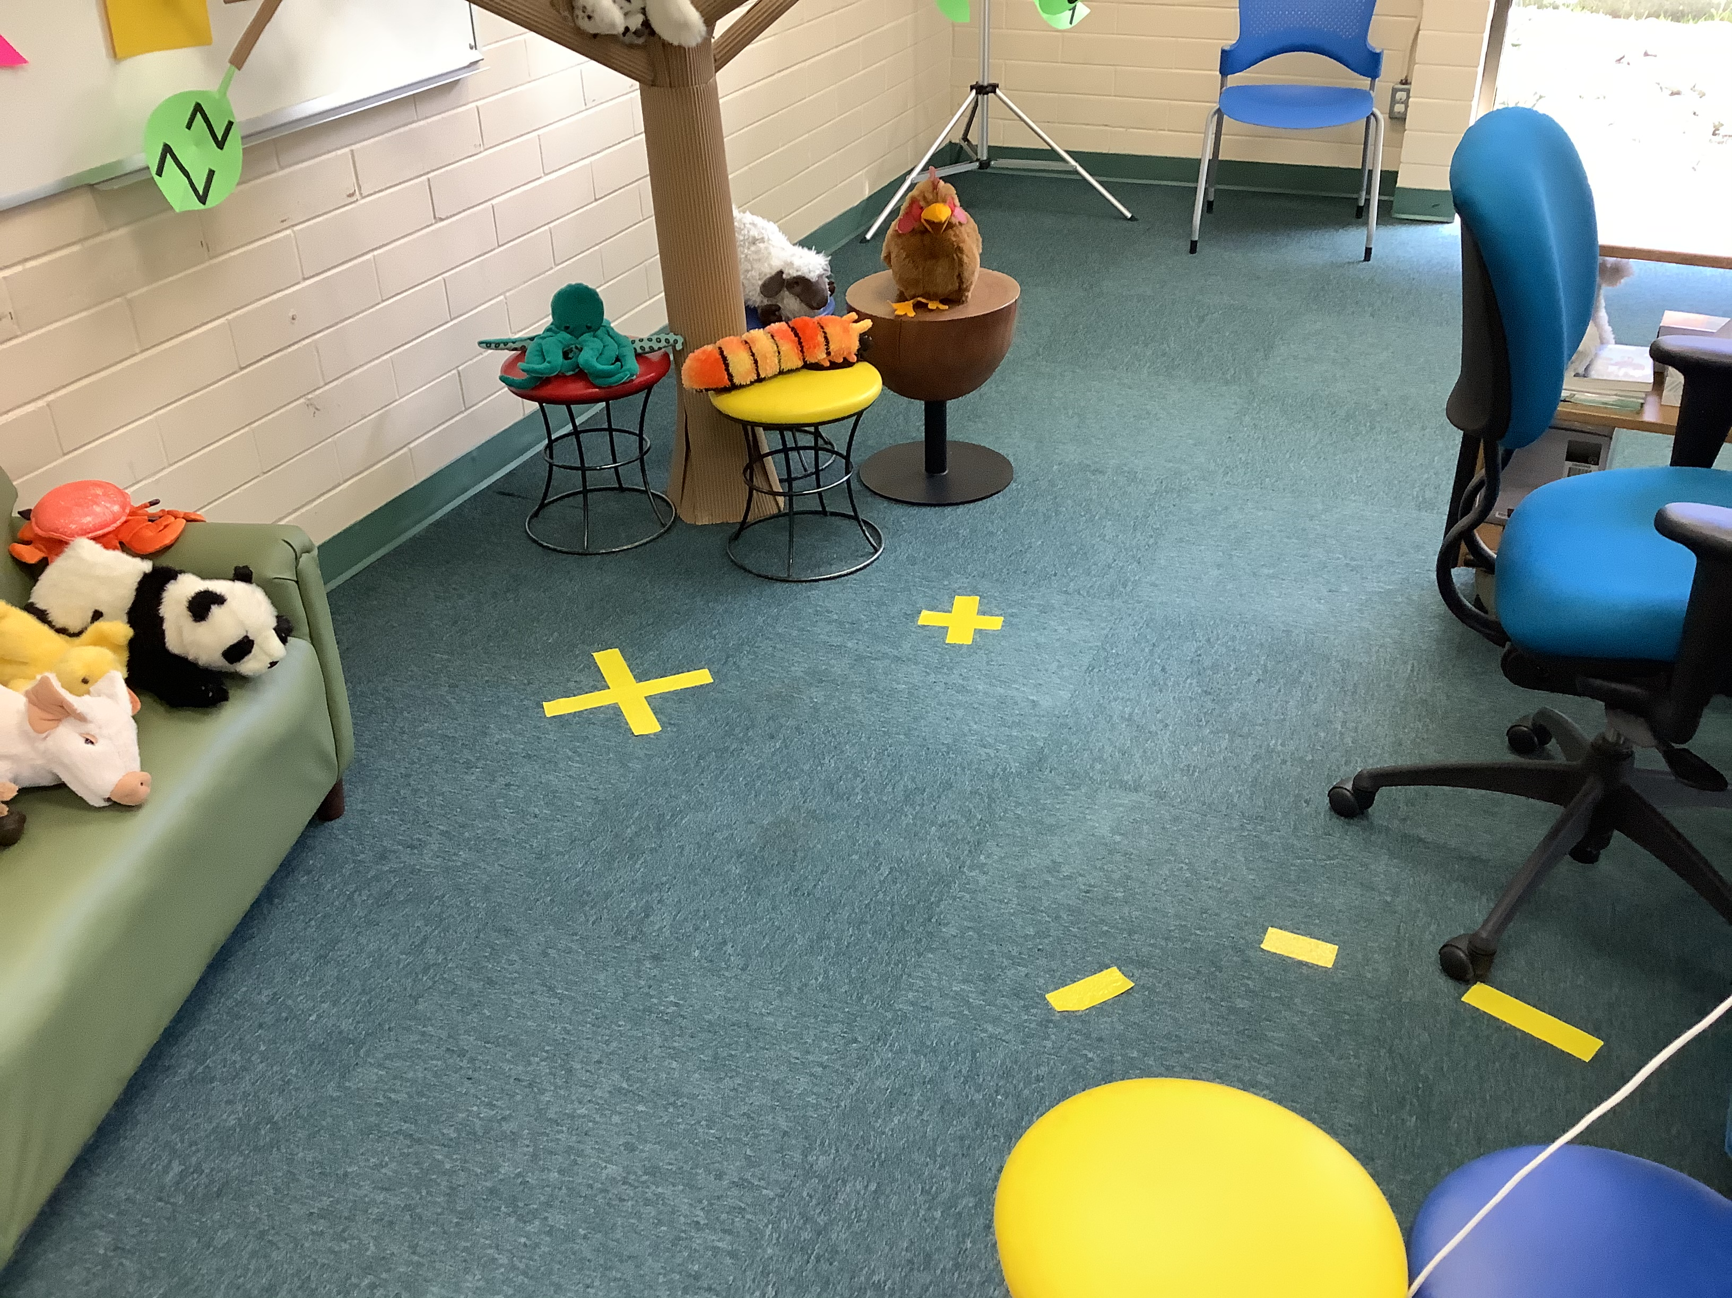
Notes:
We still offer a variety of types of songs and rhymes - face rhymes, lap bounces, get up and dance. Caregivers really appreciate the variety. In order to offer a variety of songs and rhymes you need plan your space. Take time before the program to figure out how far you can be from your camera. This picture shows there to move the chair to keep it in view, and it shows places the presenter can move to and still be in frame either standing or sitting. You don’t want to be fumbling around with this during a storytime, so make sure to do lots of testing before hand.

Slide 11
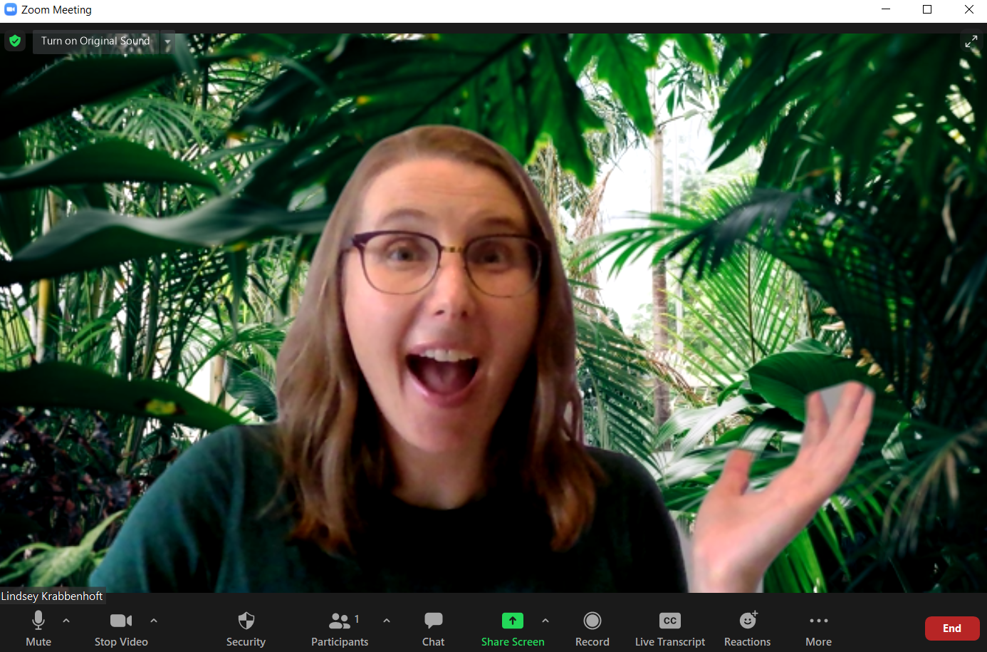
Notes:
Tip #3: Make songs into little stories. Put up a virtual background to immerse yourself into an imaginary world. In this example you have been transported to the jungle. Before you get there you could even do a little exercise with the kids where you get on a bus, put on your seatbelt, drive the bus a really long way. Now you’re wondering what animal is in the forest today. Have kids either share verbally or hold up a stuffie from home. Just make sure to take off your virtual background once you return to British Columbia!

Slide 12
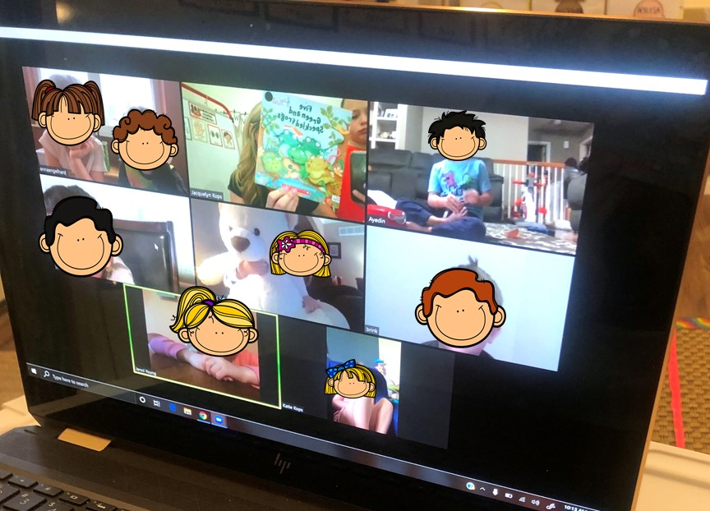
Notes:
Tip #4: Choose songs that allow kids to contribute. Use the spotlight feature to make each child’s screen front and center when you ask a question or are inviting them to participate in a song. Old classics work great – Old MacDonald Had a Farm can be filled with things from the child’s home. We’ve always encouraged interactivity and participation at storytime, we’re just doing it in a slightly different way now.

Slide 13
Let's all clap because Sophie is here, Sophie is here, Sophie is here. Let's all clap because Sophie is here. Sophie is here today!
Heckety peckety bumblebee
Won’t you say your name for me?
Lindsey
Let’s say it: Lind-sey
Let’s clap it: Lind-sey
On your lap: Lind-sey
With a whisper: Lind-sey
With a shout: Lind-sey
Notes:
Name songs in particular have been especially well received. We use the renaming feature at the beginning of storytime and we use it constantly. This slide has a few examples of our favourites. One storytime parents said “The instructor interacting with the children by calling their names really put them glued to the class.”
If you have a big group you don’t have to do a verse for every child. You could pick three kids every week. Naming also helps build a sense of community.

Slide 14
Songs & Rhymes
Repetition
Interaction
Sense of wonder
Notes:
To sum up, the three most important things that we’ve found for using songs and rhymes in virtual storytime are repetition, interaction through naming and sharing, and the sense of wonder the storytime presenter bring by channeling their inner child.

Slide 15
Books
Notes:
For babytime, presenters have mostly been using board books. They are smaller, they fit in the screen better, they are short and developmentally appropriate. But they also don’t draw the baby into the screen. When we share books in virtual babytime, we are mostly doing it for the caregivers - to show them how to read a book to a baby, to expose them to great titles they can check out and read 1-1. Our book choices are intentionally interactive - which books feature body parts a caregiver can touch while you read, which ones are songs, which ones promote bonding.
See Choosing Virtual Storytime Books on the Library Toolshed: https://librarytoolshed.ca/content/choosing-virtual-storytime-books

Slide 16
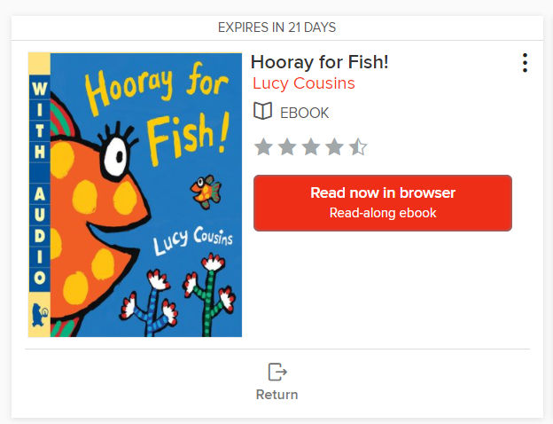
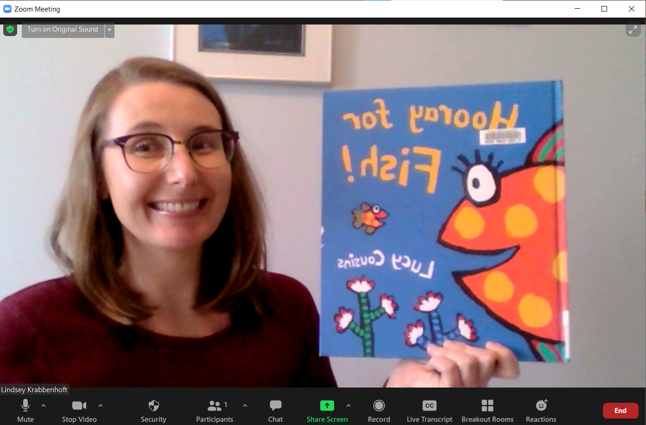
Notes:
For toddlers and preschoolers, most presenters use eBooks. They will often have a physical copy of the book that they hold up and show the kids, but then they read the eBook version. This does take a bit of extra planning as you have to see what’s available in your eBook collection and ensure you have the physical copy too. Reading eBooks makes it a little harder to see the audience’s reaction but they see images crisp and clean. You don’t have to worry about glare or holding the book at a certain angle. It is a better experience for the toddlers and preschoolers. You can have a co-host or second staff member watching the participants and clueing you in to someone’s reaction.

Slide 17
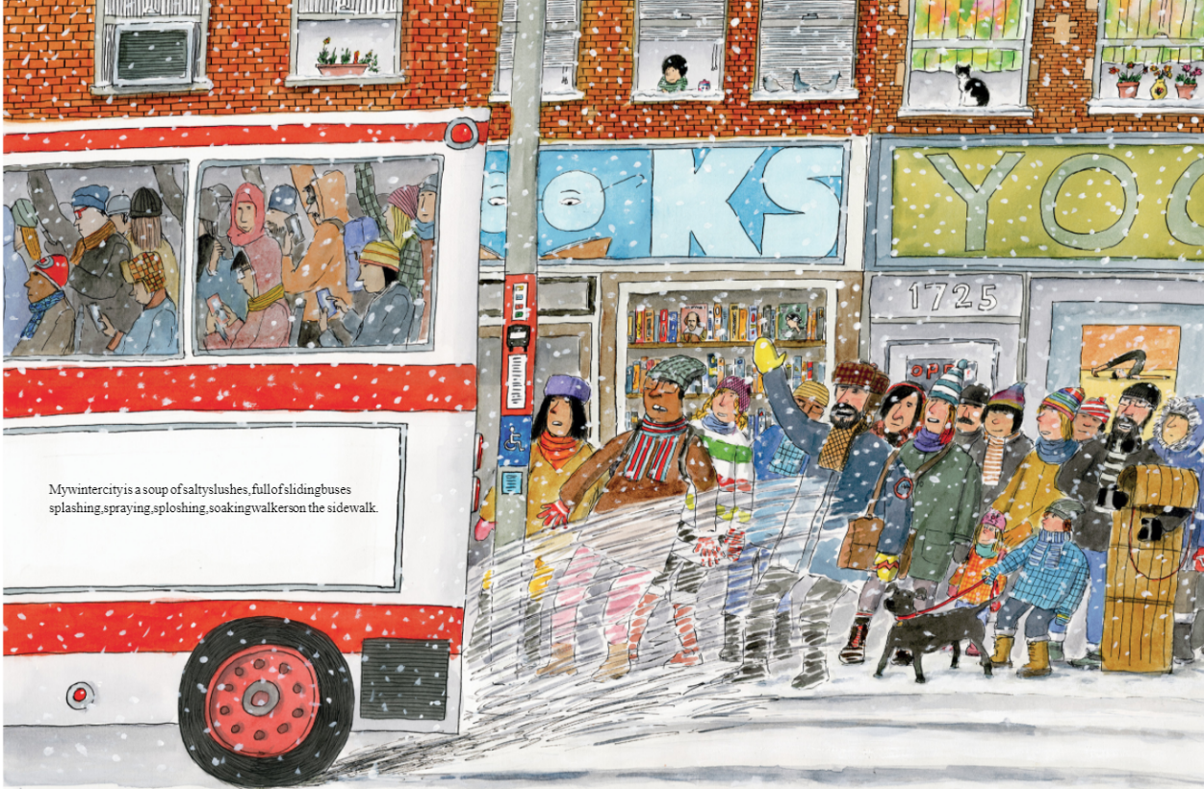
Notes:
Preview the book! Just like you would check for ripped pages, pop-outs working correctly in a print book, you need to preview eBooks to ensure the text is easy to read, the eBook has a double page spread. In this example you can see how hard the text is to read.

Slide 18
Notes:
You have to add personality and sounds with voice! They can’t see you anymore, focus is on the screen. Think about your voice inflection – call on that “motherese” type of talking. Keep your pace slow and steady. You also want to think about where you can ask for nonverbal feedback. For example, ask the kids to tap the little fish. Or ask the kids to clap their hands if they think Larry should push the button. See my document on library toolshed for tips and tricks on selecting books for virtual storytime.

Slide 19
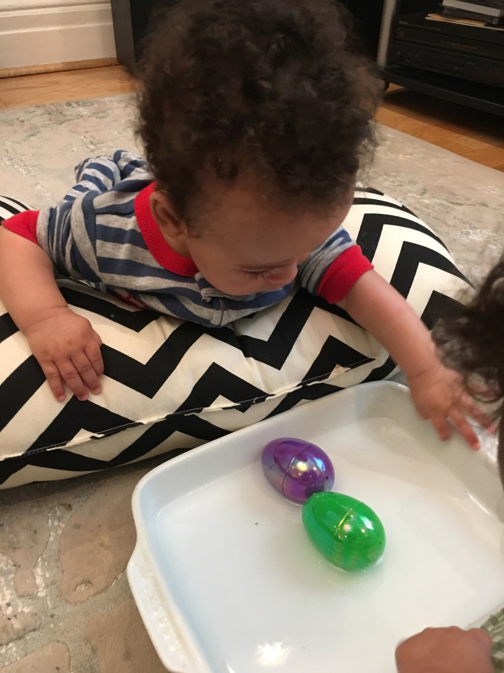
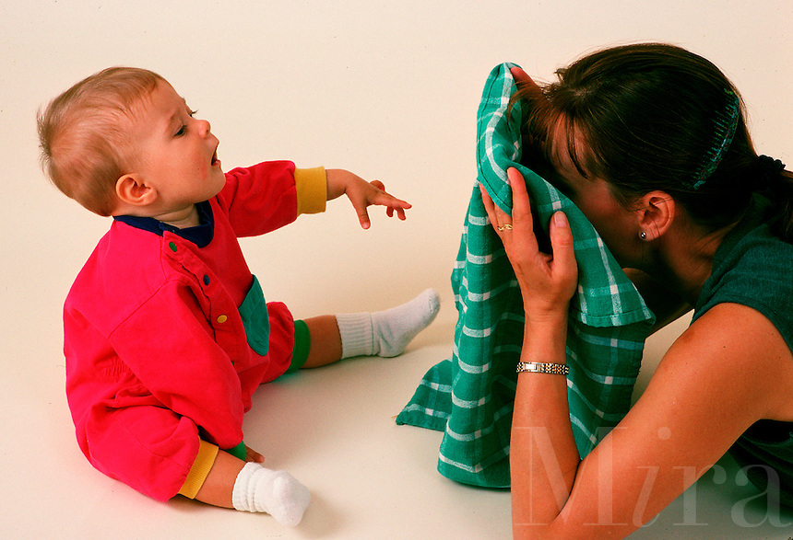
Notes:
We still use props, but we try to focus on things that caregivers can find around the home. In babytime, props are meant to be used by the caregiver to help build a strong emotional connection and to support early literacy. The presenter is modeling how to use the prop. Instead of scarves, we ask them to grab a blanket, wash cloth, pillows – and other things to play peekaboo. You can ask them to grab a stuffed animal or even email them ahead of time saying today we’re going to do some songs and rhymes using a stuffed animal. In babytime the use of props is minimal - we are trying not to draw the attention of the baby to the screen but to the caregiver.

Slide 20
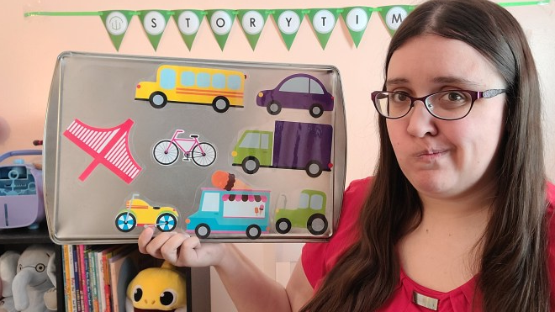
Notes:
Traditional props like felt stories, puppets work really great. Kids still love them and are engaged with them. Felt stories that have kids copy a movement or that ask them a question they can unmute or use body language to answer are a great way to foster interaction.
The picture on the right is from Anne Marie at Book Cart Queens. She found a great hack to sharing “felt” stories – use a tray with magnets. You can visit her blog here: https://bookcartqueens.com/tag/online-storytime/

Slide 21
Show D’Arcy’s Video
Notes:
In this video my colleague D’Arcy shows how he uses his sloth to do a song. One way to make this more interactive is to ask the kids to grab something in their home to put in the soup and have the puppet interact with those items.
{Unfortunately this video cannot be embedded]

Slide 22
Notes:
We’ve been trying to get creative with tying in props to the books we just read. In this video, Kelly and I demonstrate how two staff members can interact with a prop.

Slide 23
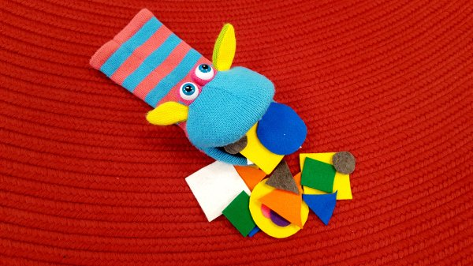
Notes:
Here’s another example called The Shape Monster. We sing thing rhyme: “Shape Monster, Shape Monster, hungry for lunch! What kind of shape would you like to munch?” Then Shape Monster says the shape it wants to eat and kids bring up the shape or help me find the right shape on the board.
Visit Storytime in the Stacks to see the rhyme: https://storytimeinthestacks.com/2018/02/01/flannel-friday-shape-monster/

Slide 24
Notes:
We can also start to think creatively about props, especially with preschoolers who have the executive function skills and language skills to start telling stories together as a group. I attended a webinar by Tomasso Lana about embodied learning and he talks a lot about using props that can be easily made or found around the house the cardboard stories in this image. For example, if you’re telling a story with two characters, maybe they are a fork and spoon. Size doesn’t matter the same way it used to in-person, so taking small things like a laundry clip and making it “talk” is a great way to encourage storytelling in kids with things they are likely to have in their environment.
You can register for the workshop by Tomasso Lana here: https://www.eventbrite.com/e/new-ideas-for-libraries-virtual-programs-for-young-children-tickets-132431200285

Slide 25
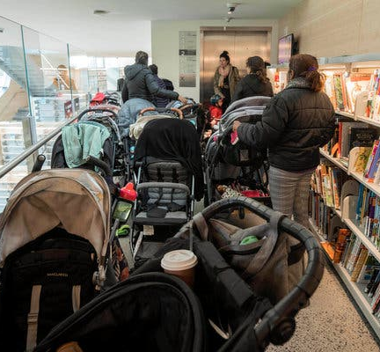
Notes:
Before the pandemic we always considered the safety and security of patrons. This included things like: fire safety limit, stroller parking, signs up about recording/filming, security manuals on how to handle difficult patrons, leaving children unattended.

Slide 26
Safety & Security
Muting/Unmuting
Camera on/off
Renaming
Waiting Room Customization
How to enable and disable screen share, annotations, and chat
How to remove a participant
Notes:
In a virtual environment, safety and security is still a high priority. Our training around these issues has focused more on how to use Zoom. We do Zoom training to ensure staff know how to do the following:
mute/unmute
Waiting room
Renaming
Removing a participant
Enabling and disabling screen sharing, chat, annotation
See the Zoom Skills Checklist in the Library Toolshed: https://librarytoolshed.ca/content/zoom-skills-checklist-programming

Slide 27
What did you change or add to Zoom storytimes?

Slide 28
Logistics
Two staff per program– “host” and “co-host”
Registration for weekly “drop-in” storytimes
Notes:
Some of our biggest changes were to the logistics of the programs. As much as possible we try to have two staff in each virtual program, one acts as the host or main presenter and one acts as the co-host or co-presenter/tech support. Sometimes the co-host is only needed for the first 15 minutes, especially in babytimes. Staff have loved having the opportunity to work so closely with colleagues.
We also instituted a registration process. This helps us limit the number of participants to a manageable range – the smaller the group the easier it is to build connection and engagement. You can rename people because you have their information and use that to call on kids or make comments about thing you see on the screen.

Slide 29
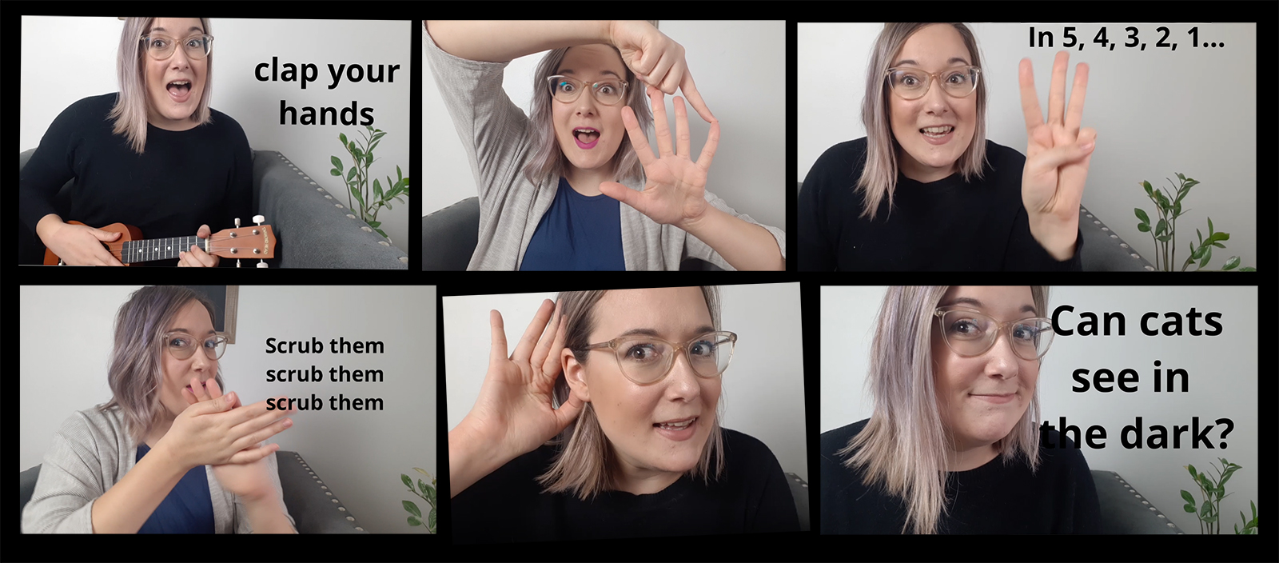
Notes:
Play with voice and facial expressions. Record yourself and watch! Do run throughs of the storytime with people on different devices and see how the experience translated on screen.
Eye contact
Smiling
Vocal intonation
Facial expressions
This image is from Karissa Fast who blogs at Ontarian Librarian. View her post: https://ontarianlibrarian.com/2020/08/06/how-to-make-your-live-virtual-storytimes-sparkle/

Slide 30
Notes:
Pre-pandemic we would plan our early literacy messaging and figure out ways to sneak in these tips during storytime. I love this method developed by Melissa Depper who blogs at Mel’s Desk for formulating a tip on why what we are doing in storytime helps children become good readers.
View Melissa’s full article here: https://www.sos.wa.gov/_assets/library/libraries/projects/earlylearning/anatomy-of-a-storytime-literacy-message-handout.pdf

Slide 31
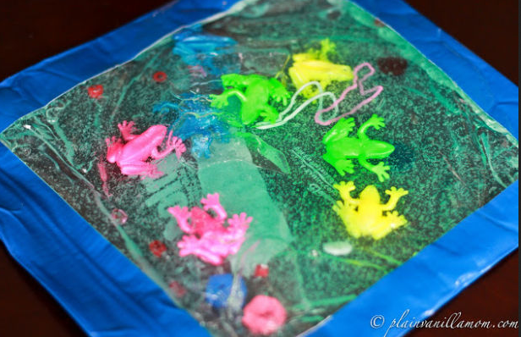
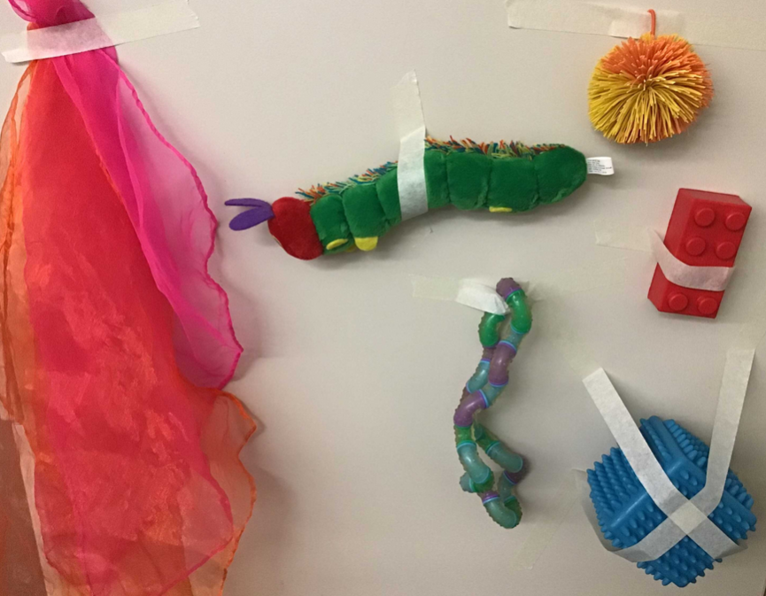
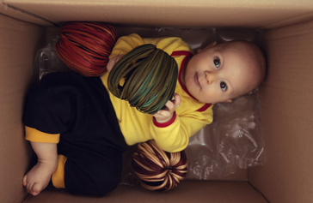
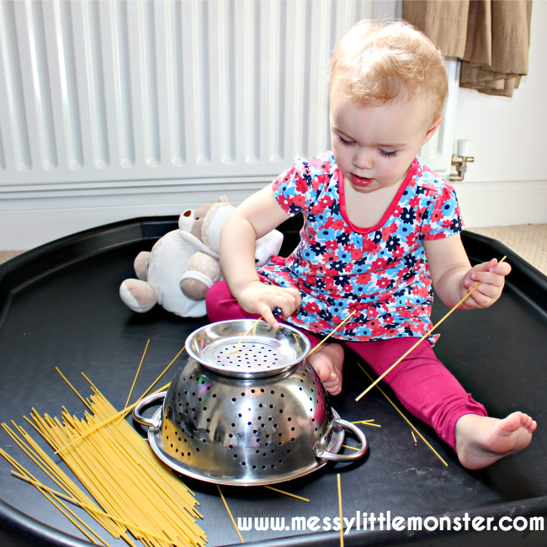
Notes:
It is hard to give early literacy tips in a virtual environment and know how they are landing. We’ve had to get creative in how we communicate early literacy messages. A weekly email communication with caregivers has been great – you can send a new tip each week along with an at-home early literacy activity. These pictures show examples of activities we’ve sent home – you can find a document on the Library Toolshed with tons of ideas.

Slide 32
Caregiver Chat
Mother Goose
Baby Life Hack
Personal Stories
Wish and a Star
Notes:
Another thing we’ve added is integrated share time for caregivers and kids.
In babytimes, find a time during the program where caregivers can talk to each other. Many people add this to the end of a babytime as to avoid interrupting the flow of the program and giving people an option to stay or leave.
Come prepared!
Ask a leading question (What's the story of your babies name?) and then really pause to wait for anyone to respond. The key here is allowing for a long pause.
Wish and a Star – Ask caregivers to share one thing they wish for this week and one thing their baby did that shined.
Asking everyone to share a tip or “baby life hack” if they have one, and build a list to be distributed at the end of the series. Participants are proud when everyone comments on how useful their suggestions are.
Be open to sharing some some personal stuff – not too much, but when we are asking participants to engage meaningfully they are taking an emotional risk, and we need to show that we are also willing to take that risk. What we say matters so much more in a virtual environment than body language, so we need to amp up our empathy through verbal communication.
Use a Mother Goose style question such as:
Tell us the history of your baby’s name
Any sleep tips or frustrations
Self-care ideas for adults
Biggest joy
Biggest challenge

Slide 33
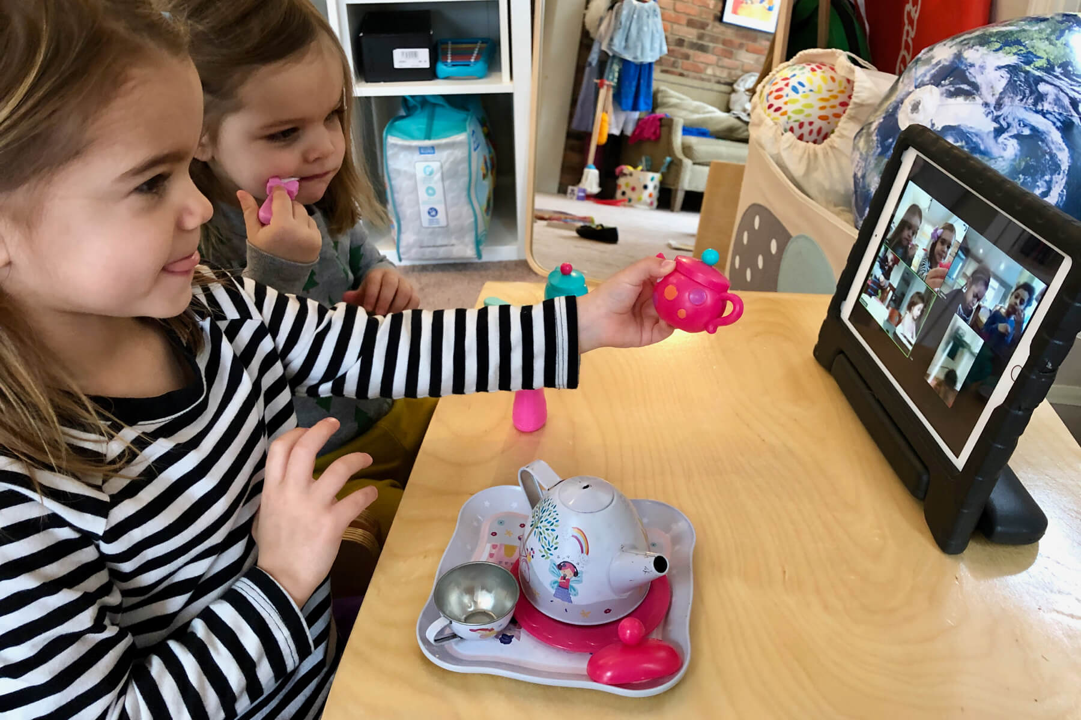
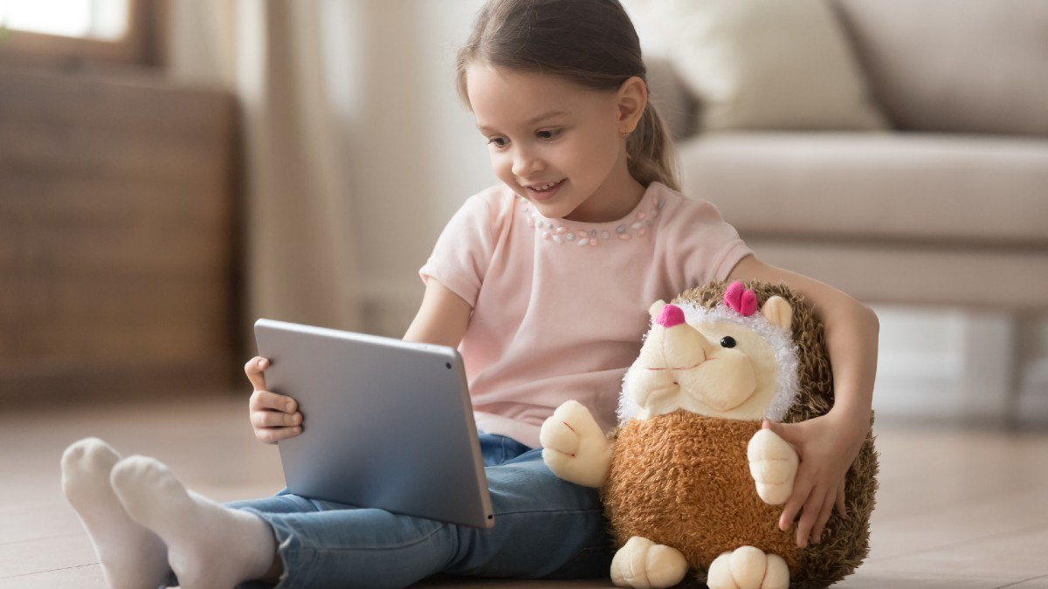
Notes:
For toddlers and preschoolers, invite them to bring a stuffed animal or toy to show to the group. Depending on group size you can unmute each child and have them tell the group about their item or you can simply point out what each child has brought without unmuting. We’ve also done special storytimes such as Costume Capers where the kids come dressed up and we leave time at the end for the kids to tell us about their costume.

Slide 34
Jamie has a firetruck today - wow! It’s big and red. A big, red firetruck.
I really like how Jayden is doing this rhyme – he is being rocked instead of bounced and it is a great adaptation.
I saw Kenzo's big smiles during that bounce - so I think we HAVE to do it again!
Look at Rose sleeping so peacefully through that huge ruckus we were making! If only we all got sleep like that!
Hi Sasha! We see you!! We see you looking love! Let's all wave to Sasha.
Notes:
The last thing that we’ve added is an increased amount of commenting, particularly using kid’s names. These are examples of the things we say during our virtual storytimes. Always be looking for reactions, body movements, or even just acknowledging people.

Slide 35
What did you have to let go of?

Slide 36
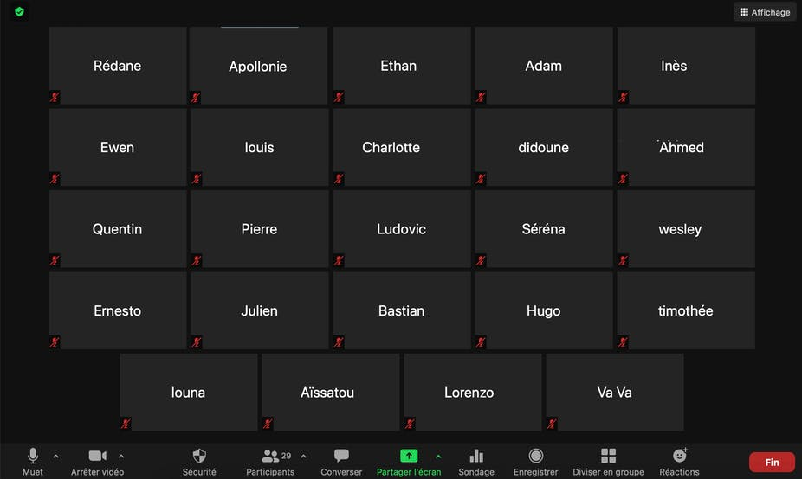
Notes:
Seeing caregivers present and engaged – there are lots of distractions abound in the home, they might be engaged but right out of view. They might need to turn off their videos because a baby needs a diaper change or they are breastfeeding or their kid accidentally turned the camera off.
It’s also hard to quickly scan the room and get a pulse for engagement and adapt based on that. You can’t “see” everyone at all times.
Ask yourself: What is in our control and what isn’t? What is the social and relationship cost of requiring screens on or calling people out during a program?

Slide 37
What feedback have we received?

Slide 38
Books and songs kept him super engaged!
Songs with actions and loud noises.
Funny action songs with suspense.
The songs (with actions) and games. Sharing something from home (stuffies, instruments) was great too.
Nice to see other little ones (my toddler calls it their “meeting”)
It was nice to see other moms and their toddlers. And the librarians encouraged discussion around issues moms might be struggling with (e.g. toddler sleep)
My child has been staying home due to Covid and I am always worried about his social development as he does not have much contact with other people/ kids. By attending the program, at least he could have some interactions with other people and get to learn some songs and story.
I felt connected to the librarians. Seeing their faces and hearing their voices each week. I liked seeing the other parents and toddlers too.
Because we are relatively new in this country and all that craziness around the pandemic has made things more difficult for me as a mom. It's difficult to raise my daughter without more children and moms around. Therefore, it has been comforting to have this program, at least once a week. Also to practice my English.
Notes:
These are examples of the positive feedback we have gathered from a recent toddler storytime survey.

Slide 39
What does a full storytime look like?
Notes:
Please see the documents on the library toolshed for sample program templates:
https://librarytoolshed.ca/content/zoom-toddler-storytime-program-template
https://librarytoolshed.ca/content/zoom-babytime-program-template

Slide 40
School-age and Teen Programs

Slide 41
Bread + Butter Programs
Literacy + Play
Social Connection
Notes:
Virtual programs work great - seen lots of new teens and kids who never came to our in-person programs. Virtual doesn’t cut into study time, teens don’t have to commute. So how did we decide which programs to run?
We looked at our bread and butter programs - the ones we were used to offering in-person that staff felt really comfortable with.
We looked at which programs could foster social connection around shared interests. How can we help them build skills in things they are already interested in - art, writing, community service hours, language
We also wanted to focus on literacy as that fits with our strategic objectives as a library, but literacy through play, sometimes unstructured play or kid or teen led play. And that’s where we’ve been able to introduce gaming programs like D&D and Among Us.
By focusing on these areas we’ve seen kids and teens deepen their connection to the library. We’ve seen higher levels of engagement, higher levels of intimacy and being vulnerable. We are meeting kids and teens where they are at.

Slide 42
Overview of Programs
Kids | Teens
Early Readers Book Club | Teen Book Club
Tween Book Club | Teen Advisory Group
Write Now! Writing for Kids | Teen ESL Conversation Circle
Among Us | Among Us
Reading Buddies | Reading Buddies
 | Dungeons and Dragons
Notes:
This is an overview of the current programs we run for school-age kids and teens.

Slide 43
What’s been working well?

Slide 44
Icebreakers
Zoom polls
Would you rather?
A Rose and a Thorn
Ask kids and teens to send you questions they want to ask others
Notes:
Kids and teens often don’t know each other because they are joining from all over the city. Icebreakers are even more important now to help build community. Some ideas for icebreaker activities include:
Zoom polls with fun and silly questions
Would you rather questions – kids can respond by doing a movement like sitting or standing or waving or clapping
Rose and a Thorn - one good thing and one bad thing that happened, helps you “read” the room. A question that helps you get visual communication cues.
Can ask teens to send you questions that they want to ask each other. Examples include what is your most used emoji and what do you at home that doesn’t involve a screen?

Slide 45
Notes:
The Winter 2020 edition of the YAACS newsletter had a wonderful article filled with ideas for virtual icebrekaers.

Slide 46
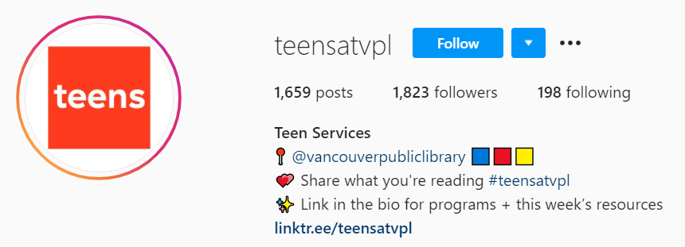
Incorporating Multimedia
Notes:
Incorporate multimedia where possible.
Showing book trailers, movie trailers, and short YouTube videos
play music
Answer questions by modeling a quick Google search
Play Kahoot - game style trivia about the book
Using social media as a way to support the program – Our teen Instagram account ran a Fake News series of posts that mimics traditional library research skills. We can’t get kids to show up to that as a program, but we can convey the information on a platform they browse.

Slide 47
Interactivity
Sharing writing and drawings
Using household objects
Using breakout rooms
Author and Illustrator visits
Notes:
Look for ways to add interactive elements.
Use Zoom features such as the whiteboard for group drawing activities.
Use breakout rooms to get kids and teens in smaller groups to do an activity before sharing with the whole group.
Create time for sharing either through open discussion or in the chat.
Have kids or teens find something in their room and make a sound and people guess what the sound is with camera turned off.
Author and Creator Visits – investigate using InterLink funds to host an author or illustrator that can interact with kids and teens directly.

Slide 48
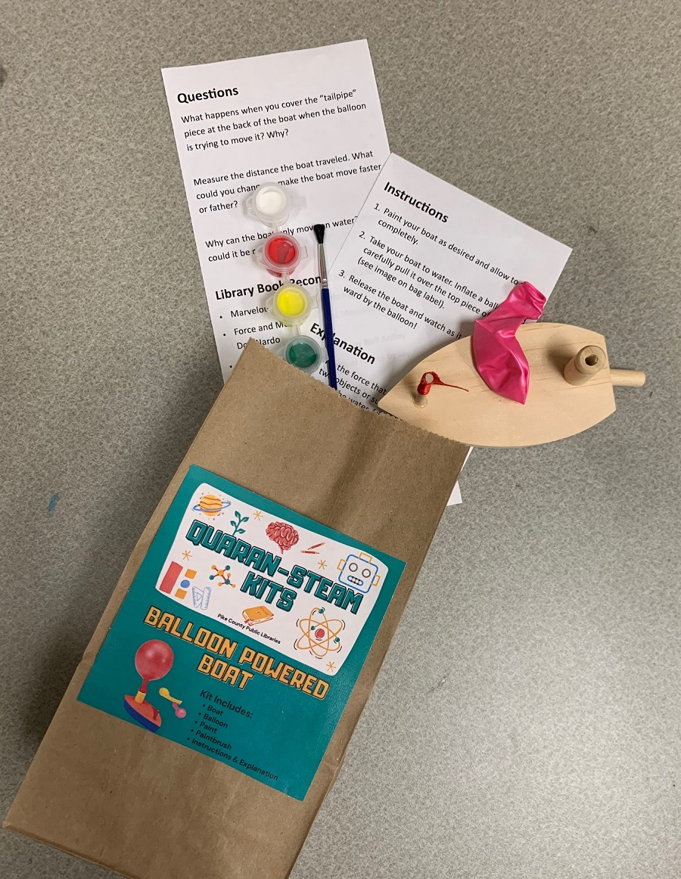
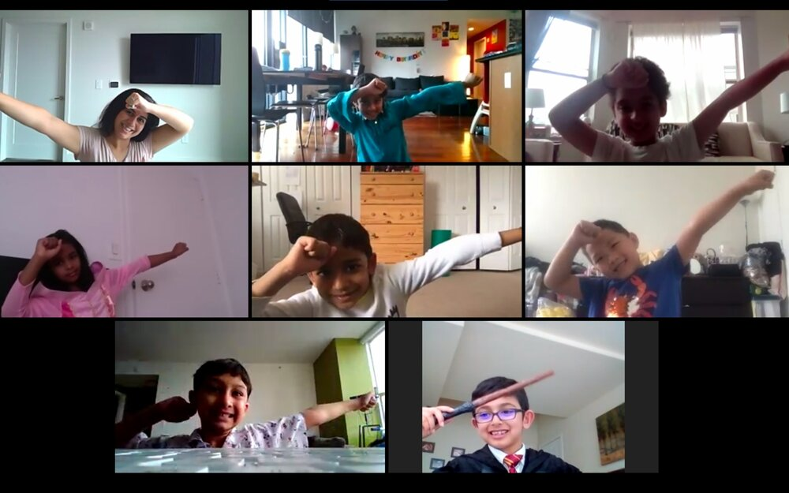
Movement and Hands-On Activities
Notes:
Weave in movement activities and hands-on activities.
Take a stretch break or do a 5-minute yoga exercise together.
Have a dance party at the end of the program.
Have kids do a scavenger hunt around the house on a specific theme
Have kids share something special in their home
Offer make-and-take kits that families can pick up at a library and use in a virtual program.

Slide 49
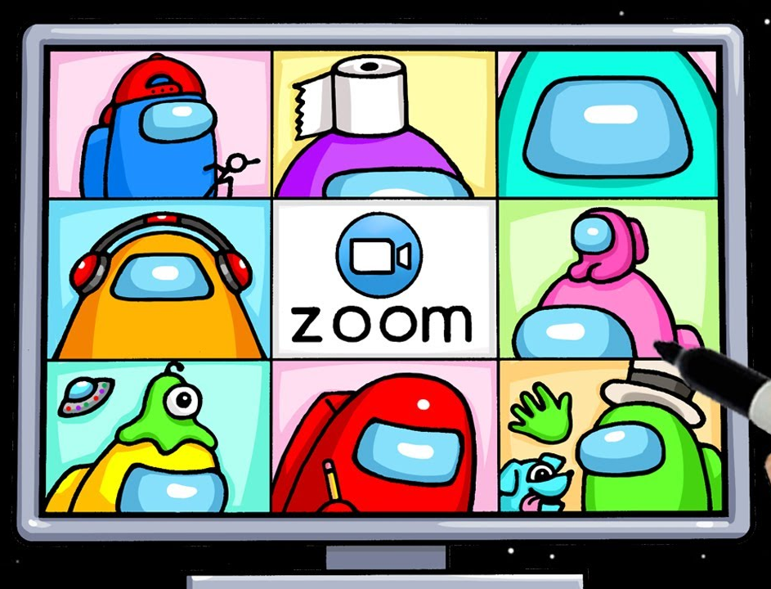
Gaming
Notes:
Gaming programs have been hugely popular. They capitalize on kid culture and should be treated as a laid back hangout.
Among Us is very easy to learn: An interstellar murder mystery that requires teamwork (and back-stabbing). What you need to play: Zoom and a smartphone, tablet or PC computer. (4-10 players). In “Among Us,” crewmates aboard a spaceship must work together to uncover the impostor(s) sabotaging their vessel and murdering teammates. The game is a live-action rendition of Clue.
Dungeons and Dragons - more work for staff behind the scene and better for teens who have already expressed an interest or know how to play.

Slide 50
Safety and Security
Registration
Muting/Unmuting
Camera on/off
Renaming
Waiting Room Customization
How to enable and disable screen share, annotations, chat
How to remove a participant
Notes:
Just like in in-person programs we try to make our virtual programs as safe and secure as possible. We train all staff presenters to use Zoom especially the functions listed on this slide. Knowing how to easily navigate Zoom makes the program flow better.

Slide 51
What did you have to let go of?

Slide 52
Notes:
Things we had to let go of include:
Providing snacks
Being able to read a room quickly and knowing how engaged participants are at all times.
Keeping teens “safe” and controlling the entire environment can actually prohibit teens from connecting, such as using the private chat function to send each other personal information. We had to let go of our level of supervision.
Being able to connect kids and teens with other kids and teens in their immediate neighbourhood. People are joining from all over the city.
What we think a program should look like - go with the flow!

Slide 53
Lindsey Krabbenhoft Children’s Librarian, Vancouver Public Library
lindsey.Krabbenhoft@vpl.ca
Notes:
Feel free to contact me with any questions!

