Slide 1
Staff Technology Training: Screencasting

Slide 2
Goals
Know what screencasting tools are available and their features
Select the best tool(s) for a screencast
Describe best practices for screencasting
Locate additional resources
Notes:
Primarily a hands-on task, learning how to screencast. Today is to familiarize people and to brainstorm for part two.

Slide 3
But First-
What is a screencast?
Recording actions on a screen, while narrating the steps.
It is a great asynchronous training tool
Notes:
Think “recording of a webinar”

Slide 4
Example

Slide 5
Tools Required
Computer
Microphone
Screencasting Software
A Chipper Disposition

Slide 6
Tools Available
Camtasia Software is installed on:
Teen Space Computers
[Multimedia Room Computers]
Communications Office Computers
Microphone Headphones are available:
CCC Credenza
Plastic Basket on Staff Devices Shelf

Slide 7
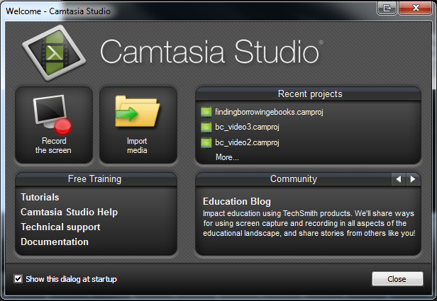
Camtasia
Notes:
Robust piece of software that can easily create great video productions.

Slide 8
Screen Recording
Use a 16:9 Ratio
F10 stops the recording
Record in steps or do one “take”

Slide 9
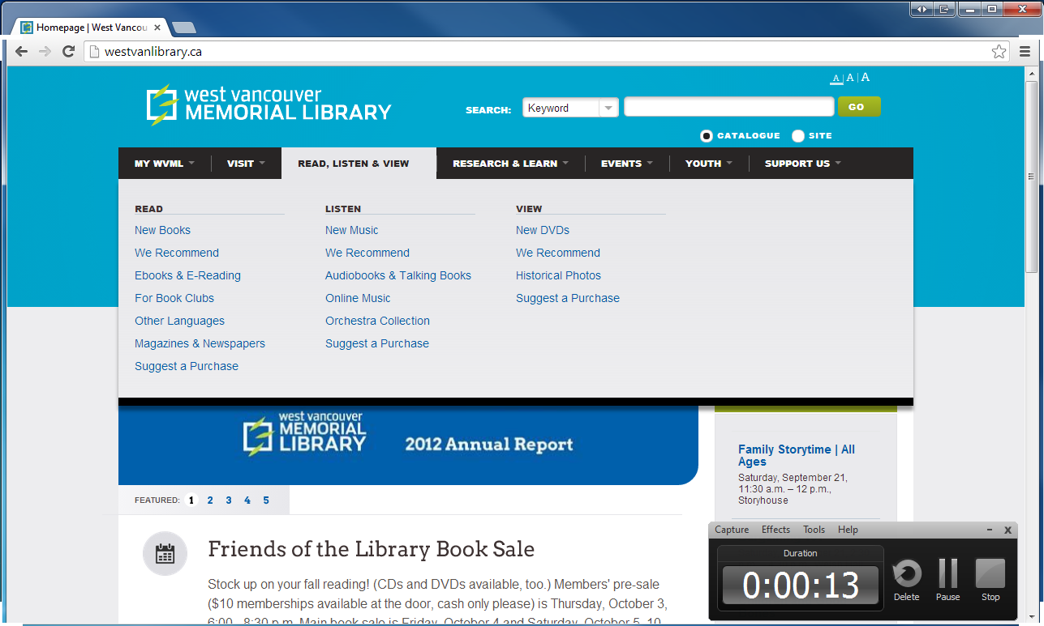
Screen Recording
Notes:
The bar in the corner shouldn’t be in your recording area (show corners) but it does show a time count.

Slide 10
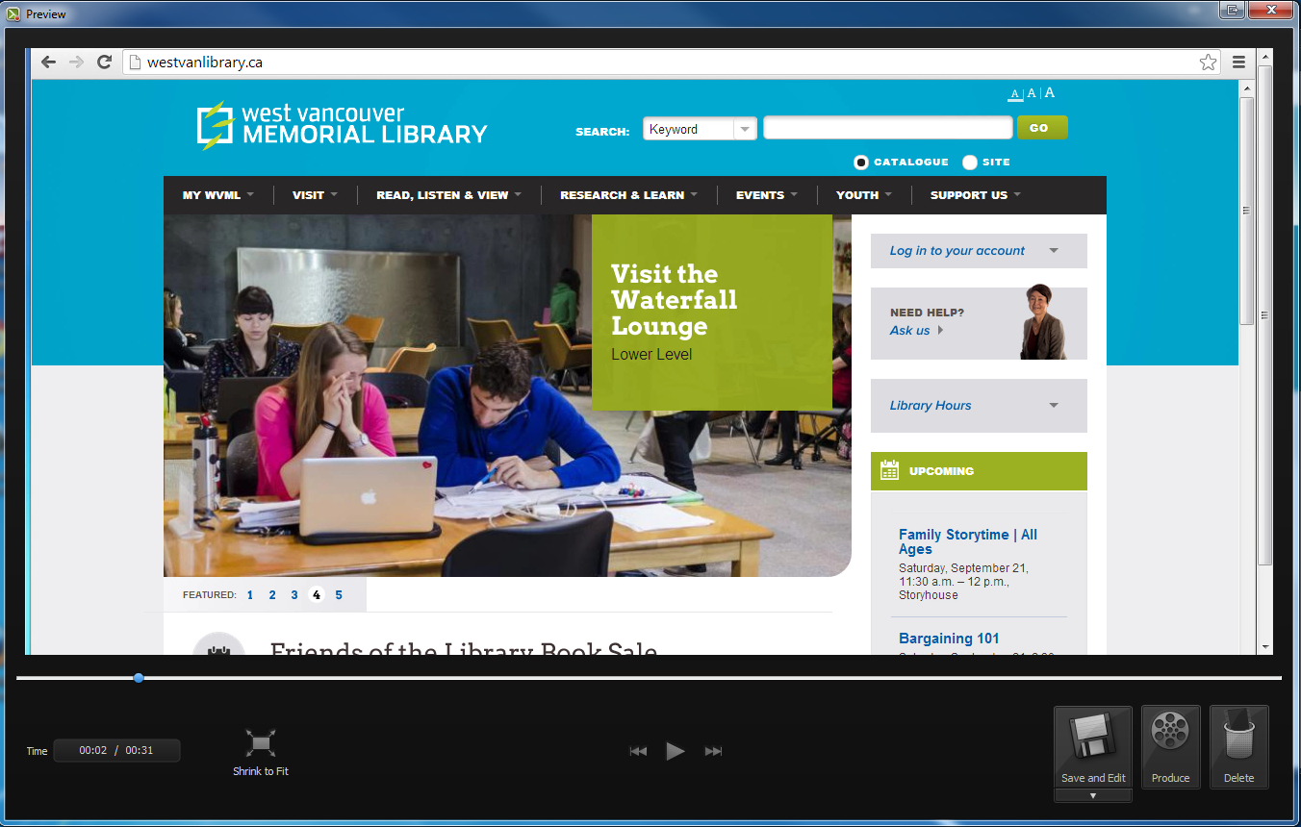
Preview

Slide 11
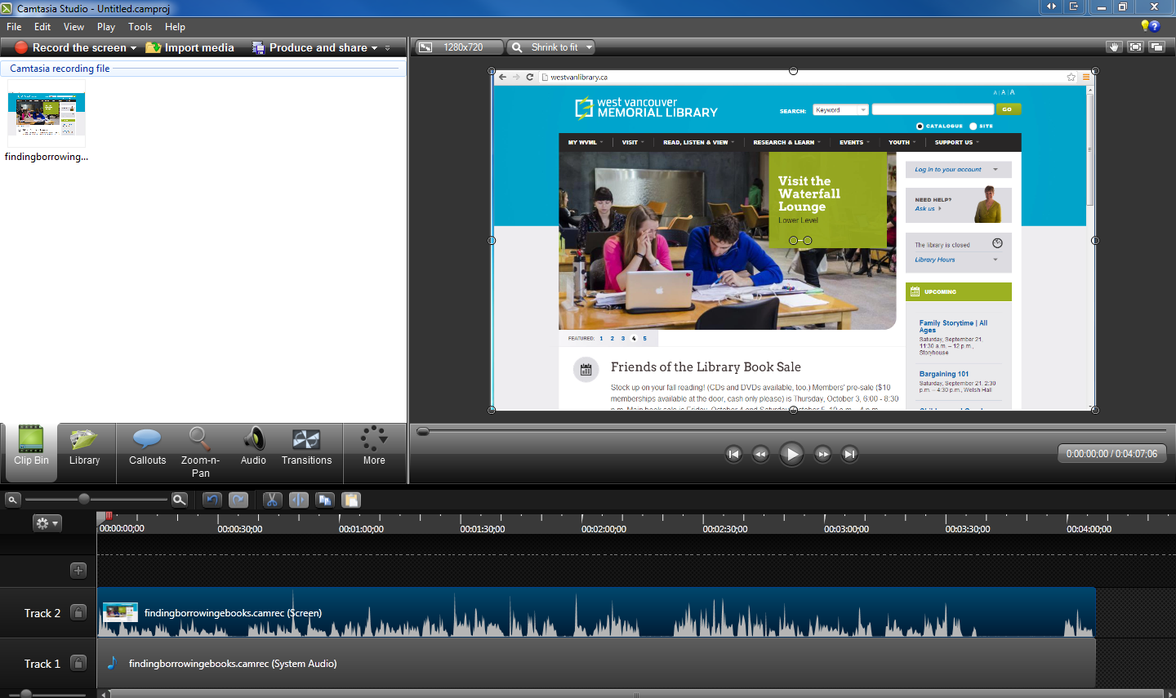
Project Editing
Notes:
3 parts to the screen
Preview – play, pause, replay as much as needed
Tacks area- layering. Looks complicated but – track two is our recording, track three is sound, and track one is where I add in extras (not required.
File browser for add-ons, other clips, music segments, title slides, callouts, transitions, etc
Talk about what I saw when this screen appeared
-dead space to remove
-knew that I needed to mask my library barcode
-knew that I wanted to add title slides
(don’t forget to save!)

Slide 12
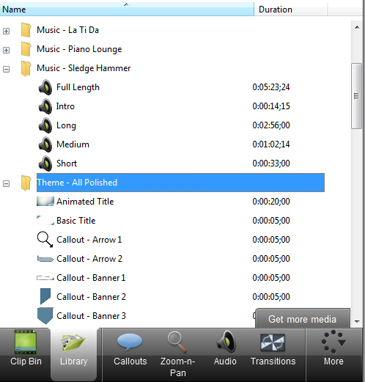
Title Slides Etc
Notes:
In the library tab there are lots of pre-set up slides and themes for adding to your recording, but you can create and customize your own

Slide 13
Splitting
Notes:
This is useful if you want to cut out middle sections of a recording – or add content.
I did this for the first time on Saturday – I wanted to remove the dead spaces without having to re-record. Something that I had not done previously.
Use the progress bar to indicate where you would like the cut to be made. Click on cut.
The gap was created by clicking on an end of a section and dragging.

Slide 14
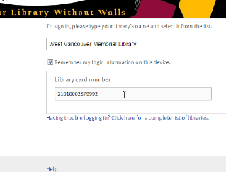
Using Callouts as Masks
Notes:
Callouts are arrows, boxes and other shapes that can be added to a recording.
I like to use them to hide personal information

Slide 15
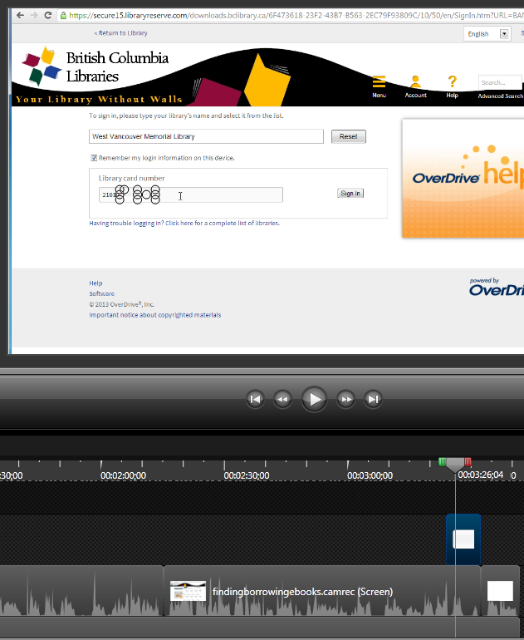
Using Callouts as Masks
Notes:
Remove transitions
Remove border
White fill
Change shape to just cover barcode
Change callout time to just be there when needed

Slide 16
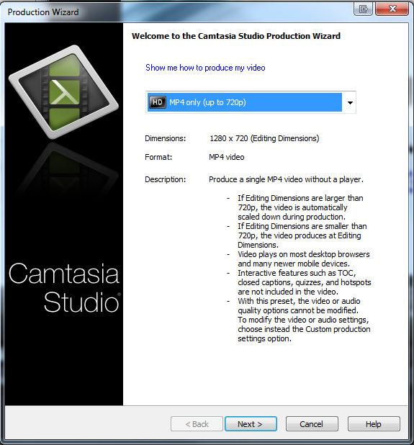
Saving complete videos
Notes:
I don’t really recommend going from production to youtube.
MP4 means that we’ll always have a copy ourselves.

Slide 17
Uploading to YouTube
www.youtube.com/westvancouverlibrary
Login: westvanlib / westvanlibadmin
Notes:
Share with the world!

Slide 18
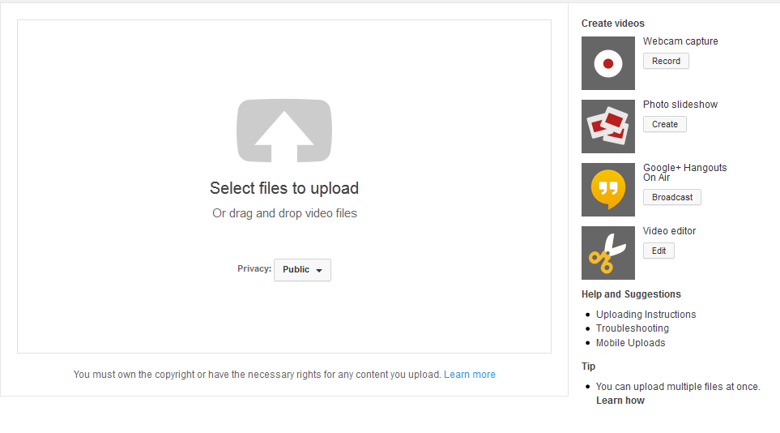

Slide 19
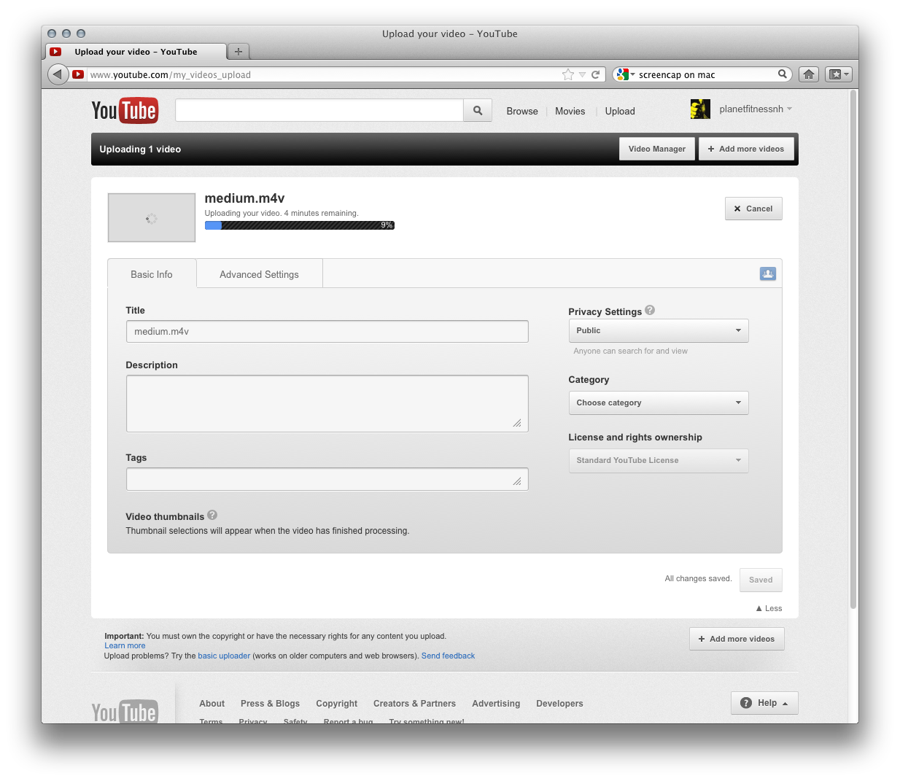
Notes:
Tags and descriptors, as always are finding tools

Slide 20
Other Tools
PowerPoint
Jing
SnagIt
Mac Movie Maker
Windows DVD Maker

Slide 21
Tips & Tricks
Know who your intended audience is
Have a script
Practice the task that you will be demonstrating
Give yourself lots of time
Videos should be 2-4 minutes
Cover only one task / topic
Notes:
What tips do you have?
What do you like to see in videos?
What do you dislike?

Slide 22
Additional Resources
Titles under 777.0285
Screencasting: how to Start: http://www.smashingmagazine.com/2008/08/19/screencasting-how-to-start/
Video: http://www.screencast.com/users/Training/folders/Training/media/a920188f-b764-428b-9d2e-3bcdddbf5699
Notes:
View movie

Slide 23
Part Two
Is all about you!
Notes:
You will have a chance to create and upload your own screencast! Practical & Hands on
-make your own or work with the other person to make one together
-2 people, get feedback, support, trust when they say you sound good
-timing: I will be around to assist if needed
I will be emailing you this as well

Slide 24
Topics
Using a database
Search tricks
Registering for a program
Finding a specific piece of information on the website

Slide 25
Possible Tasks
Creating a Zinio account
Using Mango Languages
Finding Bestsellers in the Catalogue
Requesting a Meeting Room
Registering for a Puppet Show
Changing your PIN
Finding Obituaries online
Using the Digital Photo Collection
Notes:
Think about tasks that someone may get stuck on at 11pm when at home. Or videos that may be able to supplement an instructional email that

Slide 26
Before Your Session
Choose a Topic
Have a Script
Practice the steps
(Optional) Practice with Camtasia
Notes:
If time, they can find tasks, practice, discuss, ask questions etc.

Slide 27
Questions?

