Slide 1
Programming with Raspberry Pi Microcomputers
Notes:
Welcome! Go around and share names. Can anybody tell me what’s missing from these computers? (take answers) Yes! the hard drives because we are going to build those today!
Today you will be building computers and learning a bit of code using two classic games – Snake and Pong. You are master of the games and can change the look and even the rules of the games with code.
Hands up has anyone done coding before? (look for experts that may be able to assist others)
This is a beginner’s class, so if you are more advanced you may be asked to help others. Define code? Computer code is a language that a computer understands. It tends to be very short.

Slide 2
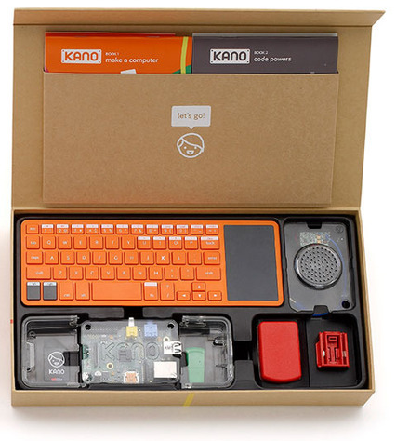
Pieces of the Pi
Processor
Memory
Speakers
Keyboard/Mouse
Power Supply
Screen
Extra stuff: Internet (wifi adapter); Bluetooth
Notes:
THIS SECTION OF THE PRESENTATION IS ALL ABOUT HARDWARE AS OPPOSED TO SOFTWARE
Point out the various parts of the Kano kit. (Detailed description of all parts in the glossary.) Point out where they are in the Kano Kit.

Slide 3
Okay…time to make a Pi
Not this kind of pie.
Notes:
Time to build your computers! Hand out a Kano Kit to everyone – give them an option of DIY with the manual or following along with the group on the PPT. They are welcome to open up the boxes and look. Assembly should take about 20 min.

Slide 4
#1 Computers need a case.
All the pointy bits face up and case is under the flat part. Be gentle.
Notes:
Building the Kanos – Insert the motherboards (green circuits) into the plastic case. Show them an example up front first. Remind them that the green circuit is fragile. TELL THEM NOT FORCE THE COMPUTER IF IT DOES NOT FIT. ASK FOR HELP.

Slide 5
#2 . Put in the SD (secure digital) card.
This is the brain of the computer. It gives it a way to memorize information.
Notes:
Look on the bottom of the computer. There is a slot that the SD card fits in. The boy’s face should face the floor when you put it in.

Slide 6
Take a look at the speaker.
Notes:
Take the speaker out. Put the blue cord through the hole in the plastic lid.

Slide 7
We need to give the speaker power.
Notes:
Point out the pins on the board. They give the computer parts power.

Slide 8
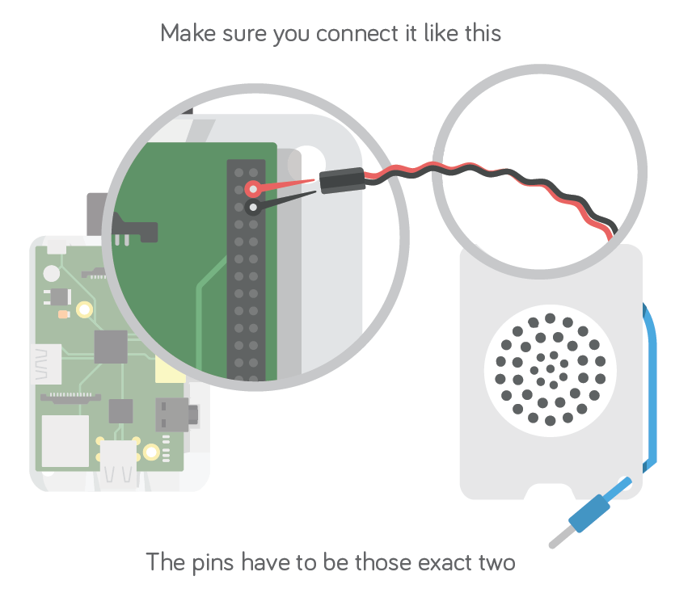
Notes:
These two specific pins shown are the only ones that work. Demo connecting the cords. Remind them to be gentle and ask for help.

Slide 9
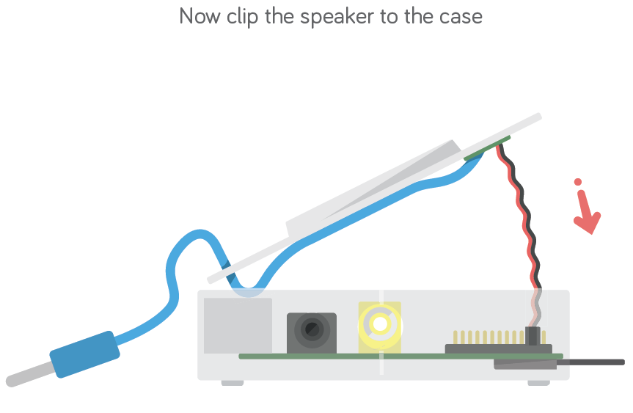
Notes:
Clip the speaker in place. Using the blue cord, plug your speaker into the side of the Raspberry Pi.

Slide 10
Time to plug in the monitor.
Plug the monitor DVI cord (white end) into the adapter.
Plug the adapter into the side of the Raspberry Pi.
Turn the monitor on. Sometimes you need to push ‘Source’ on the monitor to make it work.
Notes:
Plug the DVI cable from the monitor into the adapter (should have the cables affixed to monitors beforehand). Plug the adapter into the side of the Raspberry Pi. Turn the monitor on. If the monitor is doesn’t turn on, press Source. If that doesn’t work, double check all connections.

Slide 11
Plug the red cord of the keyboard into the R. Pi.
Then take out the white wifi antenna.
Notes:
The red cord plugs into a USB slot on the R Pi. The white antenna gets taken out of its pocket on the side of the keyboard.

Slide 12
Plug the white piece into the USB port!
Notes:
The white wifi antennae gets plugged into the other USB slot on the R Pi.

Slide 13
Put the plug together for some power!
Notes:
CAREFULLY slide the prongs into the power adapter. Plug the USB side of red cord into the bottom power adapter. Then plug the smaller end into the R Pi.

Slide 14
Plug it in. You just made a computer.
Notes:
Plug it into the Power Bar. Turn on your keyboard by pushing the white power button on the right side. There should be a green light on the keyboard and a blue light on the Raspberry Pi. If nothing appears on the screen, try pressing the 'Source' button on the monitor itself.

Slide 15
Using the mouse and keyboard
Use the grey button on the left of the keyboard to left click using the pointer.
Use the grey track pad to move the mouse.
Notes:
Use the grey track pad to move the mouse. Use the grey button on the left of the keyboard to select things with the pointer. Demo for the group.

Slide 16
Resetting the computers
Click the K in the bottom left corner of the screen
Select Code, then click Terminal
In the terminal, type sudo kano-init reset and the Enter key
The message “kano-init RESET scheduled for next system reboot” should appear. If it doesn’t, enter the command again carefully.
After the confirmation message, click K again, then Shutdown and Reboot.
Notes:
Walk participants through resetting the Pi’s. This is necessary because otherwise the apps will start on a harder/different level. Make sure participants type the terminal command exactly as they see it, hit enter, and see the reset confirmation message before restarting the second time; this is usually the step that they miss.

Slide 17
After the Reboot
What’s your name? Type VPL and the Enter key
Follow the commands until it asks you if you want to connect to the Internet
Select No Internet, then Connect Later, then Play Offline
Select Test Sound, then Play Sound
When asked to create a profile, click Skip
When the Kano starts talking to you, hit the Esc key to exit and begin coding!

Slide 18
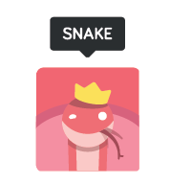
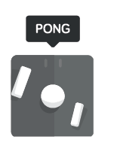
Let’s get to coding!!!
1st – Command Line Coding
2nd – Block Style Coding (G.U.I.)
Notes:
They’ll be using command lines in Snake. Ask anyone if they know what a command line is and if they have ever used it.

Slide 19
Command Lines
Command lines :
Tell the computer what you want it to do
= Open the game Snake
= Open the game Pong
= ???
Who can guess what the bottom command means?
python snake
python pong
python snake –b m
-
Notes:
Try and get them to guess what the 3rd line means.
Answer in English: I want you to make the [-b]oard a [m]edium size.
Give roughly 15 minutes for people to play Snake.
Hints for tutorials: The games have built in tutorials that make participants go through a series of challenges IF YOU WANT TO SKIP THE CHALLENGES, USE PLAYGROUND MODE and the kids can play at will. They do not need to finish all the challenges and some will not be able to do so in the time provided. Your job is to help kids as they struggle through each lesson and steer them away from only playing the game not doing the lessons. The Kano mascot (a boy in a judo suit) lets you know how you are doing during the tutorials. When you make a mistake, the kid’s face is sad and he gives you hints on what you did wrong. His arm will point to where you should click to fix your mistake.

Slide 20
Snake - Command line code
Goal: keep the snake away from the sides
python snake –b m
python snake –t jungle
-
[
Notes:
Have a short discussion about the two different types of coding that were introduced yesterday. Here are a few points to bring up:
Command Lines:
-Must type out everything you want the computer to do
-Needs to be exact. One mistake, and the computer won’t know what to do!
Block Coding (Graphical User Interface):
-Blocks fit together (kind of like Lego!)
-Putting the blocks together in different ways create different results

Slide 21
Python commands
Type this | To do this
Python snake | Launches the game
Python snake –b m | Changes the board size through a parameter
Python snake –s f | Change the speed through a parameter
Python snake –t jungle | Change to a jungle theme
Python snake -e | Editor mode
Notes:
Have a short discussion about the two different types of coding that were introduced yesterday. Here are a few points to bring up:
Command Lines:
-Must type out everything you want the computer to do
-Needs to be exact. One mistake, and the computer won’t know what to do!
Block Coding (Graphical User Interface):
-Blocks fit together (kind of like Lego!)
-Putting the blocks together in different ways create different results

Slide 22
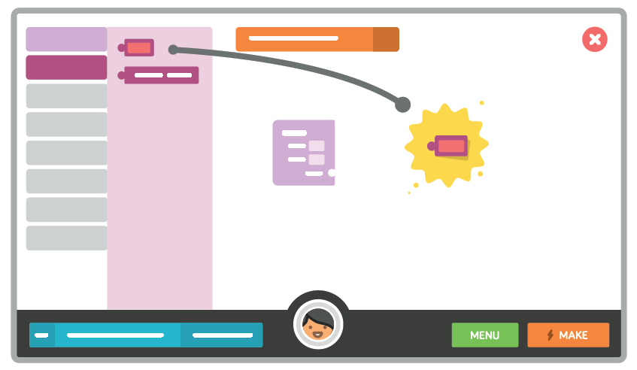
Graphical User Interface - G.U.I.
Kano Blocks
Notes:
Pong uses GUI a Graphical User Interface (G.U.I. or 'gooey' for short), a picture based way of telling the computer what you want it to do. Pong uses a GUI called Kano Blocks. Moving the blocks around does the same thing as typing code in a command line. Smartphones and computers usually use this mode. Like Lego, you can click these blocks together in a variety of combinations
Then get everyone to play Pong for the remainder of the session (about 30 min). Make sure to leave 5 min at the end to shutdown and clean up. Ask participants to avoid playing the other games unless they are very far ahead to the group.
The games will let you play them endlessly, so encourage kids to hit escape and move on to the next tutorial if they get distracted.

Slide 23
Pong - GUI Block Coding
- Blocks fit together (kind of like Lego!)
-Putting the blocks together in different ways create different results
Notes:
Have a short discussion about the two different types of coding that were introduced yesterday. Here are a few points to bring up:
Command Lines:
-Must type out everything you want the computer to do
-Needs to be exact. One mistake, and the computer won’t know what to do!
Block Coding (Graphical User Interface):
-Blocks fit together (kind of like Lego!)
-Putting the blocks together in different ways create different results

Slide 24
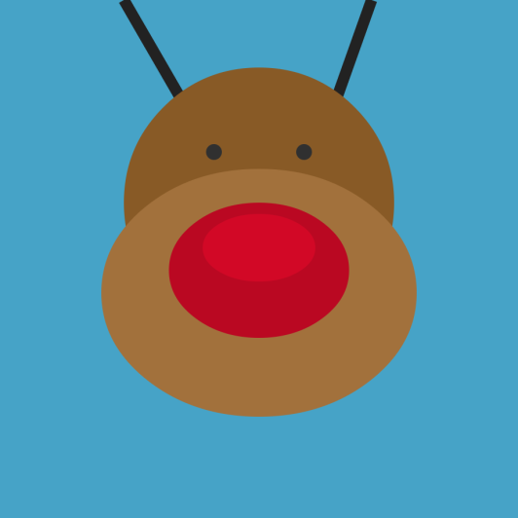
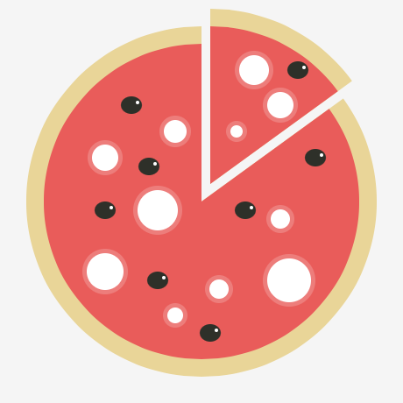
Kano Draw
Notes:
Today, we’ll be exploring 2 new programs. The first is Kano Draw, which you use to make art. Uses command line coding. All images made using Kano draw

Slide 25
Just remember, behind each drawing, there are many lines of code!

Slide 26
Unplug the red power plug.
Notes:
Last 15 minutes of program (if time permits):
Have kids unplug from Power Bar and Monitor. Have them pack their keyboard and any cords back in the box, Have kids count the number of items in the box to make sure everything is back in the kit.

Slide 27
Slide apart the plug pieces and disconnect the cable.

Slide 28
Time to unplug the monitor.
Turn off the monitor.
Unplug the adapter from the side of the Raspberry Pi.
Unplug the monitor cord from the adapter.

Slide 29
Unplug the white antenna from the computer...

Slide 30
And plug it back into the side of
the keyboard.

Slide 31
Carefully unclip the speaker from the case, and disconnect the red and black pins.

Slide 32
Remove the SD (secure digital) card.

Slide 33
Very carefully pull apart the case.

