Slide 1
Tools for Self-Publishing
Wednesday, November 19, 2014, 4 p.m.

Slide 2
Outline
What?
Why?
Who?
How?
Creating
Publishing
Getting Reviews
Notes:
Goal: Introduce aspiring authors to the tools and resources involved in self-publishing
Introduction (5 min)
-Welcome
-Me
-What we are here to discuss today, introducing tools to aspiring writers (outline)
-not a publishing expert, but as a librarian, able to help people access the tools that they need in order to be successful.
-information is as current as we can make it, publishing industry is still in flux, and changes occur every day.

Slide 3
What is Self-Publishing?
Photo by: churl from http://www.flickr.com/photos/churl/250235218/
Notes:
What is Self-Publishing?’ (5 minutes)

Slide 4
“Self-publishing is the publication of any book or other media by the author of the work, without the involvement of an established third-party publisher. A self-published physical book is said to be privately printed. The author is responsible and in control of entire process including design (cover/interior), formats, price, distribution, marketing & PR.”
-Wikipedia.org
Notes:
“Self-publishing is the publication of any book or other media by the author of the work, without the involvement of an established third-party publisher. A self-published physical book is said to be privately printed. The author is responsible and in control of entire process including design (cover/interior), formats, price, distribution, marketing & PR.”
-Wikipedia.org
(that seems like a lot of work, so…)

Slide 5
Why Self Publish?
From: http://digital.westvanlibrary.ca/index.php/4150-wvml;dc

Slide 6
You control all of the creative decisions
You set the price
You might end up as famous as E.L. James!
Notes:
Why Self Publish? (5 minutes)
You control all of the creative decisions
You set the price
You might end up as famous as E.L. James!
There are a lot of interesting statistics out there about self-publishing, and a lot of different options.
Here is an infographic from Forbes, about the breakdown of costs. (read out)

Slide 7
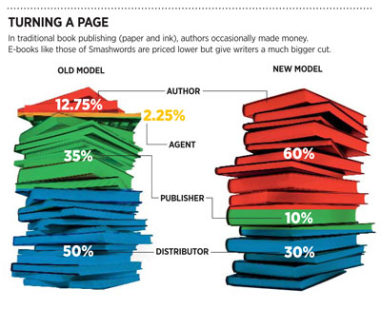
From forbes.com article “Apple's Biggest (Unknown) Supplier of E-Books”
http://www.forbes.com/sites/jjcolao/2012/06/07/apples-biggest-unknown-supplier-of-e-books/
Notes:
What does the self-publishing landscape look like?

Slide 8
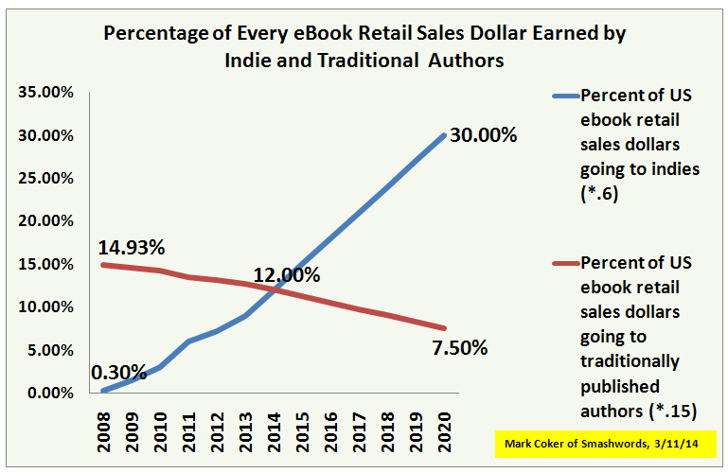
Notes:
One of the commonly cited advantages of indie ebook publishing is that indies earn much higher "royalty" rates than traditionally published authors. Smashwords authors typically earn 60-80% of the list price, versus traditionally published authors who earn 12.5% to 17.5% of the list price. The rate paid by the publisher depends on whether their publisher is selling books under the wholesale or agency models. Let's put some numbers on the bones of these percentages. A Smashwords-distributed author earns $2.40 on a $3.99 ebook sold through one of our retailer partners, whereas a traditionally published author would earn about 50-70 cents. In order for the traditionally published ebook author to earn the same $2.40, their ebook would have to be priced between $13.71 and $19.20. This explains why talented authors are feeling such strong economic incentive to go indie. Indies can price their product lower, but still earn more per unit sold than they can earn from traditional publishers who overprice their books yet continue to offer a small royalty percentage.
The chart at the top of this page is generated off of the same estimates that created the chart at left which I first shared in last week's post. The chart at top was created by multiplying the percentage of the market going to indie ebook authors (at left) by 60%, and the percentage going to traditional authors by 15%. These percentages are approximations based on the spreads I mentioned above. You can download my spreadsheet to develop and share your own estimates. Nothing would make me happier than for someone with better numbers to prove that my 2013 indie ebook market share estimate of 15% is too high (it would mean Smashwords authors have more upside in the future!). I am confident, however, that the 10 winds of change I identified in the last post will lead indies to capture increased market share in the years ahead.

Slide 9
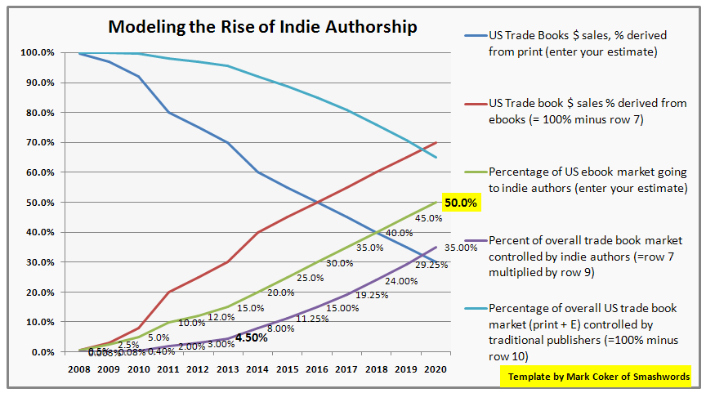

Slide 10
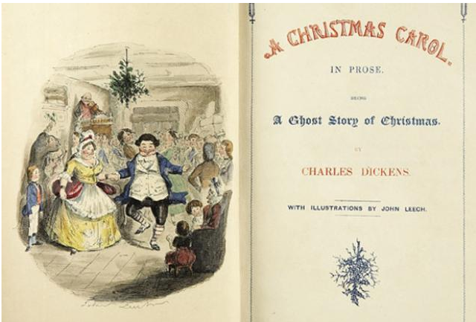
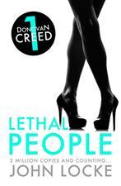
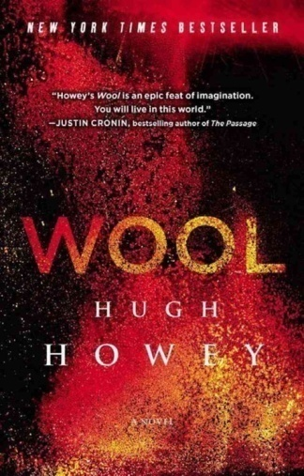
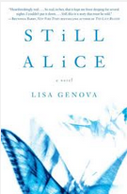
Who Self-Publishes?
Notes:
Who Self-Publishes? (10 minutes)
Examples of success stories
There is a bit of a trend at the moment where authors will self-publish, almost as a way to show traditional publishing houses that they can be successful.
Choosing self-publishing does not stop you from pursuing traditional publishing after (or having been traditionally published once, does not mean you cannot choose self publishing after).
Other authors prefer the self-publishing model.
A Christmas Carol: in 1843 Dickens published this book himself, after being disappointed with his publishers
They Joy of Cooking: originally self-published in 1931 (and had 3000 copies) and then after 5 years taken up by a publishing house, and has sold more than 18 million copies to date.
Wait for You: 1st self-published book to be #1 on the Digital Book World Ebook Best-Seller List
Other romance others like Barabara Freethy and Bella Andre have made more than a million dollars self-publishing romance novels.
Still Alice: originally self-published by an established author, it was picked up by a publishing house and debuted at #5 on the NYT Bestseller list.
Once We Were Brothers: self published by an author who couldn’t find a publishing house to take it on, it took two years for the market to discover it, but now has been picked up and is available via St. Martin’s Press.
My Blood Approves: self-published via Kindle, the author have made over 2 mil between 2010 and 2011, has recently signed with St. Martins Press
Lethal People John Locke was the first author ever to sell 1 million ebooks. All of his titles are self-published via Kindle.
Wool initially published with a small press, then sold it himself. Lots of marketing efforts and community engagement has grown the story, and he sold the film rights to Fox recently.
Guardian has a new contest – “Self-Published Book of the Month” open to UK residents.

Slide 11
“Author and professional biographer Larry Grobel has around a dozen traditionally published and bestselling titles to his credit. ..When he approached his long-time publisher with his completed book about this career… he was told what many authors have blatantly been told by the industry:
“Call us after you sell 100,000 ebooks, we’ll pick it up.”
From: http://goodereader.com/blog/e-book-news/self-publishing-how-good-is-good-enough

Slide 12
How?
From: http://digital.westvanlibrary.ca/index.php/4170-wvml;dc
Notes:
How? (2 min)
This is a big process, and we’ll discuss resources to take you from start to finish.
Now, the self-publishing process can be done for “free” in that it is just your time and energy that goes into the process. But there are a lot of services out there, that can often improve your book that do cost. A recent article put the average cost of self-publishing a book at $2300. Others put the cost at $4000.
http://www.writer.ly/community/how-much-does-it-cost-to-self-publish-a-book/
http://www.pbs.org/mediashift/2013/05/the-real-costs-of-self-publishing-book/

Slide 13
Creating Your Book
From: http://digital.westvanlibrary.ca/index.php/4650-mcp;dc

Slide 14
Writer’s Resources
At the Library:
Books: 808.3
Space: Laptop carrels, tables, comfy chairs
WiFi: Free throughout the library!
Computers and Printing:
3 hours a day
$0.20 p/page B&W
$0.50 p/page Colour
Notes:
Writers Resources: (5 min)
At the library: I know that this talk is called “online tools” but for creating the best book possible, I thought that some print resources might not go amiss. You can find our writing books at 808.3. (Outline other things at the library)

Slide 15
Writer’s Resources
Online:
LitLift: http://www.litlift.com/
Scribophile: http://www.scribophile.com/
NaNoWriMo: http://nanowrimo.org/
WattPad: http://www.wattpad.com
WritersCafe.org: http://www.writerscafe.org/
Review Fuse: http://www.reviewfuse.com/
Notes:
Online: there are some websites that are meant to help people out with writing.

Slide 16
Writer’s Resources
Locally:
North Shore Writers’ Association: http://www.nswriters.org/
Seniors Centre Writing Groups
http://writers.meetup.com/cities/ca/bc/west_vancouver/
SFU Writing and Publishing Program
Greater Vancouver Writers’ Groups: http://www.canauthorsvancouver.org/groups.html
Notes:
Locally: there are some local writers groups. Meetup.com is a great place to find groups (or create them!). Also, SFU does have a writing and publishing program.
Top 5 Apps for Writers: http://www.teleread.com/apps/top-5-apps-for-writers/
http://www.thebookdesigner.com/
http://copperbadge.livejournal.com/3310197.html

Slide 17
Editing
Photo by krisinnador from http://www.flickr.com/photos/kristinnador/7666431386/

Slide 18
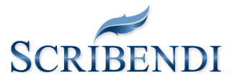
Editing
Notes:
Editing (12 minutes)
The editing process is as important as the writing process. You can use writing groups and online forums, family and friends to help with the editing process, but there are also a number of online editing services available.
Editing Services Online:
Scribendi
Kirkus Author Services
Allograph
First Editing
West Coast Editing Services
The editing company
(go through each one’s services page)

Slide 19
Cover Design
Notes:
Covers (10 minutes)
[something about the importance of a good cover]
Cover art:
DIY: http://www.hongkiat.com/blog/designing-book-covers/
Think about what you like best!
But once you have an edited book and cover in hand, you have everything you need to publish! Or are you?

Slide 20
Covers
DIY
Jo Sabin from DesignCrowd.com http://www.hongkiat.com/blog/designing-book-covers/
Completely Novel: http://completelynovel.com/self-publishing/writers-toolbox-cover-design
Publisher’s Weekly: http://www.publishersweekly.com/pw/by-topic/authors/pw-select/article/60851-diy-how-to-design-an-indie-book-cover.html
Notes:
Suggested size is 1600x2400 pixels for most websites.
http://ebookindiecovers.com/ebook-cover-size-requirementsspecifications/

Slide 21
Covers
Design Firms
Cover Design Studio: http://www.coverdesignstudio.com/
99 Designs http://99designs.ca/
Book Baby: http://www.bookbaby.com/ebook-cover-design
Notes:
Design Firms
Cover Design Studio: http://www.coverdesignstudio.com/
99 Designs http://99designs.ca/
Book Baby: http://www.bookbaby.com/ebook-cover-design
(go over and look at pricing pages again)

Slide 22
Formatting your Book
Notes:
Formatting your book (12 minutes)
Depending on the type of book that you have written and who your expected audience is, there are some tools you can use.
Sometimes you can do all of the formatting / publishing in one spot
Smashwords
Pressbooks
Accelio
inckle

Slide 23
Microsoft Word
Or other word processors can be used for formatting you book
Familiar interface
But, cannot see what readers will see until file is converted for sale
Notes:
Can also save as pdf (for ease of printing) or sharing an un-editable copy via email.

Slide 24
Step-by-step guide
Themes can be applied to your book
Do it yourself, or use their professional service (starting at $250)
http://guide.pressbooks.com
Notes:
Do a demo of editing content, showing how to add and remove content
Demo an export: login sfelkar & regular simple password.
Include the upgrade to remove promotion material in export$10 for one book. EBOOK PRO

Slide 25
A “Do it yourself” solution
They provide materials like video workshops and books with types on style, formatting, and marketing.

Slide 26
Multimedia Content
Allows for a feedback process
Aimed at business publications and guidebooks

Slide 27
Allows for interaction and multimedia
Mix computer skills and creative writing

Slide 28
Software for writing and creating your book
Available for Windows and Mac OSX

Slide 29
Offline Options
Easy: MS Word, Pages, Word Perfect
Medium: MS Publisher
Hard: Adobe InDesign, Quark Xpress
From: http://www.thebookdesigner.com/2010/11/book-design-page-layout-software-a-guide-for-diy-authors/

Slide 30
Publishing & Distributing Your Book
From: http://digital.westvanlibrary.ca/index.php/4132-wvml;dc

Slide 31
Things to consider
Keywords
Subject Headings
Description of the book (blurb) both short and long

Slide 32
File Types
EPUB: Ebook format
DOC: Common MS Word Format
DOCX: Newer MS Word Format
MOBI: version of Kindle format
ODT: Open Document (OpenOffice)

Slide 33
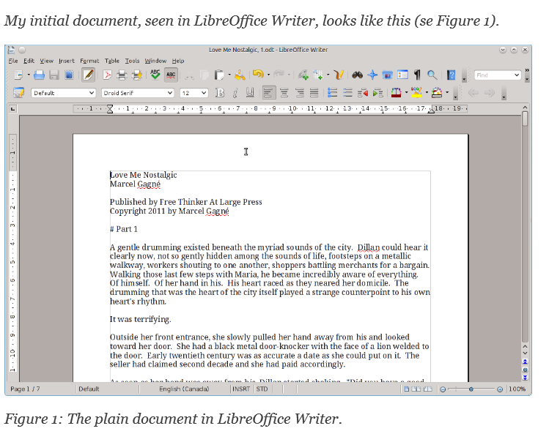
From: http://download.kobobooks.com/learnmore/writinglife/KWL-Content-Conversion-Guidelines.pdf

Slide 34
Formatting Tip
If you are using Word, Pages, or other word processing software, use Headings
Ex. Heading 1 for Chapter headings

Slide 35
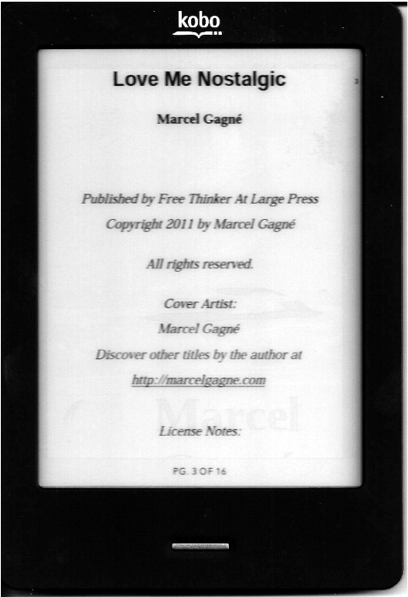
Formatting Tip
Centre your front matter

Slide 36
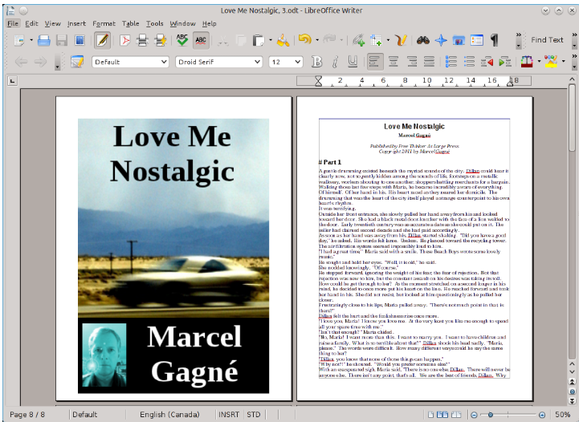
Notes:
Add cover in the ebook doc

Slide 37
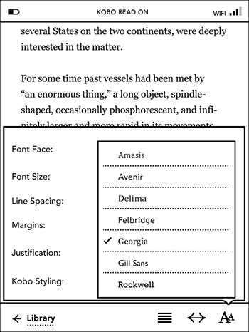
Formatting Tip
Don’t get too creative!
Readers will want to change font size and other aspects, but may not be able to if you use complex formatting.

Slide 38
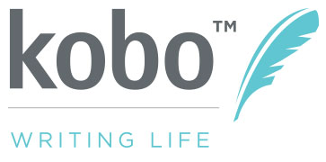
Notes:
Publishing & Distributing Your Book (12 minutes)
Kobo Writing Life:
(Includes pay structure info) http://www.pocket-lint.com/news/122530-kobo-writing-life-makes-it-easy-for-authors-to-publish-their-ebooks-in-just-five-steps
Kindle Direct
Payment method info: https://kdp.amazon.com/self-publishing/help?topicId=AE24XS35AM53P
Kindle’s Create Space
Book Baby: http://www.bookbaby.com/ebook-services
Smashwords
How to publish on smashwords - http://www.smashwords.com/about/how_to_publish_on_smashwords
LuLu
This is a long established self-publishing platform, it has been around since the early 2000’s. Mostly used for print materials, it does have an e-publishing side as well.
iBooks:
If a fee is charged for the work and it is in the .ibooks format, the work may only be sold through the iBooks Store. If the work is in a different format, such as PDF or ePub, this restriction does not apply.

Slide 39
Have your book ready
Upload information
Choose price
Choose markets
Paid 2x a year
Notes:
Use Kobo as an uploading example
Personal Information that they need:
Enter your email and password
Enter your name, publisher name (optional), email (auto-populates from previous page), phone (optional) and PREVIOUS Kobo publishing account ID – if applicable
Scroll down to input country, street address, city, state, zip
Accept terms of service
Respond to email to confirm registration
Enter payment information – bank, routing number, branch address, etc, and save info
Click on “ebooks” in the top right menu bar
Click on “create a new ebook”

Slide 40
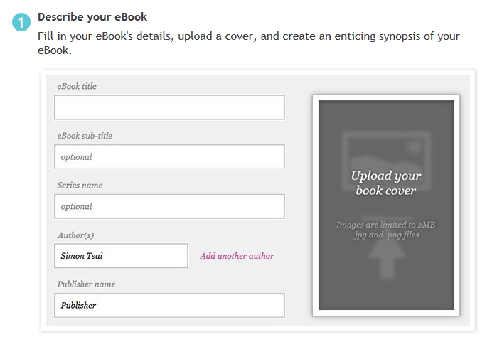

Slide 41
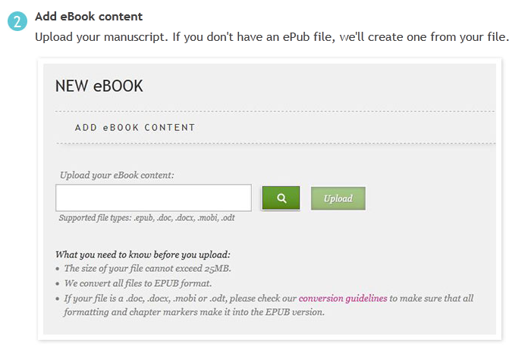

Slide 42
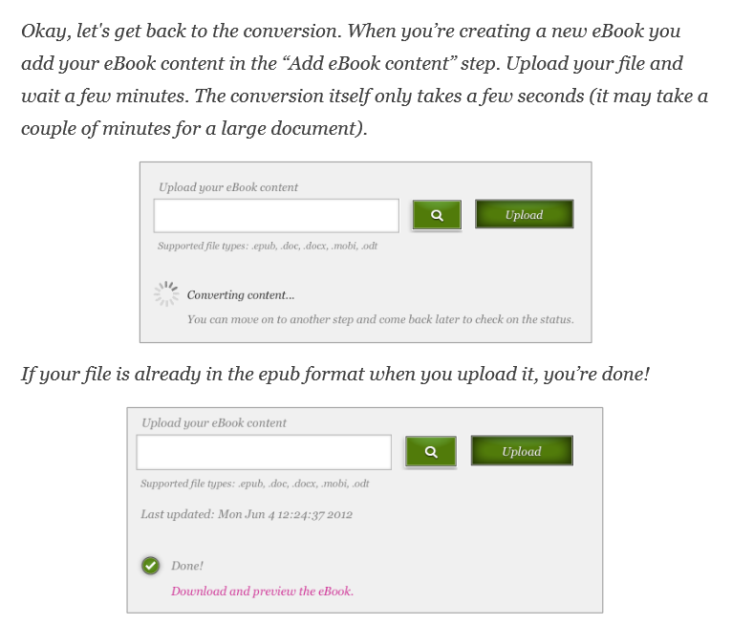

Slide 43
Notes:
This is your chance to check the book for formatting errors, and the look and feel before it goes public

Slide 44
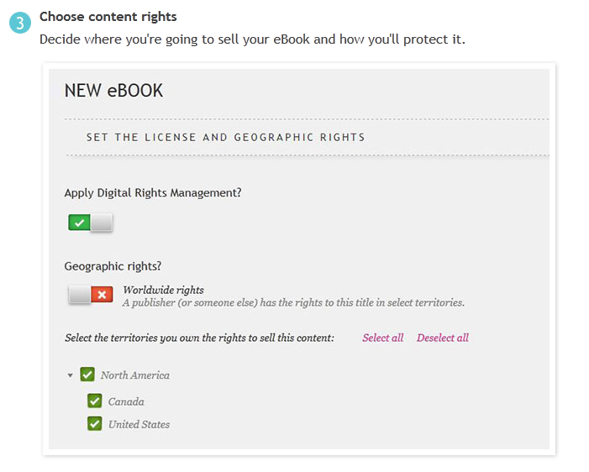

Slide 45
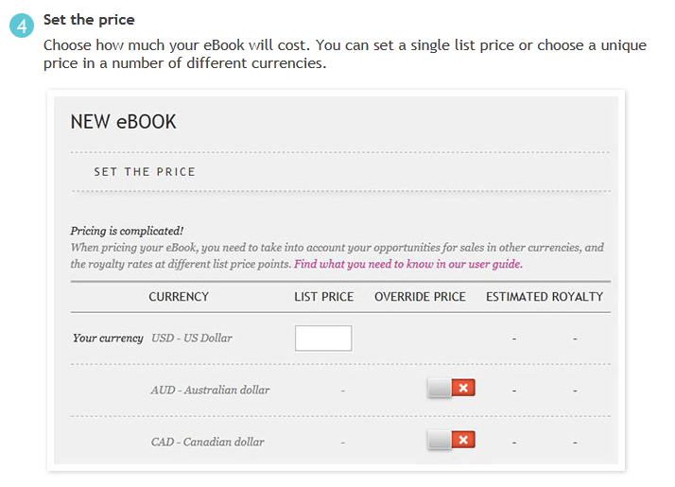

Slide 47
You have your book ready to publish and distribute
Earn up to 70% royalty

Slide 48
Free and paid services
Print items
Owned by Amazon

Slide 49
You pay to have this service distribute your book
After the initial payment, you collect all revenues

Slide 50
Distribute through as many channels as you wish
Earn 60% of price from retailers, and 85% of price from Smashwords
No other cost
Provide publishing resources

Slide 51
Ebooks or print books
Paid services available
Company has been in service since 2002

Slide 52
iBooks
If you publish in .ibooks format you can not publish your book anywhere else.
If you use EPUB, you can distribute elsewhere.

Slide 53
Getting Reviews
From: http://digital.westvanlibrary.ca/index.php/4046-wvml;dc
Notes:
Getting Reviews (5 minutes)
This is the last section of the talk, but still an important one. How do you get reviews on your book?
Be present online, start a blog, go on social media, find a way to get in contact with the people you think will enjoy reading your book.
There are a few “pay for review” services from reputable vendors, they rarely promise a positive review – which is how you know that they have a good reputation.
A free and easy place to start looking for reviews is Goodreads. This site allows you to do giveaways of your book to reviewers, and to network with other authors.
Here is a sampling of some posts on getting reviews, and I found this great list of tips for getting book reviews from Writer’s Digest that I wanted to share with you (read tips).
It is time to wrap up, these slides are available to you on our website [], because it will take time to find out what will work best for you, your book, and your audience.
Thank you.
Also: Blue Ink Reviews (pay for a review) http://www.blueinkreview.com/features-and-services/authors/how-it-works
Publishers Weekly Select: http://www.publishersweekly.com/pw/diy/index.html
http://www.theguardian.com/books/series/self-publishing-showcase

Slide 54
Start a blog
Share snippets of your writing
Discuss your inspirations
Talk about your process

Slide 55
Interact with authors and bloggers
Comment on blog posts by authors / readers / editors
Be part of the community

Slide 56
Paid review service ($475-$575)
Industry leader
Un-biased review
They choose 2 indie-reviews for each publication of their magazine

Slide 57
Many authors, both self-published and traditionally published will host book give-aways in the hope of gaining reviews
Be wary of some of the offers, apparently “review exchanges” can be seen as troublesome

Slide 58
Lists & Tips
Get Reviews for Your Self-Published Book http://blog.bookbaby.com/2013/08/get-reviews-for-your-self-published-book/
“Getting Your Book Reviewed” http://www.outboxonline.com/authors/book-review-submission/
“How To Get Book Reviews Without Spending (Too Much) Money” http://www.thecreativepenn.com/2012/03/28/get-book-reviews/
Book Blogger Directory: http://bookbloggerdirectory.wordpress.com/

Slide 59
Pick the right reviewers. This is the single most important thing you can do to help your review program. Find out what kind of books the reviewer likes to review, and only select appropriate reviewers.
(http://www.writersdigest.com/editor-blogs/there-are-no-rules/marketing-self-promotion/how-to-get-reviews-for-self-published-books)

Slide 60
Query the reviewers. Check each reviewer’s requirements. Some want you to just send the book, but many ask for a query. Some review e-books, many do not. Conforming to their requirements saves both of you time.
(http://www.writersdigest.com/editor-blogs/there-are-no-rules/marketing-self-promotion/how-to-get-reviews-for-self-published-books)

Slide 61
3. Send the book. In your query make sure to offer both versions of the book, the PDF and the print copy, or both.
(http://www.writersdigest.com/editor-blogs/there-are-no-rules/marketing-self-promotion/how-to-get-reviews-for-self-published-books)

Slide 62
4. Follow up. Don’t stalk or harass the reviewer, who is probably doing this in her spare time. But if you haven’t heard anything after a few weeks, follow up to see if they still intend to write the review.
(http://www.writersdigest.com/editor-blogs/there-are-no-rules/marketing-self-promotion/how-to-get-reviews-for-self-published-books)

Slide 63
5. Thank the reviewer. It’s common courtesy, but it also shows you appreciate the time and effort someone else took to help bring your book to the attention of more people.
Tips from: http://www.writersdigest.com/editor-blogs/there-are-no-rules/marketing-self-promotion/how-to-get-reviews-for-self-published-books

Slide 64
Other Resources
Smashwords Ebook Publishing Workshops: http://blog.smashwords.com/2013/10/smashwords-ebook-publishing-workshops.html
Editors’ Association of Canada: http://blog.editors.ca/
Author Learning Center: https://www.authorlearningcenter.com/
Free Sites to Promote Your eBook: http://www.mediabistro.com/galleycat/free-ebook-promotion_b52130

Slide 65
Other Resources
The Book Designer: http://www.thebookdesigner.com/
Self-Publishing on Writers’ Digest: http://www.writersdigest.com/editor-blogs/there-are-no-rules/self-publishing
The Creative Penn: http://www.thecreativepenn.com/2013/01/15/how-to-publish-a-book-101/

Slide 66
“This is the best time in history to be a writer”
- Mark Coker, CEO, Smashwords

Slide 67
