Slide 1
Blogging 101

Slide 2
Today
What is ‘blogging’?
Blog vs. Website
Examples
Demo
Questions

Slide 3
WHAT IS A BLOG?
Notes:
Mechanics
History

Slide 4
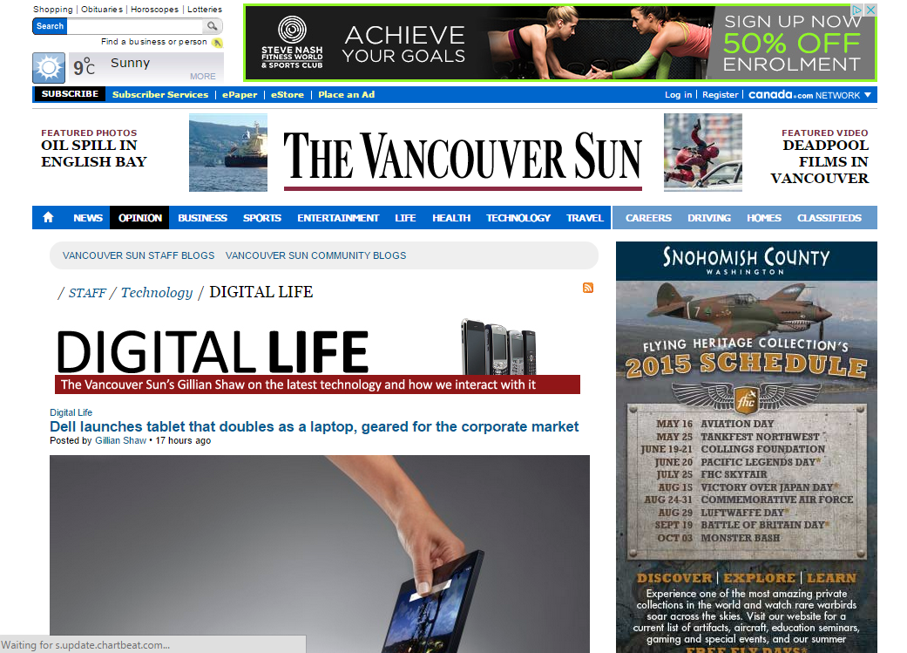

Slide 5
Blog vs. Website

Slide 6
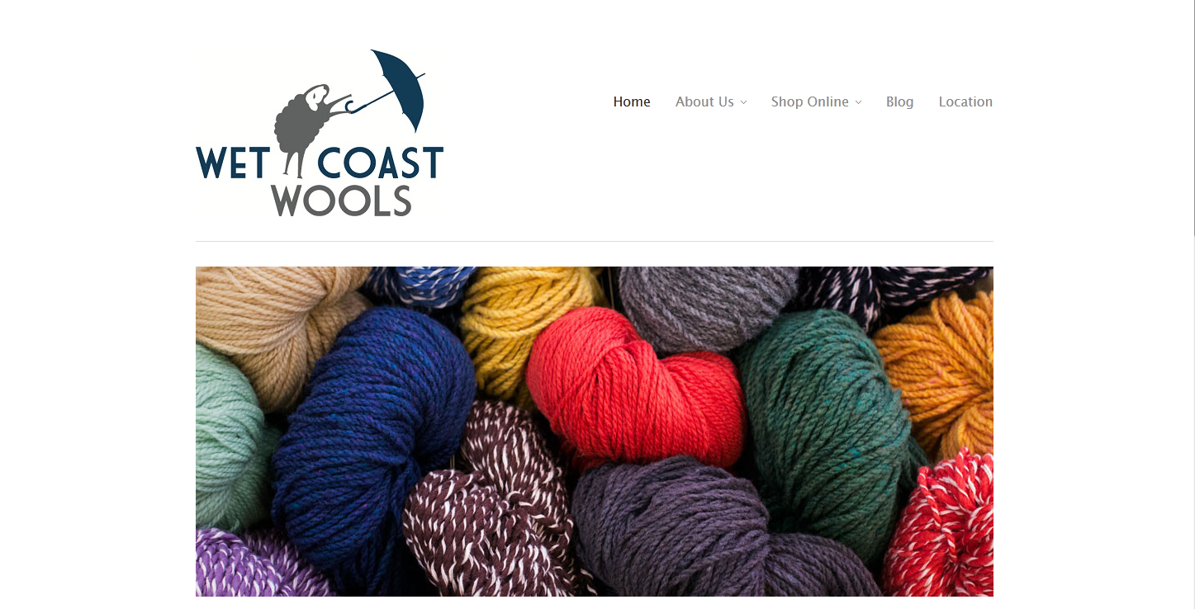

Slide 7
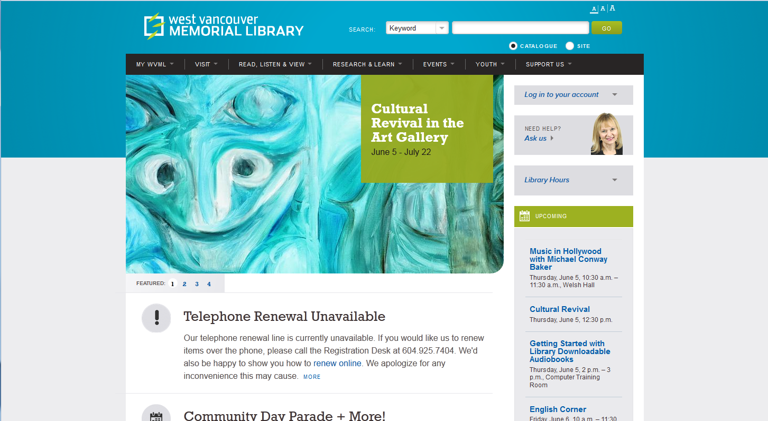

Slide 8
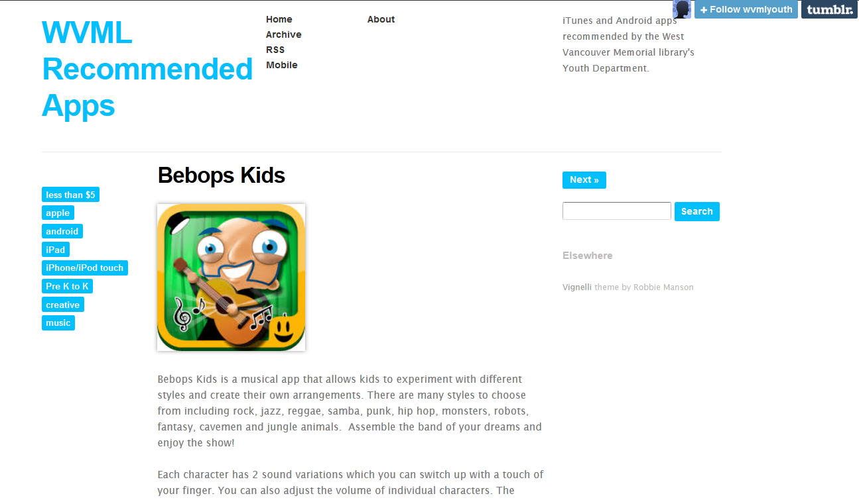

Slide 9
Type of Blogs

Slide 10
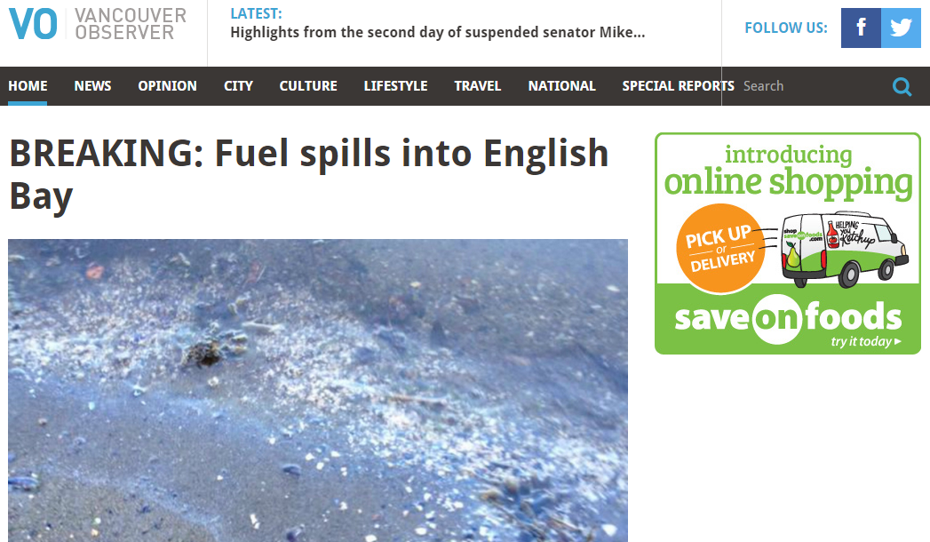
Vancouver Observer
Notes:
Policatal / News Blog
There are many political and news blogs, and news blogs from a certain political stance

Slide 11
VanCity Buzz

Slide 12
StatCan Blog

Slide 13
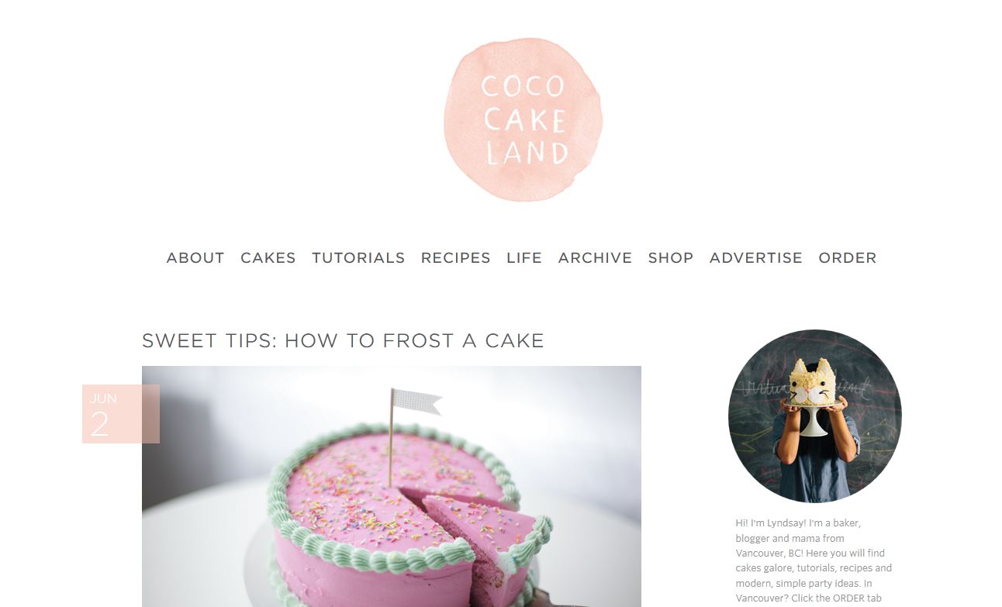
Coco Cake Land
Notes:
Food blogs!
They are everywhere and inspire, share information, and make you feel inadequate

Slide 14
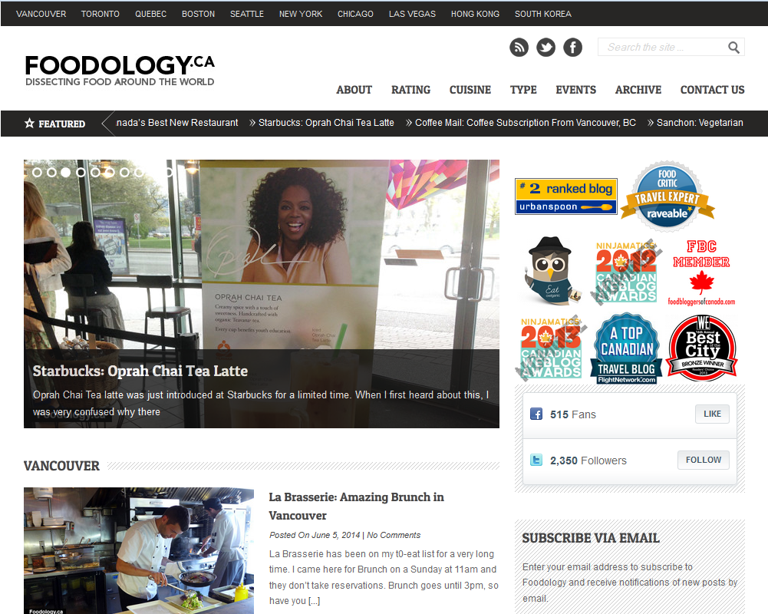
Foodology.ca

Slide 15
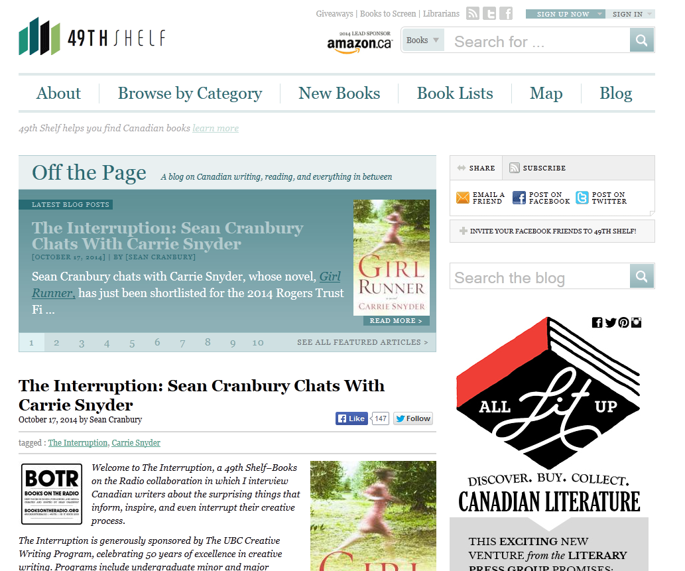
49th Shelf

Slide 16
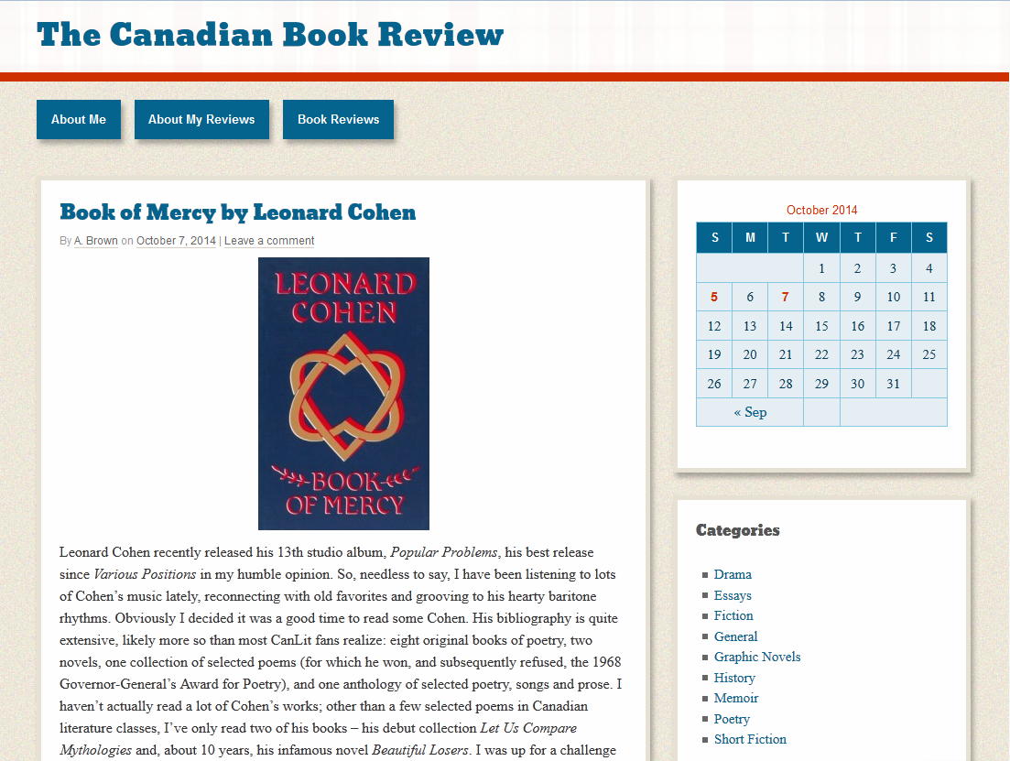
The Canadian Book Review

Slide 17
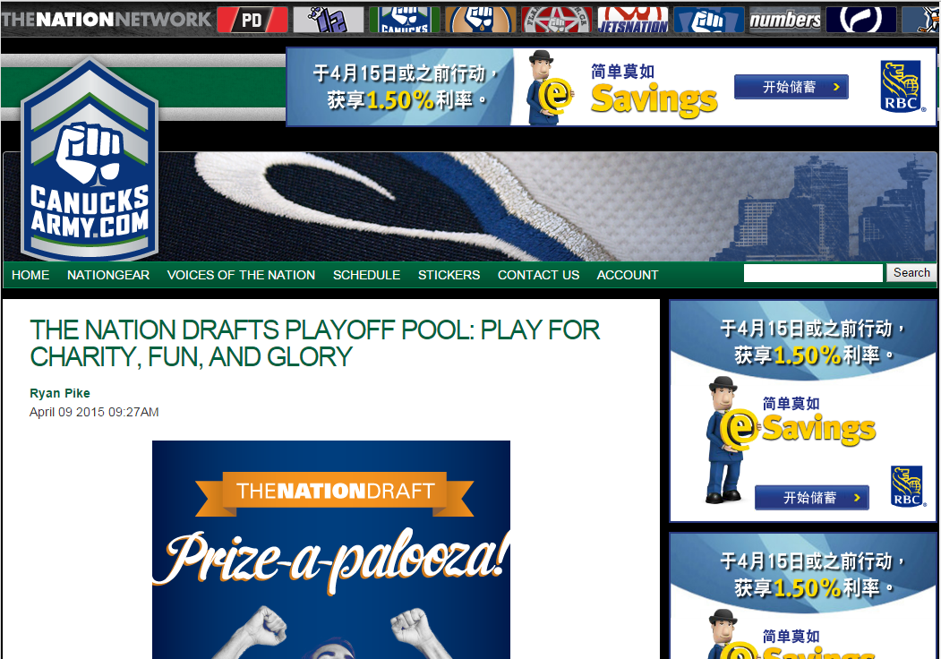
Canucks Army
Notes:
Sports Blogs

Slide 18
Lookout Landing

Slide 19
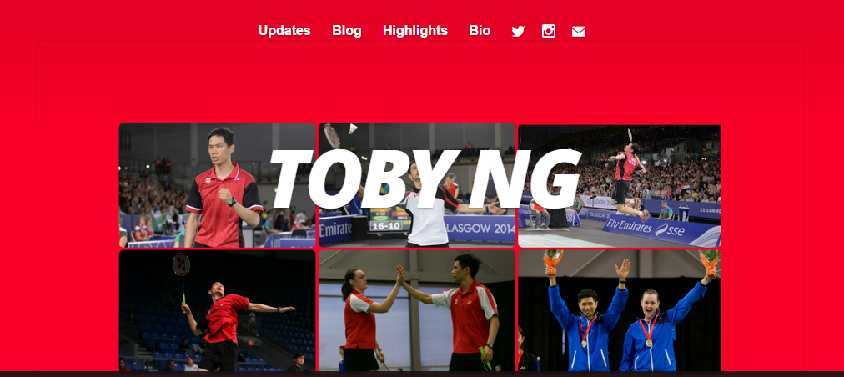
Toby Ng

Slide 20
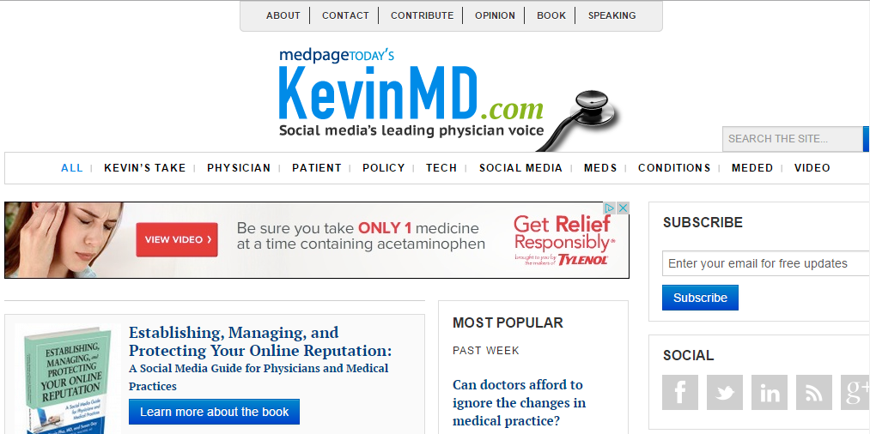
KevinMD

Slide 21
The Old Lady in my Bones

Slide 22
Kyla Bidgood Interior Design

Slide 23
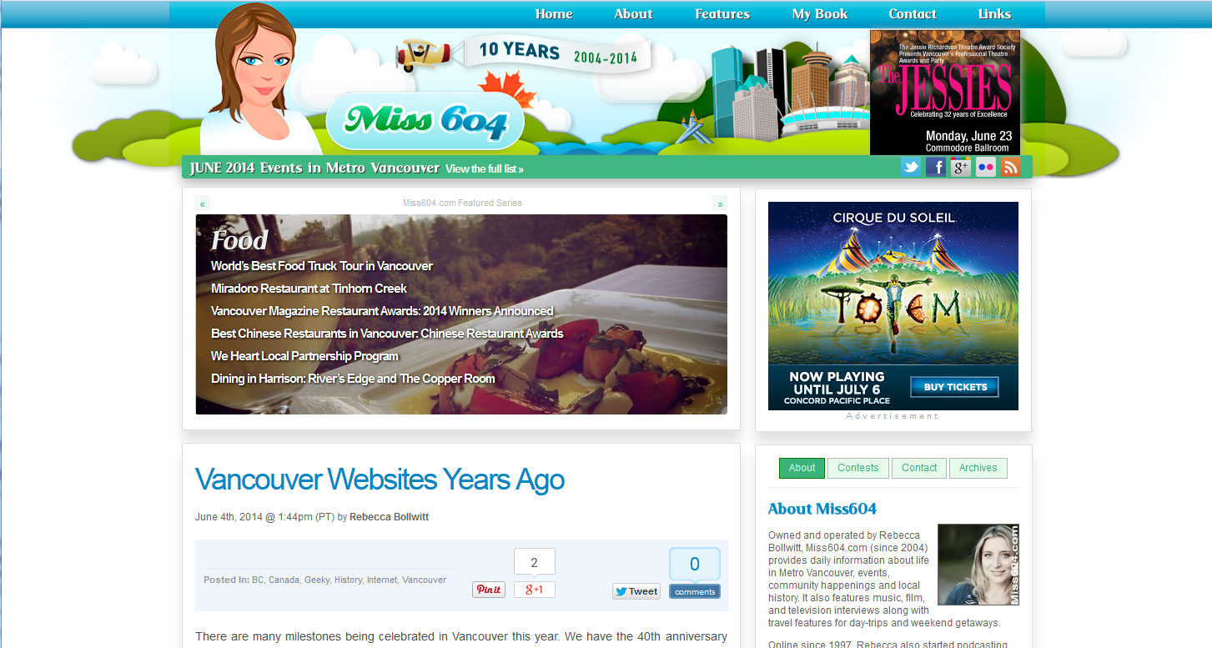
Miss604

Slide 24
Demo

Slide 25
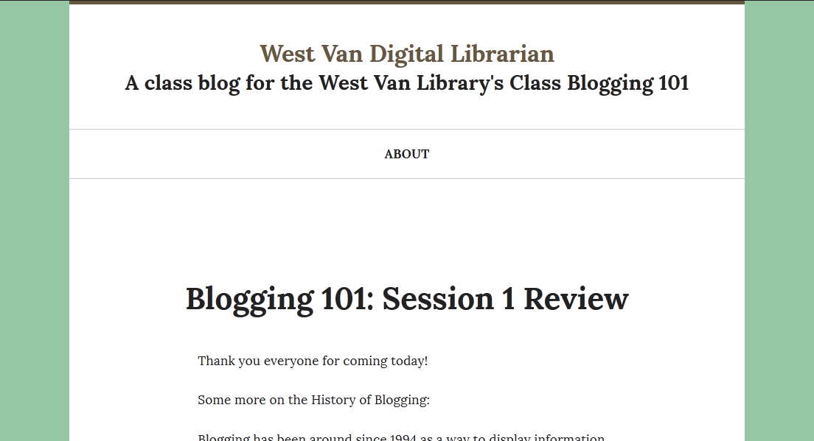

Slide 26
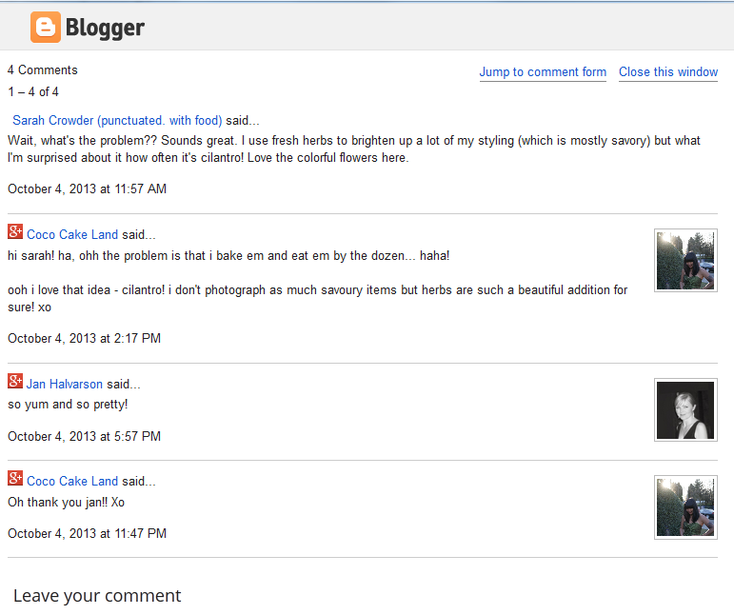
Comments

Slide 27
Next Week
Creating your own blog!
Expect an email shortly with what to prepare.

