Slide 1
CBAL-KLF Workshops Fall 2015 (focus on library services for seniors using iPads)
Presented by Sabina Iseli-Otto, BC Libraries Co-operative

Slide 2
Books in accessible formats for people with print disabilities.
NNELS = National Network
for Equitable Library Service

Slide 3
The Copyright Act
severe or total impairment of sight or hearing or the inability to focus or move one’s eyes,
the inability to hold or manipulate a book, or
an impairment relating to comprehension.

Slide 4
The Copyright Act
prescriptive
What matters: format.
If we change the format – not content – can your patron read the book?
If “yes”: eligible.

Slide 5
The Copyright Act
Q: What about low literacy or ESL learners?
A: Only if they have print disabilities.
(Many people with low literacy also have print disabilities.)

Slide 6
The Copyright Act
Sample forms available at:
librarytoolshed.ca
(search “NNELS”)
Using forms?
Remember: patron privacy is #1.

Slide 7
The Copyright Act
Reproduction in alternate format
32. (1) It is not an infringement of copyright for a person with a perceptual disability, for a person acting at the request of such a person or for a non-profit organization acting for the benefit of such a person to
(a) make a copy or sound recording of a literary, musical, artistic or dramatic work, other than a cinematographic work, in a format specially designed for persons with a perceptual disability;
(b) translate, adapt or reproduce in sign language a literary or dramatic work, other than a cinematographic work, in a format specially designed for persons with a perceptual disability; or
(c) perform in public a literary or dramatic work, other than a cinematographic work, in sign language, either live or in a format specially designed for persons with a perceptual disability.
Limitation
(2) Subsection (1) does not authorize the making of a large print book.
Limitation
(3) Subsection (1) does not apply where the work or sound recording is commercially available in a format specially designed to meet the needs of any person referred to in that subsection, within the meaning of paragraph (a) of the definition “commercially available”.

Slide 8
NNELS is ONLY for People with Print Disabilities
No digital rights management (DRM)
= content is very accessible
= it helps to be careful

Slide 9
Requesting Books
Request form available to logged-in users.
People in communities can record books for NNELS using:
a microphone
headphones
a computer
free, open-source software

Slide 10
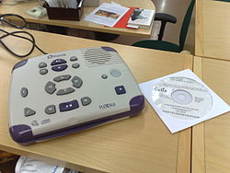
NNELS Formats
Audio: DAISY (Digital Accessible Information System) + MP3
E-text: RTF
+ PDF
+ EPUB
Audio + text: DAISY
EPUB

Slide 11
NNELS for iOS & Android Devices
At the time of these workshops, we know of only one app that allows direct-to-device downloading from NNELS: the Voice Dream app.
Other DAISY apps require transferring files from computers to devices.

Slide 12
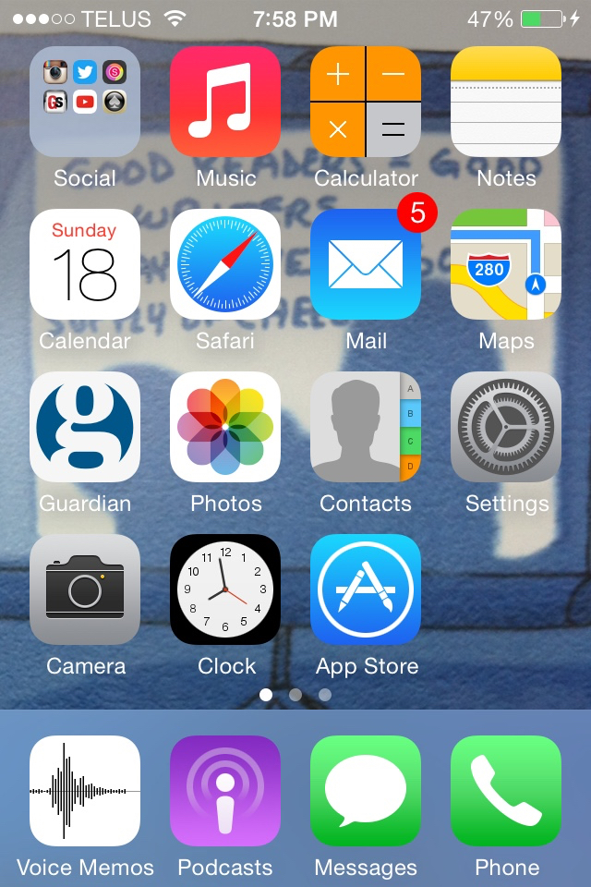

Slide 13
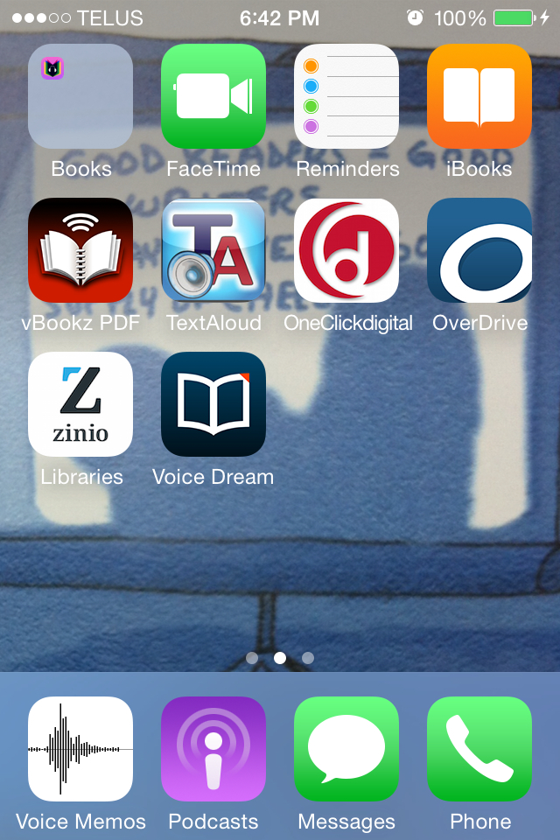

Slide 15
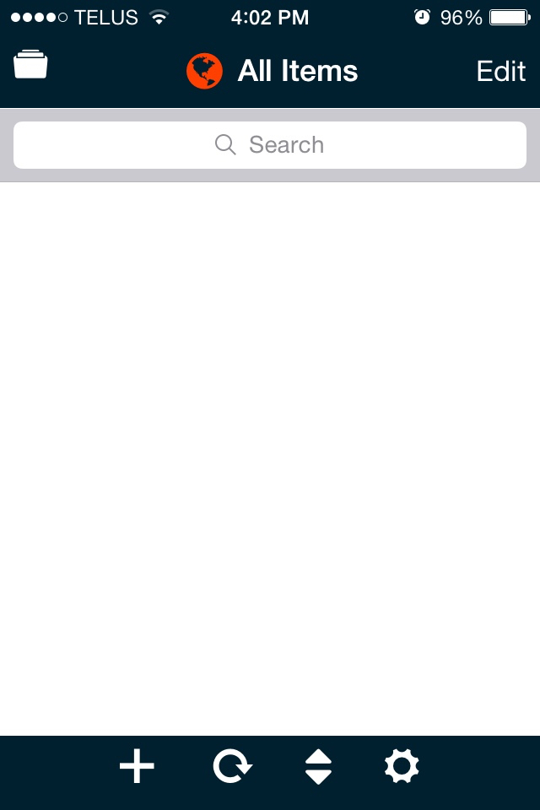

Slide 16
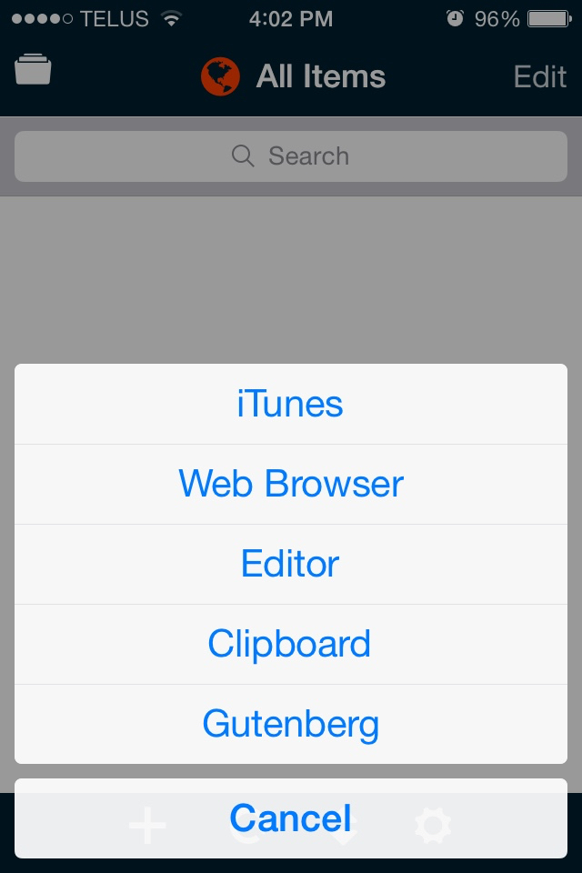

Slide 17
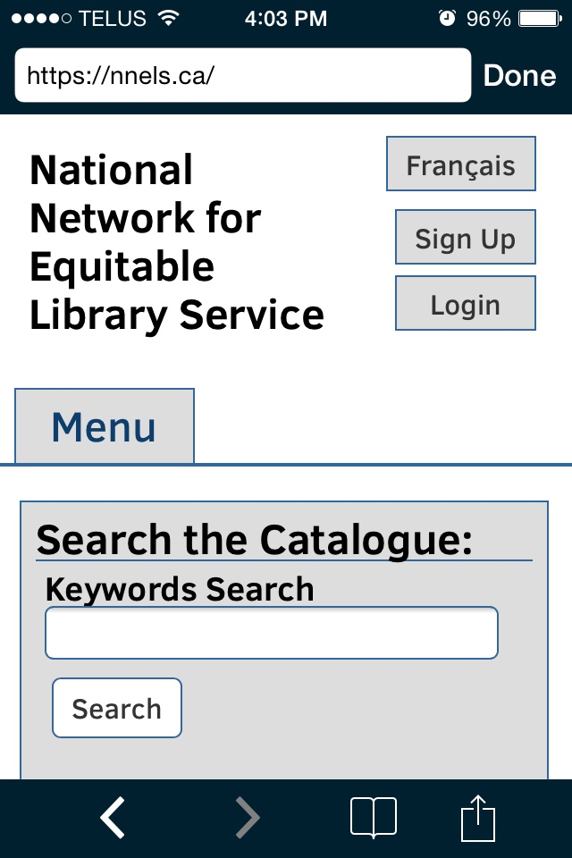

Slide 18
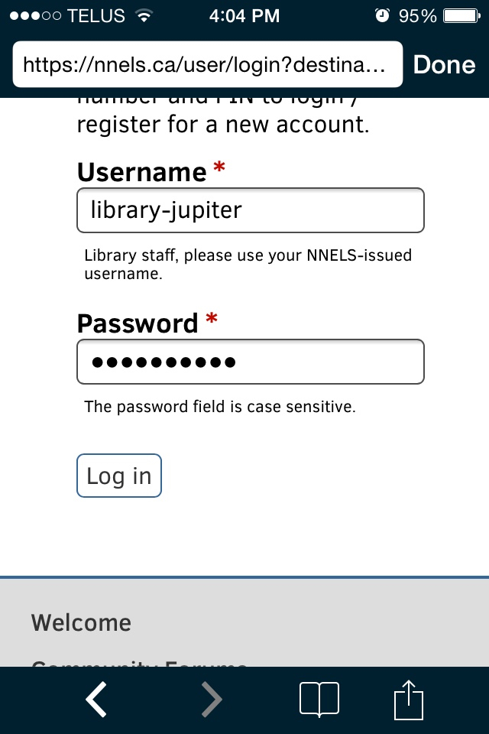

Slide 19
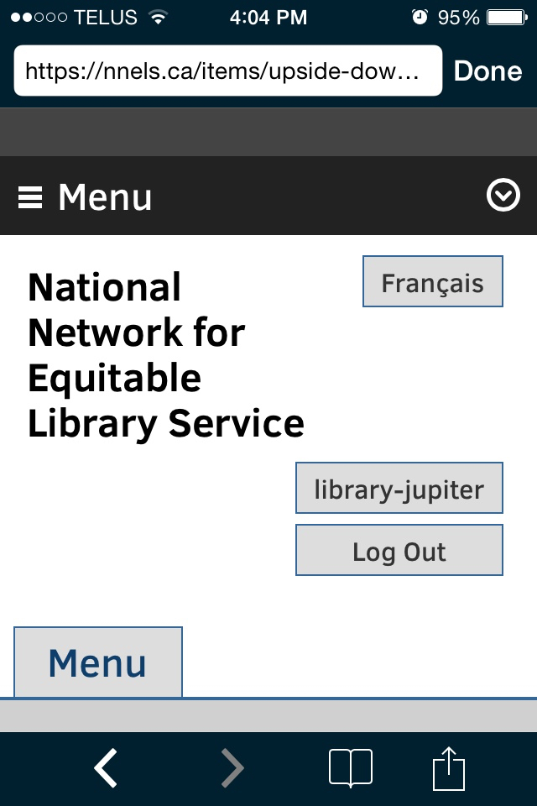

Slide 20
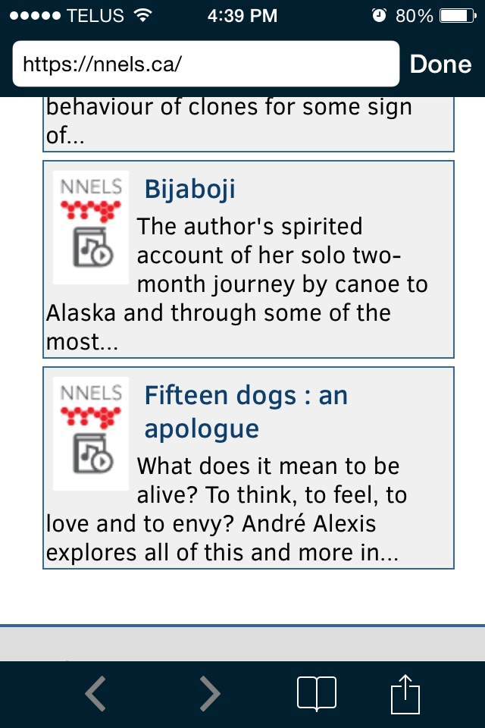

Slide 21
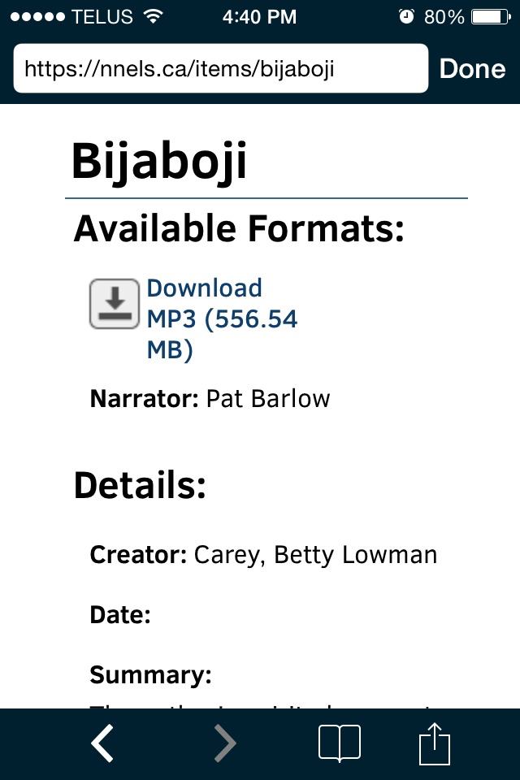

Slide 22
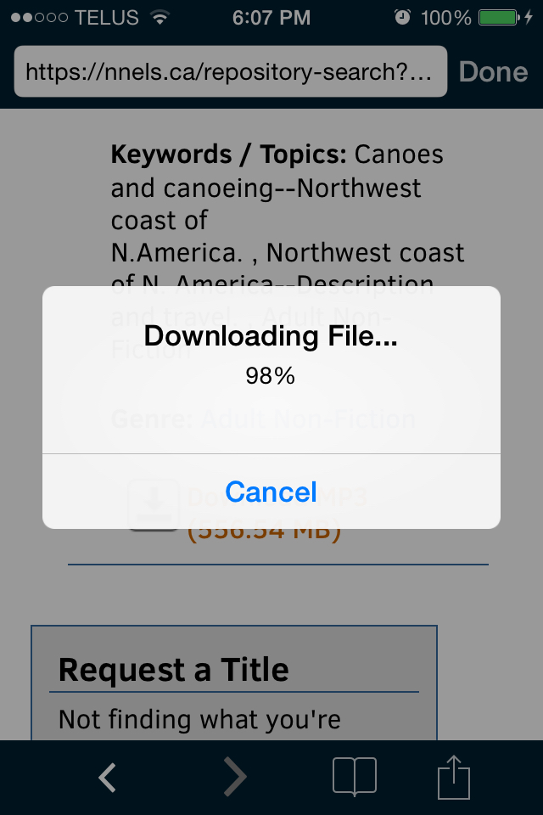

Slide 23
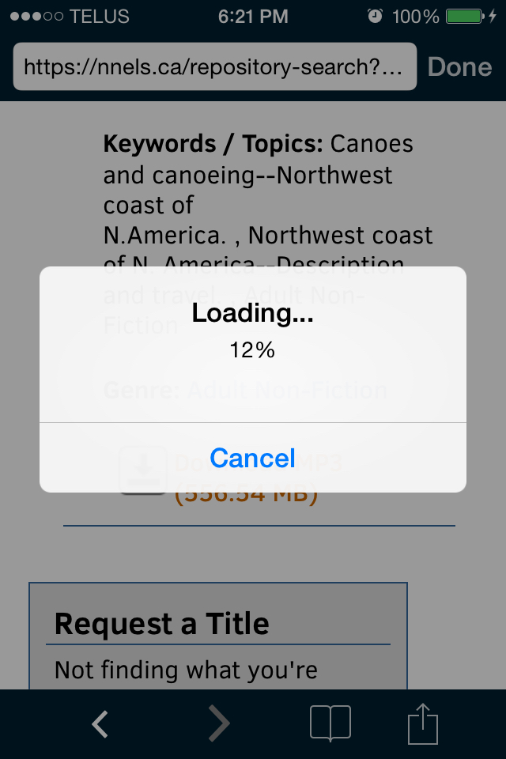

Slide 24
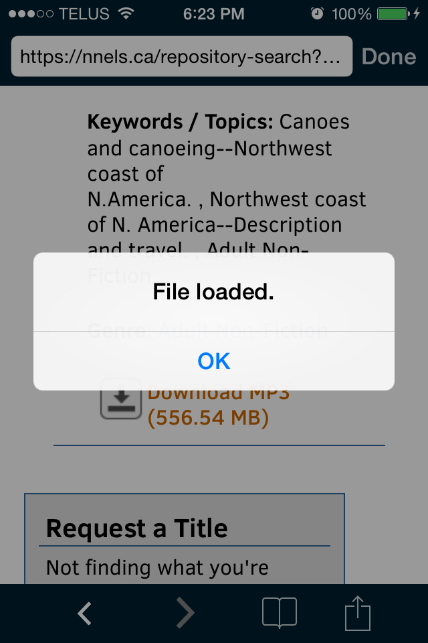

Slide 25
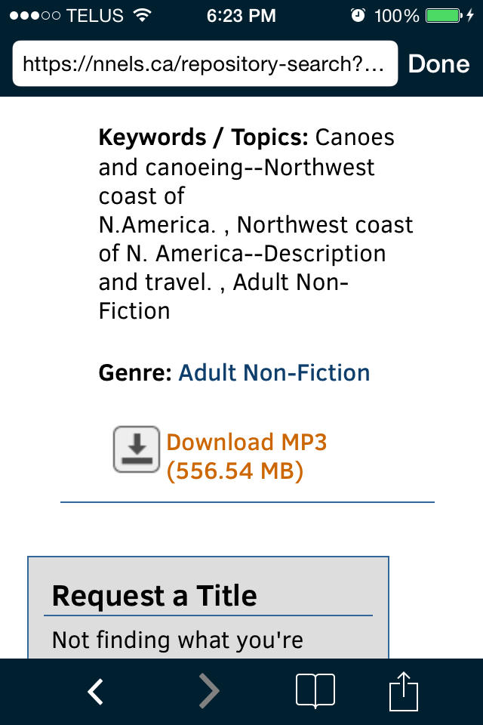

Slide 26
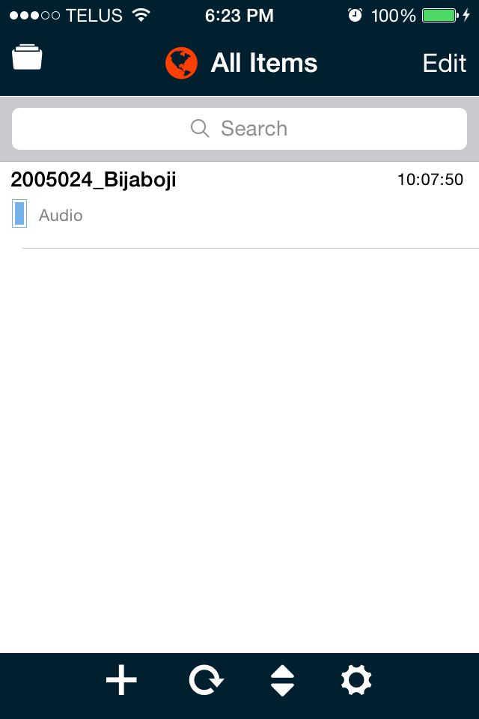

Slide 27
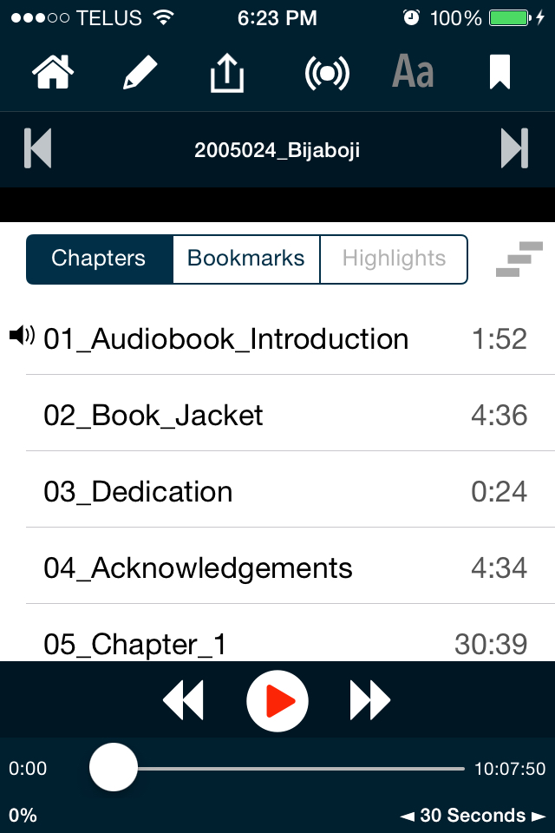

Slide 29
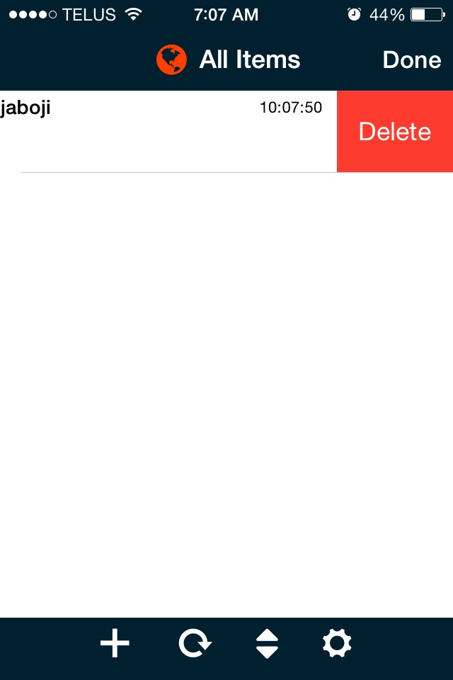

Slide 30
NNELS Website Tips
Step-by-step instructions are located on our “Tutorials” page.
There’s good stuff to be found in “Our Collections”, linked from front page.
“Apple Somebody” is a synthetic narrator.
New titles are announced on our Twitter page (twitter.com/nnelsca).
We welcome (!) questions and comments by email and phone; contact info at the bottom of every page on NNELS site.

Slide 31
Being a Library Accessibility Advocate
Accessibility for Ontarians with Disabilities
Act
Independence
Dignity
Integration
Equal Opportunity

Slide 32
Being a Library Accessibility Advocate
~10% of Canadians have a print disability

Slide 33
Being a Library Accessibility Advocate
GTT: “Getting Together with Technology” program, via Canadian Council of the Blind
Contact them to find out if there are local people who would like to meet at the library to share tech knowledge with others.

Slide 34
Being a Library Accessibility Advocate
Many libraries have DAISY or MP3 players for loan or demonstration.

Slide 35
Worlds to Explore
AppleVis: applevis.com
(Useful for anything related to Apple products& accessibility)

Slide 36
Worlds to Explore
Dyslexie: dyslexiefont.com

Slide 37
Worlds to Explore
Search:
Operating system
(e.g. “Ubuntu”, “Windows 8” or “OSX” )
+
“accessibility features”

Slide 38
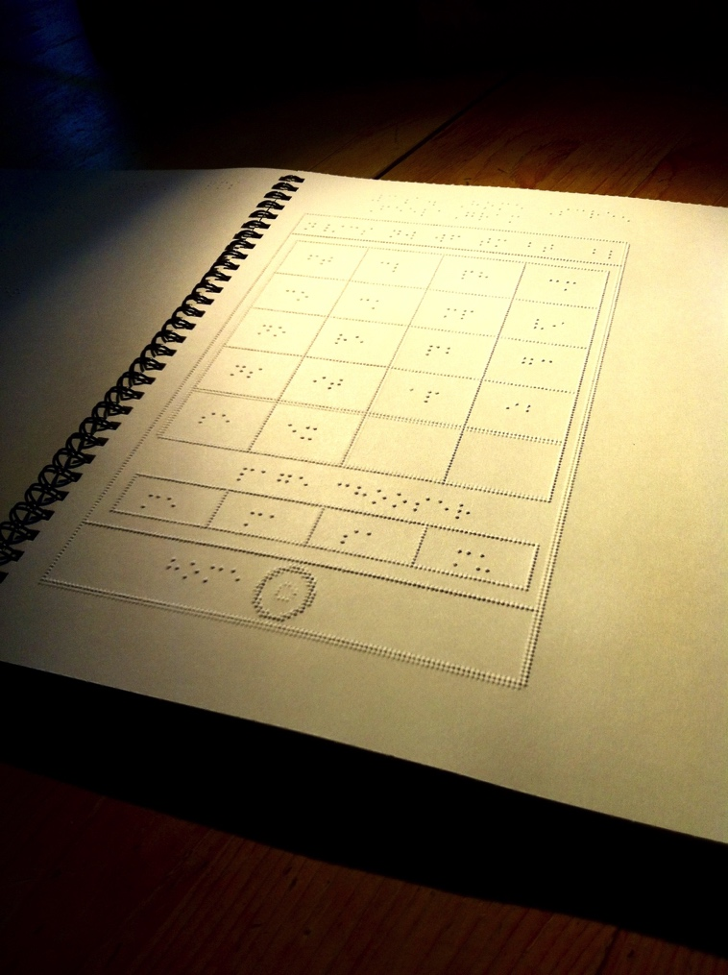
Worlds to Explore
iFeelagrams
Tactile Screenshots for iPad and iOS
Published by National Braille Press.

Slide 39
Worlds to Explore
VoiceOver (on Mac computers or iOS devices such as iPods, iPads, and iPhones)
Videos (on YouTube):
- RNIB
- search “Shane Aguilera iPad”

Slide 40
More Free, Quality, Content
Librivox
Project Gutenberg
Podcasts

Slide 41
Best Advice
“Relax! We know about blindness; you know about libraries. Let's both enjoy learning something new.”
- Mary Ellen Gabias
President, Canadian Federation of the Blind

Slide 42
“A library in the middle of a community is a cross between an emergency exit, a life-raft and a festival. They are cathedrals of the mind; hospitals of the soul; theme parks of the imagination. On a cold rainy island, they are the only sheltered public spaces where you are not a consumer, but a citizen instead.”
- Caitlin Moran

Slide 43
“In all honesty, I did not know that reading could be so much fun. Thank you for lighting my fire.”
- Anonymous Returning Reader

Slide 44
Happy reading!

Slide 45
Fun with Tech (and Reading)
Brought to you by :
BC Libraries Cooperative
Columbia Basin Alliance for Literacy
Kootenay Library Federation
Slides created by Sabina Iseli-Otto (support@nnels.ca), October 2015. No copyright on these contents, so please feel welcome to modify and share as you wish.
This project is funded by the Government of Canada’s New Horizons for Seniors Program.

