Slide 1
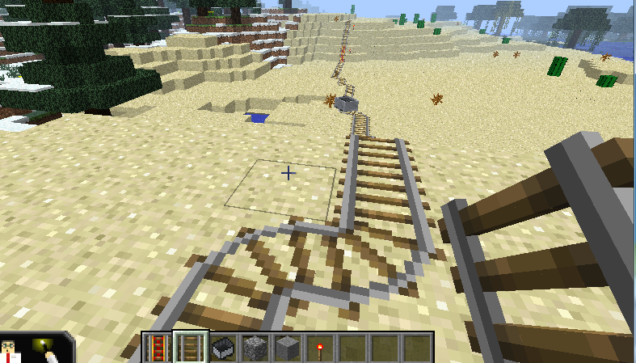
MinecraftEdu Program:
Train Stations
Setup
Explore Your World
Building Train Tracks
About APLEN

Slide 2
MinecraftEdu Program:
Train Stations
Introduction
Minecraft is a popular world building video game that enables its user to build, collaborate and innovate using virtual building blocks.
MinecraftEdu is a version of Minecraft that allows educators and library staff to easily set up local Minecraft games for their patrons.
In Castle Fun! Libraries are able to set up a program where participants collaborate to build castles and then defend them against each other.
Using MinecraftEdu and APLEN Mobile Laptop labs, and staff can easily set up a fun dynamic program for library patrons that involves collaboration, content creation and a lot of fun!
Setup
Explore Your World
Building Train Tracks
About APLEN

Slide 3
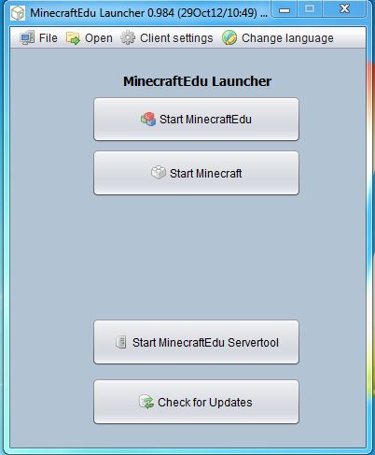
MinecraftEdu Program:
Train Stations
Setting up the MinecraftEdu Server
If you have not already done so, set up a network. Connect all of the computers you are planning on using for MinecraftEdu to the network. (If you are unsure of how to do this, please check the APLEN Training Centre at tc.aplen.ca for resources on how to set up a network).
Run the MinecraftEdu Launcher and Start a new server.
Setup
Explore Your World
Building Train Tracks
About APLEN
Click Here

Slide 4
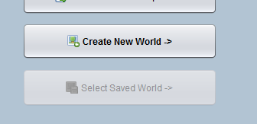
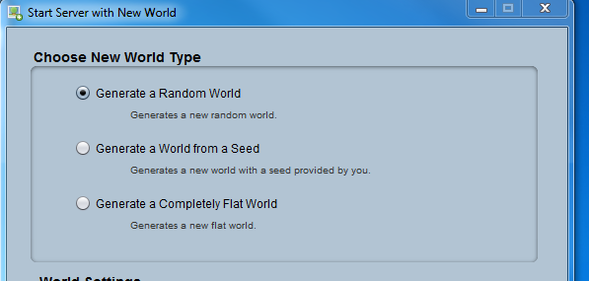
MinecraftEdu Program:
Train Stations
Setting up the MinecraftEdu Server
Click “Create New World”
Leave “Generate a Random World” and then click “Start Server with New World”
Setup
Explore Your World
Building Train Tracks
About APLEN

Slide 5
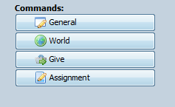
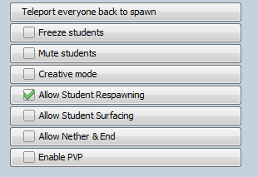
MinecraftEdu Program:
Train Stations
Setting up the MinecraftEdu Server
Under commands, click “General”
Select “Creative Mode” and “Allow Student Respawning” (For some reason the creative button doesn’t get a check box when clicked, but don’t worry it works).
Click on World and uncheck “Night” and “Weather effects” (Make sure to keep this window handy, you can use it to change the settings for the game).
Setup
Explore Your World
Building Train Tracks
About APLEN

Slide 6
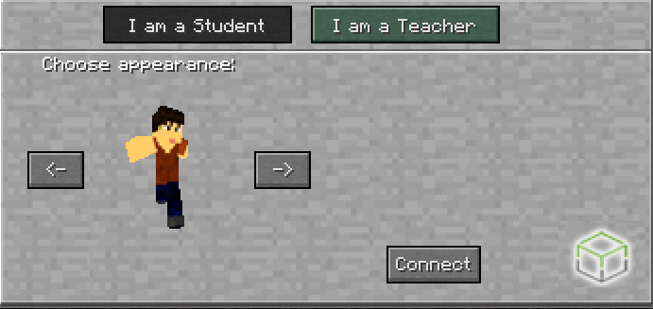
MinecraftEdu Program:
Train Stations
Join the MinecraftEdu Server
Go back to the MinecraftEdu Launcher and connect to the MinecraftEdu Game you have just set up. (If you do not know how to do this, consult with the resources available on the APLEN Training Centre).
Make sure that when prompted you choose Teacher.
Setup
Explore Your World
Building Train Tracks
About APLEN

Slide 7
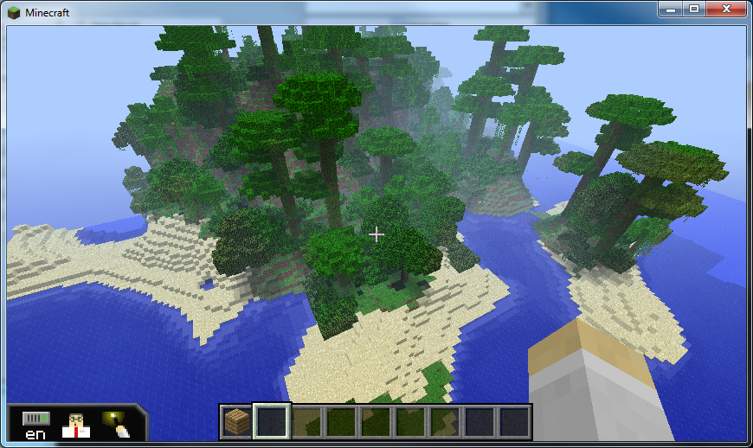
MinecraftEdu Program:
Train Stations
Explore Your World
Congratulations, you have now created a new Minecraft world!
Once you are, explore the world to find a good starting point for your train tracks. The best way to do this is by flying (For more information on the MinecraftEdu controls, check the APLEN Training Centre).
To start flying, double tap the “space bar”. To increase altitude press the “space bar”, to decrease press the “shift” key.
Setup
Explore Your World
Building Train Tracks
About APLEN

Slide 8
MinecraftEdu Program:
Train Stations
Explore Your World
Once you have found a suitable location for beginning the train tracks, you can teleport all of the program participants to your location.
Press “P” to open the teacher menu and then click the “Teleport Students Here” Button. All of the participants in the game will then be brought to your location.
Setup
Explore Your World
Building Train Tracks
About APLEN

Slide 9
MinecraftEdu Program:
Train Stations
Getting Ready to Train Tracks
Setup
While in creative mode, students are able use any resources they want by pressing the “e” button and then dragging them into their “active dock”
For building train tracks they will need powered rail, rail, and redstone torch and button.
Explore Your World
Building Train Tracks
About APLEN

Slide 10
MinecraftEdu Program:
Train Stations
Laying your Train Tracks
Setup
When laying tracks down, remember that in order to power your “powered rails” you will need to place redstone torches next to them.
Also, remember that powered are not able to bend, whereas normal rails can bend.
For more information using rails in Minecraft check out the MinecraftWiki (www.minecraftwiki.net)
Explore Your World
Building Train Tracks
About APLEN

Slide 11
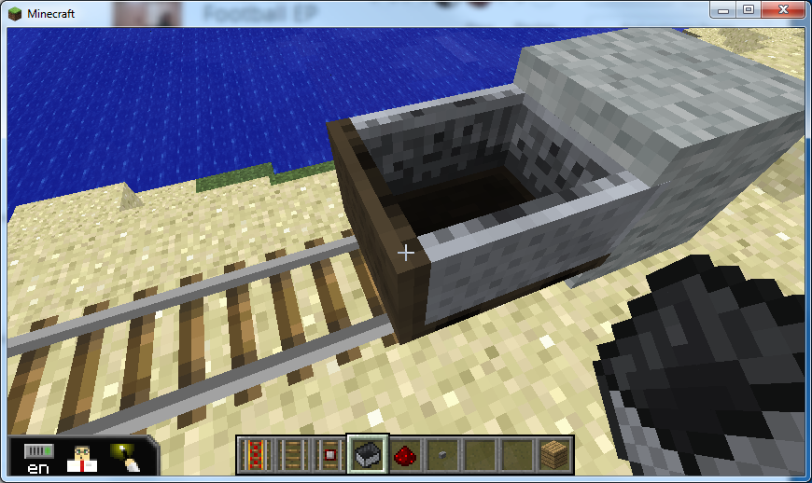
MinecraftEdu Program:
Train Stations
How to get your Cart to Move
You use carts to travel on your tracks. After you place a cart on the tracks, you enter it by right clicking.
Setup
Explore Your World
Building Train Tracks
About APLEN

Slide 12
MinecraftEdu Program:
Train Stations
Getting Your Cart Rolling
One way to get a cart to move forward is to place a powered rail and then place a block nearby with a button and a torch on it. When you press the button, the torch will temporarily turn on the rail and then send your cart accelerating.
Setup
Explore Your World
Building Train Tracks
About APLEN

Slide 13
v
MinecraftEdu Program:
Train Stations
Creating Assignments
Don’t forget, you can send your participants “Assignment” by using the MinecraftEdu Teacher Menu
Setup
Explore Your World
Building Train Tracks
About APLEN

Slide 14
v
MinecraftEdu Program:
Train Stations
Conclusion
Remember the object of this program is for participants to collaborate and build a train system together. You could try sending participants to opposite parts of the world and try and connect their track together.
Try building tunnels for your tracks to go through!
Setup
Explore Your World
Building Train Tracks
About APLEN

Slide 15
MinecraftEdu Program:
Train Stations!
Starting Player vs. Player Combat
Setup
The Alberta Public Library Electronic Network (APLEN) supports Alberta public libraries in their services to the public.
Alberta Public Libraries are able borrow Mobile laptop labs that come loaded with MinecraftEdu and are able to run their own MinecraftEdu programs.
For more information about MinecraftEdu and APLEN Mobile laptop labs please contact the APLEN Training librarian at training.librarian@thealbertalibrary.ab.ca or at 780-414-0805 x. 230.
Explore Your World
Building Train Tracks
About APLEN

