Slide 2
Who We Are
Carson Statham
Computer Services Coordinator
Olds Municipal Library
cstatham@prl.ab.ca
Brian Lin
Training Librarian
The Alberta Library
blin@thealbertalibrary.ab.ca

Slide 3
What is Minecraft?
Minecraft is an Open World Sandbox Style Game!
Credit: NiegelvonWolf on DeviantArt
Credit: Michal1995 on DeviantArt
Credit: mickmoffat on DeviantArt
Notes:
Minecraft is an open world sandbox (https://en.wikipedia.org/wiki/Open_world) computer game that allows gamers to collaborate and build whatever their imagination can create from scale models of the Star Wars Death Star and roller coasters to adventures such as flying to the moon. There is also a fun survival mode where users have to build shelters, tools and food. Gamers of all ages and skill levels can play Minecraft and there have been over 10 million purchases of Minecraft across the world (not including console and mobile versions).
- Survival - You start in a lush world with lots of environment and you need to build things up from scratch. Collecting items to make more items along the way and you have the ability to die from falling great heights, by other players, or by creatures.
- Creative - This is where you get all of the building blocks available and gives you invincibility and the ability to fly to make structures easier and faster
*Both gametypes come with the ability to change other various options like difficulty, flat world generation, or other options*

Slide 4
What is Minecraft?
Minecraft is a Survival / Adventure Game!
Credit: Remakelearning.org
Credit: Kerry J on Flickr
Notes:
Minecraft is an open world sandbox (https://en.wikipedia.org/wiki/Open_world) computer game that allows gamers to collaborate and build whatever their imagination can create from scale models of the Star Wars Death Star and roller coasters to adventures such as flying to the moon. There is also a fun survival mode where users have to build shelters, tools and food. Gamers of all ages and skill levels can play Minecraft and there have been over 10 million purchases of Minecraft across the world (not including console and mobile versions).

Slide 5
What is MinecraftEDU?
An affordable Minecraft License for educators and (by extension) libraries
Allows license holders to install Minecraft on any computer that they own
Provides unique set of tools that allows library staff to easily set up Minecraft programs within their library that is unavailable through typical Minecraft License:
In Game Teacher Menu which allows library staff to easily set up and modify worlds
Central launcher for setting up MinecraftEdu clients and Servers
Pre designed words for educational settings
And more!
Notes:
MinecraftEDU is a Minecraft license intended to enable educators to set up networked Minecraft games so that many people can play Minecraft together. Instead of having to purchase individual licenses for each computer, MinecraftEDU allows libraries to make a single purchase and then install MinecraftEDU on as many computers as they own.

Slide 6
Why MinecraftEDU in your Library?
Brings gamers together in safe place to play Minecraft
Meets Plan of Service needs that identify content creation, safe place for young people, stimulating imagination and any youth programming goals libraries might have
Opportunity to connect with gamers of all ages in your community
Credit: Circulating on Flickr
Notes:
MinecraftEDU is great for bringing gamers in your community together to play Minecraft in a group setting. It is an opportunity for new gamers to be introduced to Minecraft and learn from seasoned vets. Instead of playing at home and communicating through a screen, gamers are able to connect with other gamers face to face.

Slide 7
Minecraft Program Resources
Go to the TAL Toolshed for Minecraft Programming Resources at:
Toolshed.Thealbertalibrary.ab.ca
Notes:
MinecraftEDU is great for bringing gamers in your community together to play Minecraft in a group setting. It is an opportunity for new gamers to be introduced to Minecraft and learn from seasoned vets. Instead of playing at home and communicating through a screen, gamers are able to connect with other gamers face to face.

Slide 8
- Creating a Minecraft Program
- Setting up MinecraftEDU
- Playing MinecraftEDU
Credit: Kings Landing from Game of Thrones Series http://westeroscraft.com/

Slide 9
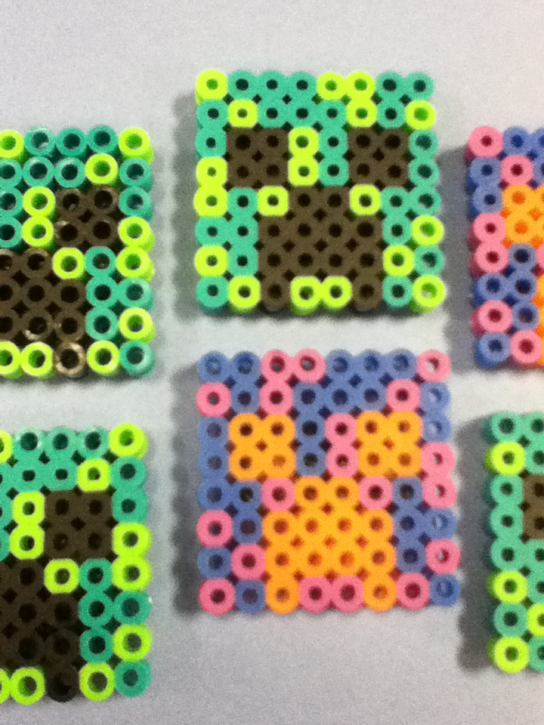
Promote and Plan
- Uses Prizes and Props for some reward that the kids get if they play Minecraft at the library rather than just at their own home.
- Promote the program in elementary schools, middle schools, and even high schools. Yes even high school students play minecraft.
- Promote for newcomers to Minecraft as well. Original Minecraft costs about $27 to get an account, this makes it not accessible to everyone. MinecraftEDU gives players a chance to play Minecraft without needing to pay for an account.
- Plan a Minecraft Week or Day Program and try to organize it in the summer, week kids get off school, or weekend.
- Use Pinterest and follow and join boards like the one from Olds municipal library to collaborate with some fun ideas
- Using Minecraft Crafts to set on display can capture kids attention and you can use them as prizes (cost less than a dollar and 10 min to make.) EXAMPLES TO RIGHT

Slide 10
Keeping Kids Engaged
- Ask the kids before hand to come up with some ideas and contest that they would think is fun
- Use variation if you are creating multiple contest, you will most likely get the same set of kids in each time
- Let them freeroam, don't restrict them to doing a bunch of contests. Let them explore the game and just have fun.
- Get Feedback from the kids of what they liked and didnt like for next time. *Kids don't like to fill sheets out, so ask them some questions face to face*
Credit: Circulating on Flickr

Slide 11
Program Ideas
- Surprise Build - Print off a bunch of pictures that aren't too complex and put them in a hat. Each contestant pulls out a picture and has to build that as best he can in creative mode. Take screenshots of your structure in the same angle to compare how close it is.
- Hunger Games - Based on the Hunger Games story players have to battle to the last man standing while collecting resources and surviving.
- Best Castle Design - No limitations, Build the best castle possible in creative mode and take screenshots of it to submit your design.
- Library Build - Try to build your own library on Minecraft, (interior and/or exterior) closest representation wins.
*All programs can be done in a few hours or over a few days*
Example: Suprise Build Winner
Credit: http://www.luxurywallpapers.net

Slide 12
Set Up Mobile Labs
- Use a room with lots of space to set up labs
- Organize laptops evenly apart from each other
- Use Cord Management to Run Ethernet and Power Cable along without people tripping on them
- Use a router and switch for connecting lots of ethernet cables into all labs
Refer to set up instructions on Alberta Library Toolshed

Slide 13
Testing
CHECKLIST
- Check all cables are properly plugged in
- Power on every laptop to see if they start up
- Start up MinecraftEDU on every laptop
- Start up a server on one laptop and see if a few laptops can connect to the same world
- Let every staff know about the set up so they can help with problems that may arise
*Note you may have to turn off your firewall if computers are refusing to talk to each other*

Slide 14
Google Groups Minecraft EDU Teachers - Help with issues and ideas
https://groups.google.com/forum/?fromgroups#!forum/minecraft-teachers
Minecraft Wiki - Everything you need to know about Minecraft
http://minecraft.gamepedia.com/Minecraft_Wiki
Minecraft EDU Wiki - General information about Minecraft EDU
http://minecraftedu.com/wiki/index.php?title=Main_Page
Minecraft Olds Library Pinterest Page- Ideas and Minecraft related crafts
http://www.pinterest.com/oldslibrary/minecraft-program-ideas/
The Alberta Library Toolshed - Minecraft help sheets of how to set up, play, make crafts, and contest ideas
http://toolshed.thealbertalibrary.ab.ca/allresources?keys=minecraft
How to Play Tutorials - A few very basic tutorials directly from minecraft website
https://minecraft.net/game/howtoplay
*Find more info by using Google Search*

Slide 15
Controls
*Default Controls can be changed in Settings - You can assign each action to a tifferent key on the keyboard*

Slide 16
Todays Assignment!
Build a library in Creative Mode!
Notes:
Program for Participants:
Collaborate to build Library in Creative Mode for rest of session. Tell participants to ask us any questions during remaining time.

Slide 17
Go to MinecraftEdu.com to Register for a License
Currently MinecraftEdu is $41 USD
You can also purchase Minecraft Licenses
Go to http://minecraftedu.com/page/purchase for more information

Slide 18
Carson Statham
Computer Services Coordinator
Olds Municipal Library
cstatham@prl.ab.ca
Brian Lin
Training Librarian
The Alberta Library
blin@thealbertalibrary.ab.ca

