Slide 1
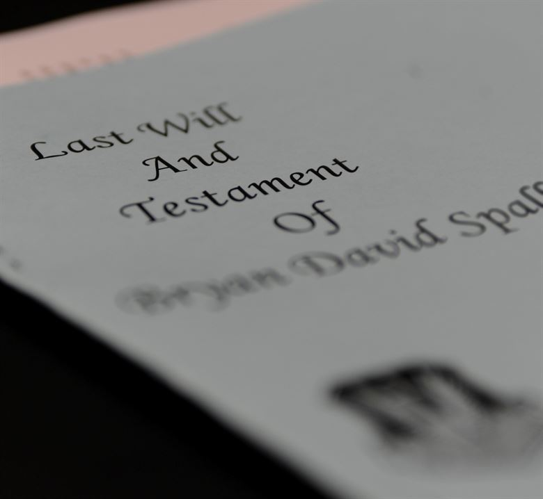
Welcome!
Thank you everyone for joining Digital Wills
We’ll get started right at 12 p.m.

Slide 2
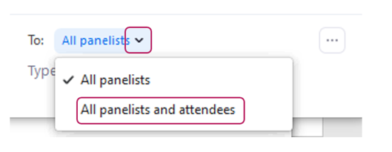
How to Participate and Ask Questions

Slide 3
Outline
Why and when should I make a will?
What is a digital will?
What are digital assets and digital accounts?
Why should I care about digital assets/accounts?
What are my options for dealing with digital assets/accounts?

Slide 4
When and why you should write a will
From Dial a Law:

Slide 5
How to write a will
You may be able to write your own will using:
A kit from Self-Counsel Press
My Law BC
But it is always a good idea to check with a legal professional:
Lawyer Referral Service
Legal Assistance options for low-income individuals
Ask friends, family, co-workers or others for a personal recommendation

Slide 6
Making sure your will is up to date
The second week of April is Make-a-Will Week in British Columbia
Mark your calendar this year to write a will if you haven’t already
Or
Mark your calendar to update your will to incorporate a digital will!

Slide 7
What is a digital will?
A will that outlines what a person would like to happen to their digital estate after they die.
It can be a part of your overall will.
Digital estate = anything of yours that is stored online or in a digital format.

Slide 8
What is a digital estate?
A digital estate is made up of digital assets and digital accounts.
Digital asset = an individual electronic file. This includes: a photograph taken with your smartphone, an email, a Word document.
Digital account = an online account such as an email account, Facebook account, online banking account, etc.

Slide 9
Why should I care about my digital estate?
Passing on sentimental digital items (photos, emails)
Passing on digital items of monetary value (music accounts, PayPal, eBay)
Subscriptions can continue to charge the estate
Helping people manage your overall estate (access to online banking)
Privacy!

Slide 10
What happens if I don’t manage my digital estate?
It can be nearly impossible for anyone to access your accounts/assets.
The account will most likely:
Stay online
Provide the ability for others to continue to interact
Could potentially be at risk for identity theft

Slide 11
What to consider in managing my digital estate
Do you want:
Accounts shut down immediately
Accounts up temporarily so that others can post condolences?
Assets passed on to a friend or family member

Slide 12
How can I manage my digital estate?
Make a list of all digital assets and accounts
Easiest to use a password manager
2) Create a digital estate plan
3) Designate a digital estate manager
4) Include the instructions in your will
5) Keep your will up to date (check it over once a year)

Slide 13
Other considerations
Organize your digital assets now so that you can decide what you want to pass on:
Do you really want to pass on every email? Or a selection of meaningful ones?
Do not put any passwords in your will itself.
Digital accounts of a business may be an asset of the corporation. Check with a legal professional.

Slide 14
When to write a will
When you have children
When you have valuable assets (property, a business, etc.)
When you have online accounts/assets

Slide 15
For more information:
Courthouse Libraries BC - Wills and personal planning resources https://www.courthouselibrary.ca/how-we-can-help/legislation-case-law/guides/acts/wills-personal-planning-resources
Clicklaw - Wills & Estates https://www.clicklaw.bc.ca/global/search?f=Wills+%26+estates
Contact the CCC at tech@westvanlibrary.ca or 604.925.7405

