Slide 1
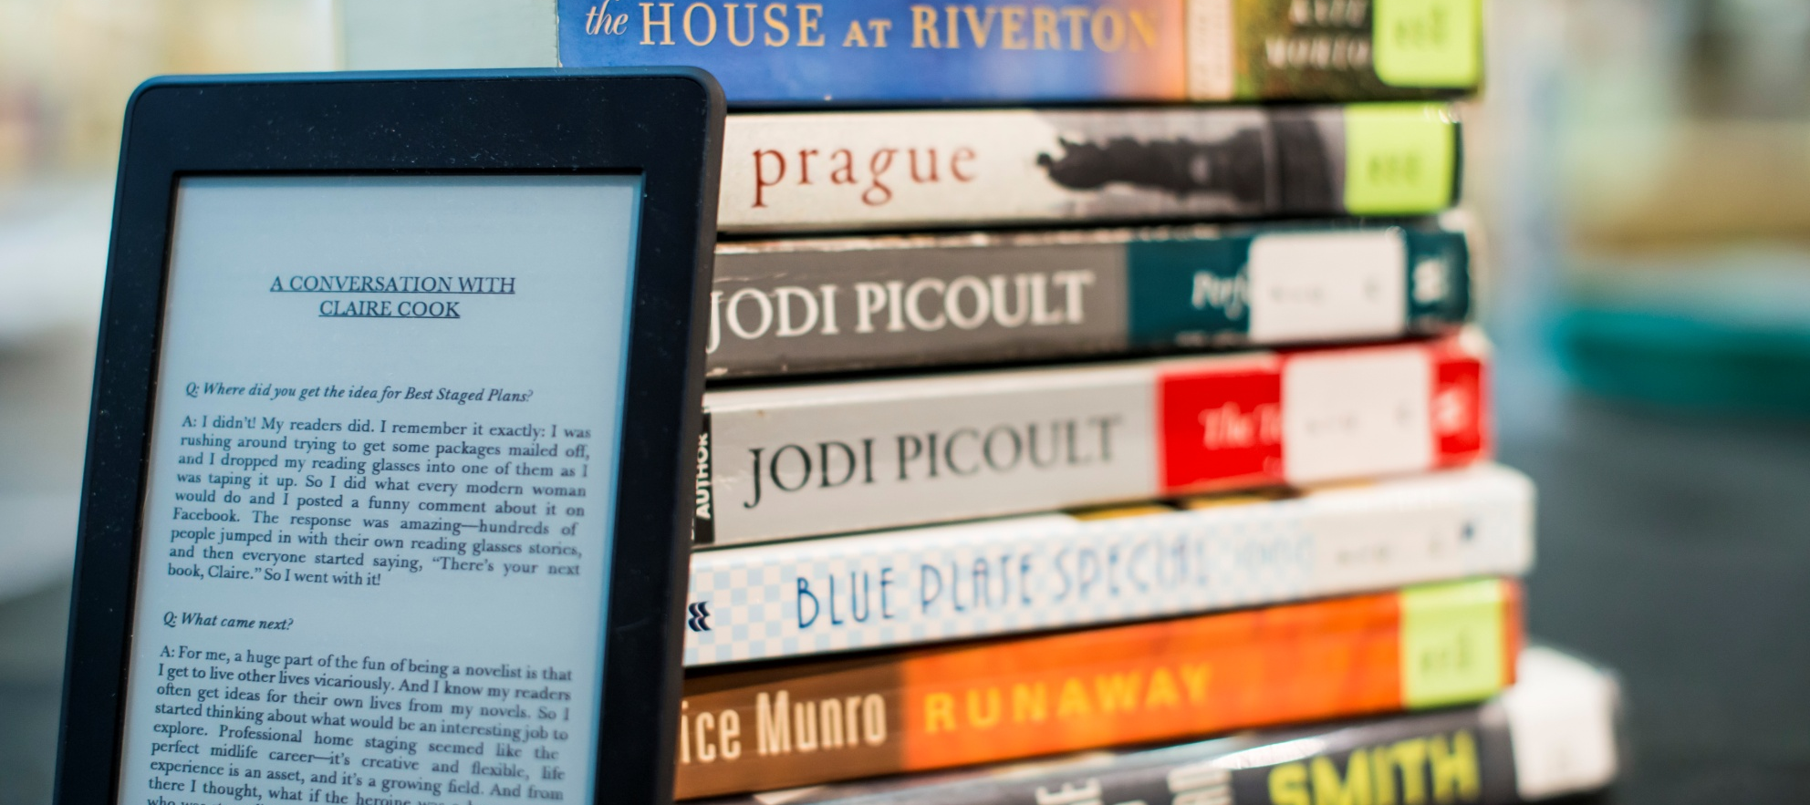
Introduction to Ebooks and E-Readers
Notes:
Introduce program and self
-Basics of ebooks
-Ereaders
-Where to get ebooks
-Demo library ebooks
-look at other palces to get ebooks
-lots of time for questions

Slide 2
What is an Ebook?
An electronic version of a book
They are smaller than a picture file!
Special formats:
EPUB
PDF
AWZ
Notes:
A regular ereader can hold around 500 books!

Slide 3
What is EPUB?
A special ebook file type that allows you to:
Change the font size of a book
Read easily on any sized screen
Read on many devices!
Notes:
Also change text style, margins and more

Slide 4
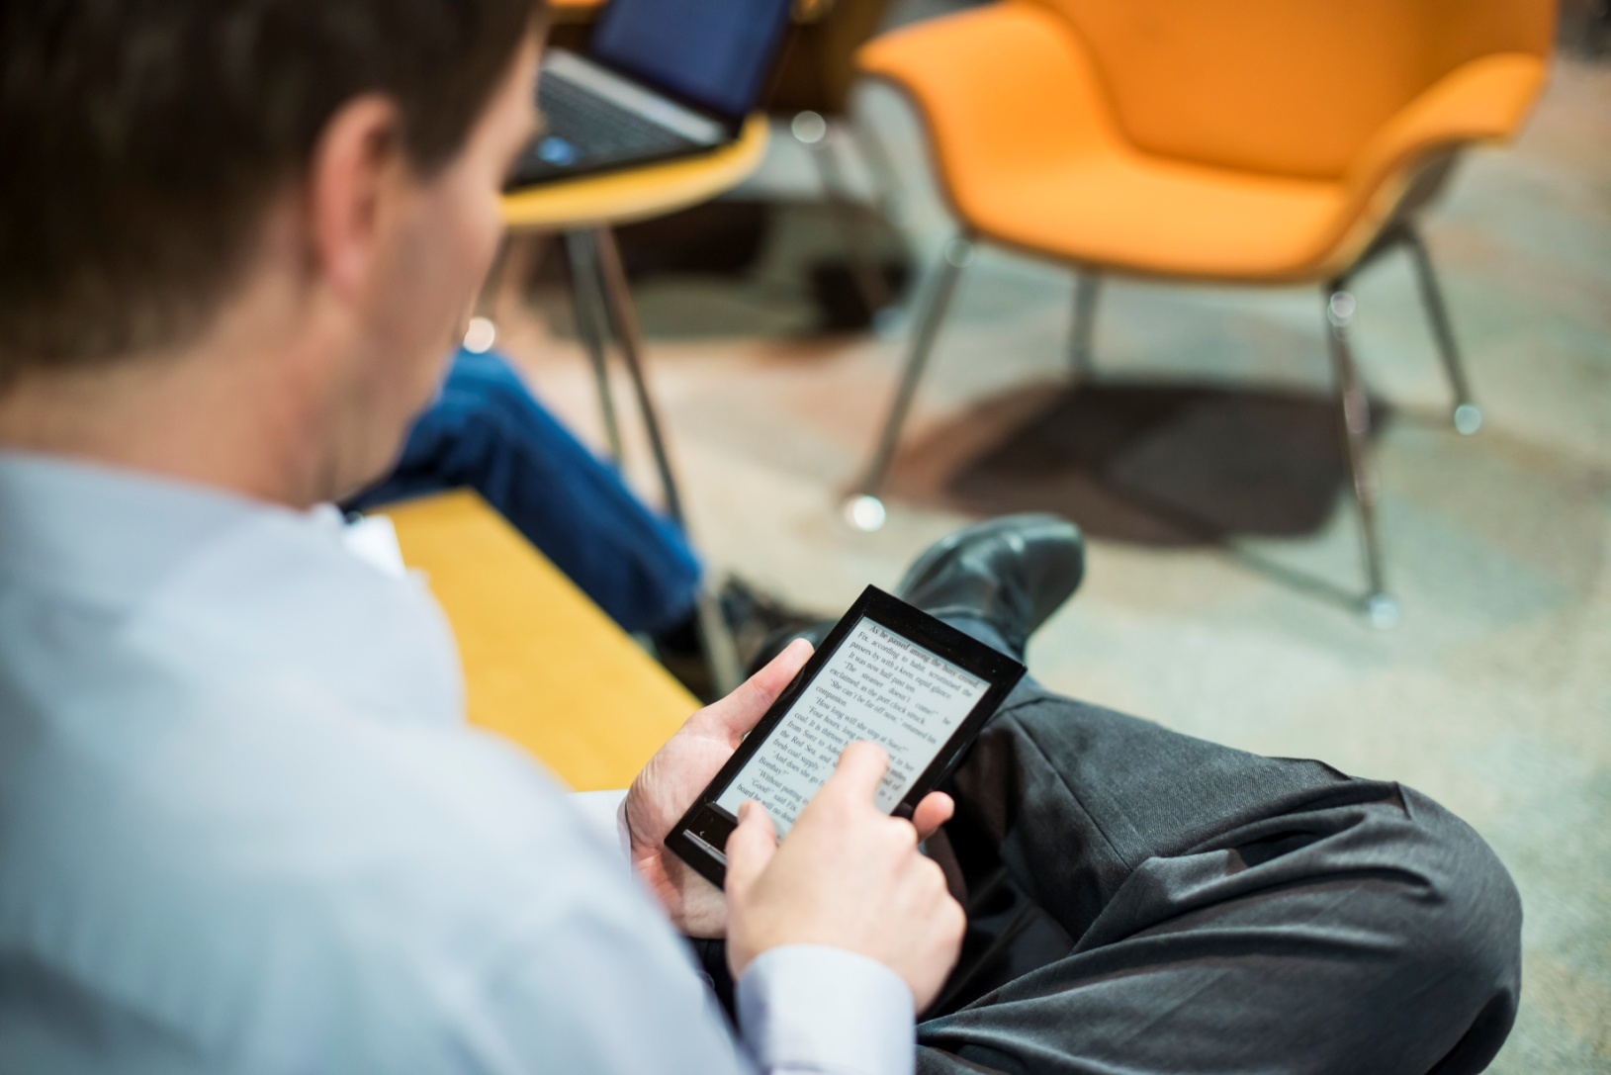
How do I read an ebook?
Notes:
Demo ereaders, different types
-turn on select book, turn pages

Slide 5
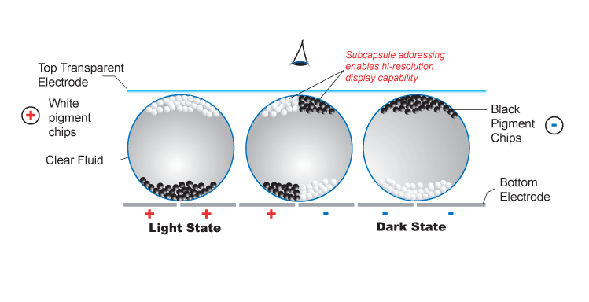
How does an E-Reader Work?
Notes:
Means the battery lasts a long time (10,000 page turns)
Can read outside in the sunshine
Used to mean couldn’t read in bed without a light, but now with Kobo Glo and other, you can!

Slide 6
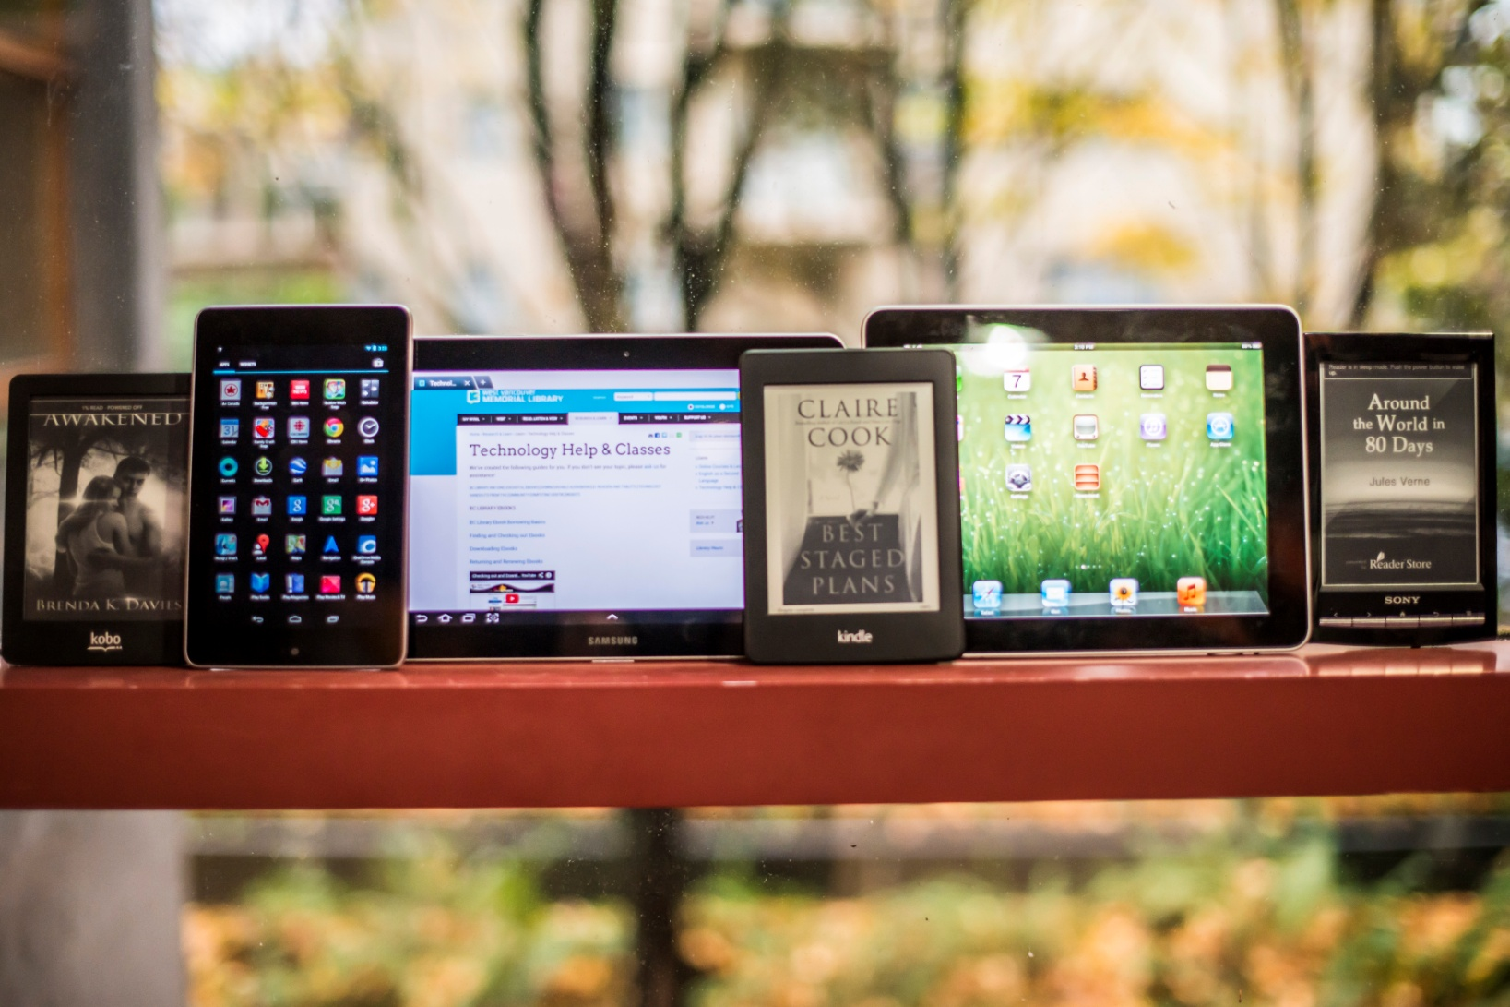
What E-Readers are there?

Slide 7
Where can I get Ebooks?
At the Library
From Free Online Websites
From Commercial Sites

Slide 8
What do I need to read a library ebook?
An email address
An Adobe ID (more on this!)
Access to a computer where you can download:
Adobe Digital Editions 2.0
Notes:
Explain what is needed

Slide 9
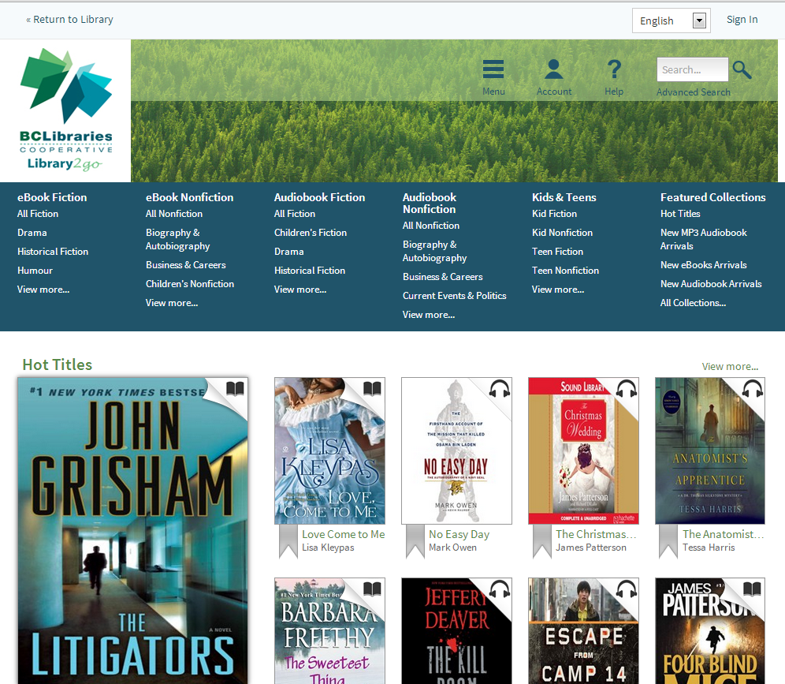
Where do I get Library Books?
http://downloads.bclibrary.ca
Notes:
Demo book checkout and download

Slide 10
What is DRM?
Might look like “Adobe EPUB eBook” or “Adobe DRM EPUB”
Digital
Rights
Management
A digital lock on ebooks to prevent piracy

Slide 11
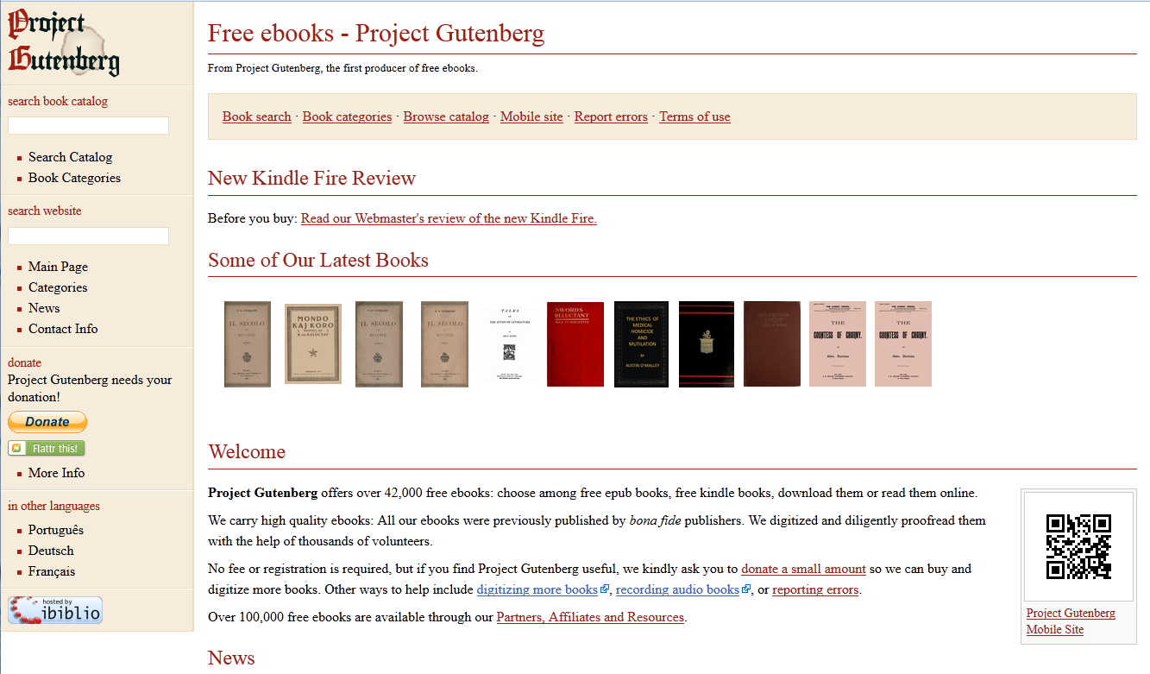
Where do I get Free Ebooks?
Project Gutenberg: http://www.gutenberg.org/
Notes:
Demo gutenberg

Slide 12
Where do I get other books?
Kobo, Amazon, Sony, Smashwords & publisher websites.
Notes:
Demo some price comparisons

Slide 13
Free Kobo Books!
http://www.kobo.com/free-ebooks

Slide 14
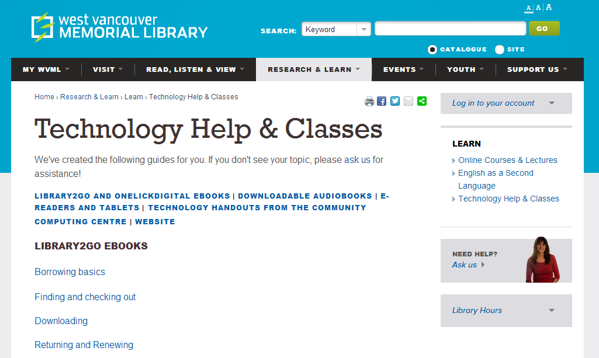
Where do I get Help?
Library Website: www.westvanlibrary.ca
Community Computing Centre
Notes:
Demo website help
CCC Help
Digital Buddies

Slide 15
Questions?

