Slide 1
Welcome!
Thank you everyone for joining Appy Hour: Mango Languages. We’ll get started right at 5 p.m.

Slide 2
How to Participate and Ask Questions

Slide 3
Agenda
After this class, you’ll be able to:
Say what Mango Languages is, what it’s for
Create an account
Access Mango
Log in
Navigate the app
Get help if you need it
Know what you need to get started today!

Slide 4
What is Mango Languages?
An online subscription-based resource to help you learn over 70 languages, including English
Free to access with your WVML card
Like Duolinguo, but more focused on practical communication rather than translating
Integrates cultural lessons, not just language – great for travel

Slide 5
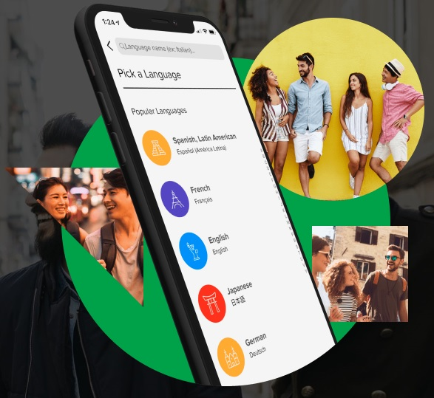
Why create an account?
You will not be able to access most lessons or save your progress without a Mango account
Account is free to make – get access to unlimited lesson materials with your WVML card
Can now create accounts
directly in the app

Slide 6
Download Mango on a mobile device
Download the app
iPhone/iPad → App Store
Android → Google Play Store
Open app
Tap Sign Up
Enter an email & password
Agree to the terms & conditions

Slide 7
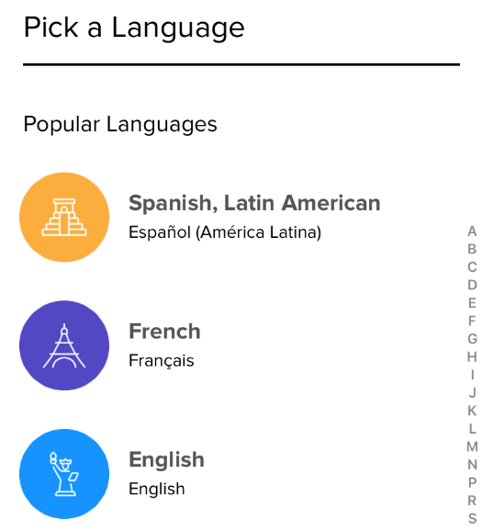
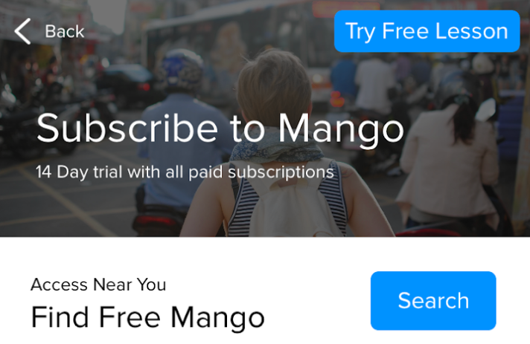
Link your Mango and WVML accounts
A list of languages will appear - tap to select any language on the list (doesn’t matter which one!)
Select Search next to Find Free Mango

Slide 8
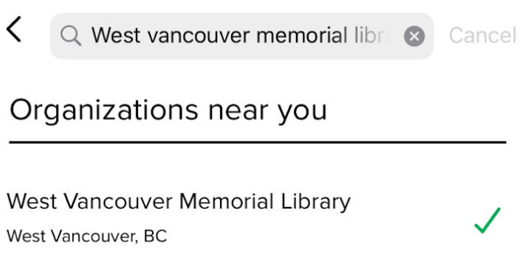
Link your Mango and WVML accounts
Type in West Vancouver Memorial Library and tap on the name in the results list
Enter your library card number and PIN
Then your account will be linked with your Mango account!

Slide 9
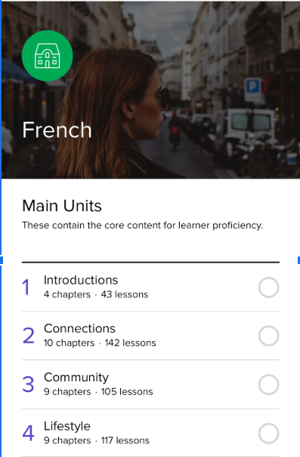
Learn lesson by lesson
Start the first Unit
Units follow a natural progression of learning
They contain chapters, lessons, and recaps

Slide 10
Or go straight to learning a specialized topic

Slide 11
Switching between languages
Tap Languages on the top of the screen
Then tap to pull up and select from the list of languages

Slide 12
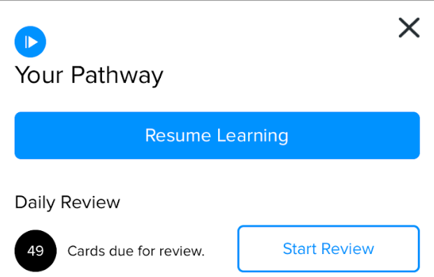
Using Mango for practice
When you open Mango, press the play button at the bottom right of the screen
You will have a choice to Resume Learning from where you left off or to Start Review to review flash cards

Slide 13
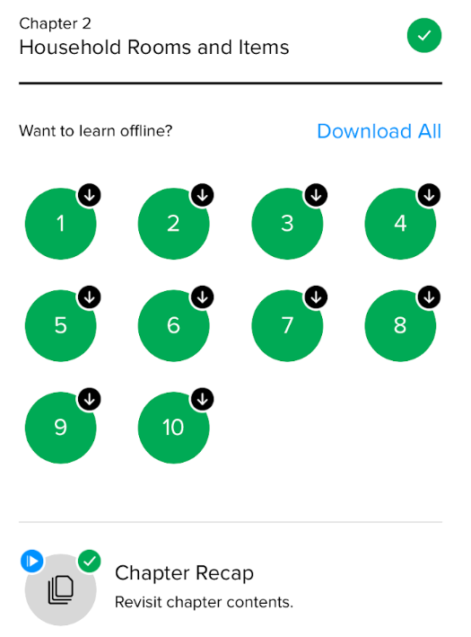
Practice further!
You can go back to already completed lessons at any time
Redo each individual lesson or the Chapter Recap

Slide 14
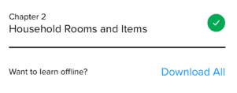
Download Mango Lessons to learn offline
Within a chapter, you can download all lessons and the chapter recap to learn while offline

Slide 15
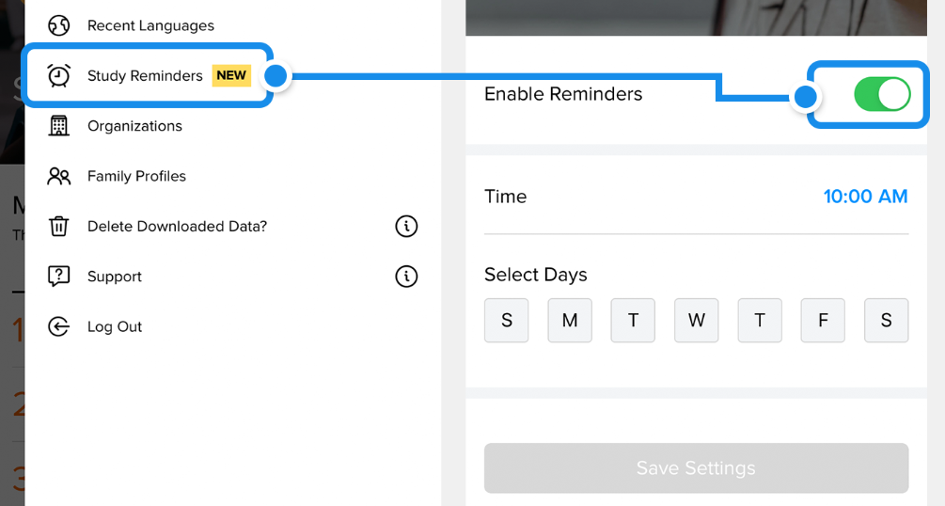
Set up Study Reminders
Tap on the person icon on the top right
Then tap on Study Reminders to set up daily or weekly reminders at specific times

Slide 16
Try it!
Recap:
Get the app
Create an account
Log in
Choose a language
Start learning!

Slide 17
Getting Help
Video tutorial:
https://my.nicheacademy.com/westvanlibrary/course/1103
Mango Languages support website:
https://support.mangolanguages.com/
In the app:
Tap person icon in top right corner then tap ? Support at bottom of side menu
Ask us! 604.925.7400 or email tech@westvanlibrary.ca
Notes:
Remind that you will send the slides via email, so people can keep these links

