Slide 1
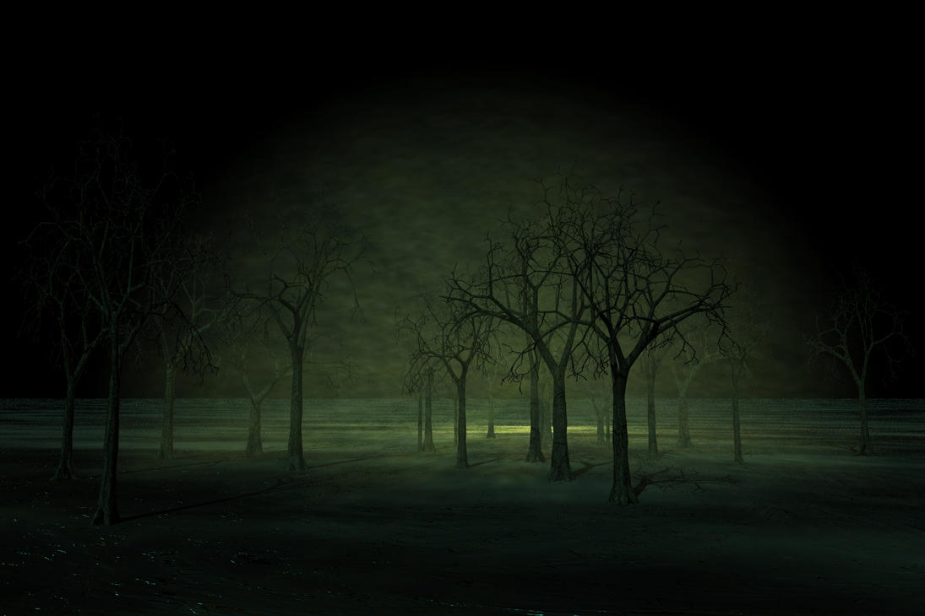
Horror Stories are like Hot Sauce
You might want to start with a mild one and then gradually work your way up the scale of fear.

Slide 2
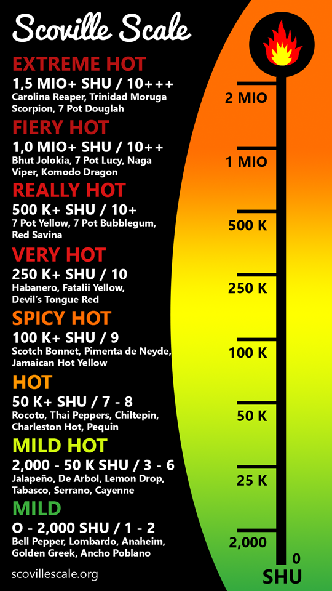

Slide 3
Just like the Scoville Scale rates Hot Sauces from mildest to hottest…
We can make a Scareville Scale to rate horror stories from mildest to most terrifying.

Slide 4
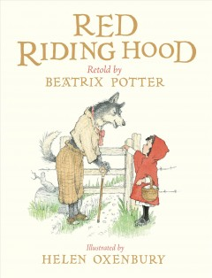
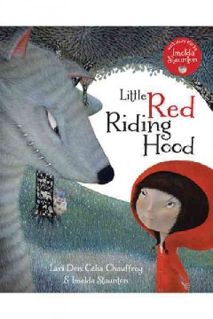
Scareville Scale of Fear
Books
Movies
Graphic Novels

Slide 5
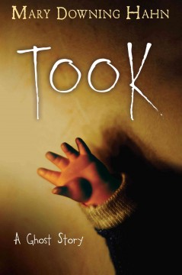
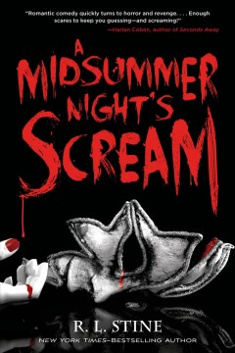
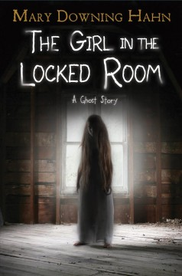
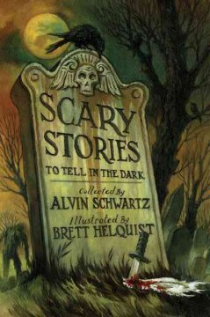
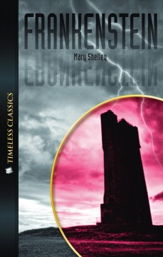
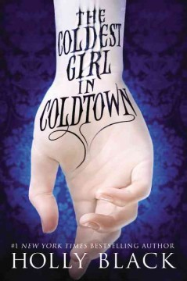

Slide 6
Did you know that you can suggest titles for the library to purchase? If there is a book or movie you would like the library to purchase you can

Slide 8
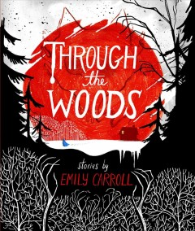
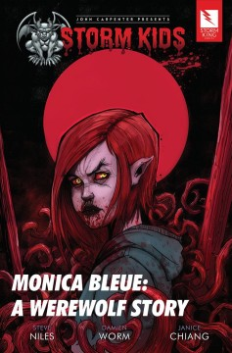

Slide 9
Who are the writers?

