Slide 1
Batchload Process for Alberta Libraries
Carol Ritzenthaler
Customer Support
OCLC
July 2013

Slide 2
Welcome
Welcome to OCLC and to the
Alberta Group Catalog Project!
We Look Forward to Working with you!

Slide 3
Agenda
Welcome and Introductions
Review Batchload Project Types
Review the Ordering Process & Options
Review the Batchload Process &Timeline
Questions and Discussion
Notes:
The basic agenda for today’s session includes: (click)
A review of the different types of batch load projects typically done to ensure a successful WorldCat Local implementation . (click)
An exploration of what is produced from a batch load project and what can or should be done with that output (click)
An overview of the Batchload process and the roles OCLC and you play to ensure that your library’s project is completed on time and to your satisfaction (click)
A dedicated question/answer period at the end to address your immediate questions or concerns about getting your holdings up to date in WorldCat and the OCLC number locally indexed in your library’s OPAC. (click)

Slide 4
Why Batchload is Important
Add OCLC #s to Records in Your Library System
Displays Your Library Information in WorldCat
Makes Your Items Searchable in WorldCat and in the Group Catalog

Slide 5
Project Types
Type | When to use . . .
Reclamation – If you DO have holdings in WorldCat | Holdings not fully maintained in WorldCat Cannot identify when to set/cancel holdings Need to sync WorldCat & local holdings
Retrospective – If you do NOT have holdings in WorldCat | No holdings in WorldCat
Notes:
Let’s start our session today by looking at the different types of Batchload projects that you may wish to request from OCLC:
Reclamation – If your institution’s holdings have not been fully maintained in WorldCat, it may not be possible or easy to identify records for which you need to cancel or set holdings. If this is your library’s situation, a reclamation project may be the best choice because its goal is to sync your WorldCat holdings with the holdings in your local OPAC.
When holdings are updated in WorldCat, the date of that transaction is recorded along with the holding. As part of a reclamation project, a Scan/Delete of holdings with a date stamp earlier than the one attached to the batch-loaded transaction is preformed after processing is complete. The date is typically the date on which you locally extracted the records that you sent to OCLC. This allows library’s to continue cataloging after extracting and submitting files to OCLC for batchload. Holdings you set after that date will contain a date stamp later than the stamp used in the scan/delete, therefore they will not be removed from WorldCat.
A Retrospective project is a one-time load without a Scan/Delete. This type of load might for a new OCLC member that has no holdings in WorldCat, for libraries that catalog online with OCLC but never added holdings for items acquired prior to joining OCLC , or if you need to simple fill gaps in your WorldCat holdings or gaps in OCLC numbers in your local system (e.g., special collections).
Symbol Flips – Sometimes, an institution’s holdings are represented in WorldCat by more than one OCLC Institution symbol. If this is the case at your library and you now determine fewer symbols would better suite your needs, OCLC can perform a scan to flip all occurrences of an institution symbol to another one.
This type of project does not require a file containing the records to be submitted by your library to OCLC. It is only necessary to send a written request to OCLC Batch Services. It should be noted that OCLC can perform other types of symbol flips that may require a record submittal, for example flipping a subset of holdings… as the scan flip option flips all occurrences found.

Slide 6
Timeline for Holdings Maintenance
Plan 8 to 10 weeks to complete the batchload process
Week 1 = Review the Checklist and Submit Order Form
Week 2 = Submit Data to OCLC and
Week 2 = Decide How to Maintain Holdings Going Forward
Connexion or Ongoing Batch Project.
Weeks 3 – 7 = OCLC Processes Data and Returns Files
Week 8 = Reload Your Records Back In To Your Local System With OCLC Numbers.

Slide 7
The Online Service Center
Go to the Online Service Center http://www.oclc.org/servicecenter
Select
Create an Account –
Select Institution Account
Enter your OCLC Institution Symbol and more.
OCLC Account Set Up (24 hours to complete)
Email Confirmation from OCLC with Logon Information

Slide 8
Complete the Order Checklist
The “Order Checklist” Helps Prepare For Questions That Will Be On the Order Form.
This Will Be a Single Institution Project

Slide 9
The Online Service Center
The OCLC Online Service Center is a secure, Web-based tool that you can use to manage your OCLC account and purchase some OCLC products and services.
https://www.oclc.org/webapp/wcs/stores/servlet/OSCPortal?storeId=10051

Slide 10
Order Checklist for Bibliographic Batchload
http://www.oclc.org/us/en/support/documentation/batchprocessing/using/checklistfororderingBib.pdf

Slide 11
Order Checklist – Page 2
Select
Single
Institution

Slide 12
Order Checklist – Page 2
Alberta Group Catalog
Select: An OCLC Group Catalog

Slide 13
Order Checklist – Page 3
Select: MARC21 (preferred)
Character Encoding: MARC-8

Slide 14
Order Checklist – Page 3
Local system number used for Cross reference report
Match point for reloading records back to your system

Slide 15
Local System Numbers
Essential match point when re-loading records
Local system number aka
Title Control Key
Bibload Report #
Import Source
Bib #
Location (examples)
001 43328

Slide 16
Order Checklist – Page 3/4
ONLY If you have OCLC #s in records. If none have the OCLC #, select NONE.
Derived Title is the default qualifier.

Slide 17
Order Checklist – Page 4
Select: One Time / Set for All
Reclamation: if you have holdings to match in WorldCat
Or Retrospective: if you do not have holdings in WorldCat

Slide 18
Order Checklist – Page 5
Select:
No – if you do Not want original records added

Slide 19
Order Checklist – Page 6 – Output
Option to Get Your Records with the OCLC # Added.

Slide 20
Cross Reference Report
Two-column text file
Matches OCLC numbers to local system bib numbers
from incoming files
E-mailed as a .txt attachment
Format:
Use the Cross Reference Report to:
Match OCLC numbers to your bibliographic records
Merge OCLC numbers into bibliographic records in your OPAC.
Note: To merge numbers, you may need to work with your ILS vendor. OCLC does not provide this level of support.
OCLC Control # | Submitted 001 Field
48110766 | .b21361198
179104583 | .b21512760
229024760 | .b21512772

Slide 21
Your Records w/ OCLC Numbers
Specify in Output section of Order Form
OCLC number merged into 035 $a with “(OCoLC)” prefix*
Example:
OCLC # | Default Merge*
48110766 | 035__|a (OCoLC)48110766
179104583 | 035__|a(OCoLC)179104583
229024760 | 035__|a(OCoLC)229024760
* By default, the OCLC number is merged into 035 $a. If you prefer to use some other field, please specify that in Output in the Batch order form. For example, you may want the OCLC number in 001 with the ocm or ocn prefix.

Slide 22
Order Checklist – Page 7
How to submit your files
Product Services Web http://psw.oclc.org
Request the PSWeb authorization
FTP via EDX
Required for libraries with Innovative III Local System.
Request the EDX account

Slide 23
Order Checklist – Page 7
How to submit your files
YES – to get the
Needed authorization

Slide 24
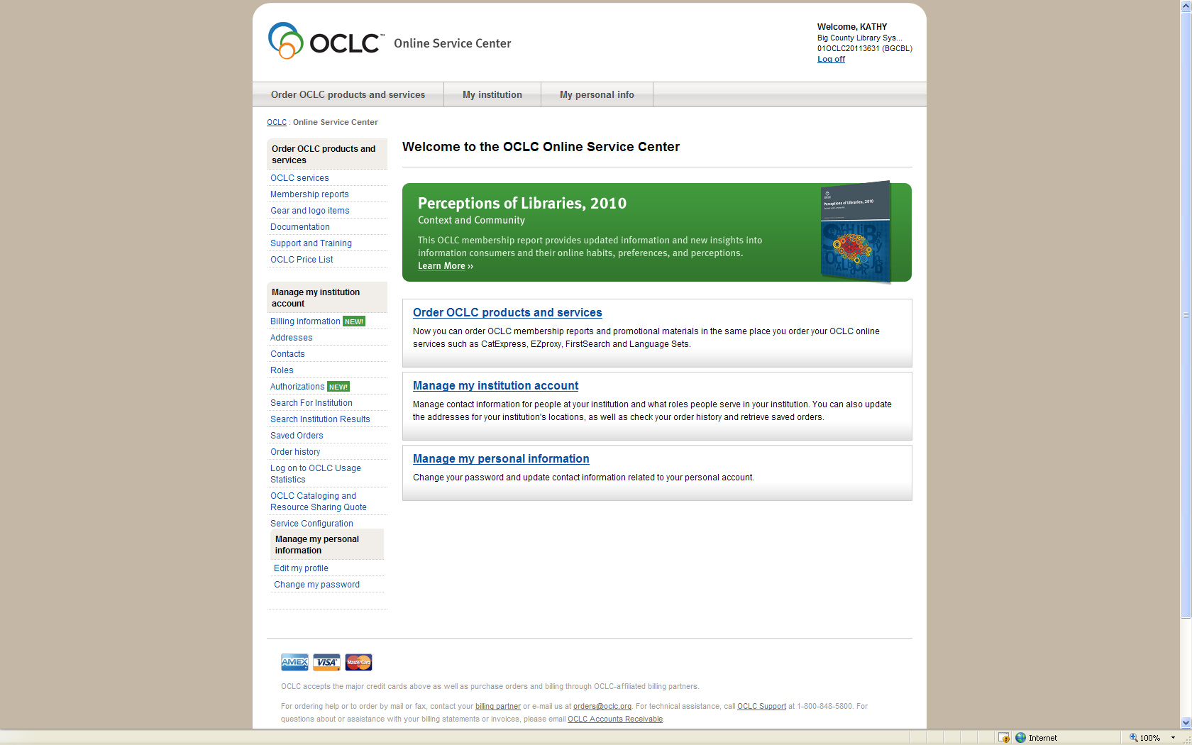
Welcome Screen

Slide 25
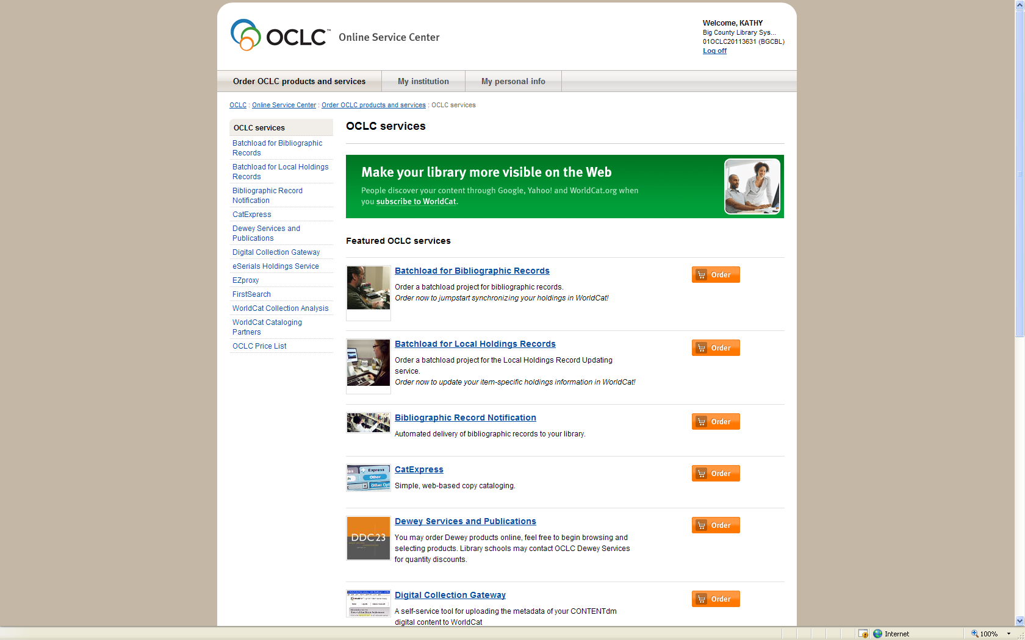
OCLC Services

Slide 26
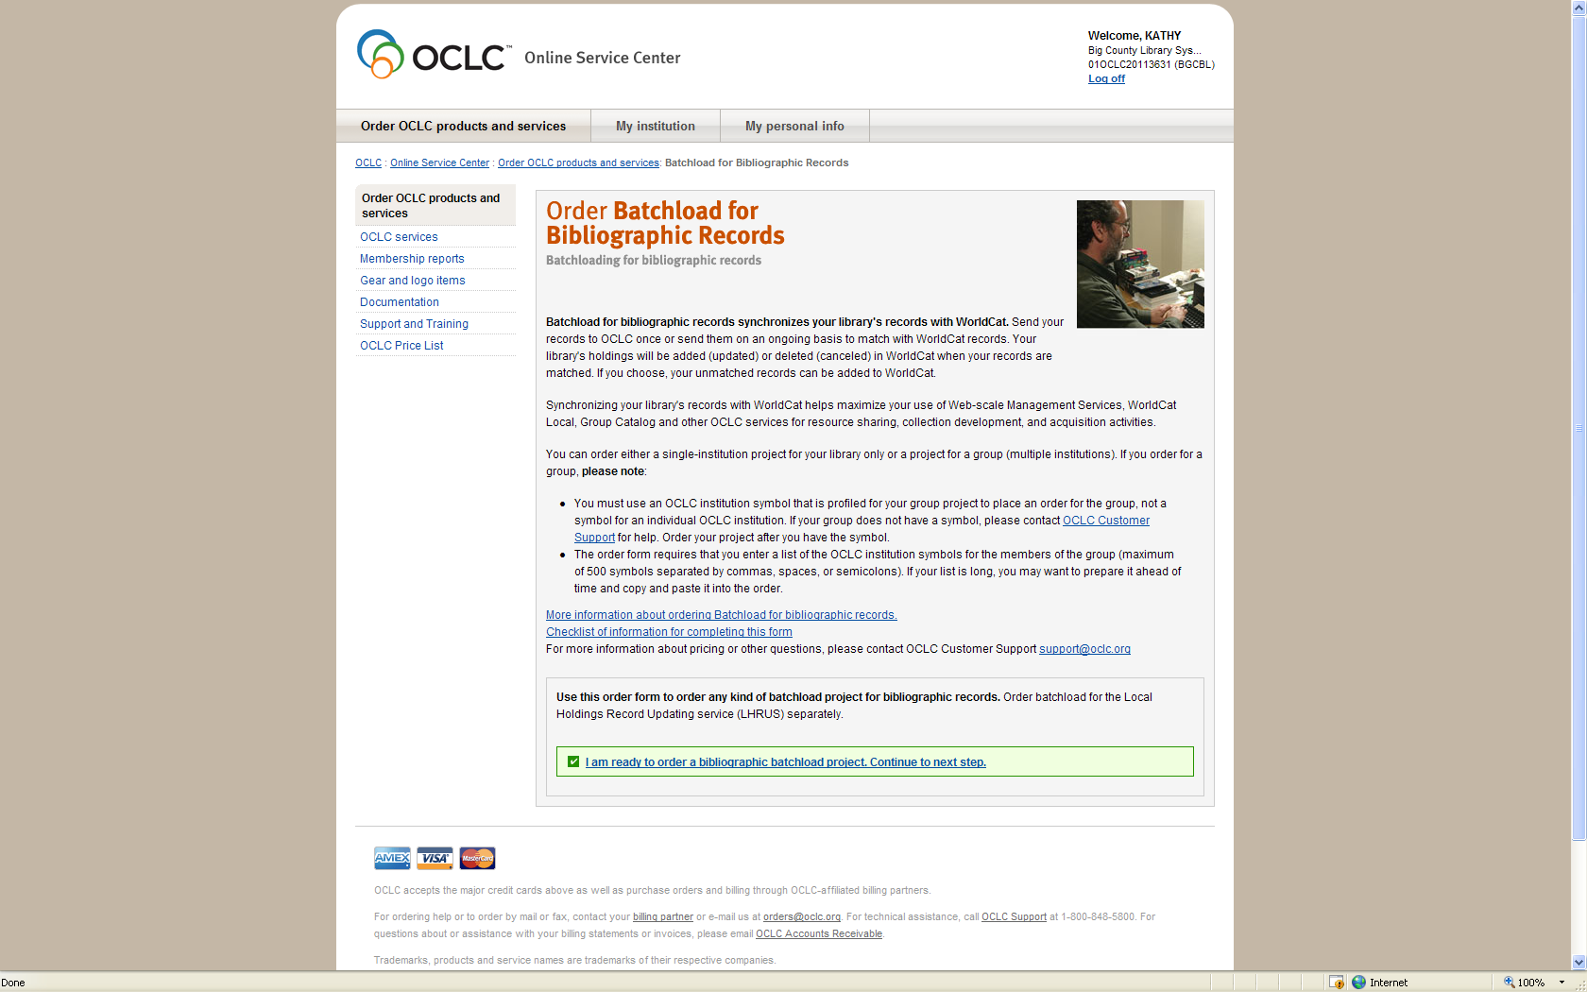
Batch load Order Form

Slide 27
Submit the Order Form
Once completed, review the order form
Click Continue to see Terms & Conditions
Click I Agree to go to next screen
Click Submit to submit the order
You will get a Web receipt / “What’s next”
Email confirmation with Project ID
Copy of order form / What’s next

Slide 28
What’s Next … part of order confirmation
Create Your Files and Send Them to OCLC
See file submittal instructions for file naming details.
Click the following link for detailed file submittal instructions: http://www.oclc.org/content/dam/support/batchload/documentation/using/PSWebinstructions.pdf
You Will Receive Email When OCLC Receives Your Data.
Your Project Will Enter the Queue for Processing.
You Will Be Notified Again When Processing Begins.

Slide 29
Send MARC records using PSWeb
http://www.oclc.org/content/dam/support/batchload/documentation/using/PSWebinstructions.pdf

Slide 30
Batchload Documentation and Resources
OCLC Batch Services User Guide
Batchload Solutions for Bibliographic Quick Reference
Instructions for Sending Files
Import….and Resolve Records in Connexion
http://www.oclc.org/support/services/batchload/documentation.en.html

Slide 31
Example: Data Files
Name Your Files This Way:
DATA.Dyymmdd.FILE1, etc
For example,
DATA.D130708.FILE1
DATA.D130708.FILE2
DATA.D130708.LAST
(for the last file or if only one file is sent)

Slide 32
Example: Label files
Create a Label File for Each Data File
Include the following lines: (do not double-space)
DAT 20130708000000.0
RBF 35356
DSN DATA.D130708.LAST
ORS TXxxx
FDI P01xxxx

Slide 33
More about Naming Files
Verify that each file does not have an extra file extension after the name
LABEL.D130708.LAST.txt
If so, rename the file to remove this extension using Windows Explorer

Slide 34
File upload
To Product Services Web – http://psw.oclc.org
http://www.oclc.org/content/dam/support/batchload/documentation/using/PSWebinstructions.pdf
Email notification to confirm successful file pick ups

Slide 35
PSWeb: File Uploads
http://psw.oclc.org

Slide 36
Email Confirmation
Summary of EDX.EBSB scan for TXxxx completed on Friday, November 16, 2012 at 2:06 am.
"Hdrcnt" is the count recorded from the EDX header (default 0).
"Rejects" are strings of data ending in a record terminator which may be badly formatted records. These will normally be written to a separate PASS file (if the name is included below).
"Copied" is the count of records accepted for further processing.
Header data in error is automatically substituted and will appear in parentheses below.
EDX.EBSB files read and copied:
Inst HdrDate Run Option Hdrcnt Rejects Copied
__________________________________________________
DGW 20121116 P011526 148 0 148
New DBS.@DGW.MARCIN.D091706 148

Slide 37
No Email Confirmation?
Review Your Data and Label Filenames
Check for File Extensions
Re-post Files
If Still Not Received,
Contact OCLC Support, 800-848-5800

Slide 38
Files returned and re-indexed
Email Notification When Project is Completed
Pick Up Files and Reports From Same Location Where Posted…
PSWeb at http://psw.oclc.org
Records and Reports
OCLC Batch Services records and reports

Slide 39
Go to PSWeb to pick up files
Files of records to download
Reports to view

Slide 40
File extensions
Successfully processed data (no file extension)
D121116.R417114
.UNRES = Unresolved records
brief or original records did not match
.DUP = Duplicate records**
Multiple records with same LBN
First record processed; others in file
** may be re-processed if not true duplicates

Slide 41
Cross Reference Report

Slide 42
For more information…
OCLC Customer Support
Phone: 800-848-5800
Email: support@oclc.org
Subject Line: “Batchload – Alberta Project”

Slide 43
Thank you

