Slide 1
10 Ways to Make Your Library More Accessible

Slide 2
What is NNELS?
“National Network for Equitable Library Service”
(See report: “Opening the Book” from
Canadian Library Association, 2005)
Funded and supported by the governments of
AB, BC, MB, NS, NWT, NU, SK, YT

Slide 3
Housed at, and by, the
BC Libraries Co-op

Slide 4
support@nnels.ca
1-888-848-9250, option 5
https://nnels.ca/about

Slide 5
1. Build Accessible Digital Material
When you save a document as a PDF:
Save as PDF.
Do not “print” to PDF.
Do not scan the document after it’s printed.
What’s the difference?

Slide 6
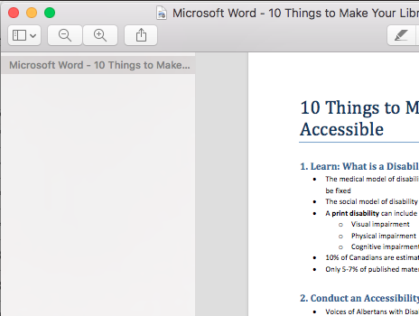
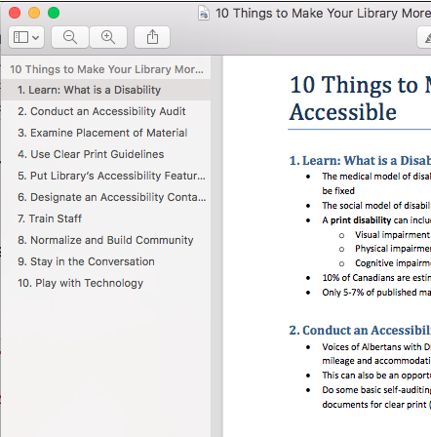
Spot the difference:

Slide 7
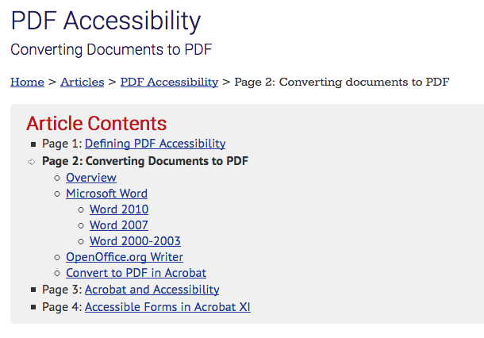
WebAIM (webaim.org)

Slide 8
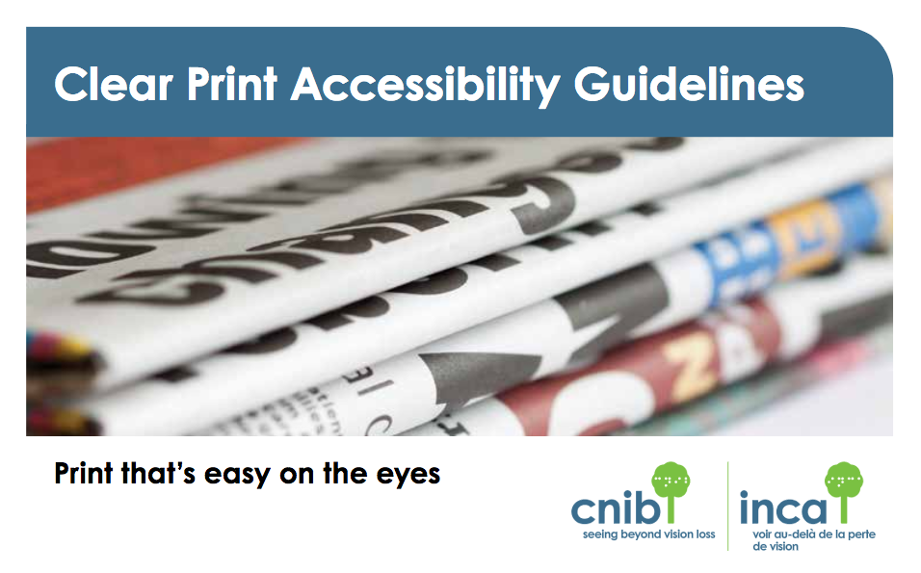
Follow Clear Print Guidelines
  Consider:
  Contrast
  Colour
  Size
  Font
  Letter spacing
  Margins
  Paper finish

Slide 9
Hello, digital divide, old friend.
What computer should I buy?
The one your friends and families have.
You know so much about computers…
I search: “How do I find my privacy settings Mac”
When you see people do things the hard way:
“You might have an easier time if you tried…”
Also: https://community-broadband.ca/
(Thanks to Jessamyn West)

Slide 10
2. Understand the Copyright Act

Slide 11
Definition of a “perceptual disability”
severe or total impairment of sight or hearing or the inability to focus or move one’s eyes,
the inability to hold or manipulate a book, or
an impairment relating to comprehension.

Slide 12
Hang on:
What about low literacy or ESL learners?
Access to restricted collections only if individuals have print disabilities.
But many accessibility tools are very useful for people learning to read
(for example, just about any app or program that converts text to speech can highlight the text as it reads)

Slide 13
Rule of Thumb
What matters: format.
If we change the format – not content – can your patron read the book?
If “yes”: eligible for access to restricted content (e.g. NNELS & CELA).

Slide 14
Section 32
It is not an infringement of copyright for a person with a perceptual disability, for a person acting at the request of such a person or for a non-profit organization acting for the benefit of such a person to
  (a) make a copy or sound recording of a literary, musical, artistic or dramatic work, other than a cinematographic work, in a format specially designed for persons with a perceptual disability;

Slide 15
Section 32
Limitation
(2) Subsection (1) does not apply if the work or other subject-matter is commercially available, within the meaning of paragraph (a) of the definition commercially available in section 2, in a format specially designed to meet the needs of the person with a perceptual disability referred to in that subsection.

Slide 16
We care that:
copyright-protected books are only for eligible readers - Gatekeeper Role 1
eligible readers have access to those copyright-protected books – Gatekeeper Role 2

Slide 17
3. What is disability theory?
Definitions on the following slides are based on:
Llewellyn, A. & Hogan, K. “The Use and Abuse of Models of Disability” Disability & Society, Vol. 15, No. 1, 2000, pp. 157 – 165.

Slide 18
1. Medical Model
Disability is the result of physiological impairment due to injury or disease. And that’s all.
In a library:
She can’t read that book -- she has a brain injury.
Danger in this model: people cannot define their own disabilities & so are defined by them.

Slide 19
2. Social Model
Individuals who are different by virtue of an impairment find that they are oppressed by societal views of normality.
In a library:
He has Parkinson’s and the library doesn’t have the book he wants in a format he can read.

Slide 20
3. Systems Model
Individuals are part of an ecosystem, and other players in that ecosystem can drive or accelerate the course of development.
In a library:
An individual library staff member can drive or accelerate an individual’s interest in reading.

Slide 21
4. Transactional Model
Individuals are active synthesisers of information from the environment.
In a library:
A reader who had a bad childhood experience with a library might think all libraries (and library staff members!) are alike.

Slide 22
Keep “social model” glasses handy.
However possible, focus on the accessibility (the social construction) rather than the disability (the individual’s impairment).
Build for universal design.

Slide 23
Sidebar: Principles of Universal Design
Equitable Use
Flexibility in Use
Simple and Intuitive
Perceptible Information
Tolerance for Error
Low Physical Effort
Size and Space for Approach and Use

Slide 24
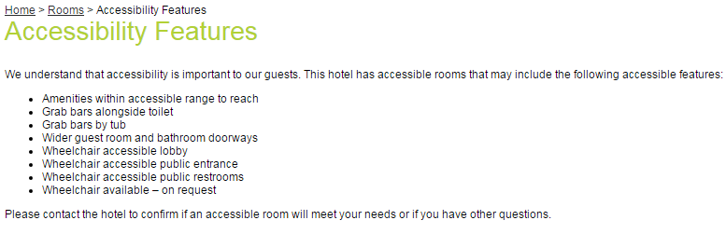
4. Put library accessibility features on the website.

Slide 25
Also, small things:
Make library contact information easy to find on a website.
Don’t turn your email signature into a pretty JPEG image.
Put only completely non-essential information into images.

Slide 26
5. Build Community; Follow Conversations
Curiosity > Knowledge
Organize a technology meet-up, with coffee & tea afterward. Example: Getting Together with Technology (GTT) program, Canadian Council of the Blind.
Watch for “#a11y” — a c c e s s i b i l i t y
a 1 2 3 4 5 6 7 8 9 10 11 y

Slide 27
6. Designate an Accessibility Contact
Or become that person!
PATAQ: “Person into Answering Technology & Accessibility Questions”
Takes training. Follows conversations. Asks questions. Keeps accessibility lenses on.
Needs time.

Slide 28
(Returning to 2. The Copyright Act)
severe or total impairment of sight or hearing or the inability to focus or move one’s eyes,
the inability to hold or manipulate a book, or
an impairment relating to comprehension.

Slide 29

7. Build Your Toolkit 1
AppleVis: applevis.com

Slide 30
Build Your Toolkit 2
Learn how to install and use
dyslexic fonts such as
Open Dyslexic & Dyslexie.

Slide 31
Build Your Toolkit 3
Learning some accessibility features of different devices and operating systems:
Search for operating system (e.g. Windows 10) + “accessibility features”
Search “Shane Aguilera iPad” for a good, short, and unintimidating introduction to VoiceOver on an iPad.

Slide 32
Build Your Toolkit 4
In case these are useful, here are some excellent sources of books in Braille:
braillebookstore.com (based in Abbotsford)
seedlings.org
actionfund.org
BeulahReimerLegacy.com

Slide 33
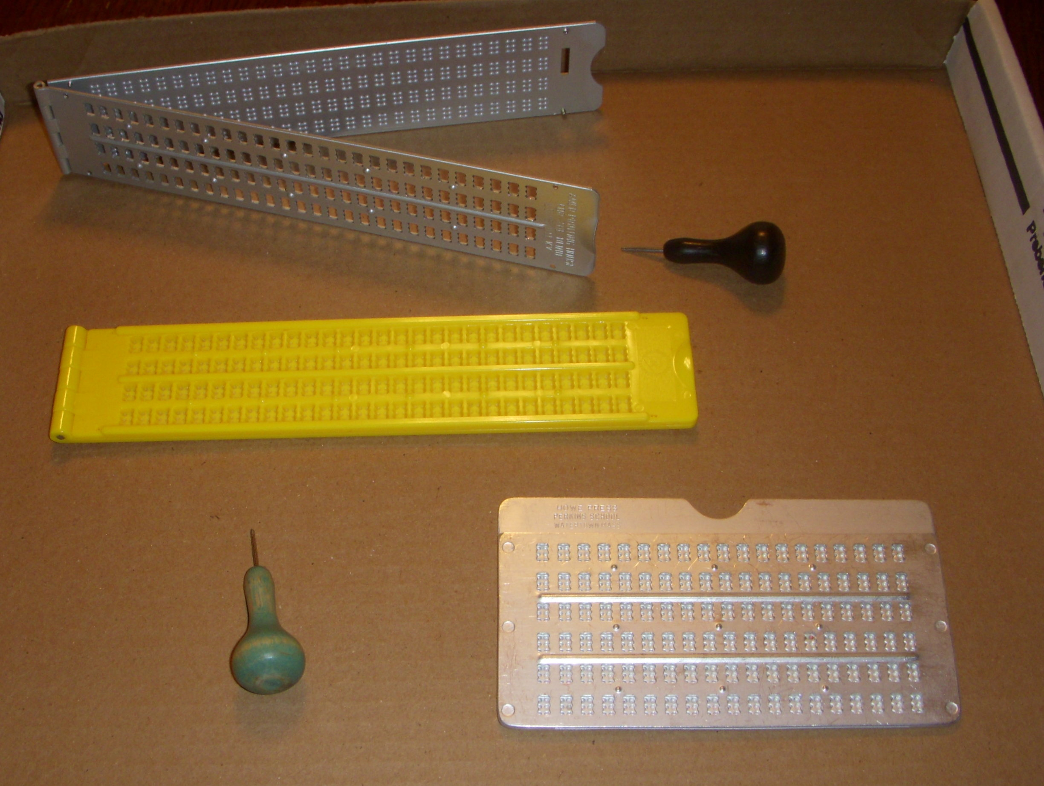
Build Your Toolkit 5
Writing a note in Braille can be as simple as having:
A slate and stylus;
A Braille guide;
Remembering to braille backwards & in reverse.

Slide 34
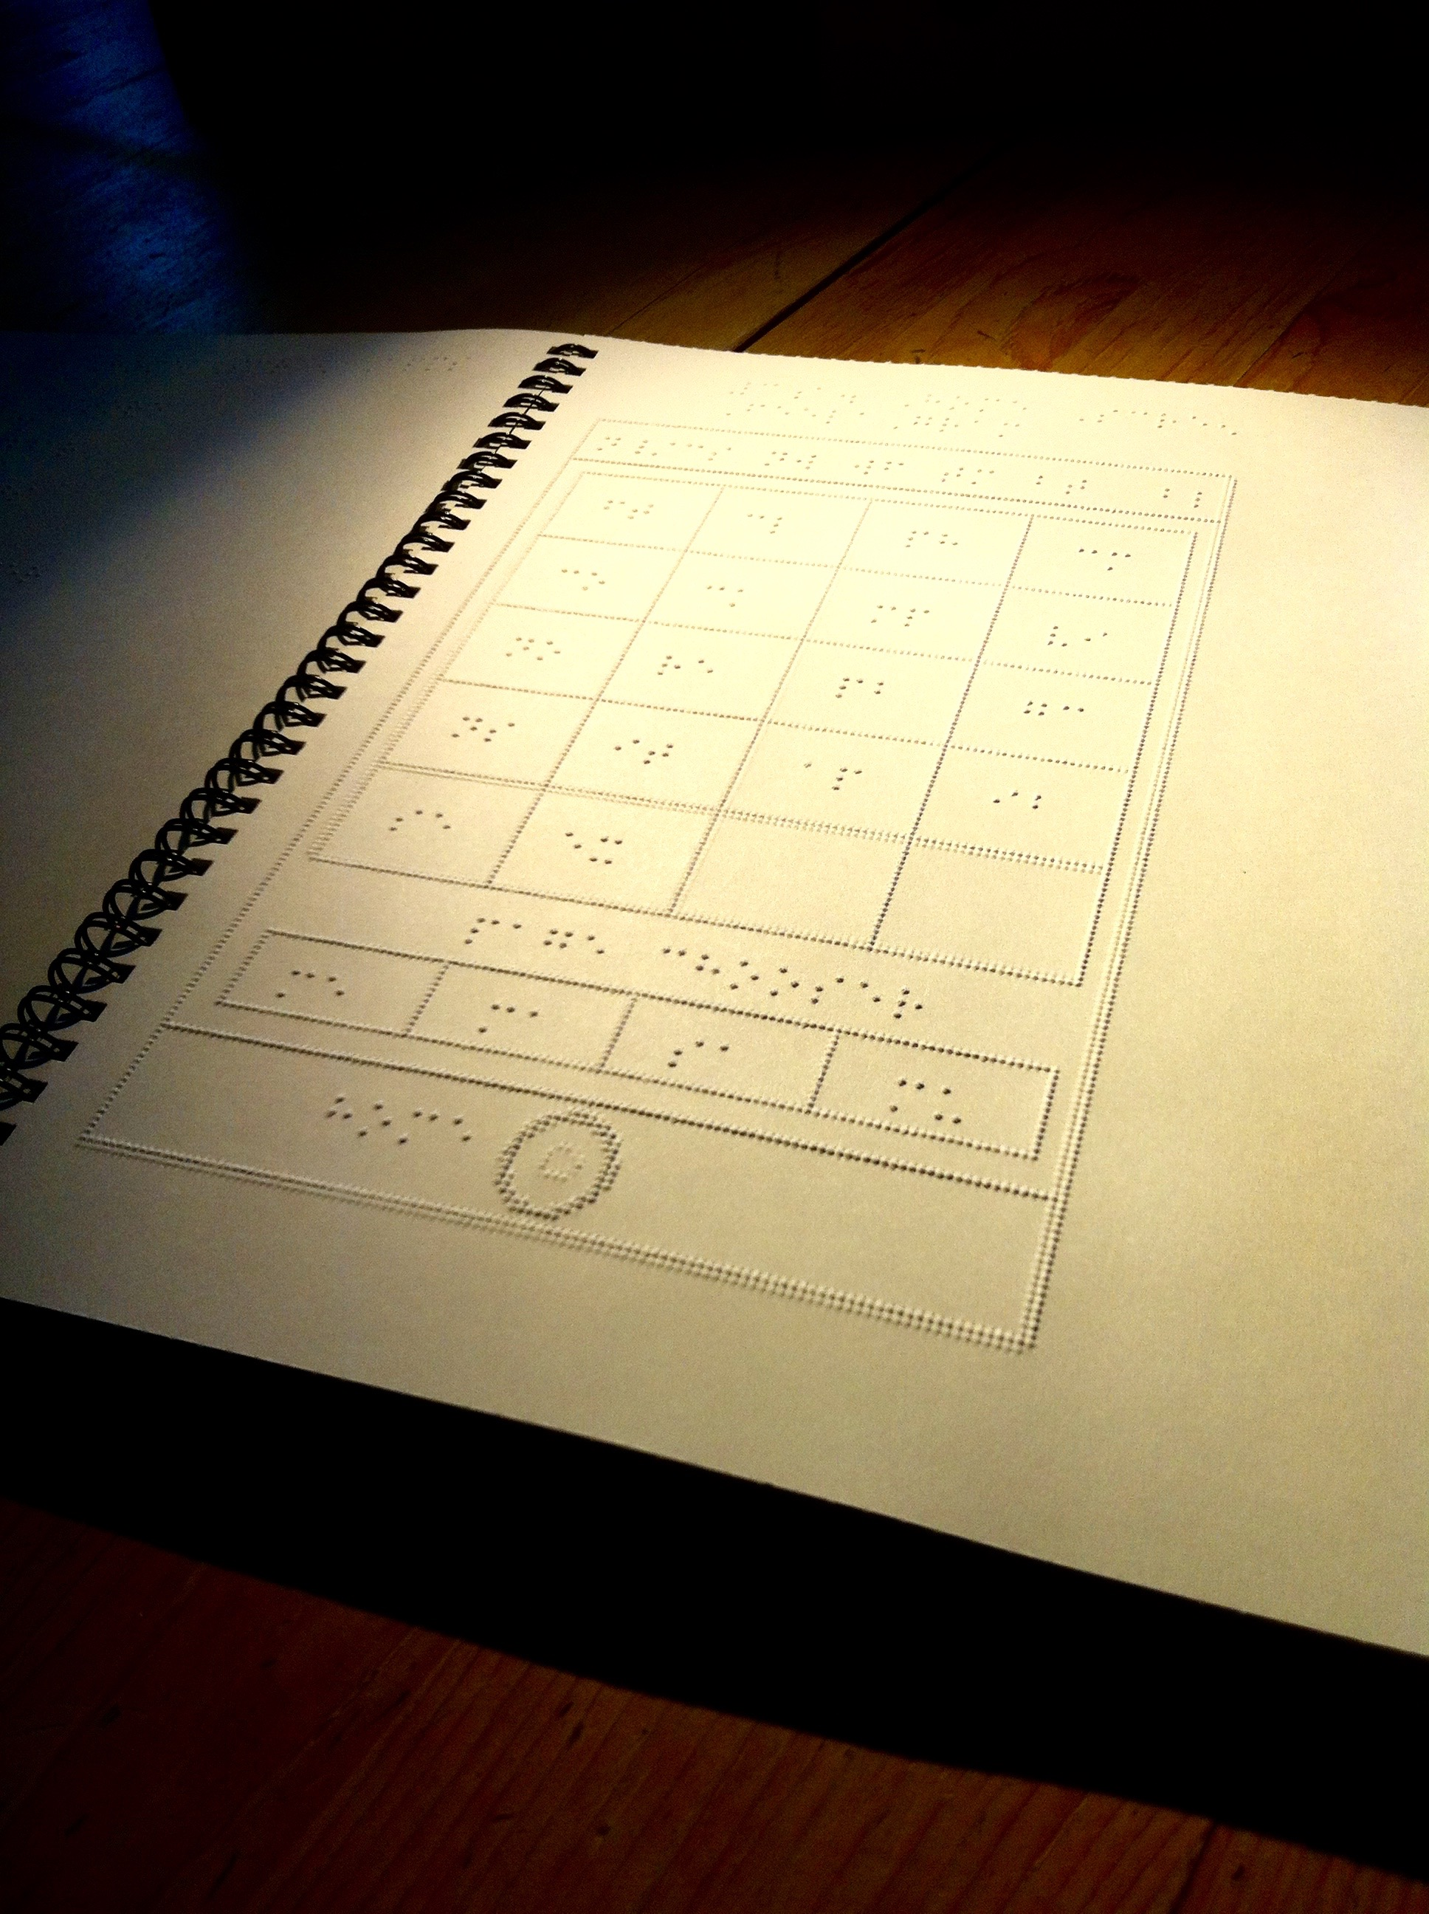
Build Your Toolkit 6
Braille can make maps and diagrams accessible.
Example: “iFeelagrams” are tactile Screenshots
for iPad and iOS published by National Braille Press.

Slide 35
8. “How Do You Read?”
And some other questions to ask new patrons:
What tools do you use to read?
What format works best for you? What else works?
What can we do for you to make the most use of the library?
What do you like to read?

Slide 36
9. Know the basics;
Ask the advanced
Know:
how to create access to the content,
that tools and formats exist,
where to go with your questions.

Slide 37
Find out who knows more than you do.
Ask:
before speaking or acting on behalf of others.
when in doubt: technology, approach, history…
Okay to say:
I’m not sure. I’ll find out. What’s the best way to reach you?
I remember a thing from a presentation maybe related to this… help?

Slide 38
10. Know Little, Be Much
“Feeling lost, crazy and desperate belongs to a good life as much as optimism, certainty and reason.”
- Alain de Botton

Slide 39
“A library in the middle of a community is a cross between an emergency exit, a life-raft and a festival. They are cathedrals of the mind; hospitals of the soul; theme parks of the imagination. On a cold rainy island, they are the only sheltered public spaces where you are not a consumer, but a citizen instead.”
- Caitlin Moran

Slide 40
“Relax! We know about blindness; you know about libraries. Let's both enjoy learning something new.”
- Mary Ellen Gabias, President
Canadian Federation of the Blind

Slide 41
From an email we received:
  In all honesty, I did not know that reading could be so much fun.
  Thank you for lighting my fire.

Slide 42
Thank you for your time, APLA et al!
Sabina Iseli-Otto
NNELS Public Service Librarian
sabina@nnels.ca

