Slide 1
Check-out the internet
Hotspots as a service at EPL

Slide 2
Background

Slide 3
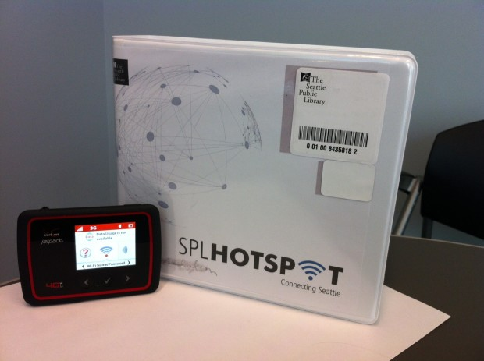
What is a hotspot?
A cell-phone sized device that creates a cellular internet connection.
Allows multiple devices to connect at once.

Slide 4
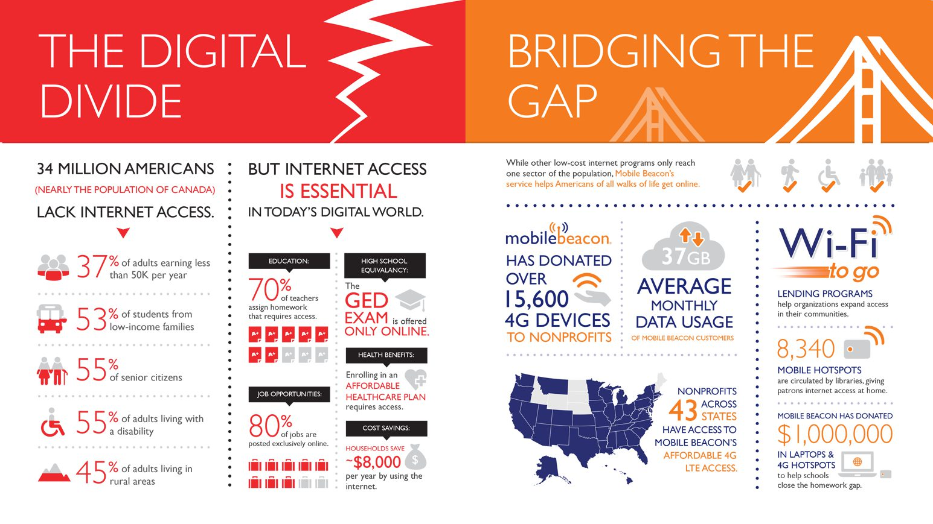
Why are libraries loaning hotspots?
From mobilebeacon.org

Slide 5
Canada’s Digital Divide
87% of households have internet connections but:
Only 62% in the lowest income quartile are connected
Broadband only available to 85% of rural customers
Canadians are the second heaviest users of the Internet globally, averaging 41.3 hours/month online
Notes:
http://www.huffingtonpost.ca/2014/03/20/digital-divide-canada-broadband-access_n_4995560.html
Regionally, British Columbia and Alberta have the largest number of connected households, with 86 per cent, while connection rates were lowest in Quebec and on the East Coast, where rates are under 80 per cent.

Slide 6
What public libraries are loaning hotspots?
New York – began loaning to families with children in NYC schools in 2014
Chicago – started loaning hotspots out of 3 branches in early 2015
Seattle – program started in 2014; no borrower restrictions
Notes:
NYPL early pilot - $10/mth unlimited data. $500k grant from Knight foundation to start; $1mill added by Google
New York Public Library, Brooklyn Public Library, Queens Public Library
Purchased 10k devices; $13/mth = $130,000 /mth = 1.56 mill/year
Specific borrower type only – must have a child in an NYC school
Due at end of school year
Chicago – 3 week loan period
400k Knight foundation, 175k Google
purchased 300 hotspots. 100 for each of 3 libraries. Expanded to 13 branches.
Shuts off service when not returned
Grant funding ends in 2018
Uncertain monthly cost
10 branches have Chromebook/hotspot kits
Only borrowing restriction is geographic
Seattle – also funded by Google ($175k); began in May 19. Purchased 150 devices. No borrower restrictions. 3 week loan period

Slide 7
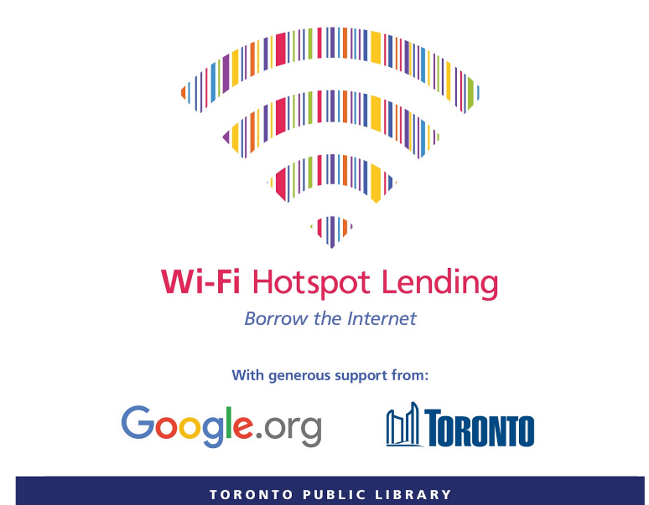
What Canadian public libraries are loaning hotspots?
Kitchener – 1st in Canada (October 2015). 2 week loan period.
Toronto – Pilot launched June 2016. 6 month loan period.
Notes:
Kitchener – started with 20; got another 20 and operating costs from Sandvine (ISP) in Dec 2016. 14 day loan period
Toronto – Approached by Google; grant. 10GB limit initially. 200 devices, 6 month loan period, low income individuals. Now 500 devices, unlimited data; partnership with Google, City of Toronto, Rogers.

Slide 8
EPL’s Hotspot loaning program

Slide 9
EPL’s Project Goals
To loan hotspots primarily to customers who do not have home internet. Customers who are socio-economically disadvantaged are the primary target of this program.
Success: 2/3 of users report through the follow up survey that they do not have home internet

Slide 10
EPL’s Project Goals
To increase digital literacy of customers who do not regularly use the internet through exposure to home internet
Success: 50% of users report using the hotspot to increase their comfort and familiarity accessing online content
Notes:
Fewer than 25% (n=10) hotspots are lost, damaged, or stolen during the first year

Slide 11
Year 1 – Circulation Details
Followed Seattle and Kitchener model:
3 week loan period
Adult borrowers with email address on file
No geographical restrictions
$1/day if late; $18 max
$210 lost fee
Notes:
Went to RFP; connected with Rogers
Reliant on self-selection for eligibility

Slide 12
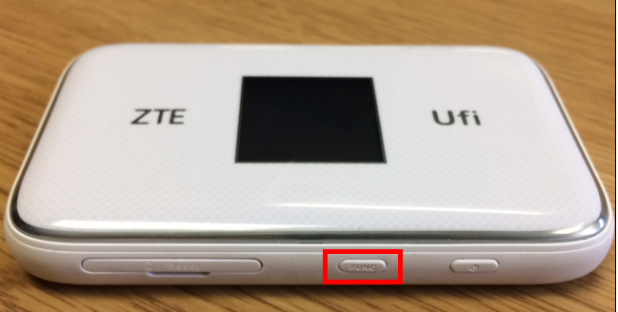
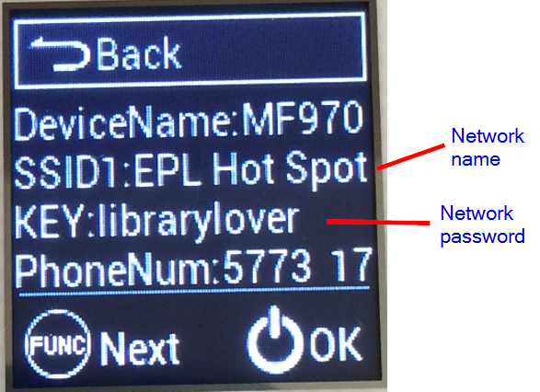
Year 1 – Additional logistics
Exit survey sent upon check in
Staff encouraged to NOT borrow
Service cut off on first day overdue
Notes:
Circulate in audiobook cases with charger
Small booklet included
Staff to demonstrate how to use with a branch ipad when checking out.

Slide 13
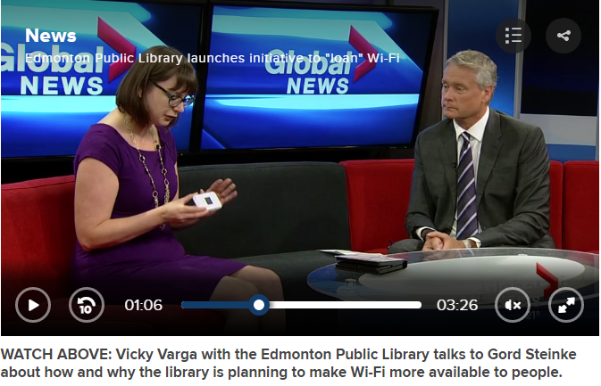
Year 1 – initial uptake
Media attention
530 holds in 1.5 weeks
Early postal code analysis suggested not reaching intended demographic
Notes:
Holds pa

Slide 14
Year 1 – Mid-Pilot Results
When you borrowed the hotspot, did you have internet access where you were living?
Response | # of responses | % of responses
Yes | 47 | 69%
Yes, but only through my cell phone | 15 | 22%
No | 6 | 9%
Success: 2/3 of users report through the follow up survey that they do not have home internet
Notes:
November 4
68 responses out of 117 transactions – 58% response rate
It is possible that these responses are not fully representative of the borrowing population; hotspot borrowers without home internet may be less likely to fill out the survey as they do not have easy access to the internet
While a majority of users (59%) indicated that they accessed the internet through their phones prior to borrowing a hotspot, only 3 of these users (4% total) chose this as their only response to the question.
No respondent indicated that they did not access the internet regularly prior to borrowing the hotspot

Slide 15
Year 1 – Mid-Pilot Results
Has using the hotspot increased your comfort with trying new technology?
Response | # of responses | % of responses
Yes | 46 | 68%
It had no effect | 19 | 28%
No | 3 | 4%
Success: 50% of users report using the hotspot to increase their comfort and familiarity accessing online content
Notes:
However, the program’s objective is “to increase digital literacy of customers who do not regularly use the internet through exposure to home internet”. Thus, while the program may be succeeding in increasing digital literacy skills among EPL’s customers, the intended audience has not been reached to date.

Slide 16
Year 1 – Mid-Pilot Results
Did you use the hotspot for any of the following reasons? (Choose your top 3 uses)
Response | Number | Percent
Maintain an internet connection while traveling | 33 | 49%
Connect with friends or family (Skype, Facebook, etc) | 21 | 31%
Read news / current events | 20 | 29%
Get directions (e.g. Google Maps) | 14 | 21%
Provide entertainment to a child while outside the home | 13 | 19%
Access banking or financial information | 10 | 15%
Watch something entertaining while traveling, running errands or exercising | 9 | 13%
Check out a product or service before buying | 8 | 12%
Complete work for my current job | 5 | 7%
Get information about health | 4 | 6%
Watch something entertaining at home | 4 | 6%
Learn job-‐related skills (such as certification) | 2 | 3%
Find or apply for a new job | 1 | 1%
Complete forms for health/other services | 1 | 1%
Help a child with his/her schoolwork | 0 | 0%
Notes:
Responses to this question further support the finding that the hotspot pilot to date is not meeting its objectives. Slightly fewer than half of all respondents (49%) indicated that they used the hotspot to maintain an internet connection while traveling. Conversely, only a single user indicated that they used the hotspot to find or apply for a job.
Similarly, while 13 users (19%) reported using the hotspot to provide entertainment to a child outside the home, no users indicated that the hotspot was used to assist a child with schoolwork.
The pattern of usage outlined by the responses to this question suggests that borrowers to date are not socio-economically disadvantaged (the primary intended audience of the program).

Slide 17
Year 1 – Mid-Pilot Postal Code Analysis
Compared to the entire population of Edmonton, people who borrowed hotspots:
Have a 19% higher average household income and have 24% higher average median household income
Are 29% more likely to have a university degree
Are 46% more likely to work in management; 37% more likely to work in a Science occupation, and are 22% more likely to work in a Health occupation
Notes:
In all, these characteristics do not paint a picture that aligns with the intended audience of the hotspot borrowing program. The generalized portrait that emerges is not of a group of users that are socioeconomically disadvantaged, lack home internet, or have low digital literacy skills.
This data further affirms the findings of the self-reported survey data – the current borrowing model is not successfully reaching the target audience. Borrowers to date have not self-selected for eligibility and/or have not internalized the message that the primary intended audience are those without existing home internet connections.

Slide 18
Year 1 – Mid-Pilot Postal Code Analysis
Compared to the entire population of Edmonton, people who borrowed hotspots:
Use their mobile phones to read digital newspapers, digital magazines, listen to radio/podcasts, and download videos as higher rates (20%+) than the average citizen
Use a tablet or eReader to watch movies/videos, search the Internet, email, watch TV, or access a social network at higher rates (20%+) than the average Edmontonian
Notes:
In all, these characteristics do not paint a picture that aligns with the intended audience of the hotspot borrowing program. The generalized portrait that emerges is not of a group of users that are socioeconomically disadvantaged, lack home internet, or have low digital literacy skills.
This data further affirms the findings of the self-reported survey data – the current borrowing model is not successfully reaching the target audience. Borrowers to date have not self-selected for eligibility and/or have not internalized the message that the primary intended audience are those without existing home internet connections.

Slide 19
Year 2 – Started July 4
Chicago model:
Loaning out of a subset of 4 branches
Toronto/New York model:
Recruiting borrowers via Community Librarians
Loan period = 3 months
Notes:
Based on demographic data available from Environics and Stats Canada, 4 EPL branches (SPW, ABB, CAL, HIG) score in the lowest third of branches for both average income and average home internet penetration
Recruitment strategy is aligned with Toronto and New York Public Libraries’ hotspot lending programs. Both libraries have vetted borrowers in advance of loaning and provide hotspot access for 6 months (Toronto) and a year (New York).
Loaning from subset of branches aligns with Chicago’s approach

Slide 20
Questions?

