Slide 1
FIRST NATIONS PEOPLE IN PICTURE BOOKS
Alberta Library Conference, Jasper, April 30, 2018
Presented by Gail de Vos, slis
Gail.devos@gmail.com

Slide 2
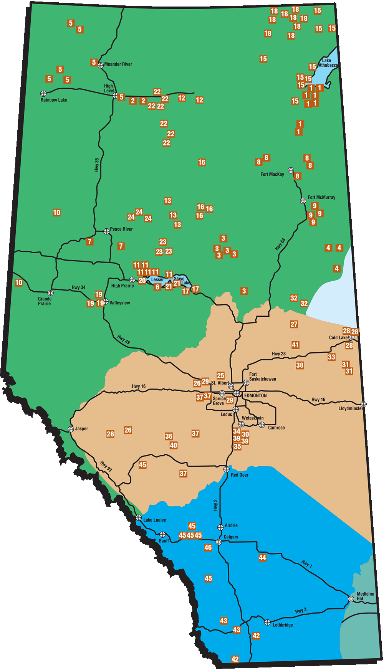
Alberta treaties
Treaty 8: 24 Alberta First Nations
Signed at Lesser Slave Lake in 1899; Covers portions of northern Alberta, British Columbia, Saskatchewan and part of Northwest Territories
Treaty 6: 16 Alberta First Nations
Signed at Carlton and Fort Pitt in 1876; Covers central Alberta & Saskatchewan
Treaty 7: 5 Alberta First Nations
Signed at the Blackfoot Crossing of Bow River and Fort Macleod in 1877
Covers southern Alberta

Slide 3
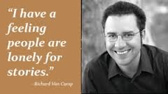
“Stories are powerful. Through story, we find out that we all share the human experience, no matter what culture we come from….Canada is a diverse country, and children should be exposed to other cultures in an atmosphere of tolerance and respect.” (Purdy, 18)

Slide 4
“Words and stories live: they help us to keep other beings alive, and they reinforce the bonds between ourselves and “all our relations,” to invoke a key phrase in many indigenous cultures, and world views, as well as in indigenous studies” (5)

Slide 5
Two categories that dominate the field of aboriginal children’s literature
Retellings of traditional tales and legends
Fictional stories about aboriginal youths in historical and contemporary settings

Slide 6
Cite and respect the source
Retold folktales, myths and legends specify the source for the story and details regarding changes the author made in retelling the story. The retold story reflects the tribe from which it originated.

Slide 7
Contemporary tales
Can be fiction or nonfiction
Can rely on traditional stories or not
“We exist as contemporary peoples, too, and our experiences in the 21st century are no less authentically indigenous” (Vowel, 97)

Slide 8
Primary characteristics:
Avoidance of the historical past, especially the 19th Century, as setting
Attempt to bridge oral tribal literature and contemporary written literature by depicting an egalitarian relationship between humans and other living things, including the land
Creation of resourceful, vibrant, and tenacious characters who act as counterpoints to the stereotypes of native peoples as an unsophisticated and dying race. (Wolf and DePaquate (90)

Slide 9
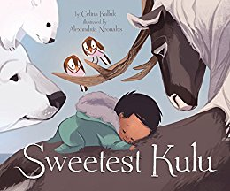
A Sense of community and family
Typically depict older generations playing crucial roles in helping aboriginal children establish or strengthen their place in aboriginal communities through the passing on of traditional knowledges.

Slide 10
Authenticity of voice
We believe native children should have books that do not demean or embarrass them or their heritage, but neither should they put them on a pedestal or in a glass case…children who are not native should be able to choose titles about native Americans—be they set in historical or modern times—that are free of outdated, stereotypical notions and free of factual errors” (Reese)

Slide 11
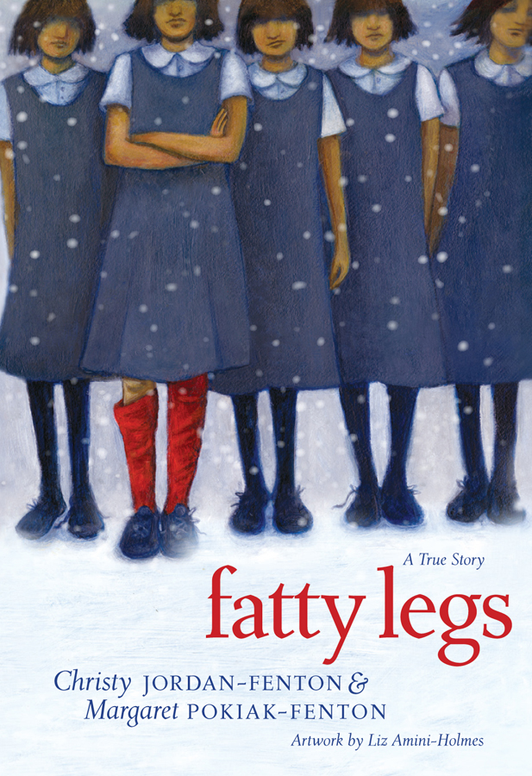
diversity
“Despite the diversity of tribe and lifestyle, most books that children read about native Americans are not about a specific tribe. Rather than creating culturally specific artwork, illustrators have intended to mix elements from different tribes, such as including a tipi and a totem pole in the same scene” (Reese).
Notes:
Reese, Debbie. “Authenticity and Sensitivity: Goals for writing and reviewing books with Native American Themes, December 1, 1999. online.

Slide 12
Common pitfalls in selecting first nations picture books for children
(Unfortunately the list keeps growing)

Slide 13
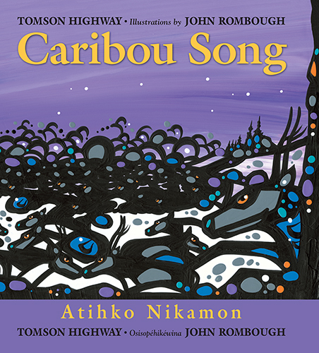
Not knowing enough
“As a society, we receive little formal information to be able to notice errors [when reviewing and selecting books]” (Reese)

Slide 14
“Fighting cultural appropriation is not just a way of lashing out at people engaged at it. There is a real desire to get accurate information out there, for indigenous and non-indigenous peoples alike.” (Vowel, 88).
“The emergence of social media platforms has created amazing possibilities for indigenous peoples to combat centuries-old stereotypes and misconceptions.”

Slide 15
CULTURAL APPROPRIATION
Until recently, “Within children’s literature the word appropriation usually refers to the taking of stories without crediting the source of the story” (Reese)

Slide 16
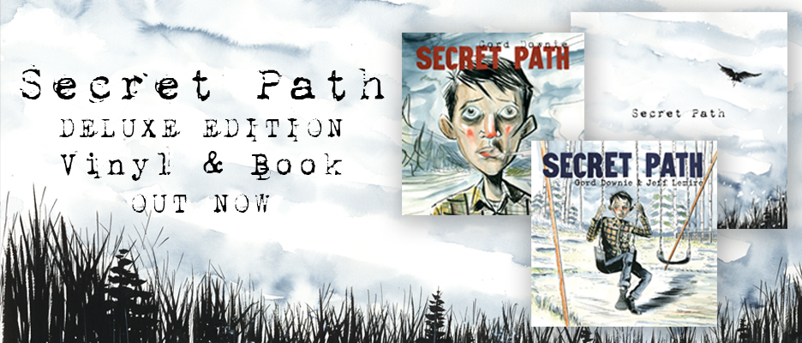

Slide 17
“There is a category of symbols in Canadian culture that is restricted within that culture. Not everyone can use those restricted symbols. There are rules about
how you can earn them,
who can fashion the symbols for you,
who can present you with these symbols,
What you can do with the symbols. (Vowel, 82)

Slide 18
MOST APPROPRIATED IN POPULAR CULTURE
“For the most part, headdresses are restricted items. In particular, the headdress worn by most non-indigenous peoples imitates those worn traditionally by only a handful of plains nations” (Vowel, 84)

Slide 19
“when authors write outside their own cultures, it is irresponsible not to consult several sources…they must be mindful of biases that exist in terms of who prepared the source, and when….it is necessary to ask expert readers with extensive knowledge of the culture to critique the manuscript prior to publication – and to listen to their recommendations” (Reese)

Slide 20
Not native enough

Slide 21
“There are specific protocols (rules) in telling stories that lay this provenance out for those listening. The person telling the story describes how he or she came to know the story, often sharing the circumstances surrounding being gifted with this piece of entertainment and knowledge.”

Slide 22
Selection criteria
Questions to ask when selecting picture books written by and about indigenous peoples

Slide 23
Important Questions to ask to determine authenticity
Which specific indigenous nation is this story from? (Cherokee, Cree, Dene, Navajo?)
Which community is this story from? (e.g. Saddle Lake Cree Nation, Enoch Cree nation. It needs to be a community that actually exists or existed at the specific time a version of the story was told.)
Who from the community told this story?

Slide 24
Is the story sensitive to the culture presented? Are the facts correct?
The terms First Nations or Aboriginal can refer to a diverse group of people, each with its own culture, language and history.
Each is distinct and should be regarded as such in the literature.

Slide 25
Common stereotypes: an aboriginal person depicted as the strong savage, the European as the heartless oppressor.
Are Native peoples portrayed as savages, or primitive craftspeople, or simple tribal people, now extinct?

Slide 26
Does the book invite understanding and acceptance? How will it affect a child’s self-image?
Who is the author? If the author is not from the culture being written about, does he or she cite references? Does he or she have a reputation for doing thorough research before writing? What is the author’s perspective?

Slide 27
Do the text and illustrations complement each other, adding to the effectiveness of the total book?

Slide 28
How is language used?
Language should not be used to demean another group.
Are there special words with special meanings? If so, are they explained?

Slide 29
1) In ABC books, is “E” for “Eskimo” or “I” for Indian present?
2) In Counting books, are “Indians” counted?
3) Are children shown as “playing Indian”?
4) Are animals dressed as “Indians”?
5) Do “Indians” have ridiculous names, like “Indian Two Feet,” or “Little Chief”?

Slide 30
Is there an ethnocentric Western focus on material objects, such as baskets, pottery, rugs? Examples include depicting these objects strictly as “art,” or as a means to trade with Euro-Americans.

Slide 31
Are Native peoples shown as “relentlessly ecological”?

Slide 32
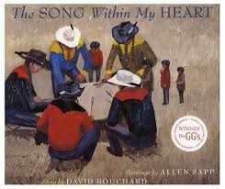
Are elders treated as a dispensable burden upon their People, to be abandoned in times of trouble or famine? Are they portrayed as querulous, petulant, demanding, nagging, irritating, or boring?

Slide 34
Residential schools
Additional picture books that address the various experiences in Canada

Slide 35
150 years of operation
150,000 children who attended
6000 children (at least) who died while in the system
67 % of schools run by the Roman Catholic church, 20% by the Anglican church, 10% by the United church, 3% by the Presbyterian church
1996 – the year the last school closed

Slide 36
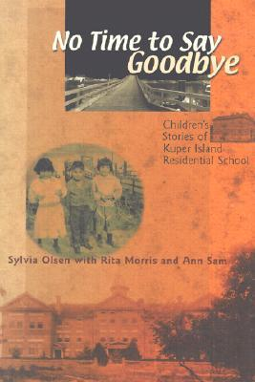
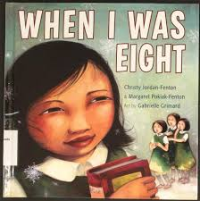
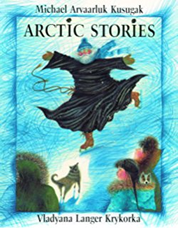
Truth and reconciliation commission of Canada (trc)
“We are explaining what is wrong, why it happened/happens, and what has to be done in order to create real change” (175).

Slide 37
The commission believes education is the key to reconciliation
QUESTIONS TO ASK

Slide 38
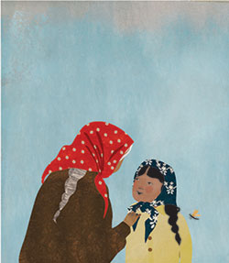
Don’t we learn enough about indigenous peoples in elementary and secondary school?

Slide 39
What about inclusion of indigenous topics in k-12.

Slide 40
What about our library collections?

Slide 42
Younging said these are some of the most common mistakes made by editors about Indigenous literature:
That non-Indigenous people can write about Indigenous communities and interpret their culture through their own perspectives.

Slide 43
That because Indigenous people are modern, they are no longer authentic. Editors assume that "when Indigenous peoples participate in modernity, they are turning their backs on their ancestors."

Slide 44
Indigenous people are written about in the past tense, when they are in fact very much alive and thriving.

Slide 45
That Indigenous literature is a subcategory of CanLit.

Slide 46
That publishers have the right to publish traditional stories — a trend Younging sees in children's literature.

Slide 47
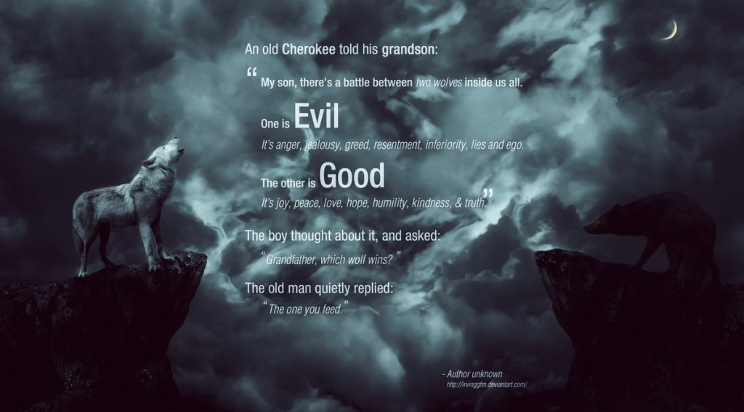
Notes:
https://shamanmysticsdreamingofapaganearth.wordpress.com/2014/05/19/the-cherokee-legend-of-the-two-wolves-myth-or-fact-the-possible-damage-from-fb-and-other-media-sources-not-checking-out-their-information-or-quotes/

