Slide 1
What’s the Deal
with Public Library Collections?
Findings of EPL’s 2018-2019
Collections Assessments & Trends Intern Project
Quincy Hiscott & Angela Lieu
The Alberta Library Conference 2019

Slide 2
Presentation Outline
Project Goals
Background Information
Digital vs. Physical
Circulation Trends at EPL
Costs Per Checkout
Collection Users
Customer Usage Trends
Demand-Driven Acquisition
Interlibrary Loan
Concluding Thoughts

Slide 3
Research Questions
What are emerging trends in physical and digital formats and how will they affect EPL’s customers?
Are EPL’s customers impacted by the digital divide?
Do EPL’s current collections policies and practices match collection usage, emerging trends, and customer expectations of collection size and selection?
How can EPL’s current collections practices, including interlibrary loan, be made more sustainable?
How does EPL compare with other similarly-sized library systems in terms of collections policies and practices (e.g. weeding, floating, lending policies, demand-driven acquisition) and interlibrary loan?
How does EPL compare with other similarly-sized library systems in terms of digital vs. physical collection size, budget, and usage?

Slide 4
Setting the Stage
Edmonton Public Library:
Population Served: ~1 million
Active Cardholders: ~275,000
Branches: 21
Collections Budget: ~$7 million
Notes:
This is some background info about EPL to help you contextualize all the other numbers we’re about to throw at you
Edmonton is approaching a population of a million
Out of those, approx. 275,000 Edmontonians were active cardholders in 2018.
We have 21 branches
Our collections budget has remained pretty steady over the last 5 years at ~$7 million.

Slide 5
Digital vs. Physical
Notes:
With the ever shifting technological landscape, libraries are challenged with finding an appropriate balance between physical and digital collections. So it’s important to consider both usage and costs

Slide 6
Digital vs. Physical
DVD loan period changed from 1 week to 3 weeks
Large shift in budget from physical to digital
Notes:
Overall, total circulation – when we consider both physical and digital usage - at EPL has increased.
Although physical circ has shown annual decreases, this has predominantly been made up for by increases in digital usage
Although the numbers tell us that physical collection usage is trending downward, contextualizing circulation data is very important.
Discuss the arrows (more on budget later)
We also know that there have been large changes in the commercial market in the last few years, with the rise of Netflix, Spotify, and other streaming services that have shifted how media is used
Measuring digital usage is also complicated…
Key finding: the numbers don’t tell the whole story; Usage of the physical collection at EPL is shifting and adapting rather than simply declining

Slide 7
Contextualizing the Data
Notes:
Following up on the added ‘context’ that we showed in the last slide, we saw pretty early on that it was useful to visualize this context in the same place, like this timeline!
Having a living “timeline” of significant events such as branch opening/moves can help explain changes seen in data. This is something we’ve recommended going forward at EPL, and we would recommend for your library to keep if you don’t already
[next slide]

Slide 8
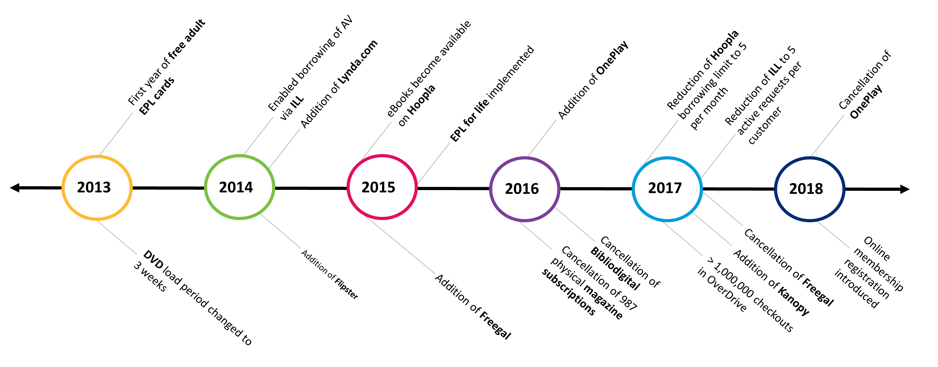
Contextualizing the Data
Notes:
To complement the locations timeline, we also found it useful to keep track of major shifts in our physical and digital offerings
The addition/cancellation of resources – particularly digital – can drastically impact circulation activity: this timeline serves as an extra checkpoint when you see a sudden increase or decrease in circ stats (i.e. impact of Freegal on eMusic stats).

Slide 9
Budget vs. Usage
Notes:
As usage has shifted, so have libraries’ budgets. The chicken vs. egg question is one we’ve wrestled with. (eg. how have changes to budget allocations affected circ figures, and how have those figures in turn impact how the budget is allocated)
This graph shows the % of circulations (dig. vs phys) compared with the % of the materials budget allocated between dig vs. physical collections
Circ = 30% digital, 70% physical
Budget = 40% digital, 60% physical
As you can see, budget allocation between the physical and digital collections broadly are a bit disproportional when compared with circulation (and even more so when compared to the number of customers served – will discuss later)

Slide 10
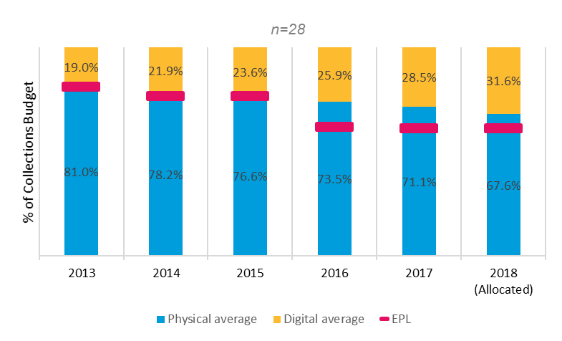
Budget: Industry Trends
Notes:
In order to compare this (as well as other policies/practices at EPL) with other public libraries in N. America, we conducted a large industry survey.
We won’t have time to go over the results of the survey in detail, but are happy to share the aggregated data (we’ll grab emails at the end)
Results of our industry survey suggest that: Generally, libraries materials budgets are increasingly being attributed to digital collections. Although EPL’s materials budget allocation on digital collections has been relatively similar to the industry average between 2013-2015, it’s been slightly higher than the industry average after 2015.
It’s important to note that libraries vary in their budget, population, and circs; EPL does generally offer more digital content than most other libraries

Slide 11
Circulation Trends
Notes:
With all this in mind, we will be further contextualizing circulation with emerging commercial trends and changes to policies, practices, etc.

Slide 12
Circulation by Format
Notes:
Methods:
Physical circulation data: BLUEcloud Analytics
Digital circulation data: Individual vendor platforms/emails
As we all know, comparing the two is difficult. What counts as a “circulation” in the digital realm can be defined differently, and this results in different metrics reported from various vendors.
With physical circulation, in-house use and renewals are not directly comparable to digital circ models.
Using the aforementioned methods, we calculated % of circs by format when compared to the whole. Just remember that physical circs still account for the majority of overall circs, so these two pies aren’t equal.
On the slide here, you can see that print books are still the bread and butter of library circulation (accounting for 63% of physical circulations, and x% of overall circulation). It’s interesting that eBooks only account for about a ~1/3 of digital circs, and that eLearning accounts for such a large chunk (this collection in particular does not have a direct physical counterpart).
These are also good for reference as you do format specific analyses, as we’re about to go through.

Slide 13
Trends at EPL: Books
Notes:
We will now go through some trends we’ve found when it comes to both physical and digital collections by format. For all the slides – Digital is blue, Physical is purple.
Print books are by far the most popular format at EPL, and has shown very little decreases in circulation despite significant environmental changes, with just a 4% decline from 2013-17 including the relocation of our central branch
When we dove deeper into specific sub-collections, we actually found that 70% of the decrease between 2014-17 are attributable to adult mass-market pbks alone (a collection that has been significantly impacted by print publishing trends)
Although eBooks are increasing in popularity, their usage falls far short of print, with only 16% of book usage being digital (increasing from 8% in 2013)
Interestingly, EPL circulates more juv print books than adult print books; but over 80% of eBook circulation is accounted for by adult materials.

Slide 14
Trends at EPL: Video
Notes:
DVDs/Blu-rays are the second most circulated physical format at EPL. In 2017, DVDs/Blu-rays accounted for approximately 25% of total physical circulation, while eVideo accounted for 3% of total digital circulation.
While DVD/Blu-ray circulation has dropped 26.6% from 2013-2017, as we’ve already mentioned the two largest annual decreases in circulation can be attributed in part to the change in DVD loan periods from one week to three weeks in 2014, and the closure of MNA in Q4 of 2016 (which you can see in the bar graph here).
It has been predicted that the optical disc may become obsolete within the next decade; however, a majority of popular content is not made available to public libraries digitally – and that is reflected our stats – looking at the pie chart timeline (TM Angela Lieu).
Contrary to other collections, adult content makes up the majority of EPL’s DVD/Blu-ray collection and circulation; however, the turnover rates between adult, juvenile, and teen material are relatively similar.

Slide 15
Trends at EPL: Audiobooks
Notes:
Audiobooks don’t make up a huge percentage of overall checkouts (3% of phys; 11% of dig), but their usage has shifted drastically over the last few years
Physical audiobook usage has decreased slightly, but as you can see – the usage of eAudiobooks has grown significantly, overtaking physical circs after 2015.
Compared to 2013, audiobook usage in 2017 have almost done a complete role reversal, with eAudiobooks now accounting for nearly two thirds of format usage.
Of course, changes to the accessibility and convenience of eAudiobooks, as well as technology shifts in smart phones, the lack of CD players in cars, etc., has spurred this change
Despite growing popularity and demand of eAudiobooks, public libraries are still facing challenges related to content availability by multinational publishers.

Slide 16
Trends at EPL: Music CDs
Notes:
Changes in the music industry, which have seen the rise of large-scale streaming and downloadable content, and have contributed to the decrease in sales of its physical formats, which we see echoed in our circulation stats (42% decrease in circulation between 2013 and 2017). It’s interesting to note that while adult music accounts for the majority of circulation, the juvenile collection has a higher turnover rate.
Here’s where you can see the impact of an eResource being added/cancelled, as Freegal increased digital offering eMusic between 2015-2017. Like eVideo, libraries aren’t able to offer the same content that is available commercially, or that we can offer with physical CDs, so it isn’t surprising to see that eMusic has not taken off.

Slide 17
Trends at EPL: Magazines
Notes:
The landscape of magazines has also shifted a lot in recent years. eMagazine circs have exceed print magainze circs at EPL since 2014; however, it is really important to note that at EPL customers are not able to check out the most recent issue of magazines, therefore a significant number of “uses” are not captured. We will talk about this a bit more later, but this speaks to the importance of collecting and considering in-house use data to contextualize physical collection usage – particularly for magazines and books. The limited in-house use data EPL collects does suggest that in-house is significant, and further closes the gap of physical/digital usage.
EPL also went through a significant reduction of the print magazine collection in 2015 which has certainly impacted this collection’s usage in subsequent years.
In terms of our eMagazine platforms, RBDigital (formerly OneClick Digital) account for about half of our circulations, while DragonSource (Chinese magazines) account for just over a quarter and Flipsster accounts for around a fifth. PressReader rounds out our eMagazine providers at 8%.

Slide 18
Customer Usage Trends
Notes:
In the interests of taking a break from pie charts, we’ll move on to discussing Customer Usage Trends. We investigated patterns in holds, weeding, and floating of the physical collection through our analytics tool BCA. Comparing holds, check-ins, weeding, and movement with checkouts can provide insight into how a library’s collection is being used and how policies and practice might be adjusted to better meet the needs and borrowing habits of customers, as well as staff workflow.

Slide 19
Holds vs. Checkouts
Format | Holds to Checkouts Ratio | Avg Annual Holds per Item
All Items | 1:3 | 2.1
Books | 2:5 | 1.8
Adult Books | 1:2 | 2.0
Fiction | 1:2 | 1.8
Non-Fiction | 7:10 | 2.4
Juvenile Books | 1:5 | 1.4
Teen Books | 1:2 | 1.8
World Languages | 1:10 | 0.3
DVDs/Blu-rays | 1:3 | 3.7
Audiobooks | 7:10 | 3.4
Music CDs | 1:2 | 2.7
Videogames | 1:2 | 3.8
Notes:
Context: To evaluate our floating collection (where our materials shift between branches based on customer holds/drop off patterns), we investigated holds-checkouts and average holds/item by format/collection.
One interesting finding is that some collections at EPL are holding collections, while others are predominantly browsing collections.
For example, juvenile print books and world language books (highlighted in red) have the lowest holds-to-checkout ratios AND avg annual holds per item – indicating that they are browsing rather than holding collections
These findings might inform the ways that EPL floats (or doesn’t float) its collections in the future, and can allow us to adjust our practices and holdings such that they more closely match usage and demand.

Slide 20
Supply vs. Demand
Collection | % of EPL Checkouts | % of EPL Holdings
Board Books | RIV 14% | RIV 10%
Large Print | ESQ 7% | ESQ 15%
Collection | Top Branch % of Checkouts | 2nd Branch % of Checkouts | 3rd Branch % of Checkouts | Top 3 Total % of Checkouts
Gujarati | MLW (70.6%) | MEA (19.9%) | WMC (5.3%) | 95.8%
Hindi | MLW (43.3%) | MEA (20.1%) | WMC (10.8%) | 74.2%
Punjabi | MLW (46.9%) | MEA (30.6%) | CLV (7.4%) | 84.9%
Urdu | MLW (50.3%) | WMC (13.0%) | MEA (9.8%) | 73.1%
Notes:
When we looked at branch specific collections and compared them to circulation, we found some discrepancies between “supply and demand”
For example:
First table
This is most starkly seen with the WL collection, where a vast majority of checkouts for specific languages are concentrated within just a few branches.
This is very true of South Asian languages.
Over 90% of Gujarati checkouts are at MLW and MEA, but they only hold approximately 40% of EPL’s collection.
This type of analysis helped us identify ways we might alter our collection distribution practices and policies to more closely meet the needs of specific communities and get the most use out of our collections

Slide 21
Return on Investment
Notes:
Now to the heavy hitter: our return on investment analysis. We did this in order to compare costs on a checkout level of physical and digital collections by format (such as book vs. eBook).

Slide 22
Costs Per Checkout
Cost per checkout of physical/digital formats are relatively comparable.
Formats vary greatly in costs of acquisition and circulation.
Digital licensing models are a key factor when it comes to cost assessments
In-house use is an important consideration for assessing physical collections.
Notes:
Here are some of our key findings.

Slide 23
Costs Per Checkout
Item Costs
(purchasing and vendor processing costs)
Collection Management & Access (CMA) Costs
(selection, acquisition, cataloguing, materials handling, item entry processing)
Branch Costs
(maintenance, shelving, check-in, checkout, inventory, weeding, automated sortation/check-in/checkout)
Transit Costs
(staff costs, operational costs)
Notes:
To calculate costs per checkout by format and analyze returns on investment, we considered 4 areas of cost and workload:
Item costs: purchasing, vendor processing (including labels, MARC records, RFID…)
The cost of CMA: was determined through a division-wide time audit in which we provided staff of each position with spreadsheets to record how much time they spent working on specific formats (eg. book vs. ebook vs. DVD vs. eVideo). We then used this data and staff wages to estimate the annual cost of staff by format. Using the number of items entering the collection we then determined the average cost per item of our collections staff. This also applied to digital formats (eg. books in OverDrive still get selected, content in hoopla gets catalogued, etc.)
Branch costs: done with existing data from system-wide activity assessments that EPL performs routinely. Accounts for staff activity from shelving, check-in/out, inventory, weeding, and automated machines..
Transit costs: includes consideration of staff costs as well as operational vehicle costs like fuel and maintenance.
A key metric needed for these calculations was the average lifetime checkouts of physical items by format. We determined this by analyzing discard snapshots and averaging all the lifetime checkouts of music CDs for example. And of course the number of annual checkouts of each format were critical.

Slide 24
Sample Formulas
$$Per Checkout Cost of<CMA Position>$$
$$\text{=}\frac{[\frac{\left[\left(weekly hours spent working on<Format>\right)×\left(hourly wage<CMA position>plus benefits\right)\right]×52}{Annual Number of<Format>Items Entering the Collection}]}{Average Lifetime Checkouts by<Format>}$$
$$Per Checkout Cost of Automated Checkout \& Check−In$$
$$= \frac{[\frac{Total Cost of<Machine Type>System−Wide}{Replacement Cycle of<Machine Type>in Years}]}{Total Annual Number of Checkouts}$$
Notes:
Here are 2 examples of the formulas we used in our calculations.
The first one is a generic cost of collections staff time per checkout based on our time audit
Walk through formula
The second breaks down how we calculated the per checkout cost of automated check-in/out
Walk through formula

Slide 25
Costs Per Checkout: Books
Notes:
Compared to other formats, books are relatively inexpensive to circulate, at $1.74/checkout (yellow bar). Due to their lending models and annual circulations, OverDrive eBooks are the least expensive reading format, while hoopla eBooks are the most expensive per checkout. Just a note that the OverDrive cost in the pink (0.97) is an average between their various lending models. Could increase return on investment with Freading and Safari with increased use.

Slide 26
Costs Per Checkout: Video
Notes:
When it comes to video, physical formats (DVDs and Blu-rays) provide the best return on investment due to high avg lifetime circs (over 50) and popularity of this format; it also has significantly more breadth and depth at EPL when compared to its digital counterparts
Hoopla and Kanopy cost $3.05 and $2 per checkout respectively (so hoopla does cost about $1 more); costs do not decrease with increased use like physical items due to their pay-per-use lending models

Slide 27
Costs Per Checkout: Audiobooks
Notes:
Audiobooks are the most expensive format at EPL both physically and digitally, predominantly due to their high initial purchase cost. There is also less variance in lending models when compared to eBooks (so besides hoopla, increased use will decrease costs per checkout). This explains why eAudiobooks in OverDrive (again in pink) are so inexpensive per checkout (high use, licenses don’t expire).
Intentionally promoting content in RB digital may help to decrease its cost per checkout.

Slide 28
Costs Per Checkout: Music
Notes:
For music, music CDs are actually quite comparable to hoopla, costing $1.71 per checkout – which is 10 cents less than the average checkout cost of an album in hoopla
EPL cancelled its subscription to Freegal in 2017 and that has really limited the digital music options available
eMusic in Naxos actually emerged as the most cost effective, however it is important to note that its collection is quite niche and does not provide access to “mainstream” content like the other two

Slide 29
Costs Per Checkout: Magazines
Notes:
Print magazines were revealed the most expensive magazine format to circulate; however, they are an example of a format that is difficult to accurately assess because of the limitations of in-house use surveying (especially as new issues cannot be checked out for a month). If we factor in in-house use estimates, the cost-per-use of print magazines would decrease from $2.04 to $1.31. This is also an important consideration for print books.
Despite this, RB Digital is still by far the cheapest magazine format to circulate (perpetual access, simultaneous use model).
Since PressReader is subsidized, it is not on this chart as it is free for EPL to circulate this content.

Slide 30
Users
Notes:
Circulation and cost don’t tell the whole story. What if your library has huge circulation figures but you found out only 10 people were using the collection?
How many people are using eBooks compared to books? How many people use both?
We wanted to try and analyze customers to better understand our borrower base and potentially identify underserved populations

Slide 31
Customers
Population
Customers
Cardholders
Customers
Difficult to capture; intangible library usage
Not all customers have cards
Borrowers
Cardholders
Likely to be employed, middle-class, and well-educated
Over-representative of families with young children, homeowners
Under-representative of low income households, seniors, lone parent families, and Indigenous people
Borrowers
Smaller, more socially and economically privileged subset of cardholders
Holders & Suggesters
Smaller, more socially and economically privileged subset of borrowers
Notes:
To analyze customer demographics, we used a software called Environics, which takes inputted postal code data and uses algorithms based on census information to provide aggregated demographic, geographic, and psychographic information.
We found that there exist different layers of library participation - with each layer of users demonstrating more social and economic capital, and each being smaller than the one before.
Anyone that walks through our door is an EPL customer, and many do not have library cards or do not make “tangible” transactions, so we don’t have an accurate data set for all customers.
EPL cardholders are likely to be employed, middle-class, and well-educated. They are over-representative of Edmontonians that come from families comprised of couples with young children, have post-secondary educations, and own their homes. On the contrary, Cardholders are under-representative of low income households, seniors, lone parent families, and Indigenous people.
Borrowers are an even smaller, more socially and economically privileged subset of cardholders (they are more likely to have a university education, own their home, have higher household incomes)
Holders & Suggesters are a Smaller, more socially and economically privileged (slightly older) subset of borrowers. Barriers related to access to the internet might also prevent some customers from accessing these services.

Slide 32
Users by Format
Books
n=157,927
Video
n=70,000
Audiobooks
n=40,933
Notes:
We also compared customer data by formats. For physical usage, we used BCA to determine the number of checkouts by format to each customer barcode, and for digital we again used vendor platforms that stored/allowed us to access this data. We then compared these datasets against each other to see how many customers were using only physical resources, only digital resources, or both. Due to data limitations from digital vendors, we were only able to do this analysis with books, Video, and Audiobooks.
As you can see by the yellow pieces of pies on the slide, EPL customers are predominantly and exclusively using physical materials. With books and video (which are by far our two most used formats), a vast majority of borrowers only borrowed the physical version of these formats in 2017, with only 16% and 6% of format borrowers using both physical and digital versions of these respective formats.
Audiobooks are the only format where we know there are more users of the digital collection that the physical collection (but as we noted earlier, they account for a relatively small percentage of usage compared to other formats)
These are important considerations when thinking about spending and acquisitions as it relates to physical vs digital collections by format.

Slide 33
Power Users
Notes:
Whenever possible, we analyzed “power users” within collections-related services or platforms
That is, we looked at the top 10% of users of a specific service and figured out how much of the overall usage they account for.
Upon this analysis, it is clear that power users are prominent in all collections-related activities, with the top 10% users of a service or platform accounting for close to (and often more than) 50% of usage
For example:
10% of borrowers account for 57% of physical circulations
This means nearly 4.6 million of our 8.1 million circs are accounted for by just 17,000 people in a city with a population of almost 1 million
10% of holders account for 60% of the 2.5 millions holds placed each year
This is particularly interesting in services with smaller user bases such as digital content
eg. EPL spends over a million dollars in OverDrive content each year.
58% of checkouts in OverDrive are attributable to 10% of OverDrive users, which is only 1.4% of EPL cardholders and 0.4% pf the population.
We did find that power users are less prominent – and that usage is more spread out – in platforms with more rigorous customer limits
For example: at EPL, customers have a 5 checkout per month limit in hoopla , and as you can see– power users in this platform account for just under half of hoopla’s total annual usage

Slide 34
Demand-Driven Acquisition
Notes:
Following up on our goal to assess demand-driven acquisition at EPL, we looked at our two customer suggestion platforms: BiblioSuggest and OverDrive Recommend to Library. Since EPL is a community-led organization, there is the argument that everything we do is demand-driven and in response to community needs, so this is only part of the picture of DDA at EPL.

Slide 35
BiblioSuggest
Notes:
Methods: Looked at total requests and approval vs. denials by exporting data from BiblioCommons (using status reason to come up with approval/denial rates)
Number of requests have remained steady since the launch in 2014. When we look at approval/denial rates (pie chart timeline at the bottom of the slide) the percentage of denied requests increased by 7% after 2015 (which is when the automatic denial of titles older than 10 years was introduced).
We believe this has impacted how the ILL service is used/perceived by our customers.

Slide 36
OverDrive RTL
Notes:
Methods: “Recommendations” report from marketplace, had to manually parse out approval/denial based on the “Added to collection date” relative to “request date” in Microsoft Access.
Due to the rise in popularity of OverDrive, suggestions made in RTL have increased significantly, causing over half of requests in 2017/2018 to be denied; in large part to budget.
These findings do raise some questions about the long-term sustainability and service – especially as it relates to digital content.

Slide 37
Platform Comparisons
Notes:
OverDrive RTL surpassed BiblioSuggest in both the number of suggestions and the number of users beginning in 2017 and looks to maintain this lead
Only 5% of active cardholders at EPL make suggestions for purchase
When we cross-referenced users, we found that almost 2 thirds of suggesters are exclusively suggesting in RTL, and only 4% of suggesters make suggestions in both platforms
This is interesting considering the physical collection serves significantly more users than OverDrive does
Both these platforms (esp. RTL) have more rigorous limits than other services, so power users are less prominent.

Slide 38
Interlibrary Loan
Notes:
We also looked at usage and cost of the ILL service at EPL.
Due to reporting limitations in VDX, we were able to obtain title-level request data from OCLC going back to 2013 so that we could compare requests by format, publication year, and approval/denial.

Slide 39
ILL Requests
Notes:
As you may or may not know, EPL is the top borrower of ILL nationally, and the number of borrowing requests fulfilled for EPL customers far exceed the number of lending requests from other libraries The 5-active request limit implemented in March 2018 has led to a decrease of approximately 1000 borrowing requests per month compared to 2017.
Average turnaround time for ILL requests to be received was 42 days in 2018. This has yet to recover from the backlog of requests that were cleared also in March 2018.

Slide 40
ILL Requests
Notes:
As with other services and general circulation, books are the most oft-requested format in ILL (70%)!.
You can see, indicated by the blue bar in the bottom chart, that there is a marked increase in requested titles over 10 years old after 2015, when the BiblioSuggest limit was implement.

Slide 41
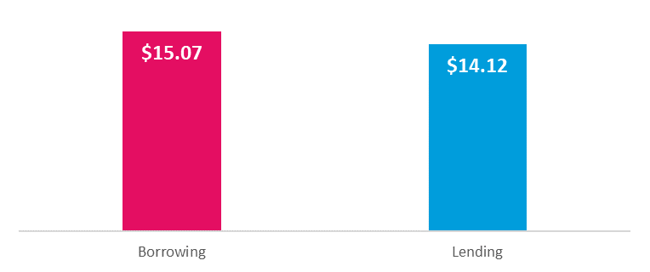
Cost of the ILL Service
$377,000
CMA Costs | Branch Costs | Transit Costs
$360,762 | $12,629 | $3,546
Annual Cost Per User: $60.21
2018: 6,260 Users
Notes:
Overall the annual cost of the ILL service is approximately $377,000, with a majority of this being attributed to the staff at CMA. ILL materials also need to be handled by branch staff and transited to and from branches, check-in/checkout add additional costs that make borrowing ILL items more costly than lending to other libraries.
To calculate the annual cost and the costs per transaction, we re-used data from our time audit and staff activity assessments to determine the time spent working on and delivering ILL materials
The cost per transaction of ILL is extraordinarily high – at $15.07 for borrowed items and $14.12 for items lent.
Compared to an EPL book at $1.74 per checkout
Almost 9 times as much!
With 6,260 users in 2018, Annual cost per user = $60.21

Slide 42
Interlibrary Loan vs. Acquisition
3 Checkouts
ILL
Acquisition
BUT:
Copies-to-holds ratios
Content availability
Collections policies
Costs & Budget
Notes:
We also wanted to compare the costs of procuring items through ILL with the cost of acquiring and circulating the same items in EPL’s own collection.
To do this, we took the cost per ILL ($15.07) and compared this with the average cost to get items “shelf-ready” by format (determined from data from our time audit and ROI analysis) plus the cost per checkout
We found that: At its current costs, the average item needs only to circulate only 3 times after purchase for the item’s acquisition to be more cost-effective for EPL than its procurement through ILL. This “threshold” number varies by format; adult fiction books need only to circulate twice; non-fiction books, DVD, and CDs 3 times; while audiobooks need to circulate at least 5 times for its purchase to be more economical than its attainment via ILL for the same number of checkouts.
This provides insights into how customer ILL requests might be used to inform collection development at EPL; however, (as you know) acquiring requested items is easier said than done. The availability, cost, and subject matter of requested material complicate this process (especially for older titles)

Slide 43
Concluding Thoughts
Collections – particularly the physical collection – remain an important, popular, and valuable service to EPL’s customers and Edmontonians more broadly.
Collection usage at EPL is shifting and adapting rather than simply declining.
Collections assessment and decisions must be contextualized with shifting market trends, library policies and practices, customer demographics and preferences, cost efficiencies, etc.
Notes:
Now that you’re probably hoping to never see another pie chart in your life, or you have an insatiable urge to seek out some pie at lunch today, we’ll leave you with some key themes that have come through all the layers of our research.
<read through slide>
Angela is now a Youth Services Librarian, while I am the Licensing and Collections Assessment Librarian, so you will be able to reach us at our EPL emails!

Slide 44
Recommendations
More robust and contextualized collections assessment and analyses.
Adjustments to collections policies, practices, and/or budget allocation to enhance sustainability and equitability.
Advocacy, outreach, and marketing opportunities.
Reducing barriers to collection access.
Pilots to assess how system-wide changes might impact customers, workflow, cost, and usage.
Notes:
We came up with many recommendations based on our findings – from low hanging fruit to big picture pilots
Broadly, we’ve really seen the importance of…
This includes in-house use, and customer surveys related specifically to collections
We’re recommending some adjustments…
This includes things like copies-to-holds rations, customer suggestion limits, etc.
We’ve identified some opportunities for advocacy, outreach, and marketing – as well as ways we might reduce barriers to collection access such as removing overdue fees and innovative ways to improve digital literacy and access
Lastly, we’re also recommending some pilots to…
Big ones include changes to the floating collection at EPL

Slide 45
Questions?
angela.lieu@epl.ca
quincy.hiscott@epl.ca

