Slide 1
Alberta Library Conference April 28,2018 Jasper, Alberta
Video in Education is NOT Dead! Is it?

Slide 2
COVERAGE
Current video needs, wants and exploration
Changes to resources in the last couple of years
How changes to LMS affects video
Streaming versus DVD
Format questions
Cataloguing, access, and platforms
Is DVD Dead? NOT!
Audience participation & Questions

Slide 3
Current Videos Needs - Let’s Explore!
What do users need? FACULTY
Easy to use with the Learning Management System (LMS)
Short (under 20 minutes for a full video or under 10 minutes for concept clip)
Can share with other faculty who teach similar courses
STUDENTS
Complete information in one video
Ability to use it at home or on their mobile device
Easy to find and use (no extra steps or software to install)
“Netflix” like behaviour

Slide 4
Current Videos Wants - Let’s Explore More!
What do users want?
FACULTY | STUDENTS
Quick and easy searching and playing | Entertainment as well as learning
All in one place | Historic information on select topics
Easy to use | Easy to use
Current and relevant | Up-to-date materials
Stable (links don’t change or disappear) | Contemporary information on contemporary issues
“YouTube” like behaviour | Citations available when they use for class work

Slide 5
Resource Exploration
Current trends in video resources
“Netflix” like presentation
“YouTube” viewing
Streaming Digital video platforms
Video Hosts
Coming trends in video resources
Video platform blended with learning management systems
Specific video type platforms (Documentary only, News Only, etc.)
Video Portals or Corporate platforms for all materials by one producer.
Digital video producers also producing ‘complete’ courses and Courseware producers creating digital video on a single platform.

Slide 6
Market Exploration
Marketplace changes
More subscription based general viewing platforms
Smaller number of video producers/distributors
Video producers/distributors moving to becoming Online Video Distributors (OVD)
Free versus fee for service
Platform changes
Smaller bandwidth demands for online video
More tools to streamline integration of video
Simplified players
Access changes
Different access models (subscription based, individual title purchases, Patron Driven Access [PDA])

Slide 7
User Exploration
Faculty changes
Incoming faculty are more tech savvy and can manage the different styles and platforms without much difficulty.
More information available about how to successfully integrate video in courses via blogs, sharing and helps.
Adding digital content to curriculum via LMS support, peer-to-peer teaching and Library services support is easier.
Example of this is the TechSmith Blog: 10 Ways You Can Use Video to Enhance Your Digital Learning Content about digital content from the makers of CAMTASIA a video capture tool. (Amboy, 2017)
Student changes
New incoming students are also more tech savvy and use their devices for more things in a given day than before. The younger students have more experience with their devices.
Digital divide still a factor – where some students are still in a position of not being able to access or to keep up with changes in the digital environment.
*age and technical capability

Slide 8
Changes to Resources - Sources
Sources in the Last 5 Years
Reduction in the number of video producers and distributors – consolidation of vendors
Growth in platform availability – more variety
Purchase model changes - addition of PDA model or license based on usage

Slide 9
Changes to Resources - Law
Law in the Last 5 Years
Canadian Copyright law update (amended 2017-06-19)
changed the definition of educational use of video materials
no longer requires Public Performance Rights clearance to use video in class for educational purposes

Slide 10
Changes to Resources - Availability
Availability in the Last 5 Years
Understanding that feature films can be used in education successfully.
Increase in free use sites
Examples*
TeacherTube, Edutopia, YouTube EDU, Classroom Clips, … Brightstorm, … Videolectures.net, TED-Ed, ….) (Dunn, 2012)
*Always remember to check the Terms of Use and your workplace policies to ensure you can use the items in your situation.

Slide 11
Learning Management Systems (LMS) Changes
Updated LMS software is now incorporating more tools to handle video resources.
BrightSpace (Desire2Learn aka D2L)
Films on Demand has a LTI (Learning Tools Interoperability) App for D2L which makes available a ISF (Insert Stuff Framework) widget in the D2L course editor to embed resources directly from the FOD platform. Authenticates video within the LMS and does not require further information from the student to access.
Links can be added to Course pages, emails, resource pages or bibliographies by Faculty with ease.
Easy sharing tools and clipping tools for embedding exactly what the faculty want to show.
Notes:
This is a time saver for faculty versus having to add the link by modifying the HTML for their course page to get it to work properly.

Slide 12
Questions of Format
Retired formats VHS, 16mm film, Betamax, & U-Matic (Broadcast)
What does retirement really mean regarding video formats?
What is still available?
DVD, Blue-ray & Digital Streaming video
What is still being used in class & Why?
What will faculty not let go of?
Are rights available to convert to alternate formats?
Can’t any item be purchased in digital format?

Slide 13
Cataloguing and Access
Access Points
Library Catalogue or Discovery Search Portal
Platform Access Links – A to Z List of Resources
Resource Lists – Libguides, pathfinders?

Slide 14
Cataloguing and Access
Considerations:
Are people using the catalogue as an access point that includes loaded MARC records for video?
Are people using only the URL link to the platform for searching?
How are students finding and using video? Google, WorldCAT, Library Website…
How are library staff training users to find materials?
It that different to how faculty is finding and using video?

Slide 15
Is Video Dead? I think NOT!
Video continues to be relevant to users.
Faculty
Faculty need & want to introduce concepts in manners that ensure the students get access to information in various forms that will help them solidify the concepts being taught.
Students
More students are self-identifying as visual learners and need the materials presented in video to solidify concepts for them in class.
Student are seeking more video materials to explore or cement concepts they have been exposed to in class.

Slide 16
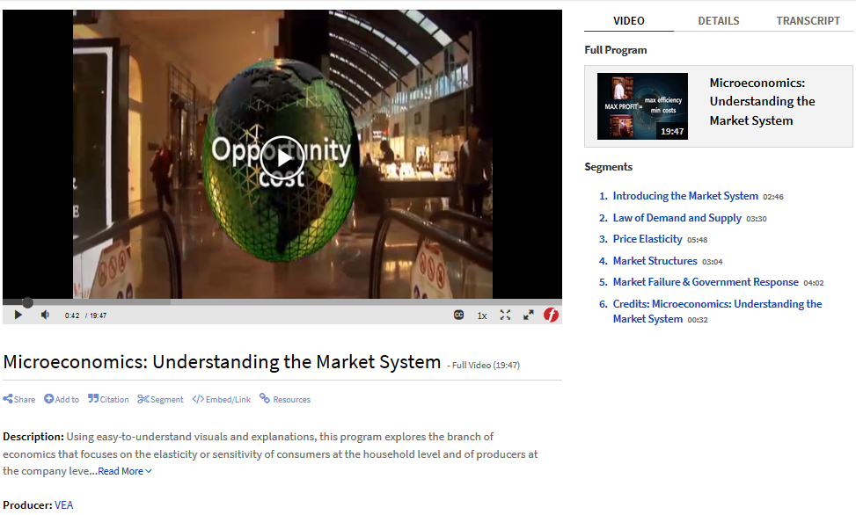
A New Way To See A Concept

Slide 17
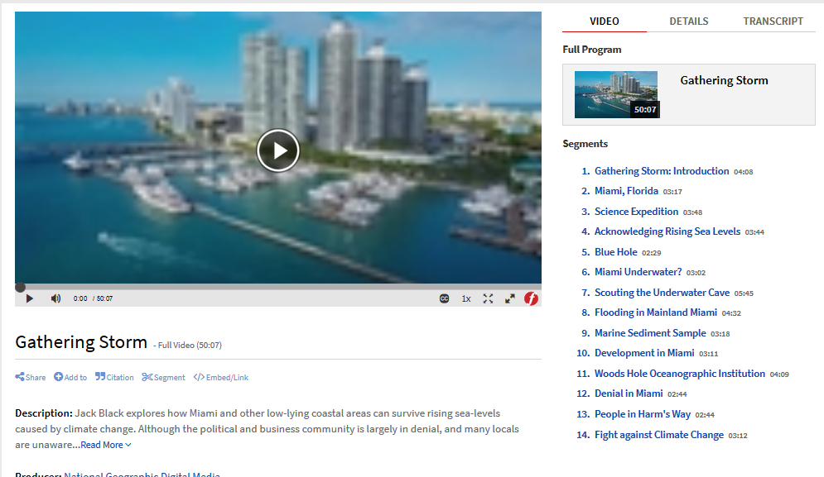
Documentary Learning

Slide 18
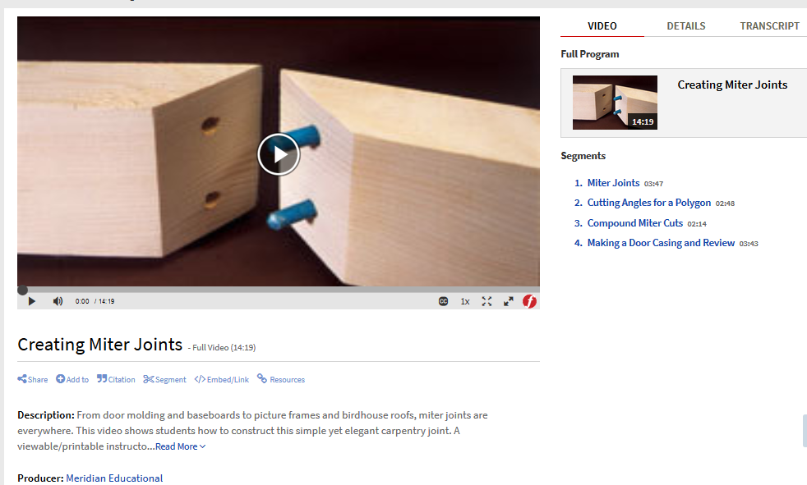
How To Video…

Slide 19
Proof Video is NOT Dead!
Materials
Video is still an ideal format for specific types of materials, including documentary information or how-to demonstrations.
As long as visual stimulation helps learning, video will continue to be relevant to students and faculty for their own reasons.
More and more materials are being made available for educators to use in classrooms to augment their own course materials.
Task specific video education is relevant for students.

Slide 20
Video is Not Dead… According To The Statistics
Statistics for Digital Video Usage

Slide 21
Video is Not Dead… According To The Statistics
Statistics for Digital Video Usage

Slide 22
Video is Not Dead… According To The Statistics
Statistics show consistent growth
Year over year growth for PDA and Subscription
Year to year dip in Films on Demand contributed to program cycle use of materials for courses that are offered every 2 years.
Acquisition type is not a factor, though there are cost savings gained from PDA or DDA programs.
Subscription materials have a larger volume of materials, but more dated material as well.

Slide 23
Video is Not Dead… According To The Statistics
Physical DVD usage
In 2016 we moved classroom use videos to a more open shelf environment after declining usage.

Slide 24
Audience Participation
Shared Experiences from the Audience?
Who else has experiences changes in how their video materials are being used?
How many have experiences changes with format requests?
Are you being asked to license more in digital now than before?
Do faculty want to speed of streaming over the dependability of DVD?
Does anyone still maintain a VHS collection or 16mm film collection? What problems is that creating?
Are any libraries seeing a decline in video use or have stopped purchasing video altogether?
Questions?

Slide 25
Bibliography
Creating miter joints [Video file]. (2004). Retrieved January 11, 2018, from https://fod.infobase.com/PortalPlaylists.aspx?wID=102699&xtid=31982.
Segment: Cutting Angles for a Polygon
http://fod.infobase.com/PortalPlaylists.aspx?wID=102699&xtid=31982&loid=15952.
Gathering Storm. 2017. Accessed January 11, 2018. https://fod.infobase.com/PortalPlaylists.aspx?wID=102699&xtid=138065.
Microeconomics: Understanding the market system [Video file]. (2011). Retrieved January 11, 2018, from https://fod.infobase.com/PortalPlaylists.aspx?wID=102699&xtid=48959.
Dunn, Jeff.(2012, August 10). The 100 Best Video Sites for Educators. Retrieved from http://www.edudemic.com/best-video-sites-for-teachers/.

Slide 26
Contact Information: AnneMarie de Groot Coordinator of Technical Services & AV Services, Reg Erhardt Library Learner Services Southern Alberta Institute of Technology Stan Grad Centre, MC115 1301 – 16 Avenue NW, Calgary AB, T2M 0L4 (Office) 403.284.8431 email: annemarie.degroot@sait.ca Pronouns: She/her

