Slide 1
Creating a sense of belonging in students using culturally responsive and inclusive teaching practices
2023 VILSC Conference May 5, 2023
Ying Liu, M.A., M.L.I.S
Linguistics, Asian Studies & Religious Studies Librarian
Aditi Gupta, M.Sc., M.L.I.S
Engineering & Science Librarian
Qichen Zhong, M.A..
Graduate Student Assistant

Slide 2
PROJECT TEAM !
Aditi Gupta | Engineering & Science Librarian University of Victoria | aditig@uvic.ca
Ying Liu | Linguistics, Asian Studies & Religious Studies Librarian | yingliu@uvic.ca
Tad Suzuki | Fine Arts & Humanities Librarian (Retired) | suzukit@uvic.ca
Dr. Tsung-Cheng Lin | Associate Professor, Pacific & Asian Studies | tclin@uvic.ca
Qichen Zhong | Graduate Research Assistant | qichenzhong@uvic.ca

Slide 3
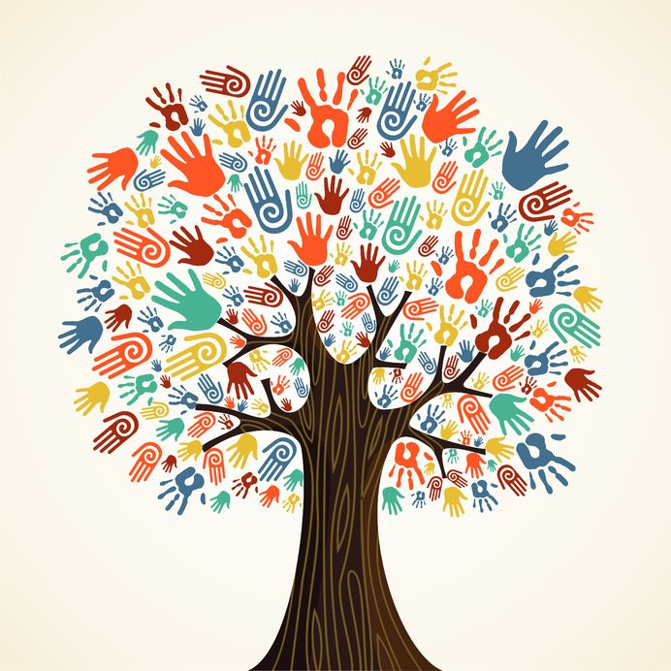
WHY THIS RESEARCH?
At UVic Libraries :
Librarians and library staff answered over many user questions
Offer library instruction sessions
Diverse student body (21000 total student population)
Very active LGBTQIA2S+ and BIPOC communities
Lack of culturally responsive and inclusive pedagogies
Lack of cultural competency skills
Our aim is to improve the student learning outcomes by creating inclusive teaching strategies and removing cultural barriers.
This Photo by Unknown Author is licensed under CC BY-SA-NC

Slide 4
Culturally Responsive Teaching
Inclusive Teaching Practices
“using the cultural knowledge, prior experiences, frames of reference and performance styles of ethnically diverse students to make learning encounters more relevant to and effective for them.” -Gay (2010)​
“The goal of inclusive pedagogy is to help all students feel like a valued member of the classroom because of the unique background and perspective they bring to the experience.”​ -Watts (2017)
Watts, J. (2017). Inclusive Cultural and Social Pedagogy in the Library Classroom. LOEX Quarterly, 44(1), 4.
Gay, G. (2010). Culturally responsive teaching: Theory, research, and practice. (2nd edition). Teachers College Press.

Slide 5
PROJECT OUTLINE
2021
2022
2023
2023
Literature Review
Focus group discussions
Developing toolkit
Wide implementation
Information literacy, frameworks of culturally responsive & inclusive pedagogies
Three to four focus group discussions with students, librarians and library staff and faculty.
Creating an open toolkit with best practices and guidelines.
Using a creative commons license will widely disseminate the toolkit

Slide 6
Faculty | Librarians/Library Staff | Students
Databases, resources, library collections have a White, Eurocentric perspective making it hard to decolonize curriculum Cultural backgrounds make faculty uncomfortable The curriculum has a settler perspective | Academic librarianship is a white profession Inclusiveness in library space, design, collections is missing Trauma-informed instruction Understanding of language and linguistic barriers, cultural norms, student demographics | Barriers - physical spaces for people with disabilities Issues - online access & connectivity Students feel library anxiety Library jargon and commercial names - create barriers

Slide 7
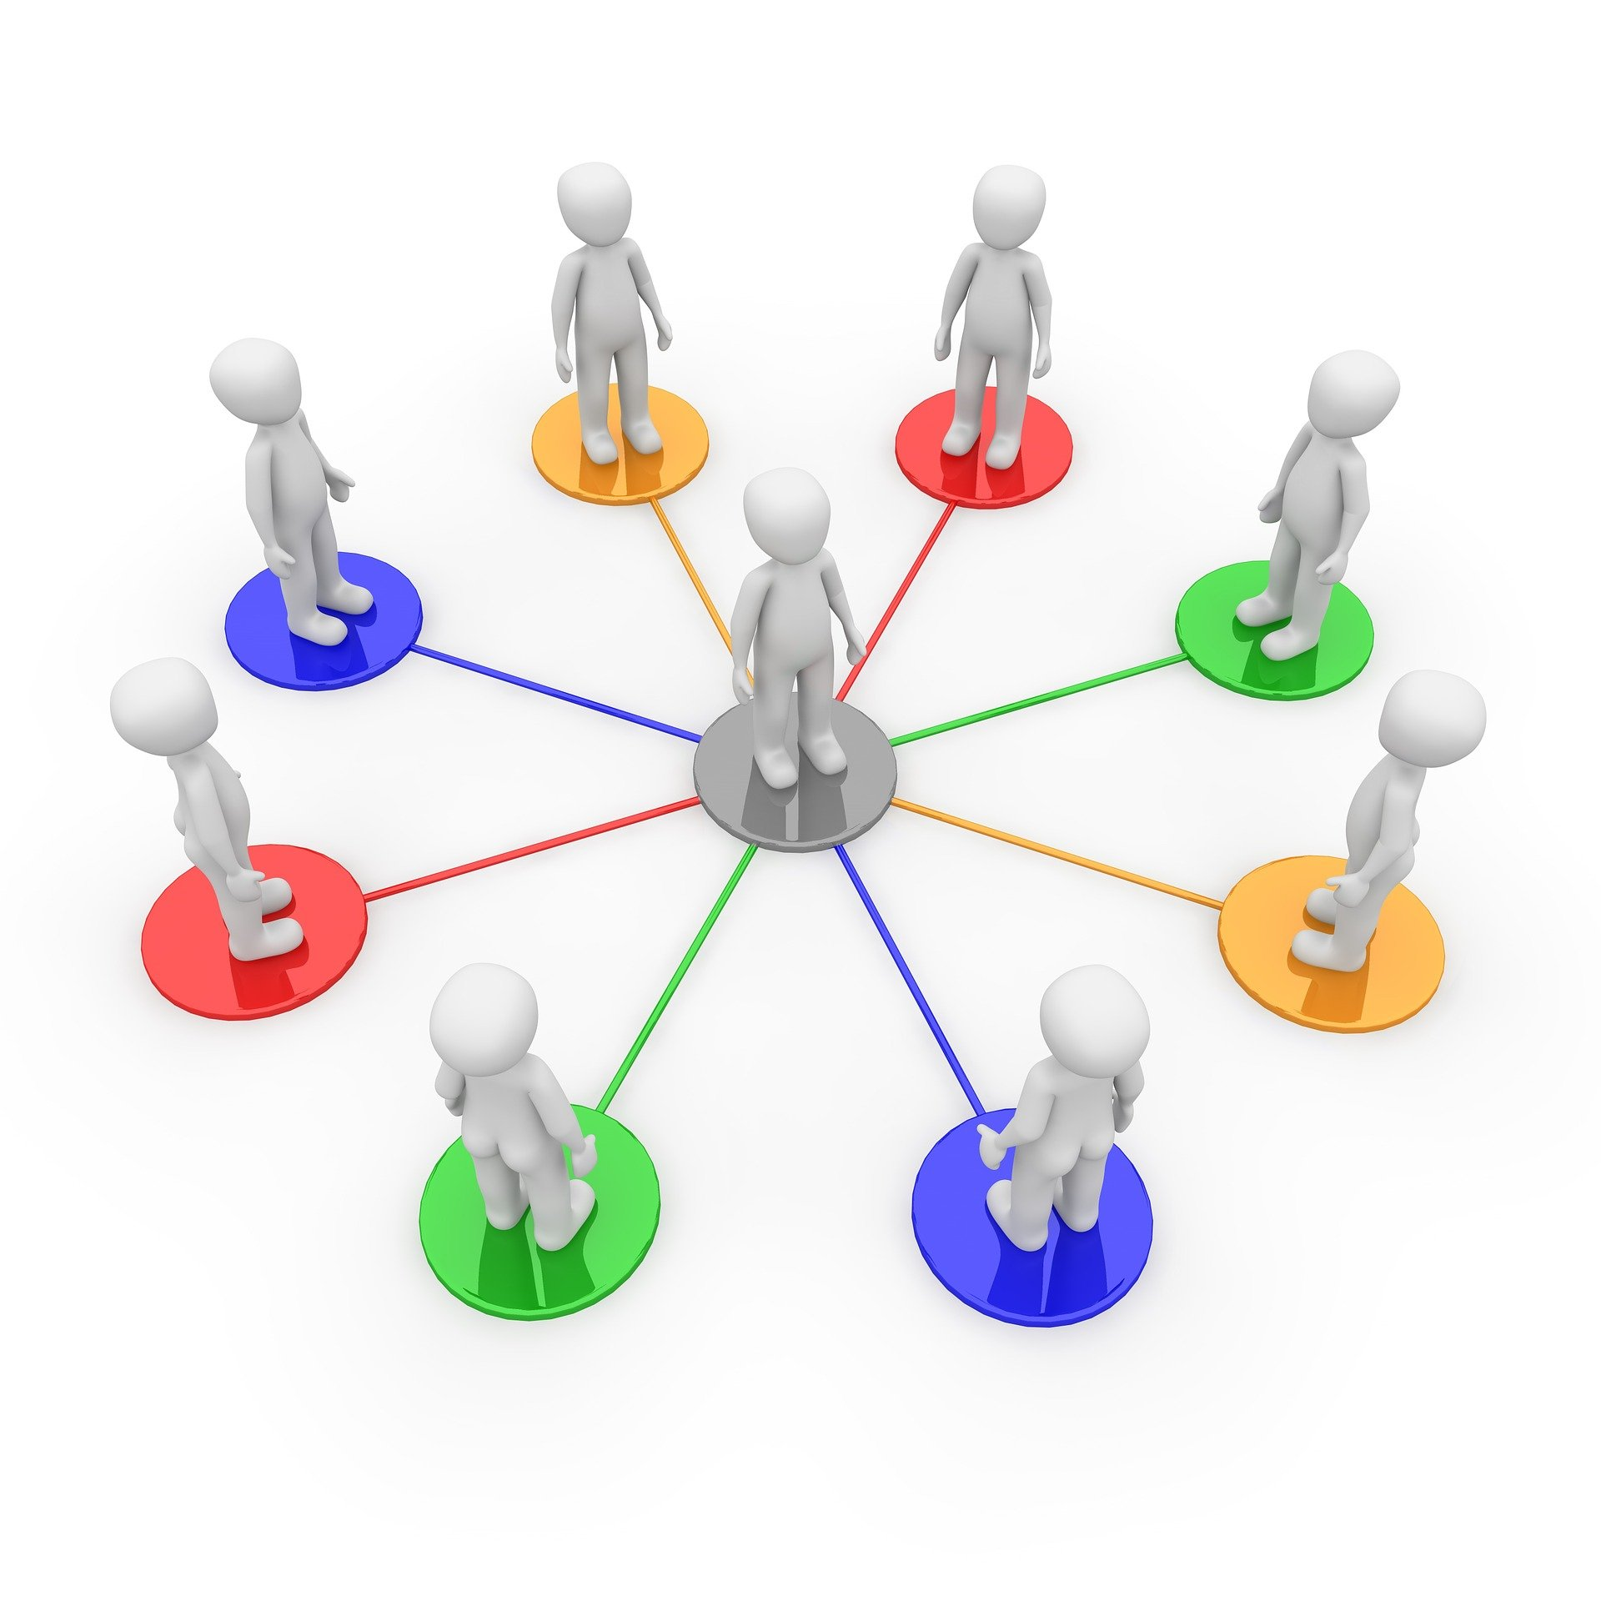
Activity
Things to keep in mind:
Making sure everyone gets a chance to speak.
Support a shared, inclusive, positive and respectful environment for all participants
Be considerate of cultural beliefs, lived experiences, racial histories in discussions
Maintain awareness and respect the diverse viewpoints, beliefs, and cultural norms that may unintentionally provide debate or disagreement
Source: https://pixabay.com/images/download/network-1019778_1920.jpg?attachment&modal

Slide 8
Scenario 1: Patron Demographics
How would you make interactions more meaningful?
Authority & Privilege
Hidden diversity
Diverse perspectives
Photo by Brooke Cagle on Unsplash

Slide 9
Large group sharing or Collective Sharing
(5-7 mins)

Slide 10
Scenario 2: Curriculum & Collections
The collections, curriculum, databases all represent a colonial view, what should I do??
The whole material is so colonial and racist
How do we develop awareness of the collections we provide to patrons? In light of the tight budgetary restrictions, what do we do to ensure our collections provide diverse perspectives?
Source: https://www.pexels.com/search/stress/

Slide 11
Large group sharing or Collective Sharing
(5-7 mins)

Slide 12
Scenario 3: Cultural acumen
They just told me, “since you are an immigrant or international student, you need to learn Canadian culture, start to speak English and forget what you learned in your country”. What should I do?
How do we engage with people from diverse linguistic and cultural backgrounds?
Source: https://www.pexels.com/photo/a-stressed-student-reading-a-document-7777149/

Slide 13
Large group sharing or Collective Sharing
(5-7 mins)

Slide 14
Questions?
Aditi Gupta: aditig@uvic.ca; Ying Liu: yingliu@uvic.ca

Slide 15
Resources for further exploration
Further Reading
Brown-Jeffy, S., & Cooper, J. E. (2011). Toward a Conceptual Framework of Culturally Relevant Pedagogy: An Overview of the Conceptual and Theoretical Literature. Teacher Education Quarterly, 38(1), 65–84. https://www.jstor.org/stable/23479642
Gay, G. (2010). Culturally responsive teaching: Theory, research, and practice (2nd ed). Teachers College.
Harris, R., Vincent, A., & Michelle, O. (2019). A work in process: Cultivating inclusive classrooms. https://www.carli.illinois.edu/products-services/pub-serv/instruction/WorkInProcess-HarrisOhVincent
Ishimura, Y., & Bartlett, J. C. (2014). Are Librarians Equipped to Teach International Students? A Survey of Current Practices and Recommendations for Training. The Journal of Academic Librarianship, 40(3), 313–321. https://doi.org/10.1016/j.acalib.2014.04.009
Ladson-Billings, G. (1994). What We Can Learn from Multicultural Education Research. Educational Leadership, 51(8), 22–26. https://www.ascd.org/el/articles/what-we-can-learn-from-multicultural-education-research
Overall, P. M. (2009). Cultural competence: A conceptual framework for library and information science professionals. Library Quarterly, 79(2), 175–204. https://doi.org/10.1086/597080
Pang, V. O., Stein, R., Gomez, M., Matas, A., & Shimogori, Y. (2011). Cultural Competencies: Essential Elements of Caring-Centered Multicultural Education. Action in Teacher Education, 33(5–6), 560–574. https://doi.org/10.1080/01626620.2011.627050
Villegas, A. M., & Lucas, T. (2002). Preparing Culturally Responsive Teachers: Rethinking the Curriculum. Journal of Teacher Education, 53(1), 20–32. https://doi.org/10.1177/0022487102053001003
Tools for improving spaces:
Privilege checklists
Ableism checklists
Personas
Examples re: equity and infrastructure:
The Talbot Ave Bridge
https://www.youtube.com/watch?v=wWjw7NnIUoc&t
Erie Viaduct
https://www.youtube.com/watch?v=m7El724iGt4&t
Mapping Inequality Project
https://www.youtube.com/watch?v=kAUr5oeBqW0
Flint, Michigan water supply
Linda Musser, Penn State University, lindamusser@psu.edu

