Slide 1
LIBRARY AS CREATOR
And not just aggregator
Nathan McKay, April Ripley, and Darby Love

Slide 2
BACKGROUND: WHY WE WANTED TO STEP MORE MEANINGFULLY INTO THIS ROLE
1
Advocate for and lead the way in community knowledge creation, sharing, reuse, and free access
2
Facilitate access to community of ideas; multi-directional flow of ideas
3
Ability to focus on locally produced knowledge and resources; respond to & meet the unique needs of our communities
4
It's something libraries already do in a number of different ways so are well-positioned to expand and innovate the role
5
Pushed forward by pandemic and sudden, new contexts
Notes:
- “The mission of librarians is to improve society through facilitating knowledge creation in their communities.”
R. David Lankes (The New Librarianship Field Guide (MIT Press, 2016, p.23)
-It's something we already do in a number of different ways and might just not have thought of it in that way (programs, videos, newsletter, instructional documents, etc.)

Slide 3
EXAMPLES FROM
VIRL'S
ADULT PROGRAMS COMMITTEE
1
Sea & Cedar: Literature & Art Magazine
Library as Publisher/Small Press
2
Meet Me in the Stacks
Library as Podcaster/Broadcaster
3
Virtual Gardening Series (w/ VIMGA)
Library as Gardening Influencers
Notes:
hi there!

Slide 4
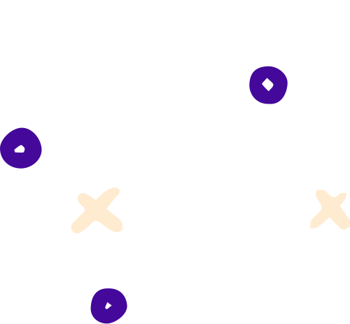
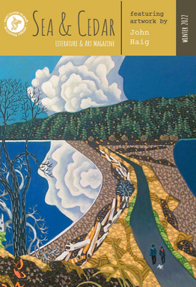
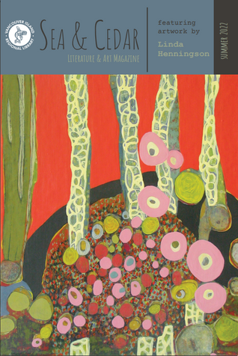
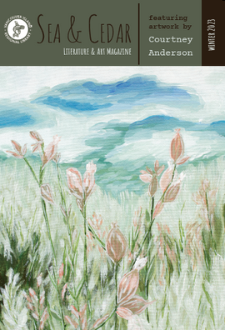
SEA & CEDAR
Literature & Art Magazine

Slide 5
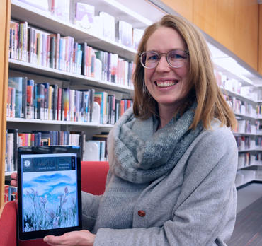
Publish selected poetry, short fiction, creative nonfiction, and art (solicit submissions from community and curate a collection)
Sea & Cedar Magazine
Pay contributors for their work (support, value, respect)
What are
we doing?
Started out digital only, expanded to print and digital combo by our 2nd issue
Twice yearly publication featuring new writing by both emerging and established writers in VIRL’s service area; also highlighting local artists with one featured artist (including cover feature and interview) and one contributing artist per issue.
Digital issues available free via website & print issues free to borrow from our collection
Limited print copies also available for purchase

Slide 6
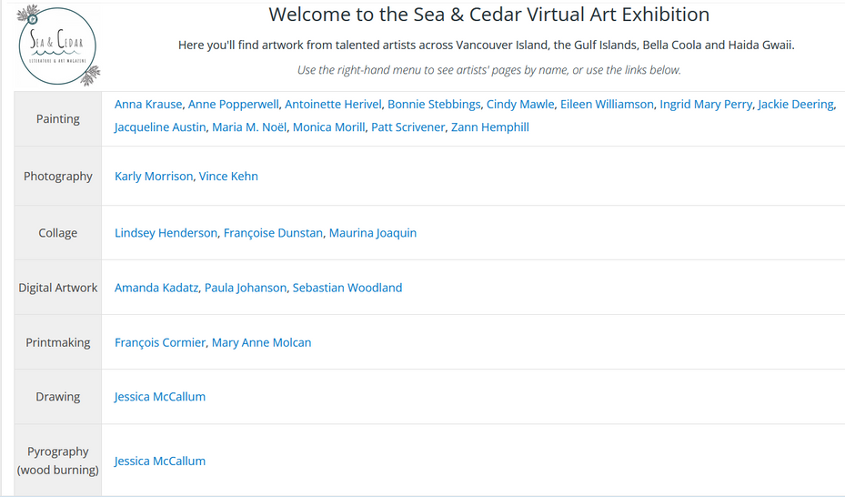
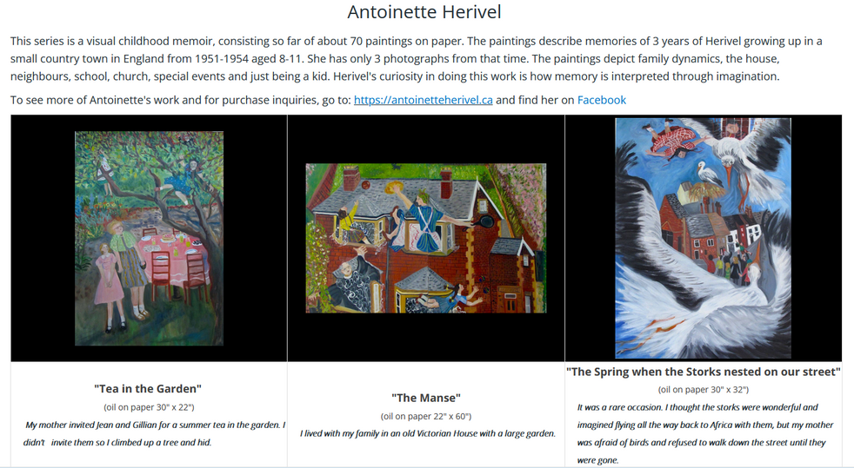
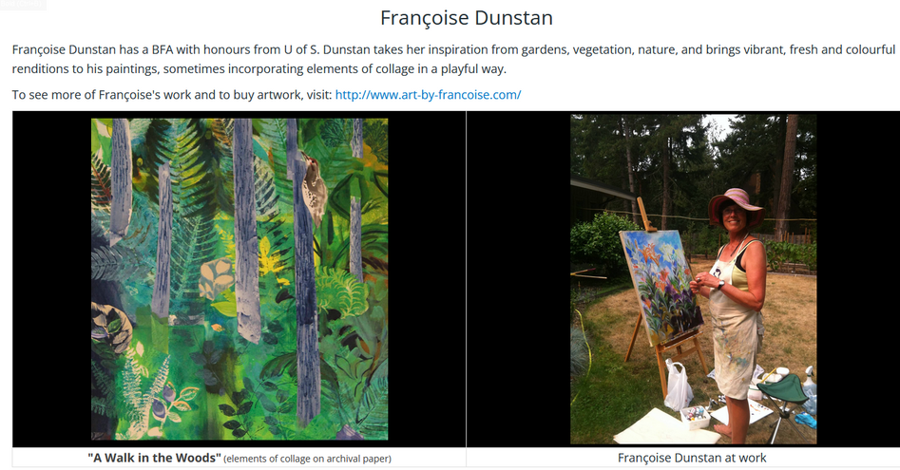
Sea & Cedar Magazine
Virtual Art Exhibition
A SUCCESSFUL IMPROVISATION
Between two 3-month long exhibitions, the VAE has received over 8600 views!

Slide 7
Benefits:
WHY LIBRARY AS PUBLISHER? WHY A LITMAG?
Provide a platform for a diverse range of voices
Actively engage and demonstrate support for creators in our communities
"When libraries publish, they preserve the vibrant history and culture of their communities, give our patrons quality literature to enrich their lives, and create a way for as many voices as possible to contribute to the song of our literary history" (Katz, 2021).
Increase local access to paid publishing opportunities
GREAT RESOURCE!
Provide access to engaging and thought-provoking local content
Katz, S. (2021). Libraries publish: How to start a magazine, small press, blog, and more.

Slide 8
Project plan & foundation:
Mission statement & scope
Budget
Format & basic design
Name
GETTING STARTED
Editorial team & responsibilities
Submission guidelines
Tone (appearance & content) Branding (fonts, logo)
Email address
Honorariums
Terms of publication & publishing agreements
Communication templates

Slide 9
Workflow and processes:
Submissions management
Content decisions
Communication w/ prospective & accepted contributors
GETTING STARTED
Editing
Software (InDesign)
Issue layout & design
Proofreading
Printing
Distribution
Sales process

Slide 10
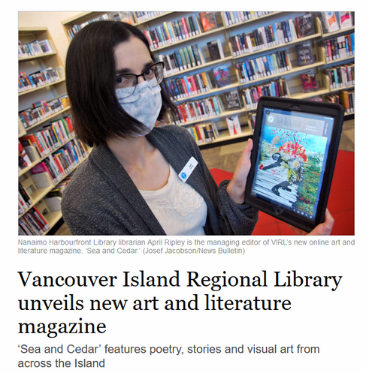
Marketing & promotion:
Website
Social media
GETTING STARTED
Local radio, newpaper
Community contacts & networks
Hosting issue launch events
Contributors

Slide 11
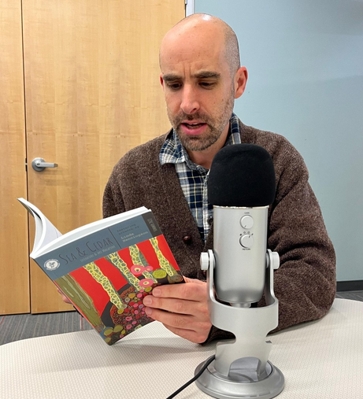
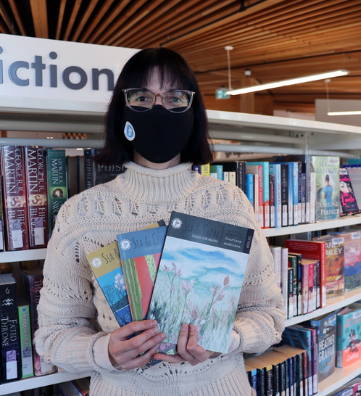
Print issues circulating continuously in our collection as some of our most popular titles in non-fiction
Sea & Cedar Magazine
Starting to be collected by other libraries (VPL)
Where we're
at now...
Receiving continuously high numbers of submissions, and room to grow
Explore new promo venues
Issue sales - room to build this up to better meet demand
FOUR ISSUES SUCCESSFULLY LAUNCHED, WITH NUMBER FIVE UNDERWAY FOR THIS SUMMER!
Linked programming and partnerships
Meet Me in the Stacks podcast episodes featuring Sea & Cedar writers
Writing workshops
Readings and launch events
Library resource promotion and collection building

Slide 12
MEET ME IN THE STACKS
A Podcast for Bookish People

Slide 13
LOTR*
Precursor to MMITS
2016 ALA Award winning radio program with CHLY
(Presidential Citation for Innovative International Library Projects)
*LIBRARIANS ON THE RADIO

Slide 14
We're making audio content
and releasing it as a podcast
MMITS Podcast
Available through VIRL website
and external services
What are
we doing?

Slide 15
Types of content
Repurposed virtual programming
(Zoom events, etc.)
MMITS Podcast
Original local content made for the pod
Cross-promotional to coincide with VIRL events
What are
we doing?
Book-ish*
*Book related or broadly book-adjacent. We're not super picky.

Slide 16
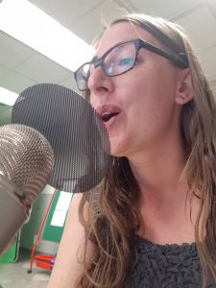
Allows us to repurpose virtual programming in a more consumable format with minimal extra effort
Allows for participation by anyone at VIRL willing to make content, not geographically constrained
Simple way of providing system-wide content available across all branches
Service to local authors & public, promotes local content
MMITS Podcast
Why are
we doing it?
Benefits!

Slide 17
Some of the topics:
Eden Robinson Interview
Theremins and Libraries of Things
Bob Joseph 21 Things you Didn't Know about the Indian Act
Island Short Fiction Winners
Rebel Mountain Press Interview
Best Books of the Year
COVID-19 Conspiracies
Talk Bookish To Me segments
Sea and Cedar Specials
Haunting of Vancouver Island
Trivia
Poet Laurate Episode
Gift of Adversity filmmaker
Fine Crimes
Phone Booths

Slide 18
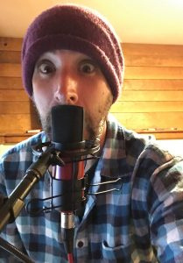
How do we make it?
Folks record audio (live, online via Zencastr or Zoom)
Nathan edits the audio and adds intro/outro and music
Darby posts episodes using Libsyn
Technical Requirements:
-Podcast or usb capable mic (Blue Yeti, Focusrite)
-Audio editing software (Logic, Garageband, Audacity)
-Zoom or Zencastr (for online recording)

Slide 19
HOW IS IT GOING????
Q: How do stats compare with branch-based adult programming?
Total Downloads: 4000+
MMITS is now the #1 library podcast on Vancouver Island!

Slide 20
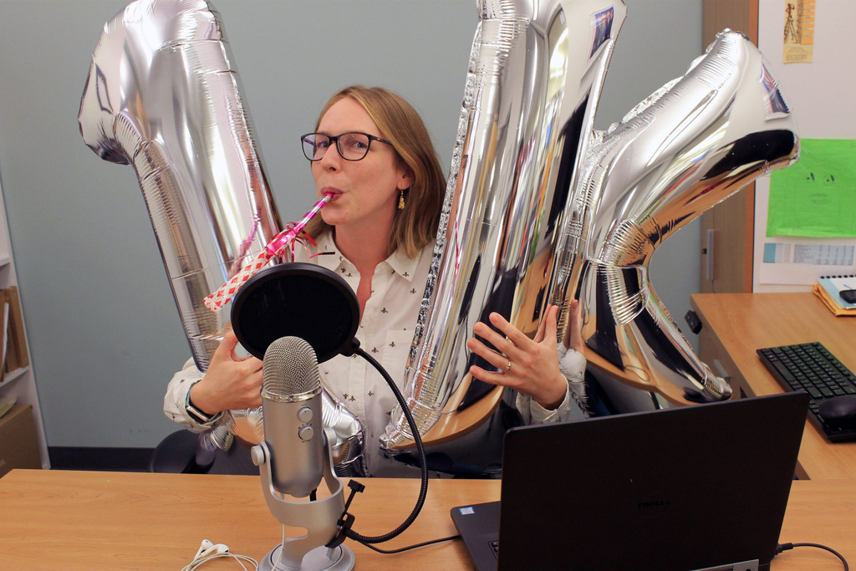
Success!
Success!

Slide 21
VIRTUAL
GARDENING SERIES

Slide 22
Virtual
Gardening Series
Hosting an ongoing monthly series of locally relevant talks provided by the gardening experts of Vancouver Island Master Gardeners Association (VIMGA)
What are we doing?
Building a library of all of the recorded events and related gardening resources
Began as a way to continue a single branch in-person program immediately following the initial COVID disruptions and has since grown continuously in popularity

Slide 23
Virtual
Gardening Series
Growing skills & literacy
Why are we doing it?
Food security & affordability
Seed Libraries in our branches
People just love gardening!
Notes:
-couldn't offer this scale of program and the quality without the partnership with VIMGA and their generosity in sharing their expertise, and tirelessly answering audience questions.
1) We help people grow their skills and various literacies as libraries.
2) governments and individuals are concerned with food security and affordability. Gardening at home (even in containers) is a way for people to have good nutrition with little money and some knowledge and work.
Pandemic supply chain issues and massive droughts/floods have had major impacts on availability of foods we take for granted, as well as the price in the past few years.
3) Just under half of our 39 branches have a seed library. This programming dovetails nicely with that service/collection.
4) People love gardening! It has huge mental health benefits and folks in our service areas are hungry for this information! It fosters community through sharing of knowledge and materials.

Slide 24
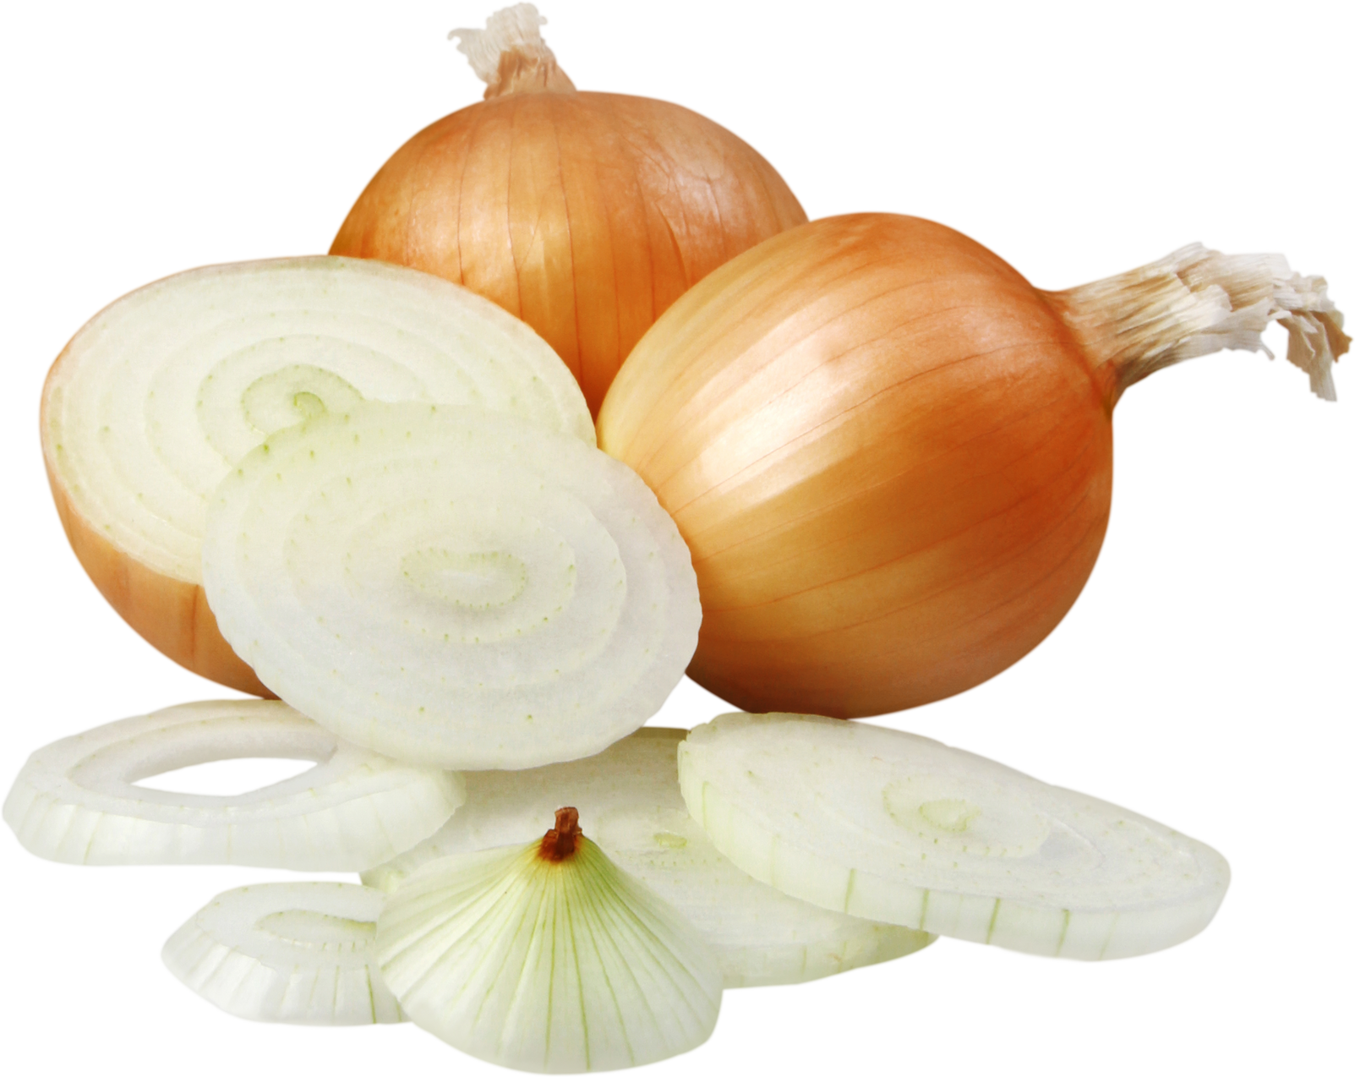
For the Onion Friends!
Virtual
Gardening Series
Why are we doing it?
Notes:
Fun story: I actually gave a participant some Egyptian Walking Onions after nobody knew where to get them in a store. I got mine from a friend!

Slide 25
Work with a VIMGA coordinator to create a yearly month-by-month schedule of topics and find presenters
Virtual
Gardening Series
How are we doing it?
Registration via Eventbrite
Use webinar function of Zoom to ensure privacy of attendees for recording
Provide book lists for topics chosen by the Master Gardener
Attendees listen to the presentation portion and put their questions into the Q & A feature of Zoom webinars

Slide 26
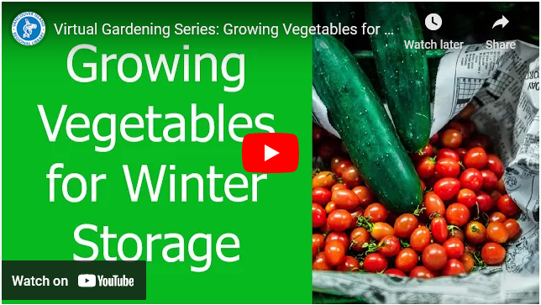
Virtual
Gardening Series
Niche Academy platform with YouTube embedded video
Notes:
We record the video, then it is edited and uploaded to YouTube. People can discover the videos on YouTube, through our Niche Academy portal from our website, or from the link that is emailed to registrants.
The Niche site is evolving so that we include the handouts and book lists with the topics as well.
The videos are kept indefinitely.
So far, they are solely arranged chronologically but as our back catalogue grows I think we will be looking at other ways of presenting the info.

Slide 27
How is it going?
Growing Vegetables for Winter Storage
Climate Change: what it means and how to cope
Intro to Pruning
Container Gardening
Rhododenrons
Growing Herbs
Notes:
-21 recordings so far
-various topics, from food to ornamentals
-people love the Master Gardeners

Slide 28
How is it going?
Registrations and live attendees at recent talks:
Feb -494 reg, 211 attended
March -500 reg, 245 attended
April -386 reg, 140 attended
Notes:
-Registrations moved from a webform via our wordpress platform website to Eventbrite for ease of use
-Social media promo and FB boosting resulted in "selling out" our webinar allowance
-We now will "oversell" the presentation knowing that about half of the adults who register will show on the day and that many reg. to get the video link after
-We were actually pretty delighted with our smaller numbers of fewer than 80 people too. Not many adult programs bring in that many people!

Slide 29
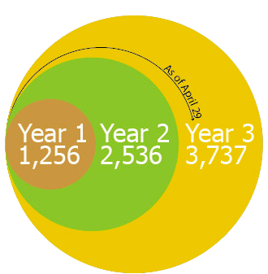
How is it going?
Total views of the videos since the launch:
Notes:
-Like with the podcast, we are making the best use of our and the presenters' time by creating these videos
-Attendance was lower for the first year, but ...
-Snowballing views!
-Year 3 numbers are just to April 29th and we have more sessions to add and 7 more months to be viewed!

Slide 30
How is it going?
Working on Master Gardeners advising on our Seed Libraries
Lots of knowledge needed for seed saving, educating the public, and making operating them sustainable.
Notes:
-We are working on creating some staff education with the MG's.
-The regional spread of our system is always a challenge as our communities are unique and the branches are differently staffed according to size.
-Currently as many ways of offering a Seed Library service as there are locations offering them.
-some are partnerships with community orgs, others are solely the branch's

Slide 31
QUESTIONS?

Slide 32
THANK YOU
for creating with us!

