Slide 1
The Truth About Fake News
Craig Silverman, BuzzFeed News | @CraigSilverman

Slide 3
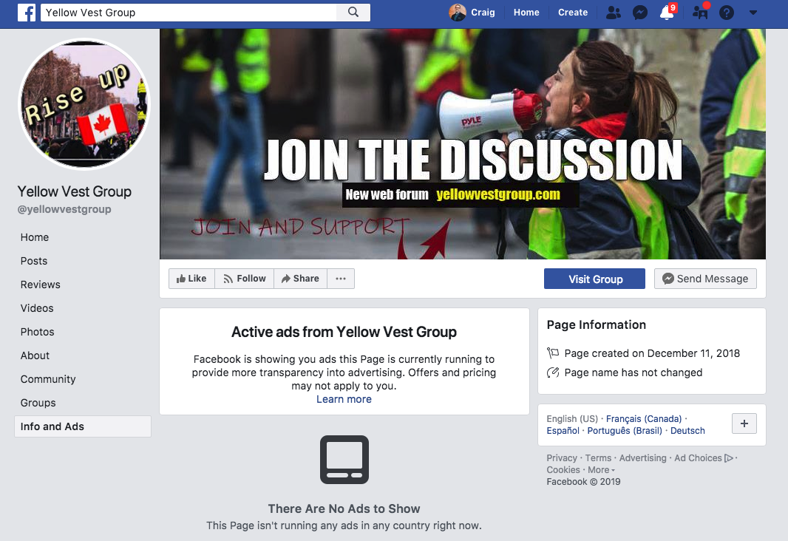

Slide 4
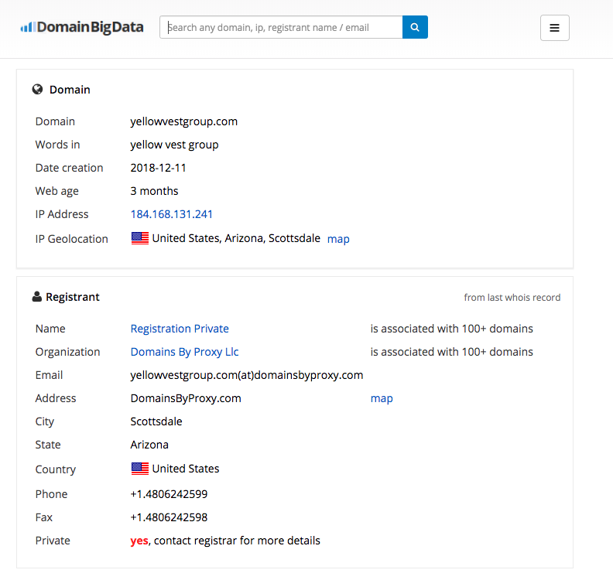

Slide 5
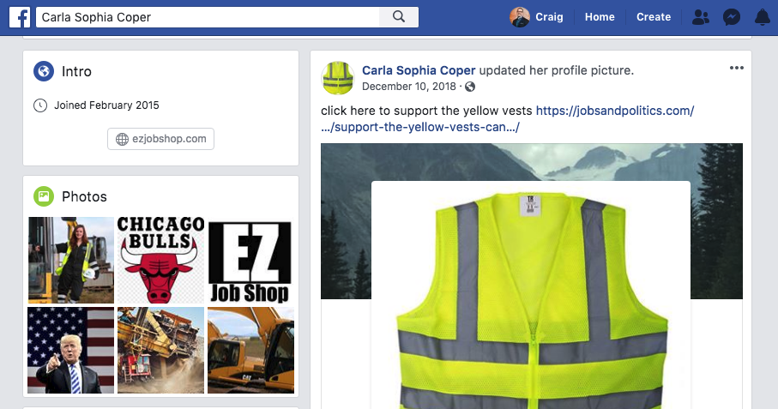

Slide 6
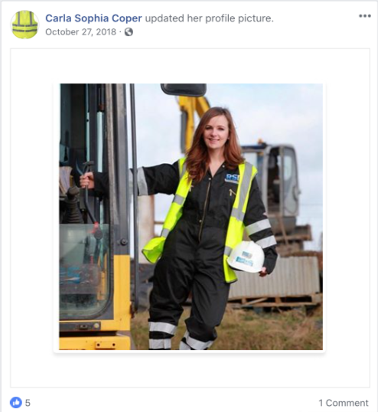

Slide 8
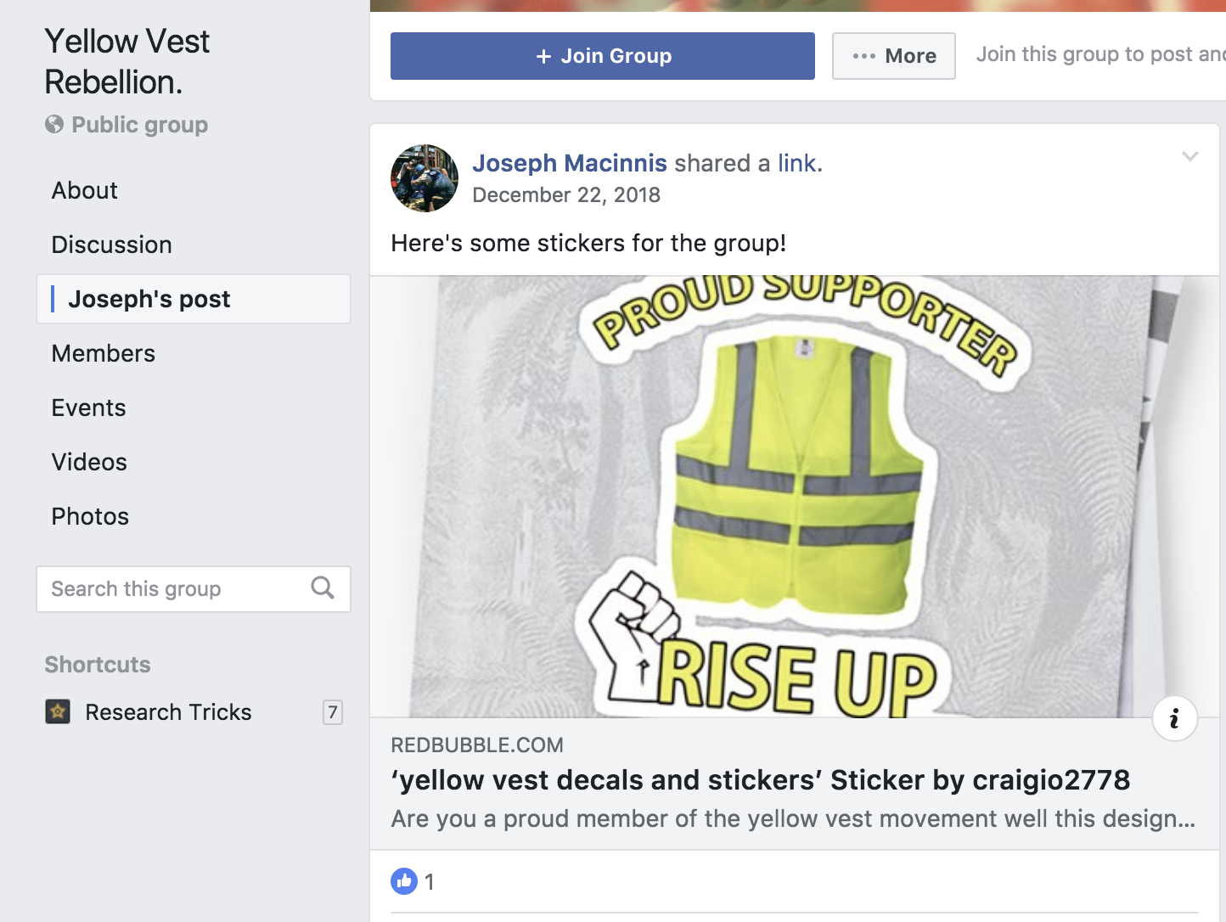

Slide 9
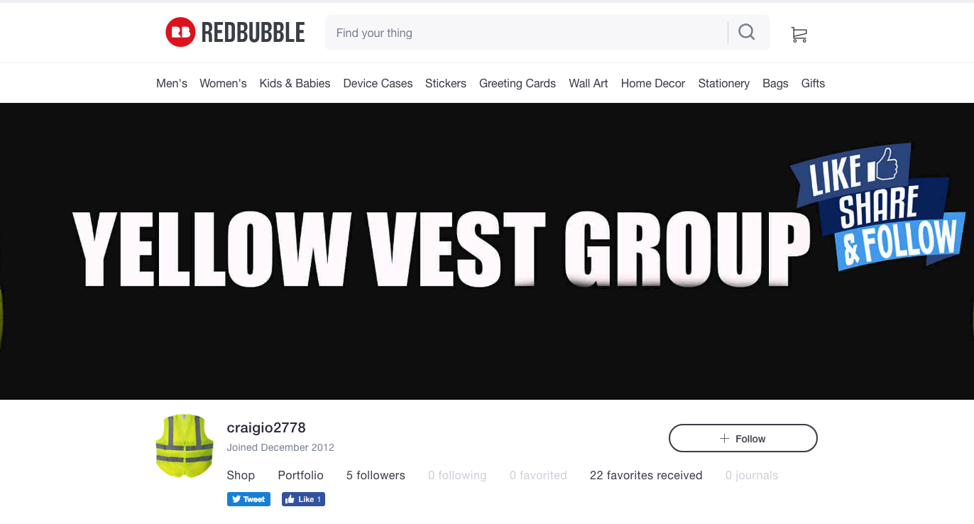

Slide 10
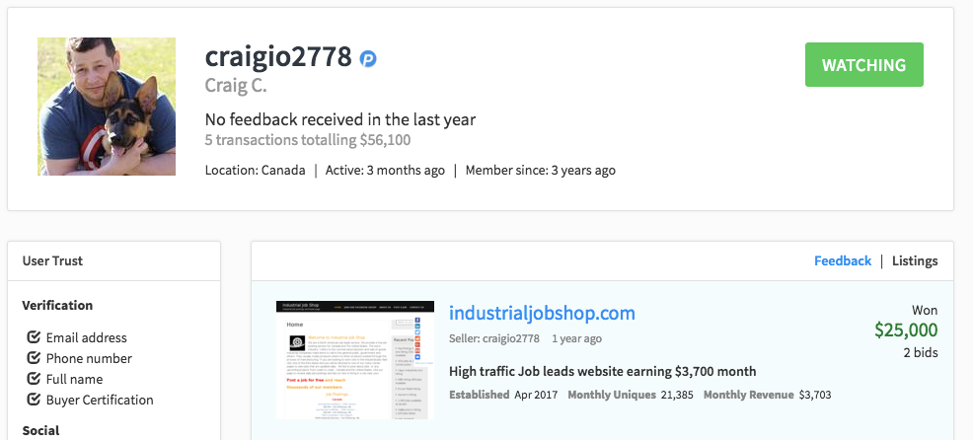

Slide 11
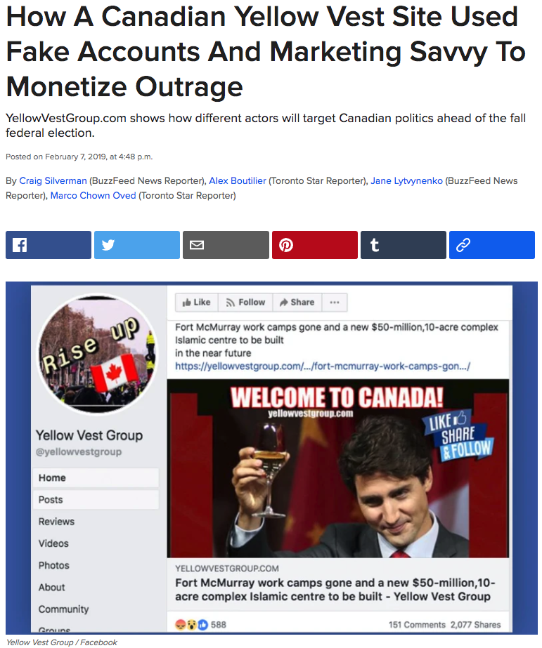

Slide 12
Let’s Talk About Mis- And Disinformation

Slide 13
It comes in many forms, with many motivations.

Slide 14
Credit : Claire Wardle, First Draft

Slide 16
It’s global.

Slide 17
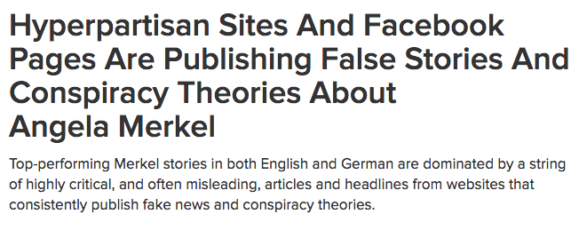
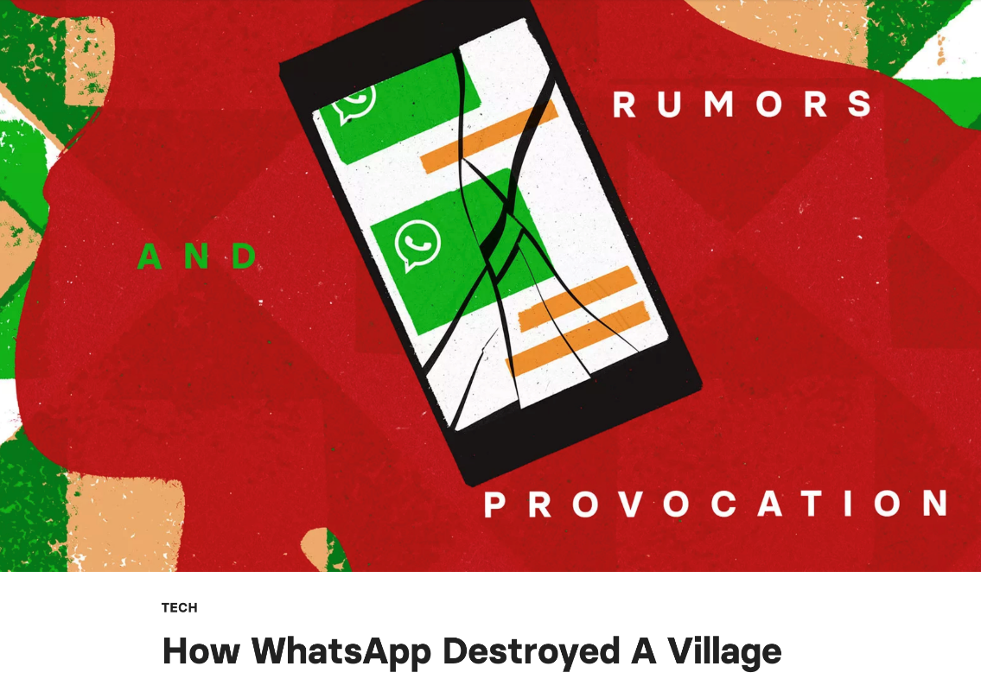
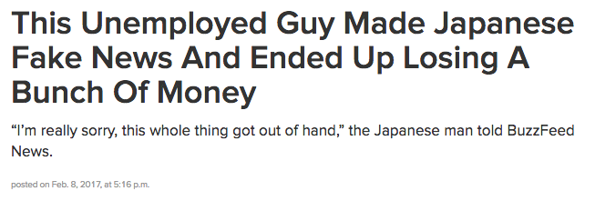
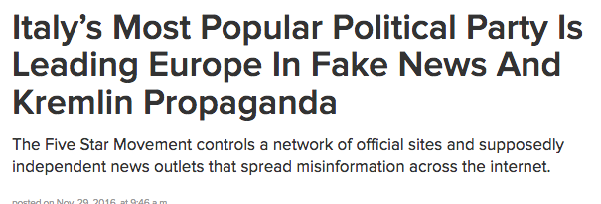

Slide 18
It feeds off polarization and human bias.

Slide 19
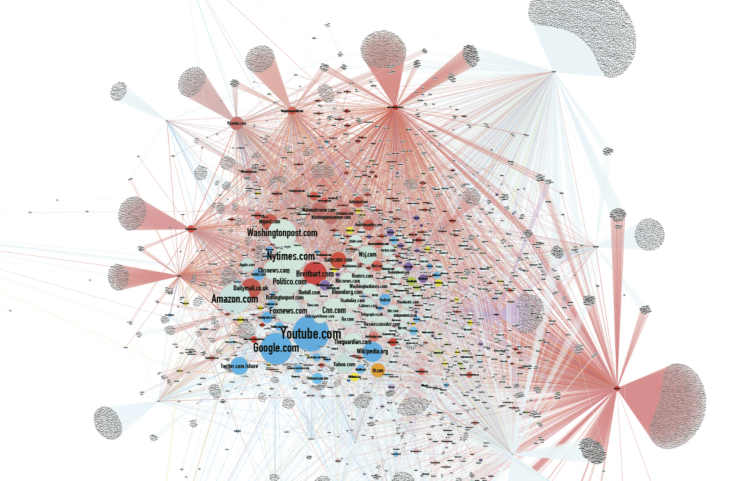
Credit: Jonathan Albright

Slide 20
“[W]e humans quickly develop an irrational loyalty to our beliefs, and work hard to find evidence that supports those opinions and to discredit, discount or avoid information that does not.”
– Cordelia Fine, the author of A Mind of Its Own: How Your Brain Distorts and Deceives, in The New York Times.

Slide 21
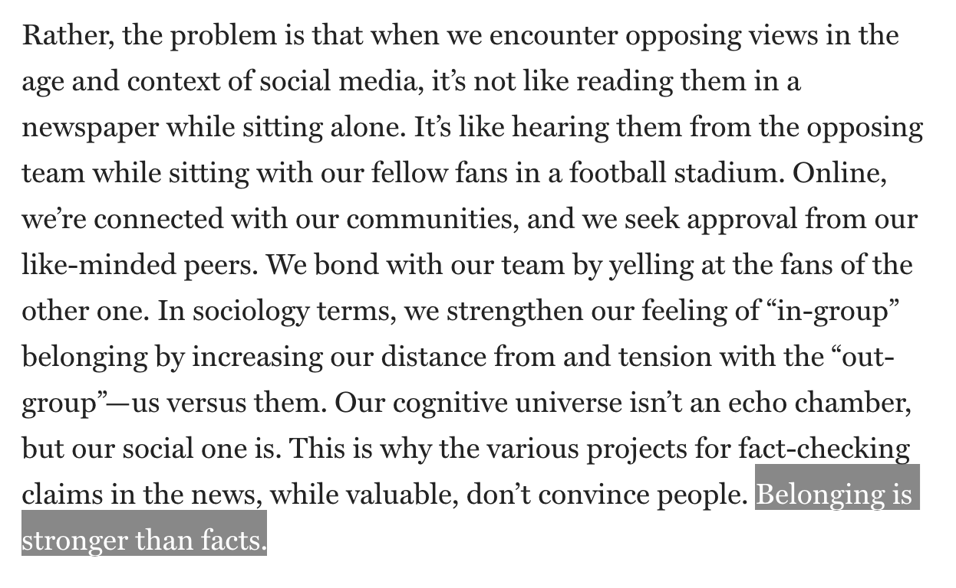
Zeynep Tufekci, “How social media took us from Tahrir Square to Donald Trump”

Slide 22
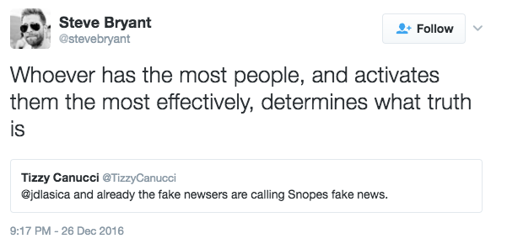

Slide 23
It exploits networks and algorithmic filtering.

Slide 24
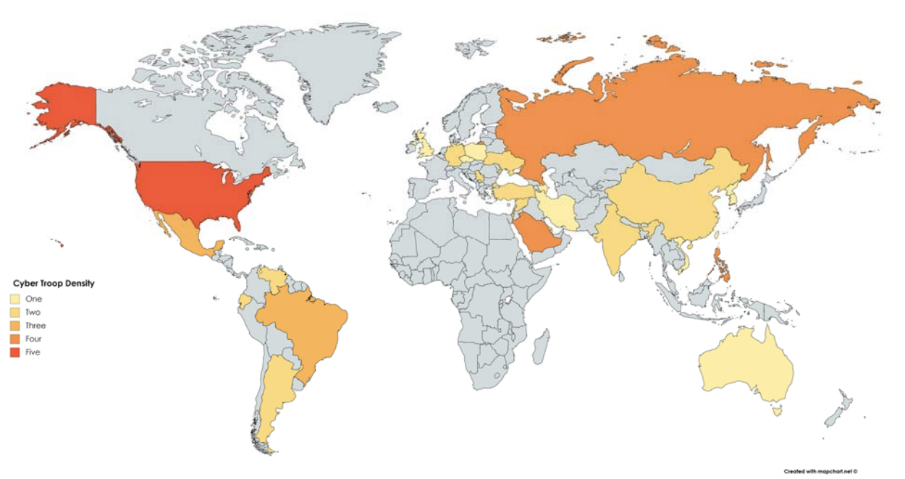
Creation Of Trolling Operations
Source: “Troops, Trolls and Troublemakers: A Global Inventory of Organized Social Media Manipulation”

Slide 25
Private Planning/Public Execution
Notes:
RT networks
Harassment campaigns

Slide 26
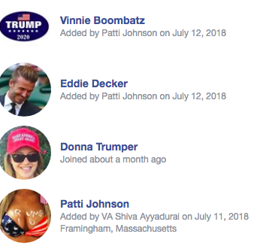
Creation/Purchase of Fake Accounts

Slide 27
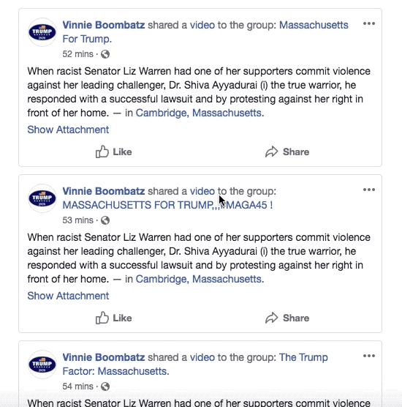
Using Them To Seed Content

Slide 28
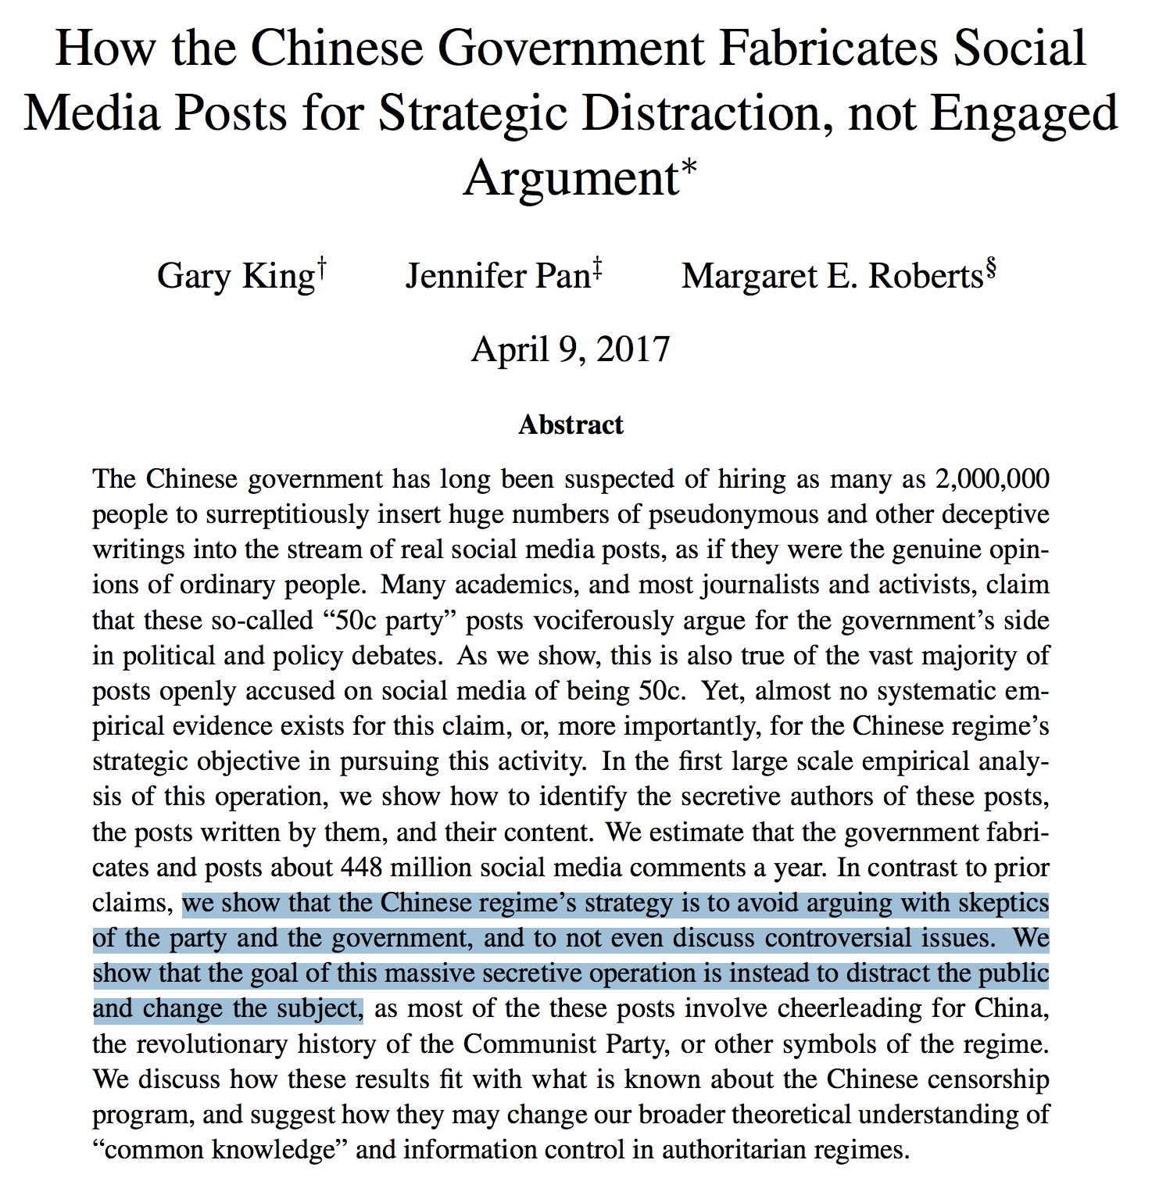
To Create Distraction/White Noise

Slide 29
To Game Algorithms And Signals

Slide 32
It’s a profitable international business.

Slide 34
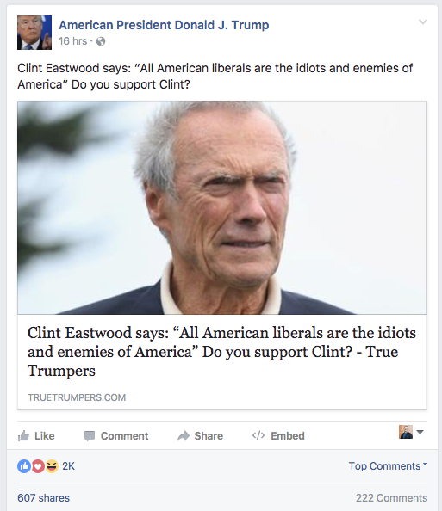

Slide 35
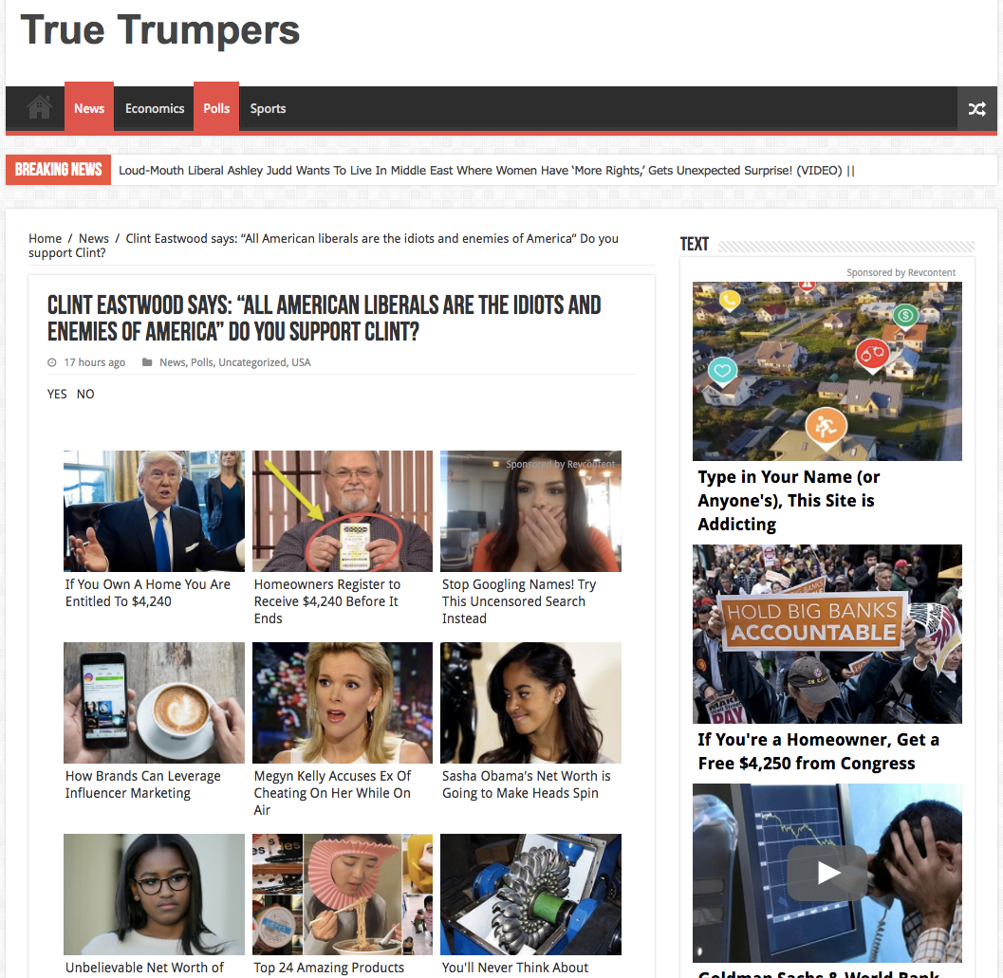

Slide 37
This environment is fracturing the way we construct and apply trust.
We must re-invent how we consume and interact with information and media — or risk losing touch with reality.
Notes:
I’m not predicting a crazy dystopian future.
We must commit to an ongoing effort to question and test what we see and hear, and investigate the internet to reveal the truth of our world.

Slide 38
OK, now for some good news….

Slide 39
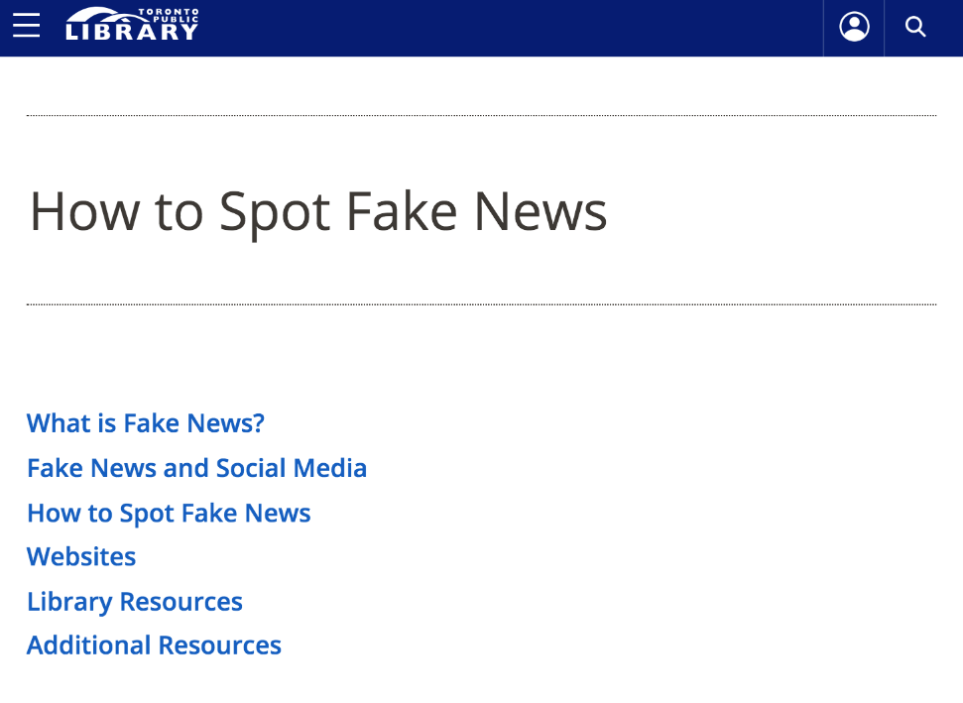
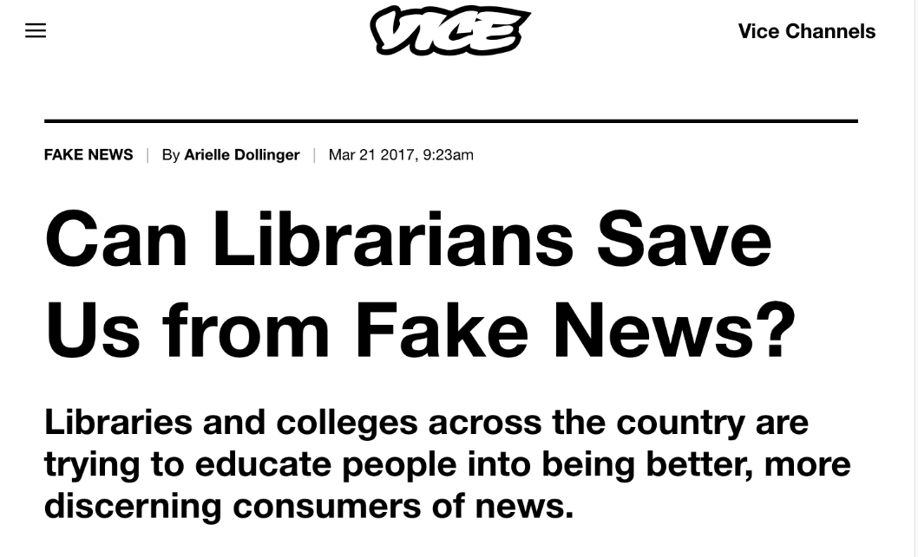

Slide 40
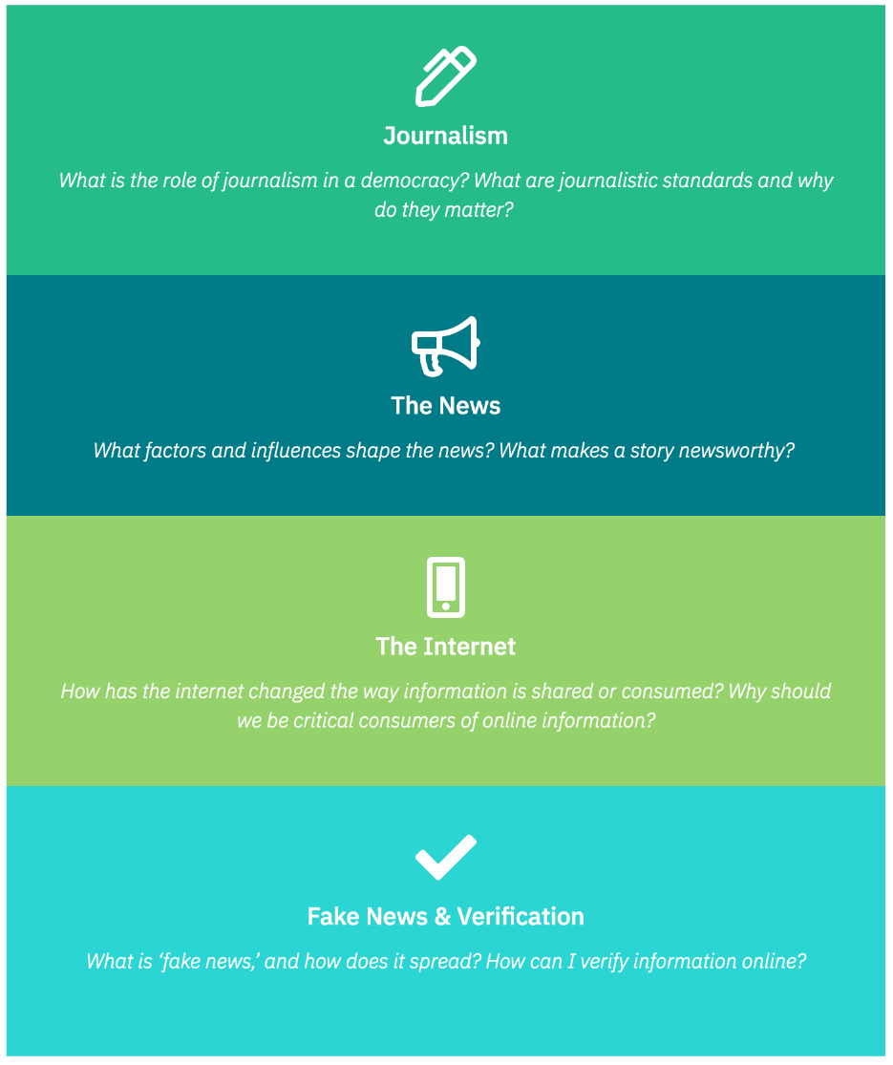
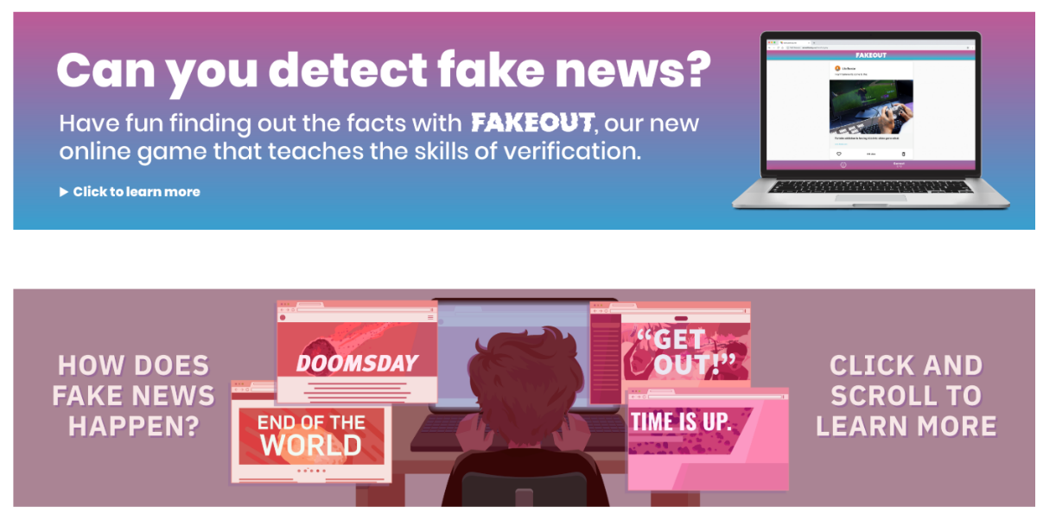
Newswise.ca

Slide 41
bit.ly/verificationtoolsandtips

Slide 42
You can make a difference.

Slide 43
Thank you!
bit.ly/verificationtoolsandtips

