Slide 1
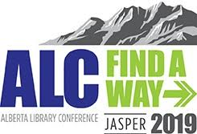

Slide 2
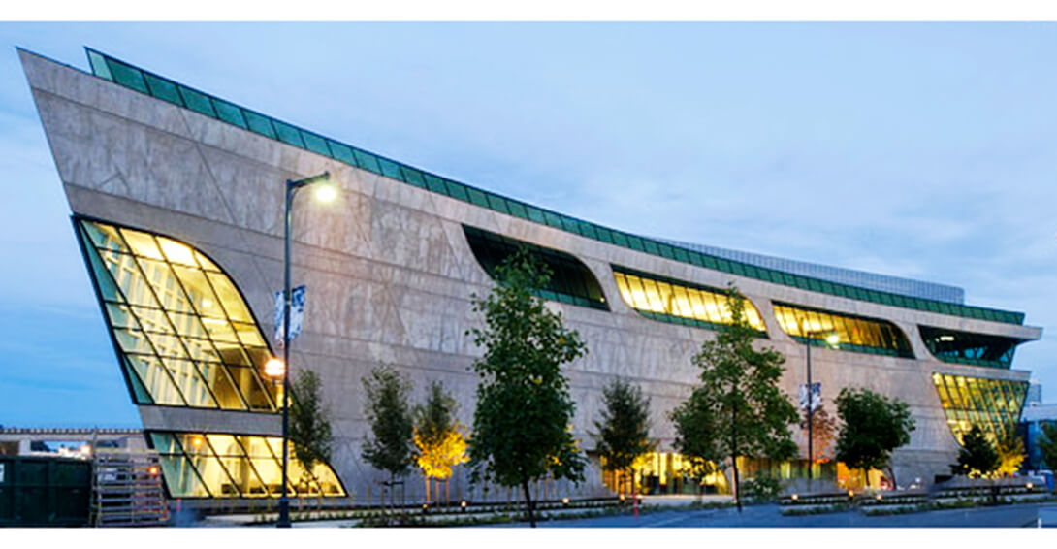
Settling In: How Newcomers Use a Public Library
John Shepherd, Instructor, Accounting, Kwantlen Polytechnic University
Larissa Petrillo, Instructor, Anthropology, Kwantlen Polytechnic University
Allan Wilson, Library Science Researcher, Prince George
Surrey Main Library
Notes:
Often it is good to study newcomers because they mistruct their home govts, and view library in a new light.

Slide 3
Newcomer Study
Study initiated at the request of ethnic librarians at the Prince George and Surrey Libraries.
A questionnaire was developed to explore how newcomers use the facilities, collections and services of public library branches.
Newcomers were defined as adults 19 years or older who arrived in Canada within the past 10 years
Questionnaires would be administered to users as were leaving the facilities. Data would be collected on what they did during their current visit.
Notes:
ADMIssION: ; no funding; in-kind

Slide 4
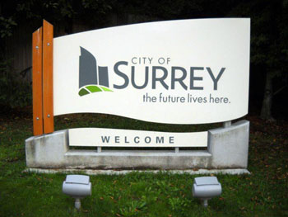
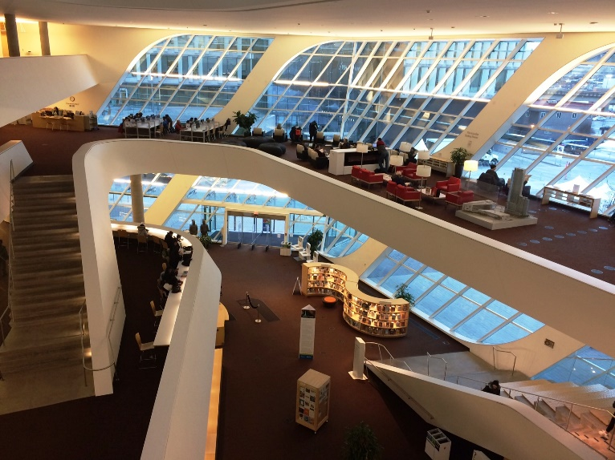
City of Surrey
30 km southeast of Vancouver
Half a million residents
47% report a non-official mother tongue
30% speak a non-official language most often at home
43% are immigrants
73,000 (14%) arrived in Canada within the last 10 years

Slide 5
Finding a Way
The study would have used library staff to collect the data as there not project funding.
The university Research Ethnics Board said no. All interviewers had to complete an ethics module.
Stopped dead in our tracks … library could not afford having of staff being paid to complete the online module.
Solution …. Anthropology Instructor, Dr. Larissa Petrillo, volunteered her class to undertake data collection as a research methods project.
Notes:
ADMIssION: ; no funding; in-kind

Slide 6
Challenges of data collection
Newcomers comprise a small percentage library users.
Newcomers are reluctant to participate in surveys.
Feskens et al (2006) described the high non-response rate in ethnic studies.
Initial response rate was extremely low. We had to quickly change locations – experimenting which branches yielded better response rates.
In comparison, the next study of general library users at the Richmond Public Library yielded 437 completed surveys.
Involving university students, from diverse backgrounds and languages, made all the difference.
Notes:
ADD:: ; multi-lingual students are valuable allies

Slide 7
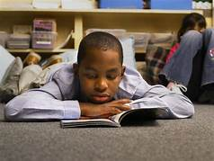
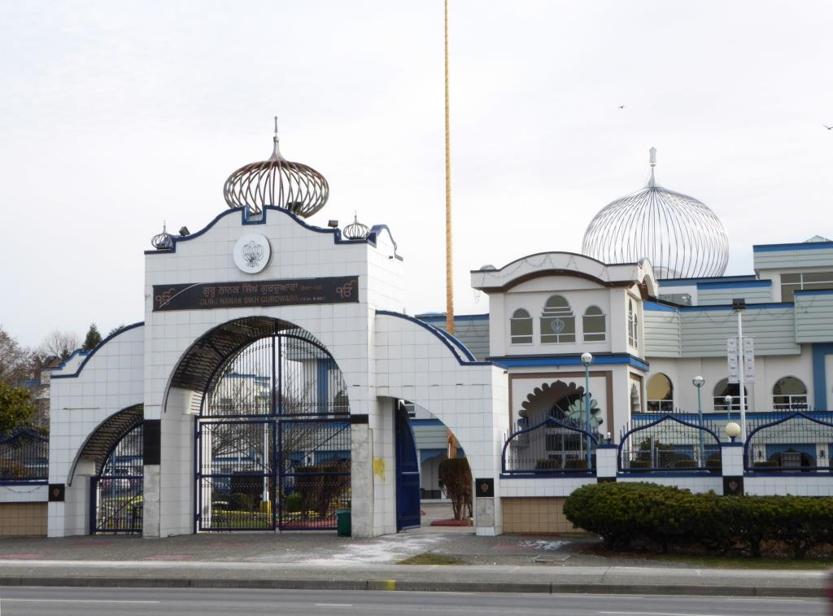
Newcomers are diverse
The word that best describes Surrey newcomers is “diversity”
Respondents arrived from 19 different countries and spoke 24 different languages at home
Most common source countries were India (27%), China (10%) and the Philippines (7%)

Slide 8
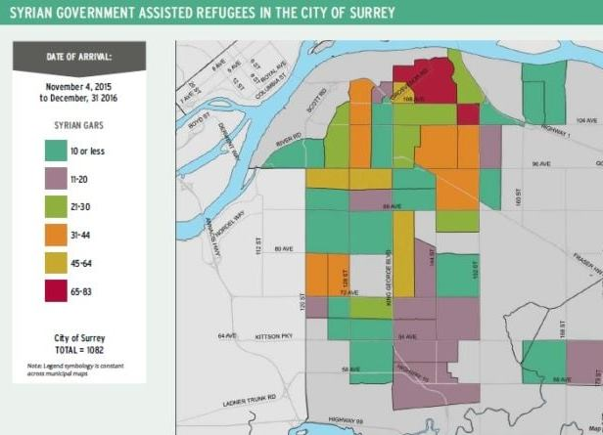
Refugees to Canada
40% of all B.C. refugees reside in Surrey in specific neighbourhoods
Refugees comprise 10 – 20% of Canadian newcomers.
Federal assistance, through settlement societies, only focus on the first year
Afterward, no single agency have overall responsibility for newcomer integration

Slide 9
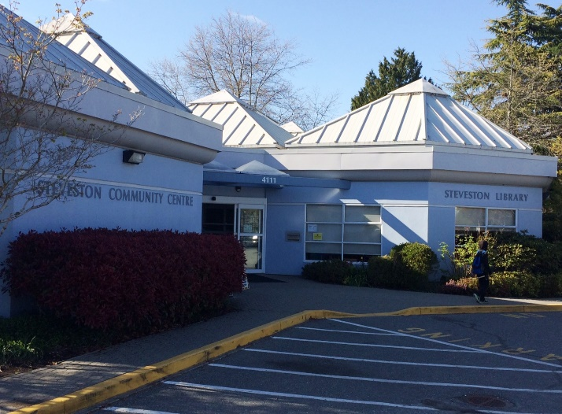
Adapting to a new home
Most immigrants are 25 to 44 years of age, possess a university education and speak one of Canada’s official languages.
Many struggle after arrival due to their lack of Canadian work experience, their limited fluency in our official languages, or employers who don’t recognize of foreign credentials and education.
Steveston Branch

Slide 10
Settling into a New Home
While newcomers have diverse backgrounds, their initial needs are similar
During the first stage, transitioning, they must deal with immediate issues such as temporary housing and learning to do basic tasks.
During second stage, settling in, they slowly become a productive member of society.
Many train for new careers and improve their proficiency in Canada’s official languages.

Slide 11
Most Newcomers arrive as young adults
Newcomers in the sample were mainly young or early middle aged adults.
Many arrive with young children
17% of respondents were 19 – 24 years and 64% were 25 – 44 years. These percentages matched 2016 Canada Census statistics
Slightly more than 50% of respondents were women a similar percentage as in the Census.
Two years earlier, Surrey Libraries conducted the library use survey of all users, enabling the comparison of the two groups.

Slide 12
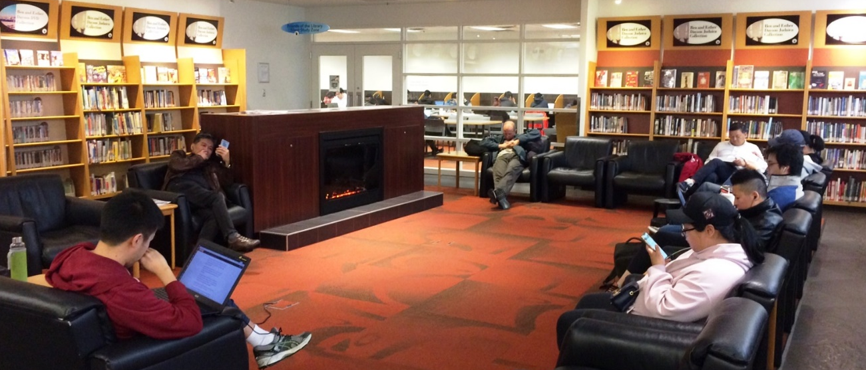
Frequency and duration of visits
The pattern of branch use by newcomers differed from that of other library users
75% of the newcomer respondents were heavy users, visiting library branches at least one a week
Visit durations were bimodal. A third resided for less than 30 minutes and nearly half stayed for one to two hours
Notes:
PHOTO CHANGED, more dynapmic.

Slide 13
Branch use by newcomers
In both surveys, similar proportions of library users were engaged in collections and computer related activities.
Newcomers made more frequent use of a wider range of library services and the facility itself.
Twenty- four percent of newcomer users attended children’s programs during their current visit and 43% of the materials borrowed were children’s books or DVDs.
Nearly all children’s materials borrowed were in English.
Notes:
Newcomers are eafer that their children learn fluent English even if they can’t.

Slide 14
User activities during their visit
Activity | % Newcomer Survey | % 2015 All User Survey
Read | 72 | 17
Returned or borrowed | 59 | 59
Studied | 34 | 10
Library computer | 34 | 26
Browsed collection | 34 | 32
Used Wi-Fi | 34 | 9
Help from Staff | 31 | 14
Met with other people | 28 | 10
Relaxed | 28 | Didn’t ask

Slide 15
Use of library facilities
Reading and studying behaviour is not surprising
60% of employed immigrants changed careers after arrival
Two-thirds of recent immigrants expect to enroll in training or educational programs (Chui, 2003)
A substantial percentage live in sub-standard housing (Francis & Hiebert, 2014)

Slide 16
Library as a social space
A common theme in the library science immigrant literature is the library as a safe, socially acceptable meeting place
28% met someone during their current visit
A study of Asian immigrants to Australia concluded that libraries were one of their most important public places (Khoir et al, 2017) after temples
Libraries are socially acceptable public meeting place for women from traditional cultures (Auduson et al, 2011).
Young immigrants use public libraries like youth centres (Berger, 2002).

Slide 17
Ways that the library helped me
Activity | % Responses
Place to study | 70
Place to learn | 67
Affordable place to read | 63
Improve my English | 53
Build confidence | 50
Welcoming place to relax | 47
Meet people and make new friends | 40
Feel connected to my community | 40
Learn more about Canada and local customs | 33

Slide 18
How the library helped newcomers
Newcomer responses indicate that the public library helped them during their education and to socially integrate.
Much of their library use was driven by their practical needs. Two-thirds of respondents selected libraries as a place to learn and to study.
Over half viewed libraries as a place where they can improve their English.
Libraries also helped them meet their emotional and social needs. The library was a safe place, a place to meet people and to feel part of the community.

Slide 19
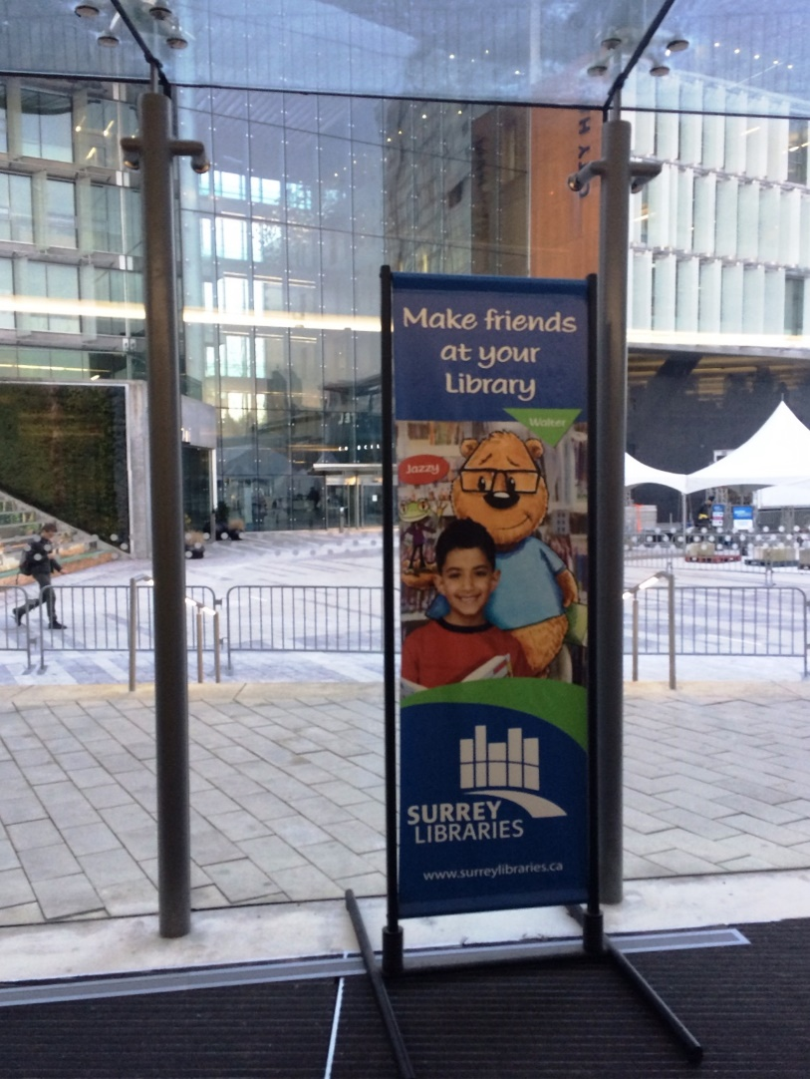
Conclusions
Public libraries have much to offer to newcomers.
All newcomers experience some degree of disorientation after arrival
Everyone have similar social, informational and psychological needs
All go through similar steps during the adjustment process.
Notes:
Changed slide with awesome photo

Slide 20
Finding a way to reach out
One challenge is to trigger their first library visit.
They are often unfamiliar with the services available in a Canadian public library. They often rely on friends, family members and people in their ethnic communities as trusted sources.
It is unlikely that a library can offer a full set of multilingual services to each language group. At best, collections and services can target the largest linguistic groups in the community.
All groups benefit from ESL materials, English conversation groups, book clubs, and similar services.

Slide 21
Finding a way to our Research
Shepherd, J., Vardy, K., and Wilson, A (2015). Quantifying patron time-use of a public library. Library Management 36 (6/7). pp. 448-461.
Shepherd, J., Petrillo, L., and Wilson, A. (2018). Settling-in: How newcomers use a public library. Library Management 39 (8/9). pp. 586-596.
Submitted for publication:
Does size Matter? A use study of two public library branches

Slide 22
To other References
Audunson, R., Essmat, S. and Aabø, S. (2011), “Public libraries: a meeting place for immigrant women?”, Library & Information Science Research, Vol. 33 No. 3, pp. 220-227.
Berger, Å. (2002), “Recent trends in library services for ethnic minorities – the Danish experience”, Library Management, Vol. 23 Nos 1/2, pp. 79-87.
Chui, T. (2003), “Longitudinal survey of immigrants to Canada: process, progress and prospects”, Statistics Canada, Housing, Family and Social Sciences Division, Ottawa, available at: www. statcan.gc.ca/pub/89-611-x/4067688-eng.htm (accessed November 29, 2017).
Feskens, R., Hox, J., Lensvelt-Mulders, G. and Schmeets, H. (2006), “Collecting data among ethnic minorities in an international perspective”, Field Methods, Vol. 18 No. 3, pp. 284-304.

Slide 23
References
Khoir, S., Du, J.T., Davison, R.M. and Koronios, A. (2017), “Contributing to social capital: an investigation of Asian immigrants’ use of public library services”, Library & Information Science Research, Vol. 39 No. 1, pp. 34-45.
Francis, J. and Hiebert, D. (2014), “Shaky foundations: Refugees in Vancouver’s housing market”, The Canadian Geographer (Le Géographe canadien), Vol. 58 No. 1, pp. 63-78.

