Slide 1
Reference & Research at the Legislative Library
Iona Reid & Megan laflin
Reference librarians, legislative library of b.c.

Slide 2
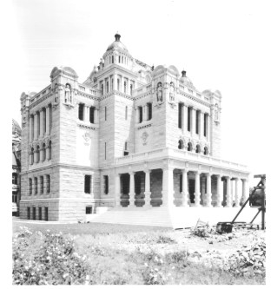
Who we are
Founded in 1863
Legislative Library Act- our statute
Largest collection of BC Government Documents
6 full time reference librarians, in addition to others
In 2016, the 2nd highest used legislative library
Notes:
The legislative Library was founded in 1863 – originally intended to serve the colonial legislature of Vancouver Island.
After confederation the library continued to grow, becoming the Provincial Library and providing library service for the entire province through the “travelling libraries” program (an early bookmobile).
As public libraries became more prevalent the focus shifted back to serving the legislative assembly. The library has its own statute- the legislative library act. the act requires the library be kept conveniently near the legislative chamber and that the librarian must maintain a catalogue of the library.
In 2015 the library celebrated 100 years in its current location - the south wing of the Parliament buildings, right outside the legislative chamber.
Today, the library houses the largest selection of BC government documents available anywhere- collecting in both physical and digital formats. Our librarians collect and catalogue these documents and make the MARC records publically available.
There are six full time librarians dedicated to reference services, and in 2016 we were the 2nd highest used provincial legislative library in Canada based on the number of research questions answered in the year.

Slide 3
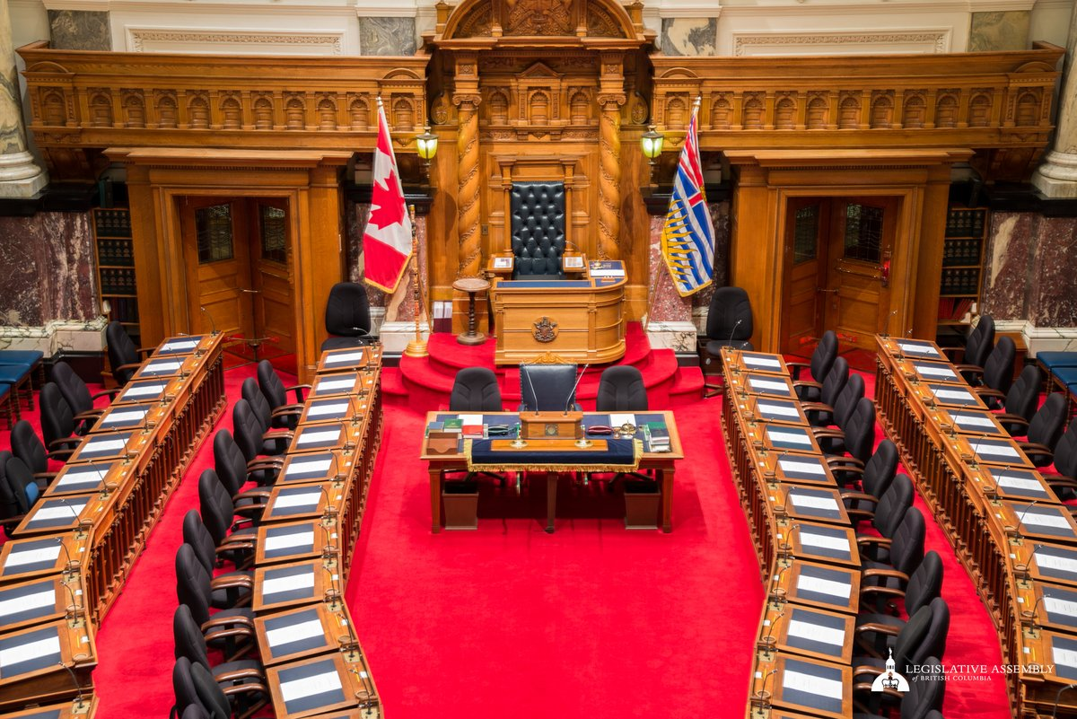
Who we serve
PRIMARY CLIENTS
MLAs,
Caucus staff
Constituency assistants,
Assembly employees,
independent officers and staff,
press gallery,
government employees
Public researchers as time allows
NON-PARTISAN
CONFIDENTIAL
TIME SENSITIVE
Notes:
As I mentioned previously, the primary focus of the legislative library is to serve the Assembly. This includes the Members and their staff– both caucus staff working in Victoria, and the employees of their constituency offices based all across the province.
Assembly employees from the Clerk to Hansard,
the independent officers and their staff– these include the representative for children and youth, the auditor general, information and privacy officer, and so on.
We also serve the press gallery and to a slightly lesser degree ministry employees– but some of these offices have their own library services.
While the house is sitting, access to the library is restricted to off-site visitors, but on breaks and on Fridays, public researchers are welcome to use the library. While we don’t perform the same in-depth research on behalf of public researchers as we would undertake for our primary clients- we do have some unique resources that are invaluable for government and historical research and we are happy to provide access and assistance with this tools- iona will go into a few of them in more depth shortly.
And finally, if there were commandments of the legislative librarian – there would only be three and they are :
NON-PARTISAIN – we serve all sides of the house regardless of political affiliation or our own personal viewpoints.
CONFIDENTIAL- any request you give to a librarian is not discussed to anyone other than other librarians – if we don’t have the answer but we think someone in the ministry of finance might- we would first have to consult with our client to see if they were ok with us taking that question outside of the library- they may not want anyone to know what they are working on and it is important to be discrete/
TIME SENSITIVE - we are very good at meeting tight deadlines. Because we work with MLAs we are very use to short timeframes time sensitive

Slide 4
Types of questions
LEGISLATIVE – STATISTICAL – HISTORICAL – CROSS-JURISDICTIONAL – COMMUNITY – DOCUMENT DELIVERY
What did the Employment Standards Act look like in November 2006?
What are B.C.’s top imports and where do they come from?
Do you have any information on Mary Ellen Smith, the 1st woman MLA elected in B.C.?
Can I see all the workers’ compensation legislation in force in Canada?
How many students attend public school in my riding?
Can you get me the land title for the following address?
Notes:
I think one of the interesting aspects of our job is that- unlike a public or academic library- where you are primarily focused on empowering your patron to conduct their own research- out clients look to us to conduct this research on their behalf– they expect quality, accurate and trimly information on a wide variety of subjects.
This also comes back to the tenant of “non-partisan” as in many cases a client may come to us with a question and expect a certain answer to back up that belief- so it’s really important that we are presenting the information we find in the most balanced way possible.
So here is just a sampling of the types of questions we may field:
We provide reference in person, over the phone and through email.

Slide 5
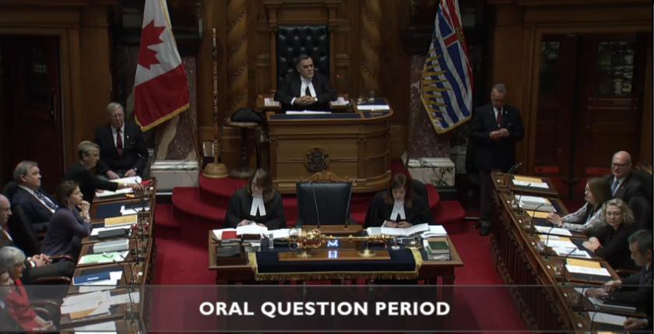
Impact
Primary Clients
Speeches, interviews, debates, news reports
Government policy and program development
Parliamentary procedure
Changes to legislation and regulations
In the constituency
Members of the Public
Genealogy
Community history
Changes to government programs
Historical events involving the Legislature
Notes:
Preparing for
Helping to understand
Authors and academic researchers

Slide 6
5 minutes…

Slide 7
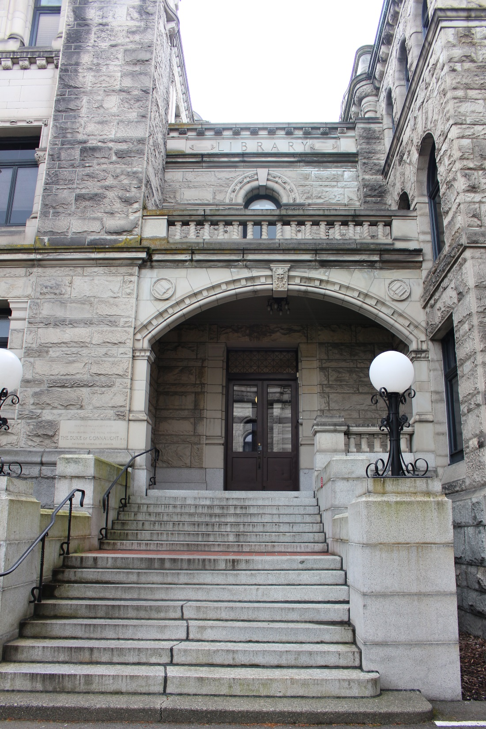

Slide 8
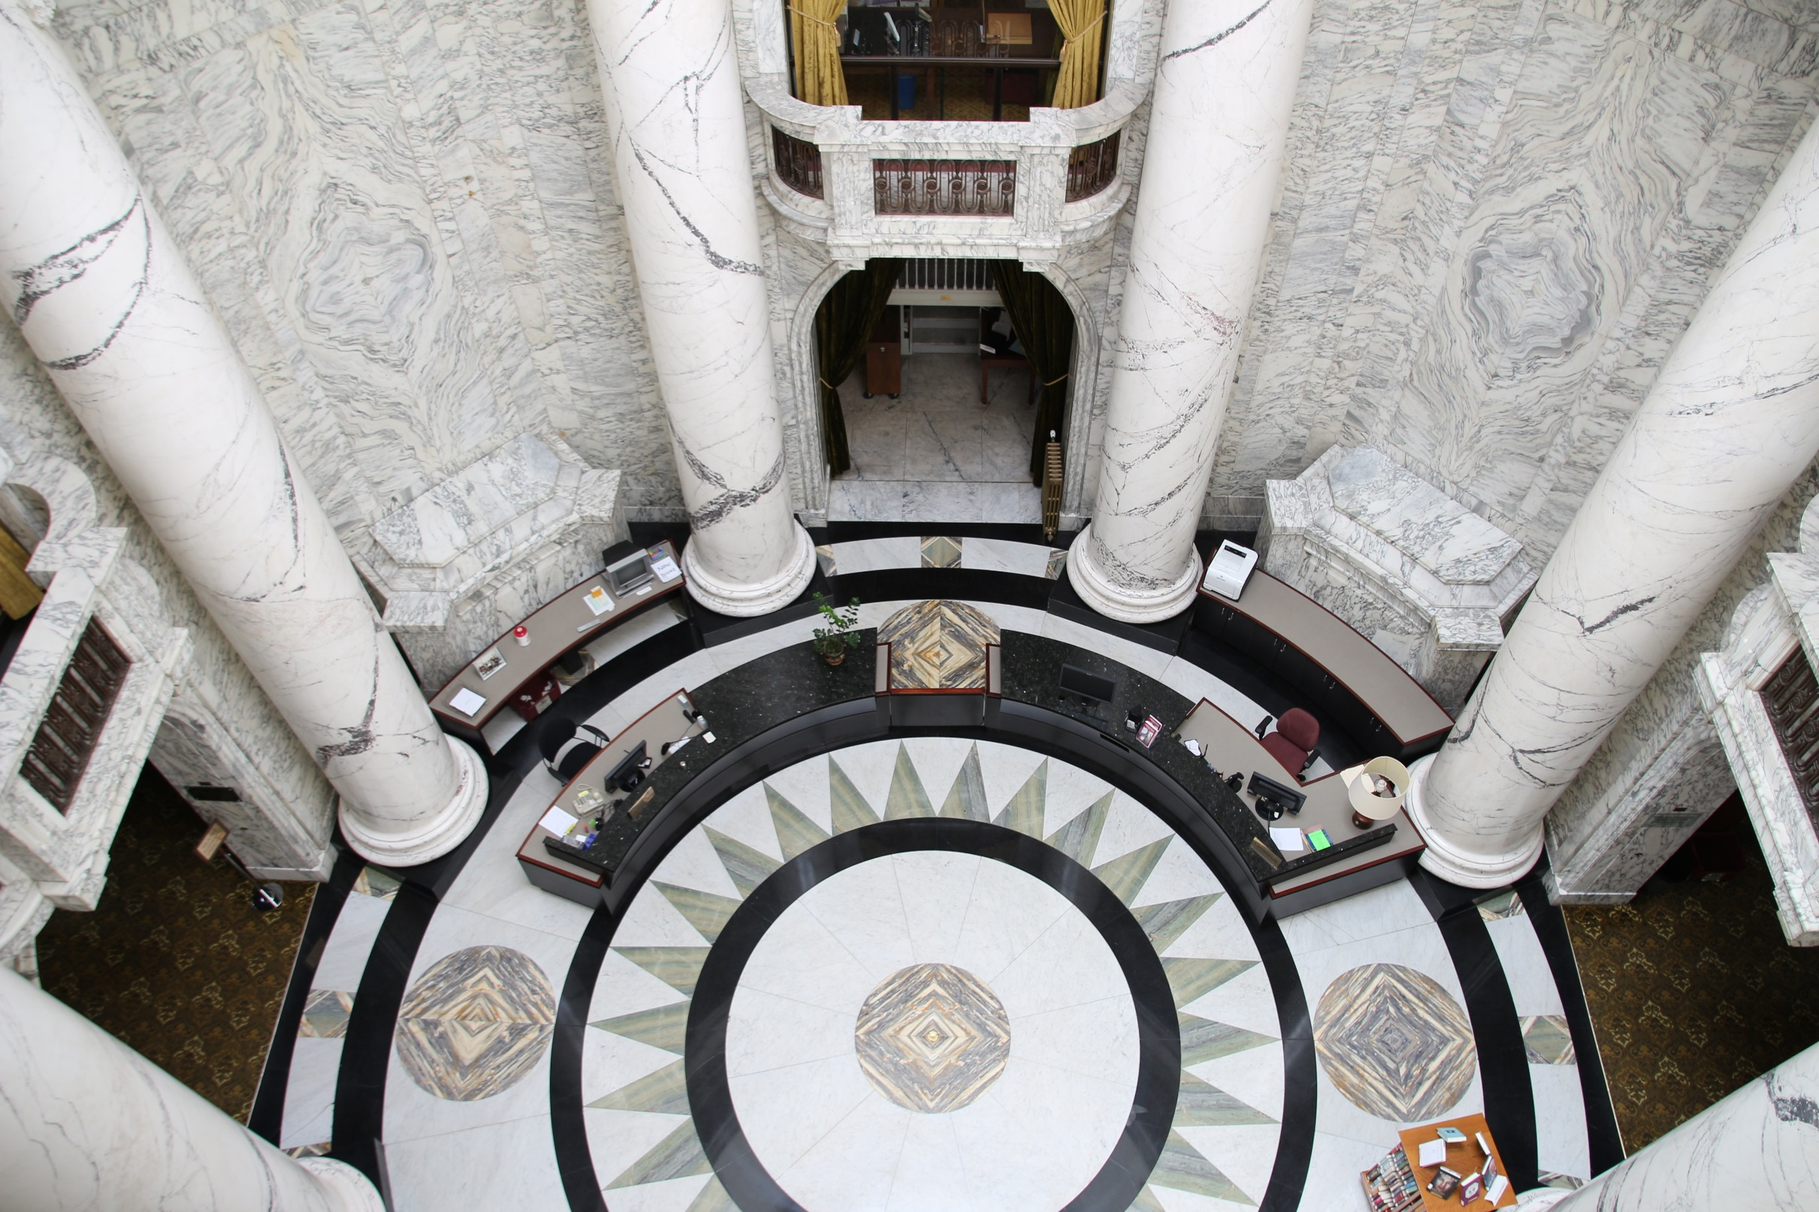

Slide 9
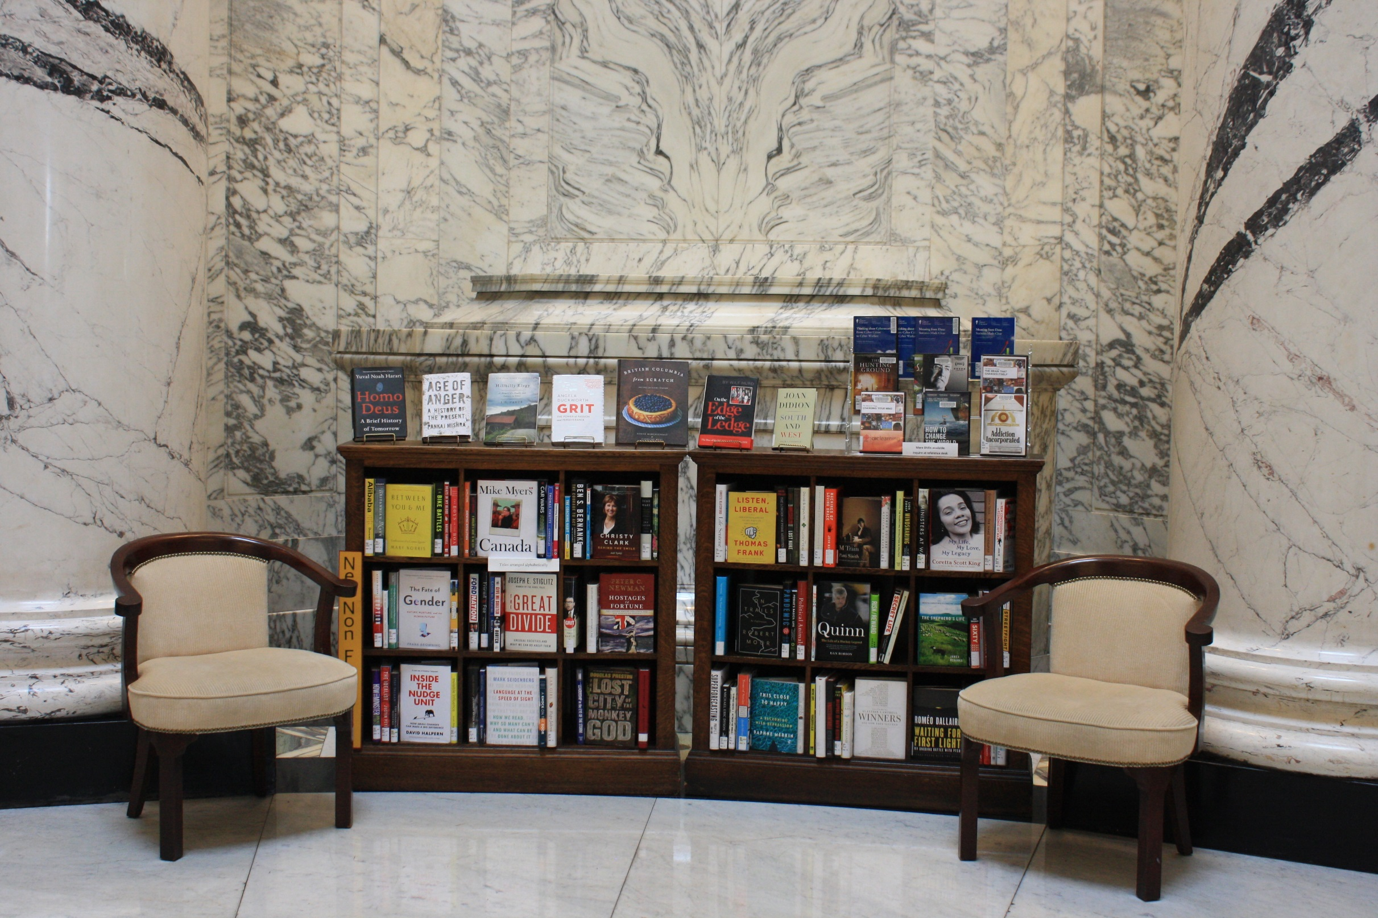

Slide 10
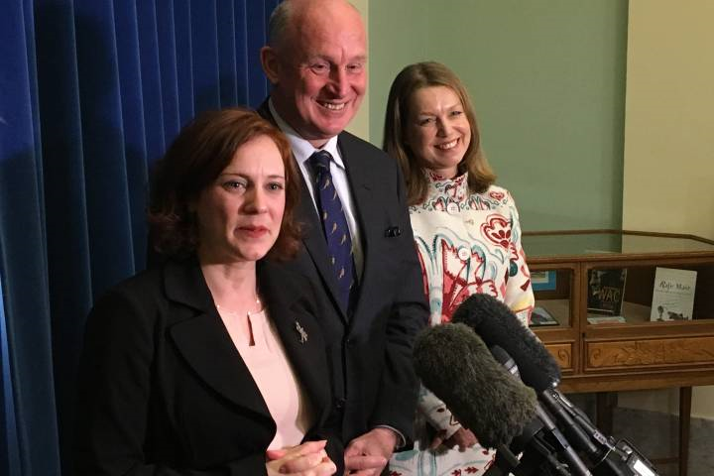

Slide 11
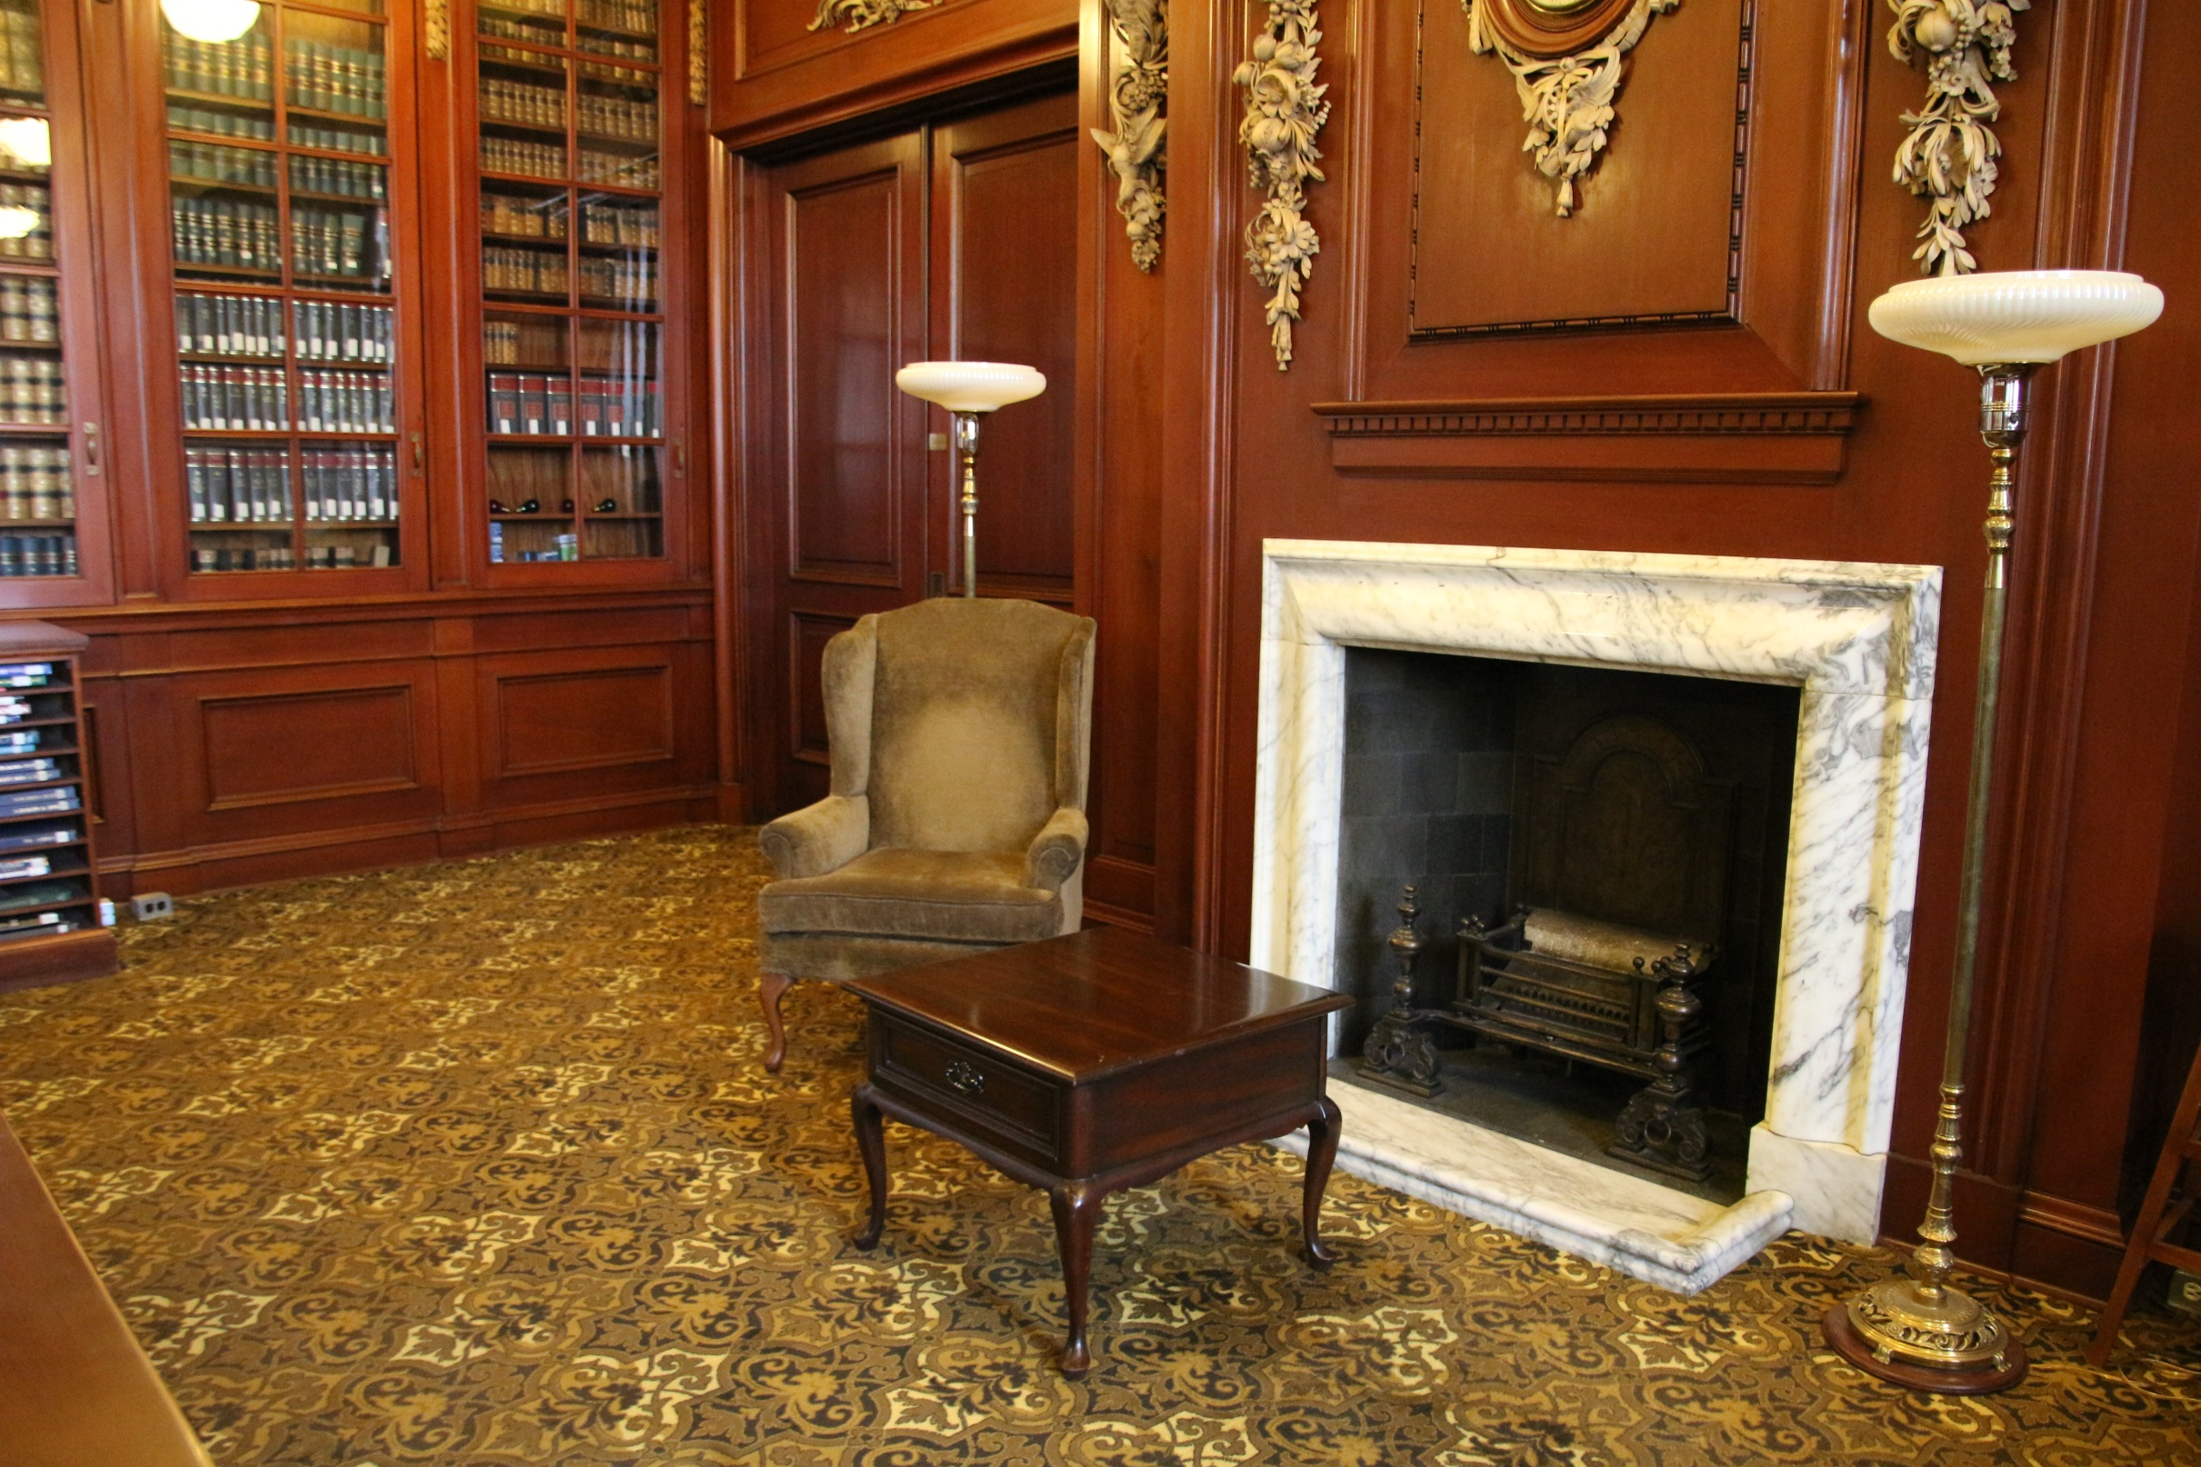

Slide 12
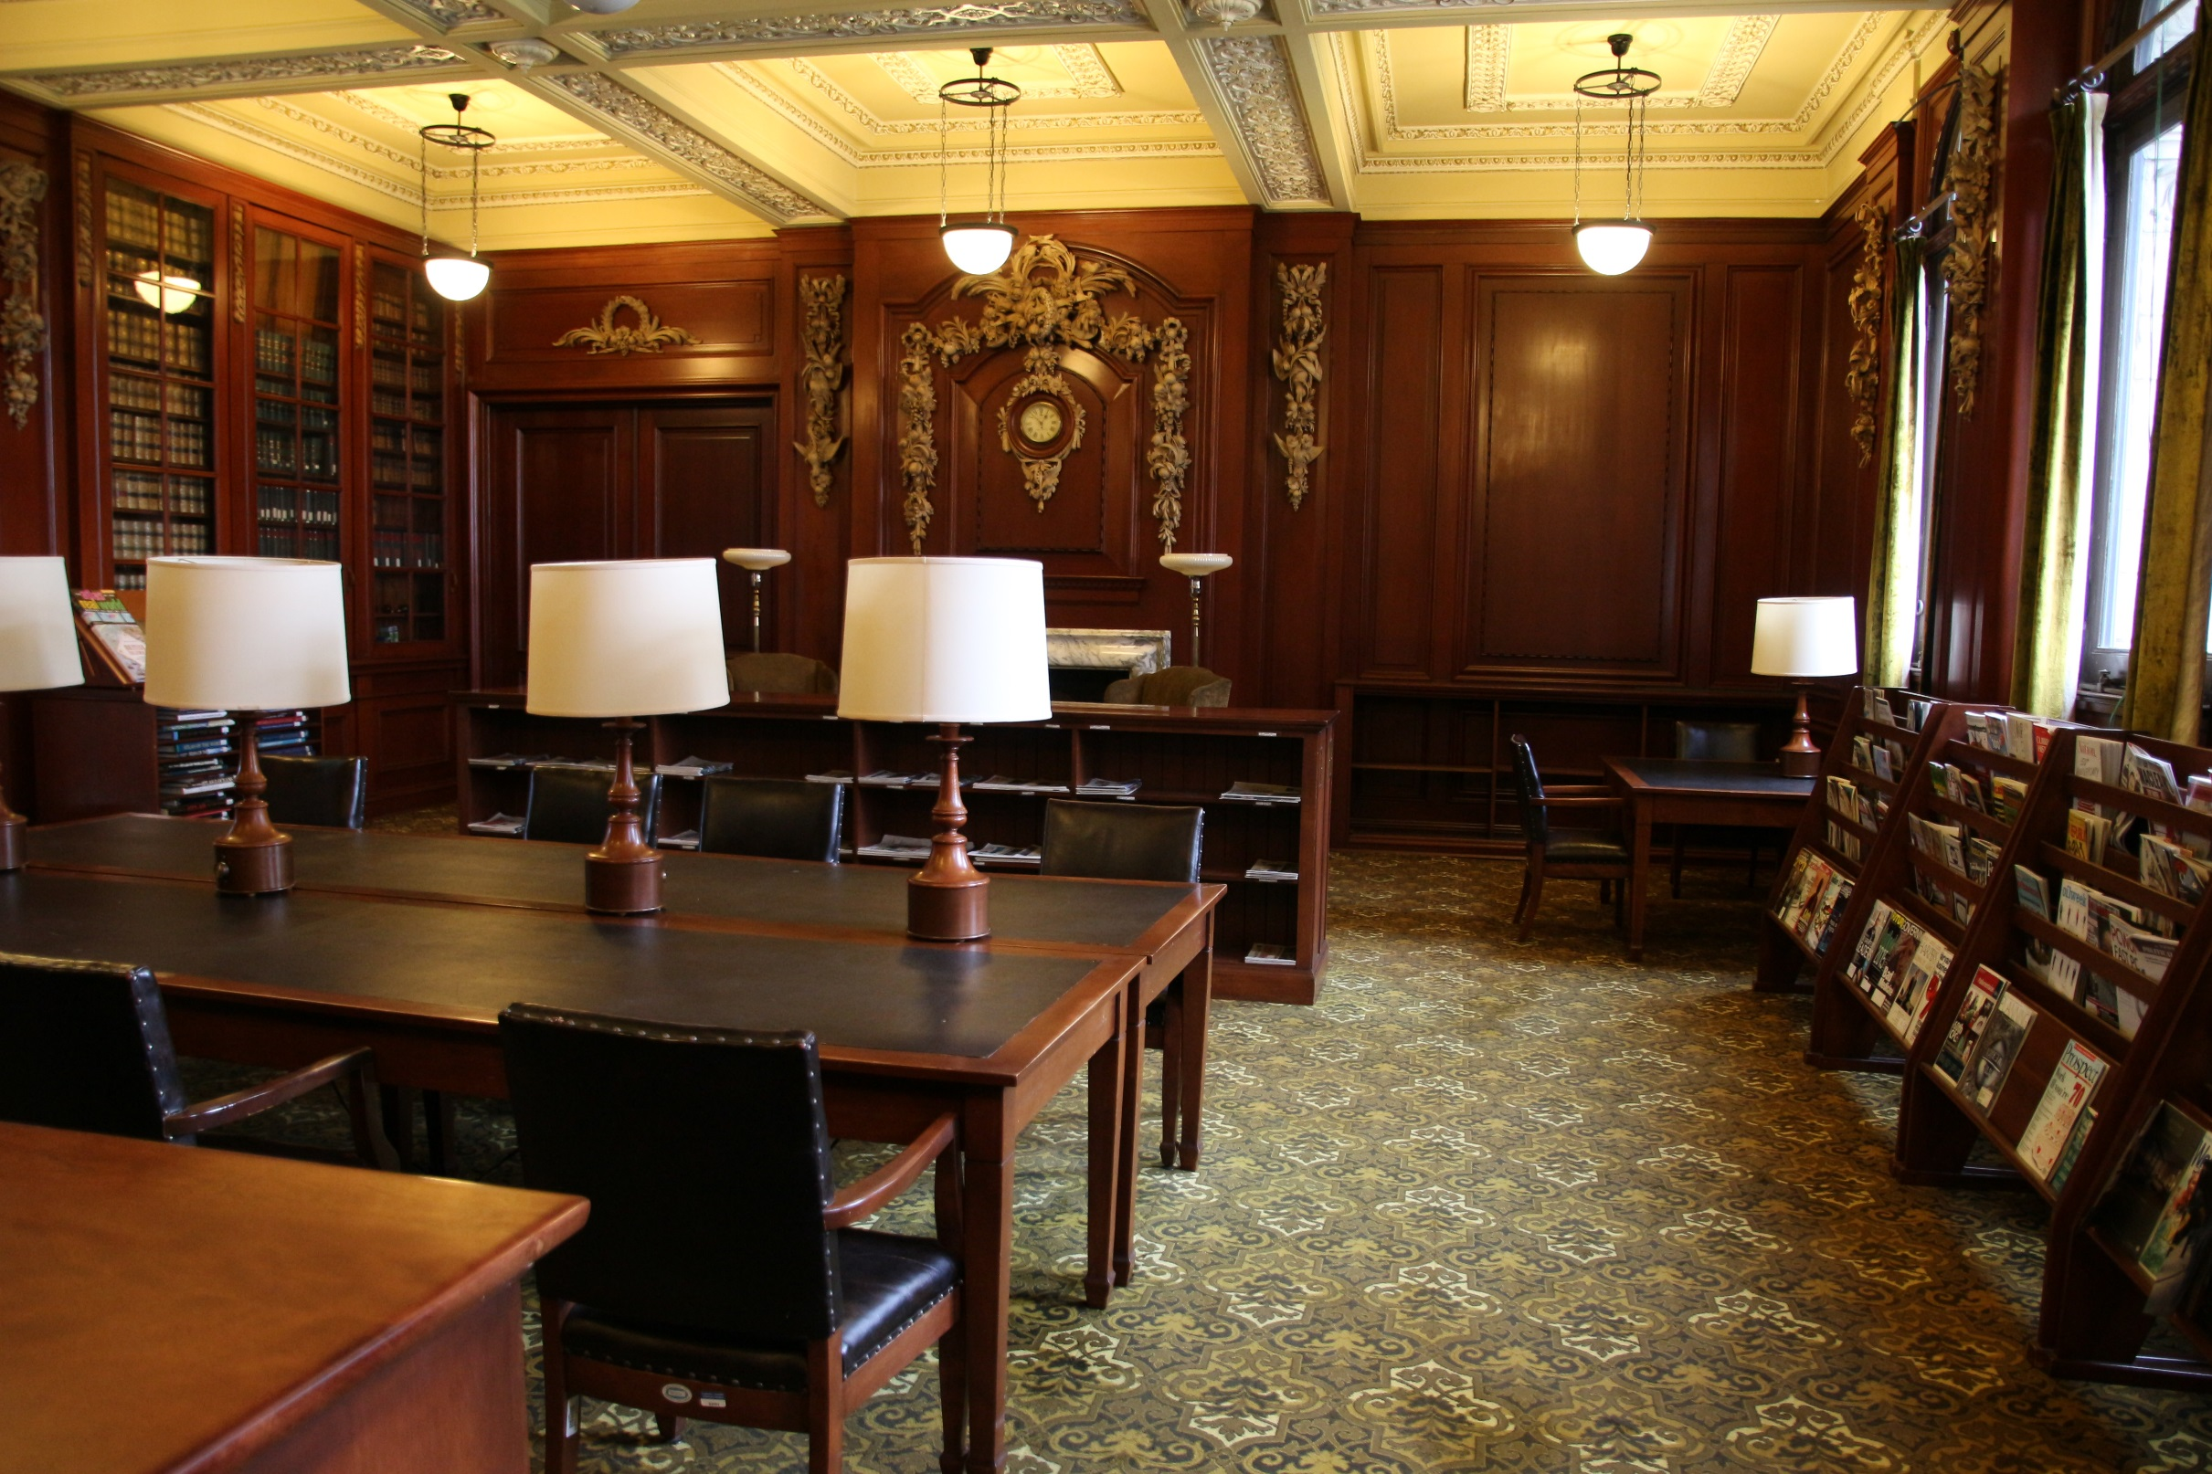

Slide 13
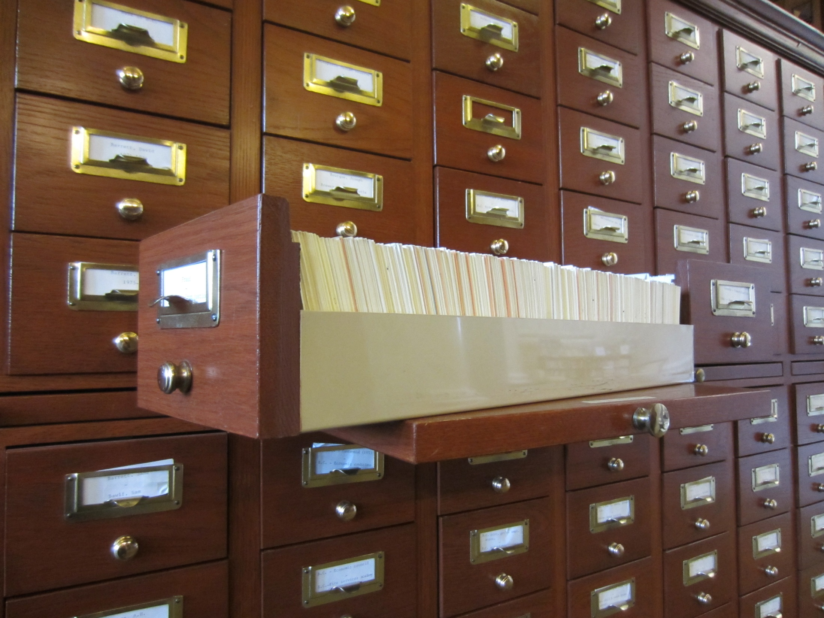

Slide 16
Unique clients, unique tools
Sessional Clipping books (Late 1890s to 1972)
What happen in the Assembly
Newspaper index (late 1890s-2007)
Citations of news articles about BC
1991-2007 Newspaper index online
MLA Files
A file on every MLA
Reference Files
Topics about the Assembly, MLAs, parliamentary procedure
Current Awareness
Local News Update and BC Daily Headlines

Slide 17
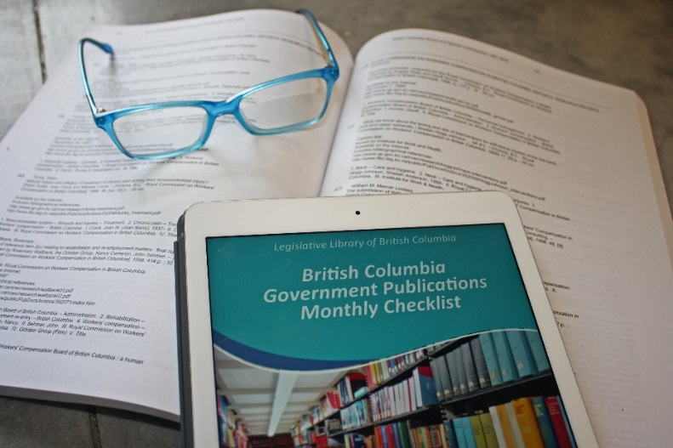
The old & the new
Legislation Research
QuickScribe
Hansard, BC Journals, BC Laws
Hard copies of Statues, BC Journals, Gazettes
Media Scans
Canadian Newsstream, Infomart, E-subscriptions
Newspaper index, microfilm, paper copies
BC Government Documents
300 000 items, the largest collection of BC government publications
50 000+ digital and accessible
Digitization of older BC government documents

Slide 18
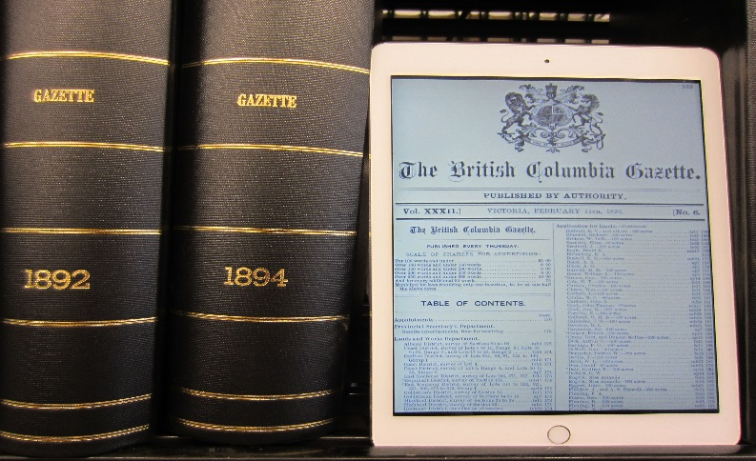
Digitization Projects
BC Sessional Papers
1865-1982 hosted by UBC
BC Gazettes
1863-1871 hosted by UVic
1872-1931 hosted by UVic via Internet Archive
2001/3-present on BC Laws
British Columbia Royal and Special Commissions
1872-1980 hosted by Legislative Library

Slide 19
Thank you!
Questions?
Contact: 250-387-6510, llbc.ref@leg.bc.ca
https://www.leg.bc.ca/learn-about-us/legislative-library
Iona Reid: iona.reid@leg.bc.ca
Megan Laflin: megan.laflin@leg.bc.ca

