Slide 1
STEAM @ VIRL A Story of Library Tinkering
Presented by
Amy Dawley, Customer Services Librarian II, Gabriola Island Branch
Julie Carter, Customer Services Librarian – Children & Youth, Nanaimo Wellington Branch
Ginger Warden, Customer Services Librarian – Children & Youth, Nanaimo North Branch
Emma Ritchie, Information Technician, Nanaimo Harbourfront Branch
Notes:
Amy – intro & welcome

Slide 2
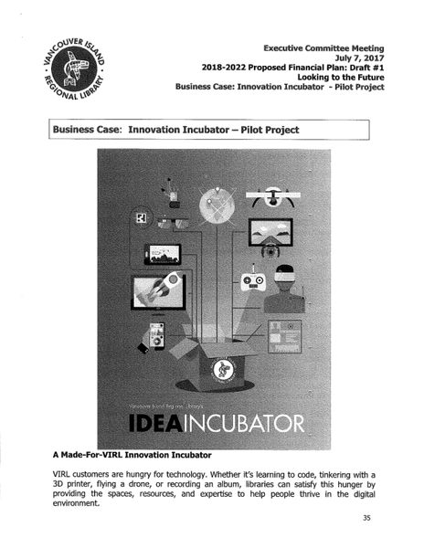
Notes:
Amy

Slide 3
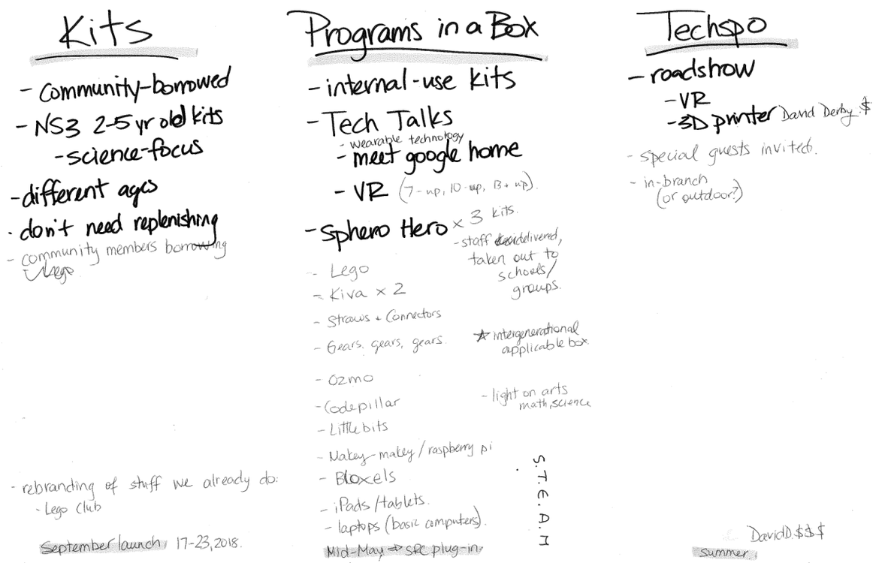
Notes:
Amy

Slide 4
Steering Committee
Children’s Services Committee
Adult Services Committee
Programs & Kits Committee
STEAM Mega-Committee – Customer Services Librarians from all three Public Services Committees
Cross-Departmental Teams
Communications
Purchasing, Finance
Teen Services Committee
Marketing & Communications
Support Services, Information Technology
Notes:
Amy

Slide 5
Mid-May 2018
Programs in a Box
STEAM Program Plans
Summer 2018
STEAM Roadshow
SRC STEAM Programming
September 2018
Tinker Totes
Science Literacy Week
Notes:
Amy

Slide 6
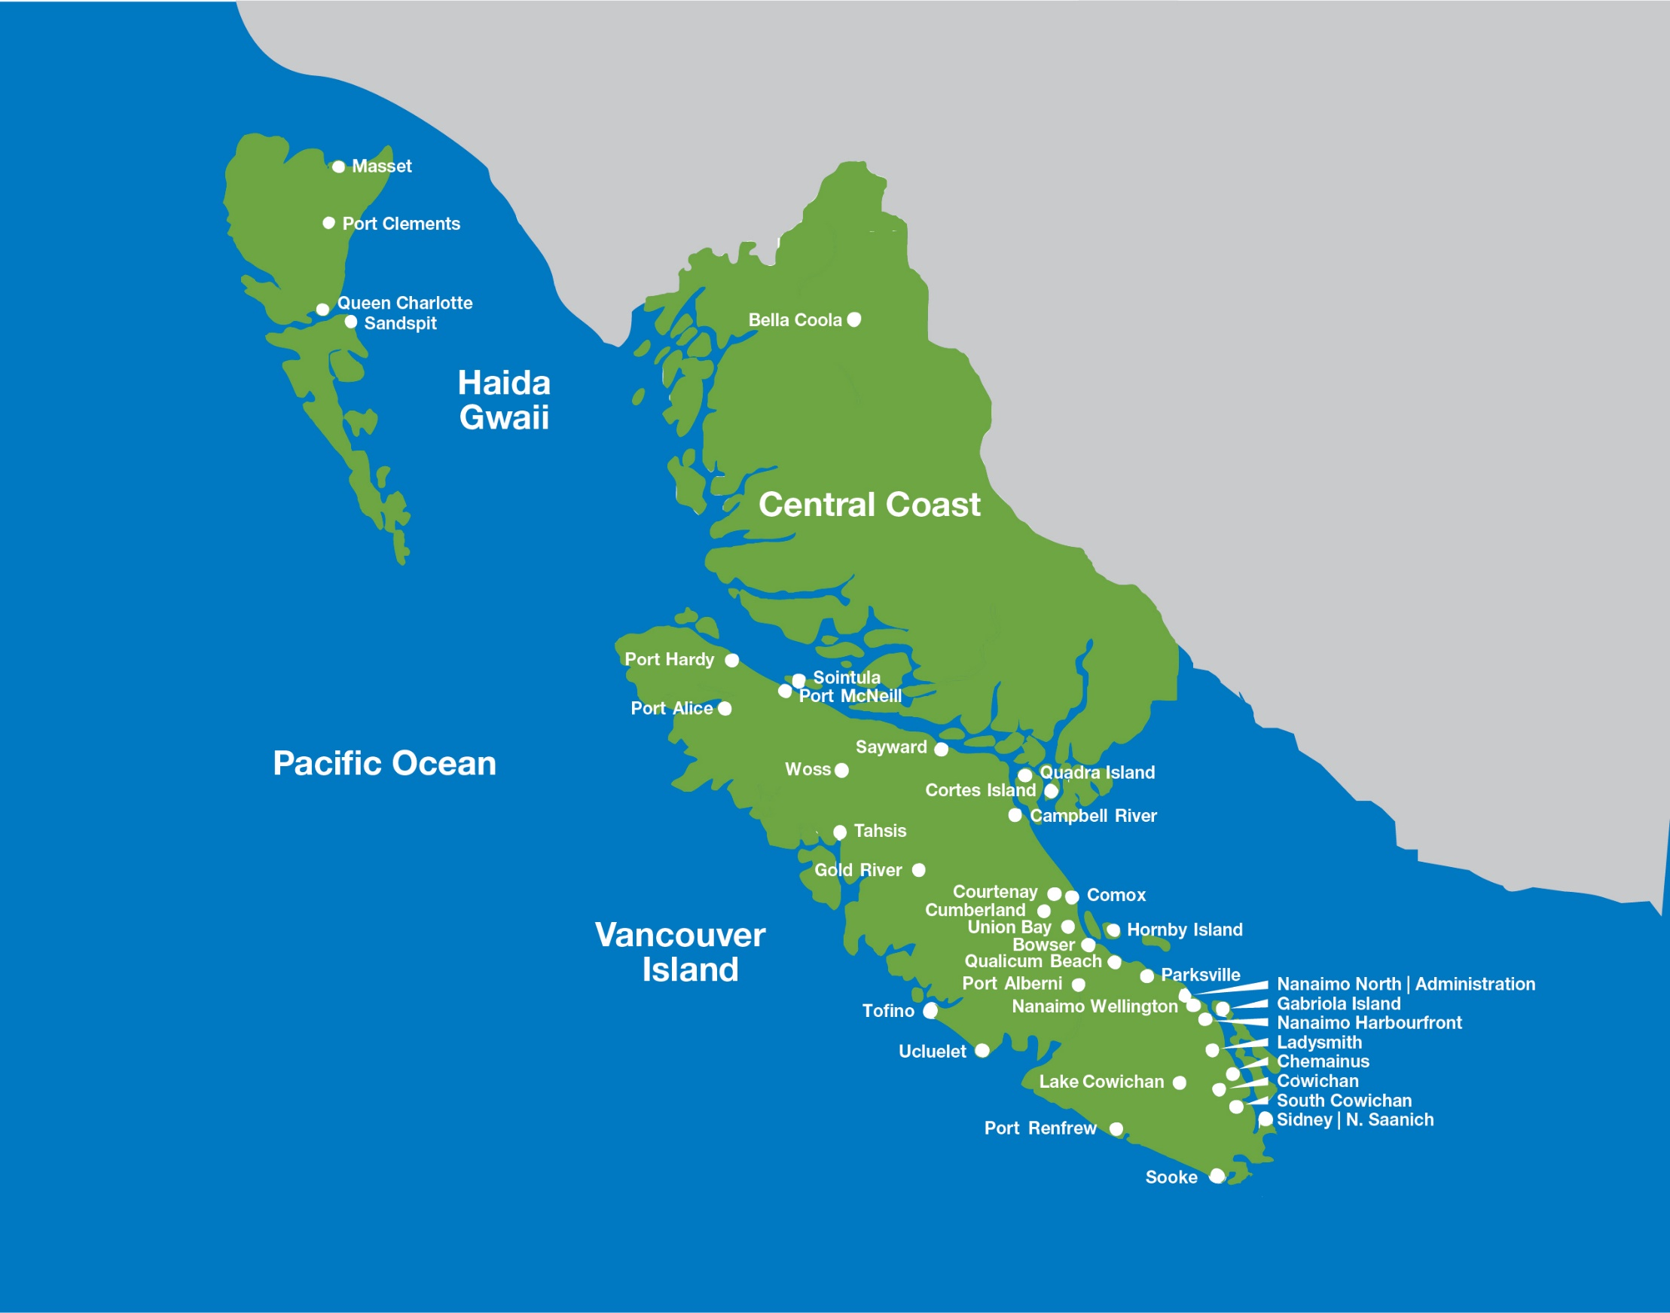
Notes:
Amy

Slide 7
Programs in a Box:
Brainstorming
Notes:
Julie

Slide 8
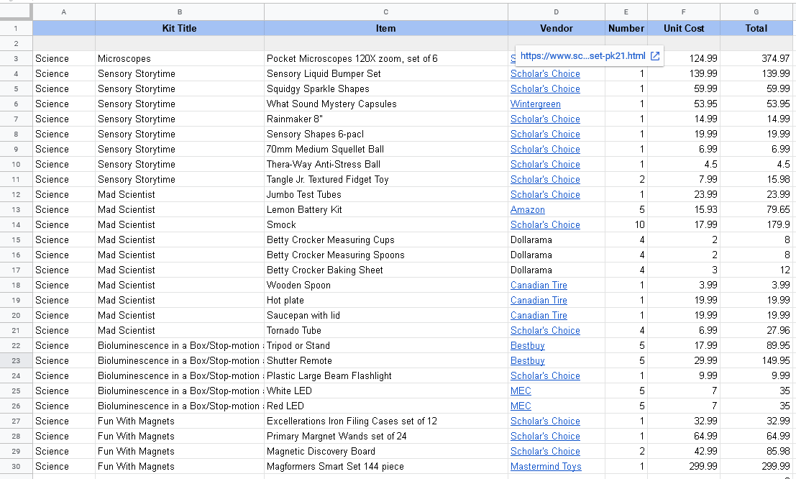
Shopping List
Notes:
Julie

Slide 9
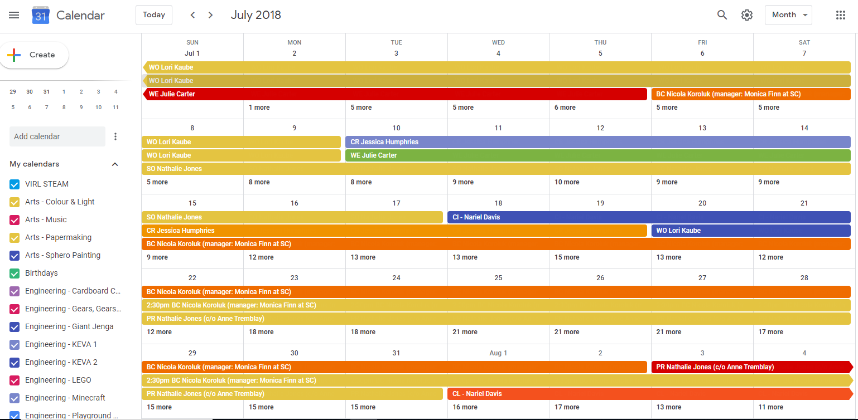
Challenge #1:
Timeline
Notes:
Julie

Slide 10
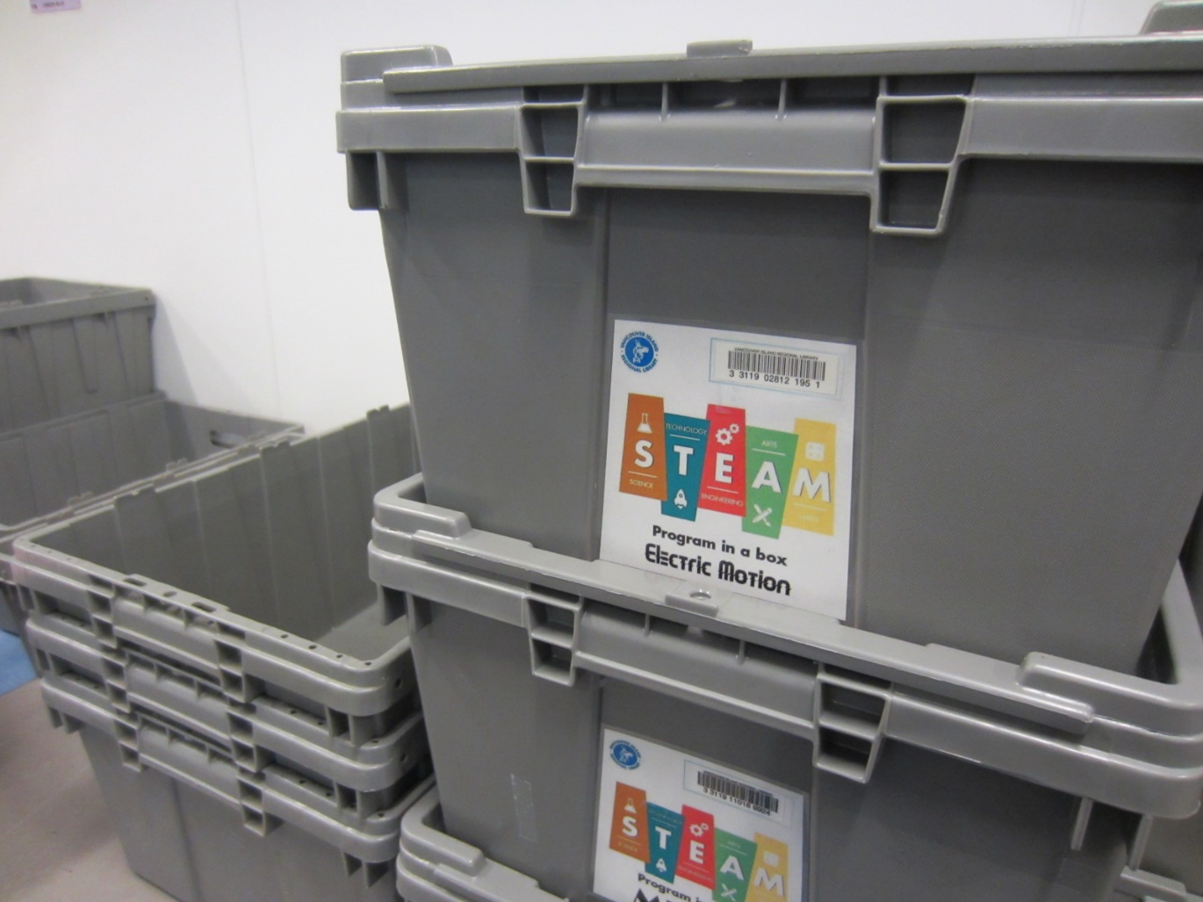
Challenge #2:
Assembly
Notes:
Julie

Slide 11
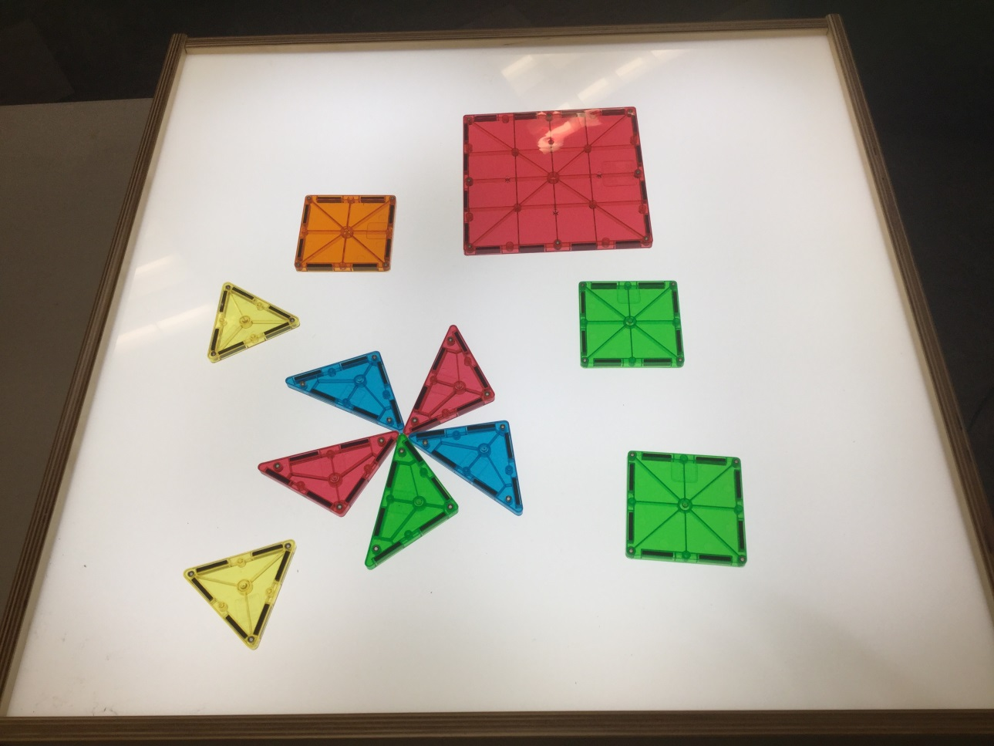
Program in a Box:
Light Table
Notes:
Julie

Slide 12
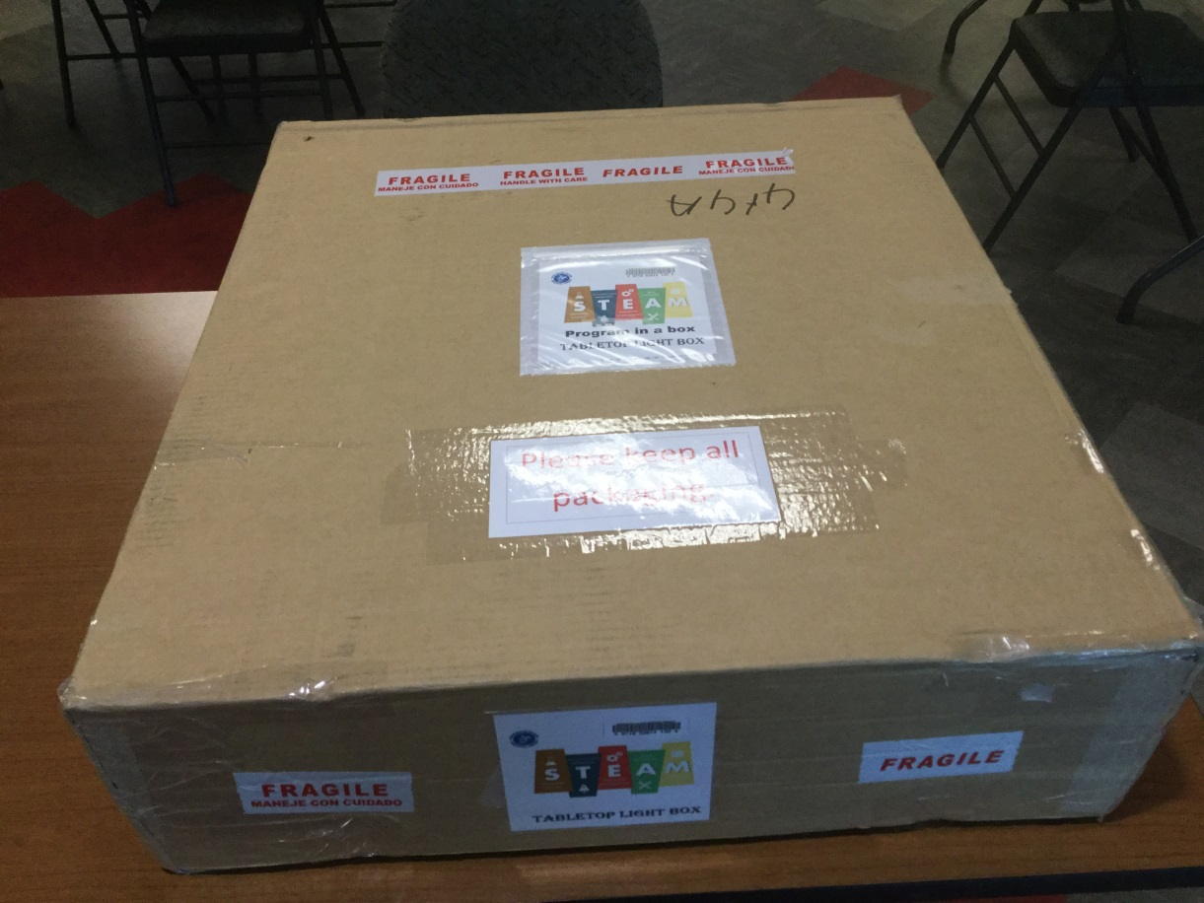
Packaging:
Light Table
Notes:
Julie

Slide 13
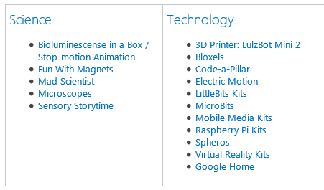
Programs in a Box
Notes:
Julie

Slide 14
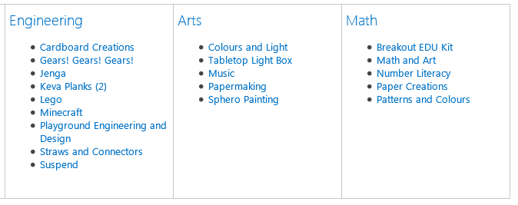
Programs in a Box
Notes:
Julie

Slide 15
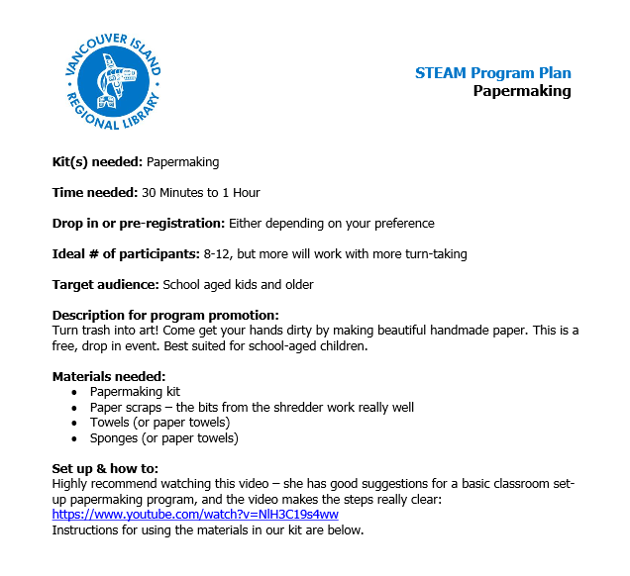
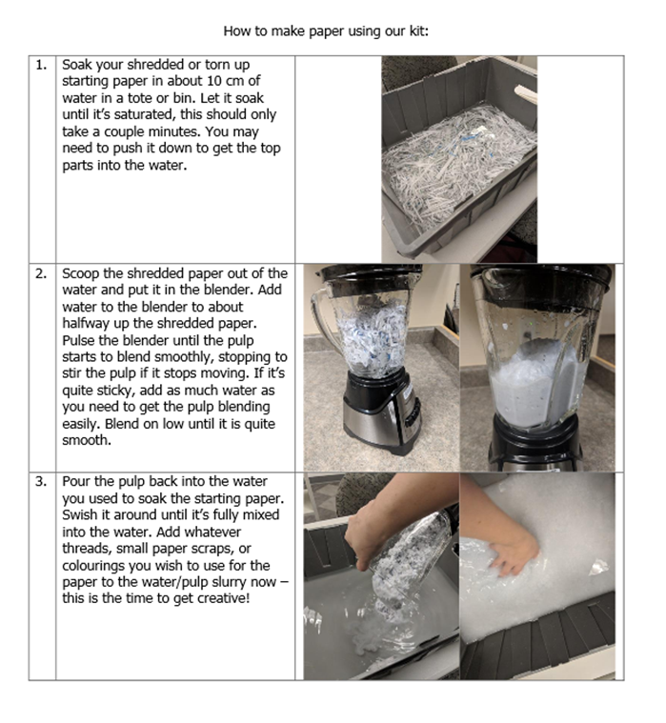
Programs in a Box:
Program Plans
Notes:
Julie

Slide 16
Notes:
Ginger

Slide 17
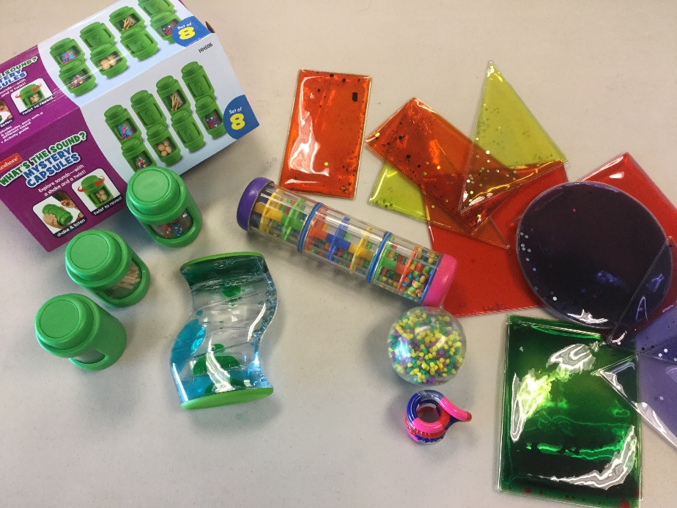
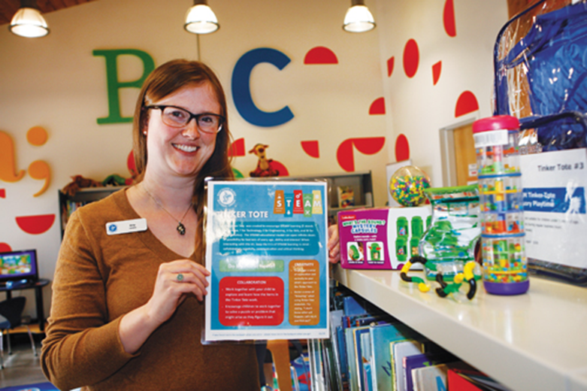
Tinker Tote:
Sensory Playtime
Notes:
Ginger

Slide 18
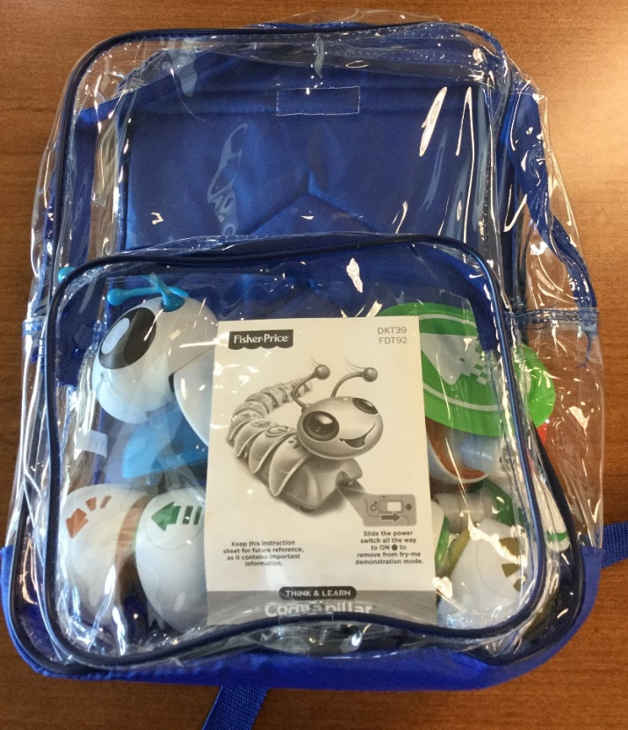
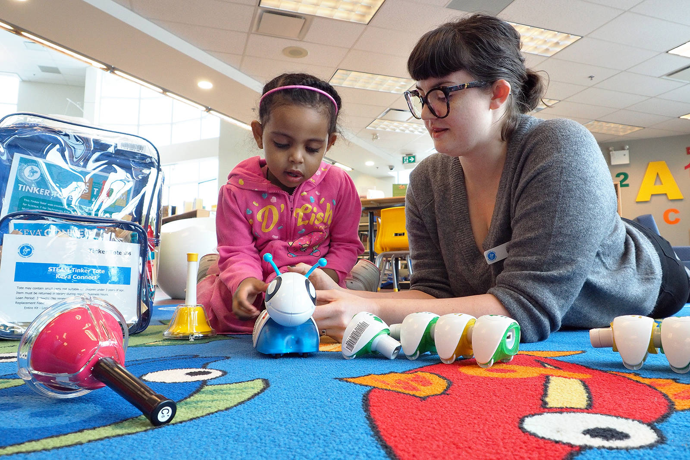
Tinker Tote:
Code-a-Pillar
Notes:
Ginger

Slide 19
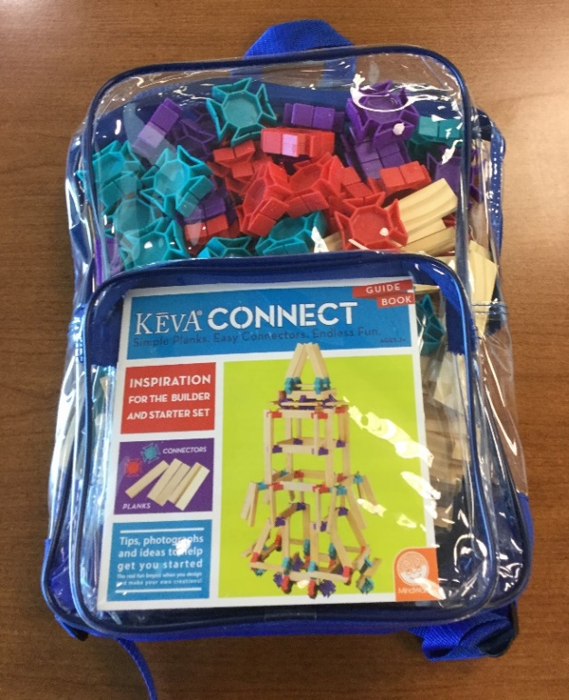
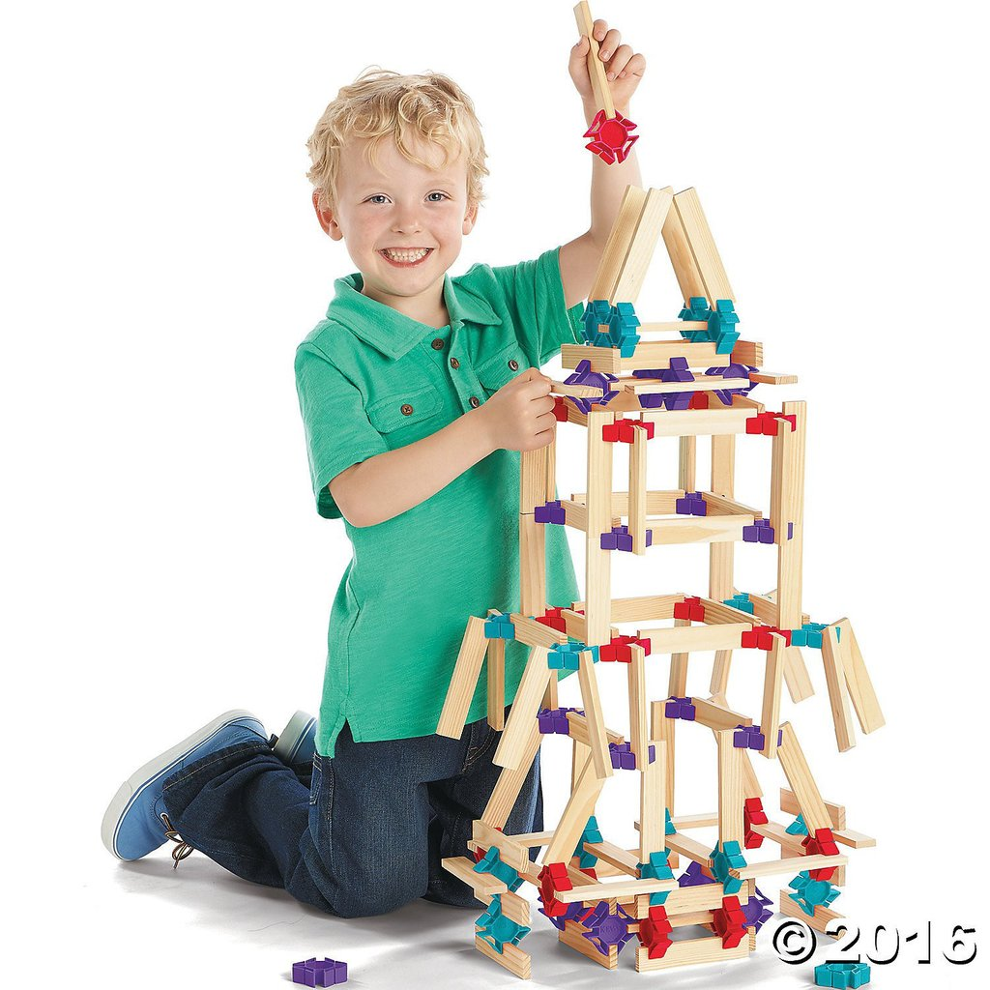
Tinker Tote:
KEVA Connect Planks

Slide 20
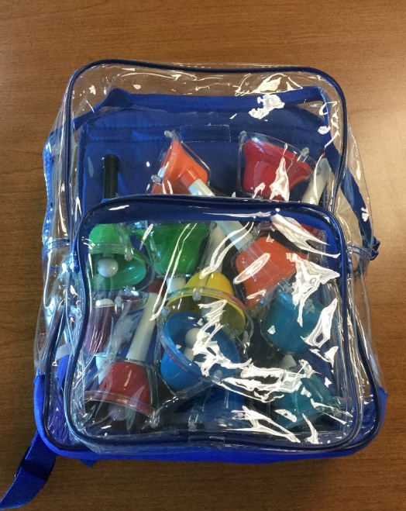
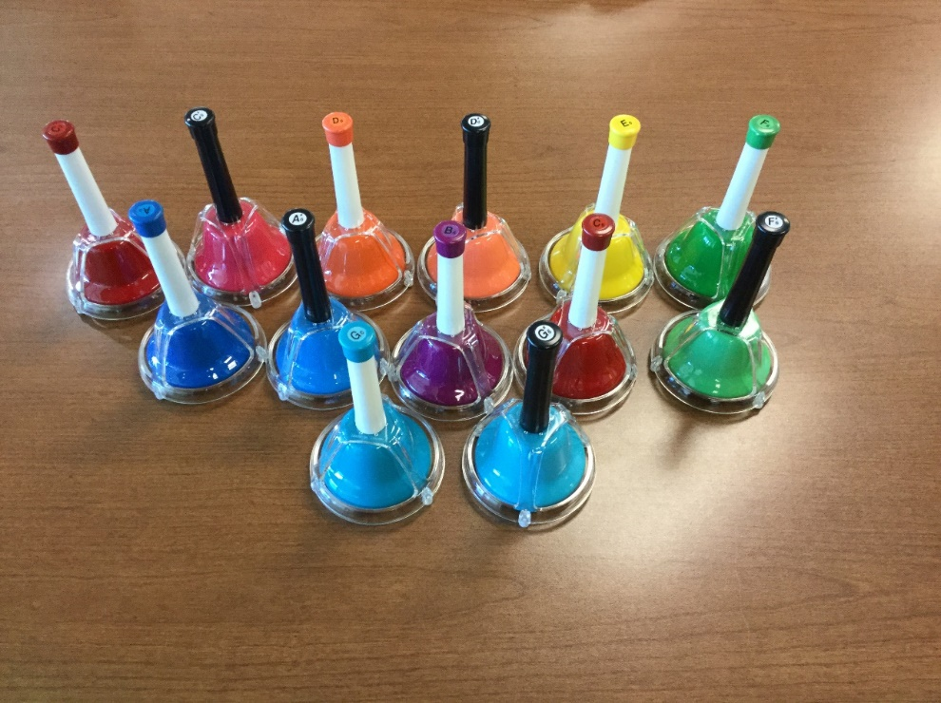
Tinker Tote:
Hand Bells

Slide 21
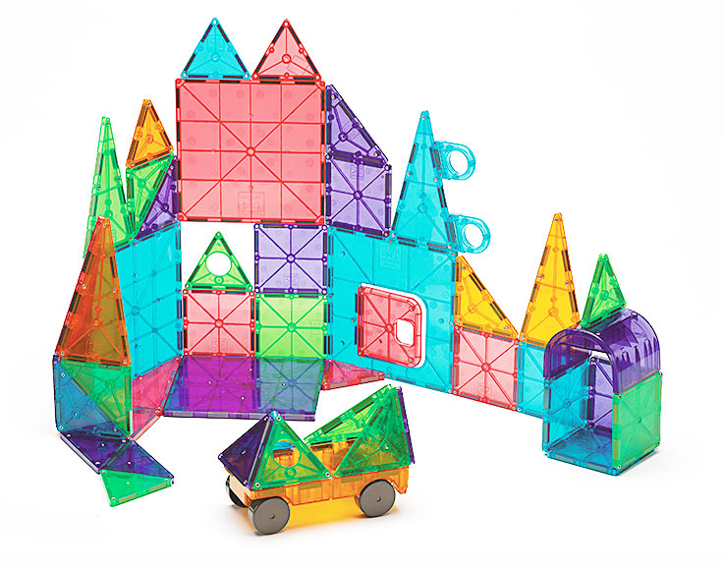
Tinker Totes:
Magna-Tiles

Slide 22
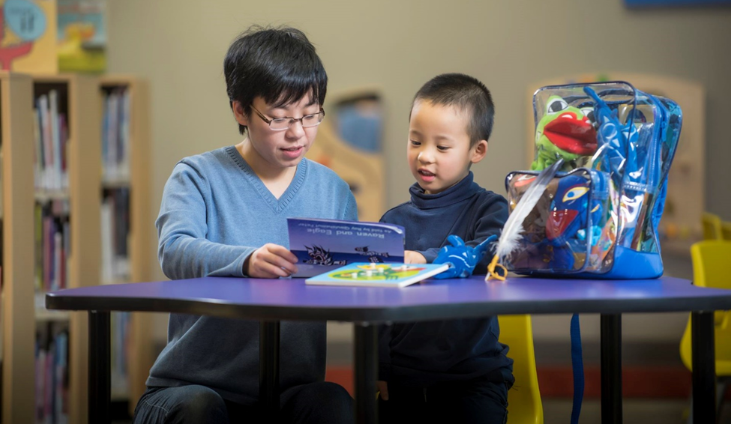
Cataloguing, Circulation Rules, and Packaging –
Following in the footsteps of our Literacy and Cultural Kits

Slide 23
Tinker Totes:
Packaging

Slide 24
Tinker Totes:
Promotion

Slide 25
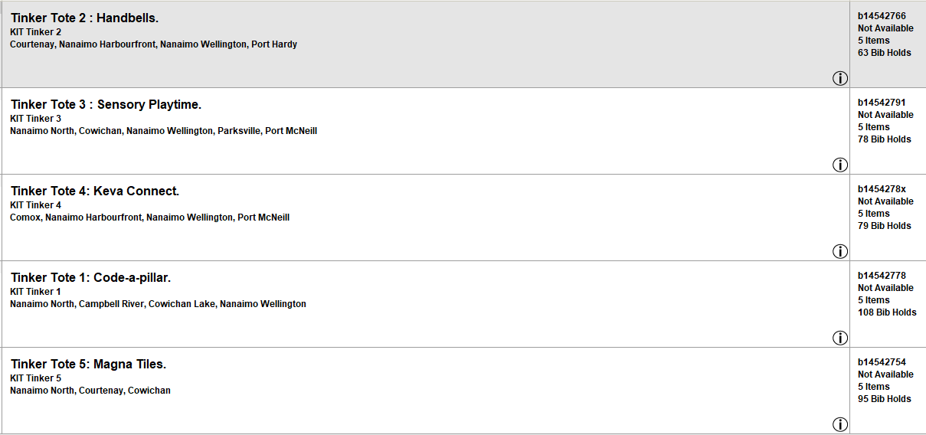
Tinker Totes:
Requests as of April 18, 2019
 | Number Have | Number Holds | Number to Purchase
Tinker Tote 1: Code-a-pillar | 5 | 108 | 15
Tinker Tote 2: Handbells | 5 | 63 | 8
Tinker Tote 3: Sensory Playtime | 5 | 78 | 10
Tinker Tote 4: KEVA Connect | 5 | 78 | 10
Tinker Tote 5: Magna Tiles | 5 | 96 | 13
 |  |  | TOTAL 57

Slide 26
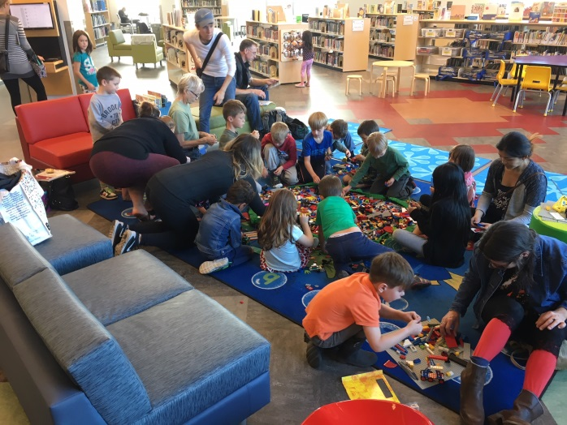
Notes:
Emma - Lego program at NA

Slide 27
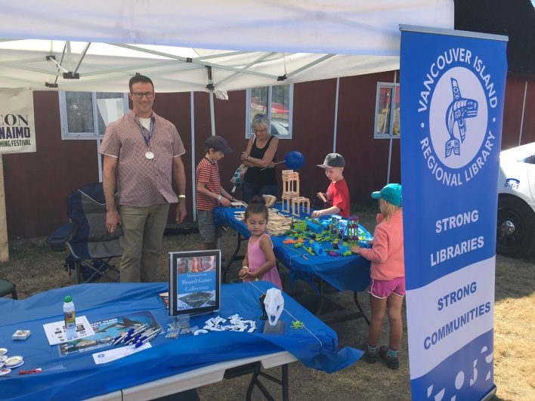
Notes:
Emma – STEAM goes to VIEX

Slide 28
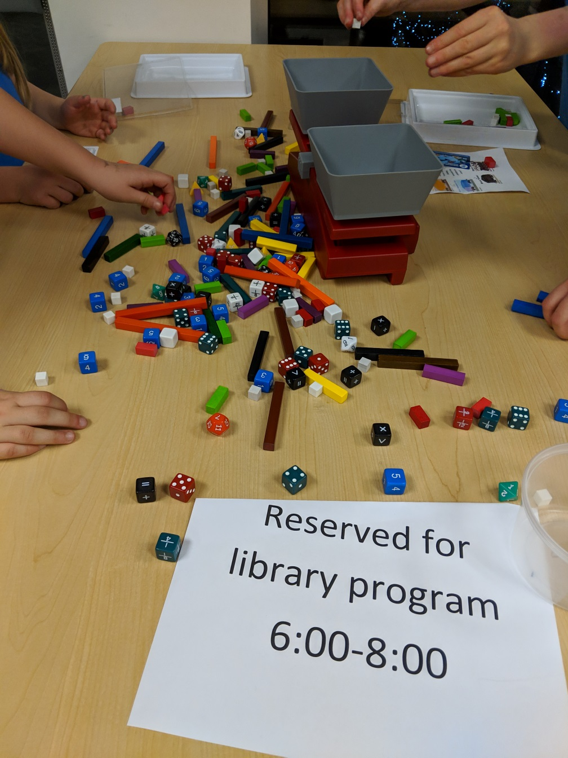
Notes:
Emma – Brownie tour at NA ended with some free play with the Number Literacy kit

Slide 29
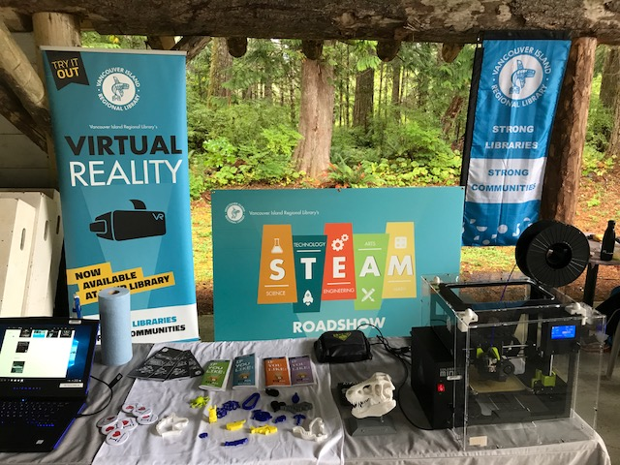
Notes:
Emma – Roadshow

Slide 30
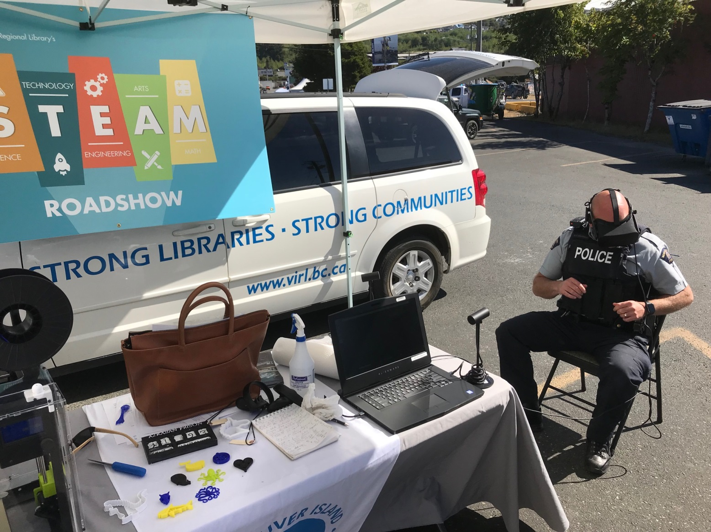
Notes:
Emma – STEAM Roadshow

Slide 31
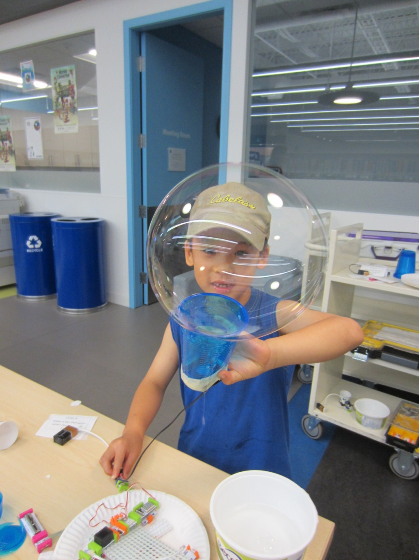
Notes:
Emma – LittleBits at WE

Slide 32
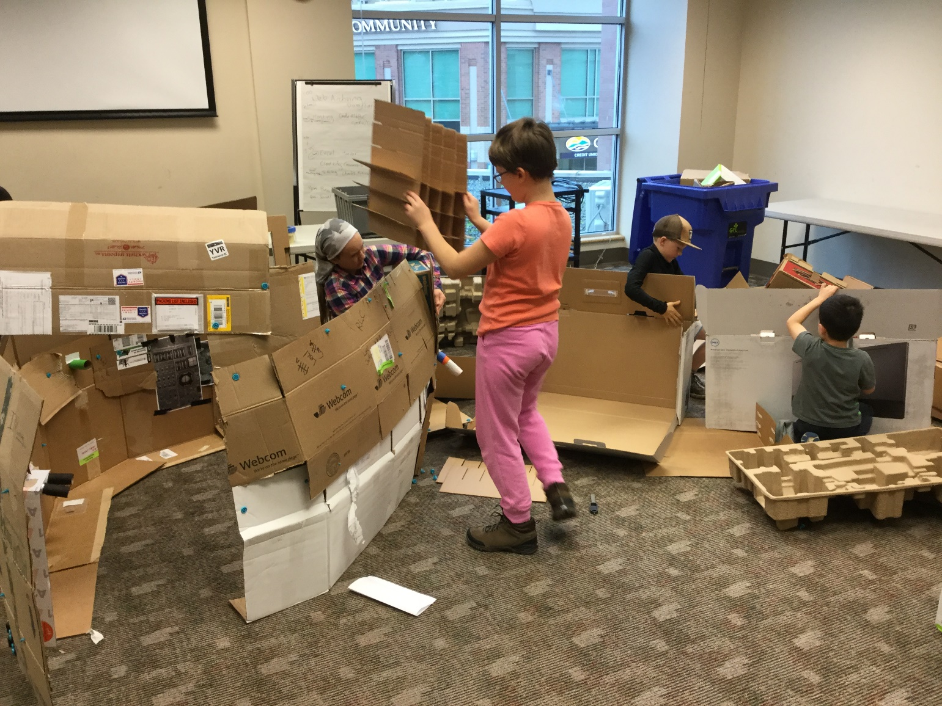
Notes:
Emma – STEAM Friday

Slide 33
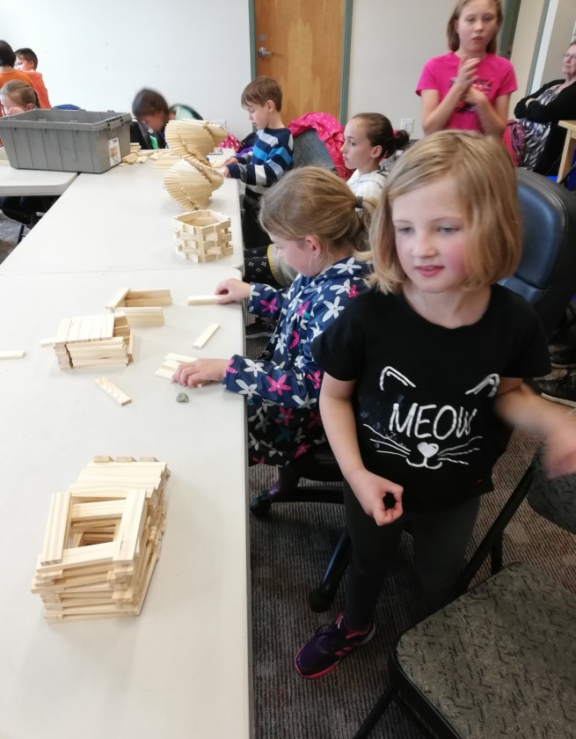
Notes:
Emma KEVA NA

Slide 34
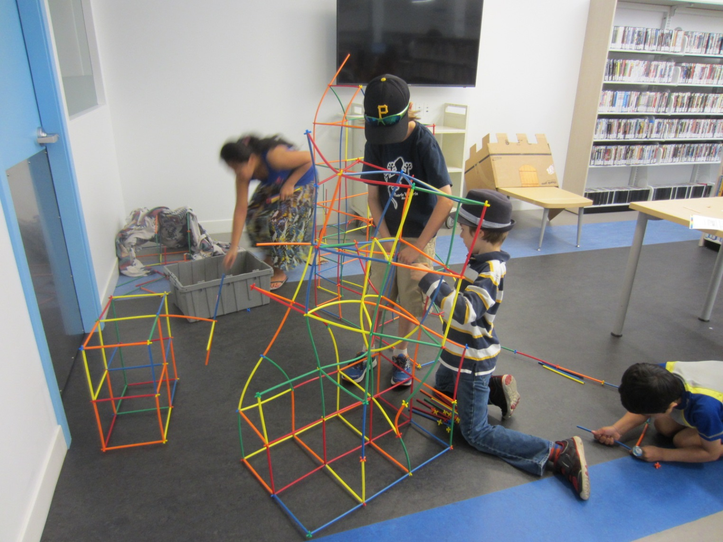
Notes:
Emma – straws and connectors at WE

Slide 35
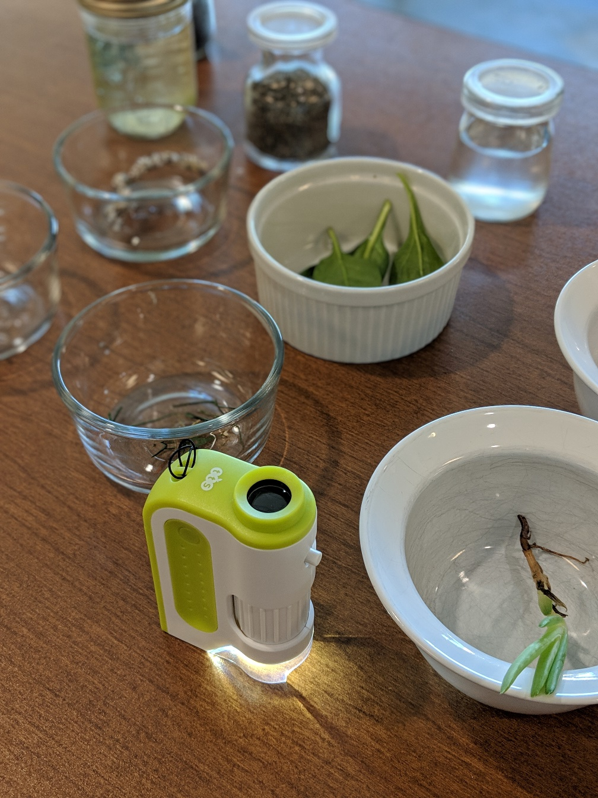
Notes:
Emma - Microscope kit

Slide 36
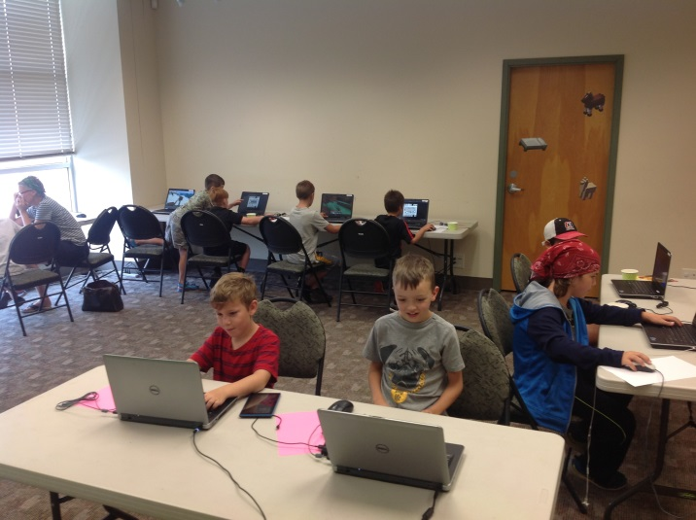
Notes:
Emma – SRC Minecraft

Slide 37
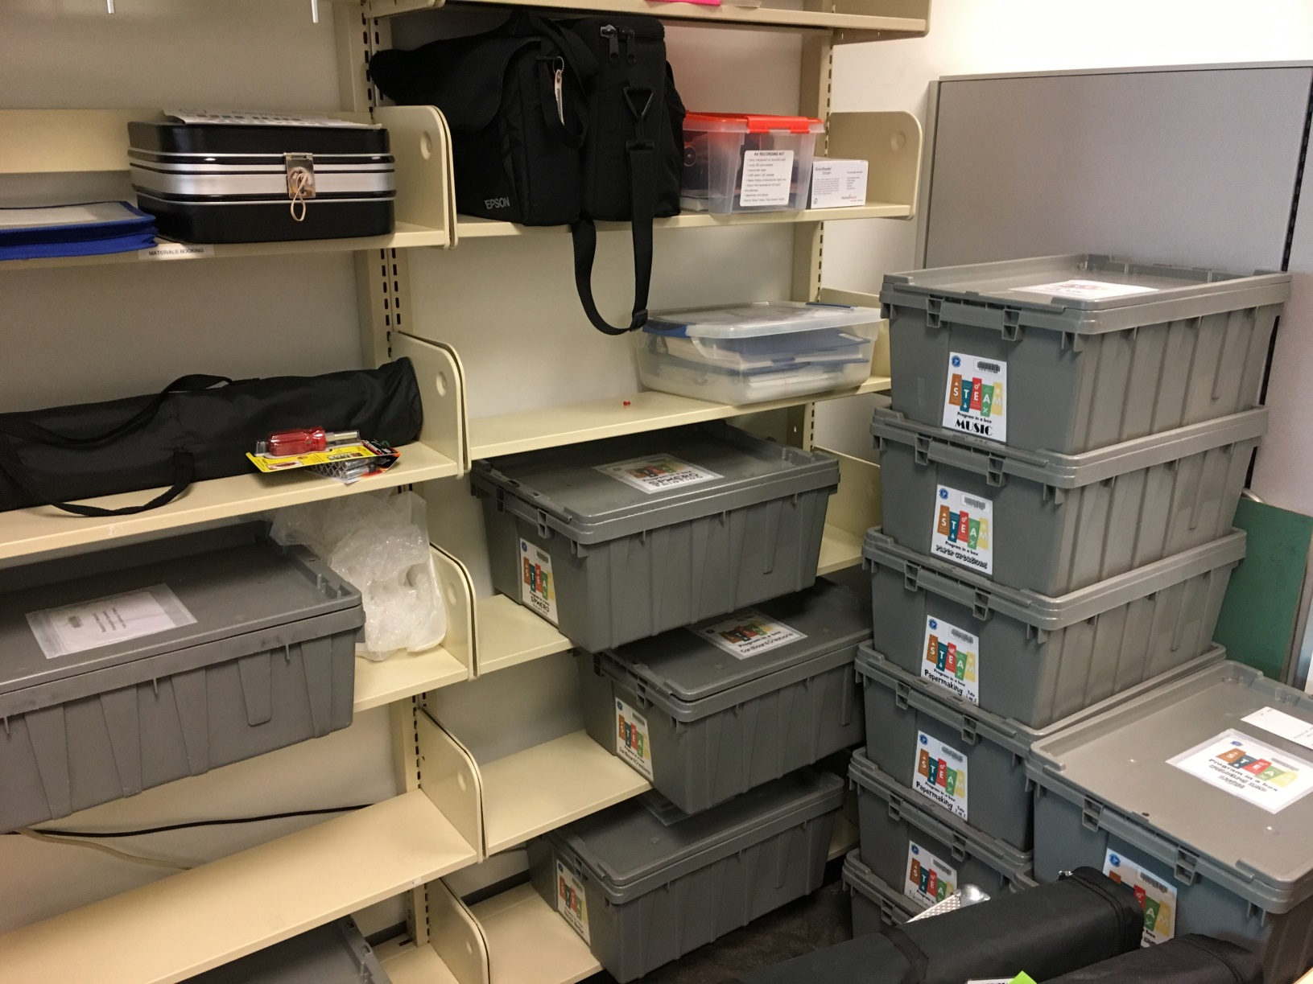
Notes:
Emma – Tote storage

Slide 38
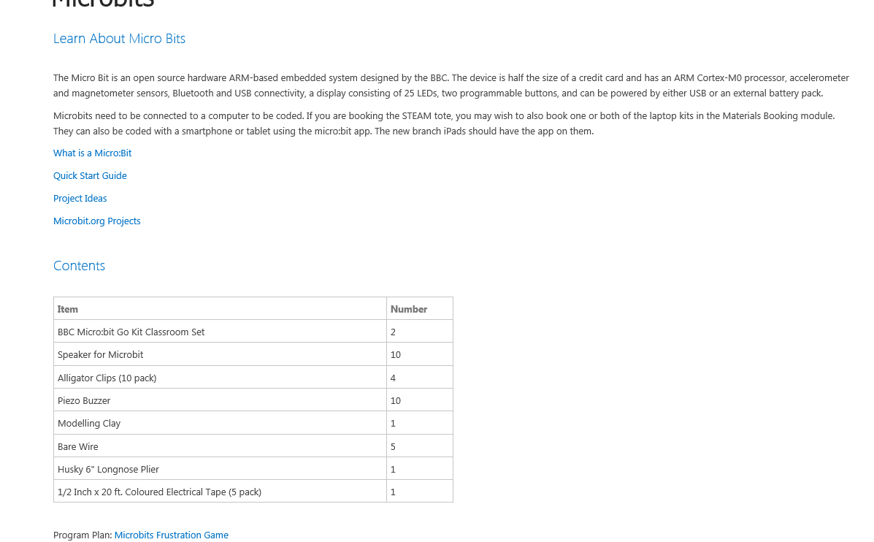
Notes:
Emma – Inside pages

Slide 39
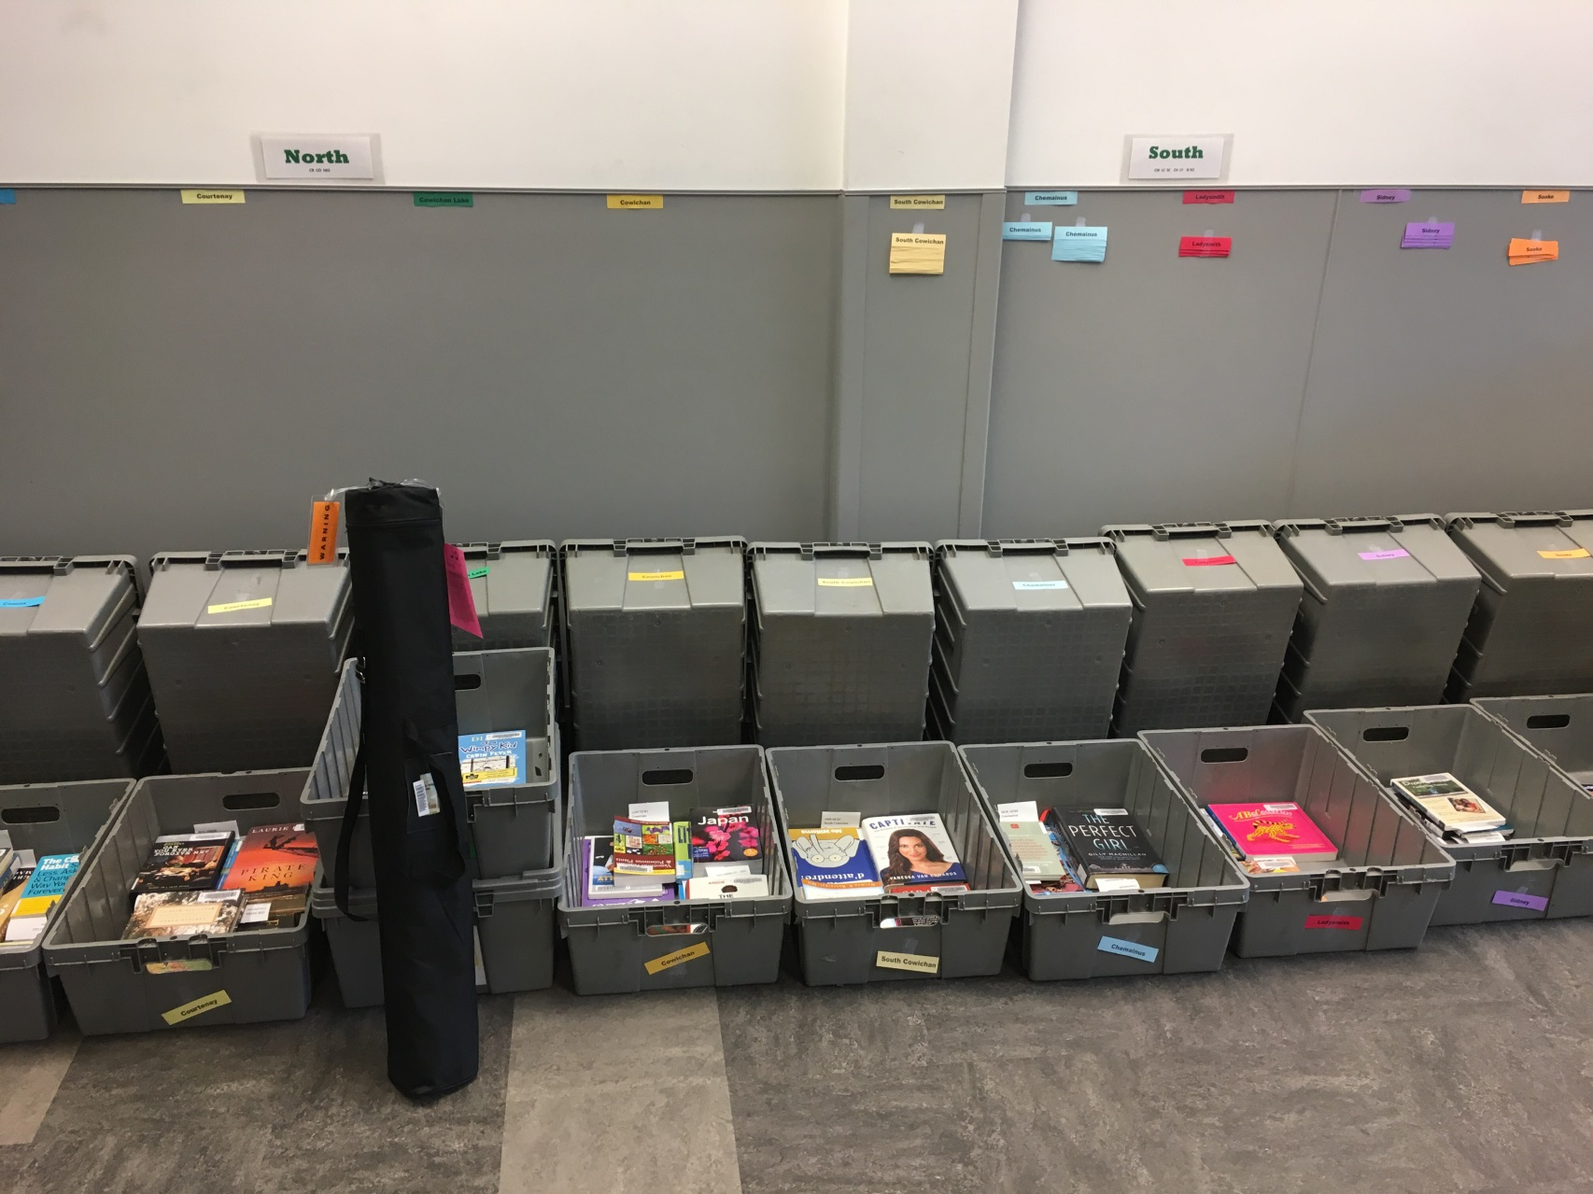
Notes:
Emma – traveling kits

Slide 40
Notes:
Emma – Replacing items

Slide 41
Notes:
Emma – new kit ideas

Slide 42
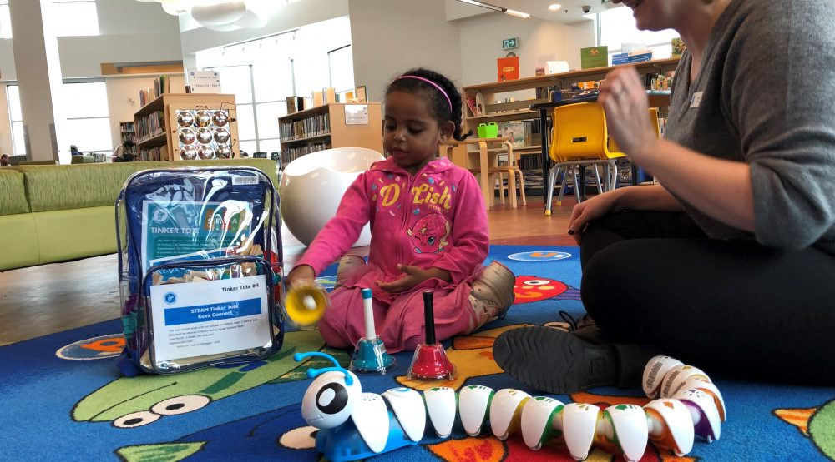
Notes:
Emma – Tinker Tote success & Amy lessons learned.

