Slide 1
ALBERTA LIBRARY CONFERENCE ADULT PRESENTATION
Penguin Random House
Lahring Tribe
Spring 2016

Slide 2
NOT WORKING
Lisa Owens

Slide 3
WE’RE ALL IN THIS TOGETHER
Amy Jones

Slide 4
A FINE IMITATION
Amber Brock

Slide 5
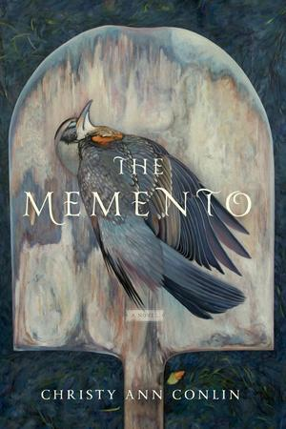
JUNE
Miranda Beverly-Whittemore

Slide 6
A COUNTRY ROAD, A TREE
Jo Baker

Slide 7
HOMEGOING
Yaa Gyasi

Slide 8
THE GIRLS
Emma Cline

Slide 9
DARK MATTER
Blake Crouch

Slide 10
YOU MAY ALSO LIKE
Tom Vanderbilt

Slide 11
THE MISTRESSES OF CLIVEDEN
Natalie Livingstone

Slide 12
THE NAME THERAPIST
Duana Taha

