Slide 1
Food for Thought:
Dishing Out What your Community Needs

Slide 2
Who We Are:
Caroline Vandriel, MLIS
Library Director
Sylvan Lake Municipal Library
Nicole Bannick
Program Coordinator
Camrose Public Library

Slide 4
What is it?
The Little Free Pantry operates on the same principles as a Little Free Library, except food is used instead of books.
Those who have, give; those who need, take.

Slide 5
Origin Story
Kids would be at the library all day, then ask staff if there was anything they could eat.
Our local food bank is open for only three hours a week: Wednesday mornings, 9-12.

Slide 6
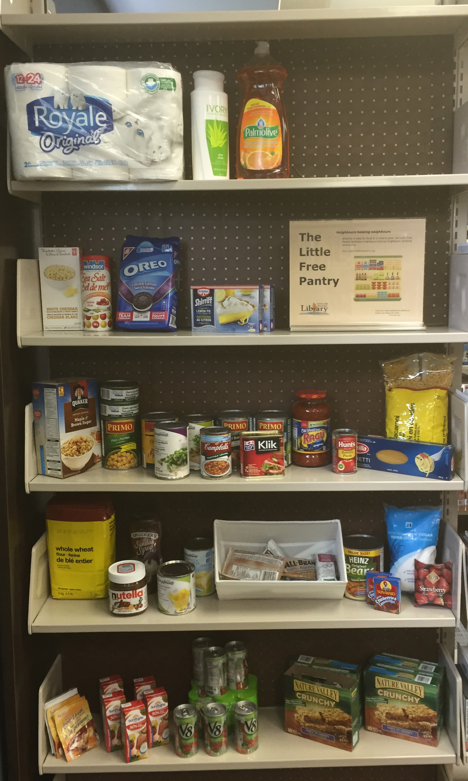
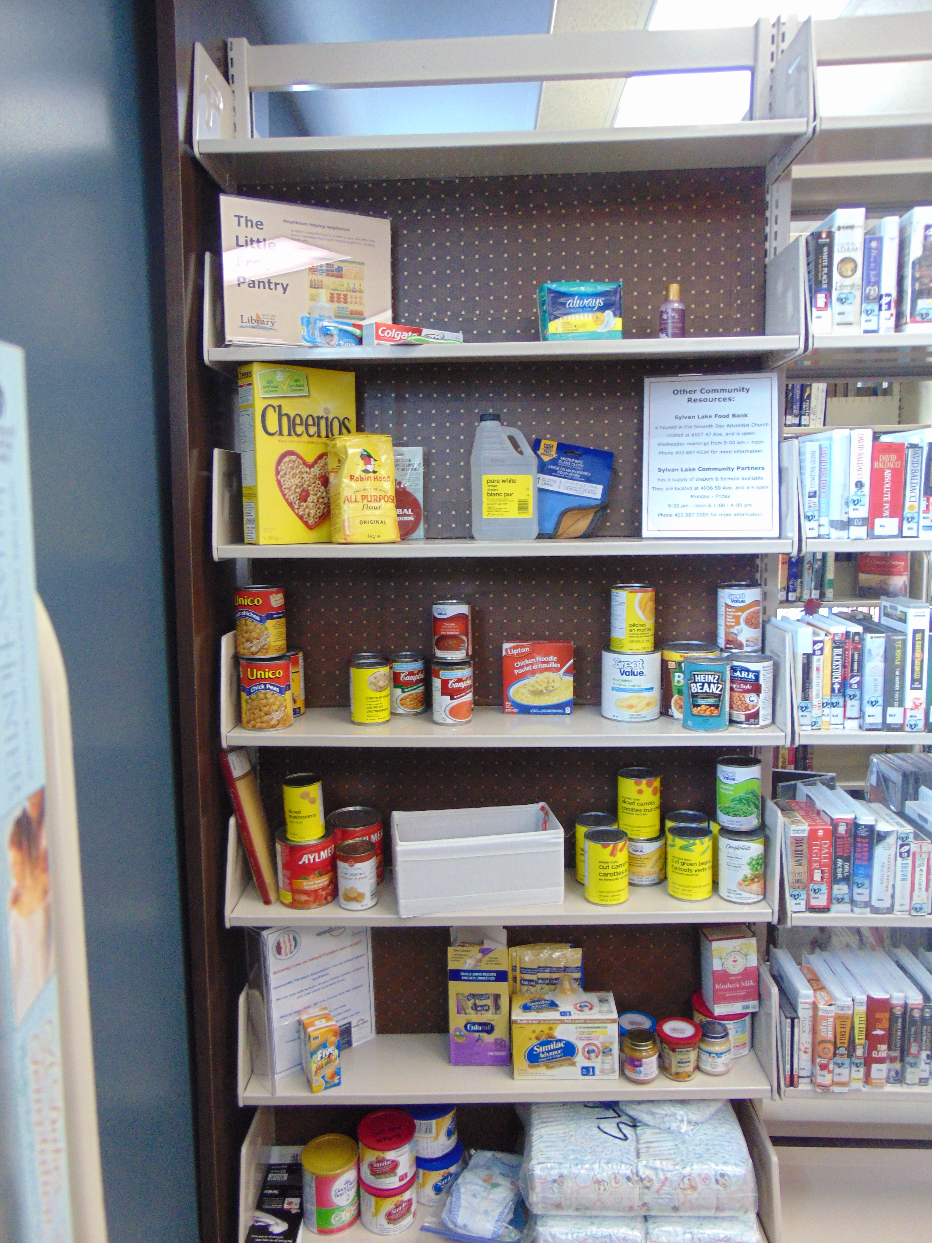

Slide 7
How does it work?
People donate food items and staff restock the shelves on a regular basis.
The pantry is in a discrete part of the library and those in need are directed to it, to take as much, or as little as they need.

Slide 8
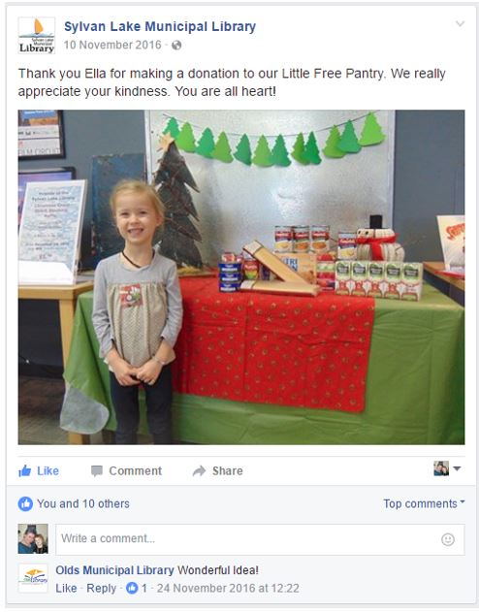

Slide 9
Who gives?
Staff (not asked to)
Regular patrons
People who have read about it and come specifically to the library to give
Other Sylvan Agencies
Kids

Slide 10
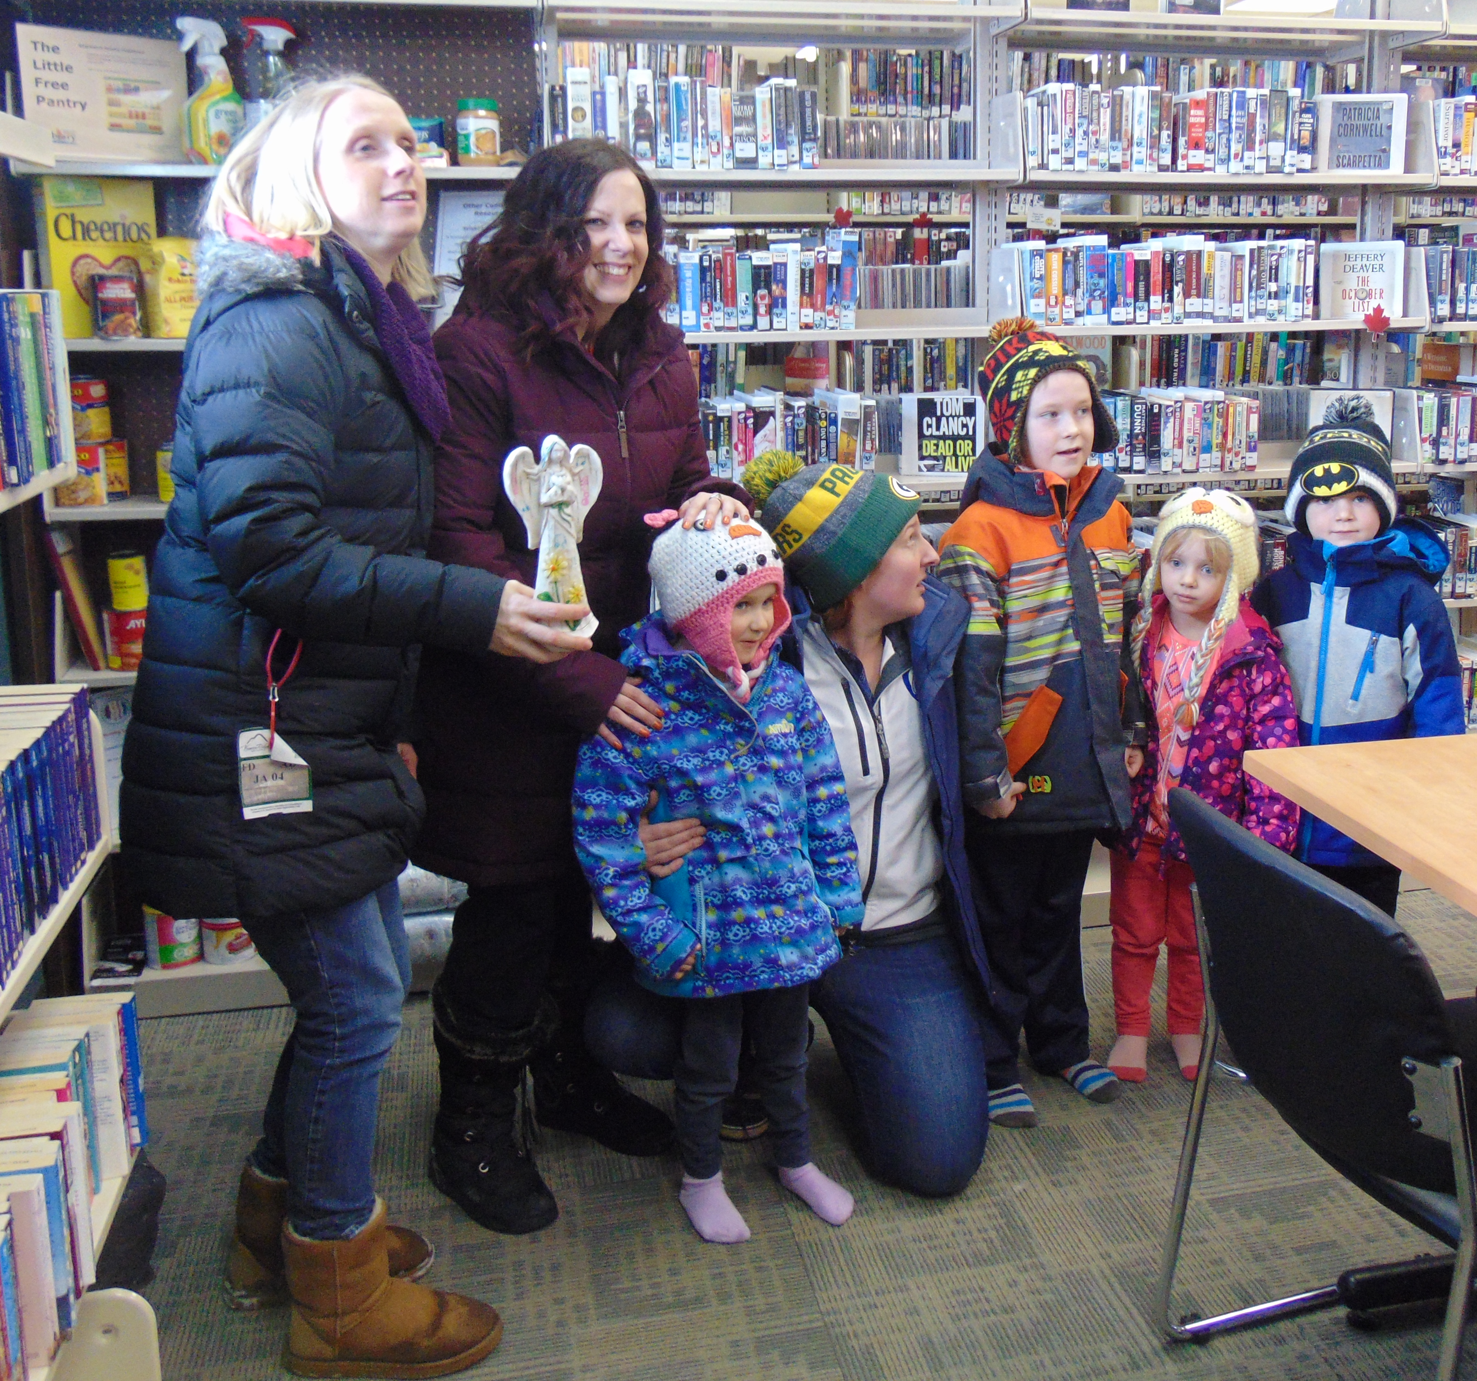
Our Lady of the Rosary School had a staff professional development day; part of it involved getting the staff out into the community to learn more about the different services by participating in the OLR Amazing Race. We (the library) were the last stop in the race.

Slide 11
Who uses it?
Kids who are “stuck” at the library without recourse to food at/from home
Computer kids
Regular patrons
Referrals from other agencies
Anyone in need

Slide 13
Stocking the shelves
Staff fill in bare spots as they appear, at least once a week, often daily.
Diapers are put into individual baggies and labelled with the size/age.
Granola bars and juice boxes are stocked individually.

Slide 14
What’s on the shelves
Canned goods
Granola bars
Juice boxes
Diapers
Cleaning products
Personal hygiene products
Rice
Pasta
Pudding
Baby food
Pet food

Slide 15
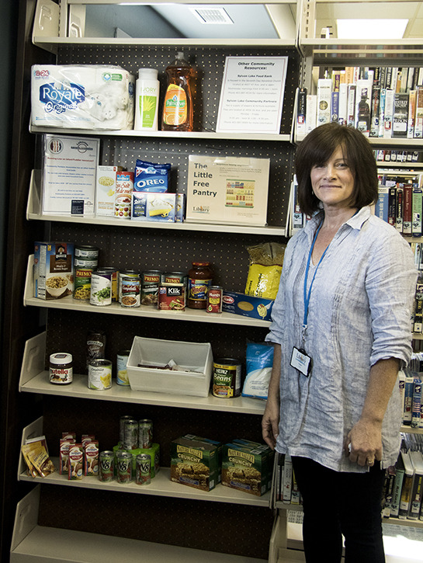
This was the image used in the local paper. Jeri, our Assistant Director and organizer of this project, does not like her picture taken or public recognition. When the reporter came to take the photo, she conned one of our desk clerks (Susan) into being in the picture in her place.

Slide 16
Sustainability
We live in a very generous community. When we start to run low, we post on social media and we get donations in. If these posts get shared or retweeted by other agencies or groups in Sylvan, the response can be overwhelming.

Slide 17
Sustainability
At this time we are looking for long-term, regular commitments. We are approaching local businesses and service groups in order to funding on a monthly basis. $25 / month actually goes a really long way.

Slide 18
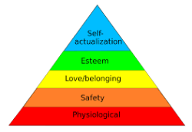
Why?
“Visit a Comfortable Space”
“Succeed in School”
Maslow’s Hierarchy of Needs
Because we saw a need and decided to fill it.

