Slide 1
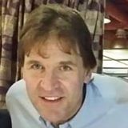
EBSCO PRESENTATION PRODUCT AND INFORMATION UPDATES MANITOBA LIBRARY CONFERENCE 2018

Slide 2
Current MLPS Products
Academic Search Premier
Auto Repair Reference Center
AUTOMATE* (Replaces Auto Repair Reference Center)
Canadian Points of View Reference Centre
Canadian Reference Centre
Home Improvement Reference Centre
MasterFile Premier
Middle Search Plus
NoveList Plus
Primary Search
Small Engine Repair Reference Center

Slide 3
REFERENCE DATABASES INCLUDE
ACCESS TO MANY
POPULAR MAGAZINES, NEWSPAPERS & JOURNALS

Slide 4
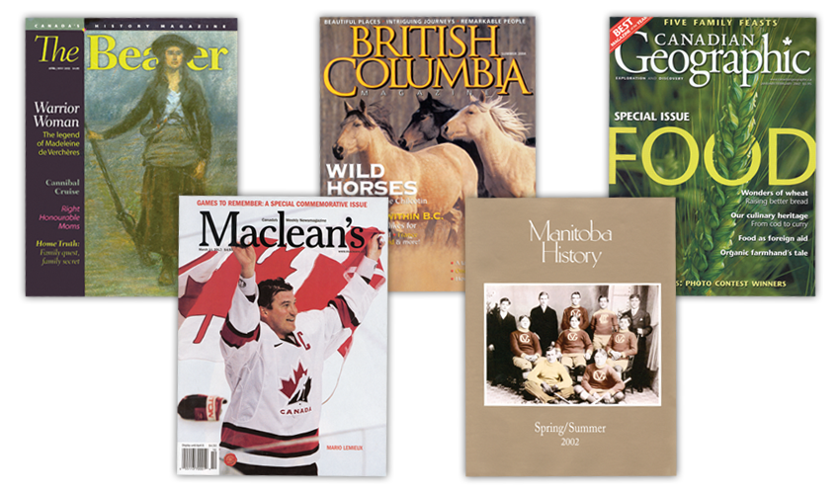
Canadian Reference Centre Offers Full-Text Canadian Magazines

Slide 5
International Magazines
Available via Canadian Reference Centre & MasterFile
Full text from leading periodicals from the United States and United Kingdom, including:
Archaeology
Architectural Record
Astronomy
Aviation Week & Space Technology
Billboard
Business Week
Consumer Reports
Discover
Economist
Forbes
Fortune
Good Housekeeping
History Today
Maclean’s
Math Trek
Men’s Health
National Geographic
National Wildlife
New Scientist
New Statesman
Newsweek
PC Magazine
PC World
People
Popular Science
Red Herring
Rolling Stone
Science News
Scientific American
Time
U.S. News & World Report

Slide 6
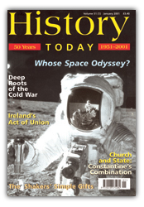
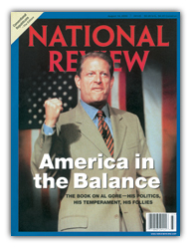
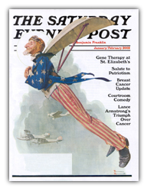
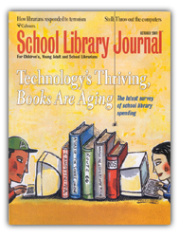
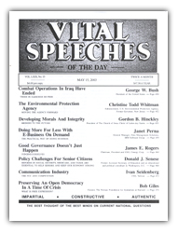
EBSCO has expanded full-text backfiles for magazines such as:
Back to 1922
Back to 1975
Back to 1975
Back to 1975
Back to 1931
Back to 1974
Back to 1975
Back to 1934
* Science News will be available in HTML back to 1975 (rather than in PDF)

Slide 7
Academic Search Premier
More than 8,500 Abstracted and Indexed Journals
More than 4,600 Full-Text Journals
More than 7,400 Peer-Reviewed, Abstracted and Indexed Journals
More than 3,900 Peer-Reviewed, Full-Text Journals

Slide 8
Canadian Reference Centre
Over 66,000 full-text biographies
An image collection for over 960,,000 photos, maps and flags
More than 86,000 images from Canadian Press

Slide 9
MASTERFILE PREMIER
Nearly 1,700 full-text periodicals
Over 935,000 photos, maps and flags
Over 81,900 primary source documents
More than 500 full-text reference books

Slide 10
MIDDLESEARCH PLUS
More than 160 full-text periodicals
Thousands of relevant photos, maps and flags
Over 102,000 full-text biographies
Over 106,000 primary source documents

Slide 11
PUBLIC

Slide 12
CONTENTS
Over 200 topics, each with the following essays:
Overview (objective background/description)
Point (argument)
Counterpoint (opposing argument)
Critical Thinking Guides
Helps the student judge Fact vs. Opinion
Enhances the student’s ability to read and think critically
COUNTER-POINT
POINT

Slide 13
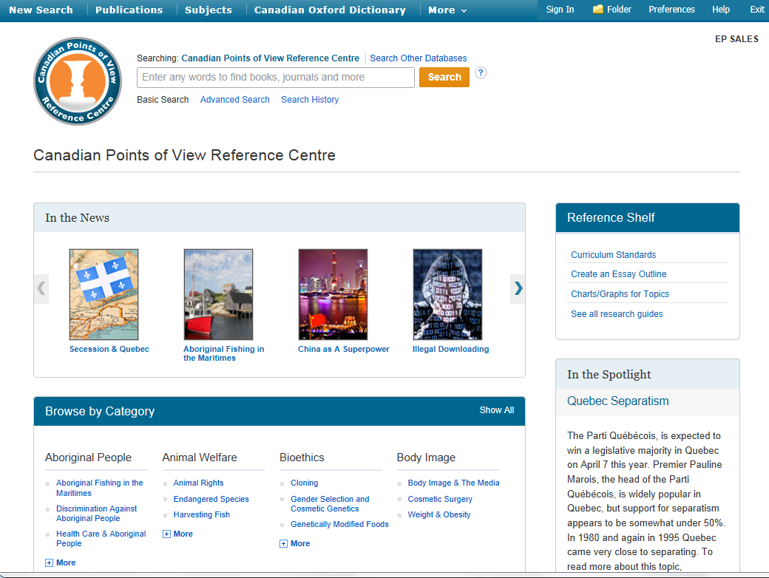
Basic Search

Slide 16
Auto Repair Reference Center
Contains information on most major manufacturers of domestic and imported vehicles
Database content includes more than 37,000 vehicles covered from 1954 to present
Millions of drawings and step-by-step photographs
Approximately 110,000 technical service bulletins & recalls issued by the original equipment vehicle manufacturer
Enhanced wiring diagrams for easy viewing and printing

Slide 17
Auto Repair Reference Center
Specifications and maintenance schedules
Labor time guide and estimator
AutoIQ
A complete guide to vehicle ownership and maintenance
New repair procedures, TSBs and updates are continually added to the product
Diagnostic information
All content created by ASE certified technicians

Slide 18
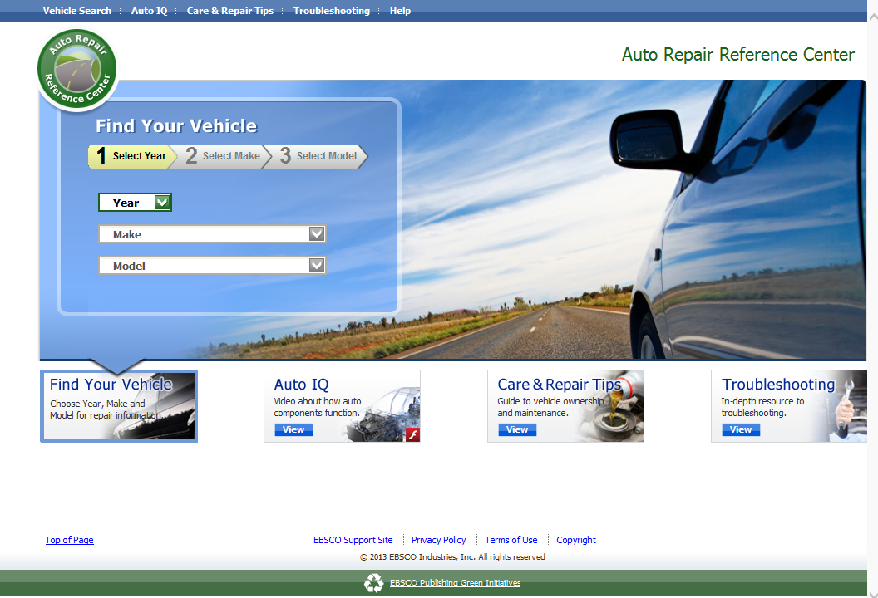
Newly Designed Homepage

Slide 19
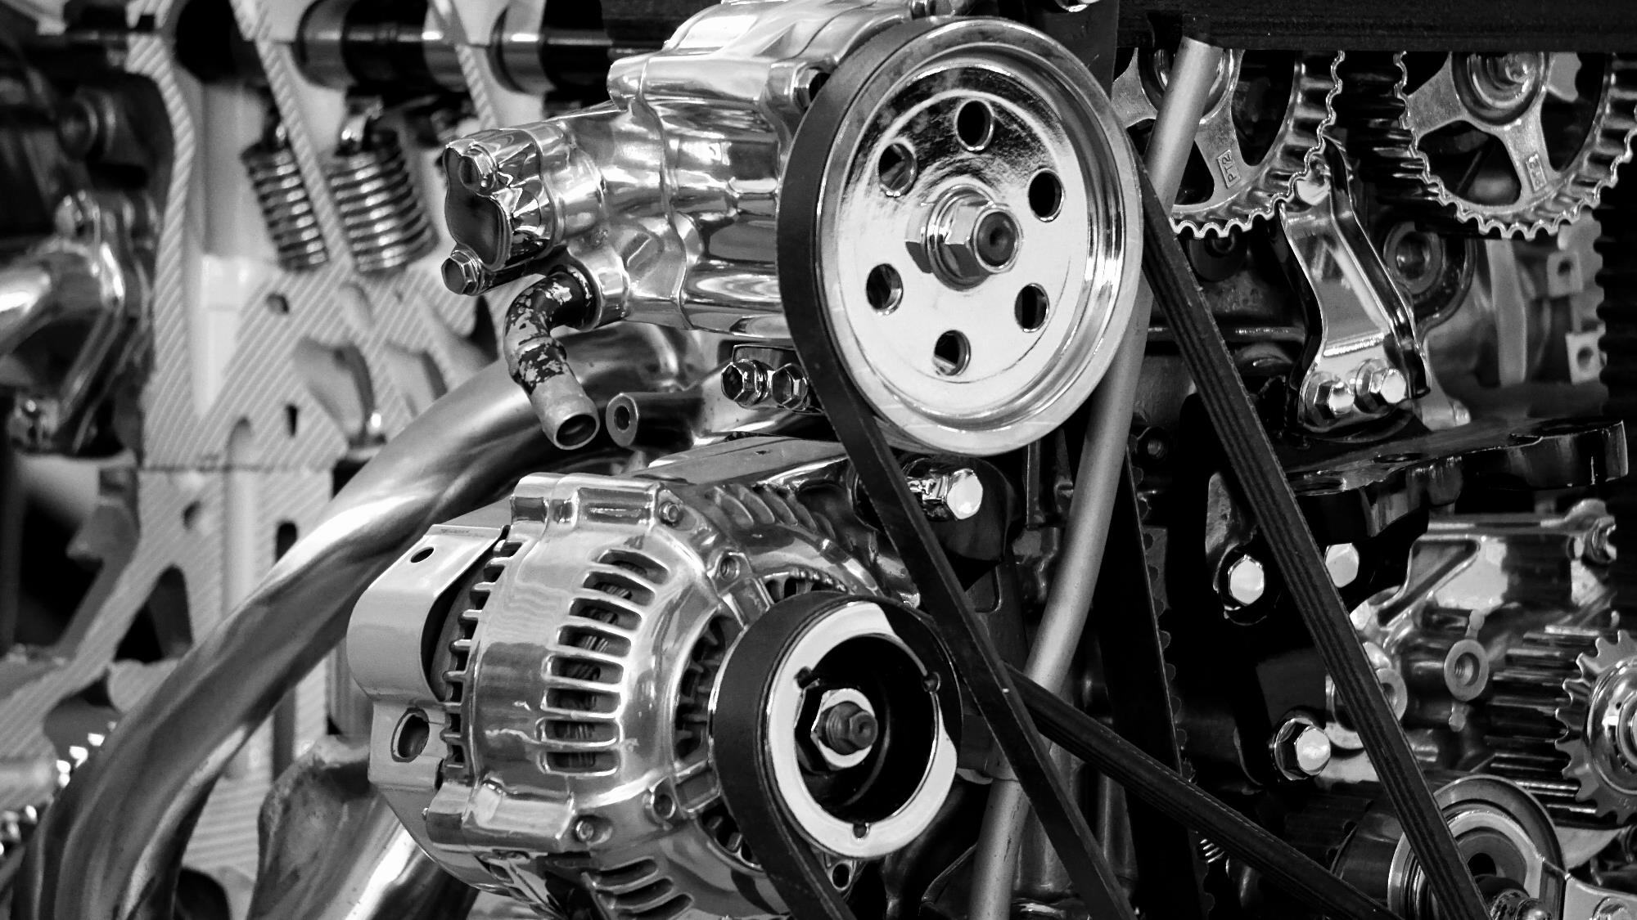
AutoMate

Slide 20
AutoMate
vs. AARC
AutoMate includes:
ARRC includes:
66 makes
33 makes with ongoing coverage
30 makes with older model-year coverage
1,731 year and make combinations
53 makes
0 makes with ongoing coverage
17 makes with older model-year coverage
1,435 year and make combinations

Slide 22
Small Engine Repair Reference Center Providing Comprehensive Assistance in the Repair of:
ATVs
Commercial mowers
Farm tractors
Generators
Motorcycles
Marine (Boats)
Outdoor power equipment
Personal watercraft / Jet ski
Snowblowers
Snowmobiles
Tillers
Other small engines

Slide 23
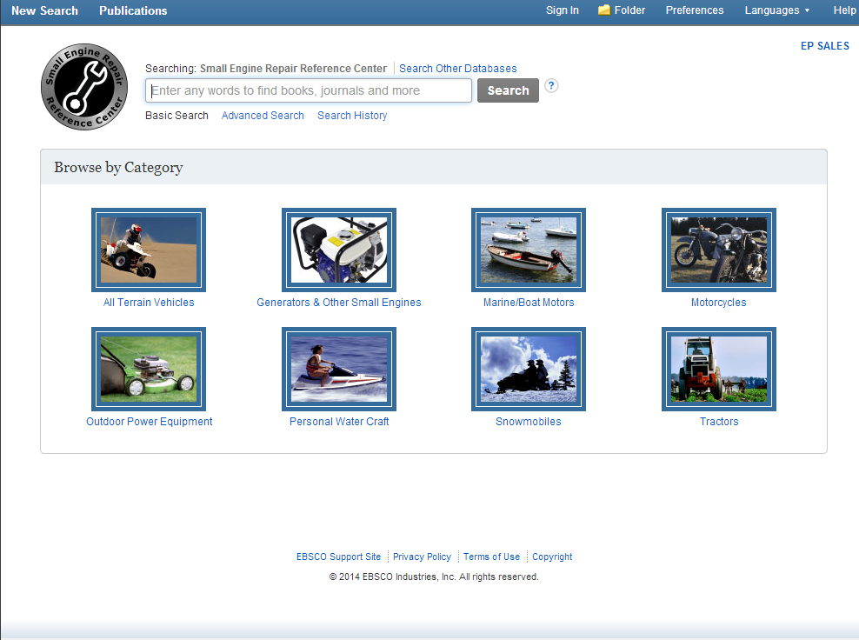

Slide 25
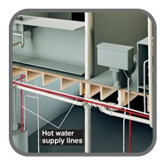
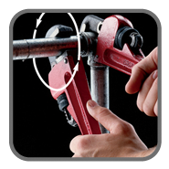
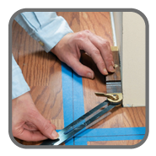
Home Improvement Reference Center
Providing Comprehensive Assistance with:
Maintenance
Remodeling
Electrical
Plumbing
Wood projects
Outdoor home improvement
Decorating home and garden

Slide 26
Home Improvement Reference Center
Providing Comprehensive, Unique Full-Text Content
More than 125 major reference works in full text with more than 35,000 images (none found available online anywhere else)
Not through other aggregators (Gale, ProQuest, etc.)
Not through eBook vendors
Also includes full-text magazines
Full text for all documents
There are no A&I-only records
There are no missing full-text documents due to rights issues

Slide 27
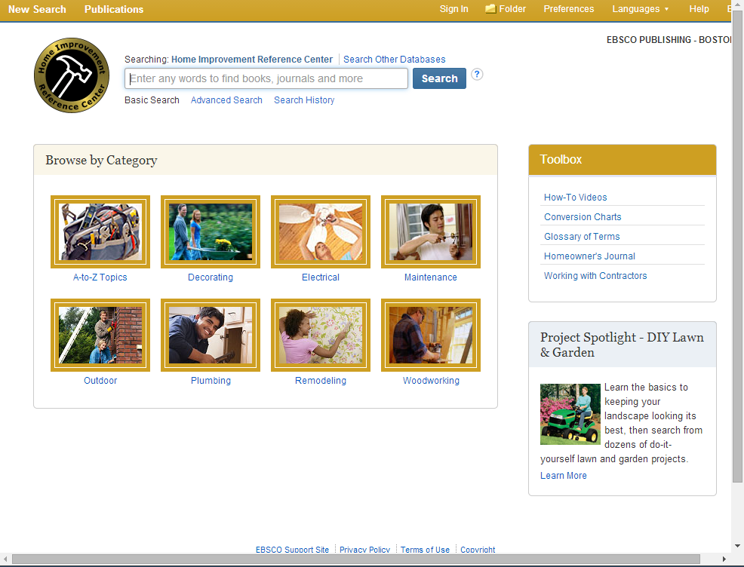

Slide 28
_{Primary Search}
Primary Search is the only magazine
database which is truly appropriate
_{for elementary students}
(based on Lexile reading levels)
Reading Level Indicators are provided

Slide 29
Top Quality Children’s Magazines

Slide 30
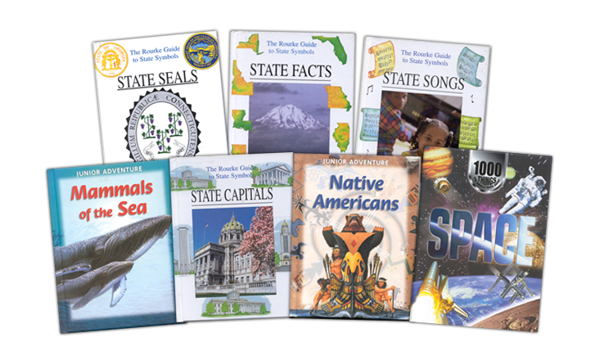
253 Reference Books, including Encyclopedia of Animals, Funk & Wagnalls New World Encyclopedia, and:

Slide 31
REVIEW OF CURRENT INTERFACE

Slide 32
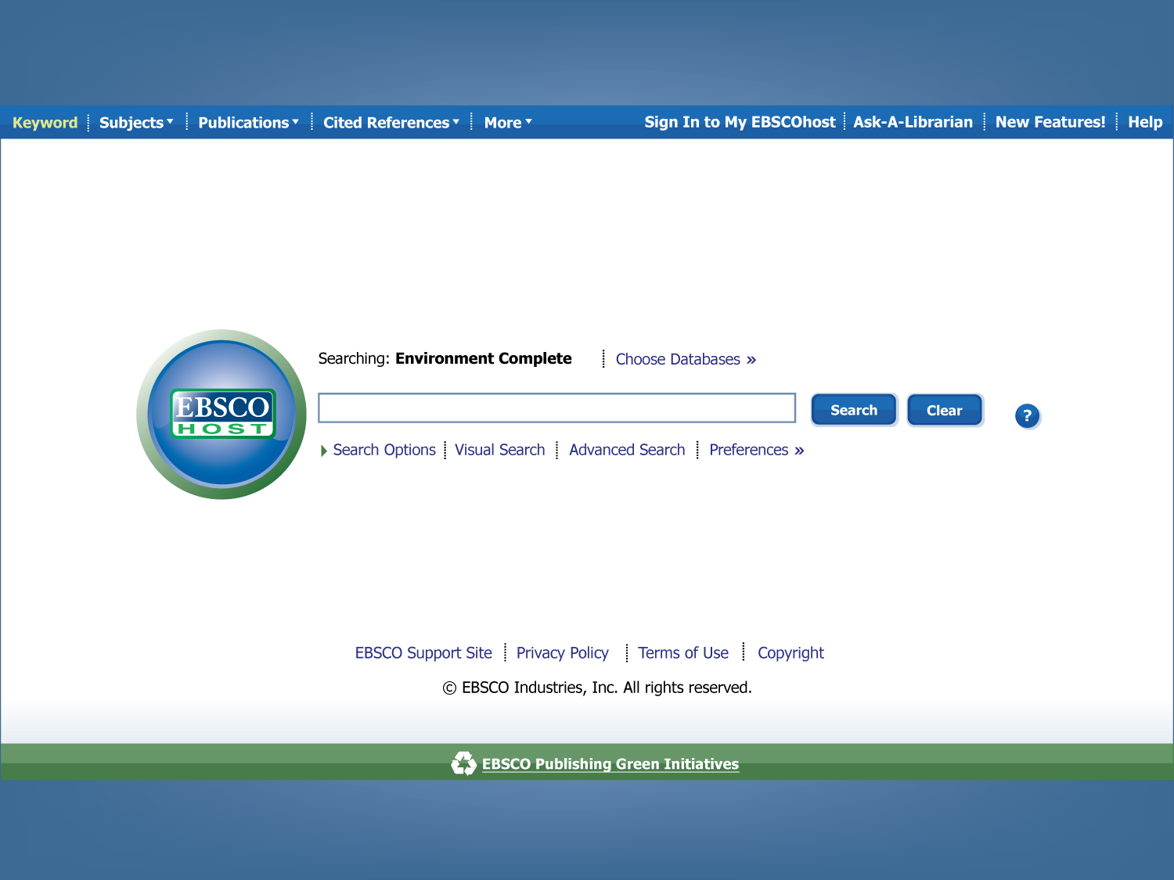

Slide 33
Introducing…

Slide 34
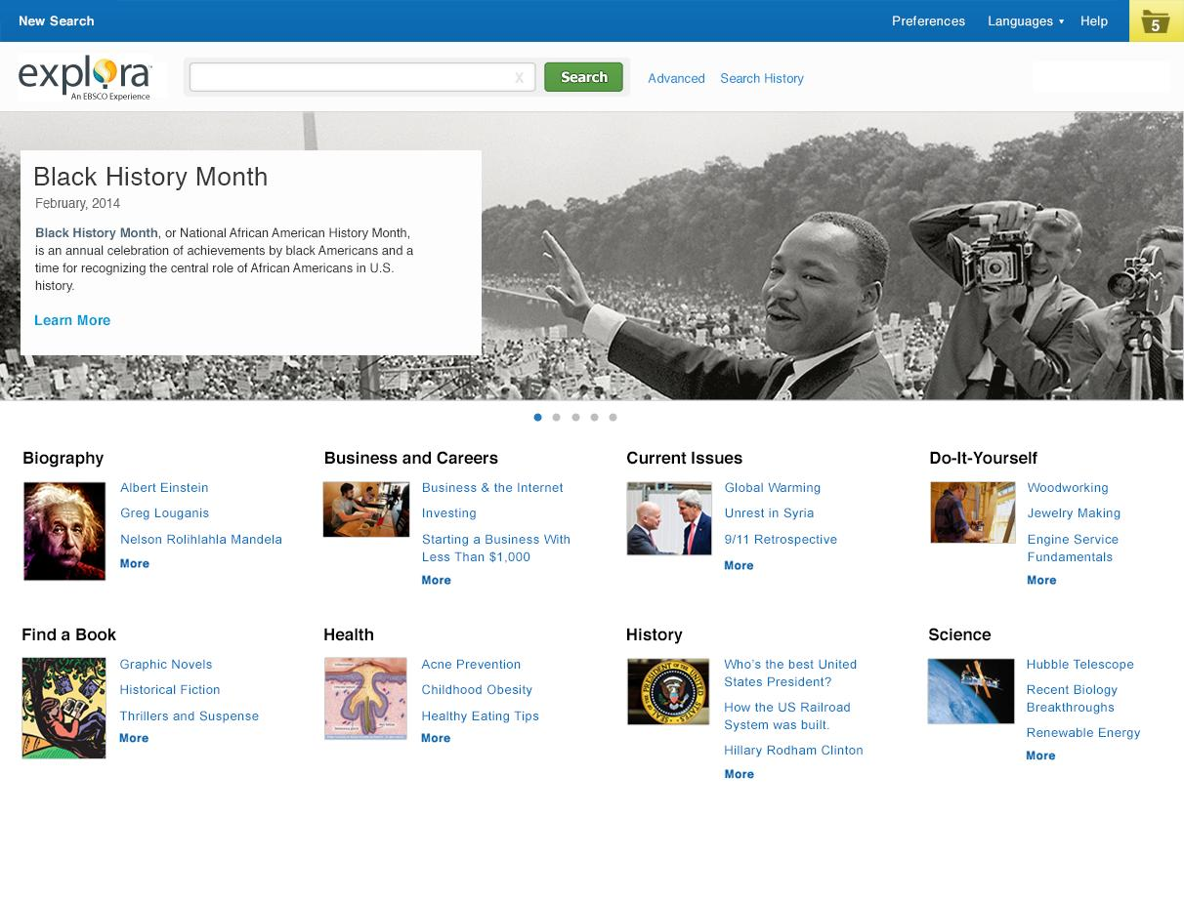
_{Explora for Public Libraries}

Slide 35
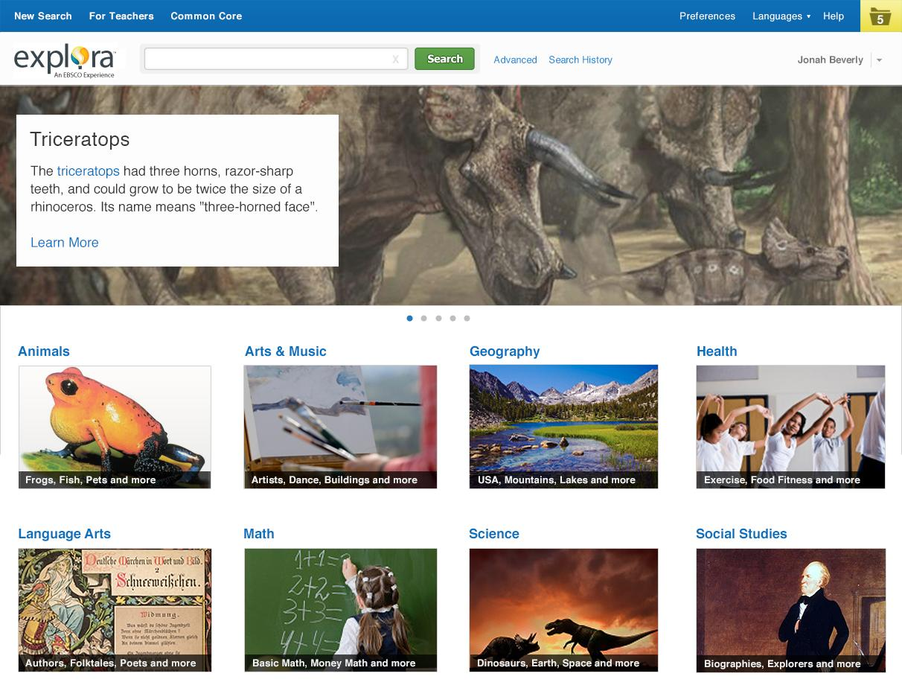
Explora for Children

Slide 36
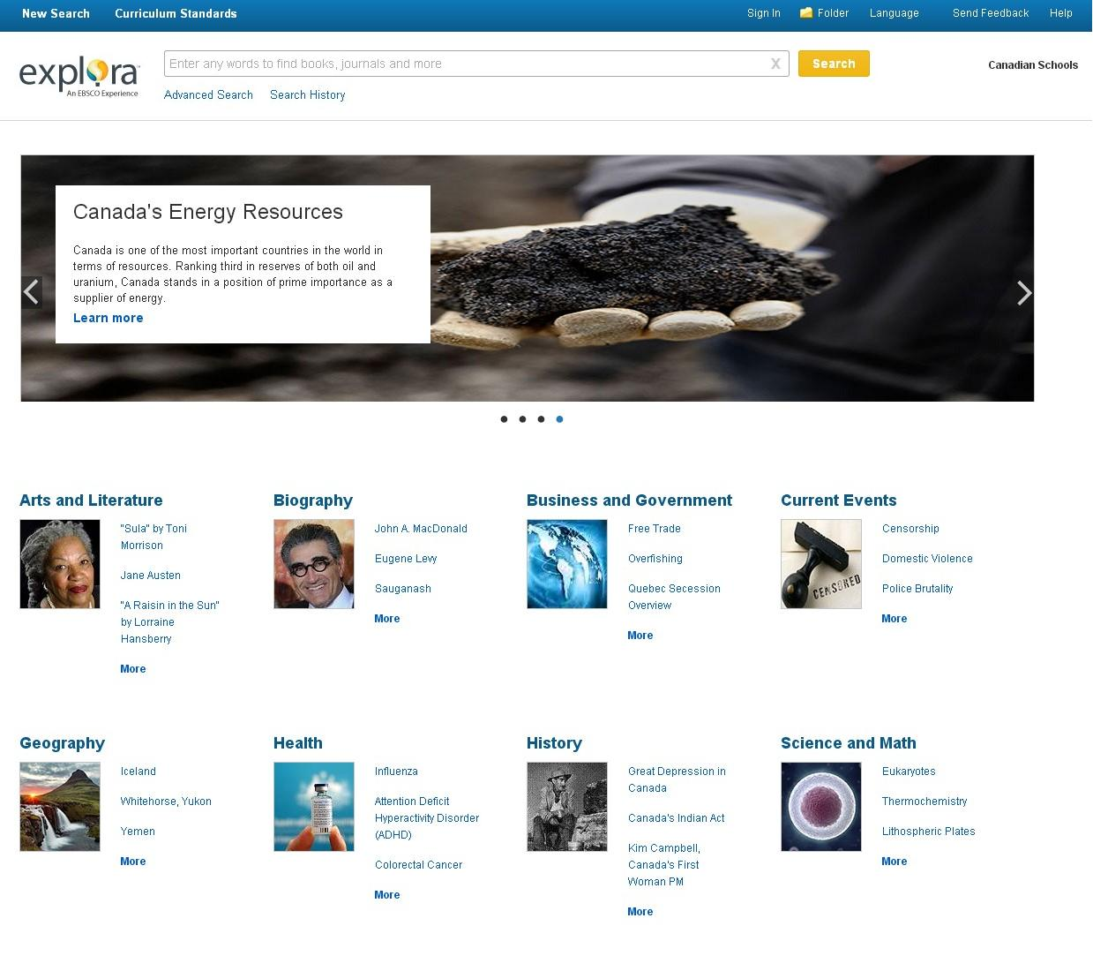
Explora for Canada

Slide 37
Also Includes Videos
Increasing demand for streaming video content in schools and public libraries
Users are looking for more than just magazine articles and books

Slide 38
AP Videos
60,000 videos from Associated Press, the world’s leading news agency
Included with Explora interfaces and subscription to MasterFILE or MAS products
Video carousel on search results
Detail records with
Transcript / shot list
Citations
Metadata

Slide 39
Databases available through Explora interfaces
MasterFILE Premier
Primary Search
Canadian Reference Centre
Small Engine Repair Reference Center
Home Improvement Reference Center
Hobbies and Crafts Reference Center

Slide 40
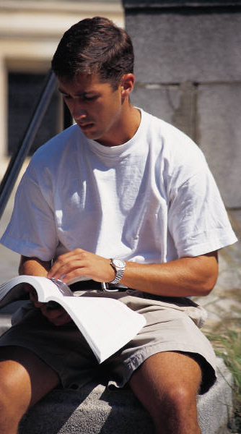
NOVELIST PLUS Recommendations for all readers
Book Discovery
&
NOVELIST K8 PLUS Recommendations for younger readers

Slide 41
NEW EBSCO PASSWORD SETTING REQUIRMENT

Slide 42
CHANGING EBSCO PASSWORDS
To change your EBSCOhost password:
Log in to EBSCOadmin at: http://eadmin.ebscohost.com
Click the Authentication Tab from the top toolbar.
On the User ID/Password sub-tab, click on the linked password.
In the Password field enter the new password.
Click Submit. Your changes are saved.

Slide 43
NEW STRONG EBSCO PASSWORD REQUIREMENTS
Include at least one number
Include at least one special character (!, @, #, etc. A space is not a valid special character.)
Password must be at least 6 characters
Password cannot include your user ID
Password cannot include the following words or parts of words: ebsco, ehost, password, pa$$word, dynamed, admin, p@ss, p@$$, pa$$

Slide 44
Point, Click, Flip

Slide 45
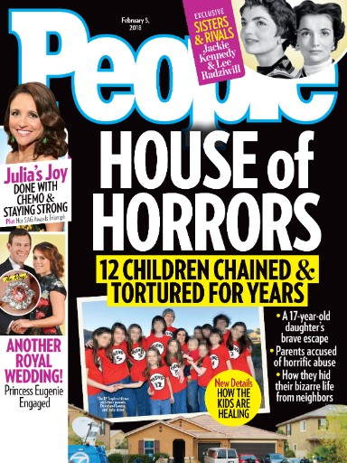
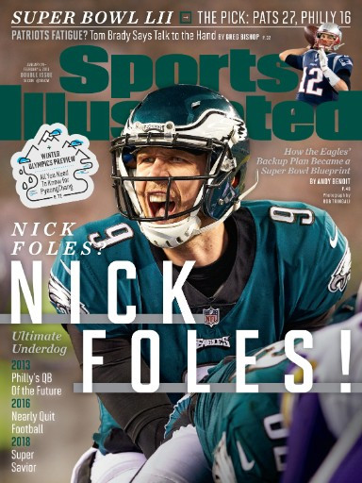
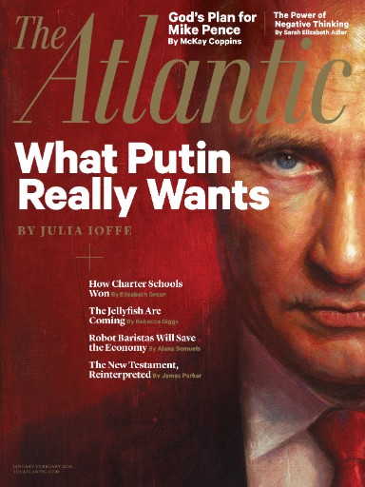
Access to the most popular magazines
Flipster

Slide 46
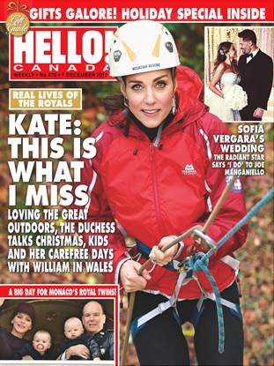
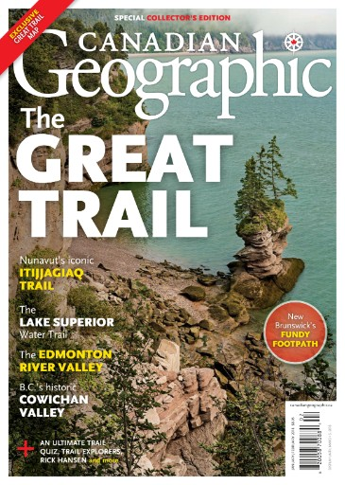
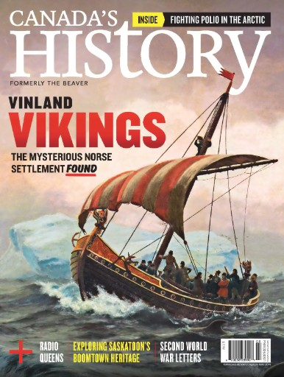
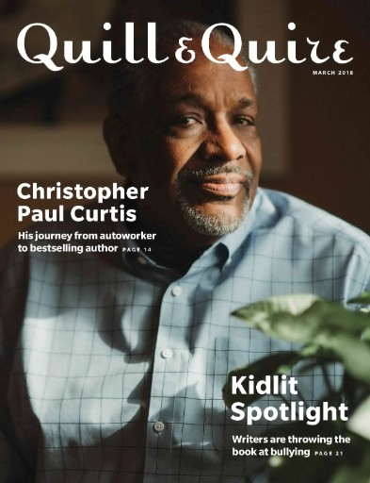
Access to the most POPULAR CANADIAN magazines
Flipster

Slide 47
Important Features
Library-centric
No personal information required
Over 1,500 titles
Sim Users
Access to back issues
Usage Statics
Simple Authentication
Flexible expiration date (can be managed to smaller subcriptions)
MARC Records and Carousel options available upon request
Apps for Kindles, Androids, iPads & iPhones
Flipster

Slide 48
Pricing
No platform fee
5% Subscription service fee
No pre-determined packages
Up to 50% discount available based on current EBSCO business
Flipster

Slide 49
Magazine Archives
Access content from cover to cover in key magazines for academic research.

Slide 50
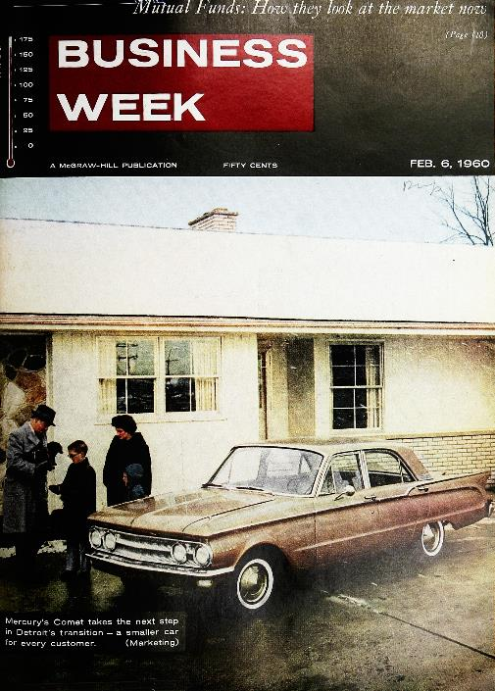
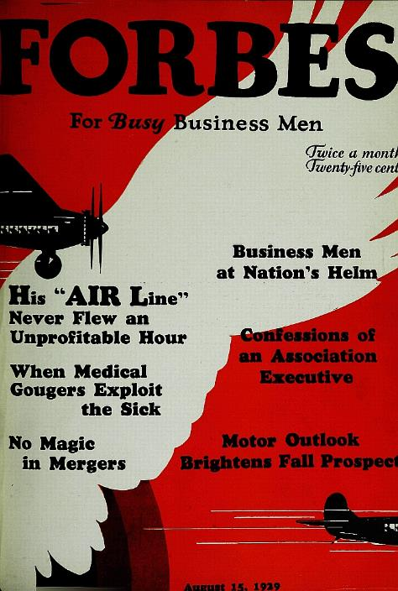
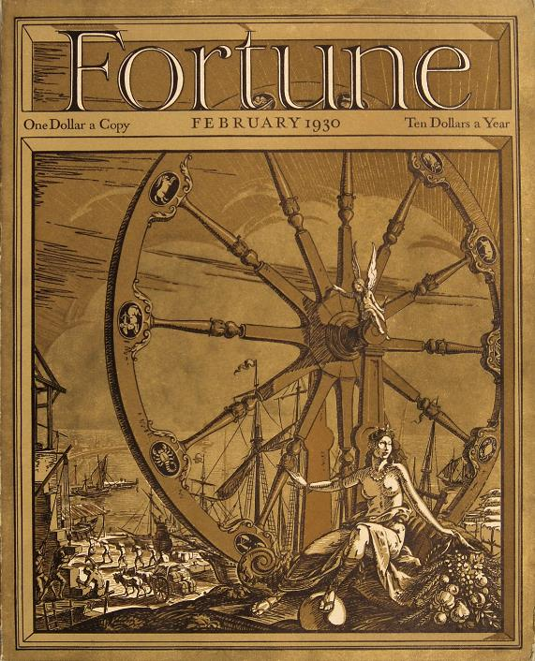
Magazine Archives from EBSCO: Business Studies
1929 - 2000
1917 - 2000
1930 - 2000
The top three U.S. business magazines

Slide 51
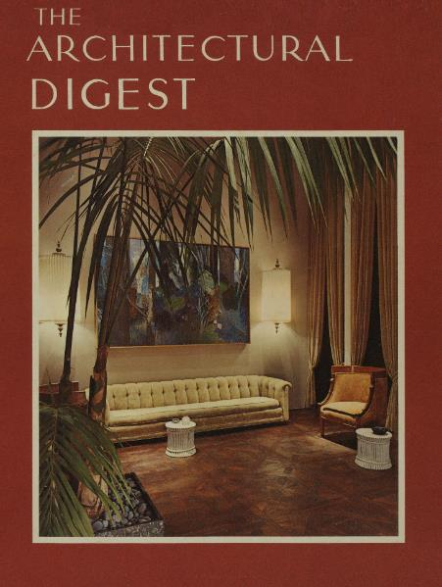
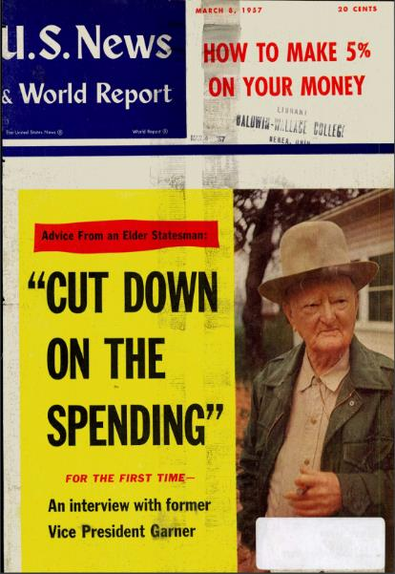
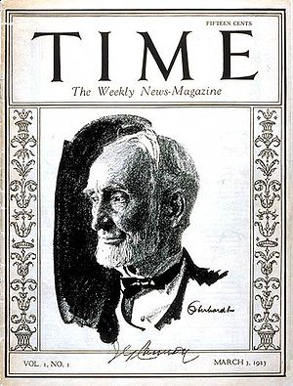
Magazine Archives from EBSCO: Multiple Disciplines
1936 - 2000
1922 - 2011
1926 - 1984
1923 - 2000

Slide 52
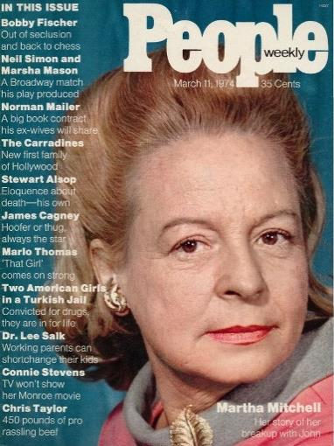
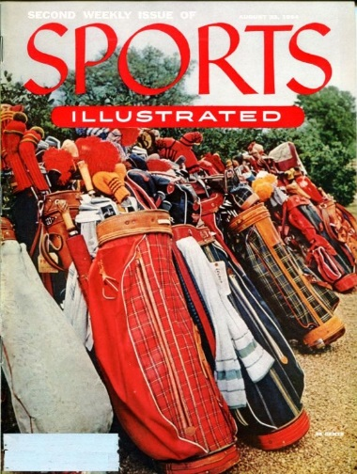
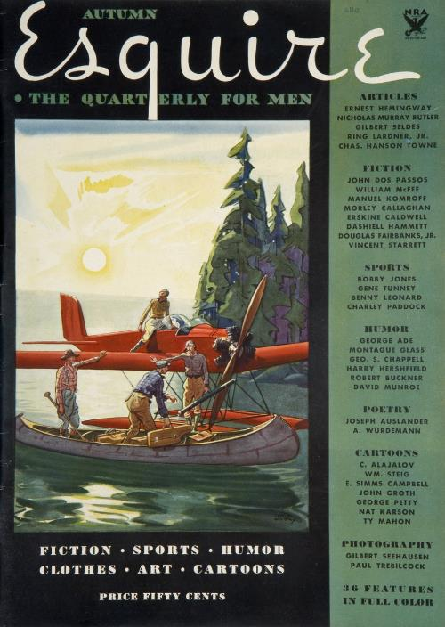
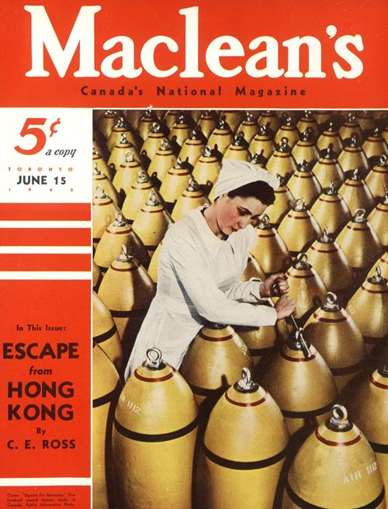
Magazine Archives from EBSCO: Multiple Disciplines
1974 - 2000
1954 - 2000
1933 - 2014
1905 - 2015

Slide 53
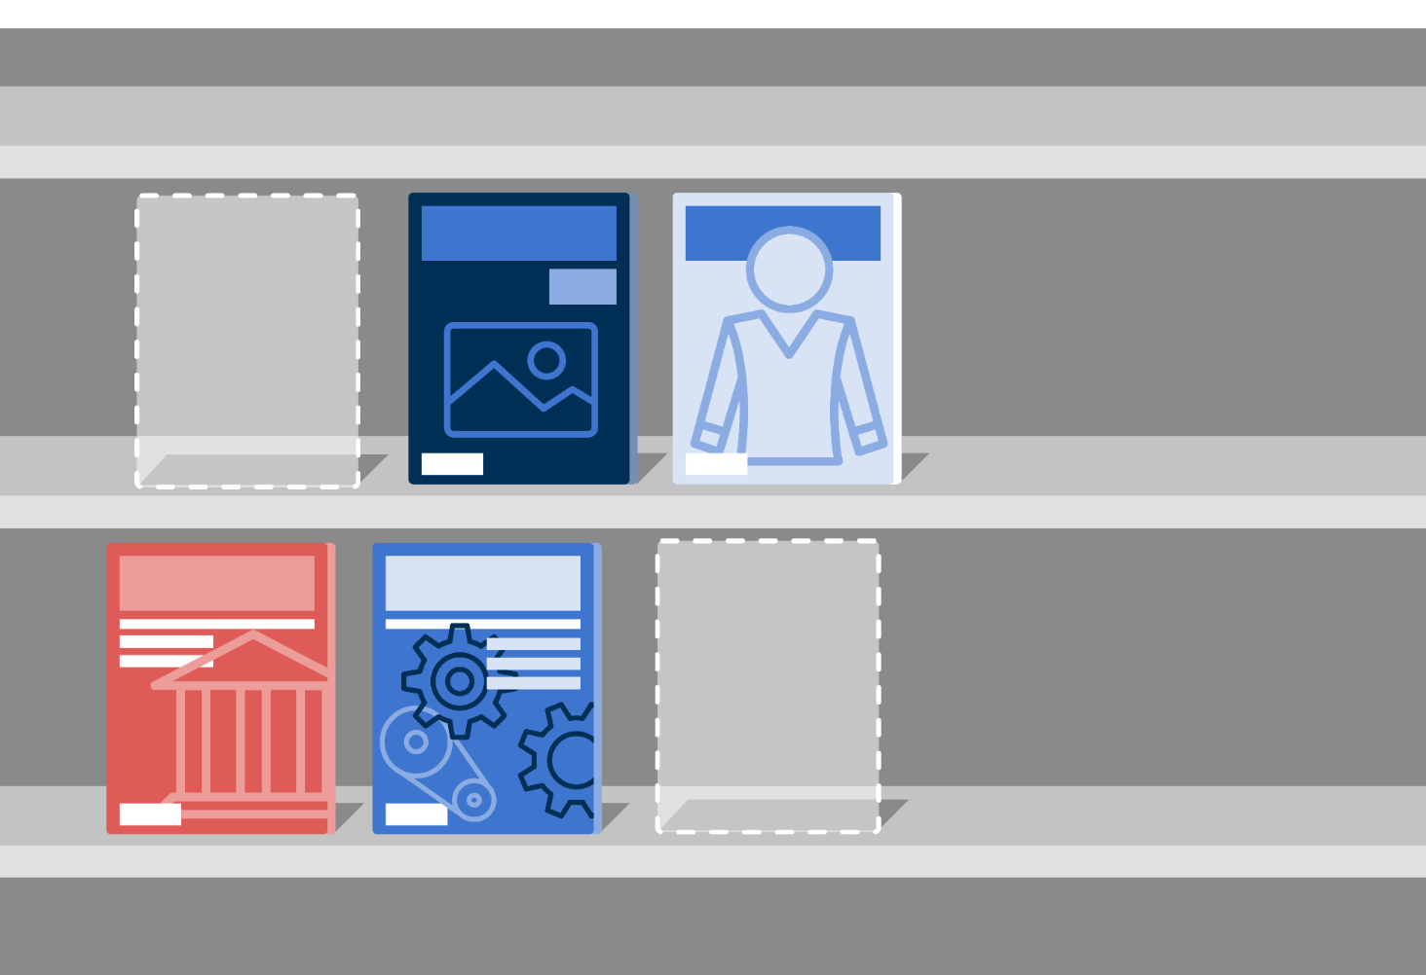
Fill in the gaps from
ONE TIME FEE - OWNERSHIP

Slide 54
Fill in the gaps from
Fill in gaps from missing, lost or damaged issues

