Slide 2
Honouring Reconciliation: A Learning Journey
Presented by:
Pat Cumming
Alexander Dirksen
Ehlam Zaminpaima

Slide 3
Agenda
Overview of Honouring Reconciliation: Hearing the Truth Panel Discussion: Working with Indigenous Communities
Reading Circle Facilitation
Next Steps

Slide 4
Overview
Description of events and activities
Challenges and opportunities
Preparation
Lessons Learned

Slide 5
Exhibit from National Centre for Truth & Reconciliation
On display September to November 2017

Slide 6
Reading Circles
Discussions of They Called Me Number One by Bev Sellars held inside the Library and in the community September to December 2017 and beyond.

Slide 7
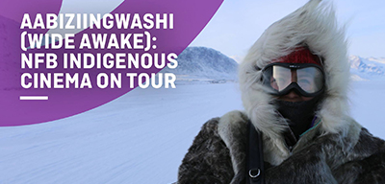
Film Series
The Road Forward, Angry Inuk, Trick or Treaty and Birth of a
Family screened October 2017.

Slide 8
Panel Discussion
Held at the Library November 27 2017 with speakers Chris Lewis, Charlene Seward, Lynne Tomlinson, Bev Sellars. Moderated by Alexander Dirksen

Slide 9
Challenges & Opportunities
Limited relationship with Local First Nations
Community readiness?
Personal, emotional nature of the work

Slide 10
Preparation

Slide 11
‘Ch’ich’iyuy Canoe Journey
Canoe journey with Wes Nahanee of the Squamish Nation and West Vancouver Police Department

Slide 12
Lessons Learned
Relationship building
Working differently
Making space for feelings

Slide 13
Panel Discussion November 26, 2017
This photo appeared on the cover of the North Shore News

Slide 14
Reading Circles: Overview
Purpose
Training & Preparation
Internal vs. External Reading Circles
Community’s Response
Facilitators’ Response
Overall Impression

Slide 15
Reading Circles: Purpose

Slide 16
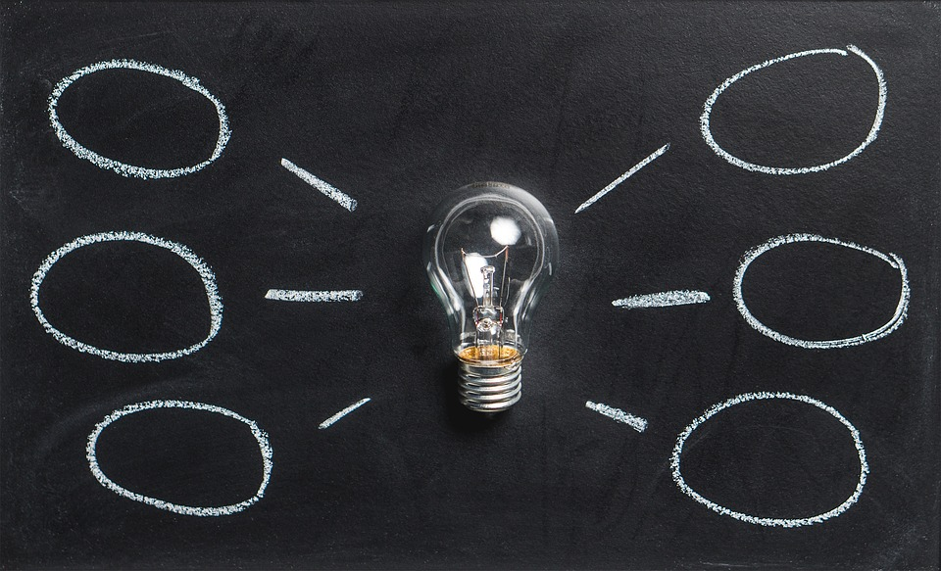
Reading Circles: Training & Preparation

Slide 17
Reading Circles: Internal vs. External

Slide 18
Reading Circles: Community’s Response

Slide 19
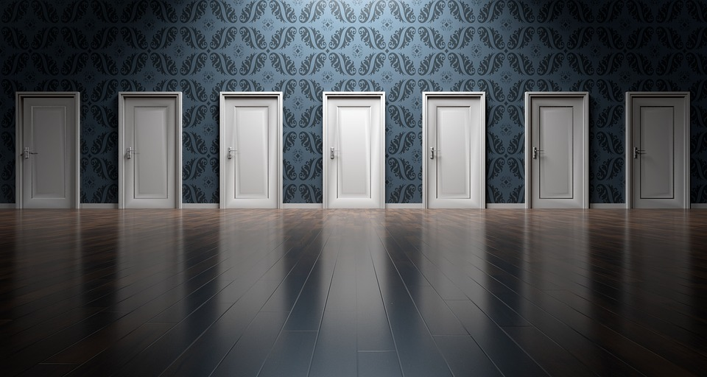
Reading Circles: Facilitators’ Response
Challenges

Slide 20
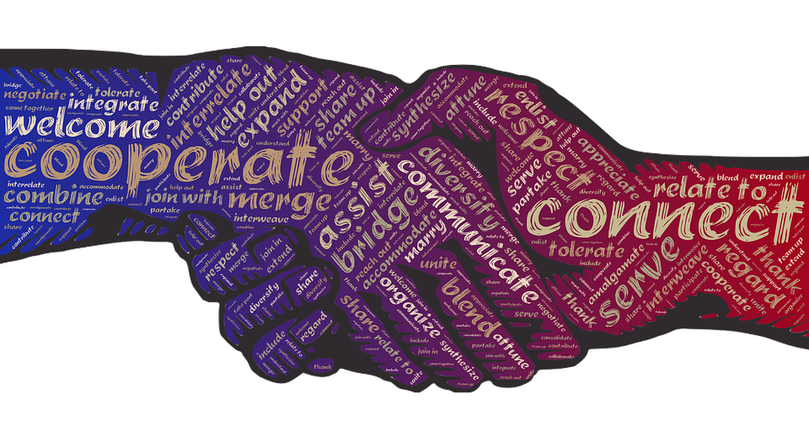
Reading Circles: Facilitators’ Response
Rewards

Slide 21
Reading Circles: Overall Impression

Slide 22
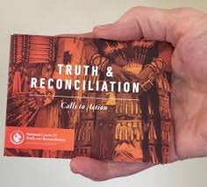
What’s Next?

Slide 23
Selected Resources
Training
Reconciliation Through Indigenous Education edX MOOC (UBC)
Indigenous Canada Coursera MOOC (University of Alberta)
Reconciliation Canada Dialogue Workshop
Indigenous Corporate Training courses
Books
Working effectively with Indigenous People by Robert Joseph
21 Things you may not know about the Indian Act by Bob Joseph
Final report of the Truth and Reconciliation Commissions
Unsettling the settler within by Pauline Regan
They called me number one by Bev Sellars

Slide 24
Find Us Online!
Twitter: @bclibraryconf
Hashtag: #BCLC2017
Website: bclaconnect.ca/2018-conference
Contact us:
pcumming@westvanlibrary.ca
alexanderdirksen@icloud.com
ezaminpaima@westvanlibrary.ca

