Slide 1
BEYOND FIFTY SHADES OF GREY
Developing and maintaining erotic fiction and erotica collections in the public library
Barbara Bourrier-Lacroix
May 2016

Slide 3
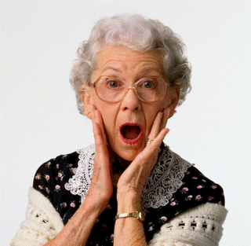
EROTICA SMUT

Slide 4
Romance
Two people fall in love
Sexual content ranges from mild to steamy
Euphemisms and ‘fade-to-black’
Happily-Ever-After (HEA)

Slide 5
Erotic Fiction/ Romance
Focus always on romantic relationship
Explicit and emotional
HEA, but may be between more than two characters
‘New Adult’

Slide 6
Erotica
Primary function of plot is for sexual interaction
Not concerned with HEA
Relationship between protagonists not necessary
Focus in on great sex
Language is explicit
Sexual content may stretch to kinky, BDSM, multiple partners
M/M fiction

Slide 7
Pornography
Plot & characterization incidental or non-existent
Sexual content is explicit
Sole purpose is to cause sexual arousal

Slide 8
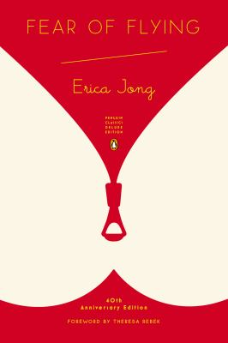
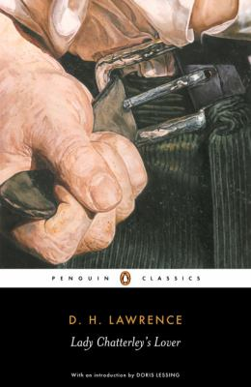
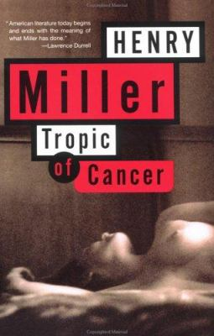

Slide 9
Where do I start?
Check your holdings
Patron suggestions
Trade and review journals:
Library Journal
Publisher’s Weekly
Romantic Times
Book awards
Lambda Literary Awards
RITA Awards
Goodreads
Publishers:
Bold Stroke Books
Carina Press
Cleis Press
Dreamspinner Press
Elora’s Cave
Melange Books
Red Sage Publishing
Riptide Publishing
Samhain
All 5 big publishers

Slide 10
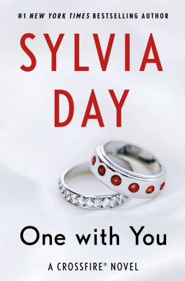
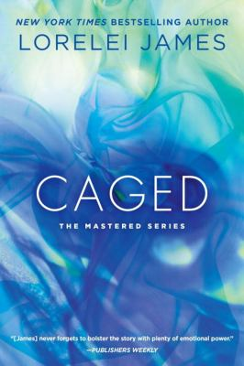
Maya Banks
Shayla Black
Jaci Burton
Opal Carew
Christine d’Abo
Lauren Dane
Sylvia Day
Cynthia Eden
Lorelei James
Beth Kery
Sierra Kincade
Christina Lauren
Roni Loren
Dawn Ryder
Kylie Scott
Shiloh Walker
… and so many more!

Slide 11
What if someone objects?
Strong collection development or selection policy
Define scope of library’s collections
Outline practices & policies that maintain them
Outline how material is selected
Outline the library’s commitment to intellectual freedom
Winnipeg Public Library http://wpl.winnipeg.ca/library/pdfs/downloadables/MaterialsSelectionGuidelines.pdf

Slide 12
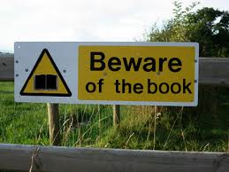
Reconsideration requests
Clear reconsideration request process in place
Inform patron of:
Process
When they can expect a response
Possible outcomes
Formal requests:
Include form
Provide patron with copy of policies
Reply to patron in writing
Intellectual freedom is about making a choice; not just about choosing what to read, but also choosing what NOT to read.

Slide 13
Thank you for coming!
Barbara Bourrier-Lacroix
bbourrier-lacroix@winnipeg.ca

Slide 14
Bibliography:
Charles J. and Mosley, S. (2006) “Core collection: erotic romance,” Booklist, 103(2), 48-49.
Clark, T. and Dunneback, K. (2012) Under the covers: erotic fiction and erotica in public libraries [PowerPoint slides]. Retrieved from http://www.ala.org/pla/education/placonference/past/2012
Dunneback, K. (2013) “Erotica’s full-frontal shelving,” Library Journal, 138(3), 20-24.
Hendzlik, J. (2012) Overdue for pleasure: staff training of the awkward kind [PDF document]. Retrieved from http://www.ala.org/pla/education/placonference/past/2012
Kohn, K. (2015) “Romance revs up,” Library Journal, 140(17), 38-43.
Taylor, C., Fleuren-Hunter, K. and Brann, L. (2016) Psst… I read smutty books [PowerPoint slides.] Retrieved from http://www.accessola2.com/superconference2016/sessions/401PSS.pdf
Warner, K. “20 legitimately good erotic novels you must read,” Cosmopolitan.com. February 13, 2015. Web. < http://www.cosmopolitan.com/entertainment/books/a36506/erotic-novels-you-must-read/>.

