Slide 1
BCLA Conference 2017 Connecting With Multicultural Communities
Presented by BCLA Diversity and Multicultural Services Committee members:
Ravi Basi, Manager of Multicultural Services, Surrey Libraries rkbasi@surrey.ca
Fereshteh Kashefi, Multicultural Services Librarian, North Vancouver City Library fkashefi@cnv.org

Slide 2
Introduction
Background
Our survey and survey results
https://bclaconnect.ca/dmsc/2016/08/25/survey-findings-trends-challenges-and-needs/
Whole workshop vs. this session
Our goal
Notes:
This session is being offered in response to an online survey that was posted by BCLA Diversity and Multicultural Services Committee back in April 2016. The survey asked library staff around BC what were the challenges for them when serving multicultural communities.
77 libraries responded to the survey.
71 % responded that their biggest challenge was a lack of familiarity with their culturally diverse communities and what their needs were.
81% indicated that intercultural training would help them better serve their multicultural communities.
This is usually a 3-hour workshop which we have presented to libraries and community agencies for several years but we’re doing it in about 60 minutes and leaving some time for questions afterwards.
Given the number of people here and the set- up of the room we are unable to do interactive exercises as we had originally hoped. Thank you for your understanding about these limitations.
And we will be referring to our full length workshop which we will hope that some of you will invite us to present in your organizations.
Because time is short we ask that you make a note of your questions and ask them at the end unless it’s a quick question for clarification purposes. Thank you.

Slide 3
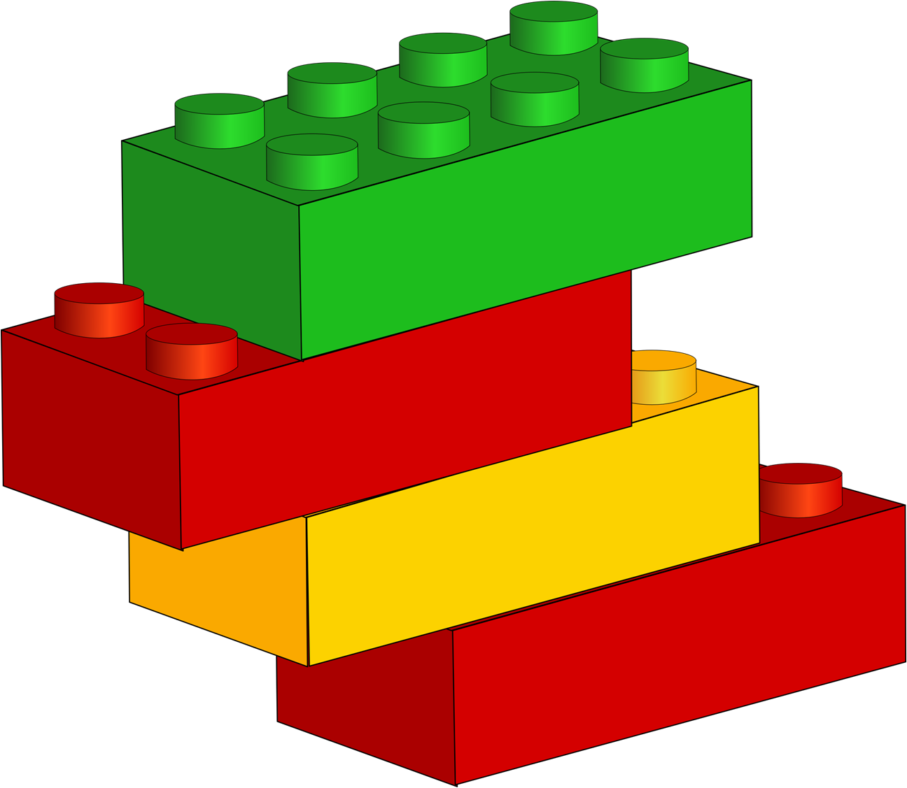
Building Blocks
Effective communication starts with a series of building blocks
Confidence
Empathy
Not the Other
Attitude

Slide 4
Attitude
Priority
Take action now or wait?
Statistics Canada

Slide 5
Not the Other
Immigrants → Other→ Stereotyping→ Barrier
Cultural differences exit
Beneath the surface are similarities
“THEY” are “US”→ better communication

Slide 6
Empathy
Empathy enables creativity
Empathy breaks down barriers

Slide 7
Confidence!
In our skills and track record
Staff development/ empowerment
Learning new skills
We can do this!

Slide 8
Connecting
Notes:
Connecting with multicultural communities involves a multi faceted approach, no different from any other segment of the community such as seniors, children and teens
Multi-faceted approach to connecting with multicultural communities

Slide 9
Collections
Notes:
Collection building does not necessarily mean new comers want novels in their own language. Their needs will vary depending on how long they have been in Canada, what their goals are, so we have to remember there is much diversity within each cultural group. So we have lots of ideas on collections in the document online

Slide 10
Programs

Slide 11
Outreach

Slide 12
Some Communication Tips

Slide 13
Notes:
There is no recipe or formula for intercultural communication, only guidelines and common sense. As front-line workers we are already highly skilled at understanding others and making ourselves understood.
Adjusting our communication style and flexibility makes Intercultural communication easier and more effective.

Slide 14
Adjusting the Communication Style

Slide 15
Switching to Written Language

Slide 16
Keep on Talking
Notes:
Bears or Pears?
Economics or Ergonomics
Big vs humongous, immense
Say reserve instead of place a hold
Library jargon can be like a secret language to others

Slide 17
Stay with your Patron
Notes:
This is what we do with everyone but newcomers and people from other cultures might need more help. For some the entire library setting is not familiar.
Compare with supermarkets

Slide 18
Remember
Sometimes even the best communication efforts might not work.
We can’t be successful all the time, so don’t feel guilty.

Slide 19
Biases & Stereotypes

Slide 20
AMERICANS ARE LOUD AND OBNOXIOUS
ASIANS ARE BAD DRIVERS
GERMANS ARE NAZIS
COLUMBIANS ARE DRUG DEALERS
MUSLIMS ARE TERRORISTS
SIKHS ARE VIOLENT
WHITE PEOPLE CAN’T DANCE
BLACK PEOPLE ARE LAZY

Slide 21
Shared Scenarios

Slide 22
Shared Scenarios: Examples
“ People from some cultures are always trying to negotiate their library fines”
“ A patron accused me of being racist when I politely asked her to stop her toddler from banging on the computer keyboard”
“I’m going to scream if I have to serve another immigrant. Why can’t they just learn English?”

Slide 23
Empathy by Brene Brown
<iframe width="560" height="315" src="https://www.youtube.com/embed/1Evwgu369Jw" frameborder="0" allowfullscreen></iframe>

Slide 24
Thank You!
Thank you for the opportunity to meet you and exchange ideas on what we are all passionate about
Find the Diversity & Multicultural Services Committee (and a copy of this presentation)
on the BCLA Connect https://bclaconnect.ca/dmsc/
Consider joining the committee, we always welcome new members
Please keep in touch and contact us if you need more information:
Ravi Basi
RKBasi@surrey.ca
604-598-7411
Fereshteh Kashefi
fkashefi@cnv.org or f_kashefi@hotmail.com
604-998-3476
BCLA 2017 Conference: Connecting with Multicultural Communities
Notes:
We hope to leave you with 2 key messages
1.It is crucial to us to learn how to connect with multicultural communities
2. We can do it by building on our existing skills and learning some new skill, bither by ourselves or our committee’s workshop and our experience. We love to share our challenges, mistakes and successes!

Slide 25
D&MS Committee’s Next Meeting
May 4th 9:30- 11:30
Location: Burnaby Public Library
Metrotown Branch
3rd Floor Board Room
See you there….

