Slide 1
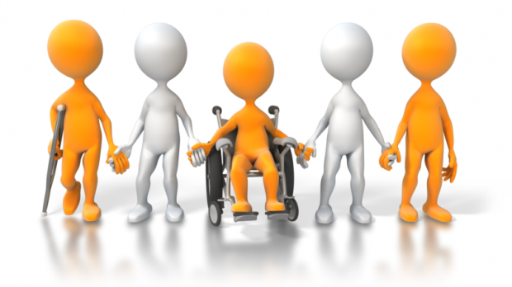
Libraries are for Everyone!
Opening our doors to people with Diversabilities (disabilities) through resource lists and programming
by Linda Youmans, Youth Collections/System Librarian, ORL

Slide 2
Current Volunteer Positions:
Community Liaison for the Learning Disability Association of B.C. (LDABC) – in 4th year
South Central Okanagan Community Living B.C. Council Member (CLBC) – 2nd year
Self-Advocate Advisor for the newly formed Okanagan Self-Advocate Group for Adults with Diversabilities – 1st year

Slide 3
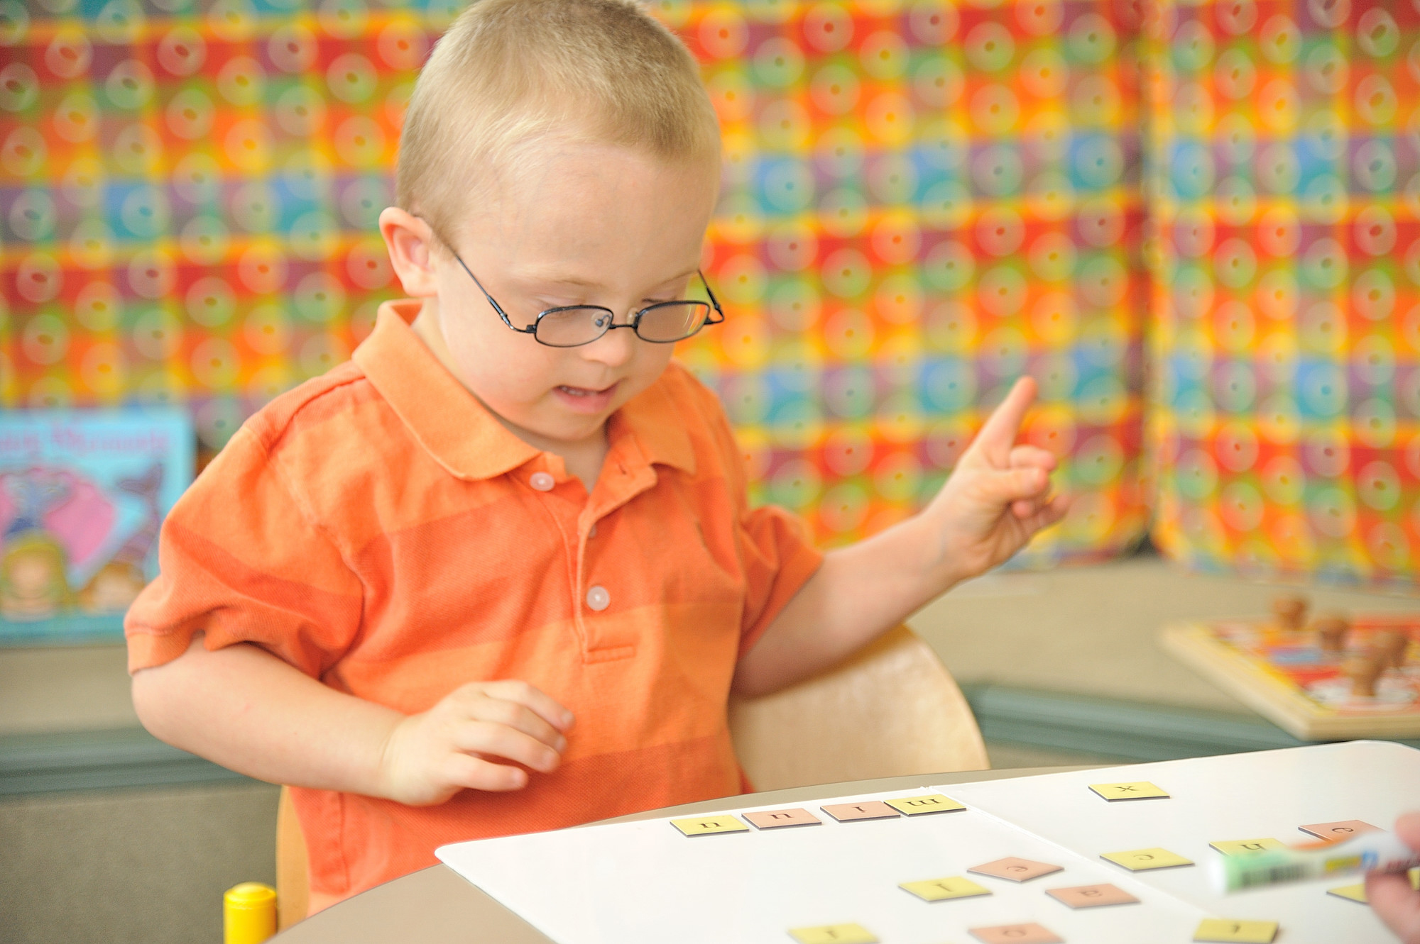
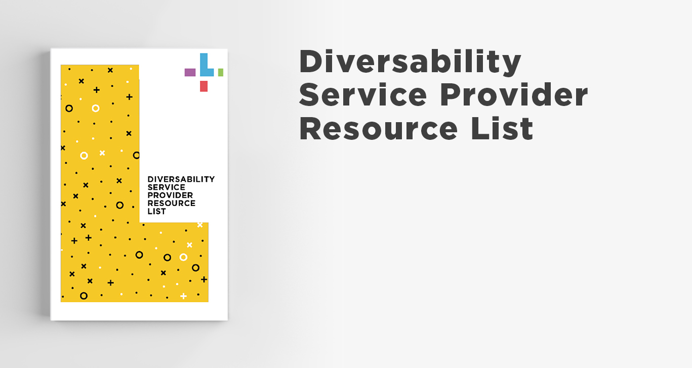
Diversability (Disability) Service Provider List
Based on my own experience as a parent of a son with autism and also received help from parents, professionals, library staff to create the list
Categories chosen: Adaptive Functioning/ Psychoeducational Assessment; Behaviour Intervention, Counselling, Education, Employment Assistance; Family Support; Financial Future/ Support; Funding or Referrals; Recreational Programs; Transitioning to Adulthood; and Tutoring
Notes:
I was asked by LDABC to create a list of Service Providers in Kelowna for their website. We increased the coverage to include the North and South Okanagan as well for all our 29 communities.

Slide 4
Support for the Service Provider List by Professionals:
“The Service Provider list will be of great value to all educators who are working with families that have children with Diversability. I, myself, will be sharing this valuable resource with families and School District #23 staff members as queries come in regarding supports offered in our community.” Cori Christiensen, Elementary Low Incidence, Dehart Student Support Services, Kelowna, B.C.
“The list on Service Providers appears to be specific to the Okanagan area, we will share it with our offices in that area. Thank you again.” Danielle Smith, Director, Inclusion Supports and Services, MCF CYSN (Children and Youth with Special Needs), Victoria, B.C.
“I just wanted to let you know that the Diversability Service Provider Resource List has been very useful in my practice as an Infant Development Consultant at Starbright Children’s Development Center.” (works with babies 0-3 years of age who are at risk for developmental delay) Karin Hesketti, Infant Development Consultant, Starbright Children’s Development Center, Kelowna, B.C.

Slide 5
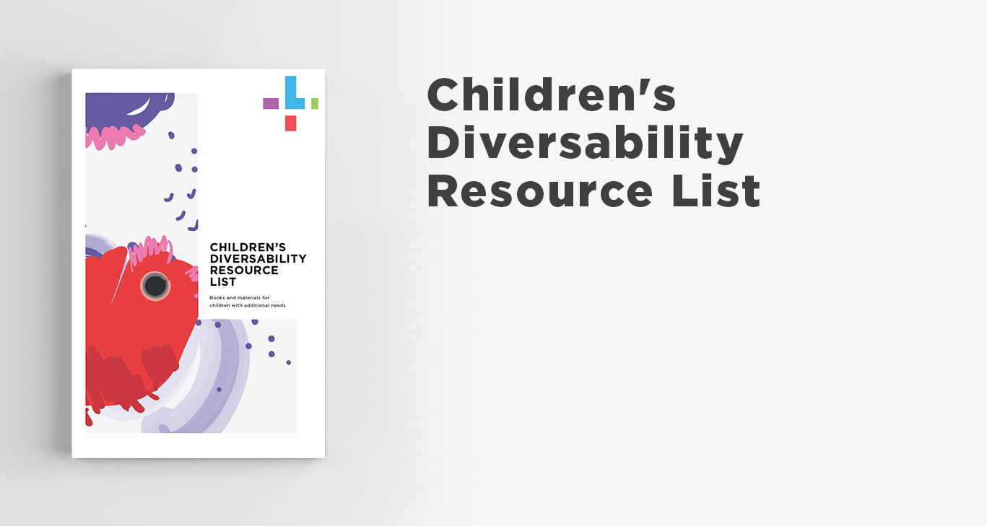
Children’s and Teen Diversability Booklists
Fiction and Non-fiction titles are featured, with the fiction titles usually with the hero of the story with a diversability – wanted to show a positive role model for children and teens
Assistance on the topics was received from professionals in the community, such as adding Anxiety, Depression, Sensory Processing & OCD (suggested by Lisa Watson, Autism B.C.) as many kids/teens have these challenges
Topics covered in lists: General (children’s only); Anxiety/ Worry; Attention Deficit Hyperactivity Disorder (ADHD & ADD); Autism Spectrum Disorder; Cerebral Palsy/Muscular Dystrophy; Depression/Sadness; Down Syndrome; Dyslexia; Hard of Hearing and Deaf; Mobility Challenges; Obsessive Compulsive Disorder (OCD); Sensory Processing Disorder; and Vision (Blind or Partially Sighted)
Notes:
Due to requests from parents for more books on these topics and to have more valuable information for families and professionals, I decide to work on two lists – one for children (preschool to Grade 6) and one for teens (grade 7-12)

Slide 6
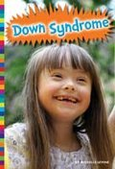
Professional Feedback about Booklists
“The Children’s Resources are excellent guides and one that we are happy to show to parents. Parents frequently ask us for appropriate books for their young children with ASD (Autism) and your guide has been immensely helpful in fulfilling these requests.” Karina Frisque, Autism Program Team Leader, Starbright Children’s Development Centre, Kelowna, B.C.
“Frequently, I consult the booklists in particular to find appropriate literature for families that have children with autism or another diversability. I will continue to share these information sources with individuals and families in the Okanagan. Thank you!” Lisa Watson, Interior Regional Coordinator, Autism B.C., Kelowna, B.C.
“This is an extraordinary resource for all parents and families with diverse children. Your work on compiling resources and books for parents has been appreciated and needed!” Becky Furney, Administrative Manager, Language Arts Programs, Mind Over Learning, Kelowna, B.C. (Tutoring)

Slide 7
Extensive Sharing of this Unique and Valuable Information:
Service Providers: Over 60 Diversability Service Providers who were featured in the booklet (many have made copies, posted on Facebook and their website)
School Districts: All 8 school districts we serve as well as private schools throughout the province (schools have distributed to CEA’s, Resource Teachers, School Librarians, Teachers, etc.)
Libraries in Canada: ½ page handouts and emailed to 29 ORL branches; emailed to B.C. Public Libraries; and all libraries throughout Canada to encourage them to create their own (Autism Connections Fredericton, New Brunswick have booklists posted on their website)
Media Outlets Contacted: 28 B.C. media outlets sent a press release about the ORL lists (published in newspapers throughout the province)
Government Organizations: Interior Health (IHCAN); Work B.C.; Ministry of Children and Family Development- Children and Youth with Special Needs (MCF CYSN); Division of Family Practice (FETCH and PATHWAYS) website for doctors and patients in the province; British Columbia Library Association Summer Reading Club (BCLA SRC); Inclusion B.C.

Slide 8
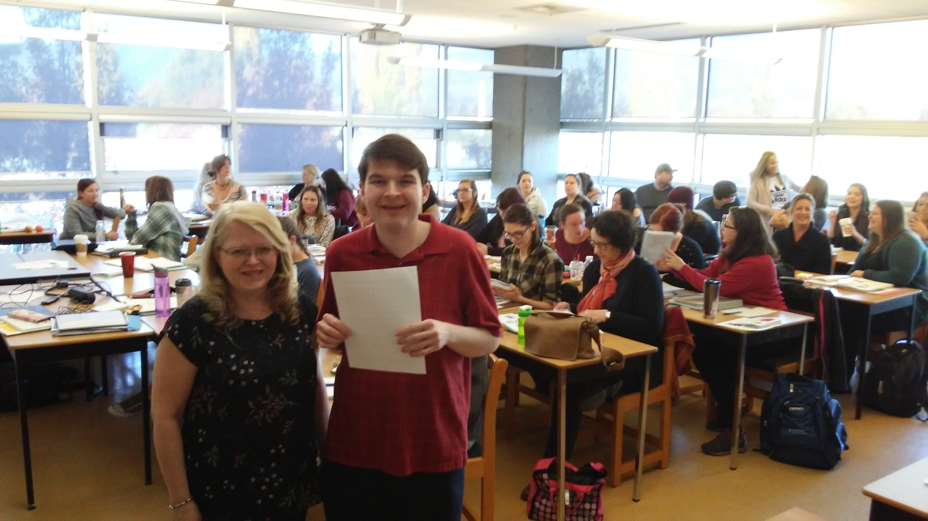
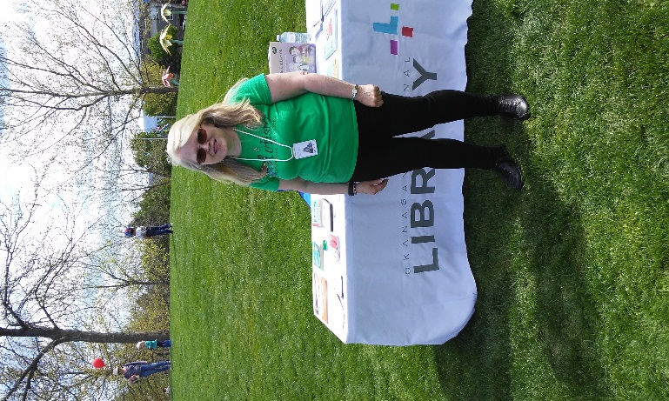
Outreach Special Events and Presentations to Organizations
Autism Walk and CLBC Community Celebration: manned ORL table at both locations for 3 years
Goddess on the Go Event (for mothers with children with autism): three years
Disability Film Festival (UBCO) presentation
Autism Parent’s Night: several talks over 3 years to parents
School District #23 Resource Teachers Presentation: 45 attended
Service Providers: such as Starbright, Mind over Learning, ARC Programs, CLBC Community Council, Stepping Stones, the Foundry, Dr. Kate Aubrey, etc.
Okanagan College: Autism Course (20 students) and Certified Education Assistant (CEA) (50 students) – partnered with son who spoke about ASD and his CEA help in school
Sprott-Shaw College: Special Education Teaching Assistant Course (SETA) (8 participants) – partnered with son who spoke about living with autism and CEA’s
Notes:
Kyle and I were contacted by Joanne Poole of Okanagan College as she used to bring her children to my story times and SRC at KL Branch. I contacted Sprott-Shaw College to see if they wanted the same talk. Kyle wowed the audience. I had a lady from England in the CEA class ask if she could send the booklists by email to her friend in England as they didn’t have anything like it there.

Slide 9
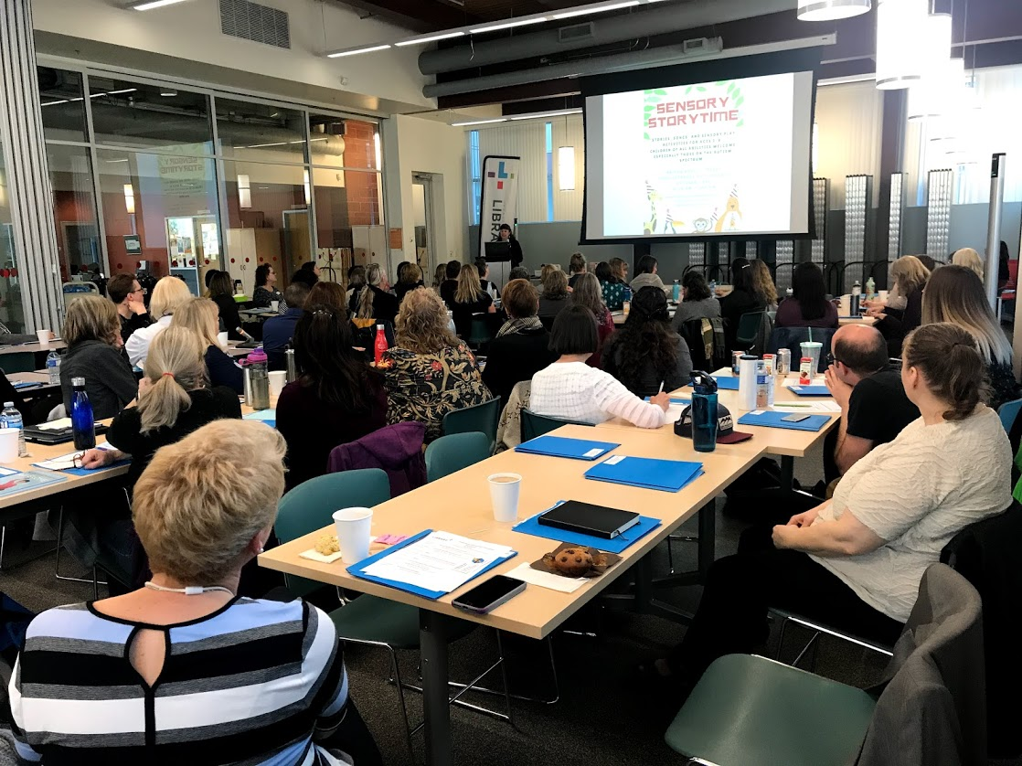
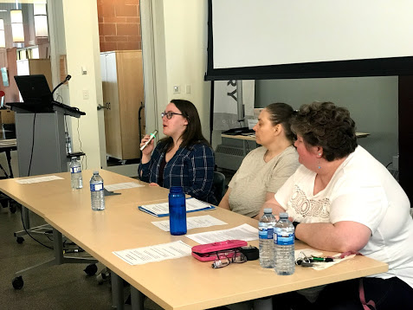
Diversability Workshop April 2019
Goals of Workshop: to learn about sensory processing challenges, train staff on how to do Sensory & American Sign Language Story Times and First Page book club (for adults with diversabilities); to hear about living with a diversability from panel, and to find out how we can improve services
Attendance: 77 participants from 28 branches – public services staff
Panel of Adults with Diversabilities: three speakers, with autism, cerebral palsy and learning / developmental disabilities spoke about their successes and challenges

Slide 10
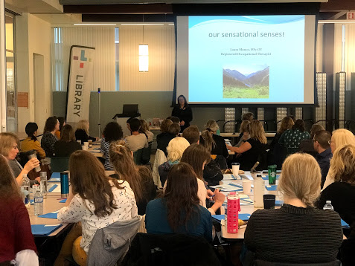
Benefits of the Workshop: It was Inspiring to Participants!
92% rated the workshop as Excellent and Very Good, with the Panel discussion and the Sensory Processing guest speaker being the most popular – panel received a standing ovation!
Shelley DeCoste, one of the panelists, was the self-advocate who had the word officially changed from “disability” to “diversability” – staff applauded her campaign
“Hard to top this workshop”; “Very knowledgeable speakers, wonderful topic, left me feeling proud to work in libraries and excited about opportunities to work with people with diversabilities” and “Good eye-opener to a subject we try to ignore” were some comments given by participants
Positive Comments about the Panel were: “The panel ☺ was very humbling” ; “Very informative and enlightening of the challenges people face but also neat to hear of their successes” and “It provided insight into the interests, needs and commonalities of people with diversabilities”.

Slide 11
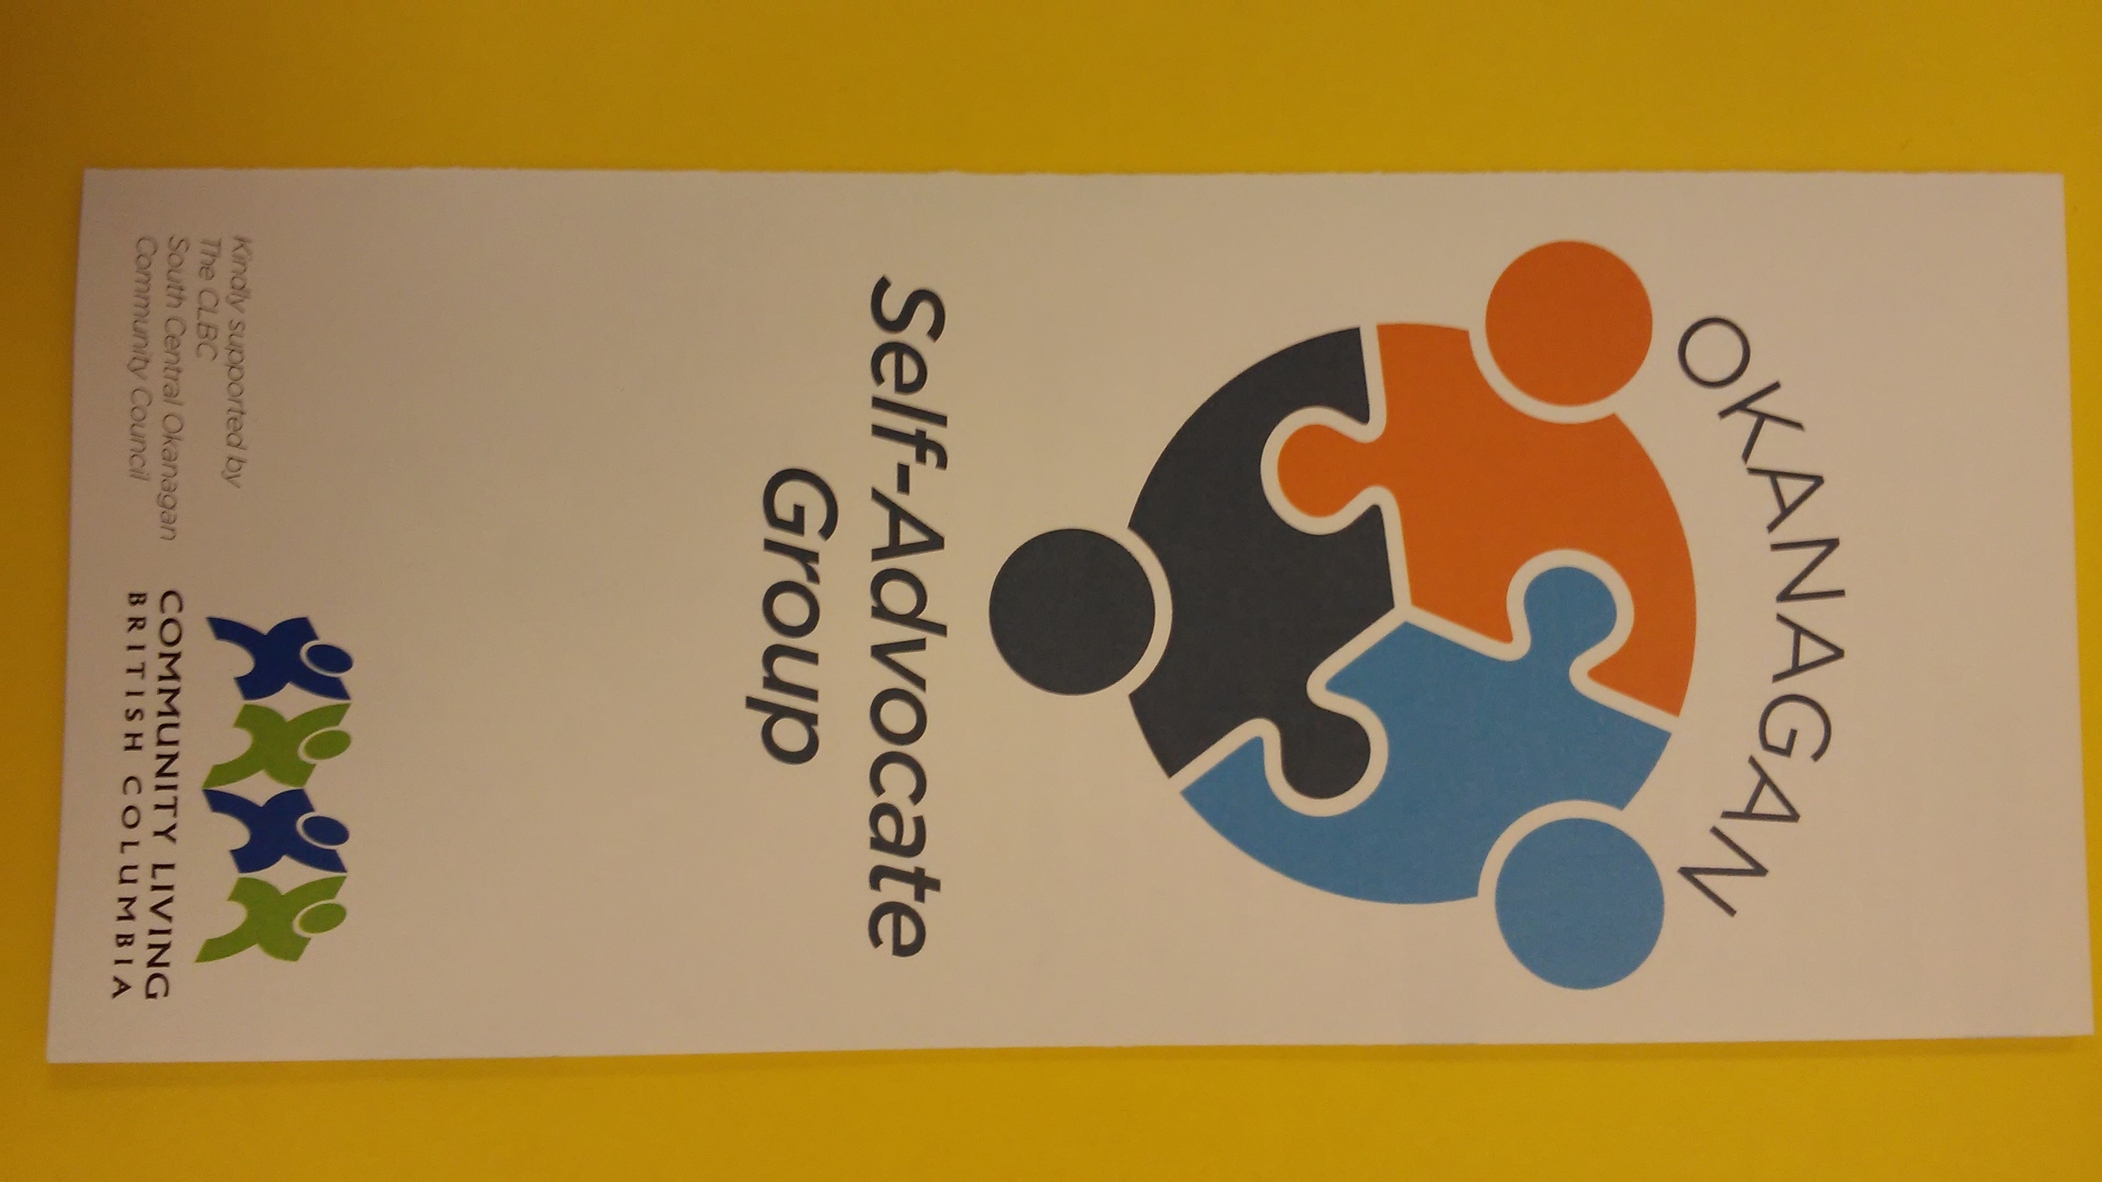
Okanagan Self-Advocate Group: For Adults with Diversabilities
At monthly meetings, the group meet to talk about important subjects receiving information and mentoring each other
Each meeting has a theme such as : having a diversability, internet & people safety, awards to businesses, social programs in the community, rights and responsibilities, budgeting, etc.
Outreach PowerPoints done at different organizations on topics such as “living with a diversability”; “benefits of hiring a person with diversability” and “great qualities of a service provider and support worker”
Notes:
As part of my role on the CLBC Community Council, I was asked to assist with the organization of the Self-Advocate Group in Kelowna. This involved creating a pamphlet, terms of reference, rules for meetings, finding a venue and booking it, etc.

Slide 12
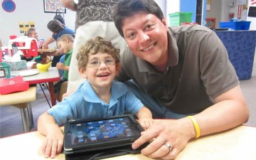
Libraries are for Everyone: Opening Your Doors to Those Who have Diversabilities
Welcome people of all ages with diversabilities to your library by:
Offering special programs such as: Sensory Story Times, Sign with Me Story Times, First Page Book Club, Audiobook Club, Computer help, Maker Space programs, etc.
Learning how to assist them more effectively with information needs and understand their sensory challenges by utilizing websites such as Libraries and Autism
Use or create teen and children’s booklists as well as Service Provider lists for both families and professionals
Invest in special collections (E-Books and E-audio books, Audio books, and Large print, etc.) and encourage registration for websites such as CELA or NNELS

