Slide 1
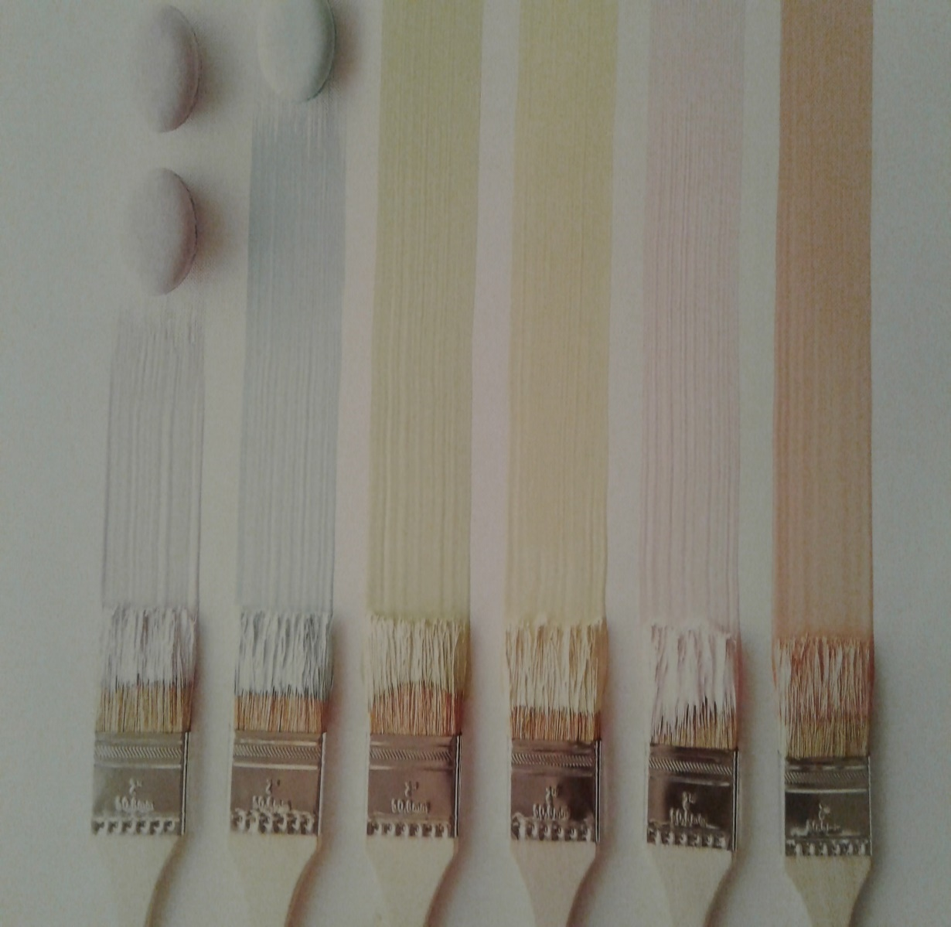
Fabric and Paint
Inspirations
and Bargains

Slide 2
How-to books from the library

Slide 3
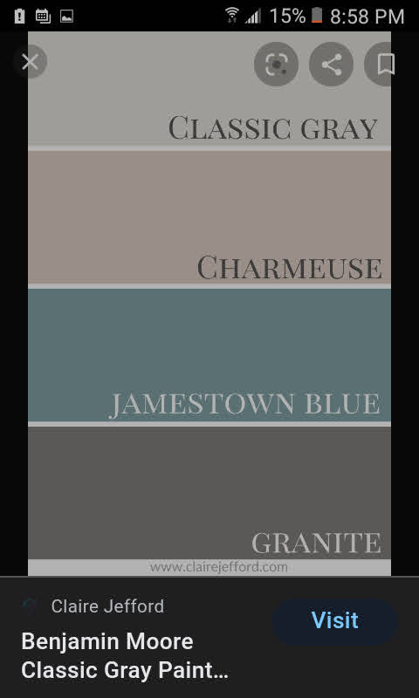
Paint store mistints - paint store websites

Slide 4
My front door

Slide 5
Supply List:
Stir sticks (stain samples)
Rags
Whiz roller
Wrap rollers, trays and brushes in Saran and stack trays
Graining Heel
Sponge brushes
Distressing brushes
Ironing Board
Fabric glue
Cereal boxes for photo matting
Ribbon for covering scissor cuts

Slide 6
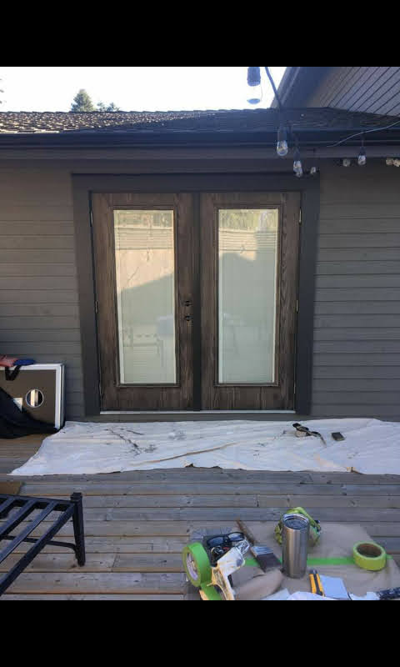
Graining heel

Slide 7
Product Knowledge
Old masters pickling white gel stain
Saman gel stain at home depot
Paint can lid is palette
Add white paint to change colour
Spray paint
Dollar Store latex paint

Slide 8
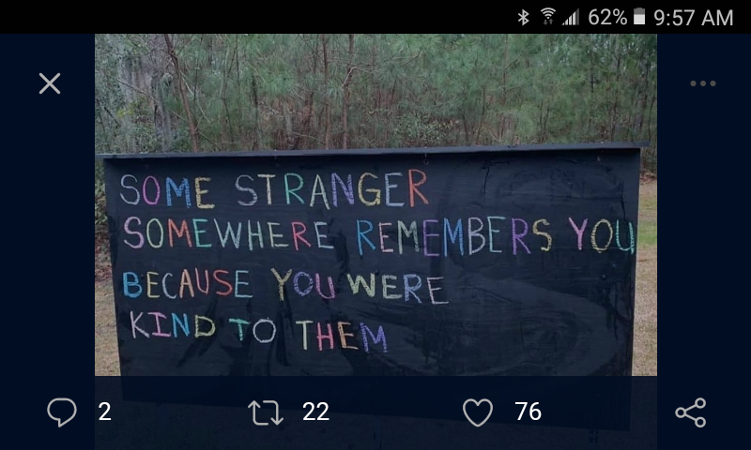
ROY G BIV
Blackboard paint
Sidewalk chalk
Ink stamps

