Slide 1
NoveList Plus Overview

Slide 2
NoveList Plus
Fiction and nonfiction
for all ages and grades
New! Audiobook recommendations
Notes:
NoveList Plus includes fiction and nonfiction for all ages, and covers all grades and ages.
K-8 Plus includes fiction and nonfiction for younger readers, especially those in Kindergarten through 8th grade.

Slide 3
NoveList is for:
Readers
Help finding the right books
Reading recommendations, lists, and more
Fresh content, including popular books and topics
Librarians
Readers’ advisory tools and guides
Advanced searching and filtering to help readers find books
Teachers, parents, others who work with readers
Find quick answers to meet demand
Easy to use
Notes:
NoveList Plus and NoveList K8 Plus are designed to make your school librarians’ job easier, with key features to address their work processes whether they are helping a student find a book to read or helping a teacher locate authentic literature to teach a reading or writing concept.

Slide 4
NoveList Plus
Fiction and nonfiction
for all ages and grades
New! Audiobook recommendations
Notes:
NoveList Plus includes fiction and nonfiction for all ages, and covers all grades and ages.
K-8 Plus includes fiction and nonfiction for younger readers, especially those in Kindergarten through 8th grade.

Slide 5
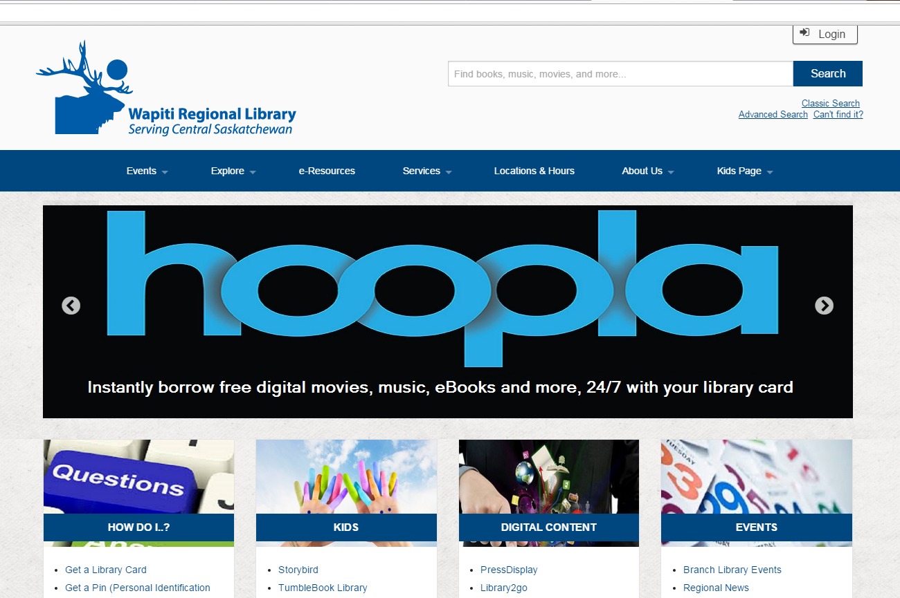
NoveList Plus
Find NoveList Plus on the wapitilibrary.ca website
Notes:
On the wapitilibrary.ca website go to e-Resources using the button at the top of the page. Then find the Encyclopedias and Reference button to expand the list. Scroll down until you see NoveList Plus. Clicking on the name will take you to the NoveList Plus website.

Slide 6
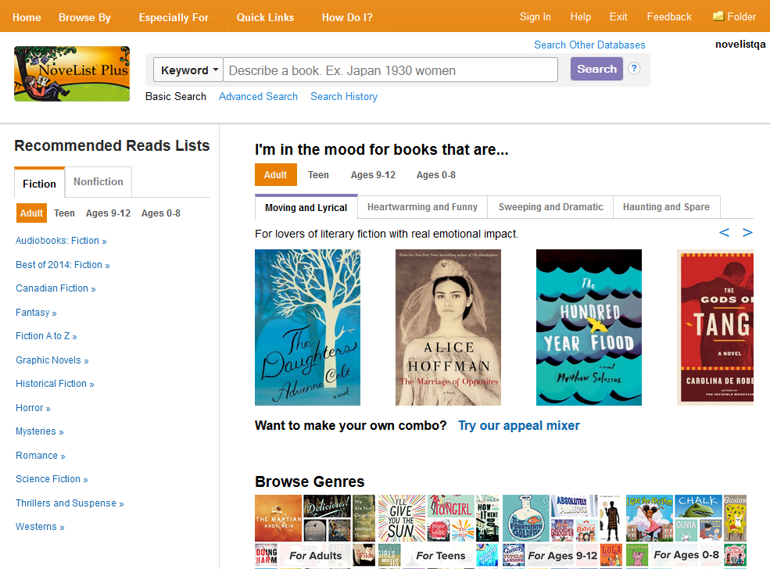
The search bar appears on each page in NoveList
Browse for books by Appeal terms combinations.
And find books by genre
Recommended Reads
Notes:
On the NoveList Plus website you’ll see:
A search bar at the top of the page
Recommended Reads Lists on the left side, broken into different ages and genres
“I’m in the mood for…” with reading recommendations based on moods, using ‘appeal terms’ that describe the sort of pace, character, tone, etc. of books
Browsing options for genres
Toolbar at the top with more options

Slide 7
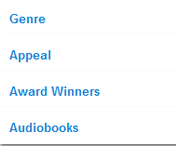
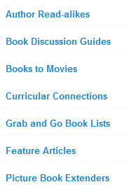
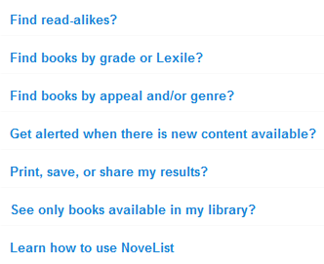
The NoveList Toolbar
Access a variety of helpful resources from the toolbar at the top of the page
Notes:
The Toolbar at the top gives you more options, including reading lists, and help using NoveList Plus

Slide 8
Basic Search
Keyword: searches most fields across all records and returns results grouped in tabs by type of record (Books, Series, Authors, Lists & Articles). Note that you can use this search for “Describe a Plot” searching.
Title
Author
Series
Narrator
Search Other Databases: Allows you to access any of your library’s EBSCO databases without having to return to your library’s website. Clicking this link will take you to a list of the products to which your library subscribes.

Slide 9
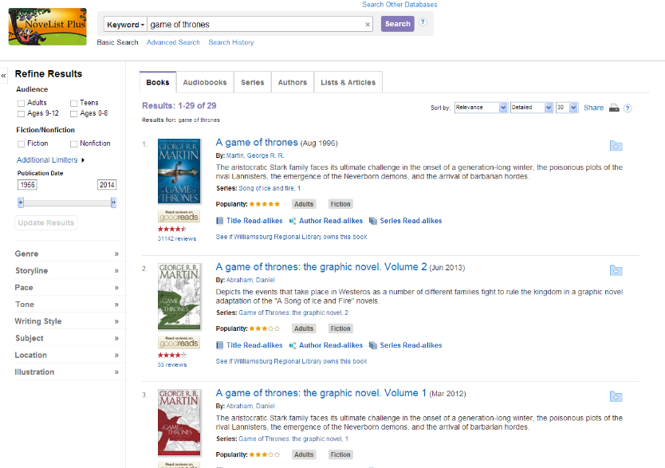
Viewing Results
Results Tabs
Limiters
Clustering
Notes:
After you type something into the search bar at the top (title, author, topic, series name, etc) you’ll get the Results list. Here you can:
Use the Results Tabs to choose to see Books, Audiobooks, Series, Authors or Lists & Articles matching what you searched for
Use the Limiters on the left side to narrow down your search by audience, genre, and even publication date
Narrow down by Genre, Storyline, Pace, Tone, Writing Style, Subject, Location and Illustration

Slide 10
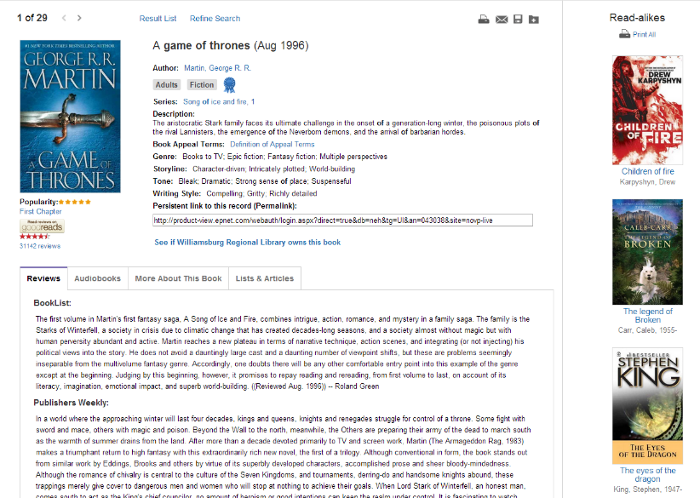
Viewing an item
Basic information
Read-alikes from NoveList
Tabs
Notes:
Clicking on the Title/Name/Series/etc on the Results page will take you to that item’s page. Here you’ll see:
Basic information including publication date, series, author, etc.
Read-alikes, which are recommendations NoveList Plus makes for books, authors and series you may enjoy based on what you are currently looking at
Tabs which let you see Reviews, if there are Audiobook versions, More information, and Lists & Articles featuring the item

Slide 11
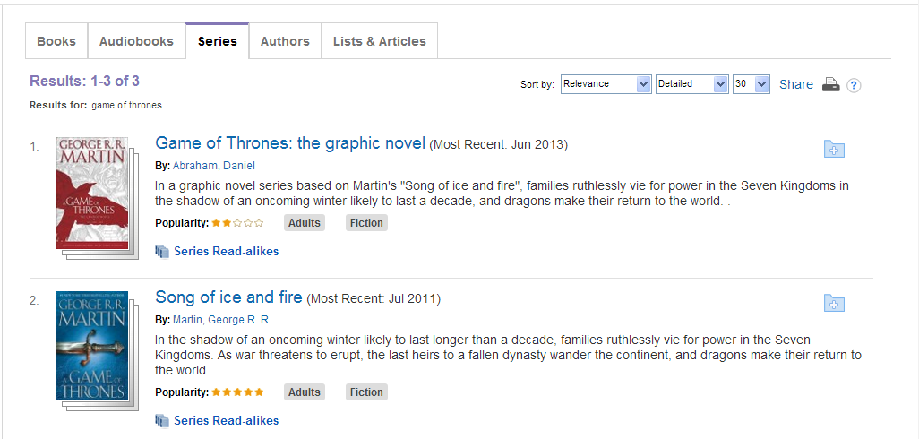
Searching for a Series
1. Enter keywords and click search
2. Select the Series tab
3. Select the series
Notes:
You can search for Series too. Enter the series title, and use the Series Tab on the results page.

Slide 12
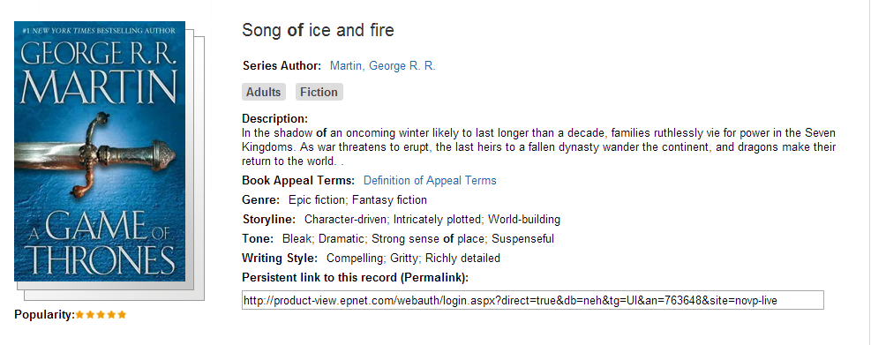
Series Information

Slide 13
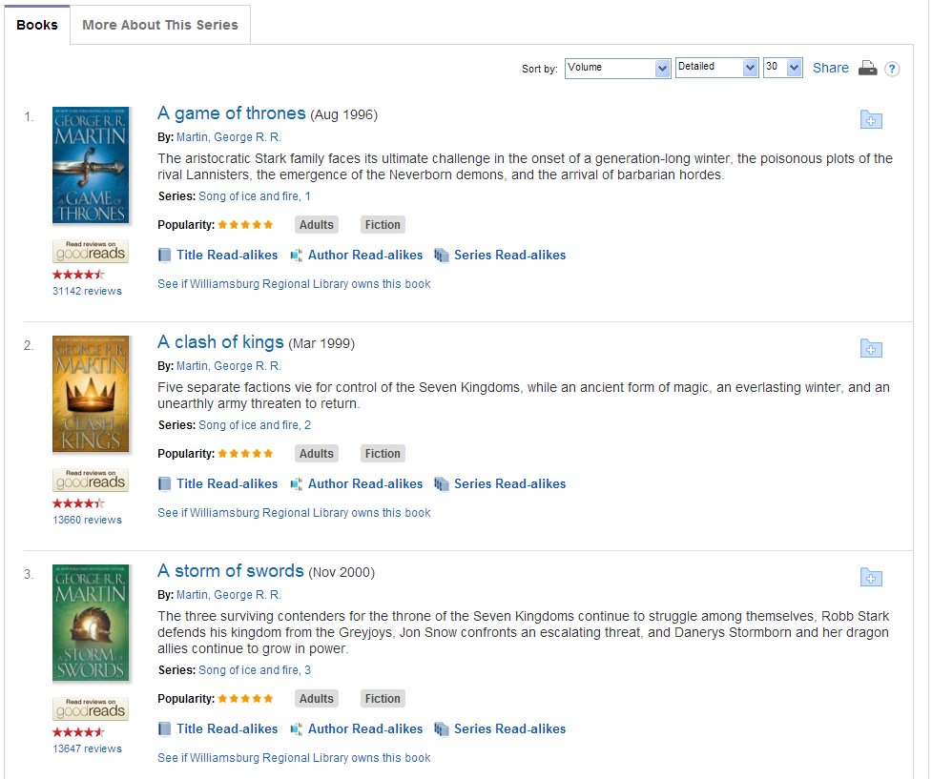
Books in the Series
Notes:
You will see a list of the books in the series

Slide 14
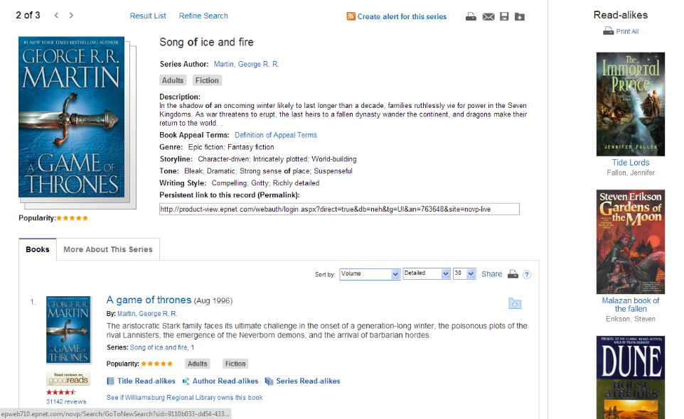
Series Read-alikes
Up to 9 read-alikes for each series
Notes:
NoveList Plus will also give you Read-alikes for series you may enjoy based on what you are looking at

Slide 15
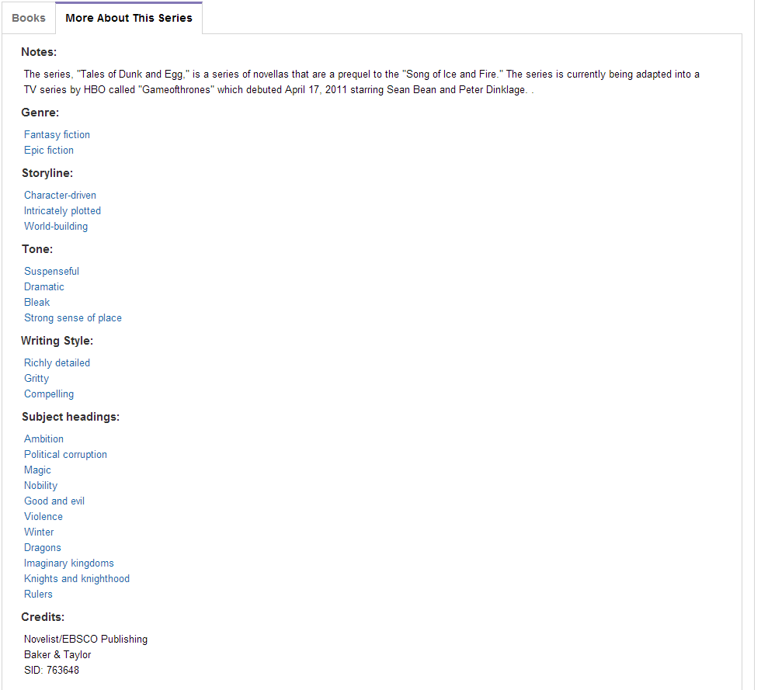
More About This Series
Notes:
The ‘More about…’ button on the Series page will also tell you more about it, including what sort of genre it belongs to, whether it has been adapted to film, etc.

Slide 16
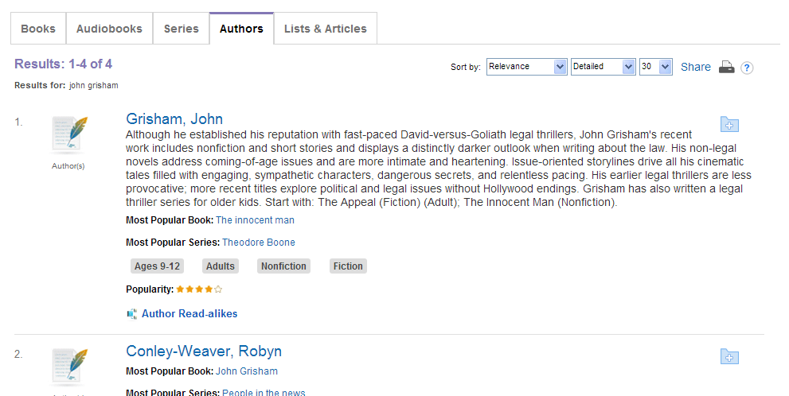
Searching for an Author
1. Enter author name and click search
2. Select the Authors tab
3. Select the author
Notes:
Search by an author by typing in their name to the search box, and then choosing the Authors tab on the Results page. Click on their name to go to their information page.

Slide 17
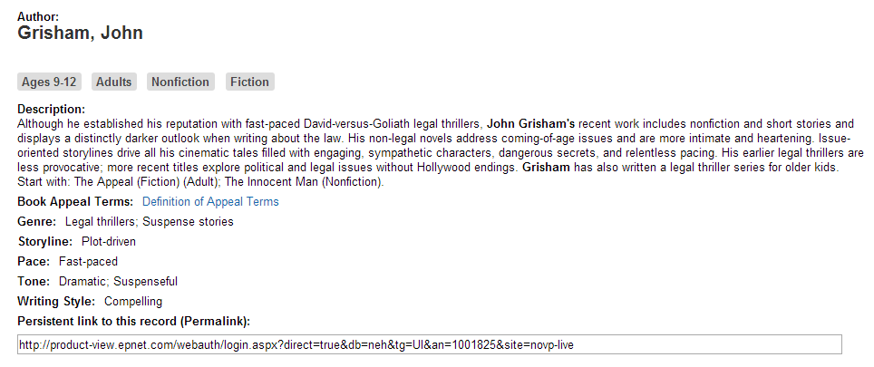
Author Details
Notes:
You’ll see information on the author including who they write for, genres they write in, and information on their writing style

Slide 18
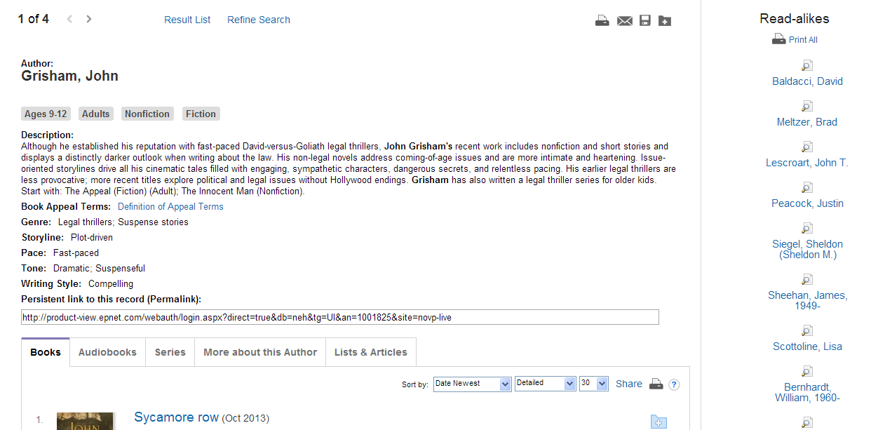
Author Read-alikes
Up to 9 read-alikes for each author
Notes:
You’ll also get Read-alike recommendations for other authors who you might enjoy based on who you are looking at. These authors will have similarities like: they write the same genre, their storylines are similar, their books have a similar pace, they have a similar writing style, etc.

Slide 19
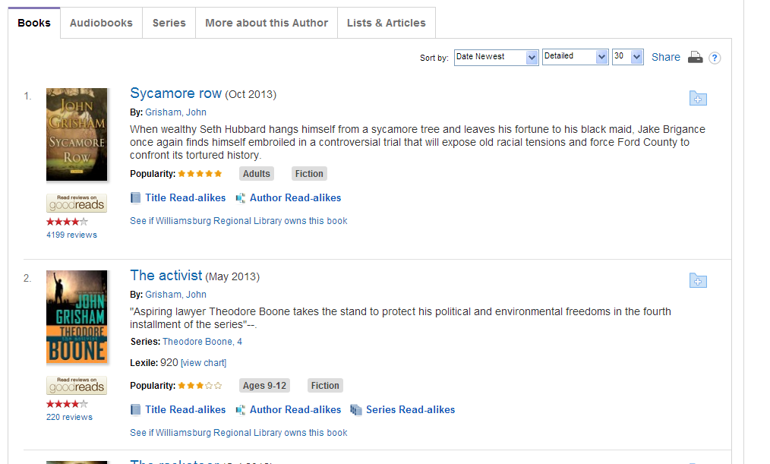
Other Author Information
Notes:
You can also see the books, series and audiobooks the author has produced, and find more information on the author, or see lists & articles featuring that author

Slide 20
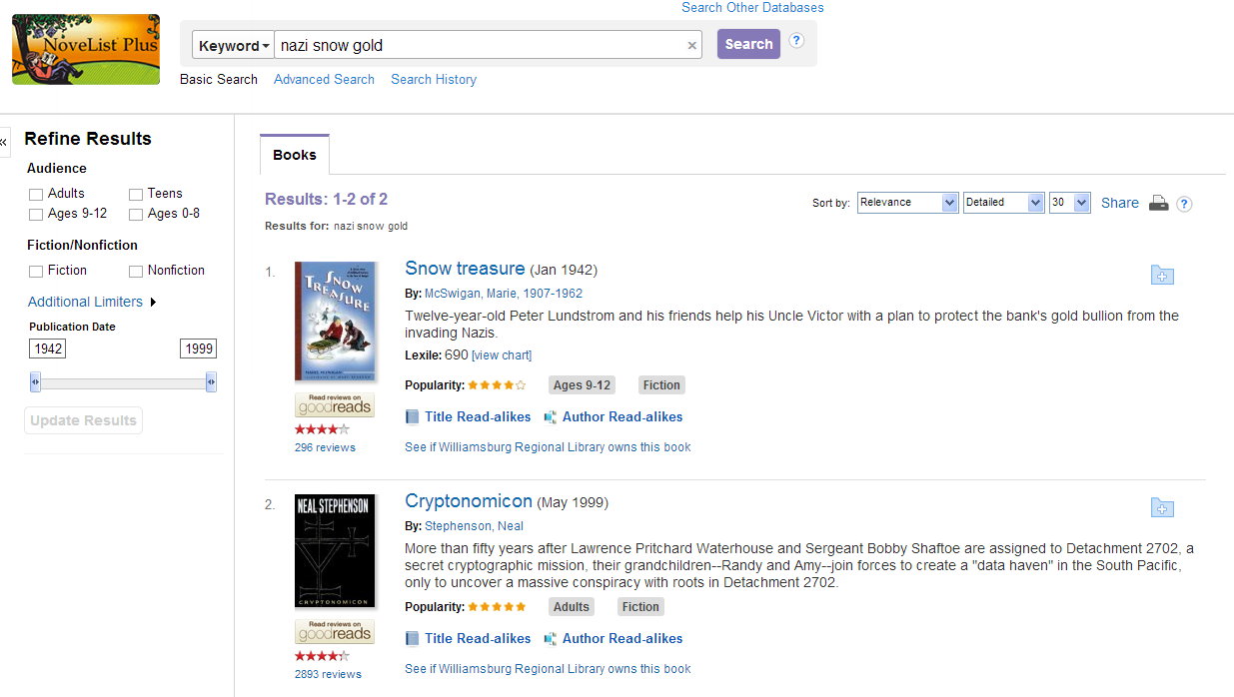
Searching by Keyword/Plot
1. Enter keywords and click search
3. Select your results
2. If necessary, refine your results
Notes:
Not sure of a title, author or series? You can also use the search box to search by keyword or plot!

Slide 21
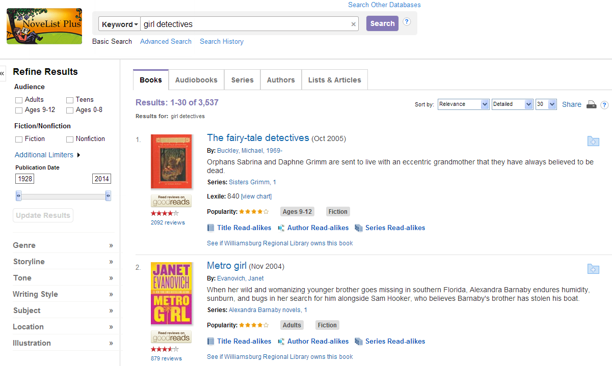
Viewing Results
View matching Books, Series, Author, Lists & Articles
Refine your results. These limiters always remain the same.
Narrow Results. These limiters change depending on your search terms.
Notes:
You can use the limiters to narrow down your results

Slide 22
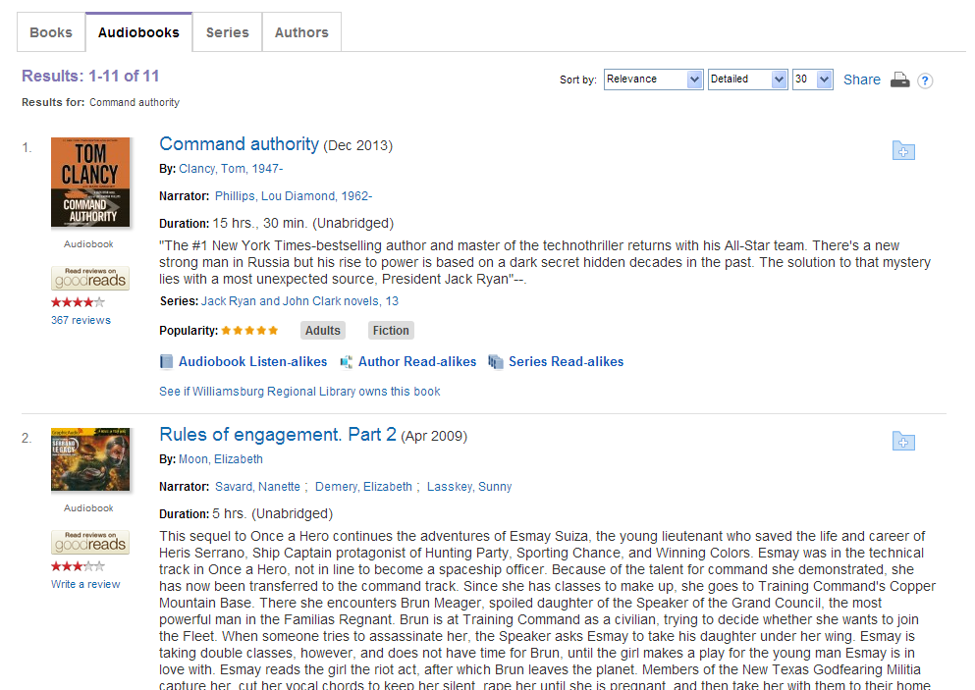
Searching for Audiobooks
1. Enter keyword name and click search
2. Select the audiobooks tab
3. Select your desired result
Notes:
Use the Audiobooks tab if you want to see Audiobooks

Slide 23
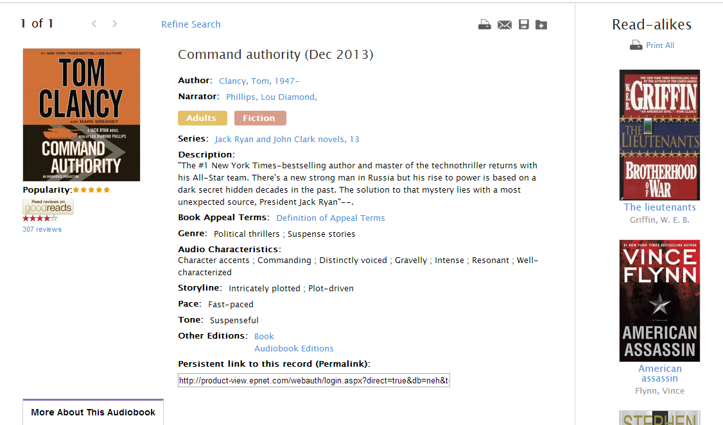
Audiobook Details
Up to 9 listen-alikes
Listen to audio samples & reviews
New audio appeal terms
Notes:
You can listen to a sample of the audiobook!
NoveList Plus also gives you ‘listen-alikes’ for similar audiobooks, and it will give you information on what the audio is like so you can see if you will enjoy the narrator of the book

Slide 24
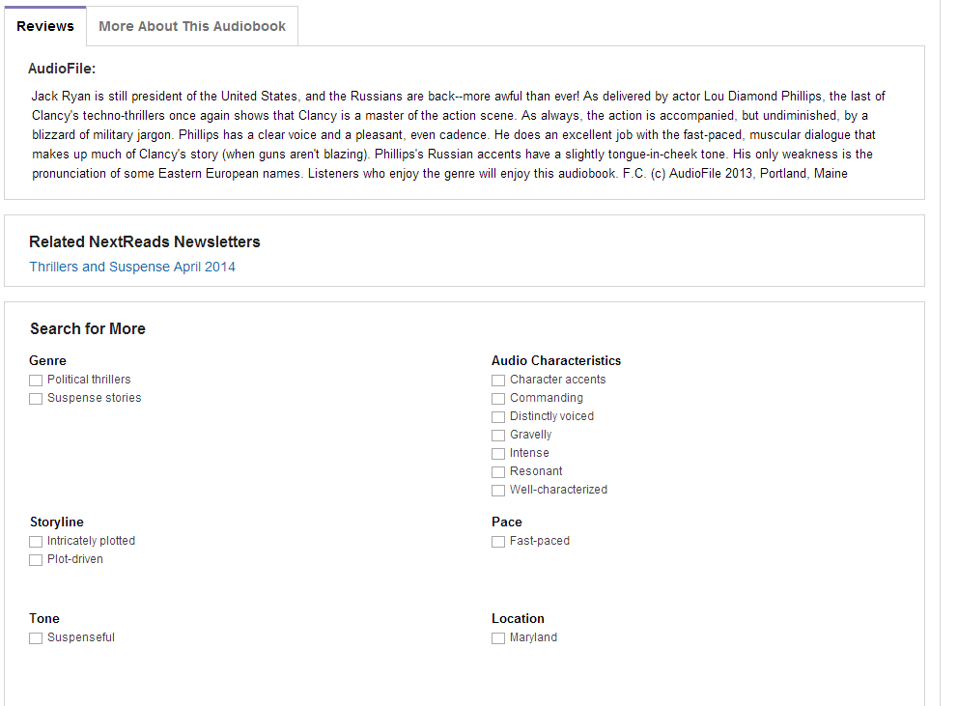
Other Audiobook information
Notes:
You can also find reviews and more information on the audiobooks

Slide 25
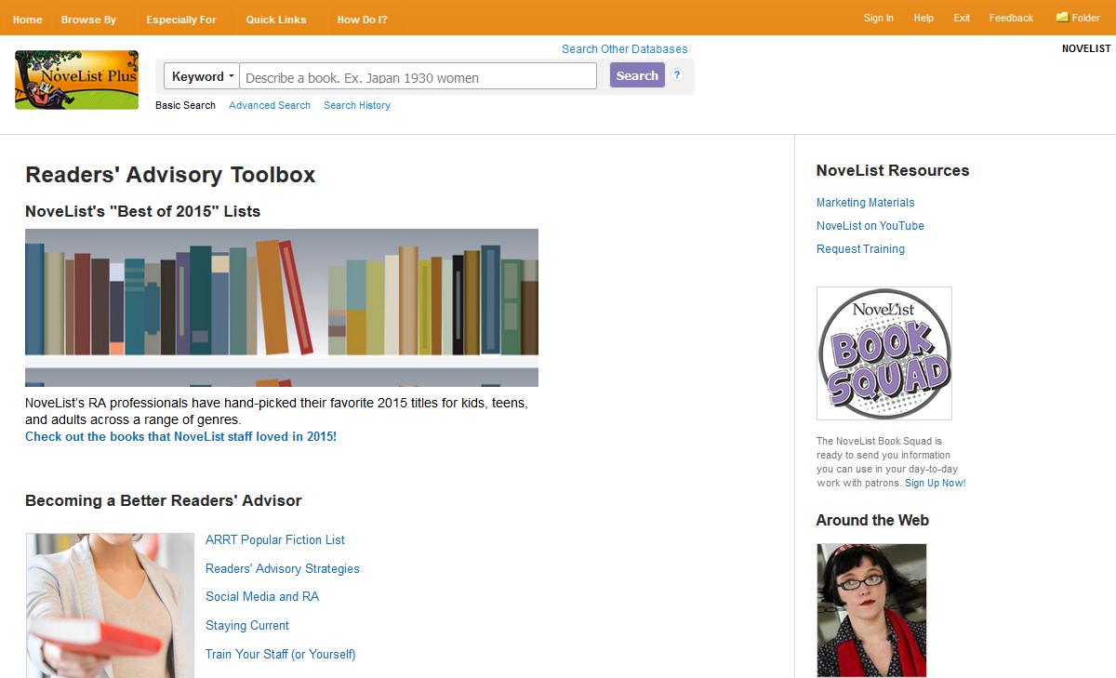
The Readers’ Advisory Toolbox
Further training & resources
Featured content like seasonal inspiration
Book Squad email list
Notes:
Using the Especially For tab at the top of the page, you can get to the Readers’ Advisory toolbox which is meant to help librarians find good books for their patrons. See ‘best-of lists’, get information on genres you may not be familiar with, and even get book display inspiration!

Slide 26
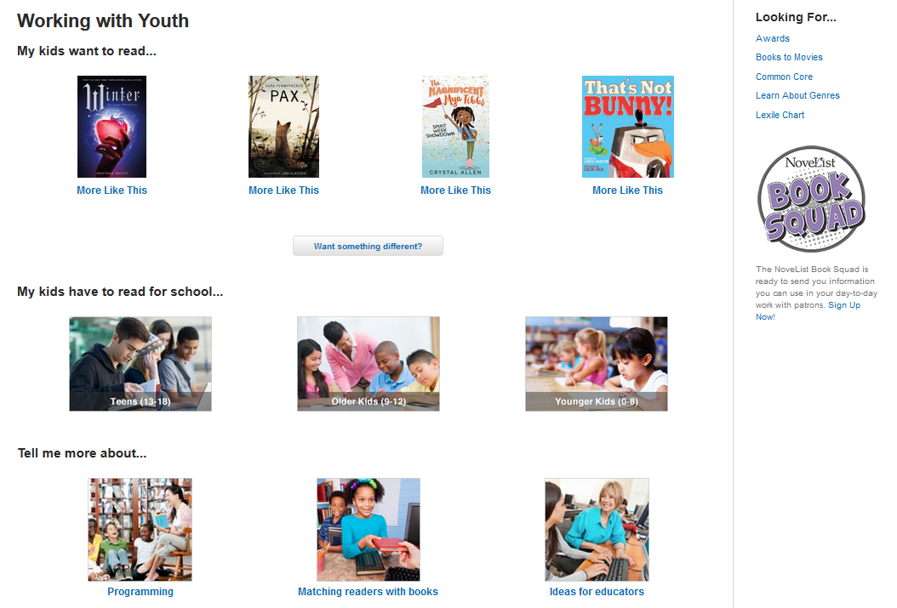
Working with Youth
Easy RA for kids and teens
Educational resources
Helpful resources
Notes:
Using the Especially For tab at the top of the page, you can get to the Working with Youth page which is aimed at helping you serve younger patrons. There’s advice for what to recommend if they enjoyed current popular titles, programming ideas and more!

Slide 27
Thank You!
Give NoveList Plus a try! If you have questions you can find videos, ‘how-to’ information and answers to common questions on the NoveList Plus website using the How do I? button at the top.
And feel free to contact me at commservices@wapitilibrary.ca
Or (306) 764-0712 ext. 204
Lindsay Baker
Community Services Librarian

