Slide 1
Braille basics for member libraries
Braille basics for member libraries
Jessica Blouin, board member, Braille Literacy Canada
Lindsay Tyler, Sr. Manager, CELA

Slide 2
Agenda
Braille Literacy Canada
What is braille?
Braille offered by CELA
Why does braille matter today?
Technology and braille
Supporting braille readers, learners, educators

Slide 3
What is Braille Literacy Canada?
Braille Literacy Canada (BLC) is a not-for-profit corporation committed to braille promotion and the right of braille users to equal access to printed information. For many Canadians who are blind or visually impaired, braille is the key to literacy and independence.
Braille Literacy Canada (BLC) is an organization of braille users, transcribers and producers, as well as educators and parents of blind children.

Slide 4
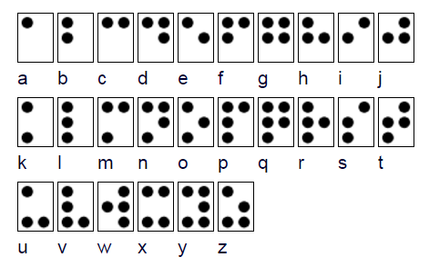
What is braille?
A tactile writing system of raised dots which is read with the fingertips.
Braille is the equivalent of print. Anything that can be represented in print can be represented in braille.
Braille codes exist for virtually every language, plus math, music etc.
Notes:
Braille is a tactile writing system of raised dots which is read with the fingertips.
The basic braille 'cell' has two columns of three dots each. These six dots can be arranged in different combinations to represent letters, words, punctuation, mathematical symbols, musical notes and more.
Braille is the equivalent of print. Anything that can be represented in print can be represented in braille.
Braille isn’t a language, it’s just a way of representing written language. So, there are braille codes for English, French, Chinese, Arabic, music, math and virtually any other written system you can imagine.
Blindness is not very common among young and working aged people, so there aren’t huge numbers of braille readers in Canada, but as we’ll explain, braille is critical for those who use it.

Slide 5
Uncontracted & contracted braille
Uncontracted braille – words spelled out letter by letter. Braille learners usually start with this.
Contracted braille – short forms are used to make braille documents shorter and faster to read
Examples of braille contractions
Notes:
Uncontracted braille is the equivalent of print spelled out.
Contracted braille uses special characters called contractions to make words shorter. In print we use contractions like "don't" as a short way of writing two words, such as "do" and "not.“
Contracted braille is important because braille is bulky – you know this if you have any braille books in your collection. Braille contractions make braille documents more compact and faster to read.

Slide 6
Braille codes to know
Unified English Braille (UEB) – an updated contracted braille code recently adopted in many countries to 'merge' various English braille codes.
UEB created to help address sharing of braille materials across borders, assist with automated transcription, better represent print formatting, and include technical notation such as URLs and email addresses
Notes:
UEB: In the past, there were multiple braille codes used in English – for example, the braille codes used in the UK and North America were a bit different. Also, technological changes meant that more and more technical notation needed to be represented in braille.
French braille has also been unified to create le Code braille français uniformisé (CBFU).

Slide 7
Braille codes to know
Music braille – sheet music in braille
Notes:
Music: sheet music was one of the applications Louis Braille first had in mind when he invented braille. He played and taught music and wanted to be able to read and write music.
Musical notation can be represented in braille.

Slide 8
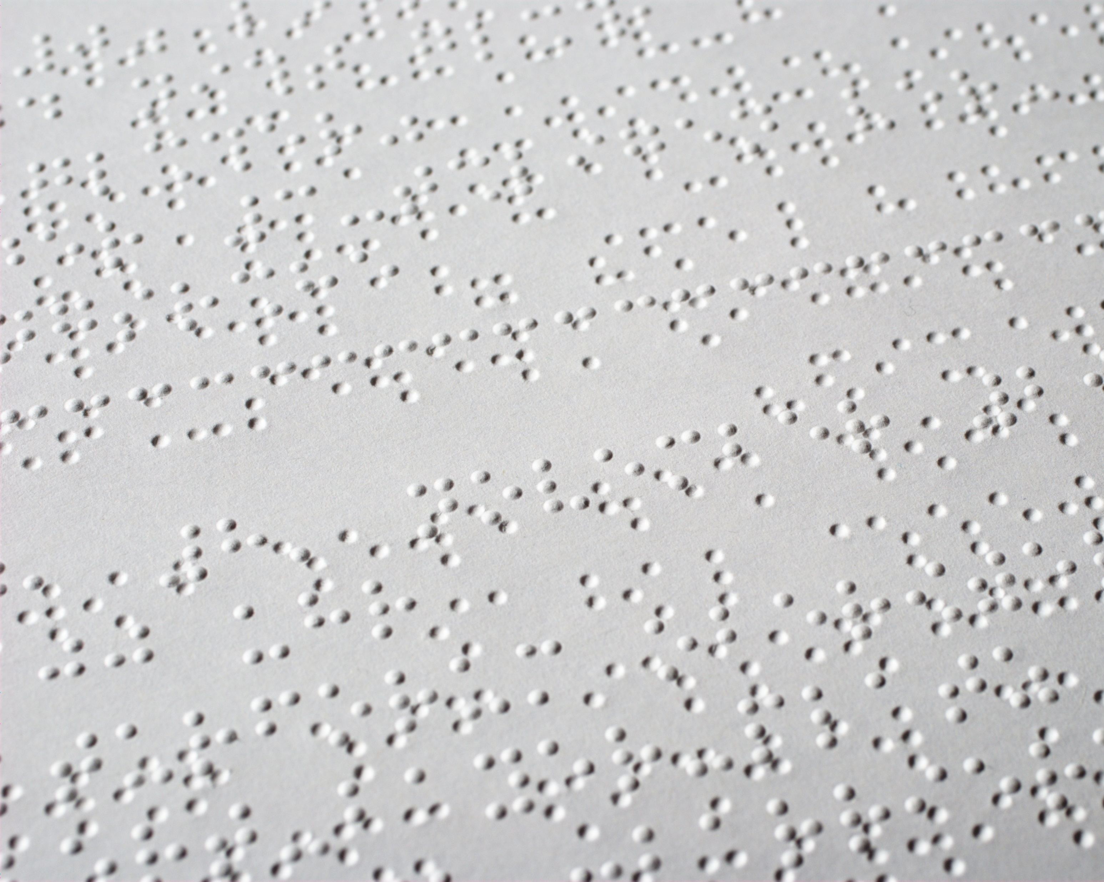
Braille materials available through CELA
Through CELA, your library can offer a variety of braille materials:
Embossed braille books
Books in braille only, usually several volumes per book.

Slide 9
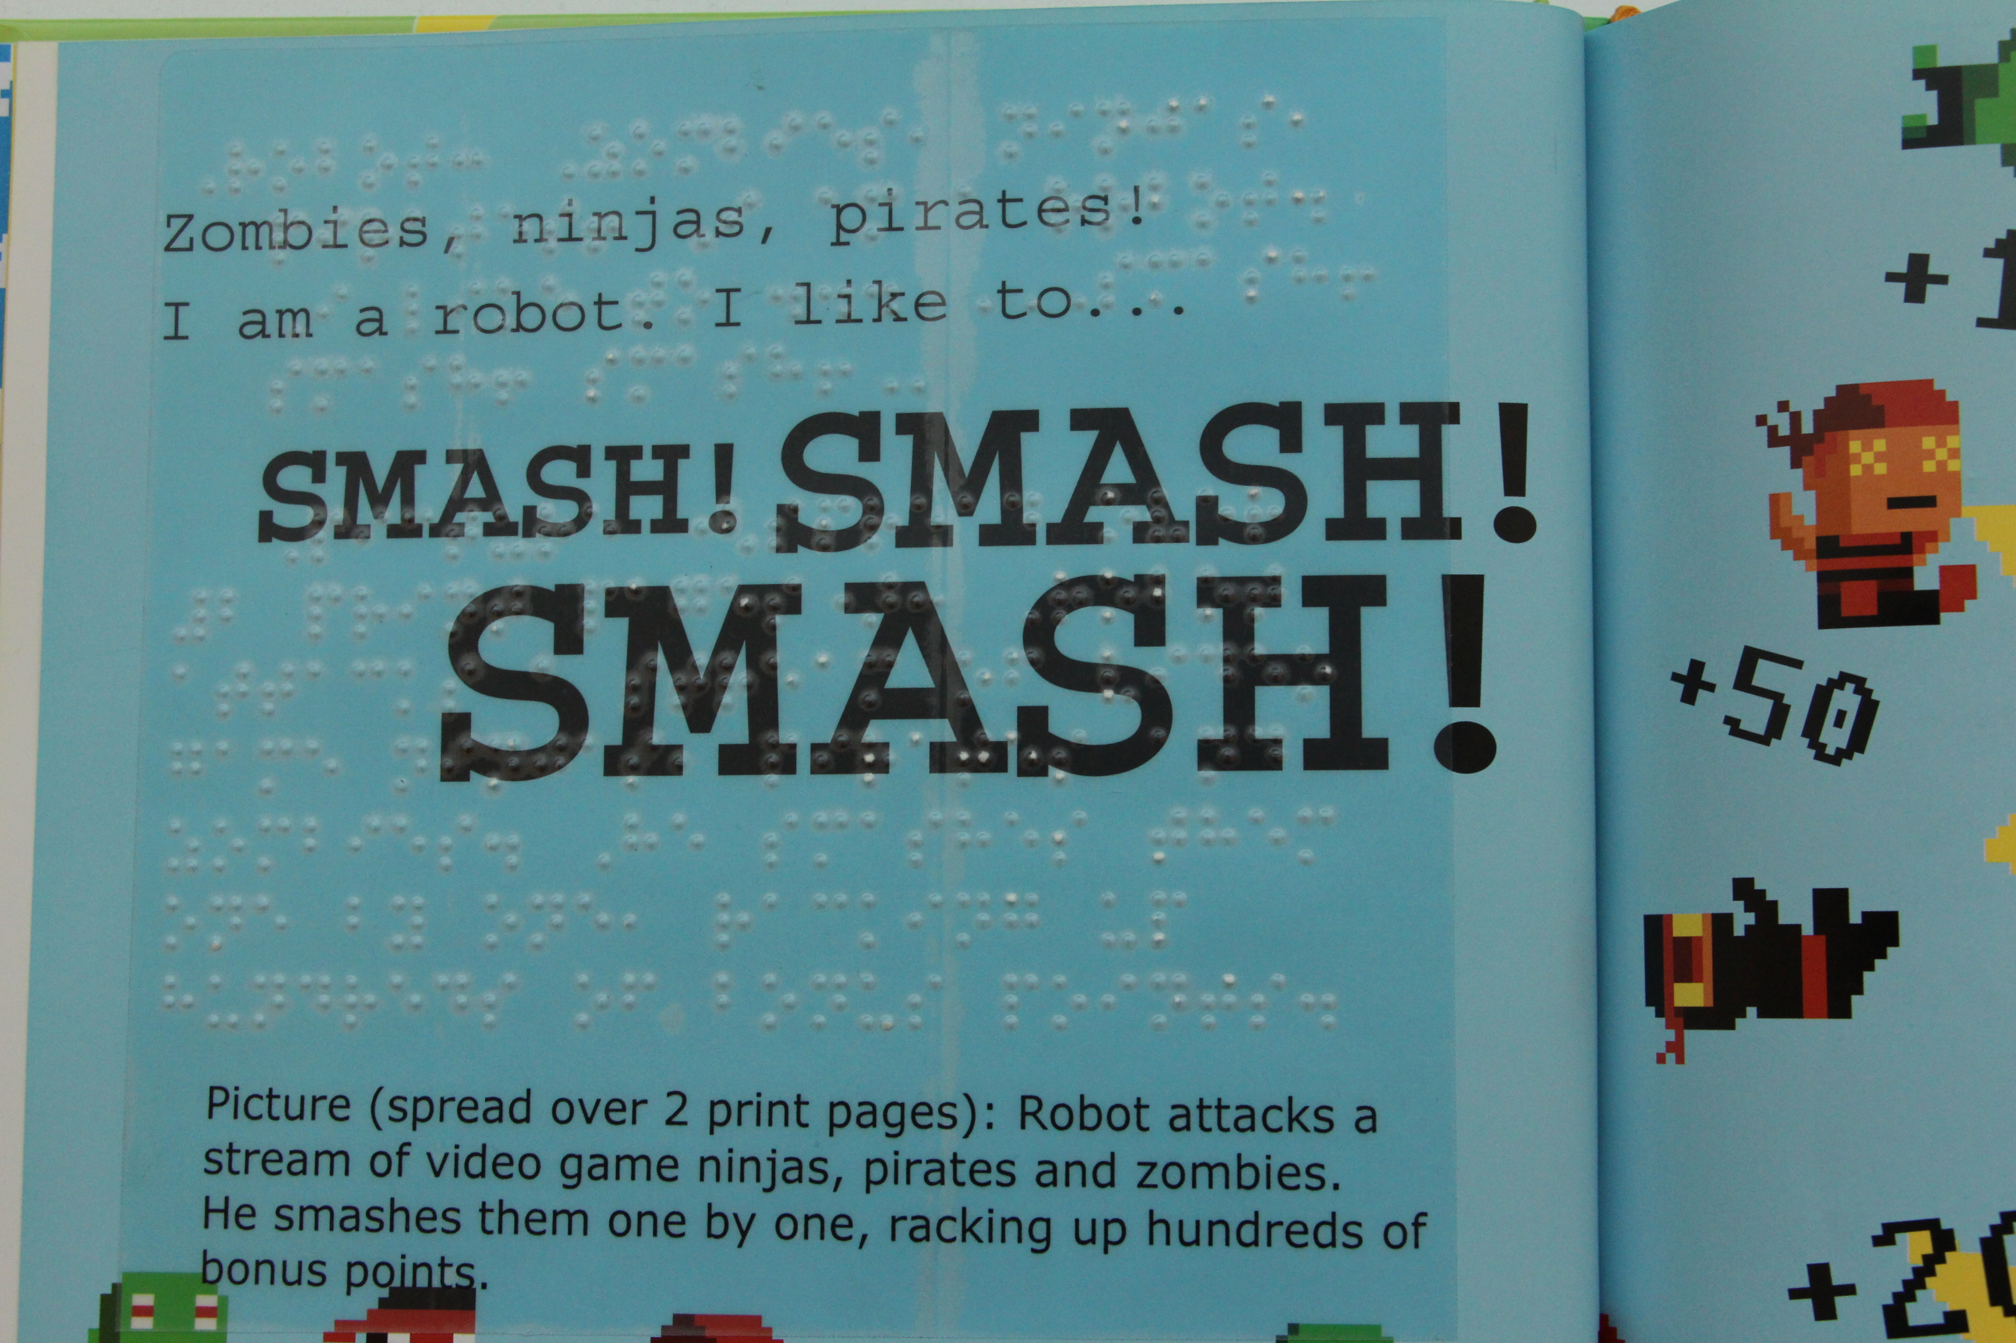
Braille materials available through CELA
2. Printbraille books: children’s picture books with braille added.
To be shared between braille and print readers, for example a sighted parent and child with vision loss
Notes:
2. Printbraille books are children’s picture books with braille added.
To be shared between braille and print readers, for example a sighted parent and child with vision loss.
Generally the picture books selected for printbraille have text that makes sense on it’s own, without the images, but sometimes a picture note will be added to give important information from the pictures.

Slide 10
Braille materials available through CELA
3. Electronic braille
Books in braille-ready file format, to be downloaded and read on a refreshable braille display, or embossed.
Bookshare offers e-braille as well.
4. Braille music scores
CELA offers some braille sheet music, including materials from the Royal Conservatory of Music curriculum.
Notes:
3. Electronic braille
Books in braille-ready file format, to be downloaded and read on a refreshable braille display, or embossed. On this slide, there is an image of a man using a small refreshable braille display, called an Orbit. We’ll talk more about refreshable braille displays in a moment.
4. Braille music scores
CELA offers some braille sheet music, including materials from the Royal Conservatory of Music curriculum.

Slide 11
Why does braille matter?
“Braille…is a method of reading and writing that is equal in value to print for sighted people.”
--From a 2017 press release from the World Blind Union marking World Braille Day.
Notes:
Why does braille matter to us as library staff?
Essentially, literacy. As braille is the equivalent of print, it allows people who are blind to read and write independently. For people who are blind, braille is essential for literacy.
Myth: Braille is 'special.' Fact: Braille is simply a writing system, not inherently more special than print. As librarians, if we think braille is 'special' and hard to understand, it can get in the way of providing good service.
Braille allows people to understand and use written language including spelling, punctuation and grammar in ways text-to-speech technology alone does not.
Employment:
Research has found that as a group, people with vision loss who are able to use braille have higher rates of education and employment than people with vision loss who are not literate in braille.
What we hear from advocates in this area is that tools such as audio books and text to speech software are useful, but not a replacement for braille and the literacy it offers.

Slide 12
Braille and technology
Technology gives new access and options to braille readers
Electronic braille displays allow people to read electronic info, as well as input in braille
Notes:
Electronic braille displays allow people to read electronic info, as well as input in braille
Refreshable braille displays have been very expensive, but real efforts are being made to create affordable braille displays.

Slide 13
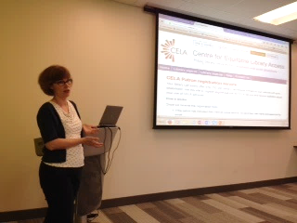
Supporting braille readers in your community
Staff training
Make sure coworkers know that you do offer braille thru your CELA service
Share the recorded version of this webinar with your coworkers

Slide 14
Registering patrons
If you're not sure which formats the patron prefers, offer braille as well as audio so they know both choices are available.
Discuss value of exposure to braille with parents of children who may learn braille later
Notes:
When you register new patrons who have vision loss for library service generally, and especially CELA service, offer braille as well as audio so they know both choices are available.
Discuss the value of exposure to braille with parents of children who may learn braille later. Just as sighted children benefit from exposure to print from a very young age in order to develop pre-literacy skills, children who are blind benefit from exposure to braille. The difference is braille is much less abundant than print in our world, so access to printbraille kids books is valuable.

Slide 15
Braille collections in the library
Some public libraries have collections of braille
Libraries may borrow braille materials from CELA
Consider replicating any shelf labelling you have for print books
Braille Literacy Canada has accessible signage guidelines for braille signs
Notes:
I said earlier braille isn’t special. This is true – it’s just an alternative to print. However, braille is pretty rare and so braille readers and children who are blind and may learn braille aren’t exposed to it as often as sighted people are exposed to print. Having braille in the library helps give opportunities for exposure to braille.
Putting braille in the library has a number of advantages -- braille is pretty scarce in the world, so offering it in the library helps make it available in the community, exposes braille learners to braille, and helps include braille readers in community services. Not all of you have braille readers in your community, and that’s ok, but know braille is available from CELA if you choose to offer it.

Slide 16
Reaching out to educators, parents
Suggestions for reaching out to braille readers and educators:
School boards often employ 'vision teachers' who specialize in teaching children with vision loss
There may also be parent groups in larger communities
Canadian Council of the Blind is a advocacy and service group of and for people who are blind
CNIB is also a resource in many communities
Notes:
Braille has not traditionally been offered by public libraries, so reach out to educators of students who are blind in your area. School boards often employ 'vision teachers' who specialize in teaching children with vision loss
There may also be parent groups for parents of children with vision loss in larger communities
CNIB is also a resource in many communities, and staff there would be pleased to know that you have braille resources.

Slide 17
Programming with braille
Celebrate different ways of reading by sharing braille books in story times
Programming opportunites: related to braille around White Cane Week (1st week of Feb), Louis Braille's birthday (Jan 4), or Family Literacy Day (January 27)
Louis Braille was a kid when he invented braille, so his life story appeals to children.
Notes:
Kids generally love braille, and braille is a great example of the many ways people can read. Also, Louis Braille was a child when he invented braille, and he persisted in spite of adults who thought it was a bad idea, so kids can identify with his story.
What a great theme for programming!
Some key dates where you might wish to bring braille into your programming: White Cane Week (1st week of Feb), Louis Braille's birthday (Jan 4), or Family Literacy Day (January 27)

Slide 18
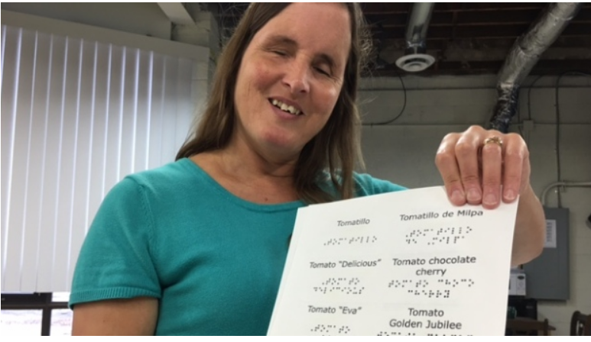
Programming with braille
Windsor Public Library Seed Library with braille labels: http://www.cbc.ca/news/canada/windsor/windsor-public-library-seed-packs-stamped-with-braille-1.3783237
Notes:
An example: Recent article about Windsor Public Library seed library program and how they are labelling the seed packs with braille. Rebecca Blavoet who worked to create the braille labels said "We don't know who is going to come across those seeds in the library, whether they're losing their vision, whether they're braille readers, whether they're large print readers and they don't want to admit it," she said.
"The seed labels are a way of broadcasting, in a certain way, casting the net a little bit, letting people know there are braille resources available in the community."

Slide 19
Conclusion
Braille is important and as relevant as ever
Your library can offer braille materials for every age, interest and tech skill level via CELA
Questions? Contact us:
members@celalibrary.ca
1-855-655-2273

