Slide 1
Introduction to Online Learning
Notes:
The notes within this powerpoint contain all talking points = SCRIPT
Last update: August 2015 – Erin Z
TRAINER PREP – BEFORE CLASS:
Review & become familiar with the following:
TRAINER PREP – IN CLASS: Write your name on the whiteboard or the flipchart. The board will be used for the opening and closing discussion, have a marker to hand.
INTRODUCTION:
Welcome the learners & introduce yourself.
Washrooms location, cellphones, food & drink policy.

Slide 2
Introduction to Online Learning Course Objectives
Understand what online learning is
Learn about the benefits of online learning
Learn what you need to begin learning online
Discover free, high-quality tools for self-led learning online
Notes:
OPENING DISCUSSION
Note to trainer: As an initial activity, ask patrons the following questions. Note down questions and responses on a chart or on a whiteboard and retain for the end of the session wrap-up. There is no right or wrong answer.
What do you already know about online courses or eLearning?
What kind of things like to learn about? [Make list on board]
Some examples: Microsoft Word skills, or even a brand new language!

Slide 3
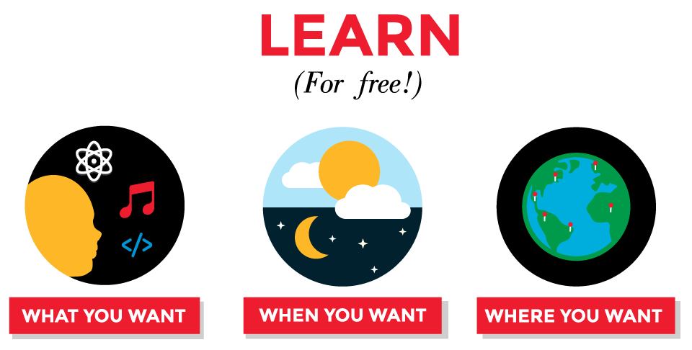
Notes:
What is online learning? SIMPLY PUT: Using the Internet to LEARN!
Online Learning = eLearning
- eLearning and online learning can be used interchangeably
- Another term might hear/see: MOOC (one type of online learning that is available – Massive Open Online Course - term coined in 2008)
Consider it your NEW Learning Playground!
Online courses can help further your education and skills, but they are also a great way to try out new things you want to learn
Trying a course and changing your focus is risk-free
Registering in different online courses is an easy way to test out new subjects in order to find out if you would like to pursue them at a higher level.
The best things about eLearning? It's learning for just for you.
…Learn what you want…when you want…where you want
This is why there are so many people trying and enjoying it!
**9 million students have enrolled in Coursera to date, one of the most popular course providers. (We will look at Coursera later)
Let’s talk a bit more about the benefits of eLearning & how it works…

Slide 4
Almost every topic you could imagine!
At your own pace, when you have the time
In your house, on the bus, in a cafe, on the beach
Notes:
WHAT YOU WANT! Topics from how to make or do something, to on-going skill-building, to learning technology, to university-level topics….
WHEN YOU WANT IT! Very flexible – you can choose when, where and what you would like to study. You may complete quizzes and assessments at your own pace.
WHERE YOU WANT IT! Can sign in and learn from anywhere… can learn on the go using a tablet or smartphone.
What kind of learning is online learning?
There is quite a spectrum of the type of eLearning available… from a single online video to an entire course with exams.
Can be big or small:
4 minute basic origami video on Youtube
Complete university courses developed by experts from across the globe online that mirror a real classroom experience with lectures, readings, assignments, class discussions and final exams
May be offered all the time ‘on demand’ or irregularly (scheduled courses that are only offered at particular times of the year. May not be scheduled to be offered again.)
Sometime opportunity for real time interaction:
Usually, there are not many opportunities for real time interaction, though some courses have webinars and online conferences using applications like Skype, or discussion forums to interact with other learners.
Anyone may sign up; there are not usually ‘prerequisites’.
NOTE OTHER POTENTIAL FEATURES (that increase accessibility):
Sometimes offered in different languages
Can include closed captioning.

Slide 5
How much does online learning cost?
Many are absolutely free!
Some eLearning providers have a tiered cost structure
Partial access FREE
Pay for unlimited access or added functions & services
= Look around the online learning sites for their free content
Notes:
We have created a guide to help you begin to find many of the free eLearning opportunities!
Some eLearning providers have a tiered cost structure
→ basic or partial access is free, but unlimited access or added functions/services may have a cost.
Each eLearning provider is different, so you'll have to have a look around each of their websites to find the free content.
NOTE: Most university-based MOOCs are free or offered at far lower rates than university courses

Slide 6
How much work is online learning?
It all depends and what you want to learn, and the structure of the course.
It's up to you!
Notes:
It all depends and what you want to learn, and the structure of the course.
You can watch a one minute video, or take a full university course — it's all up to you.
Full courses are more work, of course! Often can plan on 1 to 3 to 6 (varies) hours per week to watch lectures, do readings, take quizzes, and complete projects/assignments.

Slide 7
Being a Successful eLearner
PLAN
CONNECT
ORGANIZE
WORK
Notes:
The great thing about eLearning is that it lets you learn on your own, on your own time, in anyplace you want, at your own pace. Sometimes though, it can be a challenge to stick with your learning path.
These are some basic strategies for becoming an A+ online learner:
Plan your goals & time
Set goals: Create a short term & long term learning plan
Plan for your courses
PLAN TIME TO WORK: Schedule time to do the coursework: It's very important to build work into your schedule — use your online calendar or set an alert on your phone to nudge you along.
Organize your projects, courses, & time
You may be using more than one eLearning tool or platform. You may be taking more than one course at a time. You may have projects that you're working on or completed — where do you keep it all?
There are a variety of online tools to help you create and organize.
There are websites and apps which will help you schedule your study time, customize your learning
Connect with others to help keep you on track and exchange ideas
Use strategies to best complete the work for your learning
Tune out distractions — both physical and online
Give yourself study breaks
Reward yourself for complete coursework & learning goals
TRAINER NOTE: All of these are on the guide in “Become an A+ Online Learner” tab

Slide 8
Connect – Make it Social!
More likely to complete your course if you have in-person interactions too!
IDEA: Boost your motivation by pairing up with a buddy to take a course
Look for blended learning opportunities at VPL!
Sign up for a course + have in-person meetups
with others taking the course at a library branch
Notes:
A little bit more on how CONNECTING can make a difference in your online learning!
The web provides increasing opportunities for interaction with your online instructors and classmates — forums, bulletin boards, chats, tweet-in's and more.
Connecting with other learners will help encourage you and can also be a great support in completing work and discussing ideas and thoughts about the course. Research shows greater course completion rates for those who have some form of in-person sessions that go along with their online learning.
Over the past year, VPL has been scheduling meetups for some select online learning opportunities
Last one was a edible gardening course this summer and those taking the online course also met regularly at the Renfrew branch to discuss what they were learning in the course
- NONE SCHEDULED RIGHT NOW!!! (As of July 2015)

Slide 9
Can I get school credit for online courses?
Maybe…
Some offer completion certificate
May require payment
No guarantee that your school or workplace will accept the credentials
Notes:
This is the other BIG question that people have about online learning!!! The quick answer is...maybe.
Not for earning a degree, but some eLearning platforms offer some sort of certificate, although often require payment.
And there's no guarantee that your school or workplace will accept the credentials — always check first if your goal is official qualifications.
TRAINER NOTE – EXAMPLES:
Lynda.com offers free, downloadable certificates
Coursera charges $50?
If you choose to register for the ‘Verified Certificate’ option when you register for a course, Coursera will provide you with a digital certificate which confirms your completion of the course by checking that you have completed all material in the allotted time. This does not constitute a grade, though, and it does not include any additional comments from the host institution or professor. However, you could list this certificate on your CV.

Slide 10
What do I need to get started?
Computer/tablet/smart phone + connection to the internet
(+ maybe speakers or headphones)
Many require you to create a free account
= email address + other personal information
Can track your progress
Connect and communicate with other online learners
Receive email notifications about upcoming learning opportunities that may be of interest
Notes:
[NOTE POINTS ON SLIDE]
When creating free accounts:
- You will be asked to provide personal information - at the very least an email address.
- These accounts can be a big help with your learning:
- they can track your progress through an online course,
-- Course providers like Lynda track which video lectures have been watched & bookmarks spot left off so can return to the same place of the lecture
- allow you to connect and communicate with other online learners.
- You can also set your account up to receive email notifications about upcoming learning opportunities that may be of interest.
As a disclaimer on Privacy Policies and Terms of Service:
The eLearning providers listed on the VPL Online Learning guide are not affiliated in any way with Vancouver Public Library.
*We recommend you use your best internet privacy habits: read the terms and conditions on each provider's website to see how your personal information will be used and provide as little personal information as possible. [Plug Protecting Your Online ID course; OPTIONAL show tosdr.org/]
*exceptions are Lynda.com, Learning Express Library, Pronunciator and Coursera

Slide 11
Online Learning + Inspiration Lab Introducing Lynda.com
vpl.ca/InspirationLab
Notes:
eLearning goes hand-in-hand with VPL’s new Inspiration Lab, and we now have an amazing new resource for learning online: Lynda.com
Hundreds of courses are available from experts in different fields on 3D and animation, audio/video editing, design, web development, business and office applications and much more.
[SHOW VIDEO]
Lynda.com : Facts to share
Can take an unlimited number of courses
New videos added every week
Create playlists of related video lectures. Share these playlists with friends!
Transcripts for all the video and they are searchable!
Offers closed captioning for some video lectures
FREE downloadable certificate are available for courses completed
There is an app! (Sign up for an account on a computer first, then use your login to use the app)
What do I need to use Lynda.com?
Library card number and PIN are needed to log in even from within a branch.
If you are NOT a Vancouver resident, you will not be able to access Lynda unless you are in a branch. (Restricted to Vancouver residents only.)
Create an account to:
Save courses & course progress
Create playlists of related lessons from different courses
Show Inspiration Lab website – give brief tour of Booking, Equipment, Help, & Events sections – point out Lynda.com available on most every page
NOTE: Lynda.com MUST be accessed from a VPL webpage. [DEMO LYNDA.COM – PLG Library Card: 21383026295464 PIN: 2013]
From there, show them how to access the Online Learning LibGuide.
Talk about difference between educational sites, sites that offer full courses, or sites offering tutorials. [DEMO COURSERA]
Show online language learning [DEMO PRONUNCIATOR **Library resource]
Show online aggregators = ONE STOP SEARCHING! Let them click & try

Slide 12
How to Get More Help
Online Learning guide: guides.vpl.ca/eLearning
Inspiration Lab guides: vpl.ca/InspirationLab > Help
Tech Café – Tuesdays and Thursdays on Level 3 at 2pm
Contact VPL during library hours at 604-331-3603, by email at info@vpl.ca or visit a branch in person
Notes:
Note to trainers: As a closing activity, pull up the responses from the opening discussion activity, and write ideas or responses to the closing discussion questions alongside them.
What would you like to learn about now?
Will you use any of the platforms that we discovered today?
NOTE: You are more than welcome to work on your online courses using our open and bookable computers.
If you are working on learning any of the software or skills for using in our Inspiration Lab, you are welcome to book a computer in the Inspiration Lab. [Show how]
Refer attendees to Tech Café and Digital and Internet Safety sessions. Explain how to register or drop in for these programs.
Thank you for attending! Please remember to fill out your evaluation form – it is very helpful for our Programming & Learning team to determine the types of course you would find most useful!

