Slide 1
Planning, Sharing & Promoting Your Podcast
Vancouver Public Library
Inspiration Lab
Notes:
Plan/share Podcast Max 16
Check the following is booked:
Presentation area -no booking needed
Terry McBride ( for sound bleed)
Helpstar: iPad Air + short HDMI cable + Lightning HDMI adapter (ChargeiPad!)
Slides are on iPad under Productivity>Keynote
Alternate setup in lieu of iPad: L3 iRover laptop + VGA cord (attach laptop to Presentation screen). Get USB 1-001 (slides for trainer)
Before the Class:
Get the iPad from L6 Locker and charge
Make sure Systems brings the HDMI Cable and Adapter for the Presentation Screen
Print slides from VanDocs as your script (optional)
Print Evaluation Forms and Registration
Get music stand and remote from storage room
On Presentation Screen:
Turn on with Power Button
Press the Menu button on the Screen
Use the touch screen to select HDMI input

Slide 2
Today...
Focus the purpose of your podcast
Plan your podcast’s structure and schedule
Getting your podcast online
Enabling subscription (RSS feeds)
Using descriptive metadata
Submitting your podcast to iTunes (etc!)
A word about copyright
using other people’s work in your own
protecting and sharing your work
Promoting your podcast
Notes:
Go over objectives.
Ask people to share what they want to learn, and what kind of podcast they want to make. Ask about their previous experiences in the Lab – have they taken other courses?
Use their answers to inform your teaching.

Slide 3
Concept
What stor(y)(ies) do you want to tell?
Who is your target audience/ideal listener?
What resources (people, equipment, space, time) do you already have, and what do you need?
How often can you reasonably produce an episode? How sustainable is your concept?
Notes:
Go over these as questions podcasters should ask themselves during the planning phase. Share possible answers, and encourage patrons to share their answers. Offer encouragement, and highlight Lab resources that might help.
Example – Filled out from the perspective of S.S. Librarianship, a local Vancouver podcast made by two librarians.
Podcast: S.S. Librarianship (Catchprhase: “A podcast for librarians and the nerds who love them.”)
What stor(y)(ies) do you want to tell?: We want our show to be about libraries, but also to BE a kind of library – to tell stories and offer new knowledge and insights, as well as chronicling interesting aspects of the library world. We want to discuss and explore what it means to be a librarian in the 21st century – the new, the old, the good, the bad. We’ll ask other people to tell their stories about information work, and learn from their experiences. And, because the podcast is a reflection of us not just as librarians, but as people, we’ll also do our share of nerding out, discussing the pop culture we love and hate, and inviting guests on to talk to us about our favourite nerdy topics (like games, comics, and food!).
Who is your target audience/ideal listener?: other librarians and archivists, library school students, and nerds who love libraries and enjoy our perspective.
What resources (people, equipment, space, time) do you already have, and what do you need?: We have ourselves (there are two hosts for the show), and actually, one of our motivations for starting the show was that being in library school and working in libraries we have access to a lot of interesting, intelligent people doing important and exciting work, and this show lets us give them a platform to share their stories and experiences. We also have some free time, as we don’t have regular full time jobs yet, and we have a computer with recording software and a few USB microphones we’ve borrowed from friends with video game systems. As the show grows we might invest in more equipment, and/or use the new Inspiration Lab! (our show started in 2013, so we were on our own for the first year and a half before the lab opened).
How often can you reasonably produce an episode? How sustainable is your concept? We can probably do an episode every week, and we’ve learned from our favourite podcasters that it’s OK to take breaks for holidays or to change your frequency if you need to. We think our concept is pretty sustainable – we’ll always have new library experiences to share, new opinions on pop culture, and new people we’ve met who can share their stories with us.

Slide 4
Planning
Mix of elements
“canned” = recorded once, reused every time
“standard” = repeated structure, recorded every time
“dynamic” = completely new/different every time
Many podcasts share a common (but not mandatory) structure
Model after successful/favourite podcasts
Notes:
This slide introduces the next one, which goes into more detail and should prompt more discussion.

Slide 5
Possible Podcast Structure
Intro
Disclaimer/intro message (canned)
Theme music (canned)
Body
Music or sound effects between segments (canned)
Outro
“Housekeeping” (standard)
Host outro (standard)
Host intro (standard)
Segment content (dynamic)
Recurring segments (standard)
Theme music (canned)
http://canadalandshow.com/podcast/commons-guide-debates
Notes:
Ask folks to think about the shows they listen to – what’s unique about their structure? Can you describe how they use or don’t use some of these elements?
Play the first two minutes or so of http://canadalandshow.com/podcast/commons-guide-debates and then
CANNED ELEMENTS: disclaimers; theme songs; interstitial sound effects and music that are the same every time.
EXAMPLE: Canadaland Commons always starts with the same music.
STANDARD ELEMENTS: host(s) intro, the titles and structures of recurring segments, and the housekeeping or outro/wrapup at the end of an episode. These are done differently every time, but they follow an established pattern and allow the listeners to become comfortable and familiar, and develop a shared history with the hosts.
EXAMPLE: The introduction will always be a little different, depending on the content of the episode, but it follows the same pattern – the hosts discuss what’s coming up in the episode, introduce themselves, and welcome the listeners to the show. They also thanks the sponsors of the show – again, same format, different content each week.
DYNAMIC ELEMENTS: Everything else! The body of the episode is new each week – this is why listeners tune in. There might be standard elements, such as the name of the segment, or the way it begins, but the content of the conversation or interview will always be unique.
EXAMPLE: Once the interviews or discussions start, we’re into the dynamic content.
Ask the learners about their favourite podcasts – or radio shows – can they pinpoint these elements in those shows? What do they think the value of this mix of elements is? Lead a discussion about why listeners might enjoy this mix of elements.

Slide 6
so now you’ve recorded an episode - maybe 3 or 4. What next?
Podcasts are syndicated - episodes released weekly or monthly
Listeners subscribe through “podcatchers” (we mostly call these podcast apps these days) which pick up new episodes through RSS
There are a few steps to getting this set up

Slide 7
Road Map
Save episode
Upload to website
Create RSS feed to pull updates from website regularly
Submit RSS feed to iTunes/other podcatchers
Now that your show is available, promote it via social media
Engage with your listeners, and keep creating!
Do these for every episode!
Do these one time only!
Notes:
This is an overview of the rest of this session – we’ll talk in detail about how these individual steps work.
Emphasize that the two most complex steps to getting your show online are the two that you only have to do once!

Slide 8
Getting Your Show Online
Free vs Subscription Websites
S.S. Librarianship (SquareSpace)
Trends Like These (LibSyn)
Alternatives
SoundCloud
Notes:
There are many web hosting services that you can use to hold both your podcast audio files as well as any other information you might want to share about yourself and your show – audio, video, text...
The two things you will need are a website to contain and present your information, and an RSS feed to contain and distribute your audio files.
There are basically two ways to do this:
there are website services like SquareSpace (also Wix, Weebly, WordPress) that will allow you to do everything in one – create a website, save your audio files, and create an RSS feed within the same account. These are usually pay services, and will generally also include a domain name (yourpodcast.com, for example). Many also have tools to help you track the number of subscribers and downloads.
SHOW EXAMPLE OF SS LIBRARIANSHIP WEBSITE (sslibrarianship.com) (show front end; show rss feed link (auto generated); explain that the RSS is generated from the blog)
(2) there are free blogs and website services like WordPress, Tumblr, Blogger, and others which will allow you to set up a website for free – however they generally offer limited amounts of online storage, and may not be able to sustain hosting your audio files week after week after week. So most podcasters with free sites use them in combination with services like LibSyn, where they can upload and store their podcast audio files and extract an RSS feed to submit to podcatchers. A little more complicated, but generally much cheaper.
SHOW EXAMPLE OF TRENDS LIKE THESE WEBSITE (trendslikethese.com) (basic info; link out to RSS stored on Libsyn)
ALTERNATIVES:
Do you even need a website? Most shows have one, and it’s a great place to store additional information, and to allow users to search extensively, but you can also go the route of using a service like SoundCloud to store audio files. SoundCloud is a lot like YouTube, but for audio only. And they have useful instructions for how to extract an RSS feed from your account.
NOTE: there are lots of possible combinations here – this is just to give you the lay of the land. You could create a free blog and a paid LibSyn account… just a SquareSpace account… a complete paid blog… there are probably also possibilities I haven’t talked about here. You might also want to start free, and then upgrade as you go along.
As we’ll see, in either case, once your audio files are up on the internet, there is another crucial step to making them available to podcast listeners – RSS.

Slide 9
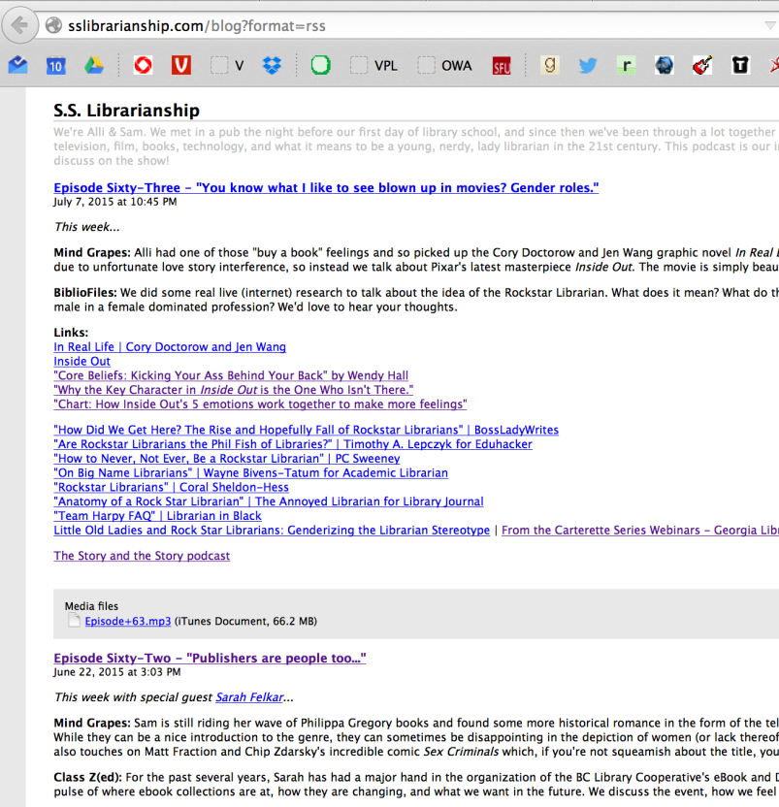
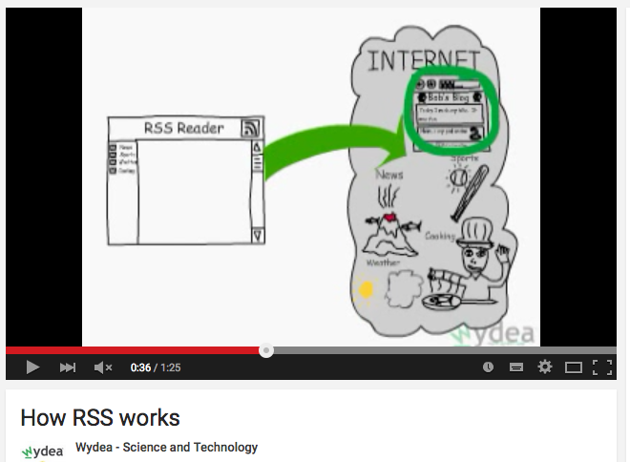
RSS
Notes:
Review w RSS video - [VIDEO https://www.youtube.com/watch?v=WzcHDvWb0mQ]
RSS is the technology that allows the user to subscribe to your show once, and then have new content pushed to them as soon as you post it (or as often as the set their podcatcher to check for new content)
Getting RSS from your website or your LibSyn or SoundCloud feed is generally quite straightforward – it’s basically another website, hidden under your website – see the S.S. Librarianship example in the slide.
RSS is the key to submitting your podcast to iTunes, as well as other podcast directories on the internet (iTunes is still by far the main directory that most podcatchers use to find podcasts when users search)

Slide 10
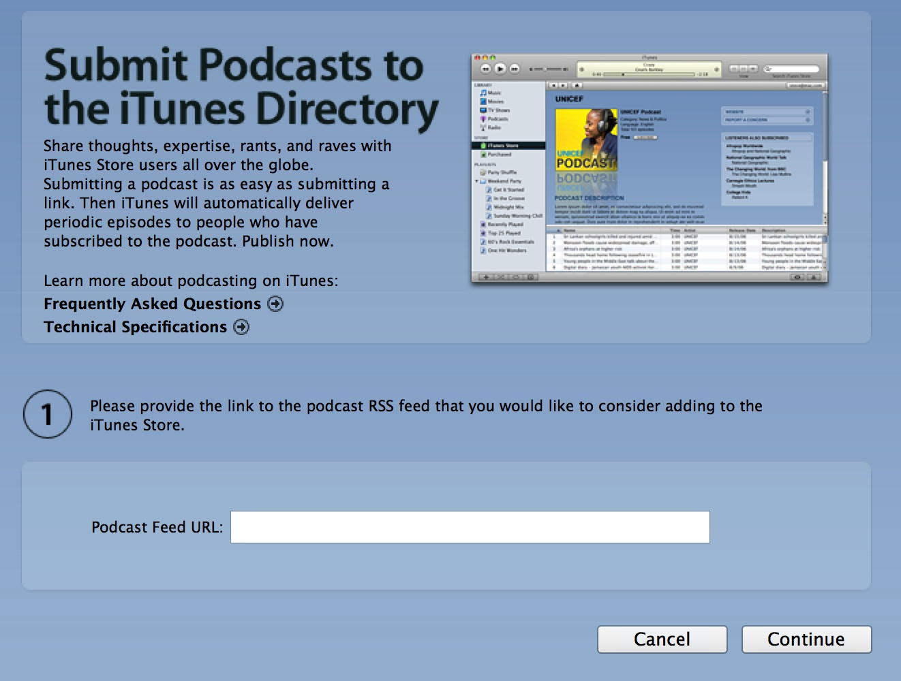
iTunes (etc)
Notes:
iTunes is still the gold standard in terms of where listeners go to find podcasts, and many other podcatchers use its index of submitted podcasts
iTunes/other podcatchers do not store your audio files – you store them on your website or account, and by submitting your RSS feed, you enable users to find your new content regularly through their podcatcher (or app).
Your RSS feed is the key piece of information that you submit to iTunes. It is also important because listeners might also have their own ways of subscribing, such as through a more traditional RSS feedreader (eg Feedly)
There are basically three steps to getting your show into the iTunes directory:
1) Set up your site, and decide where your audio files will be stored – in a LibSyn or SoundCloud account, or in posts on your website?
2) Find your RSS webpage, and submit its URL to iTunes through the iTunes program on your computer
3) Wait a few days to be approved + added to iTunes store – they’ll email you a confirmation, and now, anyone anywhere can subscribe!

Slide 11
Metadata
Notes:
Metadata is data about data – in the case of your podcast, it’s the information that allows all sorts of different computer programs to read, extract and display the title, episode number, artist names, and any other info you choose to attach to the file.
iTunes and other podcatchers can’t effectively distribute your show without it – without metadata, such as title, author, and keywords, users searching for your show won’t be able to find it.

Slide 12
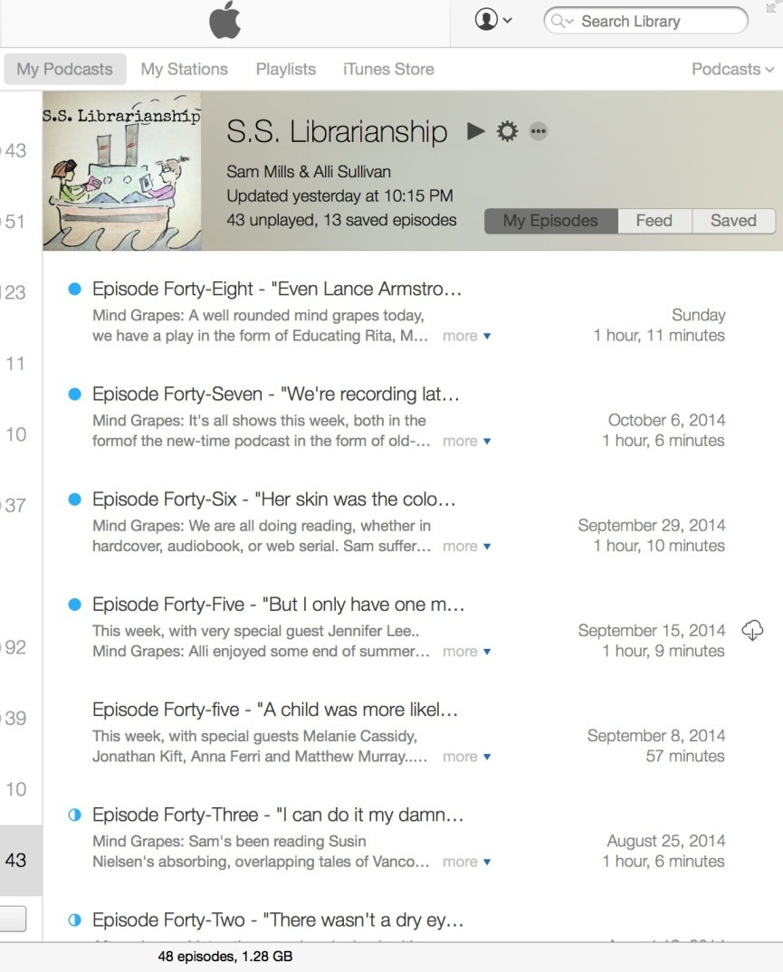
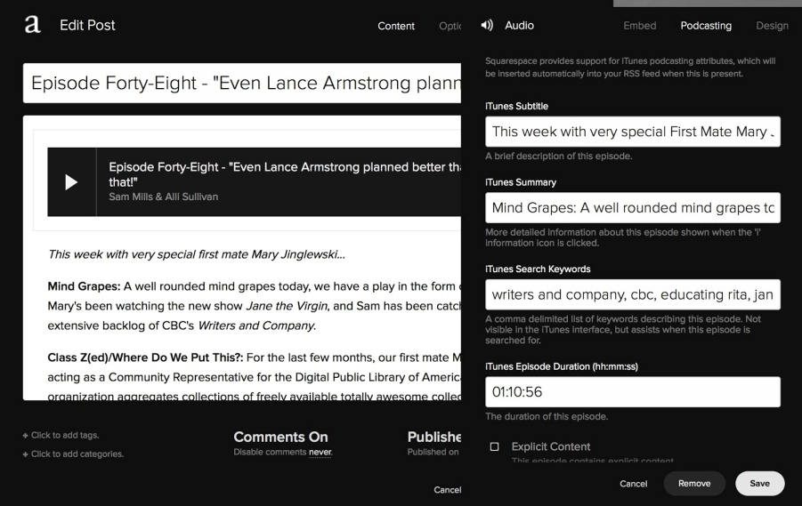
Metadata
Notes:
Website and iTunes metadata
When you upload a new audio file (episode) to your website, you will be asked to fill in metadata. It’s this metadata that allows your show to be organized and found in directories like the iTunes store.
It’s important to create a consistent naming convention for your podcast – numbers (Episode 47) or words (Episode Forty-Seven)? Which keywords will you always include in the description (library, librarian, comedy, etc) to make it findable?

Slide 13
Copyright: Using the creative work of others
Notes:
Creating something new and putting it online inevitably means you run into the issue of whose content you can use, and who can use your content.
Do you want to use someone else’s music for your theme song, or someone else’s art for your show logo? You need to find out if you have permission to do so. This Free Media Sources box can be found on many of our help guides, and one of the places it directs you to is Creative Commons Search. This is a page that helps you search for media (images, music, sound, video) that others have created and decided to make freely available.
What is Creative Commons? It’s a new form of copyright licensing used widely on the internet, allowing creators to both share and protect their work. Let’s learn more…

Slide 14
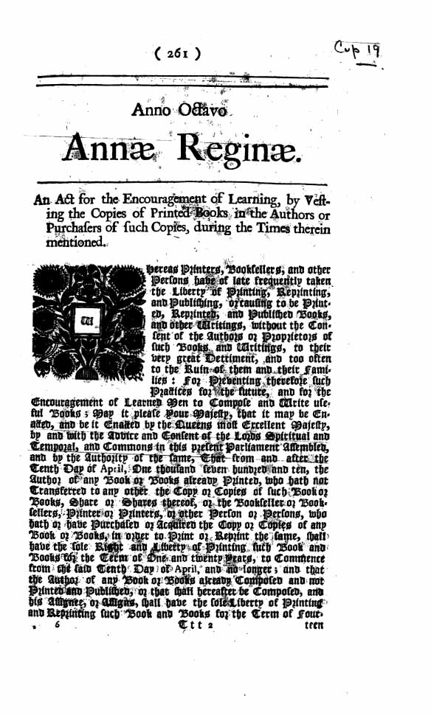
Copyright: Sharing and protecting your own work
Notes:
By default, in most cases, once you’ve created something, you own the ALL RIGHTS RESERVED copyright to it. But what if you want to share more freely than that? And what if you want to find work from others who also want to share freely? Just as with any creative work, making it freely available means that you are opening yourself up to others saving, sharing, and even modifying it. But this is NOT a bad thing!
Think of it this way:
-STEP ONE: Jonathan Coulton licenses his work through Creative Commons, specifically putting the Attribution, NonCommercial, ShareAlike license on his songs. [SHOW WEBSITE]
-STEP TWO: Alli and Sam, the hosts of S.S. Librarianship, come along, and we really want a rockin’ song to open and close our podcast each week. We do a little searching on the web and find out that Coulton has made his work available. We follow his license, crediting him on our website and in the show (attribution), and vowing to let him know if suddenly our podcast has us rolling in the dough (noncommercial). But I think the key element here is the SHAREALIKE part. This is how you pay it forward, and keep enabling new creators to create.
-STEP THREE: someone, maybe a student or another podcaster, is putting a project together and they really need a clip of a conversation about the Daredevil TV show. Well, we did that, in episode 58! So if WE follow JoCo’s “ShareAlike” license, and also put the same CC license on our show, then the cycle continues!
VIDEO + INFO: https://creativecommons.org/licenses/
In a lot of ways, this is why copyright law was developed in the first place. Widely considered to be one of the first pieces of real modern copyright law, the Statute of Anne, passed in England in 1710, was subtitled “An Act for the Encouragement of Learning, by Vesting the Copies of Printed Books in the Authors or Purchasers of such Copies, during the Times therein mentioned.”
Copyright is supposed to be a way of protecting creators, but the piece that often gets forgotten here is “the encouragement of learning” – really, the encouragement of creation itself! It’s a balance – if an artist doesn’t get paid, they can’t keep creating art; BUT if the copyright is so locked down and lasts so long that their work can never be reused, remixed, or reinterpreted by other artists, then pretty soon the production of art slows to a standstill.
In a sense Creative Commons is the modern, digital answer to this problem – it allows for the easy sharing and remixing of creative works, but places restrictions on that use, and allows the creator to decide how much to protect their work and how freely to share it – as well as encouraging the cycle of creative reuse to continue.

Slide 15
So how do you get a CC license?
You don’t have to be a coding whiz to add a license to your site – most site editors will allow the option to add code easily.
Notes:
http://creativecommons.org/choose/ lets users select how or if they want their work to be used, and get the appropriate license for their website. It generates a small amount of code which you can paste into your website, so that your license shows up there. Most website editing platforms (like SquareSpace, or WordPress) allow the option to enter a bit of code.
[Show sslibrarianship.com for an example of what the code looks like when it’s displayed (at the end of each episode entry)].

Slide 16
Promotion
Notes:
It’s a good idea to set up at least a couple of social media accounts for your podcast. Places where you can encourage listeners to rate, review, comment, and get in touch. You’ll feel less like you’re shouting into the void, and you’ll have more to talk about during the housekeeping segment of your show.
Think about where your target audience is likely to be – Twitter? Facebook? Try not to spread yourself too thin – it’s better to be on a couple of key social media services and use them well to communicate to listeners, than to be everywhere and have it be just another chore.
Turn on notifications on your phone or device so that you will know when people are talking about/to you.
Respond often!
Post and reply to things relevant to your show, even if they’re not directly about it.
Try not to rely on services like HootSuite or IFTTT too heavily – you will be less approachable and personable to your listeners if you do a lot of reposting.
Consider whether you are interested in making up front investments in things like merchandise or advertising – will it be worth it? Would it be better to wait until your audience base grows?

Slide 17
...a note about YouTube
Can be a powerful promotional tool
Eg: the podcast My Brother, My Brother, and Me has a YouTube feed where they make cartoons out of comedy bits from their show.
Can generate an RSS feed from a YouTube channel; lots of info online about this.
NOT a good idea to use it as a replacement, since videos are larger and harded for users to stream with podcatchers.
Notes:
Optional: show the MBMBAM YouTube channel – you don’t need to play any videos, just show how they use YouTube to promote their show. They’re making it easy for listeners to share short clips and spread awareness about the show.

Slide 18
Local Shows – They Did It, and You Can Too!
Notes:
Looking for inspiration, or maybe a podcasting mentor? These are some local shows.
The Story and the Story – local literature lover Sarah Kift interviews authors and readers about the stories that changed their lives.
Rain City Chronicles –
S.S. Librarianship – two Vancouver librarians review books + pop culture, and interview library staff about their jobs and passions
The One Project – local photographers talk the power of therapeutic photography
Stop Podcasting Yourself – Vancouver comedians, often with special guests. Long running, and probably one of the most successful Vancouver podcasts (part of the Maximum Fun network)
Vancouver Special – produced by VPL staff; telling stories from the past 20 years of Vancouver history, one year per episode

Slide 19
The Audio Project Process
Plan
Record
Playback
Save
Edit
Export
Save
SHARE!
Notes:
Hopefully we’ve now covered this whole process, between the audio courses you may have taken, and this class, which was all about sharing!
Today we covered Plan and Share (as well as a little about promoting). If you’re interested in the rest of these steps, there are lots of ways to learn more about them – let’s take a quick look at the Inspiration Lab website to wrap up.

Slide 20
Podcasts in the Inspiration Lab
Go to vpl.ca/inspirationlab to find out about:
Equipment
Classes
Booking equipment + PCs
Help – guides, Lynda.com, dropins
Thanks for attending! Please fill out an evaluation form to let us know how we did.
Notes:
You can come to classes, or if you’re an independent learner, you can use our Help guides and our Lynda.com subscription to learn more about audio recording, audio editing, website design, and social media sharing.

