Slide 1
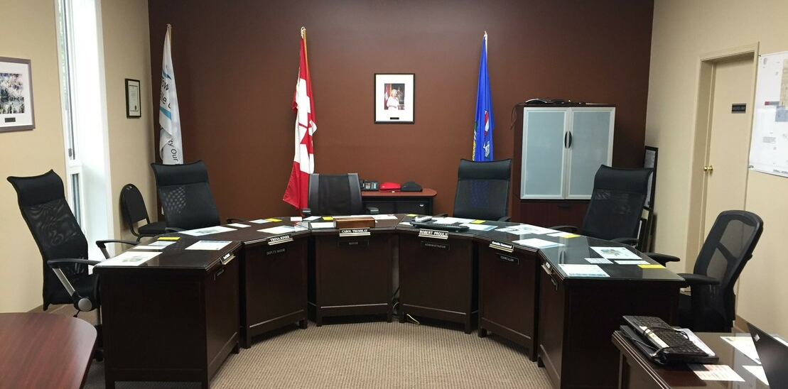
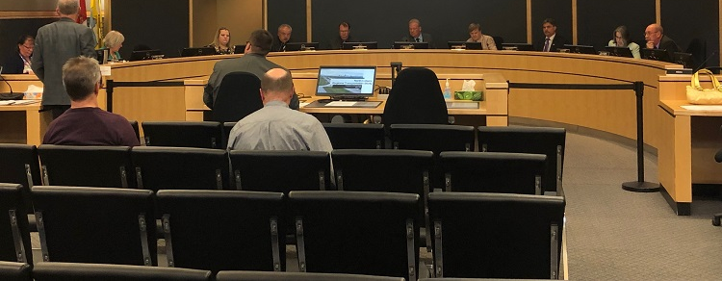
Talking to Your Council: Advocacy that counts
https://www.legal.ca/government/council/bylaws
https://www.discoverairdrie.com/local/looking-into-the-future-of-transportation-between-airdrie-and-calgary
Notes:
Before we get started I would like to acknowledge that in Alberta, except for those regions of unceded territory, we are all Treaty People sharing the traditional gathering places of diverse Indigenous people who signed Treaties 6, 7 and 8. As Treaty People we all have the obligation to take time to understand what that means and what our responsibilities are.
This is not my first presentation but it is my first webinar so I’m hoping those of you out there will be patient with me as I adapt to the technology. The amazing Brian Lin is here to keep things on track and also to gather your questions that we can explore together at the end of the session.
Our Alberta LibraryLand is not exactly uniform. In particular, the our various municipalities exist within an amazing range of population sizes. Our descriptions are also problematic; officially Stony Plain is considered a “rural” Library which if you are tuning in from a Summer Village or a hamlet is probably making you laugh out loud right now! As I go through the webinar, I am trying hard to be aware of these differences.
That being said, the core principles of talking to your Councils are the same regardless of how big or how isolated your library is. What is different, is who is going to be doing the necessary work. If you are a smaller library, your Board is going to have to pitch in and help out. It’s not realistic to expect Library Managers/Administrators/Whatever Title you use to do all of the Advocacy work with the limited number of hours you have allotted to running the library. With that in mind I’ll use the phrase “your library” a lot just to remind you that it’s not just you that has to do the work since advocacy is work that has to be done constantly; it’s not something that can be done off to the side.
Of course, if you are a larger library, it’s entire possible you have a Marketing or Communications department that is doing this work for you already. This webinar might provide a framework to think about the work those people are doing and see if it can be tweaked a little.
With that understanding of who is going to be doing the doing, let’s jump in and get started!

Slide 2
LIBRARY
Notes:
To begin with, the most important thing about talking to your Council is your appearance in Council chambers should not be an isolated annual event.
That appearance is the only one part of ongoing advocacy that your library has been doing from one Annual Report to the next. If your Library only crosses Council’s radar through the Board minutes and a once-year presentation, they are not going to know the full value your library brings to your community. This makes it much easier to cut your funding.

Slide 3
Just read a biography about a conceited opera singer…
It was entitled, “Me, me, me, me, me, me, me, me.”
Notes:
I’m really hoping that you are all singing the punchline in your head right now!
It is so important to overcome our Canadian modesty when it comes to our Library. Don’t be afraid to talk about your Library. Every now and then, when someone from the community asks how you are outside of the library, say you’re great because “insert awesome thing here” just happened or is going to happen at the Library. Use some judgement here, you don’t want to do this EVERY time you talk to people because they might start avoiding you. If no-one says hello to you anymore, that’s your sign that you’ve overdone it! But see if you can do this at least three times a month, with a different person each time. Word of mouth is a powerful, powerful tool especially in our smaller communities.
If a person using your library says something good about their experience ask them if they mind if you quote them in your Director’s Report and/or your Annual Report. If it won’t annoy the person, ask them if you can get a picture of them to go with the quote. Ask staff to email you these comments and keep a collection of them.
Get the Board to talk about the library. Include one or two of the comments every month in your report to the Board under the heading, “Tell Your Friends & Family” This makes gives your board “sound bites” and makes it easy for them to add it to their everyday conversations.
You can also ask the people with great library experiences if they would mind posting their comment on their FB/Instagram/Twitter page or if you can put it on YOUR social media platforms. If you do put it on your SM platforms tag your community or your council’s most ardent SM user. For us, it’s our Mayor and I always include his favorite hashtag #AlwaysBetterinStony. Tag your regional system too, it gives them material for their conversations about why libraries are important to communities.
Your Library has to take responsibility for getting on the radar of both the community and your council. No-one else will do it unless it’s a bad experience. Studies show people are more likely to share their bad service experiences than their good ones so you have to make sure the positive stories are already out there.

Slide 4
Notes:
Don’t just rely on word of mouth. Invite your council and your municipal administration to events at your library. If it’s Family Games Night, invite those with children and grandchildren. If it’s a speaker on local history, invite new members who might not know the stories yet. If a councilor is a long-time resident ask THEM to do the local history talk. Whatever it takes get them into your space so they can both see and hear for themselves how the work you are doing impacts your community. Elected officials like to be seen doing community things especially when it puts them in contact with voters. Getting them into your space means they’re talking to the library-lovers in the community and hearing their stories.
Depending on the size of your municipality you will have different avenues to getting in touch with your councilors. You might just be able to phone or email them directly but more often they have an Executive Assistant who handles their calendars. Take the time to find out what the protocol is for your community and follow it. You are much more likely to get access.

Slide 5
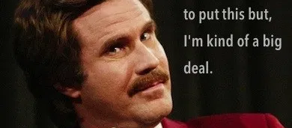
What’s so great about you?
Notes:
There’s not polite way to put this but it has to be said. All of this work your Library is doing to get on Council’s radar is based on the assumption you are actually engaging with your community to meet their needs and fill gaps.
If you watched or attended the Advocacy It’s a Way of Thinking webinar back in May, the first thing Punch Jackson and Margaret Law say is
“You’re not entitled to the money”. ( If you haven’t seen it yet, you can find it on the TAL Toolshed)
Most of us believe deeply that libraries are essential to a vibrant, thriving community. This is only true if we are active, engaged participants in that community. If your library is doing that , THEN you can go in front of council excited to talk about what you’re doing and how it makes your shared community better.
If you are struggling to find things that you are excited to share with your council, take a step back and re-examine what you do from an outsider’s perspective. It may be that you’ve gotten so used to do great things that you’ve stopped being excited by them. Remember to think in terms of scale. It’s easy for Edmonton and Calgary to do amazing things with their budgets, but what you’re doing might be more amazing when you take into account how the amount of resources you have at your disposal so don’t compare yourself with libraries of a different size and with different resources and with different community situations.
What’s important is that the things your library is doing are benefiting YOUR community and that you are telling your Council and your community about them.

Slide 6
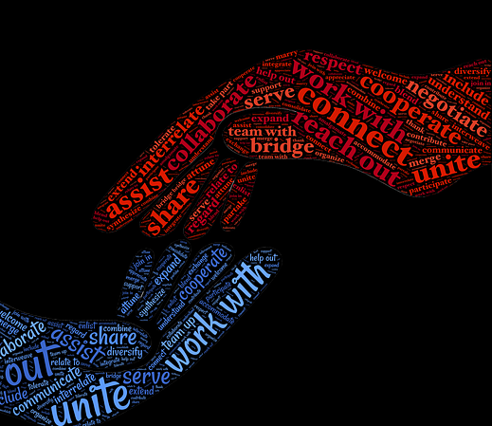
RELATIONSHIP BUILDING
“Librarians and trustees must build positive relationships with those
setting funding levels.”
Public Library Advocacy: An Evidence –Based Perspective on Sustainable Funding
http://publiclibrariesonline.org/2015/09/public-library-advocacy-an-evidence-based-perspective-on-sustainable-funding/
Notes:
Going in front of councilors is MUCH easier if your library has done the groundwork and built relationships with them before you get into Council chambers. What people struggle with is that building a relationship takes time, the one thing we all have so little of. It’s really difficult to justify taking an hour or even 30 minutes to sit down and have coffee/tea/kombucha when there are SO MANY OTHER things clamoring to get done. Relationship building is very much like libraries; we have a great deal of impact which is very difficult to measure.
We also struggle with relationship building because it’s not something that ends. All relationships, romantic, platonic, business, community have one thing in common; if you neglect them, they end. It’s tempting to not start doing any relationship building at all because of the commitment required to maintain them. The best thing to do is keep in mind how powerful relationships are and how much benefit your library derives from them.

Slide 7
Administration by Nick Youngson CC BY-SA 3.0 Alpha Stock Images
“administrative staff, budget committee members, and elected officials remain the most prominent players in the process, and therefore, the most influential in funding and budget decisions”
Notes:
Just to make life a little more complicated, it’s not just your municipal council that you have to develop relationships with. The Public Library Advocacy article by Cheryl Stensome and Ken Haycock states that
“administrative staff, budget committee members, and elected officials remain the most prominent players in the process, and therefore, the most influential in funding and budget decisions”
Developing relationships with key people in your municipality’s administration is also important. Just as your Board relies on you to bring knowledge and expertise about libraries to their decision-making, elected officials use the knowledge and expertise of the administration to help them with their decision-making. If none of the people involved in the budget decision making process know anything about the library, it’s more probable funding requests will be reduced during times of scarcity.
On the other hand, if your library has developed a relationship with the Town CAO and/or the Community Services department head as well as with some of the councilors there are people at the table who can speak up for the library when you can’t be present.
Having advocates at the budget table is definitely worth the time spent having coffee with the key people in the community.

Slide 8
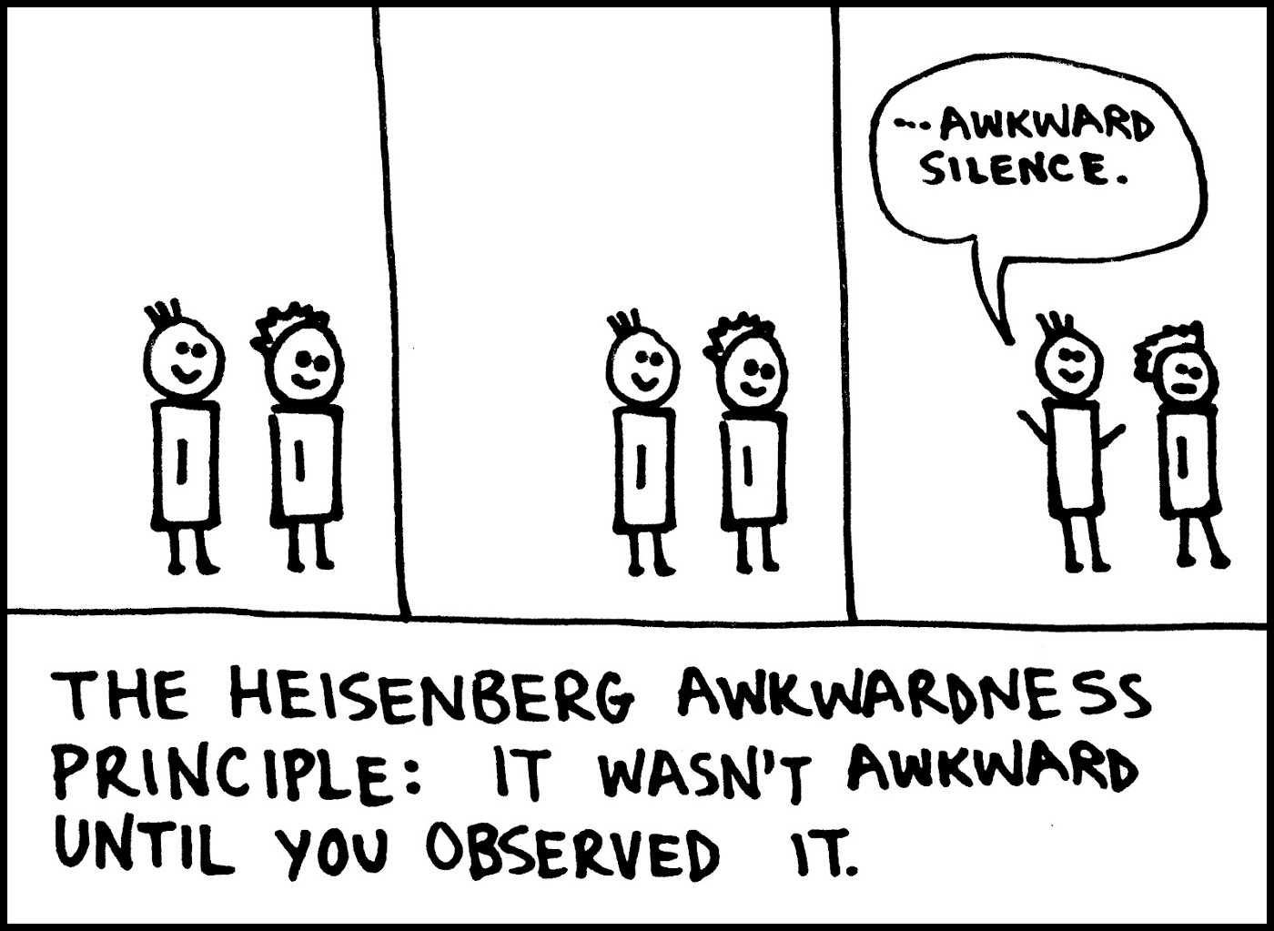
SOMETHING TO TALK ABOUT
Notes:
Don’t panic. There are specific things to talk about with municipal council and administration. If you attended Rebecca Jones’ pre-conference session at ALA in 2018 you’ll remember that she gave us three questions to ask when engaging with people in the community about the library. Rebecca is a Managing Partner with Dysart & Jones Associates used to work in public libraries and now does consulting for the library world.
This is a great first step in building a relationship because it can be a quick conversation that covers a lot of ground in about 15 minutes. This is important because council and administratin are just as busy as you are and being respectful of their time helps them to think positively about your library.
Rebecca suggest starting the conversation like this:
I would very much like to understand what you are focusing on this year to ensure the library’s focus is aligned. This conversation won’t take more than 10 minutes, 15 minutes tops. Thanks for meeting with me.

Slide 9
Question 1
What is your focus for this year? In other words, what do you really want to see the (municipality...or their organization.....) accomplish this year?
Notes:
This presentation (complete with my notes but not my terrible attempts at humor) will be posted to the ToolShed so don’t panic about writing these down.
First question. Find out what’s important to them.

Slide 10
Question 2
What are the biggest hurdles that could keep you from seeing that happen?

Slide 11
Question 3
What’s helping meet these goals? Are there other organizations that can help to meet these goals?
Notes:
Pro-Tip 1: These are GREAT questions to ask even if you already have an existing relationship.
Pro-Tip 2: These are not specific to administration or council, you can ask them of anyone that you connecting with. Try asking your partner/spouse/friend these questions as well.
They are also great questions for strategic planning. In fact, Rebecca recommends closing the conversation by thanking them and suggesting you’ll circle back to them with some moves or initiatives that might be able to support them in reaching those goals. This also gives you the opportunity for another meeting later on which supports that relationship development.
Council and administration is more likely to want to engage with you when the conversation is about THEM, not about your library. This gives you a solid foundation for beginning your relationship with council.

Slide 12
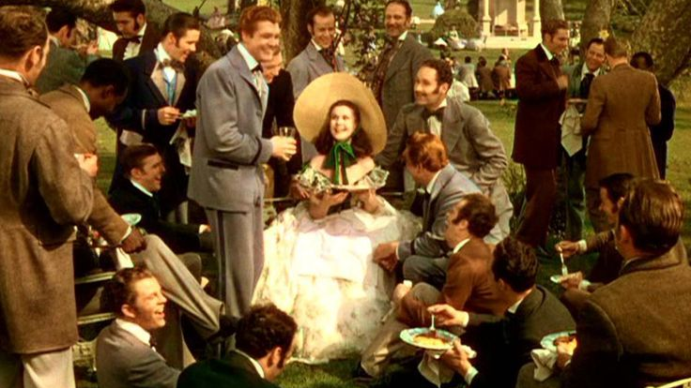
Notes:
This might seem like a backwards way to get Council to care about what you are saying but somewhat tongue in cheek I’d like to quote Scarlett O’Hara here:
“The way to get a man interested and to hold his interest was to talk about him, and then gradually lead the conversation around to yourself”
I’m not suggesting that you engage with your councilor and administration with Scarlett’s selfish self-interest but she has a point. People are deeply interested in what affects them. If you are coming from a place of empathy when you set out to engage with Council and administration, they are more likely to reciprocate and be genuinely interested in what is important to the library.
So when you are actually in Council Chambers, doing your presentation, you are not just another face asking for money, you are someone who has shown interest in the issues that Council and administration have to deal with and better yet, you’ve positioned yourself as an ally as they deal with those issues.

Slide 13
Promoting Your Library
Building Relation-
ships
Presenting to Council
Notes:
Now that you’ve started spreading the word about the awesomeness of your library and found out what’s important to Council and Administration, the actual presentation is an opportunity to bring these elements together.
We actually present to Council twice a year. Once when we present our Annual Report and once when we make our funding request. This means there is one more time when we are connecting with Council that does not involve asking for money. It’s a way to officially celebrate and broadcast both the great things the Library does and also some of the challenges we face without a monetary ask attached. Council can be invited to celebrate with the Library as allies in creating a great community. Usually we do our Annual Report presentation late May/Early June and then we do our funding request in September. We deliberately do the annual report presentation a little later in the year so it’s fresher in the minds of Council when we do go in front of them with the funding request.
I’m aware that some libraries don’t get or don’t try to get the opportunity to present their funding request to their Council but it is important because it gives you the opportunity to clarify any questions they may have. Sometimes, NOT always, there can be a less than ideal relationship with administration which prevents the library from connecting with council. Or it could be the other way around, there might be apathy or sometimes hostility surrounding the library from Council which keeps them from allowing the library to make their case for funding. We are all humans and sometimes mistakes are made. This is why the relationship building piece is so important. Sometimes its relationship repairing that needs to happen.
Yes, your municipality is required by the Libraries Act to fund their public libraries but there is nothing in the Act that states to what degree that funding has to be made. Again, we are not entitled to the money. If you have developed positive relationships with your Council and Administration you are more likely to be given the opportunity to present and make your case in person and also be facing a receptive audience.

Slide 14
Numbers vs. Narrative
Notes:
So what to talk about when you do get in front of Council? We are constantly being told, Tell Your Story, Tell Your Story, Tell Your Story. But it often seems that when we are preseting, the only thing Council cares about are the numbers. How many people from the County used the library? How many memberships do you have? How many people actually came into the library? And so on and so on. And to be fair, numbers are important to us as well. After all, if there is a significant drop in memberships, circulation or people coming into the library from one year to the next, we should be doing some serious investigation into the causes.
It is the nature of our society that people providing funding would like to know whether that funding is accomplishing anything. It’s also the nature of our society that numbers tend to dictate whether something is successful.
What we have to do is craft our all our communications so that numbers and narratives complement each other rather than compete with each other. The two are not mutually exclusive and some people will respond better to the numbers and some will respond better to the narratives. I freely admit, this is an area I struggle because I’m narrative oriented. You can throw numbers at me and the only effect will be for my eyes to glaze over. If you tell me a story that demonstrates the impact those numbers have, I will probably respond exactly the way you want me to.
It’s important to remember this because we tend to default to how we think so we unthinkingly create communication pieces which work best for us. Ideally there is someone in your library who responds to the opposite of what you respond to and they can help you develop a well-rounded presentation.

Slide 15
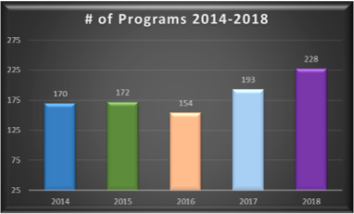
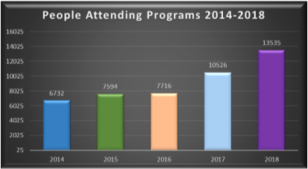
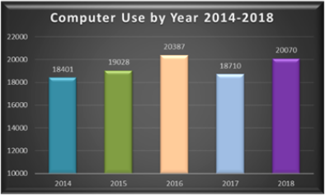
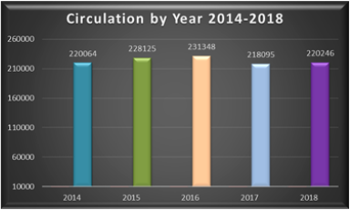
Notes:
I have been trying to keep the presentation generic so far in order to provide basic principles but to demonstrate how to blend numbers and narratives, I have to rely on providing you with specific examples from Stony Plain. This is not because I think it’s better than anybody else’s but because I have a) access to the material, b) familiarity with the thinking behind the material and c) copyright for the material!
Your communication pieces should reflect your community but if these help give you ideas then that’s great.
To begin with our actual print Annual Report contains a blend of narratives and numbers. We have all the charts and they’re comparative charts because our councillors like to see year to year.
We also include one or two specific stories that relate directly to issues that are important to council. For example, there was a Mayor’s task force in Stony Plain because one of the concerns of our council is that as a bedroom community to Edmonton, people might sleep in Stony Plain but they are working and playing in Edmonton which means their money is not being spent locally. The Mayor’s task force was focused on volunteerism but at its heart it was about civic engagement and getting residents to connect more deeply with our community.
Two programs that we partnered with supported these initiatives, the My Path program and the Parkland Poets Society. The Poet society in particular would please Council because some of their activities, supported by the Library, reversed the trend and brought people from Edmonton to Stony Plain.
These aren’t the ONLY activities we undertook in 2018 but they emphasize key issues that are important to Council. In the printed Annual Report, they were highlighted with brief outlines of about two paragraphs.
Our process in Stony Plain is to submit the print version of the Annual Report to Council prior to the in-person presentation. That print report is included in the Council’s briefing package for that night’s Council meeting. Again, having a good relationship with the Administration enables us to ask to be put on the agenda and also to know when our print material has to be submitted.
Having the material in the briefing package means that the in-person presentation does NOT have to present the same information. Instead we can focus on the narrative elements that demonstrate how our library impacts the community beyond the numbers

Slide 16
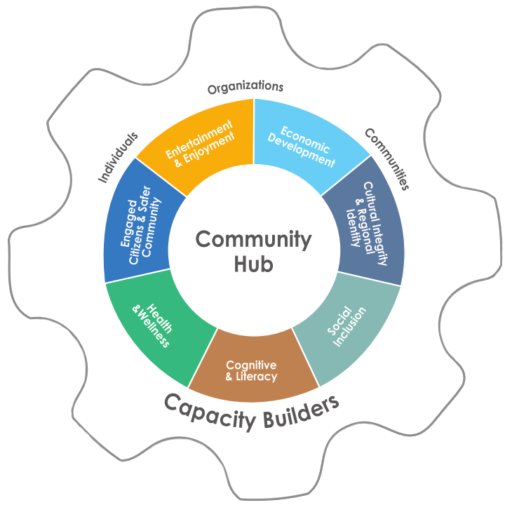
Our library is a community hub
Notes:
This image was also the front page of our annual report so council would have seen it in their briefing package. It came from the Advocy material that was distributed to us from our regional system and it provided the perfect structure for our presentation.
This was the first slide of the presentation and the rest of slides incorporated pictures from our library related to each of the pieces of the wheel. Some connections were made to the annual report to tie everything together but again, the in-person presentation was used to bring out the narrative stories rather than the numbers which council already had.

Slide 17
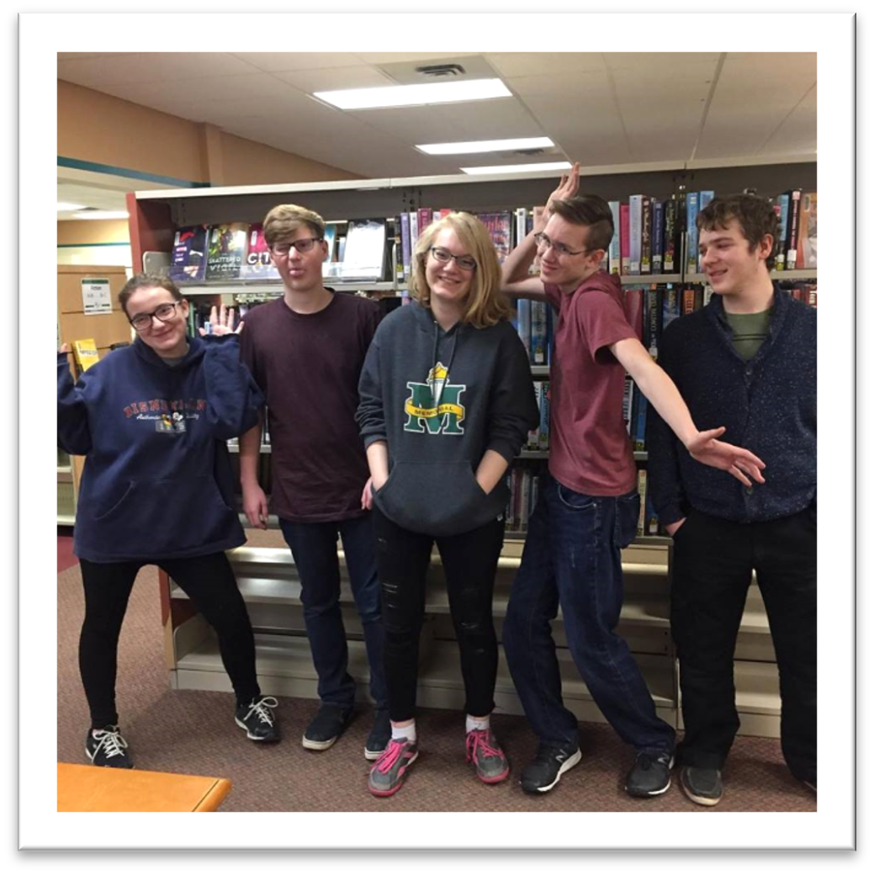
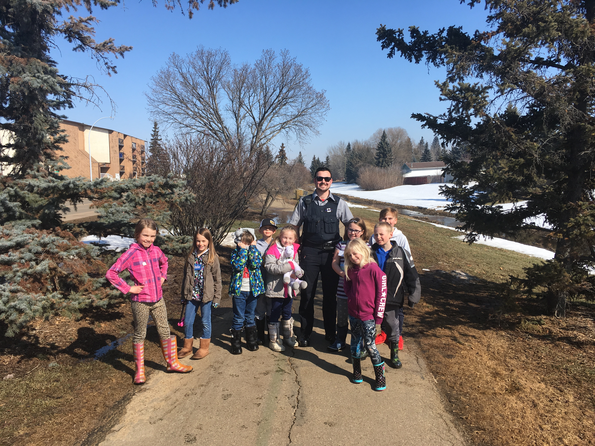
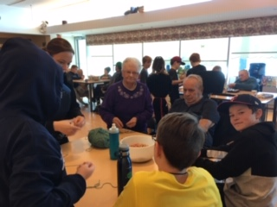
CONNECT THE DOTS
MY PATH
PROGRAM
TEEN ADVISORY GROUP
Engaged Citizens & Safer Community
Notes:
For example the Engaged citizens section of the wheel allowed us to talk more in-depth about the My Path Program that was featured in the Annual Report as well as provide other examples of how what our library does fosters engaged citizens and safer communities.
This approach has two advantages:
We can get more detailed in a verbal presentation to Council than is advisable for a print document. Council briefing packages are HUGE. If we included all of this information in our Annual Report, they might skim the information but it’s unlikely they would read all of the details that are important. Our Annual report is usually 8 pages long and very light on text.
We can make explicit connections in our verbal presentation to those issues that were identified as being important to Council and Administration. You have the opportunity to refer back to your coffee conversations: “If you remember when we were talking back in February Mayor Choy, you mentioned how difficult it is to get young kids doing things around the community. It’s very exciting for us to be able to show you how the Library is working on getting them engaged in different ways” You can’t put a statement like that in an Annual Report.
The rest of our slides followed this pattern as well. We used photographs from events throughout the year to highlight the stories we told Council that connected them with the numbers.

Slide 18
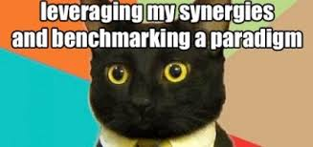
Notes:
Okay that’s enough Me Me Me Me Me!
The point of those specific examples was just to give concrete examples of how your Council Presentation is the a combination and culmination of the promotional and relationship building work your library has been doing throughout the year as well as the combination of narrative and numbers. When we acknowledge the importance of the number and connect the narrative to issues to that are important to Council, we improve the likelihood that they are going to listen to what we have to say.
Another key element of getting Council to hear you is to use language that resonates with them. Some people in LibraryLand that I know are adept at incorporating what I call “BusinessSpeak” into their conversations and presentations but this is not my strength! However, I recognize the importance of using terminology that is familiar to many councillors who often come from a business background.
So, I learned to use terms like accountability, fiscally responsible and return on investment. Clearly I can’t speak for everyone but I do believe that most of us understand that we are tax-payer funded organizations and have a duty of care with the funds we receive. We have to balance that out with trying to reduce or remove the barriers to service many people in our community but if we say that to our councils, we demonstrate an awareness of the economic dilemmas they face.
BUT make sure you actually know what the words mean! This can also be part of the relationship building work when you’re having coffee with councillors and administrations. Pay attention to the language they use when describing their issues and the hurdles they face. Ask for clarification if you don’t understand a term. For example, I found out a little bit about the Municipal Sustainability Initiative (MSI) in the past few weeks leading up to the budget. Spoiler alert, reducing the MSI funding does NOT make councillors and administration happy…

Slide 19
Wrapping it up
Questions? Email me at : allisons@mysppl.ca
Notes:
To wrap it up I realize that you were expecting fifty minutes just on the council presentation but separating out the importance of getting your library on your community’s radar and building relationships with councillors and administration from the council presentation is almost impossible if you want that presentation to be effective.
The key take-away for your libraries in terms of advocacy should be that all of your advocacy pieces are or should be connected to each other. Relationship building, promoting your library, presenting to councillors are three core pieces that fit together and need to be discussed as a whole rather than in silos.
With that I am happy to answer questions if there are any!

